Slide 1

a l a p a g o s :
a generic distributed parallel
genetic algorithm development platform
Nicolas Kruchten
4th year Engineering Science
(Infrastructure Option)

Slide 2
a l a p a g o s
Roadmap
What is Galapagos?
EAs, GAs & PGAs
Distributed Computing
Distributed GAs & PGAs
Case study: dGAID

Slide 3
a l a p a g o s
What is Galapagos?
a software framework for building
distributed parallel genetic algorithms
defines and steps through a basic
flowchart with ‘black-box’ steps
provides basic black boxes (modules),
templates for the creation of new modules

Slide 4
a l a p a g o s
Genetic Algorithms
Many ITS problems are or can be
formulated as optimization problems
Traditional methods often don’t suffice
Genetic Algorithms are powerful but can
require a lot of intuition or original coding

Slide 5
a l a p a g o s
Evolutionary Algorithms
EA = GA + EP + ES
Evolutionary Programming
  GA minus the G (single parents)
  not same as ‘genetic programming’
Evolutionary Strategies
  very similar to GA with adaptive mutation

Slide 6
a l a p a g o s
Let t = 0;
Initialize P(t)
Evaluate P(t)
Generate P’(t) from P(t)
Evaluate P’(t)
Let t = t + 1;
Assemble P(t)
from P(t-1) and P’(t-1)
Stop?
no
yes
End

Slide 7
a l a p a g o s
Parallel Genetic Algorithms
‘regular’ GA aka ‘panmictic’ GA
PGAs have multiple interacting ‘demes’ or
sub-populations (also: islands)
Interaction occurs through ‘migration’
Can converge faster, to better optima

Slide 8
a l a p a g o s
Parallel Genetic Algorithms
Many different topologies are possible:
  a few large demes
  many small demes
Other possibilities:
  synchronous vs asynchronous
  heterogeneous PGAs
  n-level PGAs

Slide 9
a l a p a g o s
Migration Path
5 Genomes
Deme

Slide 10
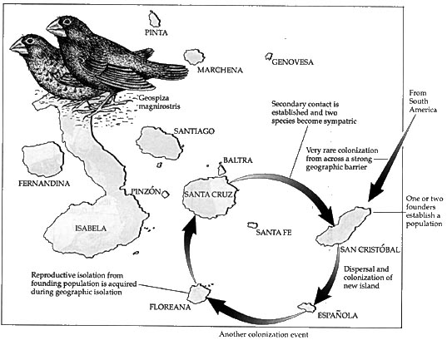
a l a p a g o s

Slide 11
a l a p a g o s
Distributed Computing
GAs and PGAs can be very slow
We can use a faster computer
Or we can use more than one computer
  Multi-processor machines
  Clusters
  Grid computing

Slide 12
a l a p a g o s : a distributed PGA platform
Resource Pool
Slave
Process
Job
Job
Slave
Process
Master
Process
Dispatcher
Slave
Process
Result
Result
Slave
Process

Slide 13
a l a p a g o s
Distributed GAs & PGAs
‘Master/Worker’ architecture:
  GAs are ‘embarassingly parallel’
‘Peered’ architecture:
  PGAs are uniquely suited to this sort of
  distribution
‘Hybrid’ architecture:
  Peered Masters with a Worker pool

Slide 14
a l a p a g o s
Let t = 0;
Initialize P(t)
Evaluate P1(t)
Evaluate P….(t)
Evaluate P’(t)
Evaluate Pn(t)
Generate P’(t) from P(t)
Evaluate P(t)
Let t = t + 1;
Assemble P(t)
from P(t-1) and P’(t-1)
Evaluate P1(t)
Evaluate P….(t)
Evaluate Pn(t)
Stop?
no
yes
End

Slide 15
a l a p a g o s
Master
Master
Worker
Worker
Master
Master
Worker
Master / Worker
Peered

Slide 16
a l a p a g o s
Master
Worker
Master
Worker
Master
Worker
Hybrid: Peered Masters with Worker Pool

Slide 17
a l a p a g o s
Galapagos and LightGrid
LightGrid: lightweight grid engine
Galapagos: generic EA/GA/PGA platform
together: very flexible and powerful base
onto which a variety of applications can
be built!

Slide 18
a l a p a g o s
Any
GA
Any
PGA
Galapagos
Any Distributed
Application
LightGrid

Slide 19
a l a p a g o s
Container
Evaluator
Controller
Dispatcher
Evaluator
Container
Evaluator

Slide 20
a l a p a g o s
Galapagos is Generic
built with the freedom of the developer
in mind at all times:
  not representation-specific
  not problem-specific
  not GA-specific
  not platform-specific (written in Java)

Slide 21
a l a p a g o s
Initializer
evaluation
evaluation
evaluation
Generator
Epoch
no
evaluation
evaluation
yes
evaluation
Migrator
Assembler
Convergence
no
yes
end

Slide 22
a l a p a g o s
Galapagos
a generic distributed parallel
genetic algorithm development platform

Slide 23
a l a p a g o s
Case Study: dGAID
Genetic Adaptive Incident Detection
Developed here at U of T
Calibrating an artificial neural network
classifier using a GA
16-dimensional maximization,
non-differentiable

Slide 24
a l a p a g o s
Case Study: dGAID
Tests run with 1-50 computers,
1 population of 50 solutions
1 computer: ~ 1 h 15 min
25 computers: ~ 3.2 min
50 computers: ~ 2.3 min

Slide 25
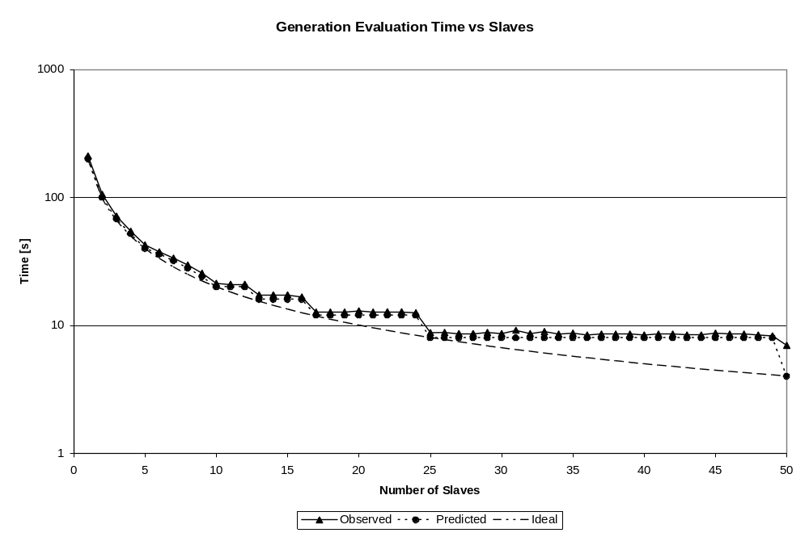
a l a p a g o s

Slide 26
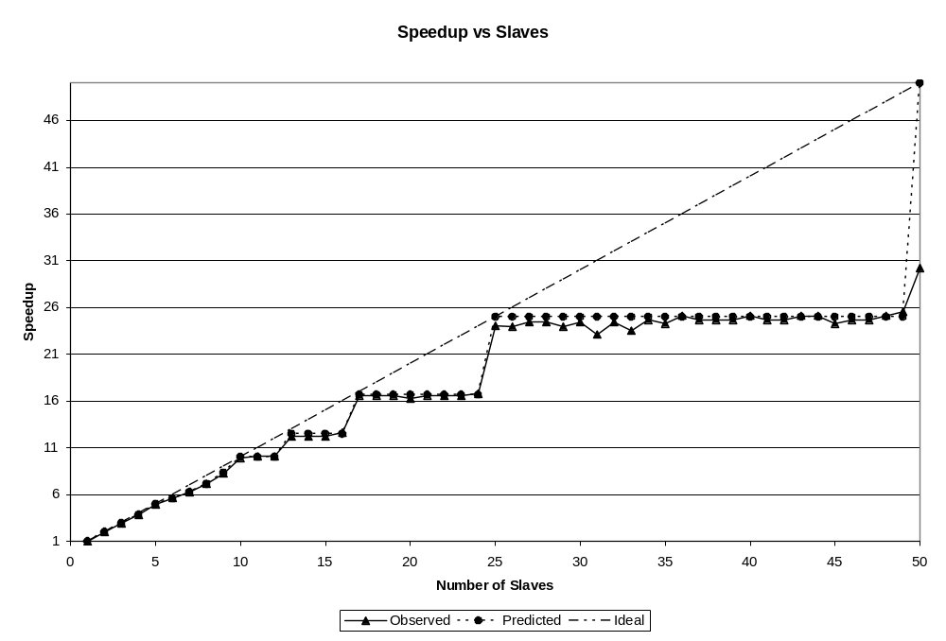
a l a p a g o s

Slide 27
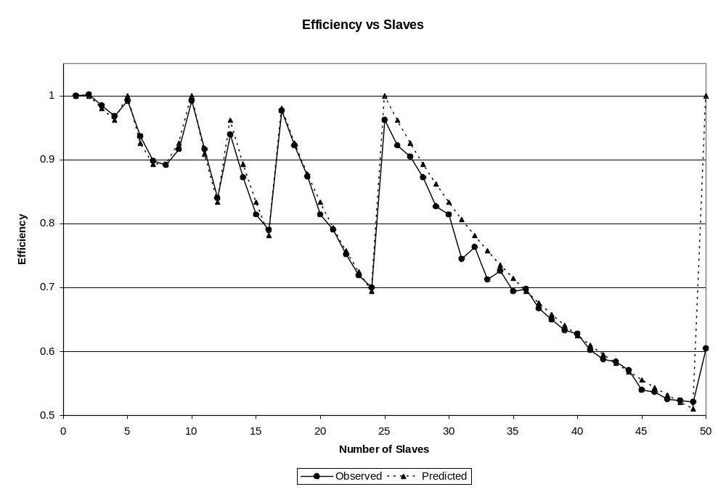
a l a p a g o s

Slide 28
a l a p a g o s
Conclusions
Galapagos brings together GAs, PGAs
and distributed computing into one package
Its use in speeding up solution of ITS
problems has been demonstrated
Come back next week for a more technical
look at how Galapagos works and how to use it

Slide 29
a l a p a g o s
Questions?
nicolas@kruchten.com
this presentation is available at:
http://nicolas.kruchten.com/

Slide 30
a l a p a g o s :
a generic distributed parallel
genetic algorithm development platform
Nicolas Kruchten
4th year Engineering Science
(Infrastructure Option)

