Slide 1
Nicolas Kruchten
How I learned to love Facebook
(but haven’t stopped worrying)

Slide 2

Notes:
A Canadian non-profit called Engineers Without Borders Canada, where I was the Director of Technology for a few years before moving to Montreal last year. Now how many of you have heard about EWB?

Slide 3
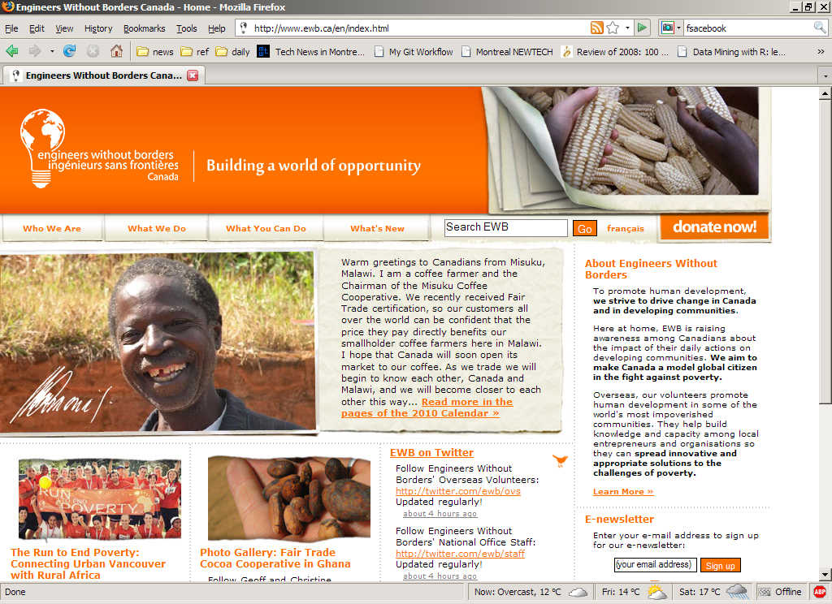
Notes:
OK, well I’m not going to go into a ton of detail about EWB’s mission because you can come ask me about it afterwards if you’re interested, but for the purposes of my talk, you basically need to know that it’s a mostly student-based organization that sends people overseas to Africa and does advocacy and outreach in Canada, with a central office in Toronto and…

Slide 4
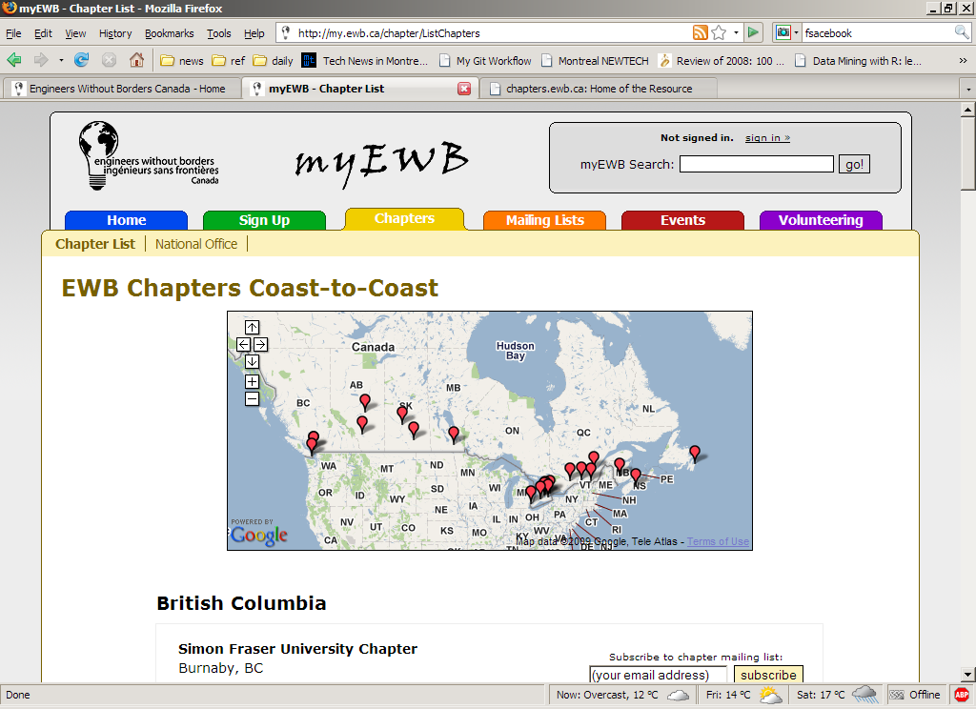
Notes:
Around 30 chapters around the country, mostly in universities. This idea of having local chapters of an organization is a pretty standard setup, lots of student or professional or religious groups are set up this way.
And in 2003, when I started volunteering at EWB’s national office, after having been involved in the University of Toronto Chapter, I realized that we had a major problem, which most similarly structured organizations face, which is that while we knew we were growing fast, we had no real idea who all of our own members were or how to reach them all at once (e.g. via email). And this is something we felt we needed to be able to do, to build the type of movement we wanted to build, raise the funds we wanted to raise etc.

Slide 5
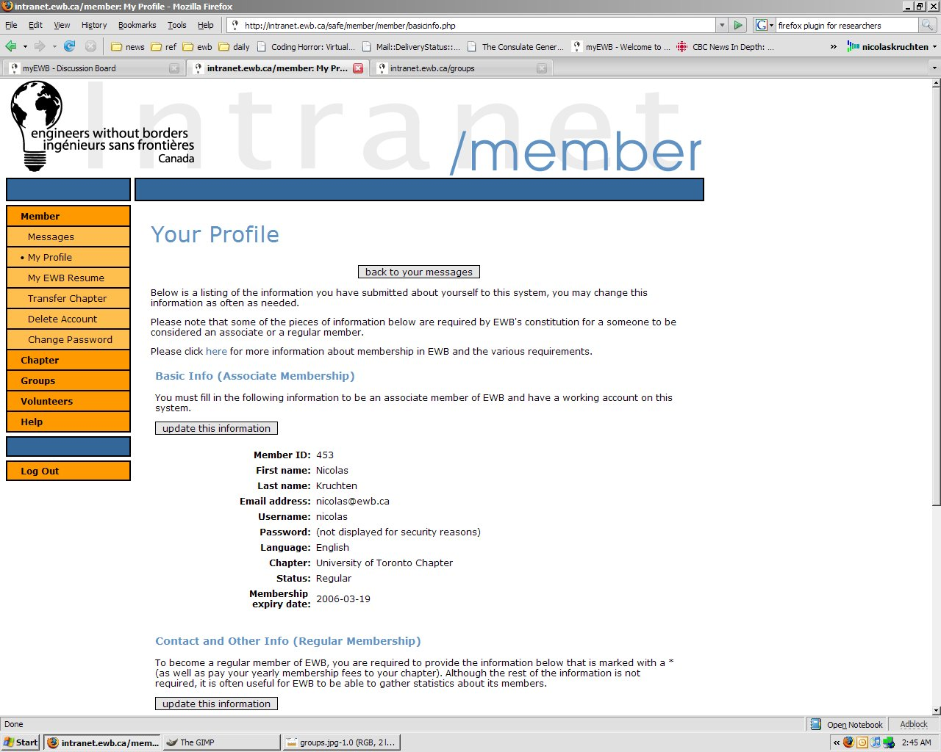
Notes:
So I put together a web-based membership management system creatively dubbed the Intranet, which you can see here. And that was fine on its face, although no one really wants to just “go and register” for its own sake, so we had to provide some carrots. For example if you wanted to attend our yearly conference, the only way to do so was to register through this system.

Slide 6
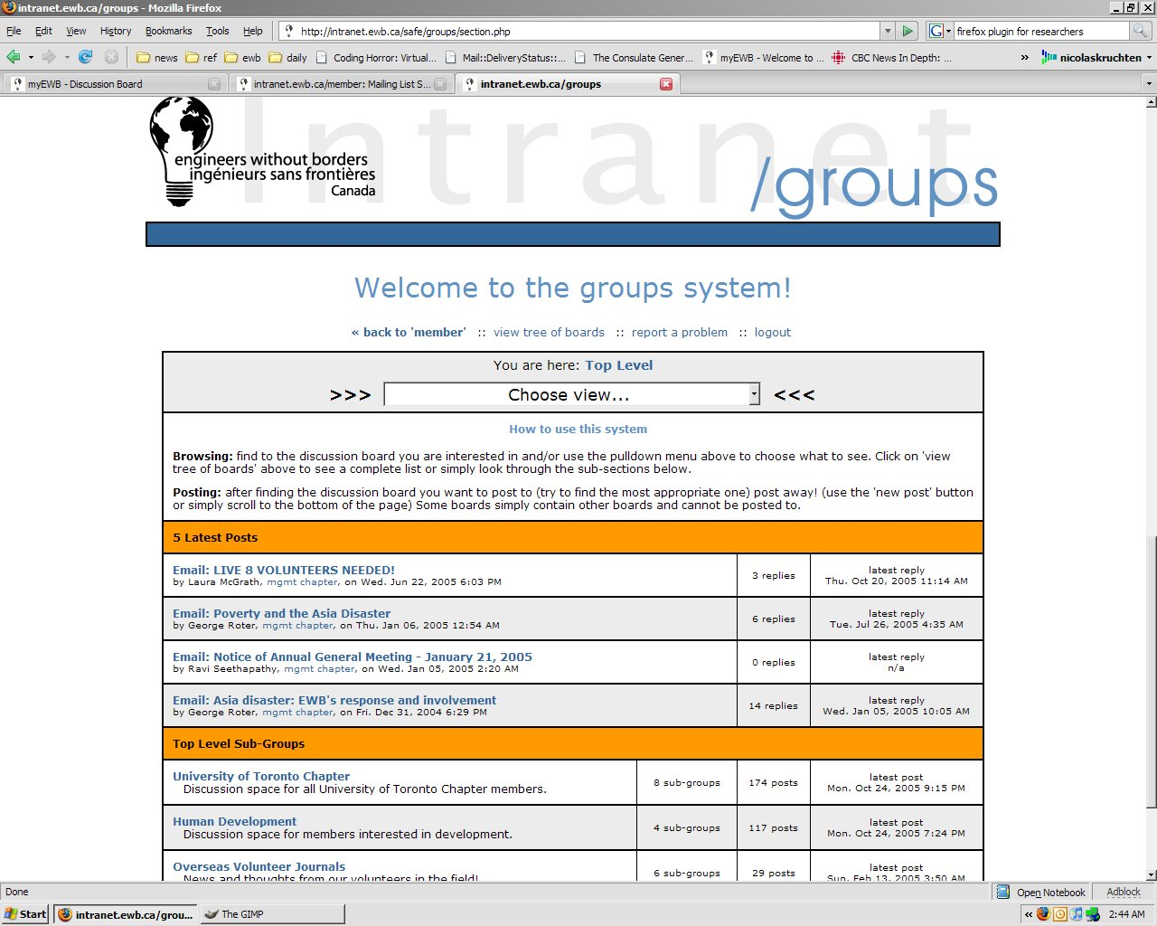
Notes:
In fact the lovely pan-Canadian group who attended these conferences liked each other so much that they wanted to keep communicating after they’d gone home, which was great, so we obliged by bolting on an ugly discussion board/mailing-list management system, and then cajoled all the chapters’ executives into migrating all of their mailing lists to the central system. Boom, problem solved: every EWB member was now in our system.

Slide 7
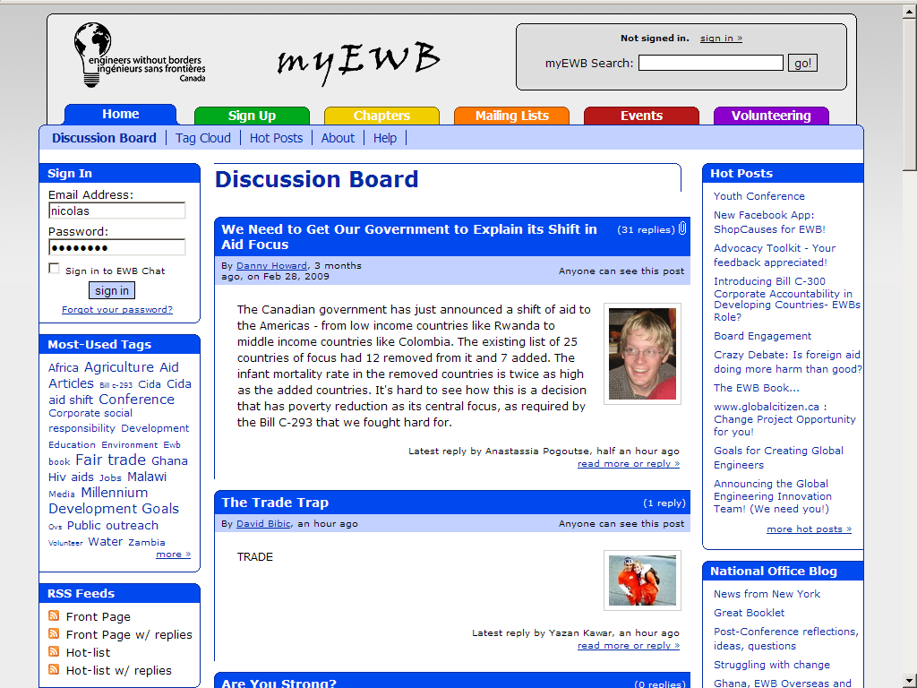
Notes:
A couple of years later, in 2005, we knew what were doing tech-wise, so we scrapped the whole thing and rebuilt it from scratch in a much more user-centric way and called it myEWB and it was great, we managed to get a lot of usage, which translates into a decent amount of traffic, users were happy, other non-profits were jealous etc. And we continued to evolve this system and it’s still in place today.
And the fact that it was centralized allowed us to mobilize as a unit quite effectively to run national campaigns etc.

Slide 8
But…
Notes:
But… there’s always a but. At the same time as we were figuring all of this out, this thing called…

Slide 9
“Web 2.0”
Notes:
Web 2.0, quote-unquote, started to happen.

Slide 10

Notes:
First of all, EWB members across the country starting using Facebook a lot to connect with each other directly.

Slide 11
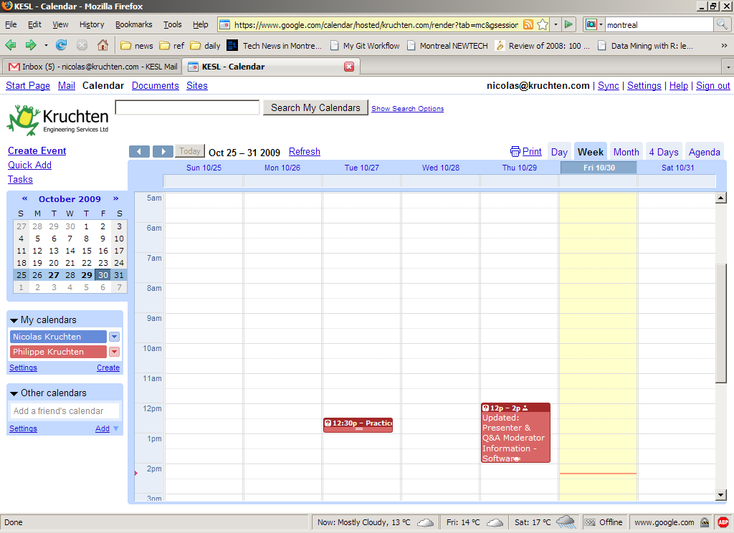
Notes:
They started using Google Calendars to plan their events.

Slide 12
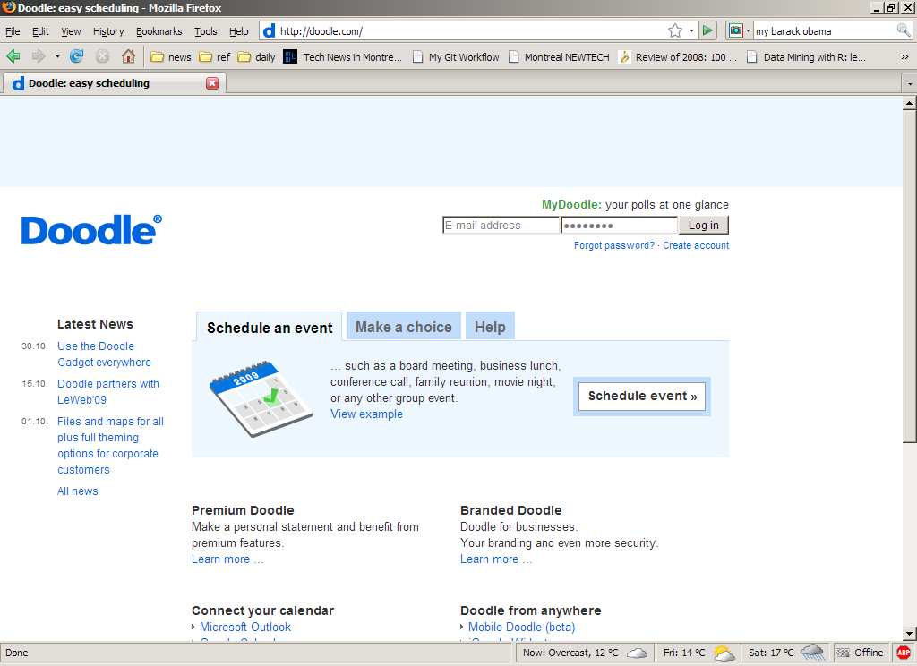
Notes:
They used web services like Doodle to coordinate meeting times. Etc.

Slide 13
Notes:
Which means that they started to stop using myEWB, and we ran the risk of having all sorts of EWB members who we knew nothing about, and weren’t on our mailing list etc. Basically, although we’d been able to stay ahead of the curve for a few years, the curve had caught up, and let me tell you, they all had WAY bigger budgets than we did.
And our response was to do our best to try to compete with the world: we added file-sharing and calendaring and wiki-like features to myEWB. But competing with Google with a one-developer team is ultimately a losing game.

Slide 14
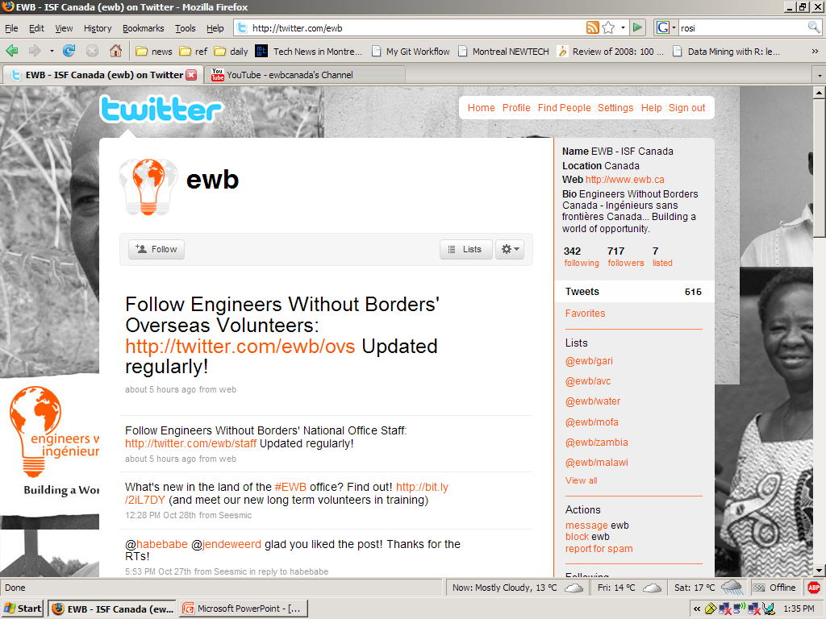
Notes:
At this point I wound up my involvement and moved to Montreal to work for an unpopular telco, but I keep in touch, and they’ve set up a twitter feed

Slide 15
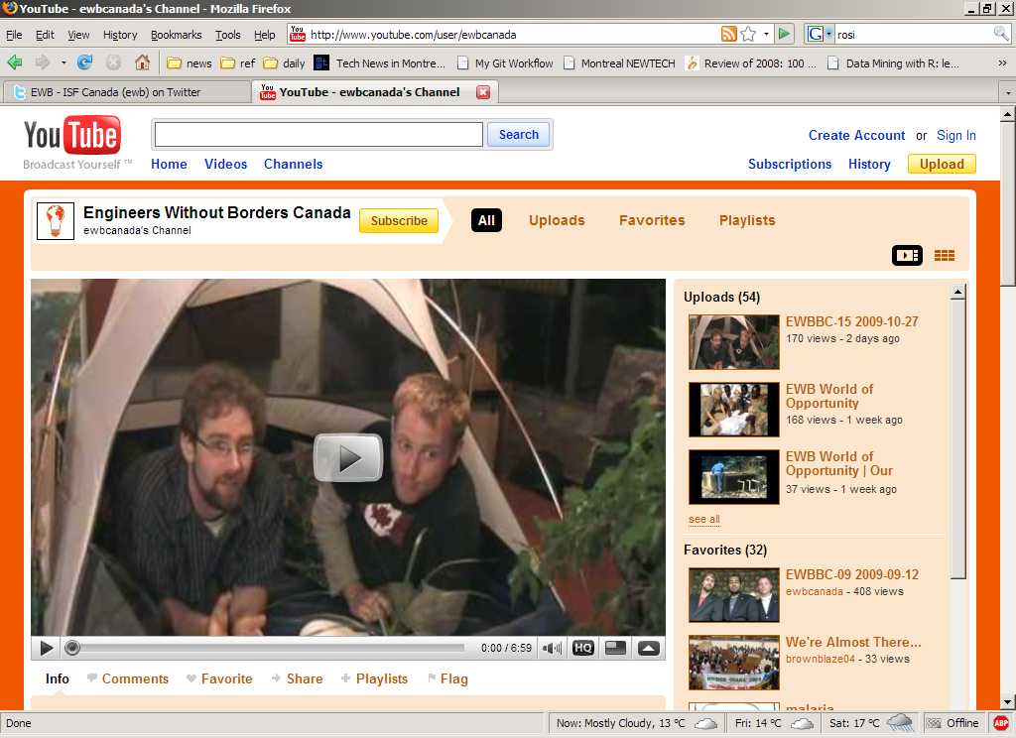
Notes:
And a youtube channel

Slide 16
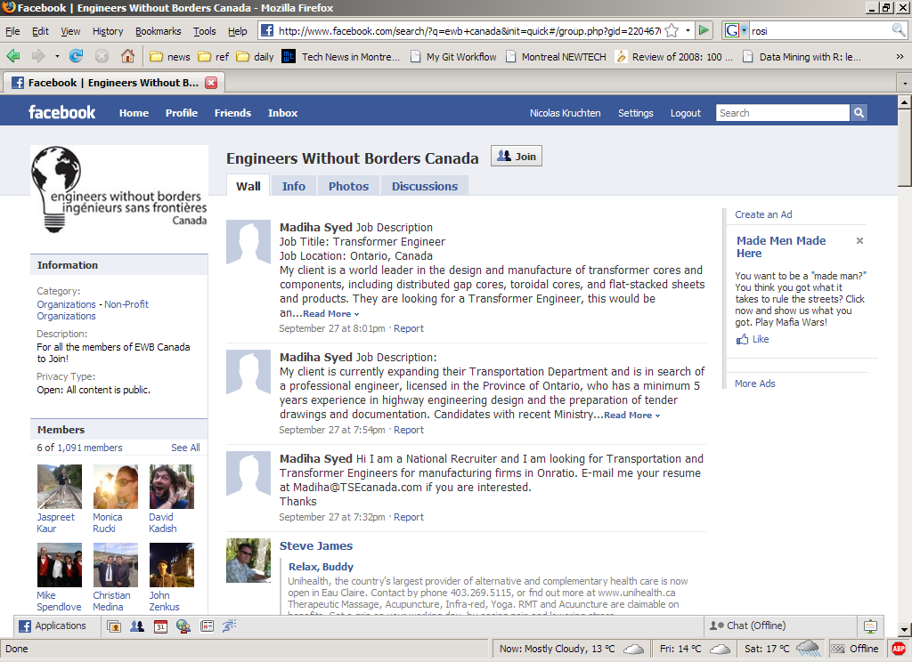
Notes:
And a facebook group. And lots of the chapters have set up facebook groups too. But this has created some real problems… First of all if you can read the slide you’ll see there’s a lot more spam and a lot lower level of discussion in the facebook group than on myEWB, and secondly, there’s a lot less inter-chapter sharing: discussions are much more fragmented because facebook was never designed for this. As a result it’s harder to know what’s going on in the EWBverse, which makes it tough to raise funds to send people overseas etc.

Slide 17
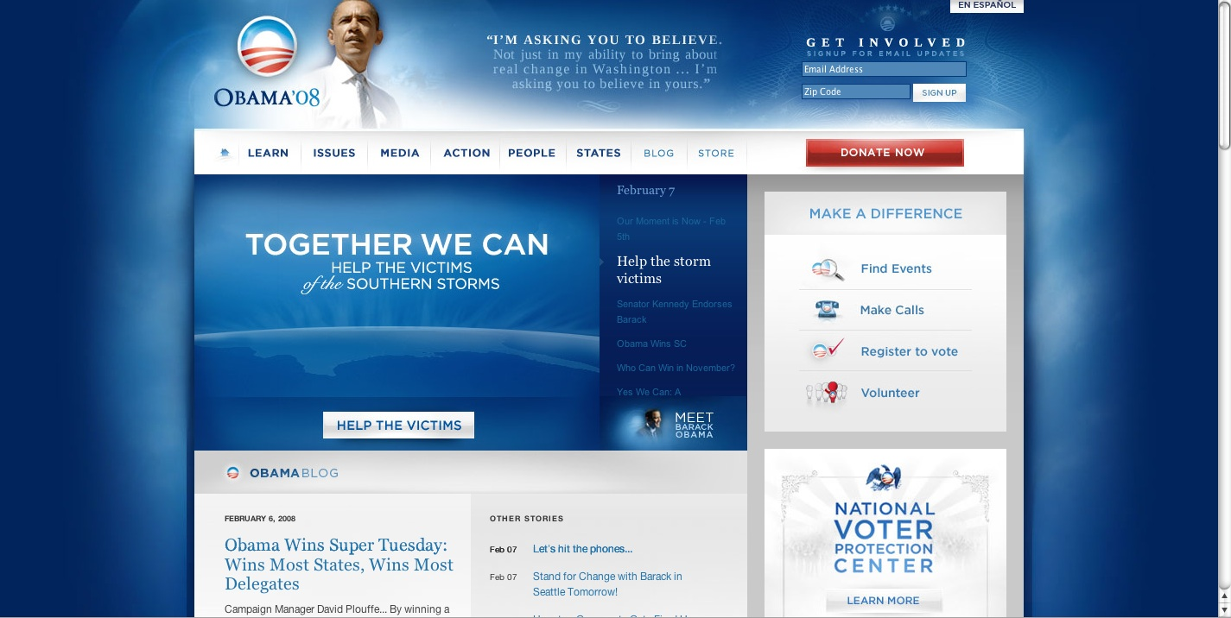
Notes:
Now, some people have managed to successfully “harness” social media, like the Obama campaign, but I would argue that a) they spent a ton of money doing it which few groups can do, and b) they were really only aiming for one single thing: to get a bunch of people out on that one day to vote. And his people have since been criticized for having either chosen not to or failed to “follow through” and build a lasting community/movement out of mybarackobama.com.

Slide 18
So… What?
Notes:
So in the end, (and I’ll try to be a bit provocative with a bleak conclusion) I think that while social media and a proliferation of free web apps for collaboration is really neat and exciting for the individual and small or short-lived groups (I tweet, I’m on facebook all the time and I like it), it might actually be a big barrier to the creation of long-lived, large-scale, coordinated social change movements. Or maybe, to rephrase, the centralized, coordinated social change movement is now outdated…

Slide 19
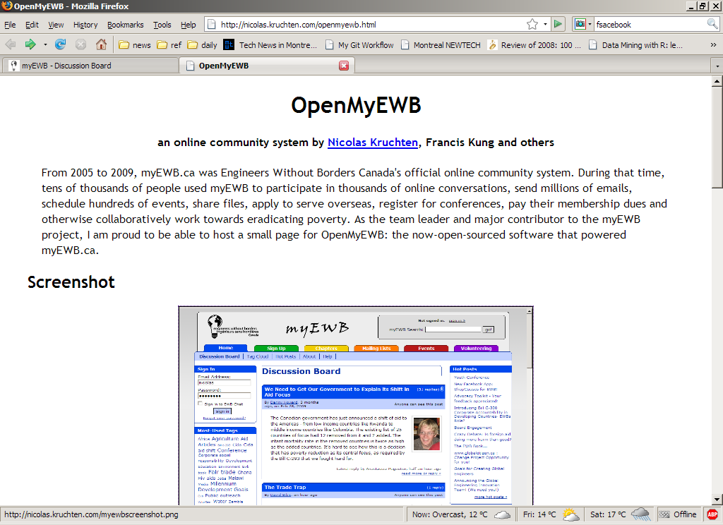

Slide 21
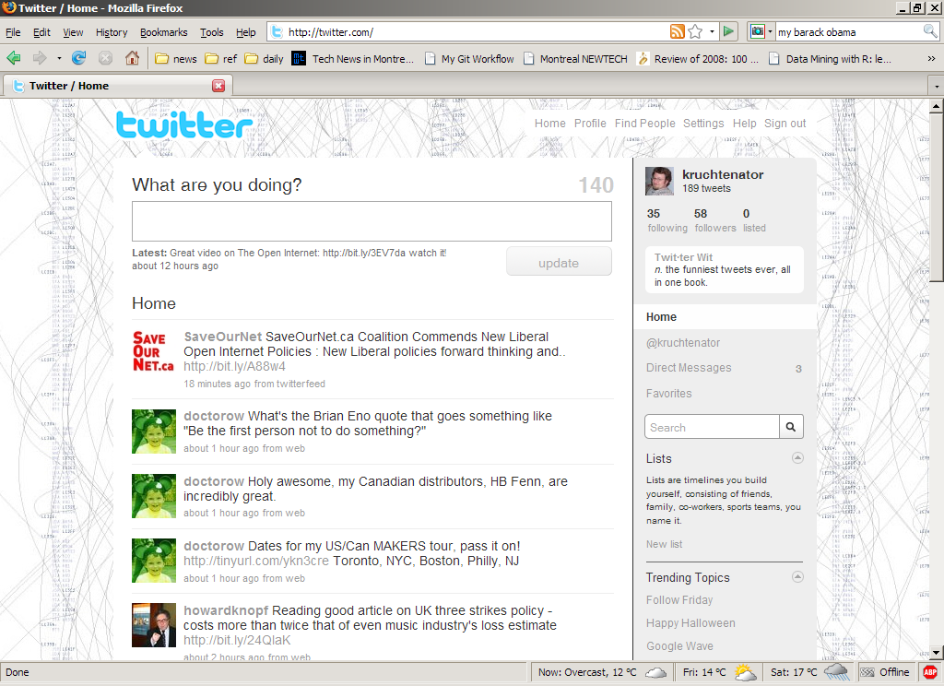

Slide 22
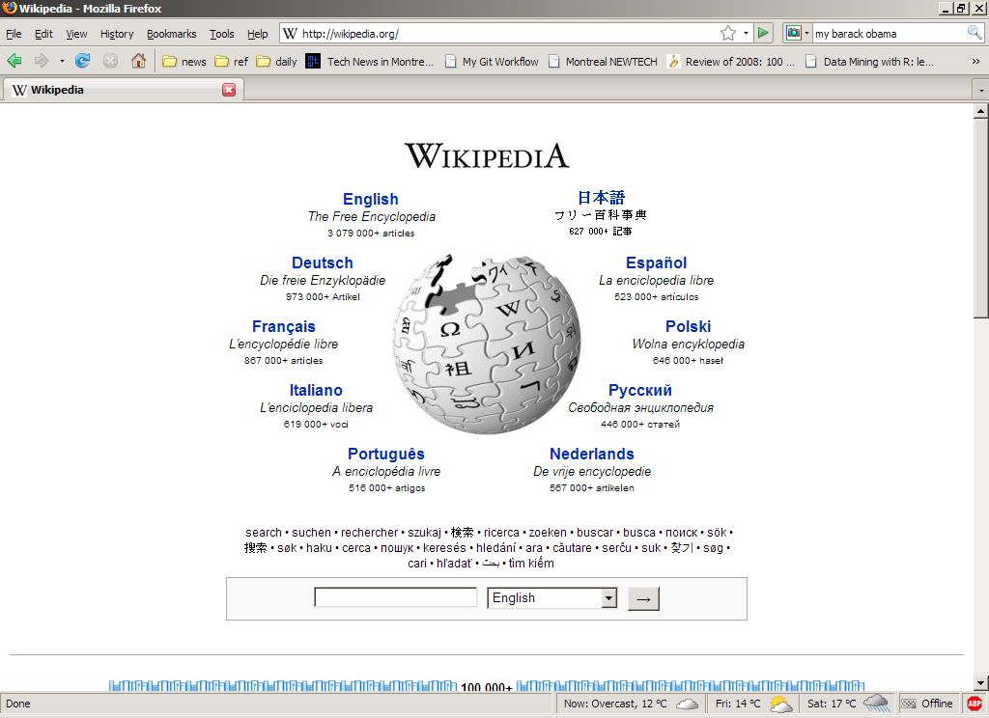

Slide 23
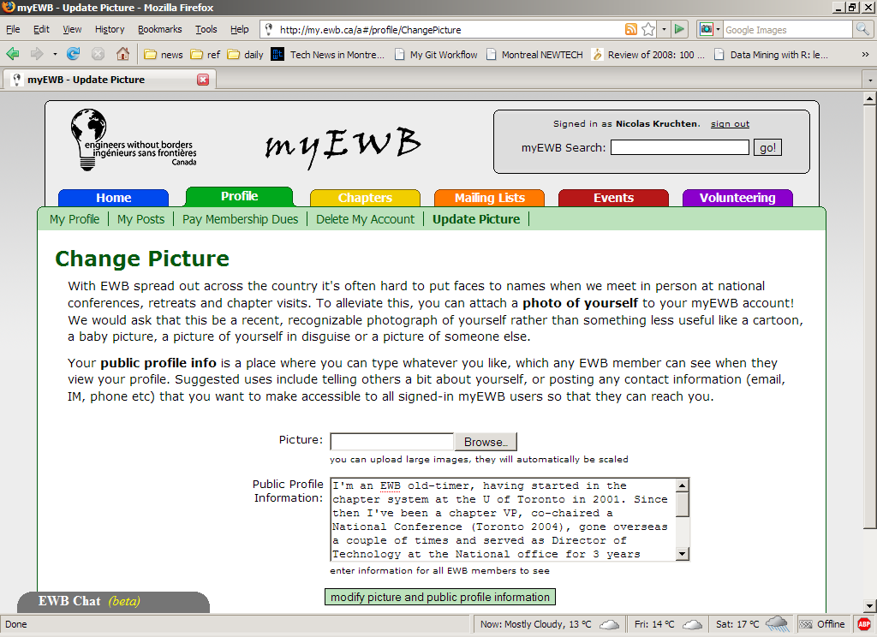

Slide 24
