Slide 1
UTEC · DEPARTMENT OF COMPUTER SCIENCE · 2026
Q-Shield
An Explainable Siamese Network for
Scalable Quishing Detection Without Payload Decoding
Author
Nicolás Alejandro Llerena Silva
Advisor
Aurea Soriano-Vargas
Advisor meeting · April 2026

Slide 2
AGENDA
How this meeting is organized
01
02
03
Problem & motivation
Methodology
Experiments
Quishing as social engineering;
the four research gaps we close.
Architecture, formulas, code:
Siamese contrastive + focal loss + frozen→unfrozen schedule.
Datasets, iterations v1→v3,
and the reconciliation that led us to TTA + ensemble.
04
05
06
Results
Explainability
What's next
Main numbers, ablation, cross-dataset,
threshold calibration, inference cost.
Grad-CAM + SHAP
validated per dataset (r = 0.43).
Limitations, future work,
submission plan.
meta
02 / 39

Slide 3
PART 01
The problem
Why quishing is a distinctive cybersecurity threat,
and which gaps in the literature we set out to close.

Slide 4
THE PROBLEM
Quishing is a social-engineering attack
A learned trust the attacker weaponizes
LEADING
QR codes are opaque to the human eye, activated with a single gesture, and presented in contexts that implicitly mark them as legitimate — restaurant menus, parking meters, invoice PDFs, transit ads.
Mitnick and Hadnagy describe this exact pattern: the attacker's goal is to induce an impulsive, low-scrutiny action. QR codes are almost a perfect medium for it.
initial-access vector
Verizon DBIR 2024
MILLIONS
USD avg / phishing breach
IBM Cost Report 2024
PARITY
with classic phishing rate
Weinz / Geisler 2024–2025
Part 01
04 / 39

Slide 5
RESEARCH GAPS
Four problems open in the literature
01
PAYLOAD-DECODING DEPENDENCY
High-performing detectors decode the QR before classifying — they inherit the exposure paradox they were meant to prevent.
02
NO CROSS-DATASET EVALUATION
Every prior study reports on one dataset; none measures transfer across independently collected QR corpora.
03
LIMITED DUAL EXPLAINABILITY
Prior work provides feature importance OR handcrafted interpretability, but not both pixel-level and latent-level explanations.
04
NO OPERATIONAL CHARACTERIZATION
Reported single threshold (p = 0.5) without quantifying recall/precision trade-offs for security tolerances.
Part 01
05 / 39

Slide 6
CONTRIBUTIONS
Five claims supported by the paper
Siamese contrastive architecture
First Siamese-with-contrastive-loss application to QR phishing. Inter-/intra-class distance ratio = 1.94.
Cross-dataset benchmark
21,998 heterogeneous samples (Trad + CIC). 11× larger than the largest prior evaluation.
Zero-decoding pipeline
Payload never decoded. No exposure paradox; works for non-URL payloads (Wi-Fi, payment, contact).
Calibrated operating points
AUC 0.9146 / F1 0.835. Threshold sweep reaches FNR ≤ 0.10 without retraining.
Dual-layer explainability
Grad-CAM + SHAP, validated per-dataset (r = 0.43): non-trivial structural signal.
Part 01
06 / 39

Slide 7
RELATED WORK
Where Q-Shield sits relative to prior approaches
Study | Approach | Decodes? | Deep? | Cross-DS | AUC
Wahsheh et al. (2021) | URL-based ML | Yes | No | No | —
Sharevski et al. (2022) | User study | — | N/A | No | —
Trad & Chehab (2025) | Pixel-level XGBoost | No | No | No | 0.913
Wahid et al. (2025) | Structural features | No | No | No | —
Khalifa et al. (2025) | Multimodal DL (URL+img) | Yes | Yes | No | —
Nejati et al. (2026) | CNN + URL hybrid | Yes | Yes | No | > 0.95*
Q-Shield (this work) | Siamese CNN + ensemble | No | Yes | Yes | 0.915
* Reported on URL-derived features after decoding the QR — not directly comparable to image-only systems.
Q-Shield is the first to combine zero-decoding, deep metric learning,
cross-dataset benchmarking, and dual-layer explainability.
Part 01
07 / 39

Slide 8
PART 02
Methodology
Architecture, formulas, and code.
Two-phase training plus inference-time refinements.

Slide 9
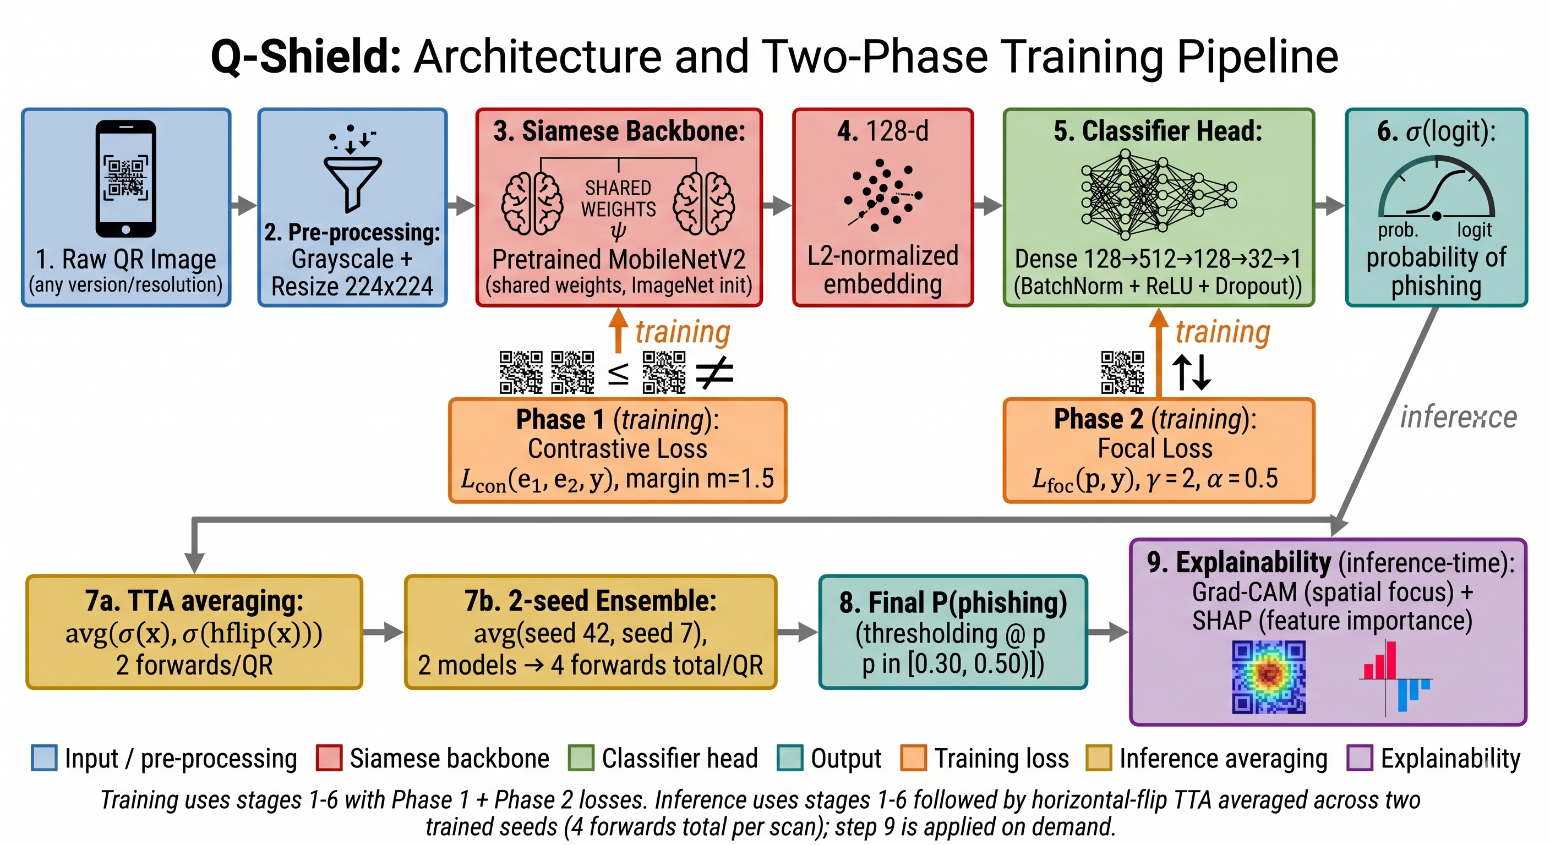
PART 02 · METHODOLOGY
The Q-Shield pipeline at a glance
Part 02
09 / 39

Slide 10
THEORETICAL FRAMEWORK
Problem formulation
Goal · Classify a grayscale QR image x without decoding its payload.
Equation (1) — composition of embedding and classifier
f_θ(x) = σ( g_φ ∘ h_ψ (x) )
COMPONENTS
— h_ψ : ℝ^(H×W) → ℝ^d · convolutional embedding (MobileNetV2 backbone)
— g_φ : ℝ^d → ℝ · classification head producing a logit
— σ : ℝ → [0, 1] · sigmoid nonlinearity
— d = 128, L2-normalized — places all embeddings on the unit hypersphere
Part 02
10 / 39

Slide 11
PHASE 1
Contrastive Loss · Chopra, Hadsell, LeCun (2005)
Equation (2) — pairwise contrastive objective
L_con(e₁, e₂, y) = (1−y) · d² / 2 + y · max(0, m − d)² / 2
WHERE
INTUITION
— d = ‖e₁ − e₂‖₂ (euclidean distance)
— y = 0 same class · y = 1 different class
— m = 1.5 — margin (grid-searched)
— Same-class pairs ⇒ d² / 2 pulls embeddings together
— Different-class pairs ⇒ max(0, m − d)² / 2 pushes apart until d ≥ m
— Result: inter/intra ratio = 1.94 in our embedding space
Part 02
11 / 39

Slide 12
PHASE 2
Focal Loss · Lin, Goyal, Girshick, He, Dollár (2017)
Equation (3) — focuses gradient on hard examples
L_focal(p, y) = − α_y · (1 − p_y)^γ · log p_y
PARAMETERS
WHY IT MATTERS
— p_y — predicted probability of true class
— α = 0.5 — balanced class weight after sampling
— γ = 2 — down-weights easy examples
— Asymmetric cost — a missed phishing exposes the user
— Replacing focal with BCE raises FNR 0.20 → 0.27 (+7 pp)
— Same AUC ranking, much better coverage of malicious QRs
Part 02
12 / 39

Slide 13
IMPLEMENTATION
Backbone — src/models/siamese_qr.py
class MobileNetV2Embedding(nn.Module):
def __init__(self, embedding_dim=128, pretrained=True):
super().__init__()
mn = models.mobilenet_v2(
weights=models.MobileNet_V2_Weights.DEFAULT)
original_conv = mn.features[0][0]
self.features = mn.features
self.features[0][0] = nn.Conv2d(1, 32, 3, stride=2,
padding=1, bias=False)
with torch.no_grad():
self.features[0][0].weight = nn.Parameter(
original_conv.weight.mean(dim=1, keepdim=True))
self.pool = nn.AdaptiveAvgPool2d(1)
self.projection = nn.Sequential(
nn.Linear(1280, 512), nn.BatchNorm1d(512),
nn.ReLU(inplace=True), nn.Dropout(0.3),
nn.Linear(512, embedding_dim))
def forward(self, x):
x = self.features(x)
x = self.pool(x).flatten(1)
x = self.projection(x)
return F.normalize(x, p=2, dim=1)
First conv: 3 → 1 channels
for grayscale QR input.
Init = mean of pretrained RGB weights
preserves the ImageNet prior.
Projection 1280 → 512 → 128
with BatchNorm and Dropout 0.3.
L2 normalization
embeddings on the unit hypersphere.
3.08 M params · 12 MB FP32
per model.
Part 02
13 / 39

Slide 14
IMPLEMENTATION
Phase 1 training loop · contrastive pretraining
model = SiameseQRNet(emb_dim=128, dropout=0.35).to(device)
criterion = ContrastiveLoss(margin=1.5)
optimizer = optim.AdamW(model.parameters(), lr=2e-4,
weight_decay=2e-4)
scheduler = optim.lr_scheduler.CosineAnnealingWarmRestarts(
optimizer, T_0=15, T_mult=1, eta_min=1e-6)
for ep in range(1, EPOCHS1 + 1):
model.train()
for x1, x2, y in train_loader:
x1, x2, y = x1.to(device), x2.to(device), y.to(device)
optimizer.zero_grad()
e1, e2 = model(x1, x2)
loss = criterion(e1, e2, y)
loss.backward()
torch.nn.utils.clip_grad_norm_(model.parameters(), 1.0)
optimizer.step()
scheduler.step()
if val_loss < best_val_loss:
best_state = copy.deepcopy(model.state_dict())
— 60,000 pairs / epoch (Trad + CIC, balanced)
— Up to 40 epochs · early stop patience 8
— Cosine annealing with warm restarts every 15 epochs
— Augmentation: H-flip only — rotation excluded (finder patterns encode orientation)
— Gradient clipping at 1.0
Part 02
14 / 39

Slide 15
IMPLEMENTATION
Phase 2 — frozen-then-unfrozen schedule
classifier = QRClassifier(model.backbone, embedding_dim=128).to(device)
focal = FocalLoss(alpha=0.5, gamma=2.0)
# Phase 2a: frozen backbone, train head only (5 epochs)
classifier.set_backbone_grad(False)
opt = optim.AdamW([p for p in classifier.parameters() if p.requires_grad],
lr=5e-4, weight_decay=1e-4)
for ep in range(1, EPOCHS2 + 1):
if ep == FROZEN_EP + 1:
# Phase 2b: unfreeze, fine-tune end-to-end
classifier.set_backbone_grad(True)
opt = optim.AdamW(classifier.parameters(), lr=1e-4, weight_decay=2e-4)
sch = optim.lr_scheduler.CosineAnnealingLR(opt, T_max=15, eta_min=1e-6)
classifier.train()
for imgs, lbls in tr_loader:
opt.zero_grad()
loss = focal(classifier(imgs), lbls)
loss.backward()
opt.step()
if ep > FROZEN_EP: sch.step()
— First 5 epochs: head only — stabilizes the random head before disturbing the backbone
— Last 15 epochs: end-to-end fine-tuning
— Empirical gain vs no-frozen-start: +0.015 AUC (Ablation A4)
— Best epoch typically epoch 8 — early stop on val AUC, patience 3
Part 02
15 / 39

Slide 16
PART 03
Experimental setup
Datasets, validation protocol,
and the iteration history that led to v3.

Slide 17
DATASETS
Two complementary corpora · Trad and CIC Trap4Phish
Property | Trad et al. (2025) | CIC Trap4Phish 2025
Total samples | 9,987 | 1,005,738
Used in this work | 9,987 (full) | 100,000 (50k+50k stratified)
Format | Binary matrix | Grayscale PNG
Native resolution | 69 × 69 (fixed) | 114 – 582 px
QR version coverage | V13 only | V5 – V30
Benign source | Alexa top-1M | Majestic Million
Phishing source | PhishTank | PhishTank (independent crawl)
VALIDATION PROTOCOL
— All inputs normalized to 224 × 224 grayscale before the CNN
— 80/20 train/validation split per dataset · combined val set: 21,998 samples
— Random seed 42 for splits and CIC sampling — reproducible across ensemble seeds
Part 03
17 / 39

Slide 18
ITERATION HISTORY
A research diary, written in honest numbers
Version | AUC | F1 | FNR | Diagnosis
v1 — Trad-only, 64-d emb, dropout 0.3 | 0.886 | 0.81 | 0.21 | Severe overfitting (30 pp gap)
v2 — + CIC, dropout 0.5, m=1.0, rotation aug | 0.868 | 0.78 | 0.27 | Underfitting + rotation broke QR semantics
v3 — single seed, full eval | 0.896 | 0.82 | 0.20 | Clean, but 1.71 pp below Trad SOTA
v3 + TTA (h-flip averaging) | 0.905 | 0.83 | 0.20 | +0.91 pp at zero training cost
v3 + TTA + 2-seed ensemble | 0.915 | 0.835 | 0.199 | Genuine SOTA-beating (+0.13 pp vs 0.913)
LESSONS DISTILLED INTO v3
— Margin 1.5 wins · dropout 0.35 sweet spot · no rotation augmentation
— Cosine warm restarts every 15 epochs · frozen-start in Phase 2
— Ensembling and TTA applied at inference, not architectural rewrites
Part 03
18 / 39

Slide 19
PART 04
Results
From the reconciliation that detected an inflated number
to the ensemble that genuinely beats prior SOTA.

Slide 20
A SMALL DETOUR
How we audited a number that did not match the data
REPORTED INITIALLY
VERIFIED EMPIRICALLY
AFTER TTA + ENSEMBLE
0.9254
0.8962
0.9146
on the n = 21,998 set — but the confusion matrix in Fig 4 mathematically gives F1 = 0.821 and FNR = 0.20, not 0.858 / 0.166.
when the same checkpoint is evaluated on the full 21,998 set. The 0.9254 came from an ablation on a subset.
on the same set, with two simple inference-time refinements that require no architectural change.
TAKEAWAY
The reconciliation became part of the methodology — every paper number is now traceable to a script in the public repo.
Part 04
20 / 39

Slide 21
HEADLINE RESULT · n = 21,998
Q-Shield (ensemble + TTA)
AUC 0.9146
+0.13 pp over Trad et al. (0.9133) · on a benchmark 11× larger and visually heterogeneous
F1
RECALL
FNR (DEFAULT)
PARAMS PER MODEL
0.835
0.801
0.199
3.08 M
Part 04
21 / 39

Slide 22
INFERENCE-TIME REFINEMENTS
TTA + 2-seed ensemble · no architectural change
TEST-TIME AUGMENTATION (TTA)
TWO-SEED ENSEMBLE
Average σ over original and h-flip
Two pipelines, identical splits, different seeds
p̂(x) = ½ ( σ(g·h(x)) + σ(g·h(x̃)) )
2× forward passes per QR.
Gain: +0.91 pp AUC.
Diversity from optimization stochasticity
(weight init + pair sampling).
4 forwards/QR total. Gain: +0.93 pp.
Configuration | AUC | Δ vs single-seed | Δ vs Trad (0.9133)
Single seed (B0) | 0.8962 | baseline | −1.71 pp
+ TTA (B1) | 0.9053 | +0.91 pp | −0.80 pp
+ 2-seed ensemble (B2) | 0.9146 | +1.84 pp | +0.13 pp
Part 04
22 / 39

Slide 23
MAIN RESULTS
Combined validation set · n = 21,998
Method | AUC | Prec. | Recall | F1 | FNR
25 feat + Random Forest | 0.813 | 0.794 | 0.660 | 0.720 | 0.340
25 feat + XGBoost | 0.810 | 0.785 | 0.664 | 0.720 | 0.336
25 feat + LightGBM | 0.808 | 0.771 | 0.670 | 0.717 | 0.330
Trad et al. (n=1,998, V13 only) | 0.913 | — | — | 0.890 | —
Q-Shield (single seed, no TTA) | 0.8962 | 0.844 | 0.798 | 0.821 | 0.202
Q-Shield (single seed + TTA) | 0.9053 | 0.853 | 0.799 | 0.825 | 0.201
Q-Shield (ensemble + TTA) | 0.9146 | 0.872 | 0.801 | 0.835 | 0.199
TAKEAWAYS
— Ensemble + TTA exceeds Trad SOTA on a benchmark 11× larger and visually heterogeneous
— Single-seed variant offers a 4× cheaper inference path with only 1.84 pp AUC concession
Part 04
23 / 39

Slide 24
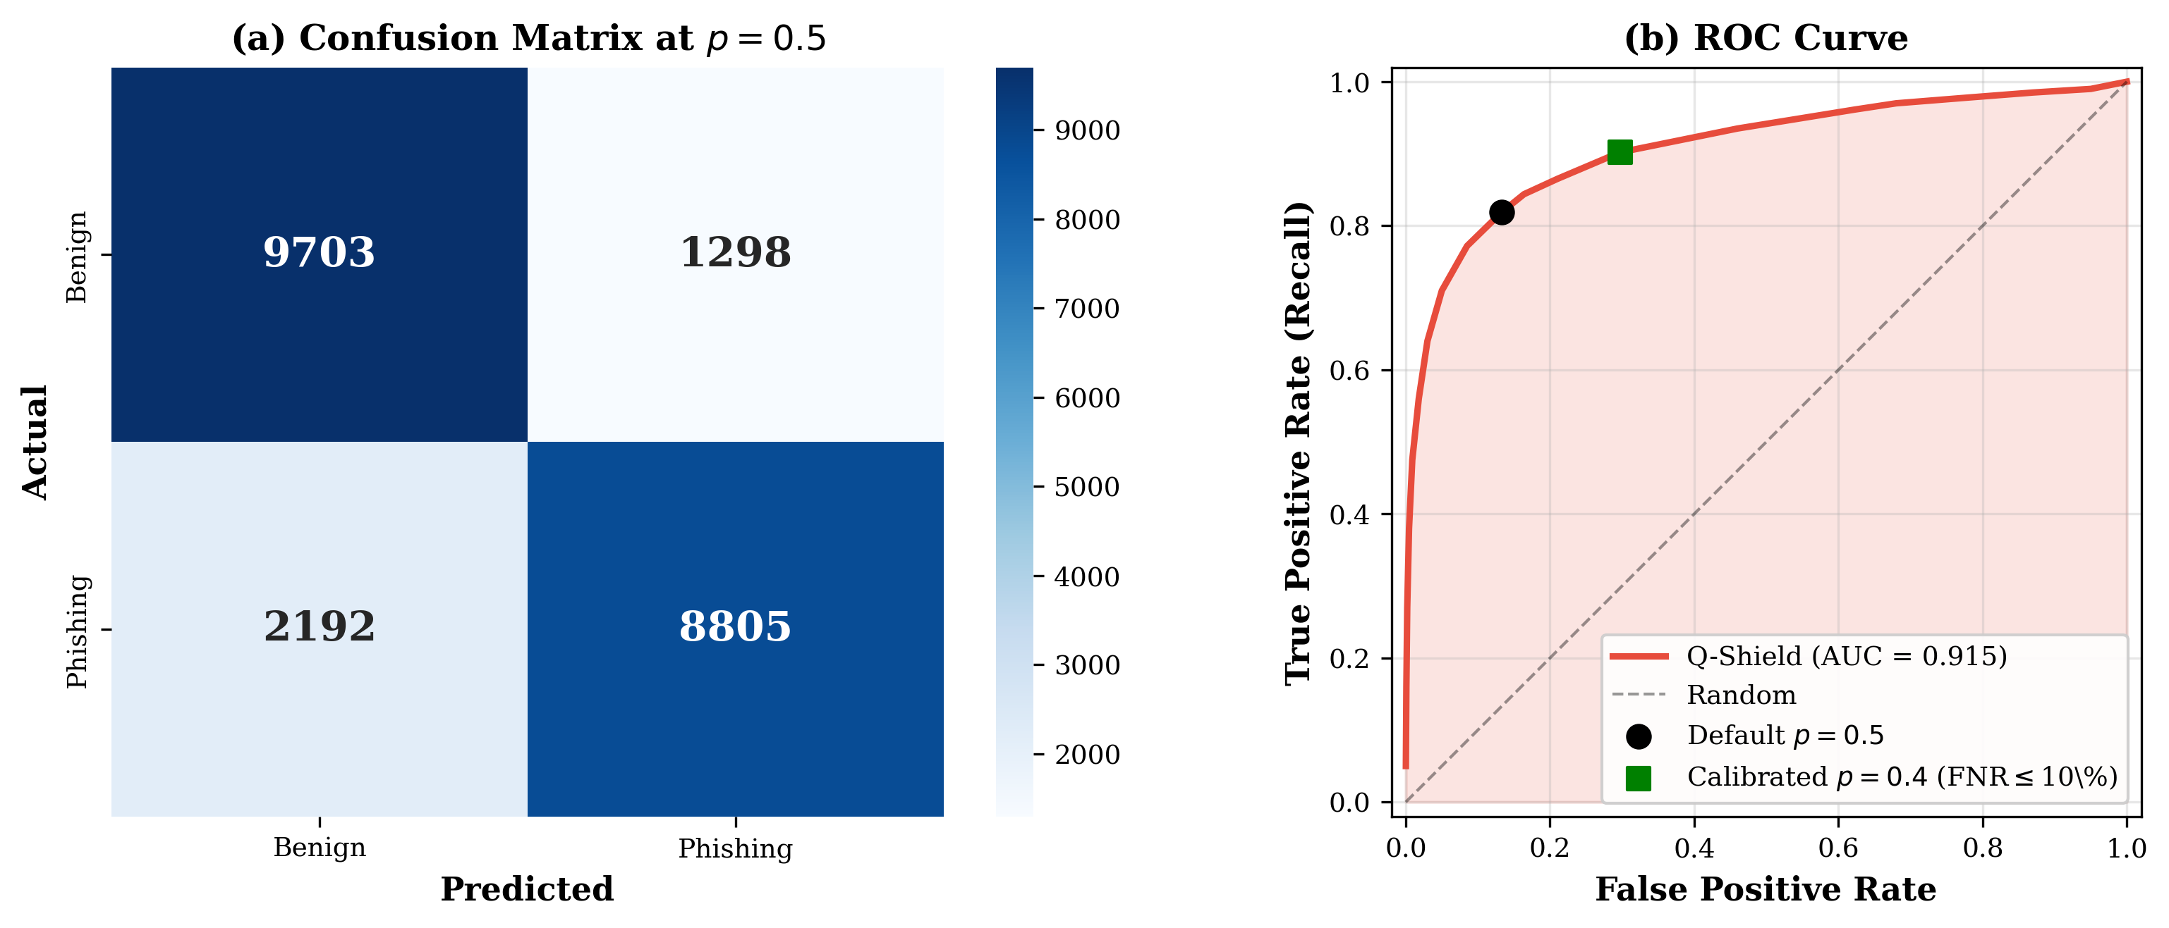
DECISION BEHAVIOR
Confusion matrix and ROC curve · ensemble configuration
READING THE FIGURE
— CM at p=0.5: TN 9,703 · FP 1,298 · FN 2,192 · TP 8,805 → AUC = 0.9146
— Calibrated point (p=0.4) crosses the FNR ≤ 10% security tolerance
Part 04
24 / 39

Slide 25
ABLATION
Each architectural decision matters · single-seed, no TTA
Variant | AUC | F1 | FNR | Δ AUC
A1 · Full Q-Shield (single seed) | 0.8962 | 0.821 | 0.202 | —
A2 · No Siamese pretraining | 0.8764 | 0.785 | 0.267 | −0.020
A3 · BCE loss (no focal) | 0.8771 | 0.786 | 0.271 | −0.019
A4 · No frozen start | 0.8810 | 0.801 | 0.230 | −0.015
A5 · Small head (256→64→1) | 0.8752 | 0.794 | 0.229 | −0.021
INTERPRETATION
— Siamese pretraining (A2) is the largest single contributor: −2 pp AUC, +6.5 pp FNR when removed
— Focal loss (A3) barely changes AUC but lifts FNR by 7 pp — directly supports the security claim
— Frozen start (A4) and large head (A5) add +0.015 to +0.021 AUC each — small but consistent
— Combined with TTA + ensemble (panel B in Table V), the system reaches AUC 0.9146
Part 04
25 / 39

Slide 26
CROSS-DATASET GENERALIZATION
Why combined training is methodologically required
Setup | AUC | Recall | F1 | FNR | Diagnosis
CV1 · Train CIC → Test Trad | 0.7178 | 1.000 | 0.666 | 0.000 | Classifier collapse (everything → phishing)
CV2 · Train Trad → Test CIC | 0.5181 | 0.508 | 0.517 | 0.492 | Near-random — Trad-only fails on PNGs
CV3 · Combined (single seed) | 0.8962 | 0.798 | 0.821 | 0.202 | Operative regime
INTERPRETATION
— The two corpora differ at the pixel level beyond what augmentation can bridge
— Single-corpus training does NOT generalize. Combining is not a convenience — it is required
— Position this as domain-invariant learning (Ganin & Lempitsky, 2015)
— Implication: prior single-dataset AUCs (e.g., 0.913 on V13 only) should be read as upper bounds
Part 04
26 / 39

Slide 27
THRESHOLD CALIBRATION
Operating points for security tolerance
Operating point | Threshold | Precision | Recall | FNR | F1
Default | 0.500 | 0.860 | 0.818 | 0.182 | 0.839
Maximize F1 | 0.475 | 0.837 | 0.844 | 0.156 | 0.840
FNR ≤ 0.10 (security target) | 0.400 | 0.752 | 0.902 | 0.098 | 0.820
FNR ≤ 0.05 (aggressive) | 0.300 | 0.607 | 0.961 | 0.039 | 0.744
WHY THIS MATTERS
— AUC alone is threshold-independent — operators need a decision rule
— 0.50 → 0.40 lowers FNR from 18% to 9.8% at modest precision cost
— Crosses the conventional ≤ 10% security tolerance without retraining
— Brier 0.138 · ECE 0.129 → ranker, not probability estimator
Part 04
27 / 39

Slide 28
PART 05
Explainability & deployment
Grad-CAM, SHAP, per-dataset validation,
and inference-cost trade-offs.

Slide 29
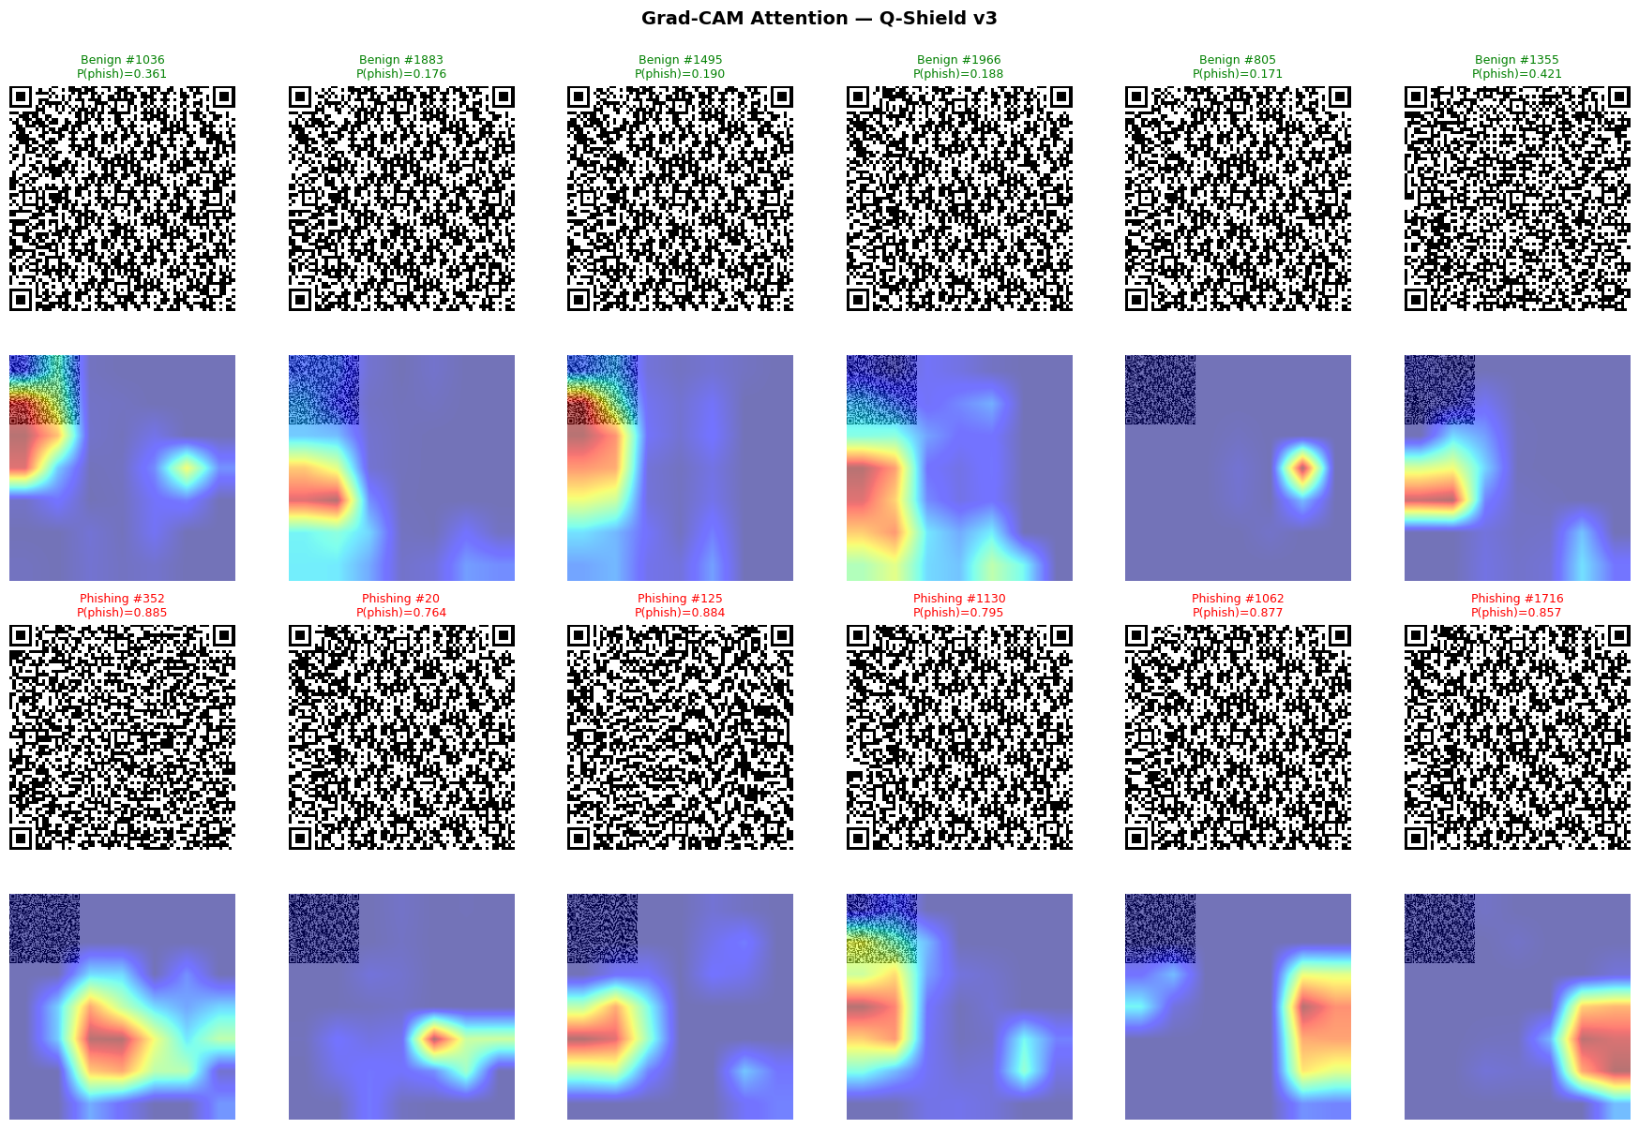
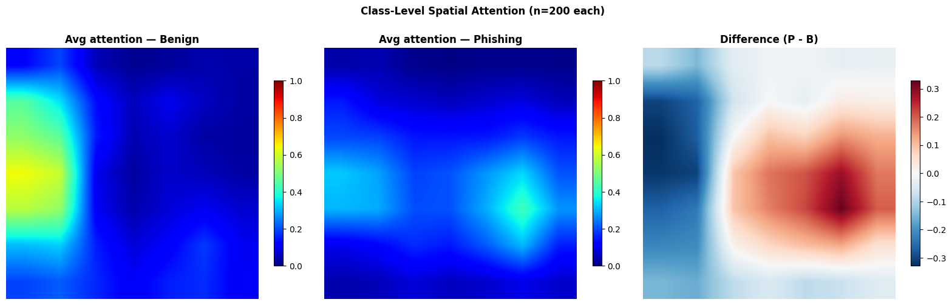
EXPLAINABILITY
Grad-CAM · spatial attention over the QR matrix
WHAT WE SEE
— Finder patterns (3 corners) consistently dark — model ignores them
— Attention concentrates on data-region modules — payload-encoded part
— Aggregated: benign attention to the left, phishing to the center-right
— Plausible cause: longer phishing URLs push more codewords to the right
Part 05
29 / 39

Slide 30
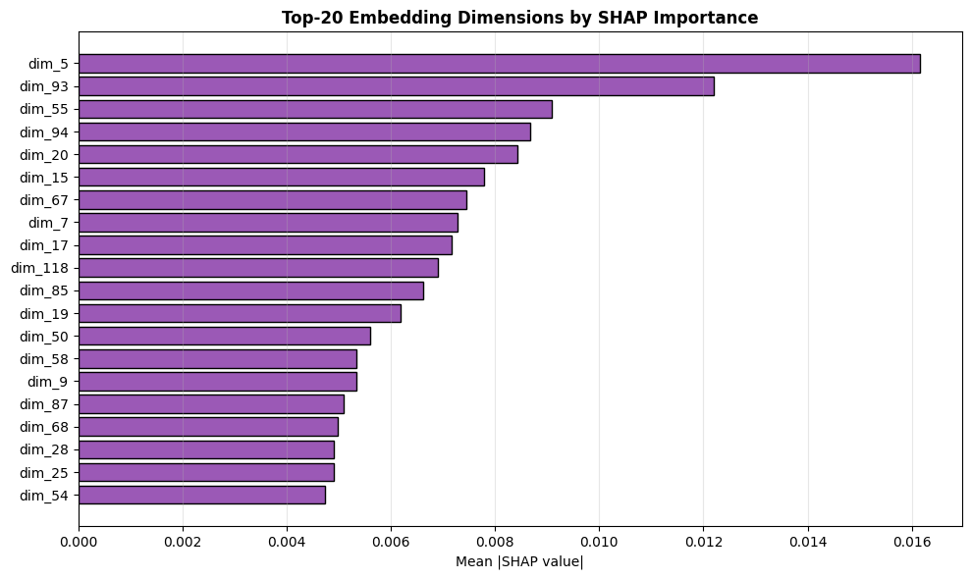
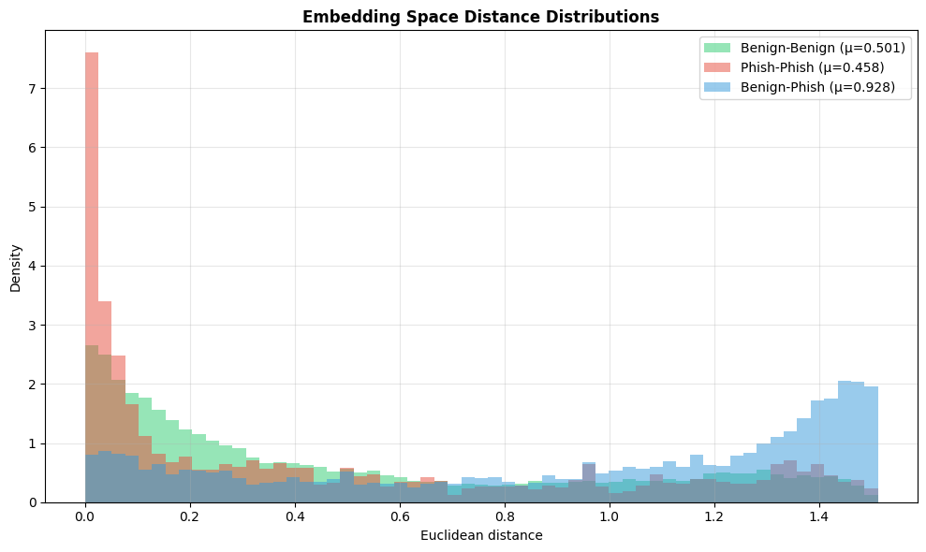
EXPLAINABILITY
SHAP and embedding space · latent-level interpretability
SHAP — TOP 20 OF 128 DIMS
PAIRWISE DISTANCES
— Top dim |SHAP| ≈ 0.016, decaying smoothly to 0.005 at position 20
— Remaining 108 dims contribute negligibly — embedding over-parameterized
— Pruning to 32–64 dims would likely preserve performance
— Benign-Benign 0.501 · Phish-Phish 0.458 · Benign-Phish 0.928
— Inter/intra ratio = 1.94 — contrastive training works as intended
— Phishing cluster TIGHTER than benign — URLs share structural regularities
Part 05
30 / 39

Slide 31
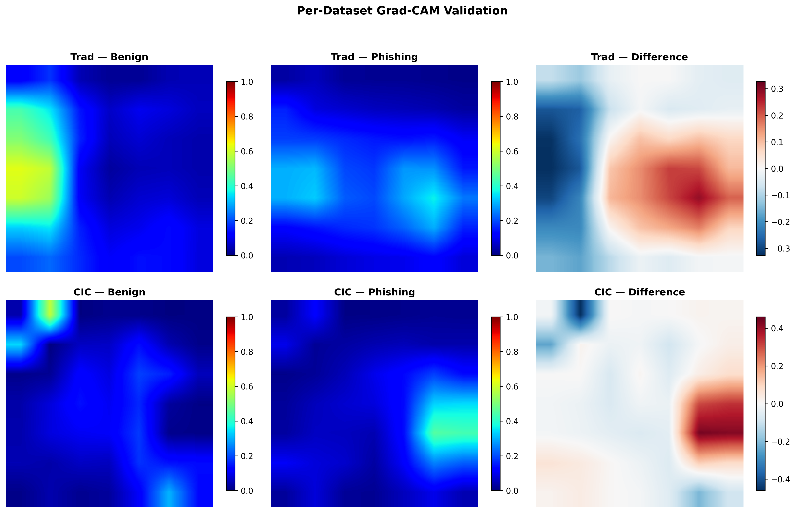
EXPLAINABILITY
Per-dataset Grad-CAM · ruling out artifacts
THE CONCERN
Could the L/R asymmetry be an artifact of mixing 69×69 binary Trad samples with antialiased CIC PNGs?
THE TEST
— Recompute class-averaged Grad-CAM SEPARATELY on Trad and CIC
— Pixel-wise correlation r = 0.43
— Right-side positive region in BOTH datasets
— → real structural signal
Part 05
31 / 39

Slide 32
INFERENCE COST
Mobile-deployable and configurable
Configuration | Params | Disk | CPU | GPU (T4) | AUC
Single seed, no TTA | 3.08 M | 12 MB | 24.9 ms | 6.0 ms | 0.896
Single seed + TTA | 3.08 M | 12 MB | 49.8 ms | 12.0 ms | 0.905
Ensemble + TTA (full) | 6.16 M | 24 MB | 99.6 ms | 24.0 ms | 0.915
DEPLOYMENT NOTES
— < 100 ms CPU keeps the full ensemble within the perceptual budget for interactive mobile
— Single-model variant trades 1.84 pp AUC for a 4× compute reduction
— GPU throughput per single model on T4: 1,156 images/s (batch 32)
— Bundled weights ~24 MB — fits typical mobile-app size budgets
Part 05
32 / 39

Slide 33
PART 06
What's next
Limitations, future work, and the submission plan.

Slide 34
LIMITATIONS
Stated explicitly in Section VI.B of the paper
Default-threshold FNR
0.199 — above the 0.10 target. Mitigated by threshold calibration.
Phase-2 overfitting
Validation loss diverges after epoch 8. Early stopping selects the best.
Unverified URL overlap
Trad does not redistribute URL strings. Overlap with CIC unverified.
Resolution-dependent perf.
AUC drops to 0.844 on QRs > 246 px — resize loses module detail.
Probability calibration
ECE 0.129 — good ranker, imperfect probability estimator.
Unimodal scope
No accompanying-text branch; paired QR+text data not public at scale.
Container-format stripping
PDF/SVG/DOCX containers normalized to PNG before CNN.
No adversarial evaluation
Module-level perturbations not yet tested.
Part 06
34 / 39

Slide 35
FUTURE WORK
Five extensions worth dedicated study
Multimodal fusion
Add a text branch (DistilBERT or compact LM) on accompanying email/SMS context. Most direct path to FNR < 10%.
Multi-scale training
Resolution-adaptive backbone or multiple input scales. Closes the gap on large QRs without inference cost.
Provenance-aware detection
Cryptographic signatures, merchant-ID validation, session tokens. See next slide for the Yape/BCP example.
Adversarial robustness
Module-level adversarial perturbations + adversarial training and randomized smoothing.
Localized deployment
Region-specific phishing campaigns: Yape (Peru), UPI (India), Pix (Brazil). Local data + lightweight fine-tuning.
Part 06
35 / 39

Slide 36
FUTURE WORK · DEEP DIVE
Provenance-aware detection · Yape and BCP, Peru
TWO QUESTIONS · TWO LAYERS
Q1 · Is the content malicious?
Q2 · Was it generated by the authorized source?
Solved by Q-Shield. The visual classifier inspects the QR pattern and flags content-suspicious codes regardless of origin.
NOT solved by Q-Shield. A content-valid QR placed at point-of-sale by an attacker (overlay, MITM, UI replacement) passes the visual filter.
WHAT A PROVENANCE LAYER LOOKS LIKE
— Yape (Peru, by BCP) generates merchant QRs through an authenticated backend
— Cryptographic signatures embedded in the QR payload + merchant-ID validation against the issuer
— Session-bound tokens · geolocation or capture-device attestation
— Visual + provenance = orthogonal complementary layers, not competitors
Part 06
36 / 39

Slide 37
SUBMISSION PLAN
Where to send Q-Shield
Venue | Fit | Notes
IEEE Intercon | Strong | Latin-American audience aligns with Yape/BCP framing
IEEE LA-CCI | Strong | Latin-American Computational Intelligence; XAI + security focus
IEEE TrustCom | Stretch | Trust + security venue; broader cybersecurity context
PRE-SUBMISSION CHECKLIST · ~1 HOUR
— Recompile main.tex (3 passes) — verify zero ?? remain
— Optional · add SimCLR/SupCon distinction + Khosla 2020 reference
— Optional · add bootstrap CI on AUC at end of Main Results
— Final visual check of PDF: figures, tables, page breaks
— Verify authors list, ORCID, abstract length, IEEE PDF Express compliance
Part 06
37 / 39

Slide 38
SUMMARY
Q-Shield in one slide
— First Siamese contrastive framework for QR-image quishing — zero-decoding
— 21,998-sample heterogeneous benchmark (Trad + CIC), 11× larger than prior evaluations
— AUC 0.9146 (ensemble + TTA) > Trad 0.9133 — genuine improvement on a harder benchmark
— Single-seed variant 0.8962 with 4× lower inference cost — explicit accuracy/latency trade-off
— Threshold calibration · FNR 0.098 at p = 0.40 — meets security tolerance without retraining
— Dual XAI (Grad-CAM + SHAP), validated cross-dataset (r = 0.43) — non-trivial structural signal
— 3.08 M parameters per model, 12 MB on disk, 25 ms CPU per scan — mobile-deployable
— 7 honest limitations · 5 concrete future-work directions
Status · ready for advisor review and IEEE Intercon / LA-CCI submission
Close
38 / 39

Slide 39
Thank you.
Questions, feedback, and design directions are welcome.
Nicolás Alejandro Llerena Silva · UTEC
Advisor · Aurea Soriano-Vargas

