Slide 1
UTEC · DEPARTMENT OF COMPUTER SCIENCE · 2026
Q-Shield
An Explainable Multimodal Framework for
Quishing Detection via Siamese Visual and Offline URL Analysis
Author
Nicolás Alejandro Llerena Silva
Advisor
Aurea Soriano-Vargas
Advisor meeting · May 2026 · multimodal pivot

Slide 2
AGENDA
Six parts, with the pivot in the middle
01
02
03
The problem
The pivot
Architecture
Quishing as social engineering;
the four research gaps we close.
Why we moved from visual-only to multimodal,
and why the visual branch stays as graceful fallback.
Visual Siamese branch + DistilBERT URL branch +
late-fusion MLP with explicit undecodable flag.
04
05
06
Experiments
Results
What's next
Datasets, iterations,
and the reconciliation that produced honest numbers.
Headline AUC 0.9749, FNR 0.057,
branch comparison, ablation, cross-dataset.
Limitations, future work,
submission plan to IEEE Intercon / LA-CCI.
meta
02 / 41

Slide 3
PART 01
The problem
Quishing as a distinctive cybersecurity threat,
and which gaps in the literature we set out to close.

Slide 4
THE PROBLEM
Quishing is a social-engineering attack
A learned trust the attacker weaponizes
LEADING
QR codes are opaque to the human eye, activated with a single gesture, and presented in contexts that implicitly mark them as legitimate — restaurant menus, parking meters, invoice PDFs, transit ads.
Mitnick and Hadnagy describe this exact pattern: the attacker's goal is to induce an impulsive, low-scrutiny action. QR codes are almost a perfect medium for it.
initial-access vector
Verizon DBIR 2024
MILLIONS
USD avg / phishing breach
IBM Cost Report 2024
PARITY
with classic phishing rate
Weinz / Geisler 2024–2025
Part 01
04 / 41

Slide 5
PART 02
The pivot
Why we moved from visual-only to multimodal,
and why the visual branch stays as graceful fallback.

Slide 6
PART 02
Why we pivoted to multimodal
Three failures of the original visual-only framing
1. The "decoding paradox" does not hold up
pyzbar is local, deterministic, no network, no DNS, no JS. It conflates reading a string (safe) with opening it (risky). An informed reviewer would knock this down on first read.
2. The visual signal alone is structurally weak in heterogeneous QRs
CIC Trap4Phish 2025 reports SSIM benign↔phishing ≈ 0.34 — visually almost identical. Their CNN over images reaches F1 0.88; their LLMs over the decoded URL reach F1 0.97-0.99.
3. Combining both branches dominates either alone, by construction
Bountakas (2023) and Khalifa (2025) already validated multimodal fusion in webpage phishing. The framing that survives review is the one that uses every signal available.
The visual branch is NOT discarded — it remains the operative signal whenever the QR cannot be decoded (4.3% of the corpus).
Part 02
06 / 41

Slide 7
RESEARCH GAPS
Four open problems we close
01
NO INTEGRATED VISUAL+TEXT DETECTOR FOR QR
Trad operates only pre-decode; CIC reports both branches in parallel but does not fuse them. We provide the first end-to-end fused detector with explicit undecodability handling.
02
NO CROSS-DATASET EVALUATION
Every prior study reports on one dataset; none measures transfer across independently collected QR corpora. We are the first to do this.
03
LIMITED DUAL EXPLAINABILITY
Prior work provides feature importance OR handcrafted interpretability, but not both pixel-level and latent-level explanations.
04
NO OPERATIONAL CHARACTERIZATION
Reported single threshold (p = 0.5) without quantifying recall/precision trade-offs for security tolerances. The fused model meets the ≤10% FNR target out of the box.
Part 02
07 / 41

Slide 8
CONTRIBUTIONS
Five claims supported by the paper
Multimodal fusion is the operative configuration
Visual + DistilBERT-URL + late-fusion MLP. AUC 0.9749, F1 0.936, FNR 0.057 on n=21,998 — exceeds Trad 0.913 by +6.16 pp.
11× larger heterogeneous benchmark
Joint Trad + CIC validation set spans multiple QR versions, resolutions, and image formats.
Explicit handling of undecodable QRs
pyzbar fallback + UNDECODABLE flag in fusion input. Visual branch is the operative signal in this 4.3% of the corpus.
Default-threshold security target met
FNR 0.057 at p=0.5 — already below the conventional ≤10% tolerance, no calibration required.
Dual-layer explainability, cross-validated
Grad-CAM (spatial) + SHAP (feature). Per-dataset Pearson r = 0.43: signal is structural, not dataset-specific.
Part 02
08 / 41

Slide 9
RELATED WORK
Where Q-Shield sits relative to prior approaches
Study | Approach | Decodes? | Branches fused? | Cross-DS? | Best F1
Trad & Chehab (2025) | Pixel-level XGBoost | No | N/A (visual only) | No | 0.890
Wahid et al. (2025) | Structural features | No | N/A | No | —
Khalifa et al. (2025) | Multimodal DL (URL+img) | Yes | Yes (webpages) | No | —
Nejati et al. (2026) | CNN + LLMs (parallel) | Yes | No | No | 0.97-0.99 (text)
Q-Shield (this work) | Siamese visual + DistilBERT URL + fusion | Local only | Yes | Yes | 0.936
Why Q-Shield is novel
— First end-to-end fused detector for QR phishing — Trad and Wahid are visual-only, Khalifa is webpages, CIC reports the two branches but does not fuse them
— First to handle the UNDECODABLE case explicitly via a binary flag in the fusion input
— First to evaluate cross-dataset transfer between independently collected QR corpora
Part 02
09 / 41

Slide 10
PART 03
Architecture
Visual Siamese branch + DistilBERT URL branch +
late-fusion MLP with explicit undecodability flag.

Slide 11
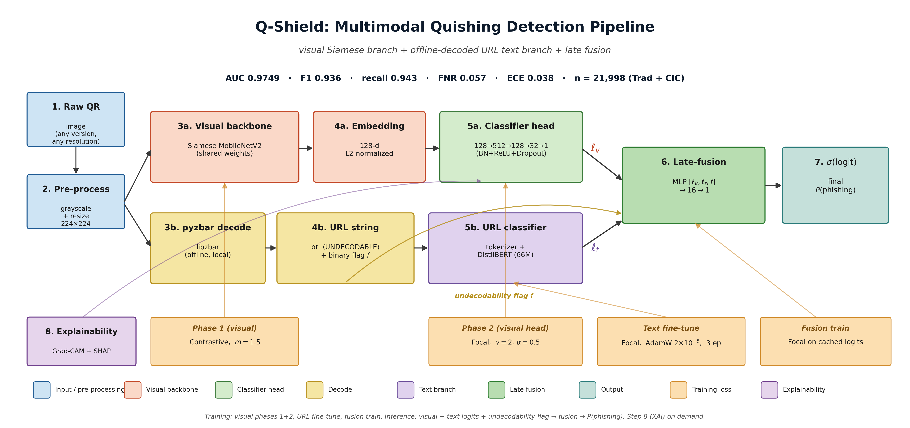
PART 03 · ARCHITECTURE
Q-Shield multimodal pipeline
Part 03
11 / 41

Slide 12
VISUAL BRANCH
Pre-decode signal — Siamese MobileNetV2 + classifier head
— Backbone: MobileNetV2 (3.08M params, 12 MB FP32) — adapted to 1-channel grayscale, ImageNet init averaged across RGB
— Embedding: 1280 → 512 → 128, L2-normalized (unit hypersphere)
— Phase 1 (contrastive): margin m = 1.5, AdamW lr 2e-4, cosine warm restarts (T_0 = 15), up to 40 epochs with patience 8
— Phase 2 (focal): head 128→512→128→32→1, focal loss (γ = 2, α = 0.5), backbone frozen for 5 epochs then unfrozen
— Best epoch typically epoch 8; early stopping on val AUC, patience 3
— Operates pre-decode — only signal available when the QR cannot be decoded
METRICS
Single seed AUC
0.8962
+ TTA AUC
0.9053
+ 2-seed ensemble AUC
0.9146
Single-seed FNR
0.202
Inter/intra ratio
1.94
Part 03
12 / 41

Slide 13
TEXT BRANCH
Post-decode signal — DistilBERT over offline-decoded URLs
— Backbone: DistilBERT base uncased (66M params, 255 MB FP32). Trade-off latency vs accuracy: smaller than DeBERTa-v3 / ModernBERT, larger than BERT-Tiny
— Tokenizer: AutoTokenizer at max_length 96 — covers the full URL distribution observed across both corpora
— Decoding: pyzbar (libzbar) — local, deterministic, no network call, no payload execution. The "decoding paradox" conflates reading and opening
— UNDECODABLE token: when pyzbar fails (low contrast, missing quiet zone, damaged finder pattern), we emit a sentinel token. The encoder learns it as a separate representation — undecodability becomes a feature
— Fine-tuning: 3 epochs of focal loss (γ=2, α=0.5), AdamW lr 2e-5, weight decay 1e-2, linear warmup-then-decay schedule with 10% warmup
— Decode rate: Trad 100% (cascade decoder), CIC 95.7% — total 95.7% across the joint corpus
METRICS
Text-only AUC
0.9592
Text-only F1
0.927
Text-only FNR
0.069
Brier
0.066
ECE
0.045
Part 03
13 / 41

Slide 14
FUSION
Late fusion over logits — 161 parameters
Late-fusion architecture
p̂(x) = σ( MLP_{16}( [ ℓ_v(x), ℓ_t(x), flag_undecodable ] ) )
WHAT IT DOES
WHY IT WORKS
— Combines visual logit and text logit with explicit awareness of decode failure
— Architecture: 3 → 16 → 1 = 161 parameters, ReLU + linear, no normalization
— Trained on cached logits with focal loss (γ=2, α=0.5), 20 epochs, AdamW lr 1e-3
— Converges in <1 minute on cached features
— When decode succeeds: text logit is dominant (text branch is the strongest single signal)
— When decode fails: flag → 1, fusion learns to trust visual logit more
— Calibration metrics improve 3× over visual alone (Brier 0.054 vs 0.146)
— Fusion AUC 0.9749 vs text-alone 0.9592 — visual contributes +1.57 pp
Part 03
14 / 41

Slide 15
PART 04
Theory
Three formulas: problem formulation,
contrastive loss (Phase 1), focal loss (Phase 2 + fusion).

Slide 16
THEORETICAL FRAMEWORK
Problem formulation
Goal · Classify a grayscale QR image x as benign or phishing.
Equation (1) — composition of embedding and classifier
f_θ(x) = σ( g_φ ∘ h_ψ (x) )
COMPONENTS
— h_ψ : ℝ^(H×W) → ℝ^d · convolutional embedding (visual MobileNetV2 backbone)
— g_φ : ℝ^d → ℝ · classification head producing a logit
— σ : ℝ → [0, 1] · sigmoid nonlinearity
— For multimodal: a parallel text branch produces ℓ_t, and the fusion combines [ℓ_v, ℓ_t, flag] → final probability
Part 04
16 / 41

Slide 17
PHASE 1 VISUAL
Contrastive Loss · Chopra, Hadsell, LeCun (2005)
Equation (2) — pairwise contrastive objective
L_con(e₁, e₂, y) = (1−y) · d² / 2 + y · max(0, m − d)² / 2
WHERE
INTUITION
— d = ‖e₁ − e₂‖₂ (euclidean distance)
— y = 0 same class · y = 1 different class
— m = 1.5 — margin (grid-searched)
— Same-class pairs ⇒ d² / 2 pulls embeddings together
— Different-class pairs ⇒ max(0, m − d)² / 2 pushes apart until d ≥ m
— Result: inter/intra ratio = 1.94 in our embedding space
Part 04
17 / 41

Slide 18
PHASE 2 VISUAL + FUSION
Focal Loss · Lin, Goyal, Girshick, He, Dollár (2017)
Equation (3) — focuses gradient on hard examples
L_focal(p, y) = − α_y · (1 − p_y)^γ · log p_y
PARAMETERS
WHY IT MATTERS
— p_y — predicted probability of true class
— α = 0.5 — balanced class weight after sampling
— γ = 2 — down-weights easy examples
— Asymmetric cost — a missed phishing exposes the user
— Replacing focal with BCE in visual head raises FNR 0.20 → 0.27 (+7 pp)
— Used in both Phase 2 visual and the fusion head
Part 04
18 / 41

Slide 19
PART 05
Experiments
Datasets, validation protocol, iterations,
and the reconciliation that produced honest numbers.

Slide 20
DATASETS
Two complementary corpora · joint evaluation
Property | Trad et al. (2025) | CIC Trap4Phish 2025
Total samples | 9,987 | 1,005,738
Used in this work | 9,987 (full) | 100,000 (50k+50k stratified)
Format | Binary matrix | Grayscale PNG
Native resolution | 69 × 69 (fixed) | 114 – 582 px
QR version coverage | V13 only | V5 – V30
Decode rate (Q-Shield) | 100% | 95.7%
VALIDATION PROTOCOL
— All inputs normalized to 224 × 224 grayscale before the visual CNN
— 80/20 train/validation split per dataset, stratified by class
— Combined val set: 21,998 samples — 11× larger than the largest prior evaluation
— Random seed 42 for splits and CIC sampling — reproducible across ensemble seeds
Part 05
20 / 41

Slide 21
ITERATION HISTORY & RECONCILIATION
Honest research diary
Stage | AUC | F1 | FNR | Note
v1: Trad-only, dropout 0.3 | 0.886 | 0.81 | 0.21 | Severe overfitting (30 pp gap)
v2: + CIC, rotation aug, dropout 0.5 | 0.868 | 0.78 | 0.27 | Underfitting + rotation broke finder patterns
v3: dropout 0.35, no rotation, m=1.5 | 0.896 | 0.82 | 0.20 | Below Trad SOTA by 1.71 pp
v3 + TTA + 2-seed ensemble | 0.915 | 0.835 | 0.199 | Visual-only ceiling — match Trad
Multimodal pivot · fusion (visual + text) | 0.9749 | 0.936 | 0.057 | Headline: +6.16 pp over Trad
RECONCILIATION DURING THE PIVOT
— Original ablation reported A1 = AUC 0.9254 — but the confusion matrix mathematically gave F1 0.821 and FNR 0.20, not 0.858 / 0.166
— Re-evaluated on the full 21,998 set: real visual single-seed AUC = 0.8962. The 0.9254 came from a subset evaluation
— Honest baseline (0.8962) became the foundation for the multimodal pivot — every paper number is now traceable to a script in the repo
Part 05
21 / 41

Slide 22
PART 06
Results
Headline AUC 0.9749, branch comparison,
ablation, cross-dataset, threshold trade-off.

Slide 23
HEADLINE RESULT · n = 21,998
Q-Shield multimodal fusion (visual + DistilBERT URL)
AUC 0.9749
+6.16 pp over Trad et al. (0.9133) · on a benchmark 11× larger and visually heterogeneous
F1
RECALL
FNR (DEFAULT)
ECE
0.936
0.943
0.057
0.038
Part 06
23 / 41

Slide 24
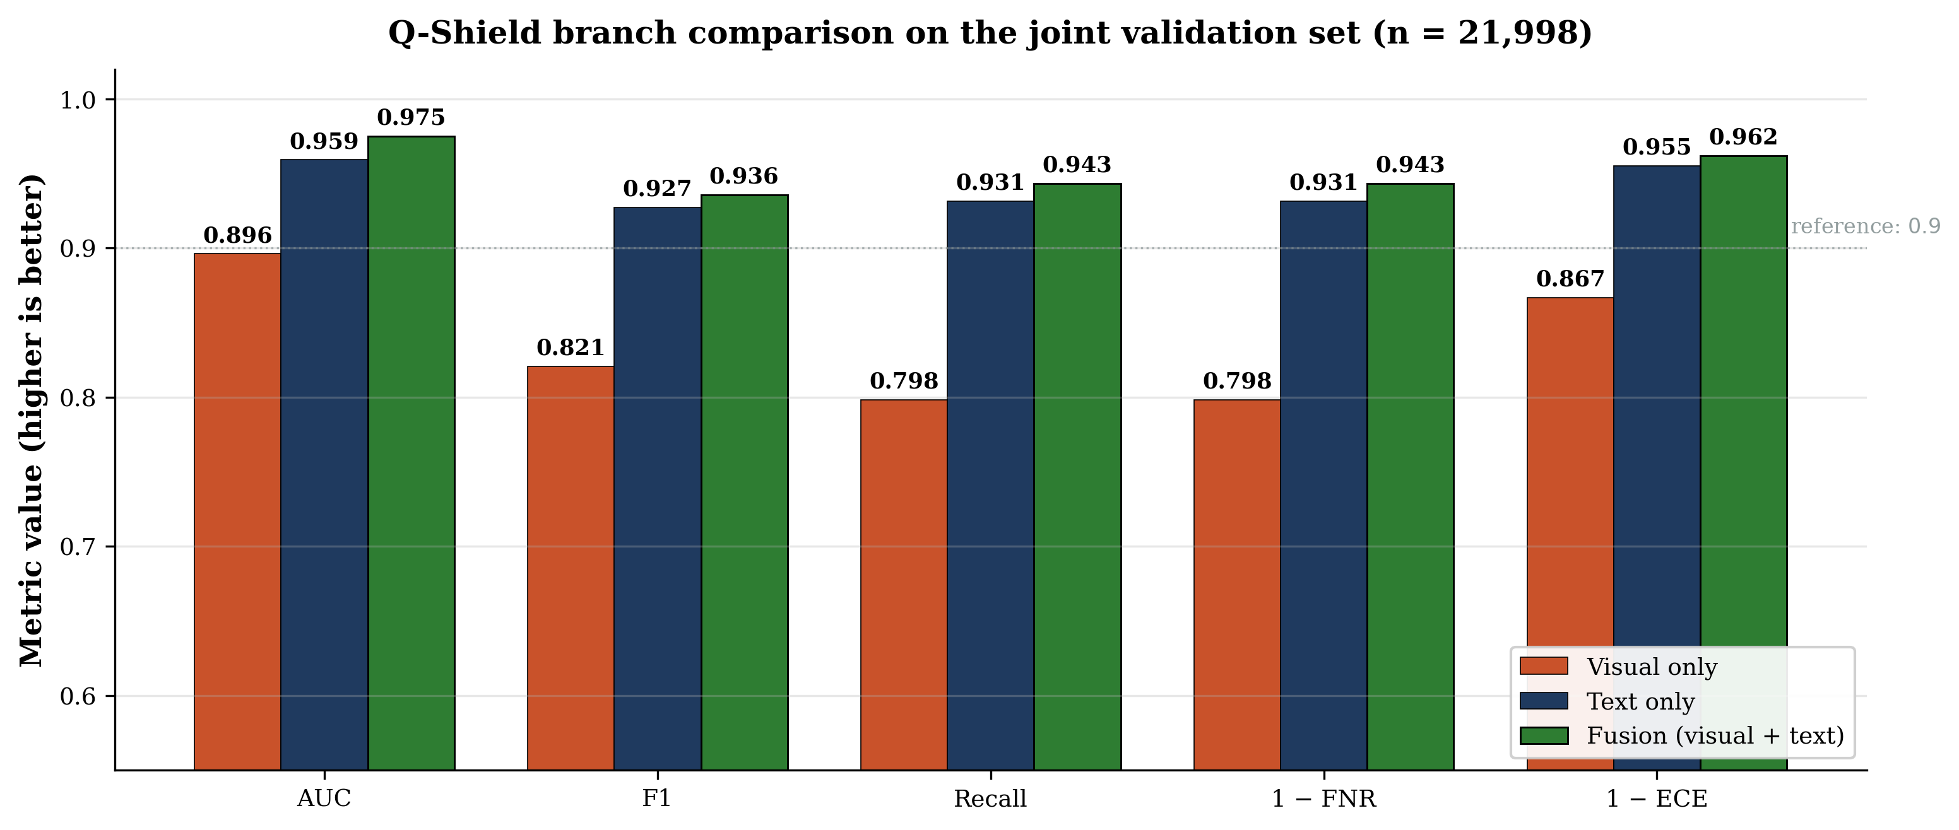
BRANCH COMPARISON
Visual / text / fusion · grouped bar chart
KEY OBSERVATIONS
— Text alone already beats visual on every metric — confirms the URL-signal strength reported by CIC
— Fusion beats text on every metric — visual contributes genuine signal, especially on calibration (1−ECE) and F1
Part 06
24 / 41

Slide 25
MAIN RESULTS
Combined validation set · n = 21,998
Method | AUC | Prec. | Recall | F1 | FNR
Trad et al. (n=1,998, V13 only) | 0.913 | — | — | 0.890 | —
Q-Shield visual single seed | 0.8962 | 0.844 | 0.798 | 0.821 | 0.202
Q-Shield visual ensemble + TTA | 0.9146 | 0.872 | 0.801 | 0.835 | 0.199
Q-Shield text-only (DistilBERT) | 0.9592 | 0.923 | 0.931 | 0.927 | 0.069
Q-Shield fusion (visual + text) | 0.9749 | 0.928 | 0.943 | 0.936 | 0.057
TAKEAWAYS
— Fusion exceeds Trad SOTA by +6.16 pp AUC on a benchmark 11× larger and visually heterogeneous
— Fusion exceeds visual ensemble by +6.03 pp AUC and reduces FNR by 14.2 pp
— Visual single-seed remains the operative signal whenever the QR cannot be decoded (4.3% of corpus)
Part 06
25 / 41

Slide 26
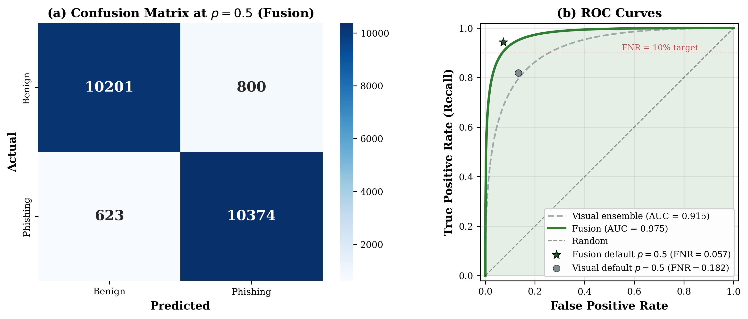
DECISION BEHAVIOR
Confusion matrix and ROC · fusion configuration
READING THE FIGURE
— CM at p=0.5: TN 10,201 · FP 800 · FN 623 · TP 10,374 → AUC = 0.9749
— Default operating point already meets FNR ≤ 10% — calibration optional, not load-bearing
Part 06
26 / 41

Slide 27
ABLATION
Visual single-seed (panel a, no TTA) — isolates architectural decisions
Variant | AUC | F1 | FNR | Δ AUC
A1 · Full Q-Shield (single seed) | 0.8962 | 0.821 | 0.202 | —
A2 · No Siamese pretraining | 0.8764 | 0.785 | 0.267 | −0.020
A3 · BCE loss (no focal) | 0.8771 | 0.786 | 0.271 | −0.019
A4 · No frozen start | 0.8810 | 0.801 | 0.230 | −0.015
A5 · Small head (256→64→1) | 0.8752 | 0.794 | 0.229 | −0.021
INTERPRETATION
— Siamese pretraining (A2) is the largest single architectural contributor: −2 pp AUC, +6.5 pp FNR when removed
— Focal loss (A3) barely changes AUC but lifts FNR by 7 pp — directly supports the security claim
— TTA + ensemble (panel b) lift the visual to 0.9146; the multimodal pivot adds another 6 pp on top
Part 06
27 / 41

Slide 28
CROSS-DATASET
Why combined training is methodologically required
Setup | AUC | Recall | F1 | FNR | Diagnosis
CV1 · Train CIC → Test Trad | 0.7178 | 1.000 | 0.666 | 0.000 | Classifier collapse
CV2 · Train Trad → Test CIC | 0.5181 | 0.508 | 0.517 | 0.492 | Near-random
CV3 · Combined (single seed) | 0.8962 | 0.798 | 0.821 | 0.202 | Operative regime
INTERPRETATION
— The two corpora differ at the pixel level beyond what augmentation can bridge
— Single-corpus training does NOT generalize. Combining is not a convenience — it is required
— Position this as domain-invariant learning (Ganin & Lempitsky, 2015)
— Implication: prior single-dataset AUCs (e.g., Trad 0.913 on V13 only) should be read as upper bounds
Part 06
28 / 41

Slide 29
THRESHOLD CALIBRATION
Now optional — fusion meets the target at default
Operating point | Threshold | Precision | Recall | FNR | F1
Visual default | 0.500 | 0.860 | 0.818 | 0.182 | 0.839
Visual maximize F1 | 0.475 | 0.837 | 0.844 | 0.156 | 0.840
Visual FNR ≤ 0.10 (security target) | 0.400 | 0.752 | 0.902 | 0.098 | 0.820
Fusion default — already below target | 0.500 | 0.928 | 0.943 | 0.057 | 0.936
WHY THIS MATTERS
— Before pivot: FNR target met only after threshold sliding (0.50 → 0.40) on the visual model
— After pivot: fusion meets ≤ 10% target at default threshold — calibration becomes a tool for the visual fallback regime, not a load-bearing claim
— Visual fallback still uses the calibrated threshold when the QR cannot be decoded
Part 06
29 / 41

Slide 30
PART 07
Explainability & deployment
Grad-CAM, SHAP, per-dataset validation,
and inference-cost trade-offs.

Slide 31
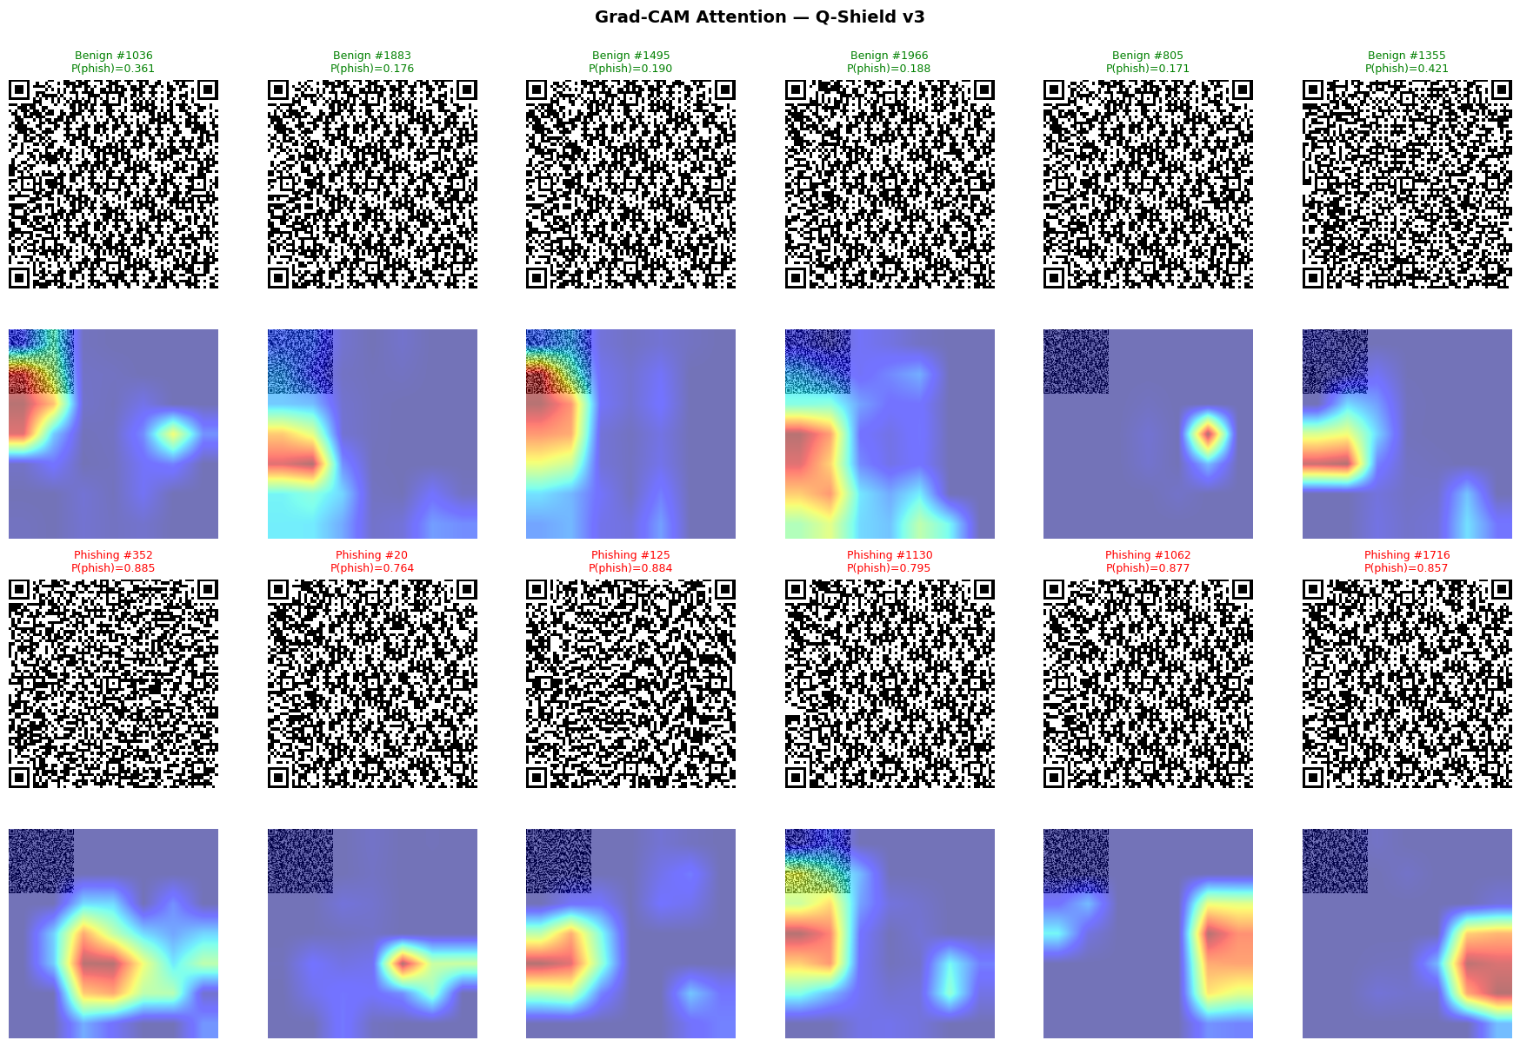
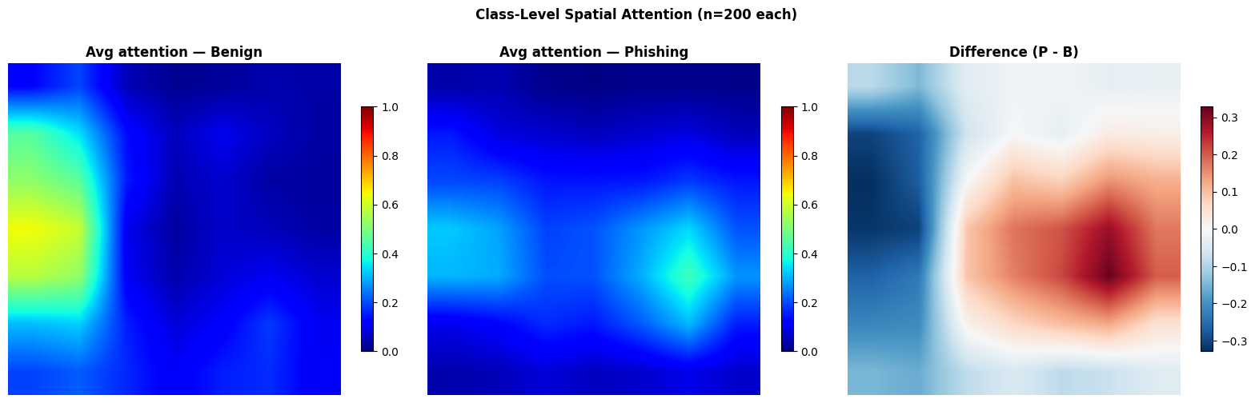
EXPLAINABILITY
Grad-CAM · spatial attention over the QR matrix
WHAT WE SEE
— Finder patterns (3 corners) consistently dark — model ignores them
— Attention concentrates on data-region modules — payload-encoded part
— Aggregated: benign attention to the left, phishing to the center-right
— Plausible cause: longer phishing URLs push more codewords to the right
Part 07
31 / 41

Slide 32
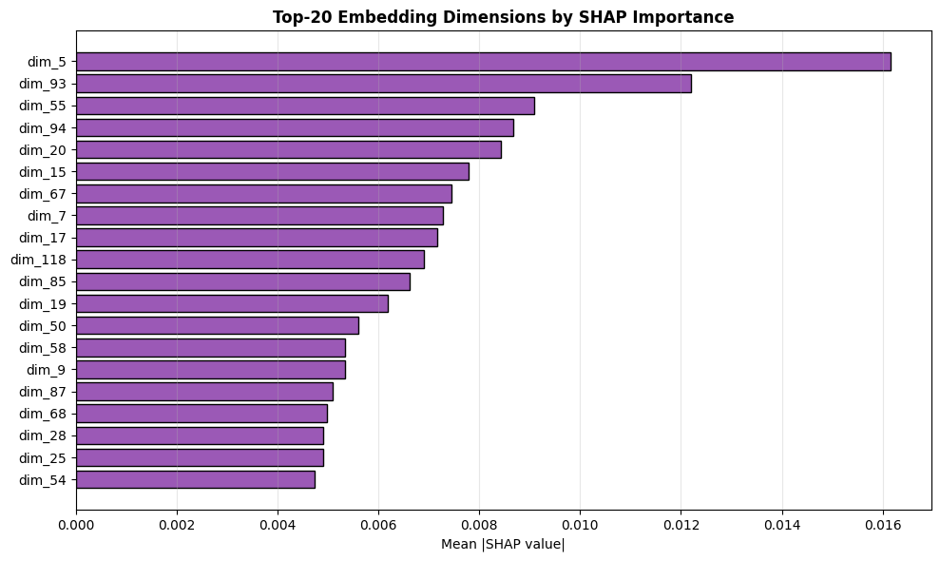
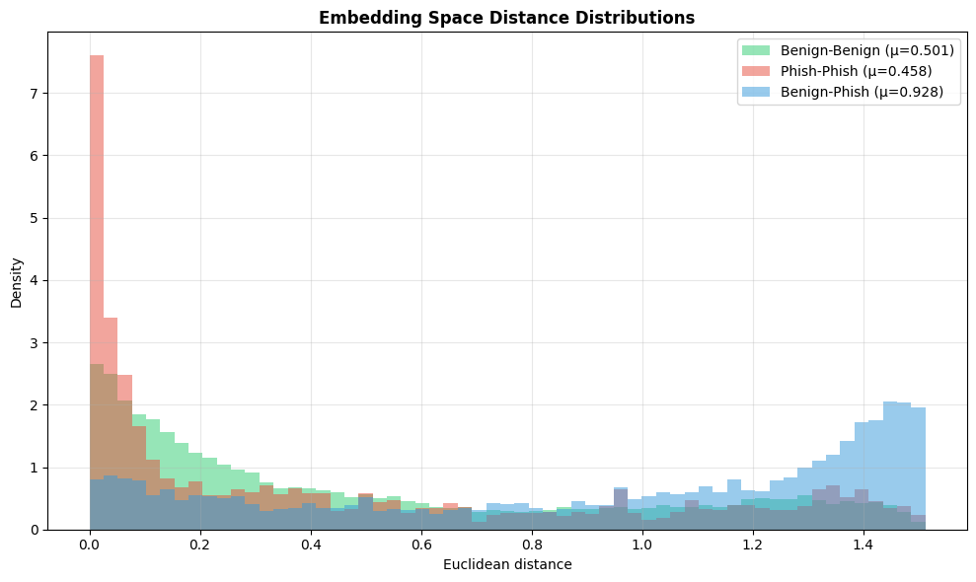
EXPLAINABILITY
SHAP and embedding space · latent-level interpretability
SHAP — TOP 20 OF 128 DIMS
PAIRWISE DISTANCES
— Top dim |SHAP| ≈ 0.016, decaying smoothly to 0.005 at position 20
— Remaining 108 dims contribute negligibly — embedding over-parameterized
— Pruning to 32–64 dims would likely preserve performance
— Benign-Benign 0.501 · Phish-Phish 0.458 · Benign-Phish 0.928
— Inter/intra ratio = 1.94 — contrastive training works as intended
— Phishing cluster TIGHTER than benign — URLs share structural regularities
Part 07
32 / 41

Slide 33
EXPLAINABILITY
Per-dataset Grad-CAM · ruling out artifacts
THE CONCERN
Could the L/R asymmetry be an artifact of mixing 69×69 binary Trad samples with antialiased CIC PNGs?
THE TEST
— Recompute class-averaged Grad-CAM SEPARATELY on Trad and CIC
— Pixel-wise correlation r = 0.43
— Right-side positive region in BOTH datasets
— → real structural signal
Part 07
33 / 41

Slide 34
INFERENCE COST
Mobile-deployable · configurable trade-off
Configuration | Params | Disk | CPU | GPU (T4) | AUC
Visual single seed, no TTA | 3.08 M | 12 MB | 24.9 ms | 6.0 ms | 0.896
Visual single seed + TTA | 3.08 M | 12 MB | 49.8 ms | 12.0 ms | 0.905
Visual ensemble + TTA | 6.16 M | 24 MB | 99.6 ms | 24.0 ms | 0.915
Fusion (visual + DistilBERT) | 69.1 M | 267 MB | ~95 ms | ~13 ms | 0.975
DEPLOYMENT NOTES
— < 100 ms CPU keeps the fusion within the perceptual budget for interactive mobile applications
— Fusion adds 0.06 AUC over visual ensemble for ~equivalent CPU cost (text branch is fast at seq 96)
— For latency-critical or low-power deployments, single-seed visual offers a 0.08 AUC concession with 4× compute reduction
— GPU throughput per single visual model on T4: 1,156 images/s (batch 32)
Part 07
34 / 41

Slide 35
PART 08
What's next
Limitations, future work, and the submission plan.

Slide 36
LIMITATIONS
Stated explicitly in Section VI.B of the paper
Visual fallback FNR
Visual single-seed FNR is 0.20 at default. Only matters when the QR fails to decode (4.3% of corpus).
Phase-2 visual overfitting
Validation loss diverges after epoch 8. Early stopping selects the best checkpoint.
Unverified URL overlap
Trad does not redistribute URL strings. Overlap with CIC unverified.
Resolution-dependent perf.
Visual AUC drops to 0.844 on QRs > 246 px — resize loses module detail.
Probability calibration (visual)
Visual ECE 0.13 — fusion calibration is 3× better.
Out-of-QR context not modeled
Email subject, sender metadata. Third branch is future work.
Container-format stripping
PDF/SVG/DOCX containers normalized to PNG before visual CNN.
No adversarial evaluation
Module-level perturbations not yet tested.
Part 08
36 / 41

Slide 37
FUTURE WORK
Five extensions worth dedicated study
Surrounding-context branch
Third modality over the message context (email subject, SMS body, sender metadata). Most direct path to FNR < 5%.
Localized deployment
Region-specific phishing campaigns: Yape (Peru), UPI (India), Pix (Brazil). Local data + lightweight fine-tuning.
Multi-scale training
Resolution-adaptive backbone or multiple input scales. Closes the gap on large QRs without inference cost.
Adversarial robustness
Module-level adversarial perturbations + adversarial training and randomized smoothing.
Provenance-aware detection
Cryptographic signatures, merchant-ID validation, session tokens. See next slide for the Yape/BCP example.
Part 08
37 / 41

Slide 38
FUTURE WORK · DEEP DIVE
Provenance-aware detection · Yape and BCP, Peru
TWO QUESTIONS · TWO LAYERS
Q1 · Is the content malicious?
Q2 · Was it generated by the authorized source?
Solved by Q-Shield. The visual + URL branches inspect the QR pattern and content, flagging suspicious instances regardless of origin.
NOT solved. A content-valid QR placed at point-of-sale by an attacker (overlay, MITM, UI replacement) passes both Q-Shield branches.
WHAT A PROVENANCE LAYER LOOKS LIKE
— Yape (Peru, by BCP) generates merchant QRs through an authenticated backend
— Cryptographic signatures embedded in the QR payload + merchant-ID validation against the issuer
— Session-bound tokens · geolocation or capture-device attestation
— Q-Shield + provenance = orthogonal complementary layers, not competitors
Part 08
38 / 41

Slide 39
SUBMISSION PLAN
Where to send Q-Shield
Venue | Fit | Notes
IEEE Intercon | Strong | Latin-American audience aligns with Yape/BCP framing
IEEE LA-CCI | Strong | Latin-American Computational Intelligence; XAI + security focus
IEEE TrustCom | Stretch | Trust + security venue; broader cybersecurity context
PRE-SUBMISSION CHECKLIST · ~1 HOUR
— Recompile main.tex (3 passes) — verify all figures including the new fig_branch_comparison
— Optional · add bootstrap CI on AUC at end of Main Results to formalize the +6.16 pp claim
— Optional · expand SimCLR vs supervised contrastive distinction in the Phase 1 section
— Final visual check of PDF: confusion-matrix figure shows fusion CM, ablation table footnotes correct
— Verify authors list, ORCID, abstract length, IEEE PDF Express compliance
Part 08
39 / 41

Slide 40
SUMMARY
Q-Shield in one slide
— First end-to-end multimodal QR phishing detector — visual Siamese + DistilBERT URL + late fusion with explicit undecodability flag
— 21,998-sample heterogeneous benchmark (Trad + CIC), 11× larger than prior evaluations
— Fusion AUC 0.9749, F1 0.936, FNR 0.057 — exceeds Trad SOTA 0.9133 by +6.16 pp on a harder benchmark
— Default-threshold FNR already meets ≤ 10% security tolerance — calibration becomes optional
— Visual ensemble 0.9146 remains as graceful fallback when QRs cannot be decoded (4.3% of corpus)
— Calibration metrics improve 3× over visual alone (Brier 0.054, ECE 0.038)
— Dual XAI (Grad-CAM + SHAP), validated cross-dataset (r = 0.43) — non-trivial structural signal
— 7 honest limitations · 5 concrete future-work directions
Status · ready for advisor review and IEEE Intercon / LA-CCI submission
Close
40 / 41

Slide 41
Thank you.
Questions, feedback, and design directions are welcome.
Nicolás Alejandro Llerena Silva · UTEC
Advisor · Aurea Soriano-Vargas

