Slide 1
Q-Shield: An Explainable Multimodal Framework for QR Code Phishing (Quishing) Detection Using Siamese Visual and Offline URL Analysis
Nicolás Llerena · Rensso Mora-Colque · Aurea Soriano-Vargas
Department of Computer Science, Universidad de Ingeniería y Tecnología (UTEC), Lima, Perú
IEEE LA-CCI 2026 · Paper 47
Notes:
[~35 s]
Good morning, everyone. My name is Nicolás Llerena, and I am from UTEC, in Lima, Peru. Today I will present our paper, Q-Shield. Q-Shield is a system that detects phishing attacks that use QR codes. We call these attacks "quishing". This is joint work with Rensso Mora-Colque and Aurea Soriano-Vargas, also from UTEC.

Slide 2
Motivation
Why does quishing detection matter?
Notes:
[~5 s]
Let me start with the motivation. Why does quishing detection matter?

Slide 3
Motivation
QR codes are part of daily life, in the world and in Peru
In the world
In Peru
2.2 billion
people expected to pay with QR codes by 2025 (29% of mobile users)
+85%
growth of QR payments in 2024
26M
QR payments every month (end of 2024)
67%
of adults have a bank account or a digital wallet (2025)
What can a QR code hold?
Web link (URL)
Plain text
Wi-Fi password
Contact card
Payment data
Most QR codes in daily use hold a web link. This is the case we study.
Sources: Juniper Research 2021 (forecast); BCRP 2025; SBS 2025
Notes:
[~75 s]
QR codes are now part of our daily life. Around the world, more than two billion people were expected to pay with QR codes by 2025. That is almost one in three mobile phone users. In Peru, the growth is very fast. QR payments grew 85% in 2024, and today there are more than 26 million QR payments every month. Also, 67% of Peruvian adults now have a bank account or a digital wallet, like Yape or Plin. But what is inside a QR code? A QR code can hold many kinds of data: a web link, plain text, a Wi-Fi password, a contact card, or payment data. In daily use, most QR codes hold a web link, a URL. And that is the case we study in this work.

Slide 4
Motivation
What makes QR codes easy to use also makes them easy to abuse
1
Needs a machine
2
One tap
3
Trusted places
A person cannot read a QR code. It needs a scanner device and a decoding algorithm.
No preview and no address bar to check before the page opens.
Menus, payment stands and parking meters look safe to users.
This is already happening in Peru
The police warn about fake QR stickers placed on top of the real Yape and Plin codes of small shops. The payment goes to the criminal.
Fake traffic fines and fake DNI procedures use QR codes that open fake bank pages or install malware.
Sources: Sharevski et al. 2022; Geisler et al. 2024; PNP High Technology Division 2024; Reniec 2025
Notes:
[~75 s]
The same things that make QR codes easy to use also make them easy to abuse. There are three reasons. First, a person cannot read a QR code. We need a scanner device and a decoding algorithm. Second, it is just one tap. There is no preview and no address bar to check before the page opens. Third, QR codes appear in places that we already trust, like restaurant menus, payment stands, and parking meters. And this is already happening in Peru. The police warn that criminals put fake QR stickers on top of the real Yape and Plin codes of small shops. So the money goes to the criminal. There are also fake traffic fines and fake DNI procedures, with QR codes that open fake bank pages or install malware.

Slide 5
“Anyone can create a QR code.
Nobody can read one without a scanner.”
Notes:
[~10 s]
So, in one sentence: anyone can create a QR code, but nobody can read one without a scanner. [Pause for two seconds.]

Slide 6
Problem Statement
What is quishing, and how big is it?
Notes:
[~5 s]
So, what is quishing exactly, and how big is the problem?

Slide 7
Problem Statement
What is quishing?
Quishing = QR + phishing. A criminal hides a malicious link inside a QR code to steal passwords, money or personal data.
1
Create
2
Place
3
Scan
4
Steal
The criminal puts a fake login or payment page in a QR code
In an email, a poster, a parking meter, or on top of a real code
The victim scans it with a phone, far from company security tools
A fake page asks for a password, a card number or a payment
Quishing is social engineering: it uses trust and speed, not a software bug.
Sources: Sharevski et al. 2022; Mitnick & Simon 2002; Kaspersky 2025
Notes:
[~70 s]
Quishing is a mix of two words: QR and phishing. A criminal hides a malicious link inside a QR code, to steal passwords, money, or personal data. A typical attack has four steps. One: the criminal creates a QR code that opens a fake login page or a fake payment page. Two: the criminal places the code in an email, on a poster, on a parking meter, or on top of a real code. Three: the victim scans it with a phone. Note that the phone is often far from the security tools of a company. And four: the fake page asks for a password, a card number, or a payment. Quishing is social engineering. It uses trust and speed, not a software bug.

Slide 8
Problem Statement
How big is the problem?
1 in 8
phishing attacks used a QR code in 2023
5×
more QR phishing emails from August to November 2025
11,000+
malicious QR codes detected every day
Our question: can we detect a malicious QR code automatically, at the moment of the scan?
Sources: Egress Phishing Threat Trends Report 2024; Kaspersky 2025; Palo Alto Networks Unit 42 2026
Notes:
[~55 s]
And how big is the problem? This chart shows the share of phishing attacks that use a QR code. In 2021, it was less than one percent. In 2023, it was 12.4%. That is about one in eight phishing attacks. And it is still growing. Kaspersky saw five times more QR phishing emails between August and November of 2025. And Palo Alto Networks detects more than eleven thousand malicious QR codes every day. So, the question for our work is simple: can we detect a malicious QR code automatically, at the moment of the scan?

Slide 9
Related Work
How do current defenses work?
Notes:
[~5 s]
Before our solution, let me show how current defenses work.

Slide 10
Related Work
Two families of defenses: each one fails where the other one works
Read the URL ^{1,2,5,6}
post-decode
Strength: Very accurate when the URL can be read
Weakness: Useless when the QR code cannot be decoded
Look at the image ^{3,4}
pre-decode
Strength: Always works, because no decoding is needed
Weakness: Less accurate on real, mixed data
The gap: no previous work joins both signals in one detector, or tests it across independent datasets.
¹ Amoah & Hayfron-Acquah 2022 ² Rafsanjani et al. 2023 ³ Trad & Chehab 2025 ⁴ Akram et al. 2025 ⁵ Khalifa et al. 2025 ⁶ Nejati et al. 2026
Notes:
[~60 s]
Today, there are two families of defenses. The first family decodes the QR code and checks the URL. This is very accurate, but it only works when the code can be decoded. The second family looks only at the image of the QR code, without decoding. This always works, but it is less accurate on real, mixed data. The problem is that these two families are used separately. So each one is weak exactly where the other one is strong. Also, no previous work tests these models across independent datasets. This is the gap that we want to close.

Slide 11
Related Work
Five research directions, and none joins both stages in one detector
Direction | Main idea | Main limitation
URL-based ^{1,2} | Decode, then classify the URL | Needs decoding; URLs only
Visual ^{3,4} | Classify the QR image directly | Weaker on mixed, real data
Multimodal ^{5,6} | Image and URL as separate baselines | Not one pipeline
Human-centered ^{7,8,9} | Why people trust QR codes | No protection at scan time
Commercial tools ² | Blocklists, secure scanners | Work only after decoding
Q-Shield (ours) | Image + URL in one detector | Covers both stages
¹ Amoah & Hayfron-Acquah 2022 ² Rafsanjani et al. 2023 ³ Trad & Chehab 2025 ⁴ Akram et al. 2025 ⁵ Khalifa et al. 2025
⁶ Nejati et al. 2026 ⁷ Sharevski et al. 2022 ⁸ Geisler et al. 2024 ⁹ Weinz et al. 2025
Notes:
[~50 s]
In more detail, we can organize previous work in five directions. URL-based methods are accurate, but they need decoding, and they only work with URLs. Visual methods work before decoding, but they are weaker on mixed, real data. Multimodal work uses the image and the URL, but as separate baselines, not as one pipeline. Human-centered studies explain why people trust QR codes, but they do not protect users at scan time. And commercial tools work only after decoding. Q-Shield is different, because it joins both stages in one detector.

Slide 12
Contributions
What does this paper do differently?
Notes:
[~5 s]
So, what does our paper do differently?

Slide 13
Contributions
Main idea: one detector for both moments of a QR scan, before and after decoding
01
Two-stage fusion
02
Mixed benchmark
Joins the image, the URL, and a flag that says if decoding worked.
21,998 test samples from two independent datasets.
03
Cross-dataset test
04
Two-level explainability
Shows that training on only one dataset is not enough.
Grad-CAM on the pixels and SHAP on the embedding.
Notes:
[~50 s]
Our main idea is simple: one detector that works both before and after decoding. We have four contributions. One: a two-stage fusion. It combines the image, the URL, and a flag that says if decoding worked. Two: a mixed benchmark, with almost twenty-two thousand test samples from two independent datasets. Three: a cross-dataset study. It shows that training on only one dataset is not enough. And four: explainability at two levels. We use Grad-CAM on the pixels, and SHAP on the embedding.

Slide 14
Methodology
How the two stages fit together
Notes:
[~5 s]
Now, let me explain how the system works.

Slide 15
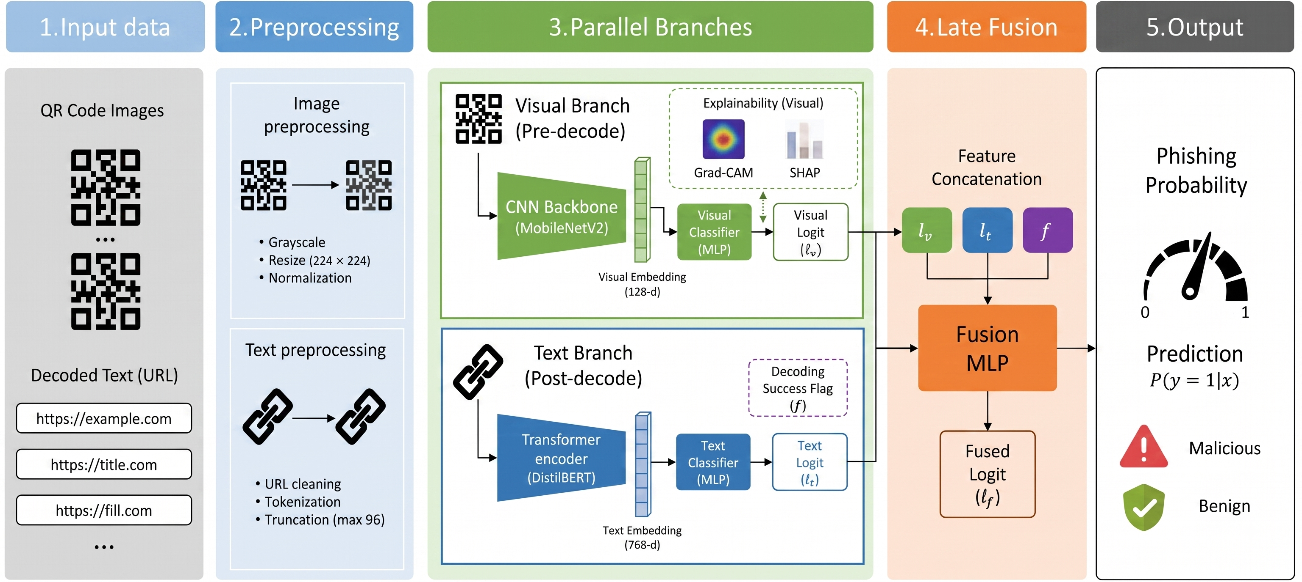
Methodology Overview
$$p\left(y=1|x\right)=σ\left(g_{fuse}\left(ℓ_{v},ℓ_{t},f\right)\right)$$
ℓ_{v} visual logit, ℓ_{t} text logit, f decode flag
Notes:
[~60 s]
This is the full pipeline. The input is a QR image. After preprocessing, the image goes into two branches in parallel. The visual branch, at the top, looks at the image directly, without decoding. The text branch, at the bottom, decodes the QR code and reads the URL. Each branch gives a score, called a logit. Then, a small fusion module combines the two scores, plus a flag that says if decoding worked. The equation at the bottom shows this idea. The probability of phishing is the sigmoid of the fusion function, and its inputs are the visual logit, the text logit, and the decode flag.

Slide 16
Visual branch: two-phase training
Learns QR patterns from the image itself, with no decoding
Input
Grayscale QR image, 224 × 224
Phase 1: Siamese pretraining
Contrastive loss: same class → close, different class → far
Phase 2: Fine-tuning
Focal loss: more weight on hard examples. Best model at epoch 8
Output
Visual logit ℓ_{v}
MobileNetV2
small, fast backbone (1 input channel)
3.08 M
parameters
0.896 → 0.915
AUC with image flip + 2-model ensemble at test time
Notes:
[~65 s]
Let's look at the visual branch. We use MobileNetV2, a small and fast network, with grayscale images of two hundred twenty-four by two hundred twenty-four pixels. Training has two phases. In phase one, we use a Siamese network with contrastive learning. In simple words, the model learns to put QR codes of the same class close together, and QR codes of different classes far apart. In phase two, we fine-tune the model with focal loss. Focal loss gives more weight to the hard examples. We keep the best model at epoch eight, to avoid overfitting. At test time, an image flip and a two-model ensemble raise the AUC from 0.896 to 0.915.

Slide 17
Text branch and fusion module
Reads the URL offline, then learns how much to trust each branch
Text branch (post-decode)
pyzbar decodes the QR locally: no internet, and the link is never opened
DistilBERT reads the URL
If decoding fails: special <UNDECODABLE> token
Fusion module
Tiny MLP: 3 inputs → 16 → 1
Only 81 parameters
Trains in under 1 minute on a CPU
Decoding works (f = 0)
→ Trust the text branch more
Decoding fails (f = 1)
→ Trust the visual branch
The model learns this by itself, with no hand-written rules.
Notes:
[~60 s]
Now, the text branch. It decodes the QR code locally, with a library called pyzbar. There is no internet connection, so the link is never opened. Then, DistilBERT reads the URL. DistilBERT is a small language model. If decoding fails, we use a special token: "undecodable". After that, the fusion module combines both branches. It is very small: only 81 parameters, and it trains in less than one minute on a CPU. The key is the flag. When decoding works, the model trusts the text more. When decoding fails, it trusts the image. The model learns this by itself. We do not write any rules.

Slide 18
Experimentation
Two datasets, one joint benchmark
Notes:
[~5 s]
Now, the experimental setup.

Slide 19
Datasets
Two very different datasets, on purpose
 | Trad et al. 2025 | CIC-Trap4Phish 2025
Samples | 9,987 | 1,005,738
Source | Generated, clean | Real-world
Image size | 69 × 69 | 114 to 582 px
QR versions | V13 | V5 to V30
Decoded offline | 100% | 95.7%
Joint benchmark
21,998
test samples
50,000 per class from CIC
80/20 split on each dataset
Train on both training sets
The 4.3% of CIC that cannot be decoded is not noise to remove. It is exactly where the visual branch is the only signal.
Notes:
[~60 s]
We use two datasets that are very different, on purpose. The Trad dataset has about ten thousand clean QR codes. They all have the same size: sixty-nine by sixty-nine pixels. CIC-Trap4Phish has more than one million real QR codes, with different sizes and versions. We take fifty thousand samples per class from CIC. Then we split each dataset eighty-twenty, and we join the test sets. This gives 21,998 test samples. Note that the decoder works on all Trad codes, but only on 95.7% of CIC codes. The other 4.3% are exactly where the visual branch is the only signal.

Slide 20
Results
Six experiments, one benchmark
Notes:
[~5 s]
Let's see the results. We ran six experiments.

Slide 21
Experiment 1: the visual fallback
How good is Q-Shield when the QR code cannot be decoded?
+0.10 AUC
over Random Forest and XGBoost
≈ previous best
matches Trad et al. (0.913) on a benchmark 11× larger
This is the floor of the system: what it still does without the URL.
Notes:
[~45 s]
Experiment one tests the visual branch alone. This is the fallback, for when the QR code cannot be decoded. Our best visual model reaches an AUC of 0.915. That is about 0.10 better than the classic baselines, Random Forest and XGBoost. It also matches the best previous visual result, from Trad and colleagues, but on a benchmark eleven times larger. Remember, this is the floor of the system. It is what Q-Shield can still do without the URL.

Slide 22
Experiment 2: multimodal fusion
Main result: image + URL together work best
0.9749
AUC
0.936
F1
0.057
FNR
3.5×
fewer missed attacks than visual only
The gain over text-only is small on average (+0.016 AUC), but it is concentrated in the 4.3% of codes that cannot be decoded.
Notes:
[~55 s]
Experiment two is our main result. Here we compare the visual branch, the text branch, and the fusion. The fusion is the best: AUC 0.975, F1 0.936, and a false negative rate of only 0.057. A false negative is a phishing code that we miss. In security, this is the most expensive error. Compared to the visual branch alone, we miss three and a half times fewer attacks. The gain over the text branch is small on average, but it is concentrated in the 4.3% of codes that cannot be decoded.

Slide 23
Experiment 3: ablation study
Every design choice helps us miss fewer attacks
Without Siamese pretraining
AUC drops by about 0.02 and FNR goes from 0.202 to 0.267
Without focal loss
AUC is almost the same, but FNR goes from 0.202 to 0.271
When a missed attack is expensive, the loss function matters.
Notes:
[~40 s]
Experiment three is an ablation study. We remove one part at a time, and we see what happens. Without Siamese pretraining, the false negative rate goes up from 0.20 to 0.27. Without focal loss, the AUC is almost the same, but again the false negative rate goes up, to 0.27. So, both parts help us to miss fewer attacks. When a missed attack is expensive, the loss function matters.

Slide 24
Experiment 4: cross-dataset generalization
What happens when we train on one dataset and test on the other?
Train Trad → test CIC
0.52
AUC: almost random
Train CIC → test Trad
0.72
AUC: says “phishing” for almost everything
Train on both
0.896
AUC: works on both datasets
Training on one dataset is not just weaker. It breaks.
Mixed training is a requirement, not a tuning choice.
Notes:
[~50 s]
Experiment four is about generalization. What happens if we train on one dataset and test on the other? If we train on Trad and test on CIC, the AUC is 0.52. That is almost random. If we train on CIC and test on Trad, the model says "phishing" for almost everything. But when we train on both datasets, the AUC goes back to 0.896. Our message is clear: training on one dataset is not enough. Mixed training is a requirement, not a tuning choice.

Slide 25
Experiment 5: operational trade-offs
Choosing a threshold and a configuration for deployment
Threshold on the visual fallback
Cost per configuration (CPU)
Threshold τ | Recall | FNR | Precision
0.50 (default) | 0.818 | 0.182 | 0.860
0.40 | 0.902 | 0.098 | 0.752
0.30 | 0.961 | 0.039 | 0.607
Configuration | Params | Time | AUC
Visual, 1 model | 3.08 M | 25 ms | 0.896
Visual, ensemble | 6.16 M | 100 ms | 0.915
Fusion (image + URL) | 69.1 M | ~100 ms | 0.975
τ = 0.40 brings FNR below 0.10 without retraining. The fusion model meets this at the default 0.50.
About 100 ms or less per image on a CPU, fast enough for mobile use.
Same trained models, three options: light, balanced, or most accurate.
Notes:
[~55 s]
Experiment five is about real deployment. On the left, the threshold. For the visual fallback, if we lower the threshold from 0.50 to 0.40, the false negative rate goes below 0.10, without retraining. The price is lower precision, so we get more false alarms. The fusion model already meets this target with the default threshold. On the right, the cost. The visual model has only three million parameters and runs in 25 milliseconds on a CPU. The full model takes about 100 milliseconds. Both are fast enough for a mobile phone.

Slide 26
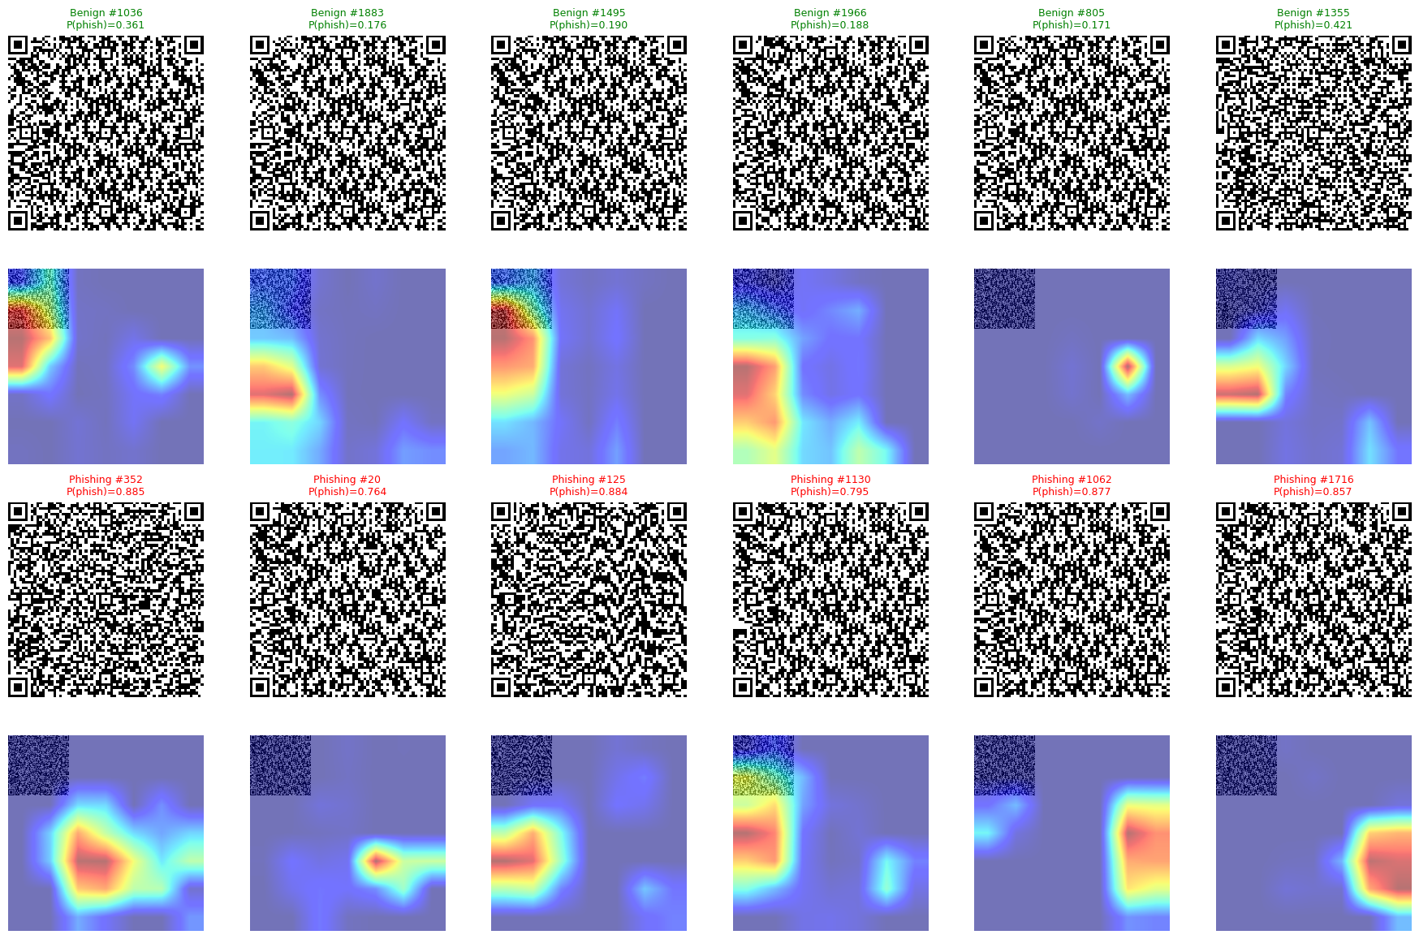
Experiment 6: explainability
Does the model look at the QR structure, or at dataset tricks?
Grad-CAM: where the model looks
Alignment patterns and data regions, the parts that carry the QR content
SHAP: which features matter
A few of the 128 embedding dimensions drive the decision
r = 0.43
Grad-CAM maps agree across the two datasets
1.94
Between-class / within-class distance in the embedding
Notes:
[~50 s]
Finally, experiment six: explainability. We want to know if the model looks at the real QR structure, or if it learns tricks from the dataset. Grad-CAM shows where the model looks. It looks at the alignment patterns and the data regions, the parts that carry the information. The attention maps of the two datasets are correlated, with r equal to 0.43. And SHAP shows that a few dimensions of the embedding drive the decision. This suggests that the model learns real structural patterns, not dataset shortcuts.

Slide 27
Limitations
What is still missing?
Notes:
[~5 s]
Of course, our work has some limitations.

Slide 28
Limitations
What is still weak in our results
1
Visual fallback misses ~20%
2
Mild overfitting in Phase 2
FNR 0.199 when the QR code cannot be decoded
Controlled with early stopping at epoch 8
3
Large QR codes are harder
4
Visual-only calibration
Performance drops on high-resolution images
Its probabilities are not perfectly calibrated
Scope: static QR images and their URL only, with no message, sender or page context. Q-Shield is one layer of defense, not the whole defense.
Notes:
[~45 s]
First, the visual fallback still misses about 20% of attacks, with an FNR of 0.199. Second, we see mild overfitting in phase two, and we control it with early stopping. Third, the performance is lower on large, high-resolution QR codes. And fourth, the probabilities of the visual branch are not perfectly calibrated. Also, we only look at the QR image and its URL, not the message around it. So, Q-Shield is one layer of defense, not the complete solution.

Slide 29
Conclusions
Closing the three objectives
Notes:
[~5 s]
To conclude, let me go back to our three objectives.

Slide 30
Conclusions
Main finding: multimodal fusion turns FNR 0.202 into FNR 0.057, and still covers QR codes that cannot be decoded.
Our three objectives
(i) Pipeline alignment
0.202 → 0.057
FNR, while still covering undecodable codes
(ii) Generalization
0.52 → 0.896
AUC when we train on both datasets
(iii) Explainability
r = 0.43
Grad-CAM agreement across the two datasets
Notes:
[~50 s]
Our main finding is this: multimodal fusion is not just a small improvement. It reduces the false negative rate from 0.202 to 0.057, and it still covers the QR codes that cannot be decoded. About our three objectives. One: by following the two stages of a QR scan, we miss three and a half times fewer attacks. Two: for generalization, training on both datasets raises the AUC from 0.52 to 0.896. And three: for explainability, the attention maps agree across datasets, with r equal to 0.43.

Slide 31
Future Work
Where this goes next
Notes:
[~5 s]
And what comes next?

Slide 32
Future Work
Four next steps
01
02
03
04
Context branch
Multi-scale training
Adversarial robustness
Regional adaptation
Read the message, sender and web page around the QR code
Better results on large, high-resolution QR codes
Test against stylized and manipulated QR codes
Adapt to Latin American QR payment systems
Content-based detection is one layer. Provenance checks and context complete the defense.
Notes:
[~45 s]
We see four directions. First, a third branch that reads the context: the message, the sender, and the web page. Second, multi-scale training, to improve the results on large QR codes. Third, robustness against adversarial and stylized QR codes. And fourth, adapting the model to QR payment systems in Latin America, like Yape and Plin here in Peru. This is very important for our region, because QR payments are growing so fast.

Slide 33
nicolas.llerena@utec.edu.pe
Department of Computer Science · UTEC · Lima, Perú
ORCID 0009-0007-3244-7746 · IEEE LA-CCI 2026 · Paper 47
Notes:
[~10 s]
Thank you very much for your attention. I am happy to answer your questions.

