Slide 1
Q-Shield: An Explainable Multimodal Framework for QR Code Phishing (Quishing) Detection Using Siamese Visual and Offline URL Analysis
Nicolas Llerena et al.
Department of Computer Science, Universidad de Ingeniería y Tecnología (UTEC), Lima, Perú
IEEE LA-CCI 2026 · Paper 47
Notes:
[~30 s]
Good morning, everyone. My name is Nicolás Llerena, and I am from UTEC, in Lima, Peru. Today I will present Q-Shield. Q-Shield is a system that detects phishing attacks that use QR codes. We call these attacks "quishing".

Slide 2
Motivation
Why does quishing detection matter?
Notes:
[~5 s]
Let me start with the motivation. Why does quishing detection matter?

Slide 3
Motivation
A QR code is easy to scan — and easy to abuse
1
Hard to read
2
One tap
3
Trusted places
People cannot read a QR code. They must trust the scanner.
No preview and no address bar to check before the page opens.
Menus, invoices and parking meters look safe to users.
4.3%
of real-world QR codes in our data cannot be decoded.
For these codes, URL-based tools (blocklists, reputation, secure scanners) have nothing to check.
Sharevski et al. 2022 · Geisler et al. 2024 · Weinz et al. 2025 · 4.3% measured on CIC-Trap4Phish 2025
Notes:
[~45 s]
QR codes are everywhere: in restaurant menus, invoices, and parking meters. But they are also a perfect tool for attackers, for three reasons. First, people cannot read a QR code, so they have to trust the scanner. Second, it is just one tap. There is no preview and no address bar to check. Third, QR codes appear in places that we already trust. And there is one more problem. In our data, 4.3% of real QR codes cannot be decoded at all. For these codes, tools that check the URL have nothing to analyze.

Slide 4
“A QR code is a URL you cannot read —
and 4.3% of the time, neither can the scanner.”
Notes:
[~10 s]
So, in one sentence: a QR code is a URL you cannot read... and 4.3% of the time, neither can the scanner. [Pause for two seconds.]

Slide 5
Problem Statement
What exactly is unsolved?
Notes:
[~5 s]
So, what exactly is the problem we want to solve?

Slide 6
Problem Statement
Two kinds of defenses — each one fails where the other one works
Read the URL
post-decode
Strength: Very accurate when the URL can be read
Weakness: Useless when the QR code cannot be decoded
Look at the image
pre-decode
Strength: Always works — no decoding needed
Weakness: Less accurate on real, mixed data
The gap: no previous work joins both signals in one detector, or tests it across independent datasets.
Notes:
[~45 s]
Today, there are two kinds of defenses. The first kind decodes the QR code and checks the URL. This is very accurate, but it only works if the code can be decoded. The second kind looks only at the image of the QR code. This always works, but it is less accurate on real, mixed data. The problem is that these two families are used separately, so each one is blind exactly where the other one works. Also, no previous work tests these models across independent datasets.

Slide 7
Related Work
Five research directions — none joins both stages in one detector
Direction | Main idea | Main limitation
URL-based | Decode, then classify the URL | Needs decoding; URLs only
Visual | Classify the QR image directly | Weaker on mixed, real data
Multimodal | Image and URL as separate baselines | Not one pipeline
Human-centered | Why people trust QR codes | No protection at scan time
Commercial tools | Blocklists, secure scanners | Work only after decoding
Q-Shield (ours) | Image + URL in one detector | Covers both stages
Amoah & Hayfron-Acquah 2022 · Rafsanjani et al. 2023 · Trad & Chehab 2025 · Akram et al. 2025 · Khalifa et al. 2025 · Nejati et al. 2026 · Sharevski et al. 2022
Notes:
[~40 s]
We can organize previous work in five directions. URL-based methods are accurate, but they need decoding. Visual methods work before decoding, but they are weaker on mixed data. Multimodal work uses the image and the URL, but as separate baselines, not as one pipeline. Human-centered studies explain why people trust QR codes, but they do not protect users at scan time. And commercial tools work only after decoding. Q-Shield joins both stages in one detector.

Slide 8
Contributions
What does this paper do differently?
Notes:
[~5 s]
So, what does our paper do differently?

Slide 9
Contributions
Main idea: one detector for both moments of a QR scan — before and after decoding
01
Two-stage fusion
02
Mixed benchmark
Joins the image, the URL, and a flag that says if decoding worked.
21,998 test samples from two independent datasets.
03
Cross-dataset test
04
Two-level explainability
Shows that training on only one dataset is not enough.
Grad-CAM on the pixels and SHAP on the embedding.
Notes:
[~45 s]
Our main idea is simple: one detector that works both before and after decoding. We have four contributions. One: a two-stage fusion that combines the image, the URL, and a flag that says if decoding worked. Two: a mixed benchmark with almost twenty-two thousand test samples from two independent datasets. Three: a cross-dataset study that shows that training on only one dataset is not enough. And four: explainability at two levels, with Grad-CAM and SHAP.

Slide 10
Methodology
How the two stages fit together
Notes:
[~5 s]
Now, let me explain how the system works.

Slide 11
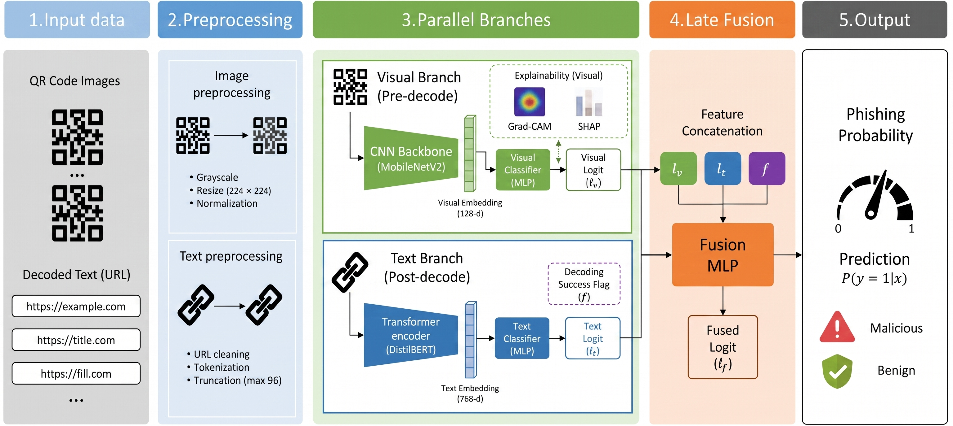
Methodology Overview
P(phishing | x) = σ( fusion( visual logit ℓ_{v} , text logit ℓ_{t} , decode flag f ) )
Notes:
[~50 s]
This is the full pipeline. The input is a QR image. After preprocessing, it goes into two branches in parallel. The visual branch, at the top, looks at the image directly, without decoding. The text branch, at the bottom, decodes the QR code and reads the URL. Each branch gives a score, called a logit. Then, a small fusion module combines the two scores, plus a flag that says if decoding worked. The output is the probability that the QR code is phishing.

Slide 12
Visual branch — two-phase training
Learns QR patterns from the image itself — no decoding needed
Input
Grayscale QR image, 224 × 224
Phase 1 · Siamese pretraining
Contrastive loss: same class → close, different class → far
Phase 2 · Fine-tuning
Focal loss: more weight on hard examples. Best model at epoch 8
Output
Visual logit ℓ_{v}
MobileNetV2
small, fast backbone (1 input channel)
3.08 M
parameters
0.896 → 0.915
AUC with image flip + 2-model ensemble at test time
Notes:
[~50 s]
Let's look at the visual branch. We use MobileNetV2, a small and fast network, with grayscale images. Training has two phases. In phase one, we use a Siamese network with contrastive learning. In simple words, the model learns to put QR codes of the same class close together, and different classes far apart. In phase two, we fine-tune the model with focal loss. Focal loss gives more weight to hard examples. We keep the best model at epoch eight, to avoid overfitting. At test time, an image flip and a two-model ensemble raise the AUC from 0.896 to 0.915.

Slide 13
Text branch and fusion module
Reads the URL offline, then learns how much to trust each branch
Text branch · post-decode
pyzbar decodes the QR locally — no internet, the link is never opened
DistilBERT reads the URL
If decoding fails: special <UNDECODABLE> token
Fusion module
Tiny MLP: 3 inputs → 16 → 1
Only 81 parameters
Trains in under 1 minute on a CPU
Decoding works · f = 0
→ Trust the text branch more
Decoding fails · f = 1
→ Trust the visual branch
The model learns this by itself — no hand-written rules.
Notes:
[~50 s]
The text branch decodes the QR code locally, with a library called pyzbar. There is no internet connection, so the link is never opened. Then, DistilBERT reads the URL. If decoding fails, we use a special token: "undecodable". The fusion module is very small: only 81 parameters. It trains in less than one minute on a CPU. The key is the flag. When decoding works, the model trusts the text more. When decoding fails, it trusts the image. The model learns this by itself. We do not write any rules.

Slide 14
Experimentation
Two datasets, one joint benchmark
Notes:
[~5 s]
Now, the experimental setup.

Slide 15
Datasets
Two very different datasets — on purpose
 | Trad et al. 2025 | CIC-Trap4Phish 2025
Samples | 9,987 | 1,005,738
Source | Generated, clean | Real-world
Image size | 69 × 69 | 114–582 px
QR versions | V13 | V5–V30
Decoded offline | 100% | 95.7%
Joint benchmark
21,998
test samples
50,000 per class from CIC
80/20 split on each dataset
Train on both training sets
The 4.3% of CIC that cannot be decoded is not noise to remove — it is exactly where the visual branch is the only signal.
Notes:
[~45 s]
We use two datasets that are very different, on purpose. The Trad dataset has about ten thousand clean QR codes, all with the same size: sixty-nine by sixty-nine pixels. CIC-Trap4Phish has more than one million real QR codes, with different sizes and versions. We take fifty thousand samples per class from CIC, we split each dataset eighty-twenty, and we join the test sets. This gives 21,998 test samples. Note that the decoder works on all Trad codes, but only on 95.7% of CIC codes. Those 4.3% are exactly where the visual branch is the only signal.

Slide 16
Results
Six experiments, one benchmark
Notes:
[~5 s]
Let's see the results. We ran six experiments.

Slide 17
Experiment 1 — the visual fallback
How good is Q-Shield when the QR code cannot be decoded?
+0.10 AUC
over Random Forest and XGBoost
≈ previous best
matches Trad et al. (0.913) on a benchmark 11× larger
This is the floor of the system: what it still does without the URL.
Notes:
[~45 s]
Experiment one tests the visual branch alone. This is the fallback, for when the QR code cannot be decoded. Our best visual model reaches an AUC of 0.915. That is about 0.10 better than the classic baselines, Random Forest and XGBoost. It also matches the best previous visual result, but on a benchmark eleven times larger. Remember, this is the floor of the system: what Q-Shield can still do without the URL.

Slide 18
Experiment 2 — multimodal fusion
Main result: image + URL together work best
0.9749
AUC
0.936
F1
0.057
FNR
3.5×
fewer missed attacks than visual only
The gain over text-only is small on average (+0.016 AUC), but it is concentrated in the 4.3% of codes that cannot be decoded.
Notes:
[~50 s]
Experiment two is our main result. Here we compare the visual branch, the text branch, and the fusion. The fusion is the best: AUC 0.975, F1 0.936, and a false negative rate of only 0.057. A false negative is a phishing code that we miss. Compared to the visual branch alone, we miss three and a half times fewer attacks. The gain over the text branch is small on average, but it is concentrated in the 4.3% of codes that cannot be decoded.

Slide 19
Experiment 3 — ablation study
Every design choice helps us miss fewer attacks
Without Siamese pretraining
AUC drops by about 0.02 and FNR goes from 0.202 to 0.267
Without focal loss
AUC is almost the same, but FNR goes from 0.202 to 0.271
When a missed attack is expensive, the loss function matters.
Notes:
[~35 s]
Experiment three is an ablation study: we remove one part at a time. Without Siamese pretraining, the false negative rate goes up from 0.20 to 0.27. Without focal loss, the AUC is almost the same, but again the false negative rate goes up, to 0.27. So, both parts help us to miss fewer attacks.

Slide 20
Experiment 4 — cross-dataset generalization
What happens when we train on one dataset and test on the other?
Train Trad → test CIC
0.52
AUC: almost random
Train CIC → test Trad
0.72
AUC: says “phishing” for almost everything
Train on both
0.896
AUC: works on both datasets
Training on one dataset is not just weaker — it breaks.
Mixed training is a requirement, not a tuning choice.
Notes:
[~45 s]
Experiment four is about generalization. What happens if we train on one dataset and test on the other? If we train on Trad and test on CIC, the AUC is 0.52. That is almost random. If we train on CIC and test on Trad, the model says "phishing" for almost everything. But when we train on both datasets, the AUC goes back to 0.896. Our message is clear: training on one dataset is not enough. Mixed training is a requirement.

Slide 21
Experiment 5 — operational trade-offs
Choosing a threshold and a configuration for deployment
Threshold on the visual fallback
Cost per configuration (CPU)
Threshold τ | Recall | FNR | Precision
0.50 (default) | 0.818 | 0.182 | 0.860
0.40 | 0.902 | 0.098 | 0.752
0.30 | 0.961 | 0.039 | 0.607
Configuration | Params | Time | AUC
Visual, 1 model | 3.08 M | 25 ms | 0.896
Visual, ensemble | 6.16 M | 100 ms | 0.915
Fusion (image + URL) | 69.1 M | ~100 ms | 0.975
τ = 0.40 brings FNR below 0.10 without retraining. The fusion model meets this at the default 0.50.
About 100 ms or less per image on a CPU — fast enough for mobile use.
Same trained models, three options: light, balanced, or most accurate.
Notes:
[~45 s]
Experiment five is about real deployment. On the left, the threshold. For the visual fallback, if we lower the threshold to 0.40, the false negative rate goes below 0.10, without retraining. The fusion model already meets this target with the default threshold. On the right, the cost. The visual model has only three million parameters and runs in 25 milliseconds on a CPU. The full model takes about 100 milliseconds. Both are fast enough for a mobile phone.

Slide 22
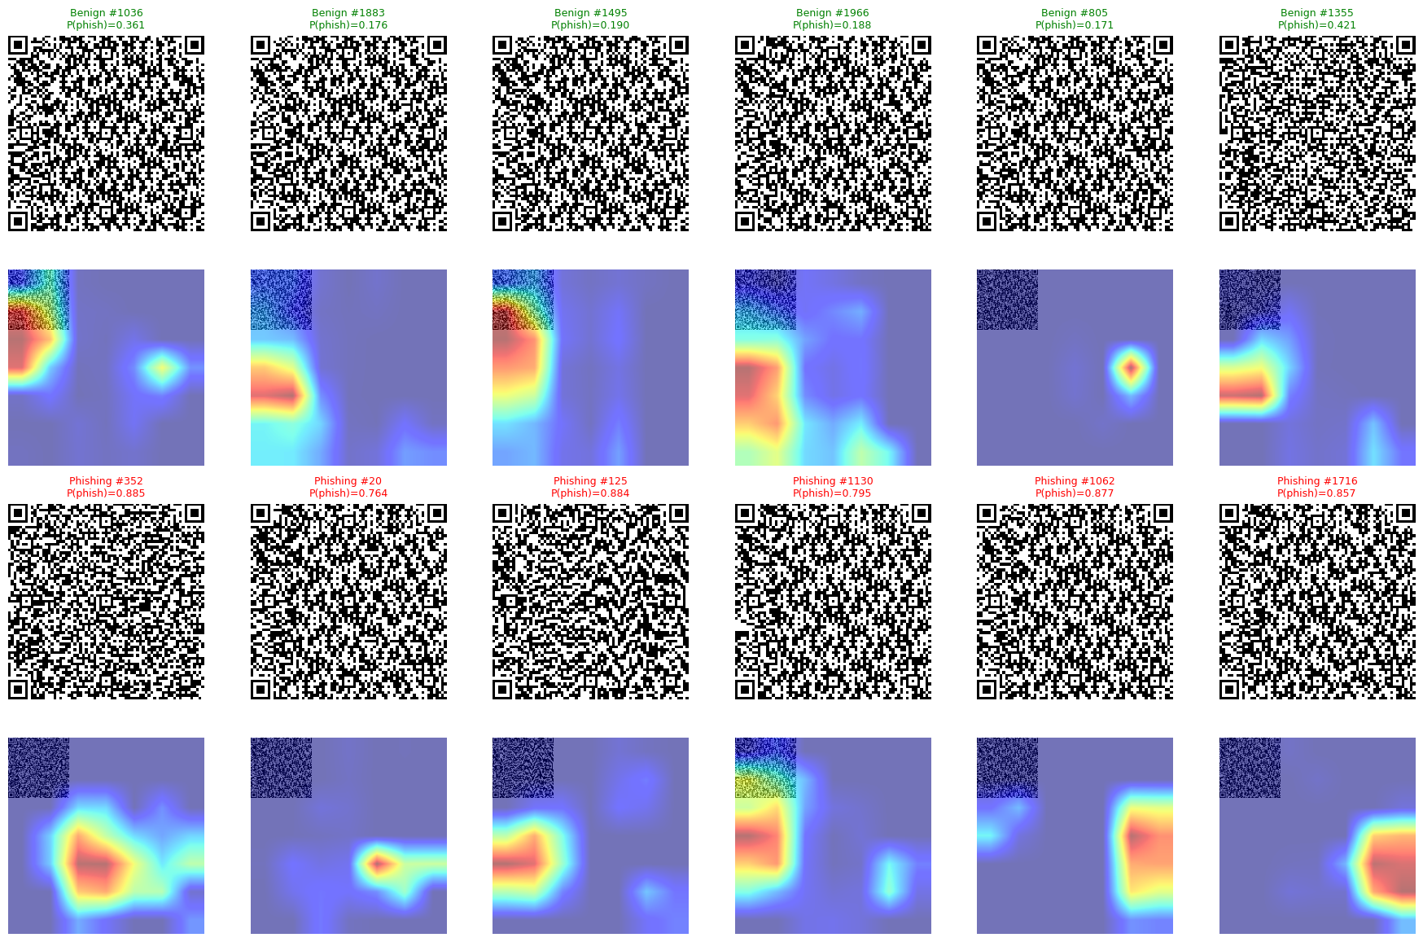
Experiment 6 — explainability
Does the model look at the QR structure, or at dataset tricks?
Grad-CAM · where the model looks
Alignment patterns and data regions — the parts that carry the QR content
SHAP · which features matter
A few of the 128 embedding dimensions drive the decision
r = 0.43
Grad-CAM maps agree across the two datasets
1.94
Between-class / within-class distance in the embedding
Notes:
[~45 s]
Finally, experiment six: explainability. We want to know if the model looks at the real QR structure, or if it learns tricks from the dataset. Grad-CAM shows that the model looks at the alignment patterns and the data regions: the parts that carry the information. The attention maps of the two datasets are correlated, with r equal to 0.43. And SHAP shows that a few dimensions of the embedding drive the decision. This suggests that the model learns real structural patterns, not dataset shortcuts.

Slide 23
Limitations
What is still missing?
Notes:
[~5 s]
Of course, our work has some limitations.

Slide 24
Limitations
What is still weak in our results
1
Visual fallback misses ~20%
2
Mild overfitting in Phase 2
FNR 0.199 when the QR code cannot be decoded
Controlled with early stopping at epoch 8
3
Large QR codes are harder
4
Visual-only calibration
Performance drops on high-resolution images
Its probabilities are not perfectly calibrated
Scope: static QR images and their URL only — no message, sender or page context. Q-Shield is one layer of defense, not the whole defense.
Notes:
[~40 s]
First, the visual fallback still misses about 20% of attacks, with an FNR of 0.199. Second, we see mild overfitting in phase two, which we control with early stopping. Third, the performance is lower on large, high-resolution QR codes. And fourth, the probabilities of the visual branch are not perfectly calibrated. Also, we only look at the QR image and its URL, not the message around it. So, Q-Shield is one layer of defense, not the complete solution.

Slide 25
Conclusions
Closing the three objectives
Notes:
[~5 s]
To conclude, let me go back to our three objectives.

Slide 26
Conclusions
Main finding: multimodal fusion turns FNR 0.202 into FNR 0.057 — and still covers QR codes that cannot be decoded.
Our three objectives
(i) Pipeline alignment
0.202 → 0.057
FNR, while still covering undecodable codes
(ii) Generalization
0.52 → 0.896
AUC when we train on both datasets
(iii) Explainability
r = 0.43
Grad-CAM agreement across the two datasets
Notes:
[~50 s]
Our main finding is this: multimodal fusion is not just a small improvement. It reduces the false negative rate from 0.202 to 0.057, and it still covers the QR codes that cannot be decoded. About our three objectives. One: by following the two stages of a QR scan, we miss three and a half times fewer attacks. Two: for generalization, training on both datasets raises the AUC from 0.52 to 0.896. And three: for explainability, the attention maps agree across datasets, with r equal to 0.43.

Slide 27
Future Work
Where this goes next
Notes:
[~5 s]
And what comes next?

Slide 28
Future Work
Four next steps
01
02
03
04
Context branch
Multi-scale training
Adversarial robustness
Regional adaptation
Read the message, sender and web page around the QR code
Better results on large, high-resolution QR codes
Test against stylized and manipulated QR codes
Adapt to Latin American QR payment systems
Content-based detection is one layer. Provenance checks and context complete the defense.
Notes:
[~35 s]
We see four directions. First, a third branch that reads the context: the message, the sender, and the web page. Second, multi-scale training, to improve on large QR codes. Third, robustness against adversarial and stylized QR codes. And fourth, adapting the model to QR payment systems in Latin America.

Slide 29
nicolas.llerena@utec.edu.pe
Department of Computer Science · UTEC · Lima, Perú
ORCID 0009-0007-3244-7746 · IEEE LA-CCI 2026 · Paper 47
Notes:
[~10 s]
Thank you very much for your attention. I am happy to answer your questions.

