Slide 1
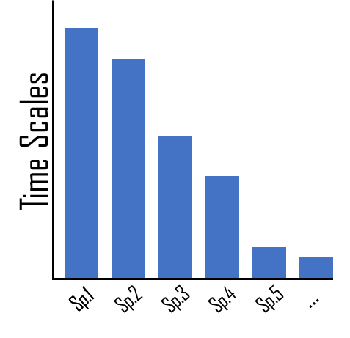

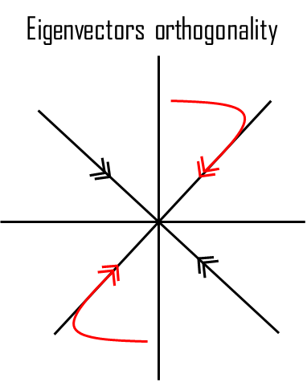
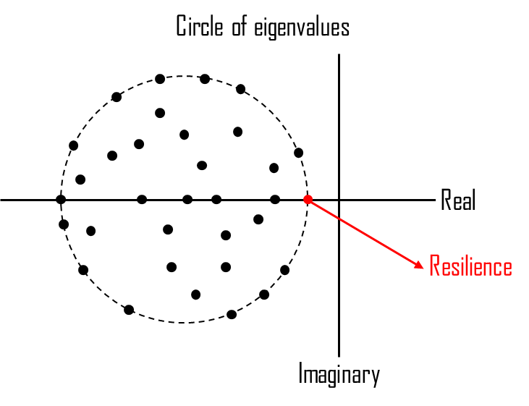

Short term
Mid term
Long term
Non-normality
$$AA^{T}≠A^{T}A$$
Recovery rate
Resilience max Real(λ)
Time after perturbation

Slide 2
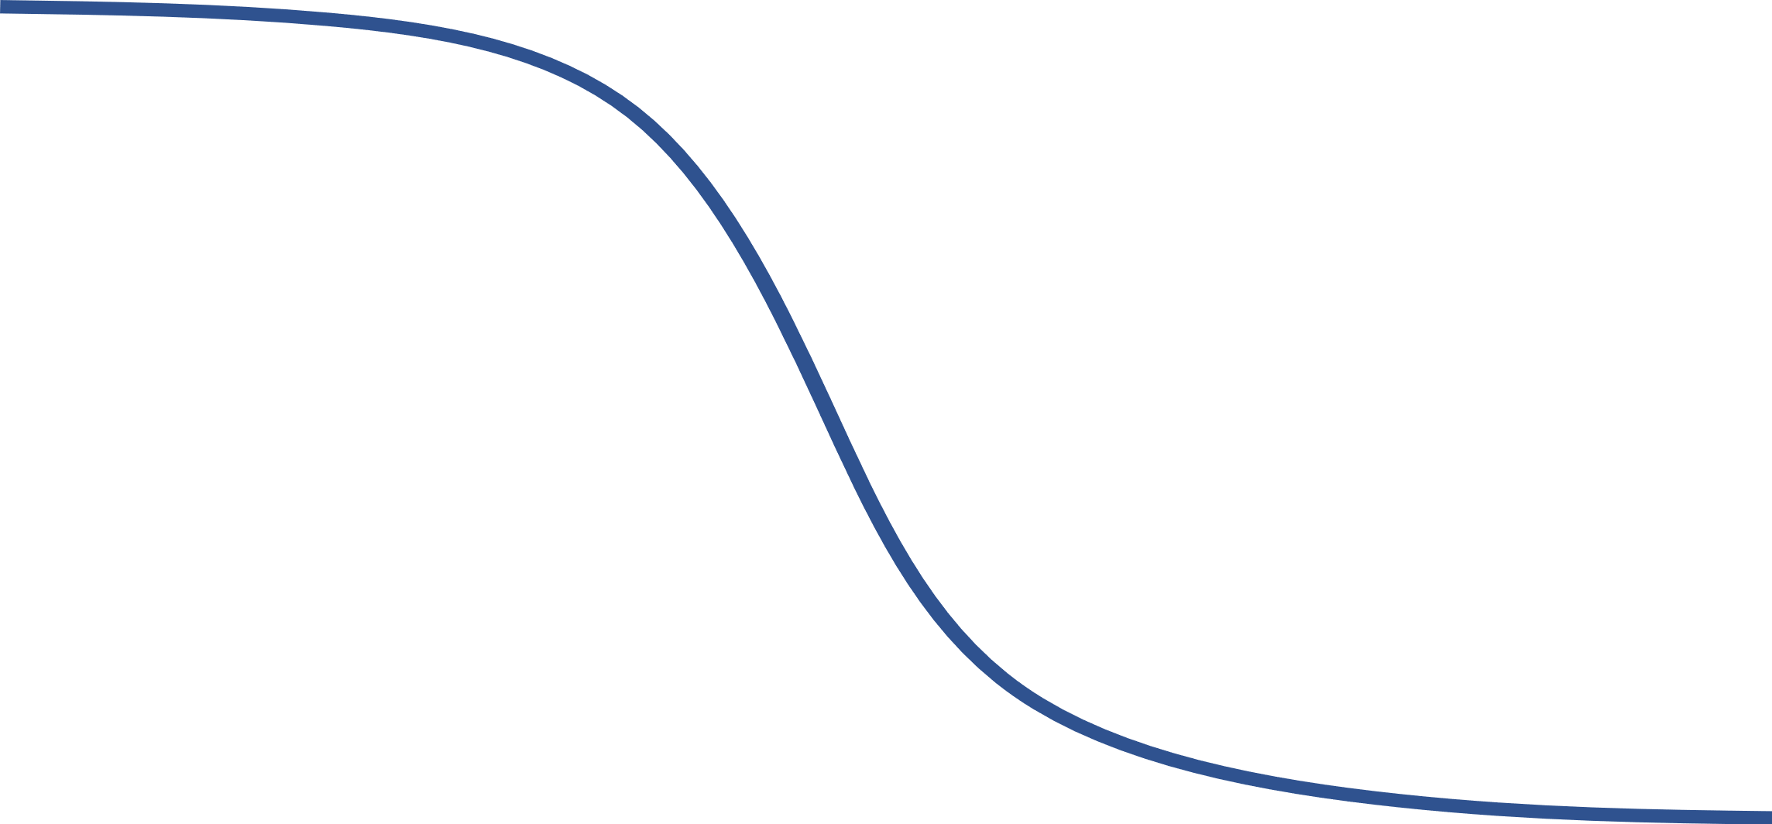
Short term
Mid term
Long term
Non-normality
$$AA^{T}≠A^{T}A$$
Recovery rate
Resilience max Real(λ_{i})
Time after perturbation

Slide 3
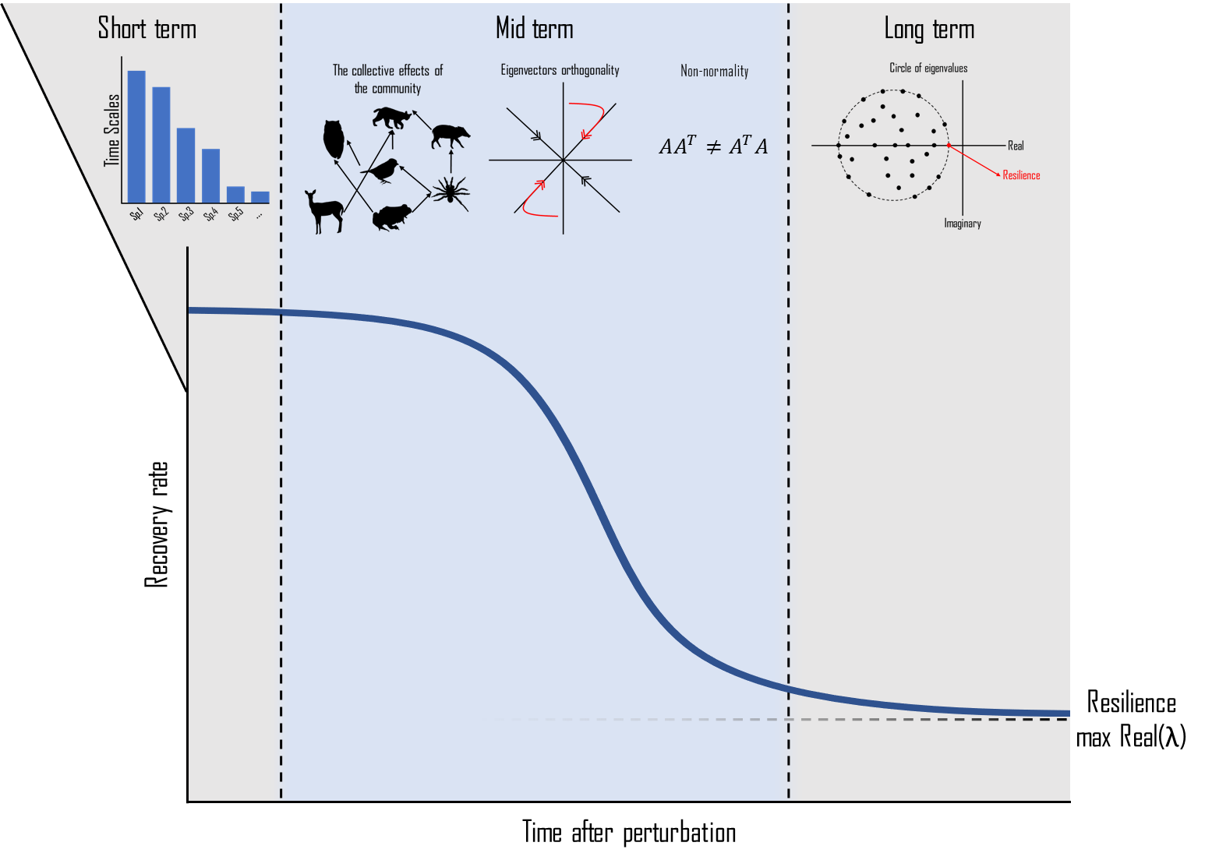
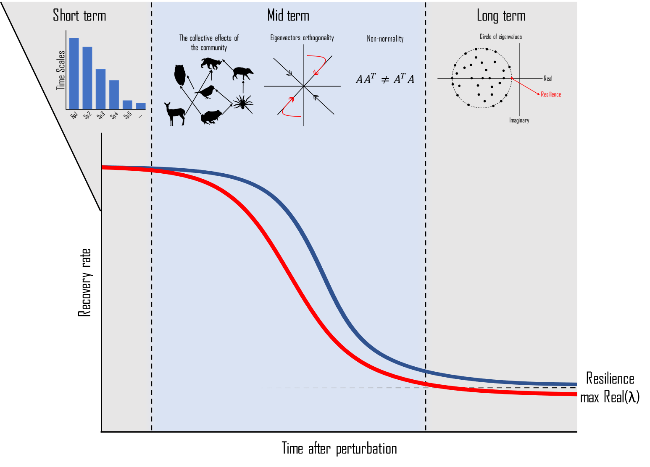
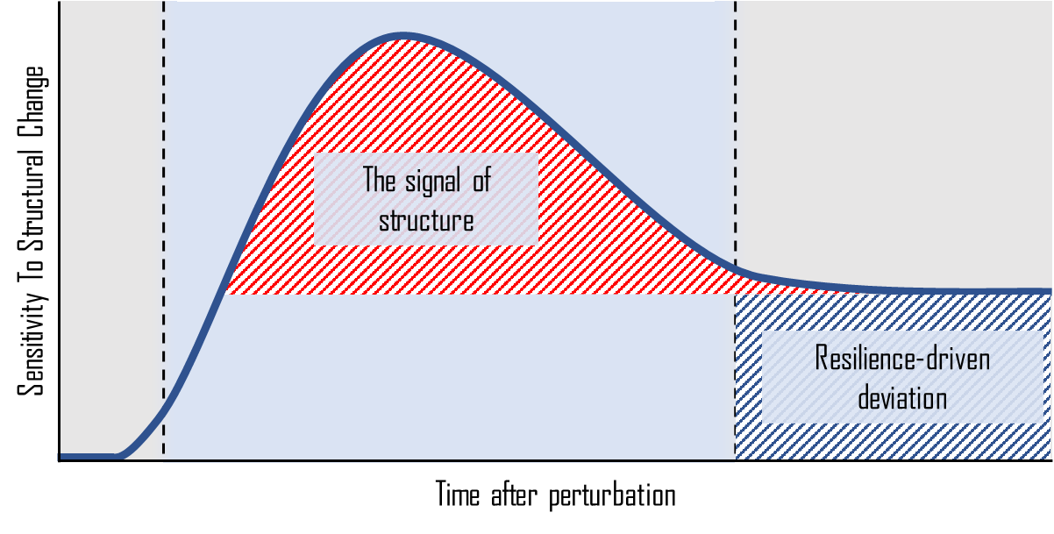

Slide 4
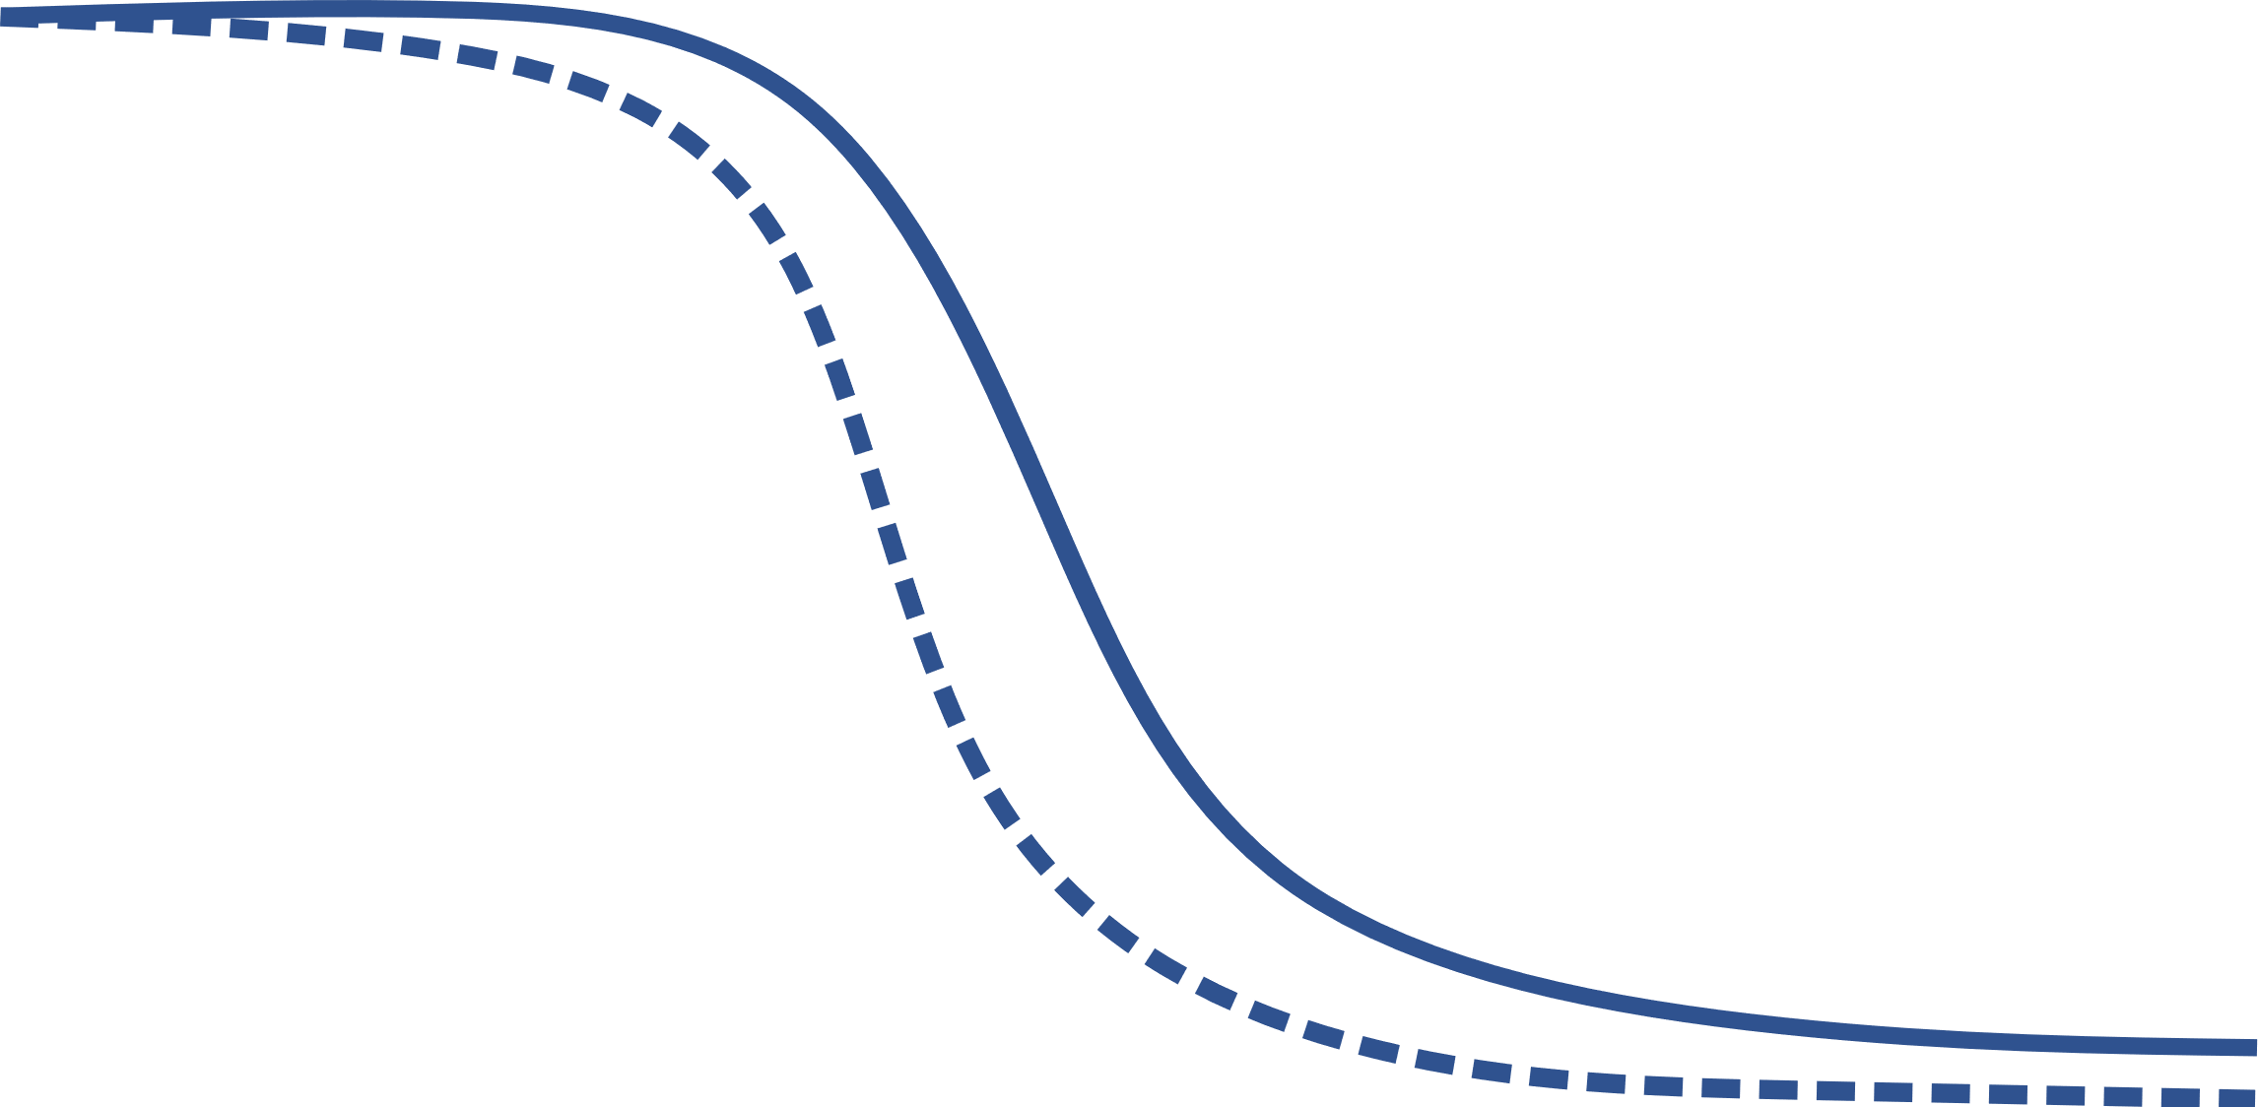
Short term
Mid term
Long term
Non-normality
$$AA^{T}≠A^{T}A$$
Recovery rate
Resilience max Real(λ_{i})
Time after perturbation

Slide 5
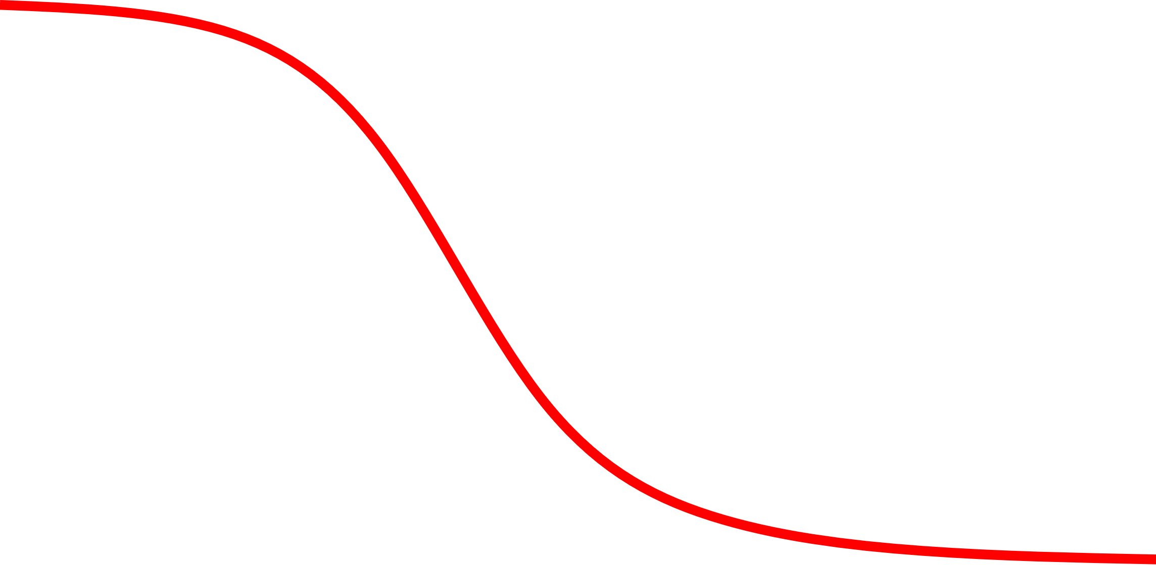
Short term
Mid term
Long term
Non-normality
$$AA^{T}≠A^{T}A$$
Recovery rate
Resilience max Real(λ)
Time after perturbation

Slide 6
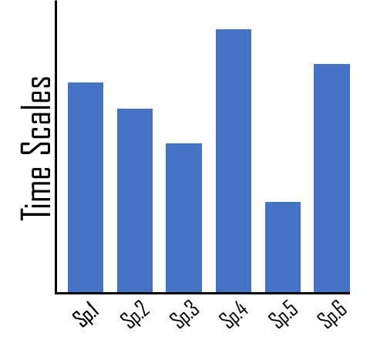
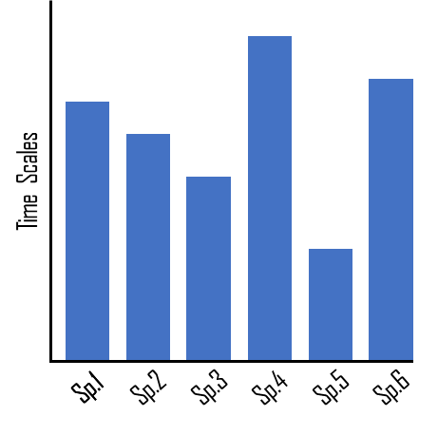
Time Scales
Sp.1
Sp.2
Sp.3
Sp.4
Sp.5
…
Sp.1

Slide 7
Circle of eigenvalues
Real
Resilience
Imaginary

Slide 8
Eigenvectors orthogonality

Slide 9







The collective effects of the community

Slide 10
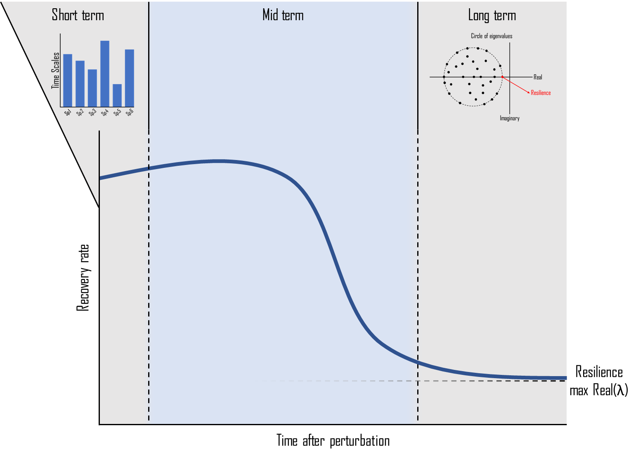
Short term
Mid term
Long term
Recovery rate
Resilience max Real(λ)
Time after perturbation

Slide 11
Short term
Mid term
Long term
Δ Recovery Rate
Time after perturbation

Slide 12
Short term
Mid term
Long term
The signal of structure
Sensitivity To Structural Change
Resilience-driven deviation
Time after perturbation

