Slide 1


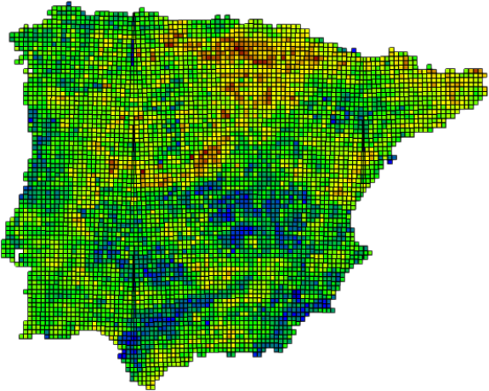

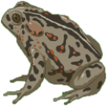

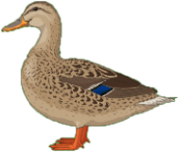
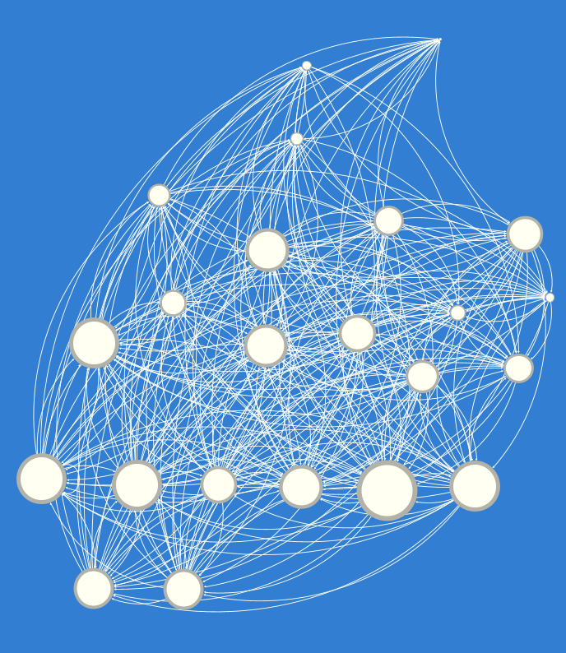
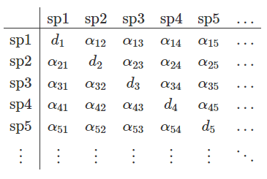
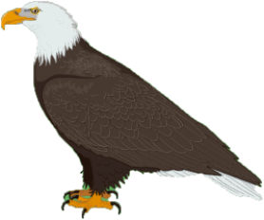
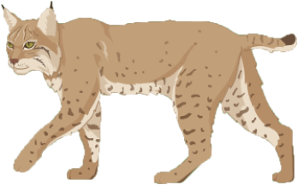
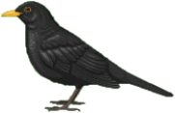

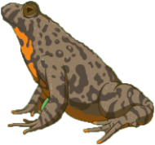
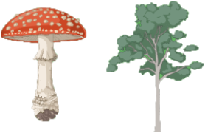


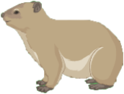
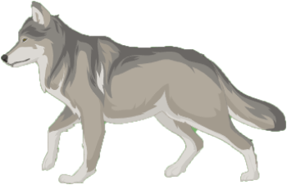
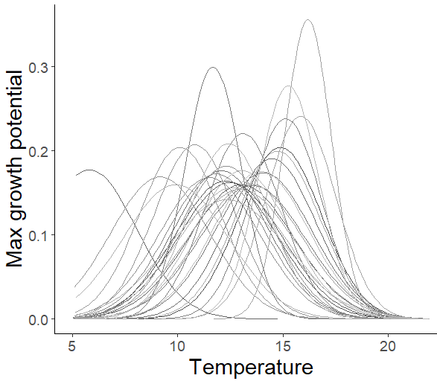
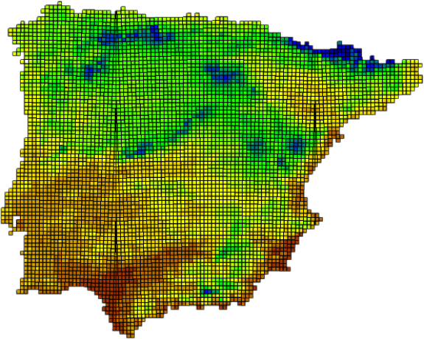
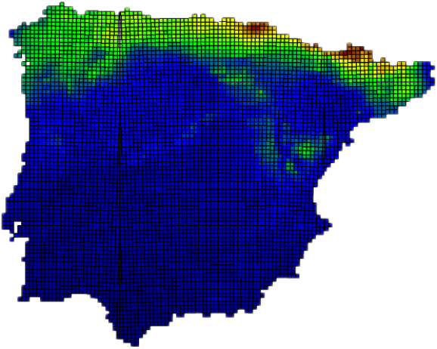


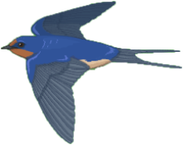





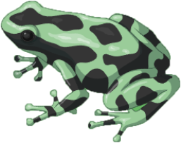
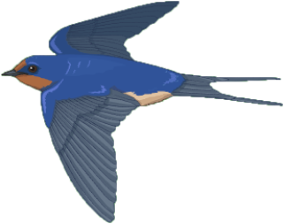
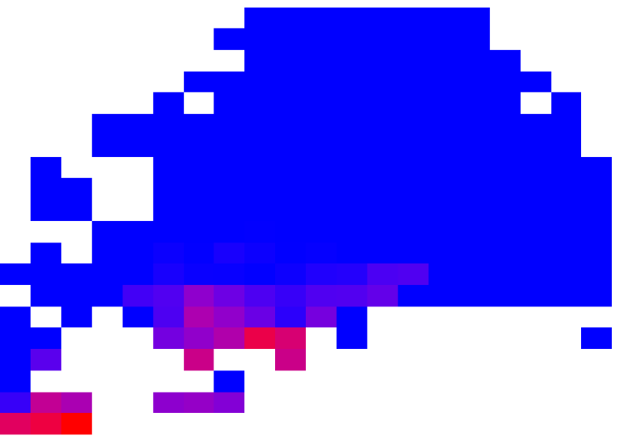
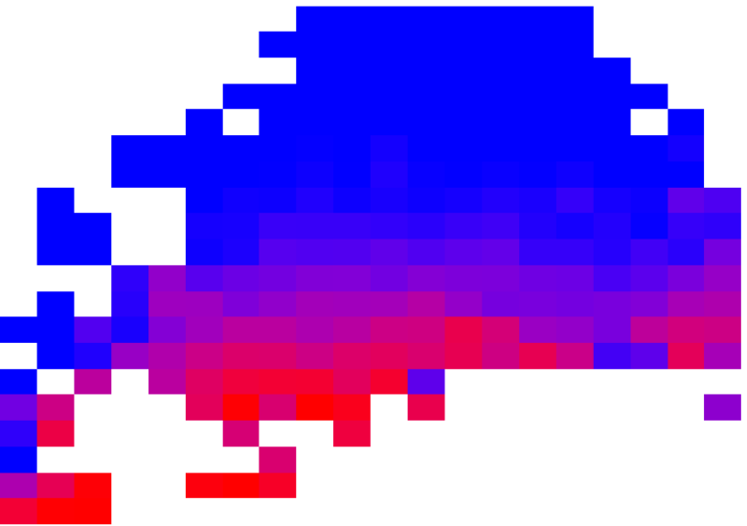
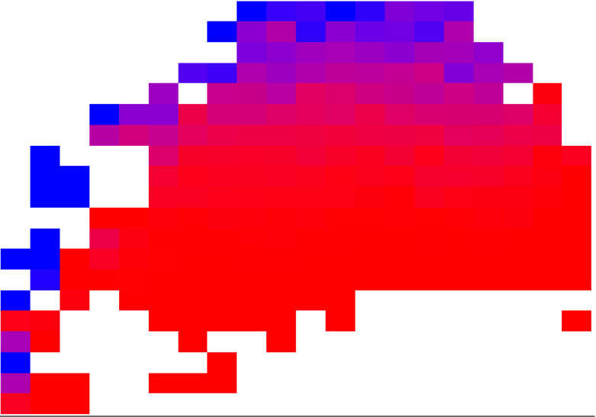


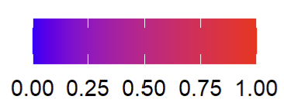
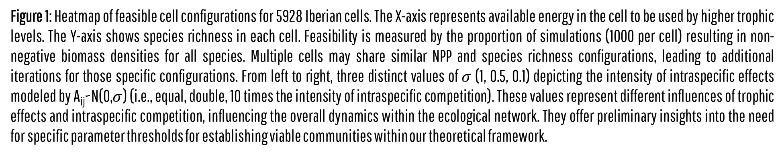
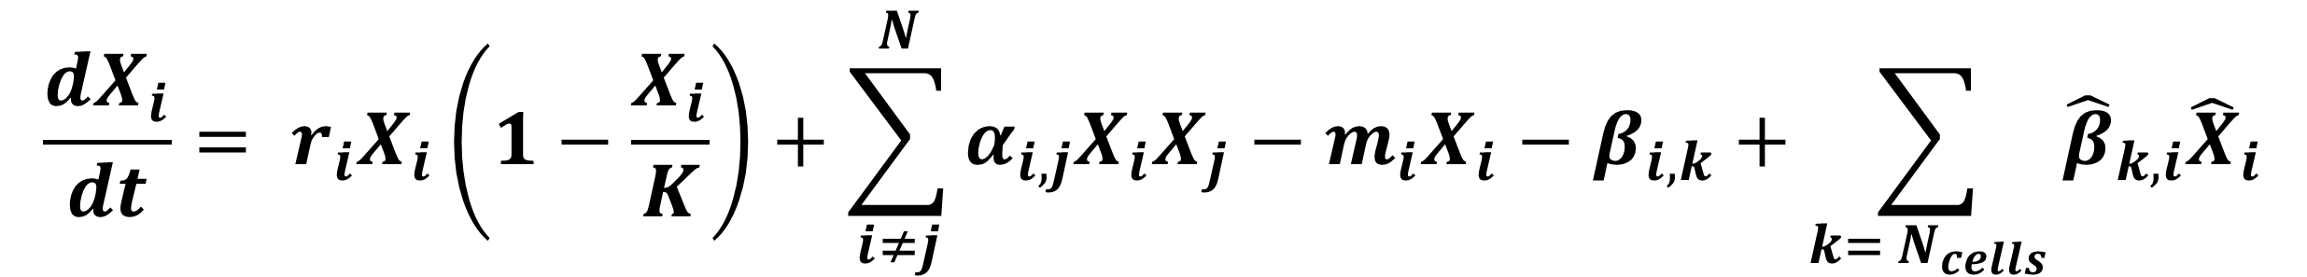
Towards a process-based understanding of macroecological pattern and process
Nicolàs Merino¹, Armand Rausell-Moreno¹, Núria Galiana¹, Miguel B. Araújo^{1,2}
¹Department of Biogeography and Global Change, National Museum of Natural Sciences (MNCN-CSIC), Madrid, Spain. ²Rui Nabeiro Biodiversity Chair, MED Inst., Évora, Portugal.
INTRODUCTION
TRAINING FIELD
Macroecology studies large-scale biodiversity patterns and processes. However, process-based methods to explain broad biogeographical patterns are largely missing. Processes like consumer-resource dynamics, dispersal rates, and density-independent climatic effects influence the distribution of species, trophic communities, ecosystem functioning and, ultimately, the services provided by nature to society. We present a metacommunity framework that integrates density-dependent biotic interactions, group-specific dispersal functions, and environmental heterogeneity to generate predictions for species distributions, community dynamics, and ecosystem functioning.
IBERIAN PENINSULA
UNIT OF STUDY
5928 cells of ~ 100 km²
SPECIES OF STUDY
34 reptiles
28 amphibians
62 mammals
172 birds
FRAMEWORK
Tetrapod diversity in the Iberian peninsula, based on ATLAS data 2022.
GENERAL PROCESS
SPECIFIC PROCESS
GENERAL PROCESS
DATABASES
BIOTIC INTERACTIONS
BASED ON POTENTIAL INTERACTIONS FROM THE METAWEB
We build
INTERACTION MATRIX
Iberian ATLAS distribution data of tetrapods
TETRA‐EU 1.0 Trophic metaweb of European tetrapods
METAWEB
TROPHIC LEVEL
INTERACTION STRENGTH
The intensity of the interaction is defined by predator and prey body-size ratios
AnimalTraits body size database
CHELSA Bioclim climate data
MATHEMATICAL FORMULATION
ENVIRONMENTAL FILTERING
ENVIRONMENTAL SUITABILITY AFFECTS POPULATION GROWTH RATES
LOTKA-VOLTERRA EXTENDED EQUATION
TEMPERATURE
PRECIPITATION
Deterministic
Probabilistic
ENERGY AVAILABLE IN THE CELL INFLUENCES CARRYING CAPACITY
$$\frac{dX_{i}}{dt}= r_{i}X_{i}\left(1−\frac{X_{i}}{K}\right)+\sum_{i≠j}^{N}{α_{i,j}X_{i}X_{j}−m_{i}X_{i}−β_{i,k}+\sum_{k= N_{cells}}{{\hat{β}}_{k,i}{\hat{X}}_{i}}}$$
Energy
NPP
K_{cell}
Environmental effects on growth rate
Trophic interactions from the metaweb
SPATIAL DYNAMICS
DENSITY - DEPENDENT
BODY SIZE - DEPENDENT
Emmigration
Immigration
Physical barriers
Source-sink effects
Neutral
dynamics
DISPERSAL
Intraspecific effects
Energy limitations of the system
Non-predatory mortality
Low mobility
High mobility
DISTANCE - DEPENDENT
PROBABILISTIC
PRELIMINARY RESULTS
RESEARCH OBJECTIVES
ASSESSING NATURAL ANIMAL COMMUNITIES: ANALYZING SYSTEM ENERGY AVAILABILITY AND THE INTENSITY OF SELF-REGULATORY EFFECTS
CHARACTERISATION & EVALUATION OF OVERALL STRUCTURE OF THE COMMUNITY
Low self-regulation
High self-regulation
PREDICTING CHANGES IN COMMUNITY STRUCTURE DUE TO ENVIRONMENTAL CHANGES CAUSED BY CLIMATE CHANGE
SPECIES RICHNESS
SPECIES RICHNESS
SPECIES RICHNESS
NET PRIMARY PRODUCTIVTY
NET PRIMARY PRODUCTIVTY
NET PRIMARY PRODUCTIVTY
LINKING COMMUNITY STRUCTURE WITH ECOSYSTEM FUNCTIONING
Figure 1: Heatmap of feasible cell configurations for 5928 Iberian cells. The X-axis represents available energy in the cell to be used by higher trophic levels. The Y-axis shows species richness in each cell. Feasibility is measured by the proportion of simulations (1000 per cell) resulting in non-negative biomass densities for all species. Multiple cells may share similar NPP and species richness configurations, leading to additional iterations for those specific configurations. From left to right, three distinct values of 𝜎 (1, 0.5, 0.1) depicting the intensity of intraspecific effects modeled by A_{ij}~N(0,$σ$) (i.e., equal, double, 10 times the intensity of intraspecific competition). These values represent different influences of trophic effects and intraspecific competition, influencing the overall dynamics within the ecological network. They offer preliminary insights into the need for specific parameter thresholds for establishing viable communities within our theoretical framework.
FEASIBILITY

