Slide 1
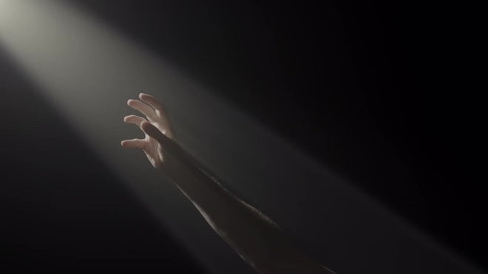
AI gave me power.
what does it mean?

