Slide 1
Experiments in Art and Technology (E.A.T.)
Founded in 1967 by:
Billy Kluver, electrical engineer at Bell labs
Fred Waldhauer, electrical engineer at Bell Labs
Robert Rauschenberg, artist
Robert Whitman, artist
“E.A.T is founded on the strong belief that an industrially sponsored, effective working relationship between artists and engineers will lead to new possibilities which will benefit society as a whole.”

Slide 2
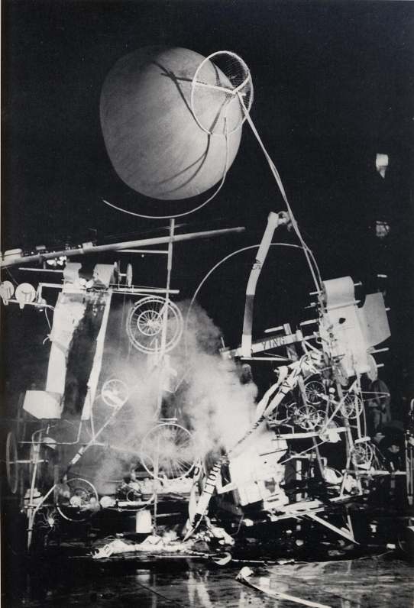
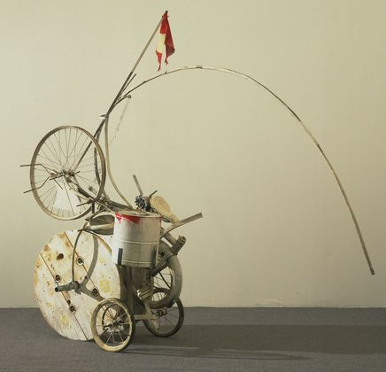
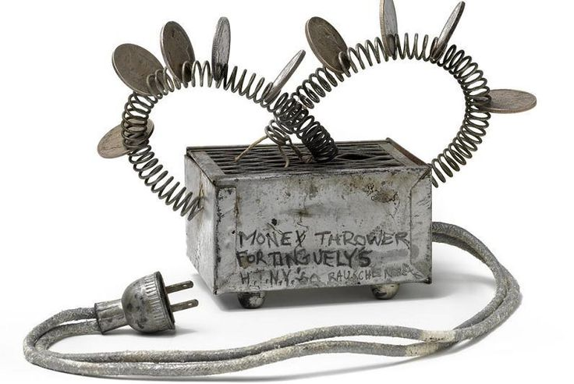
Jean Tinguely and Billy Kluver, Homage to New York, 1960 (Money Thrower by Robert Rauschenberg)
MoMA Garden
“Auto-destructive” work of art

Slide 3
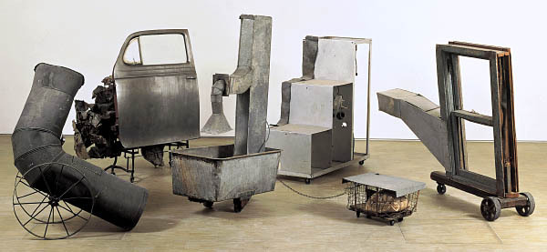
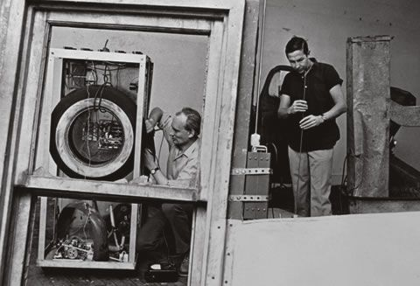
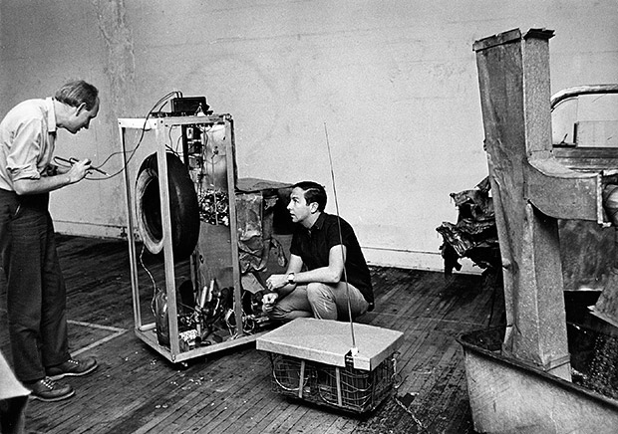
Five-part found-metal assemblage with five
concealed radios:
ventilation duct
automobile door on typewriter table, with crushed metal
ventilation duct in washtub and water, with wire basket
constructed staircase control unit housing batteries and
electronic components
wooden window frame with ventilation duct
Read from Kluver on Oracle
Robert Rauschenberg, Billy Kluver, Harold Hodges, Oracle, 1965
Pompidou, Paris
Notes:
Kluver on Oracle (and other texts) http://home.marfadialogues.org/news/some-history-robert-rauschenberg-and-social-and-environmental-activism-1-of-2/

Slide 4
9 Evenings: Theater and Engineering
October 13-23, 1966
69th Regiment Armory, NYC
Steve Paxton
Alex Hay
David Tudor
Robert Rauschenberg
Deborah Hay
John Cage
Lucinda Childs
Oyvind Fahlstrom
Yvonne Rainer
Robert Whitman

Slide 5
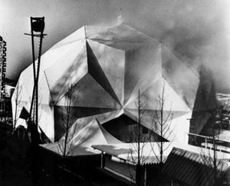
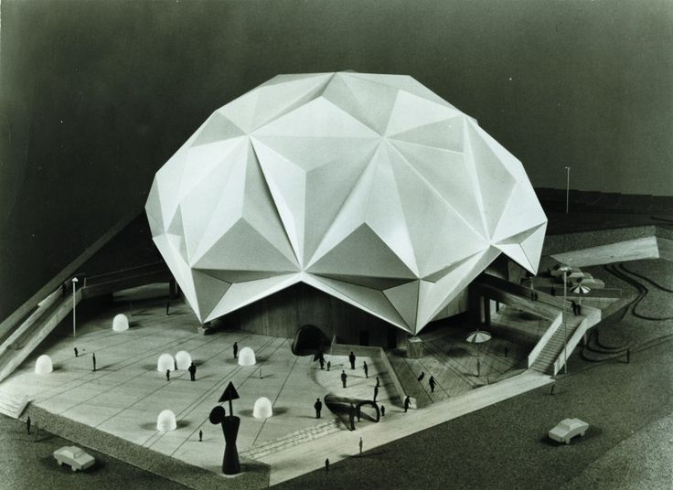
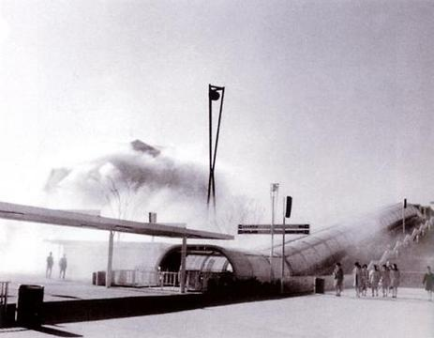
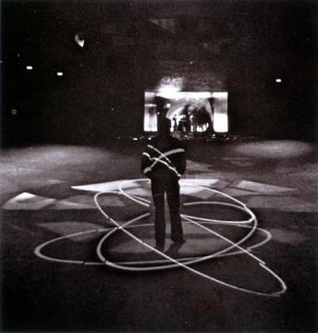
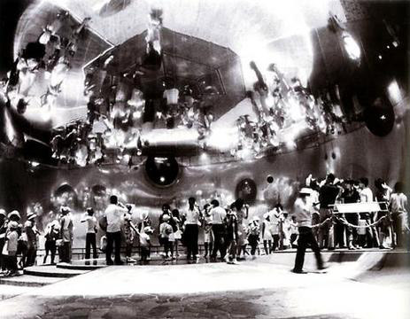
Pepsi Pavilion, Osaka Japan, 1970
63 artists, engineers, architects, scientists
“…a living, responsive environment”
Read from Kluver on Pepsi Pavilion
Notes:
Kluver on Pepsi Pavilion http://www.w2vr.com/archives/Kluver/10_Pavilion.html

Slide 6
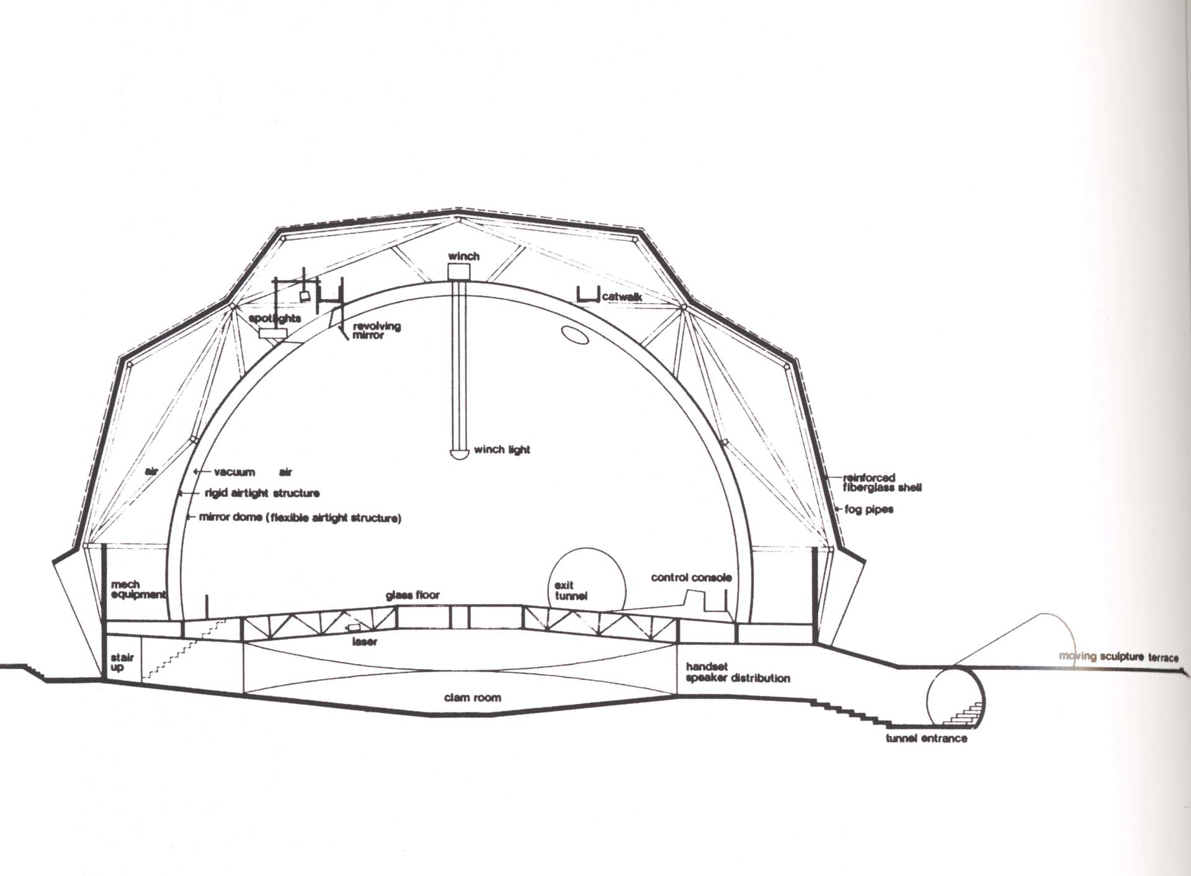

Slide 7
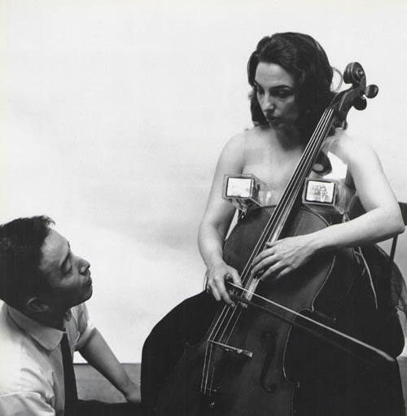
Nam June Paik
"The real implied issue in 'Art and Technology' is not to make another scientific toy,
but how to humanize the technology and the electronic medium, which is progressing
rapidly -- too rapidly. Progress has already outstripped ability to program...TV Brassiere
for Living Sculpture (Charlotte Moorman) is also one sharp example to humanize
electronics...and technology. By using TV as bra...the most intimate belonging of human
being, we will demonstrate the human use of technology, and also stimulate viewers
NOT for something mean but stimulate their fantasy to look for the new, imaginative
and humanistic ways of using our technology." - Nam June Paik, 1969
Nam June Paik and Charlotte Moorman
TV Bra for Living Sculpture, 1969

Slide 8
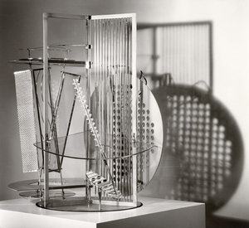
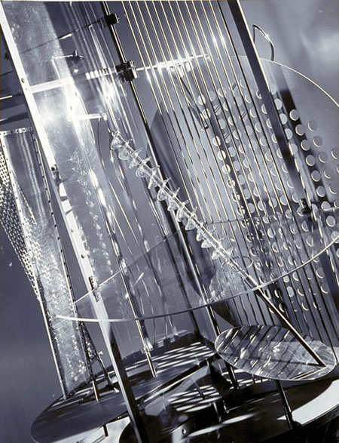
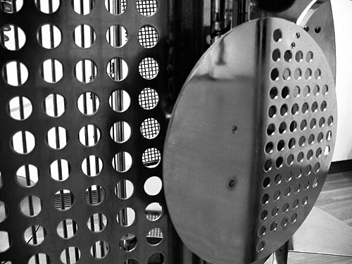
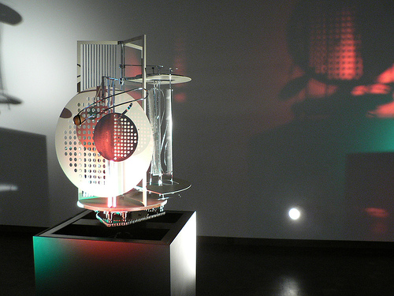
The reality of our century is technology -
the invention, construction and maintenance of
machines. To be a user of machines is to be of
the spirit of this century. Machines have
replaced the transcendental spiritualism
of past eras.” - László Moholy-Nagy (1895-1946)
Plays of light, manifestations of movement
The diagonal as a representation of the
fourth dimension (space-time)
Laszlo Moholy-Nagy and team
Light Prop for an Electric Stage (Light/Space Modulator), 1922-1930
Aluminum, steel, nickel-plated brass, other metals, plastic,
wood and electric motor

Slide 9
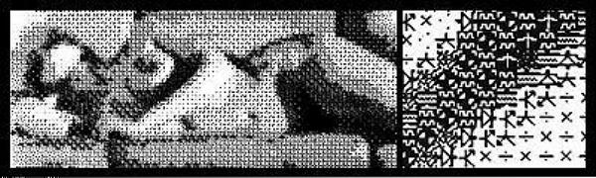
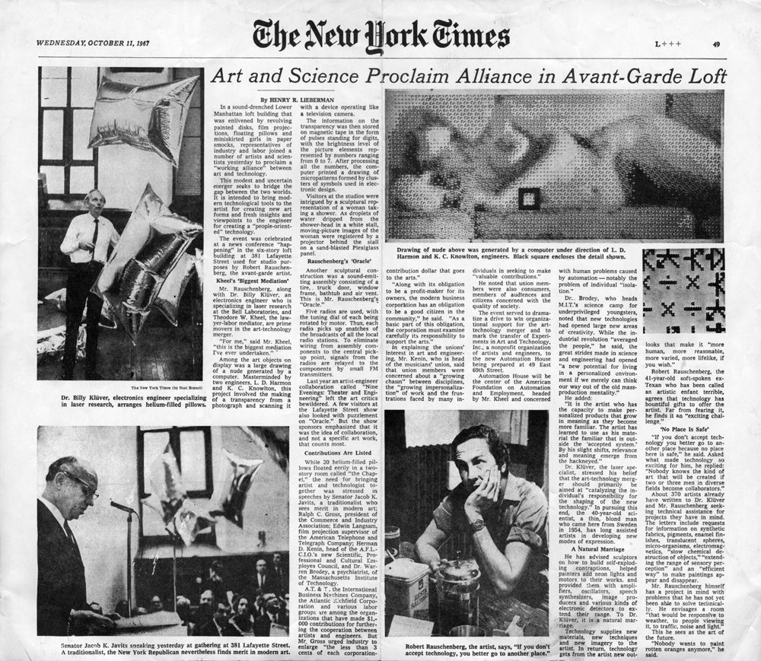
Ken Knowlton, Nude, 1966
Computer generated

Slide 10
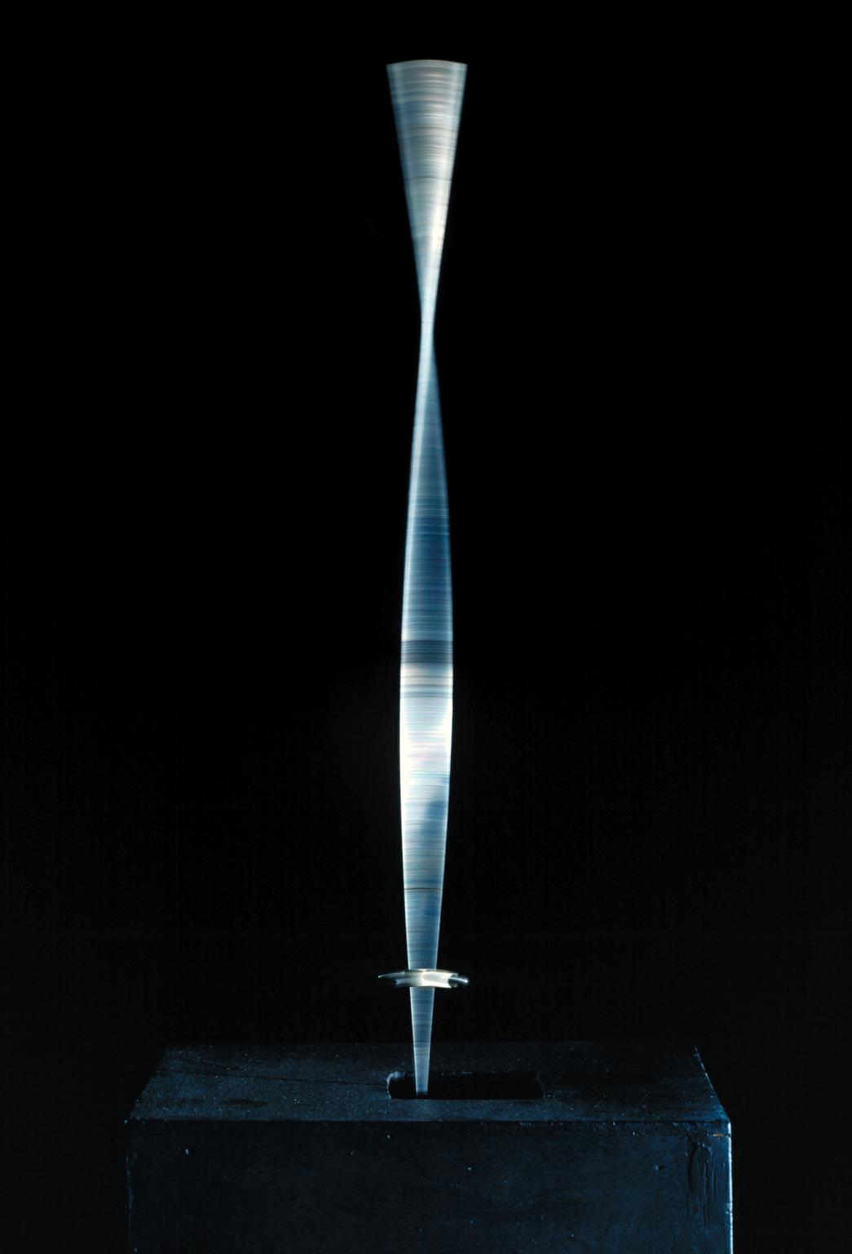
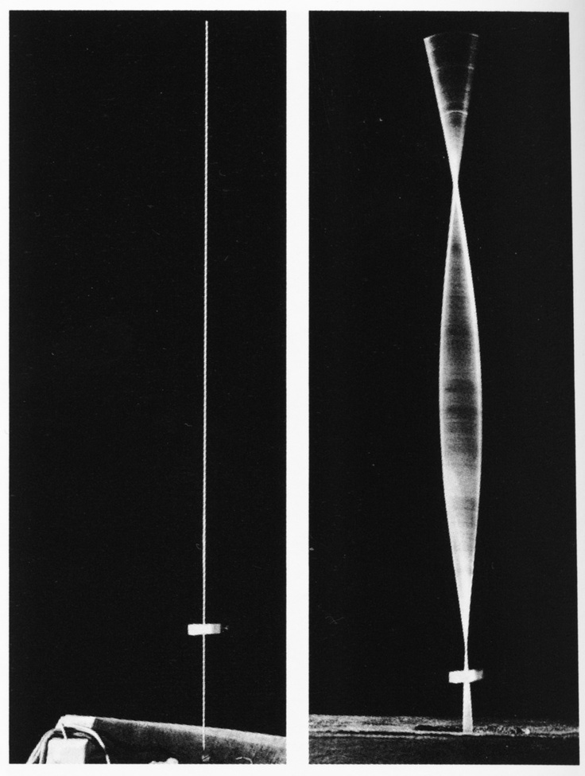
Realistic Manifesto, 1920
Naum Gabo and (brother) Antoine Pevsner
Naum Gabo, Kinetic Construction (Standing Wave), 1919-20

Slide 11
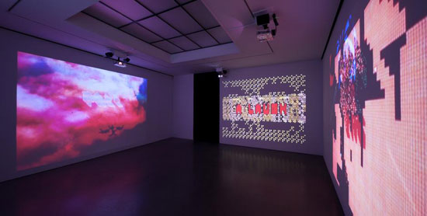
For VanDerBeek, who self-identified as a “technological fruit picker,” the mind is essentially dynamic.
Unlike a regulated path that shuttles objects and information ever forward, it is field of experimentation,
reconfiguration, process, and error that caters to an individual’s imagination. Rather than dwelling on
technology’s dystopian association with war and capitalist control, VanDerBeek was committed to finding
new processes for connecting human experience with images that enhance a viewer’s relationship with
and perception of her environment. – Kaitlyn Kramer on the work at Andrea Rosen Gallery, 2015 (review online)

Slide 12
Bauhaus

