Slide 1
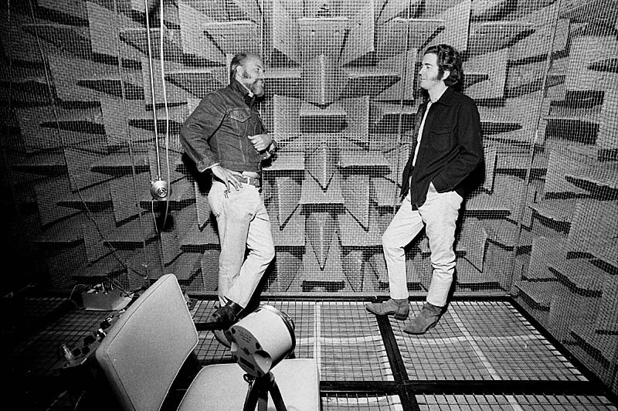

Slide 2
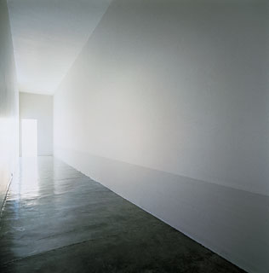
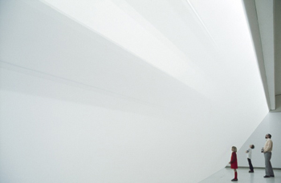
Robert Irwin, Slant/Light/Volume, 1971
Synthetic fabric (scrim), wood, fluorescent lights, flood lights
Walker Art Center, Minneapolis
Notes:
Scrim is a fabric used in theatrical stage productions. “Appearing opaque unless lit from behind, this material is often used to situate actions taking place in the foreground and background; to metaphorically frame the action in the past and present, or to distinguish realms of consciousness versus dream-states.” (some online source)

Slide 3
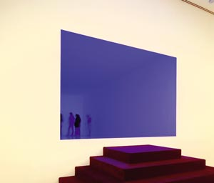
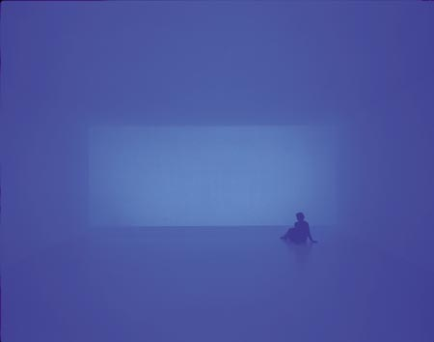
Turrell, Spread (Ganzfeld, Total Field), 2003
"I want you to see the swan as it glides across the lake,
not the fact that underneath it's paddling like hell.”
(Turrell reveals not the mechanisms of installation but
the mechanisms of sight)
Notes:
Perception and apperception. Turrell: “As you fly, you do see space that is determined not so much by physical confines, but by atmospheric and light phenomena within the space. I've seen sometimes a contrail that goes through the sky where you can see its shadow come down through the sky, the shadow of the contrail. This beautiful shadow actually divides the space in an amazing way. And so for me, sitting up there in this cockpit, I've seen so many things that reminded me of this other way of seeing, where light is the material and this makes the space.”
“We are a primitive culture in terms of light.” (we don’t have a proper vocabulary to even talk about it, we don’t know how to see the complexities of its effects).”
Turrell talks about the effects of Gothic cathedrals.

Slide 4
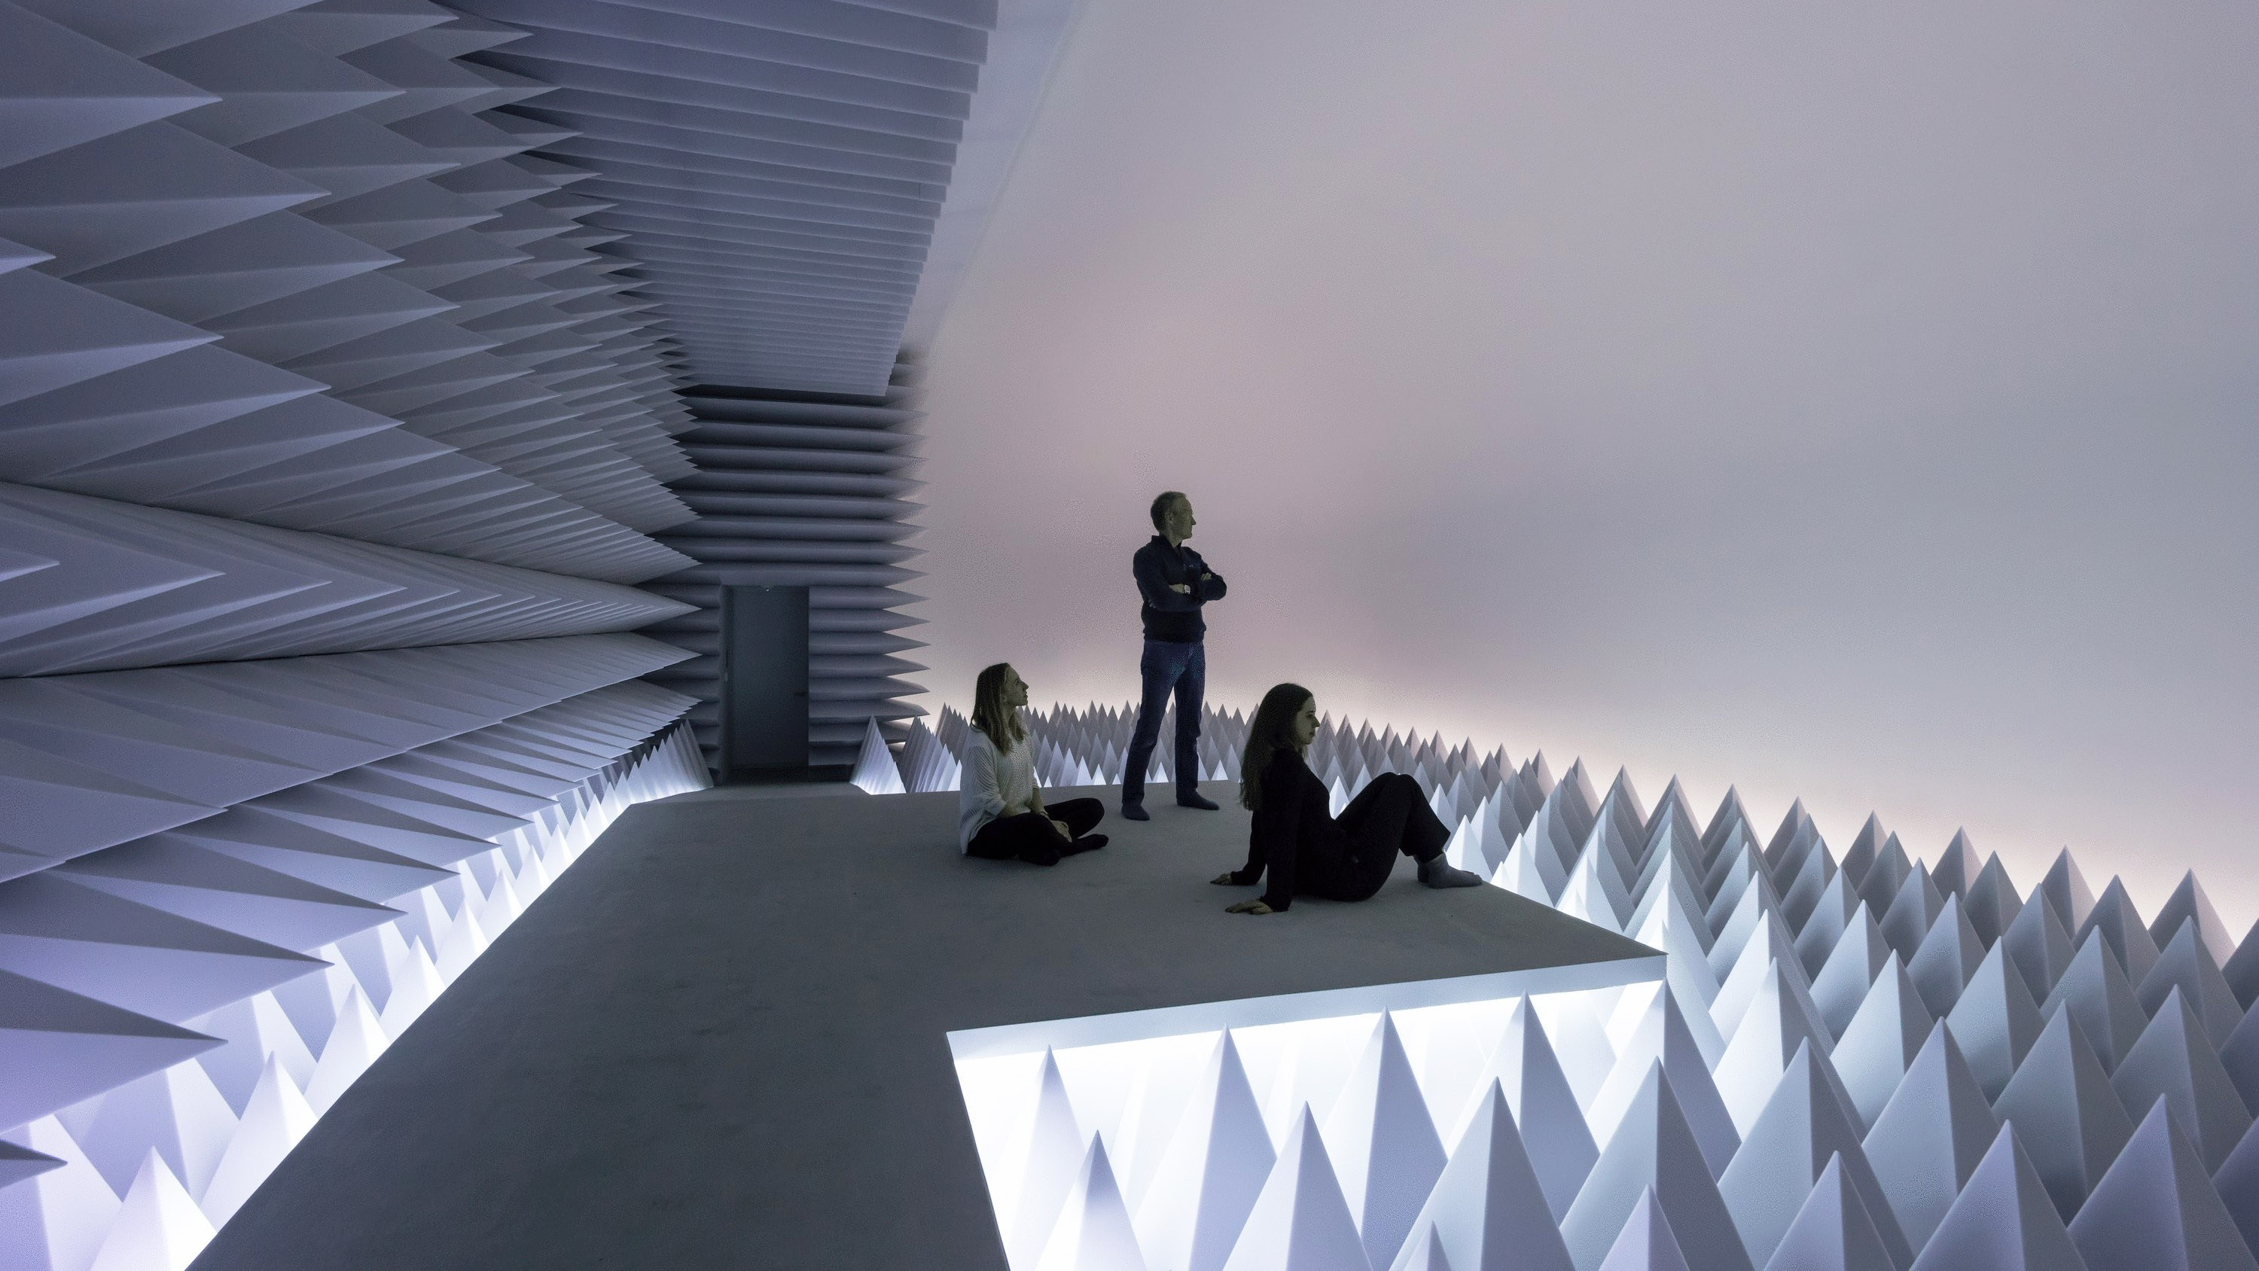
Doug Wheeler, PSAD Synthetic Desert III, 1971
Guggenheim Museum, 2017
Video

Slide 5
Doug Wheeler, infinity room, video
Look at page of Google images

Slide 6
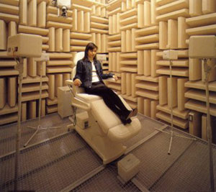
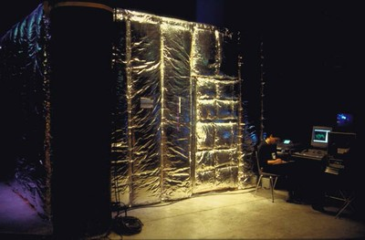
Seiko Mikami
World, Membrane and the Dismembered Body, 2000
Notes:
An enhanced anechoic chamber – information online about the artist and the work.

Slide 7
Look at Mary Corse video, Ace Gallery, 2012

Slide 8
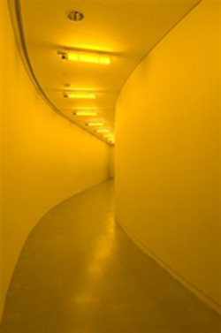
Eliasson, Yellow Corridor, 1997
Monofrequency light
Notes:
Whenever he can, Eliasson watches spectators and studies their responses in a search for new ways of surprising them, of heightening their perceptions. When he talks about his Green River project, for example, it is mostly in terms of how the witnesses react. Green River involves dyeing a river green, and so far he has done it four times. In Tokyo, he says, 'a lot of people stopped and looked... And of course they were stunned. I did it in a spot where the cherry blossom comes out a month later. It's well known as a beautiful place. Actually the police came and. basically I ran away. And the police then put up posters asking anybody who had seen somebody suspicious to contact them. [He laughs.] I have a photograph of the poster.'It is, as he puts it, 'a kind of action'. He doesn't seek permission (though he makes sure the dye is safe) and he doesn't give notice; he also picks fairly small sites and it's all over in two or three hours. 'If you do it on a big stage the mediation of the project immediately becomes quite sensational. I've tried to avoid that spectacular approach.' The purpose of the project is the response. 'Los Angeles, Stockholm, Tokyo are places where the relationship between the water and the city is completely different, and the way people experience and refer to the water in their local setting is very different. It has been interesting for me to investigate that relationship.’
The light is from sodium bulbs of a type used to illuminate Belgian motorways and Swiss mountain tunnels - chosen because, as Eliasson puts it, 'you see more'. 'The graduation of the tones is easier for your eyes to detect. The brain has to understand less information than with a whole-colour picture, so we have the sense that we see much more. The yellow room is for me like hyper-seeing, a space where the vision is advanced.''But you don't put anything in the room to look at.’’ No, that's not true. You are in there. You can look at your hands, for example. Also, if somebody else walks in you not only look at them, but you also realize very quickly that they are looking at you. In a normal space we don't think about who is looking at what and why are we looking, so it raises these questions.’ All notes taken directly from online sources.

Slide 9
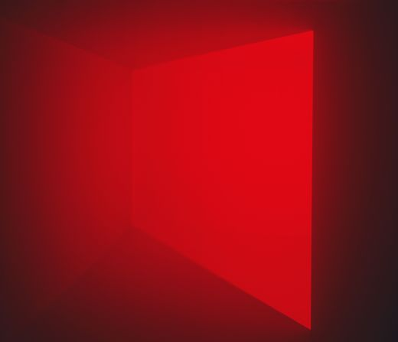
Turrell, A Frontal Passage, 1994, 13x23x34 feet

Slide 10
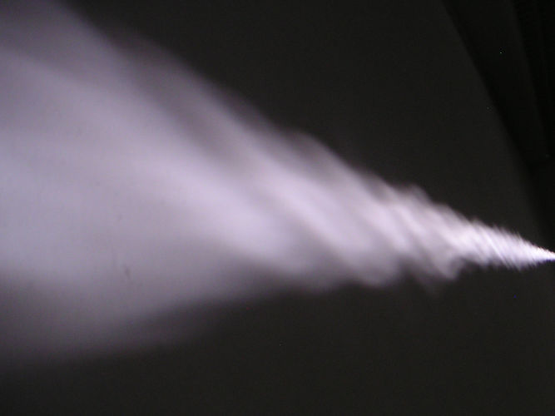
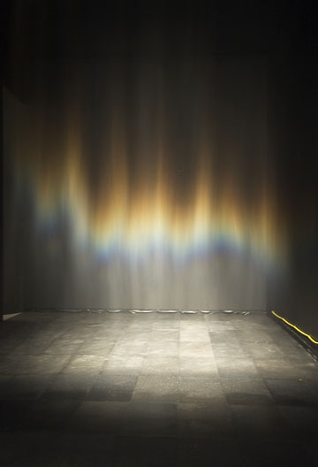
Eliasson, Notion Motion, 2005
Eliasson, Beauty, 1993
Curtain of mist under spotlight
Notes:
Light and perception as enhanced by the addition of water (mist).

Slide 11
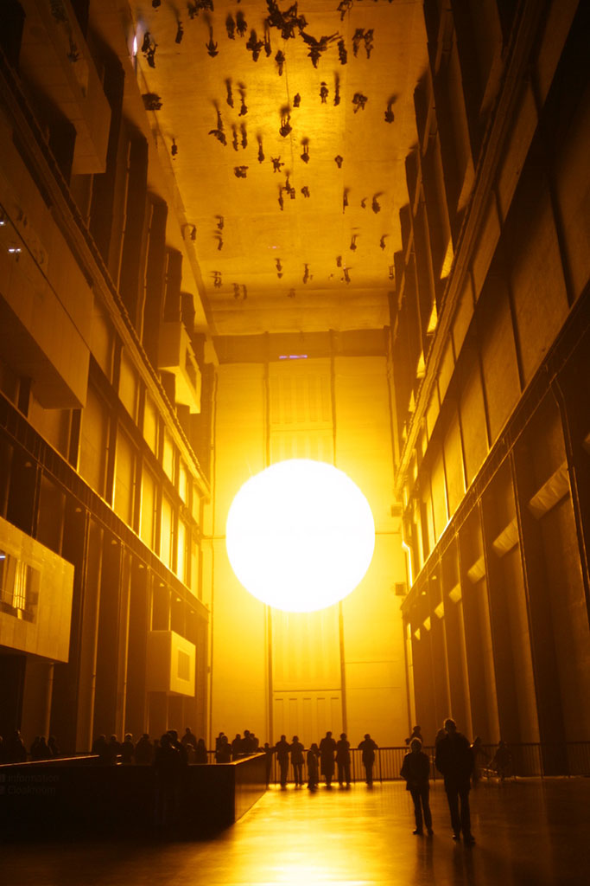
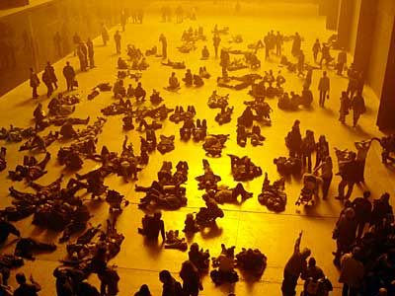
Olafur Eliasson, The Weather Project, 2003
Tate Modern, Turbine Hall

Slide 12
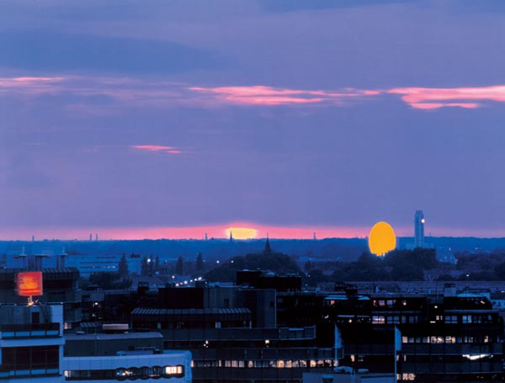
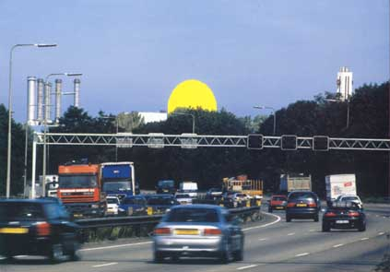
Eliasson, Double Sunset, 1999, Utrecht
Yellow corrugated iron disk lit with floodlights
40 ft. wide

Slide 13
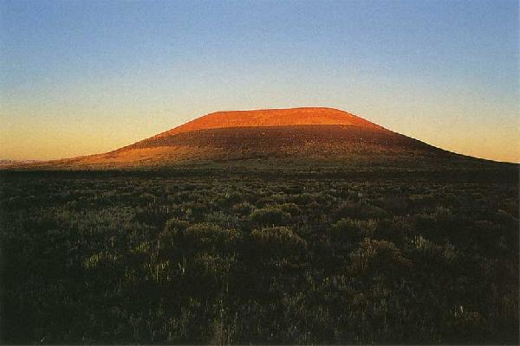
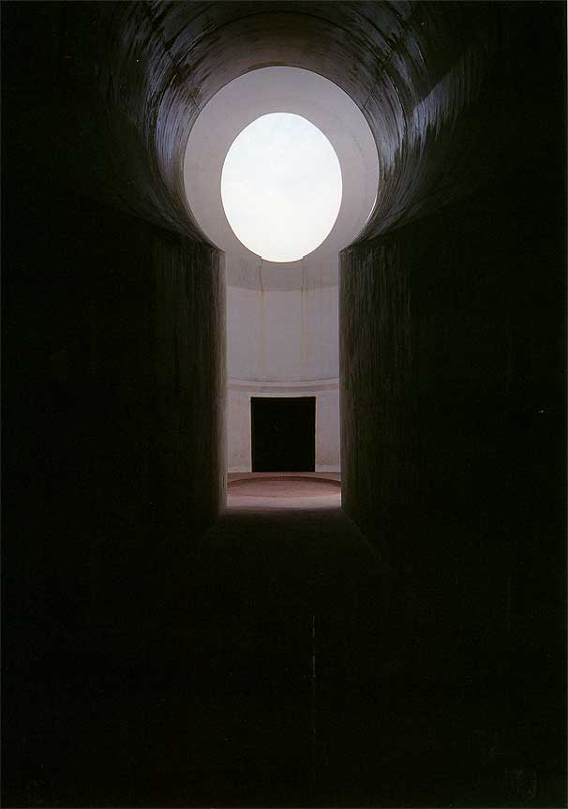
James Turrell, Roden Crater Project, 1974-present
Flagstaff Arizona
"I wanted to use the very fine qualities of light. First of all,
moonlight. There's a space where you can see your shadow from
the light of Venus alone - things like this. I also wanted to gather
starlight that was from outside the planetary system, which would
be from the sun or reflected off of the moon or a planet...
you've got this older light that's away from the light even of our
galaxy. So that is light that would be at least three and a half billion
years old. So you're gathering light that's older than our solar
system.” James Turrell

Slide 14
Light and Perception: On View in NYC
Erwin Redl, Whiteout, Madison Square Park (until March 25)
“I am intrigued by the Park’s option of a large-scale installation
that blurs the border between the virtual and the real. The
physicality of the swaying orbs in conjunction with the abstract
animations of their embedded white lights allows the public to
explore a new, hybrid reality in this urban setting.”
Listen to Rapaport’s statement
Watch short clip

Slide 15
Erwin Redl, artist statement”
My work reflects upon the condition of art making after the “digital experience.” The formal and structural approach to various media I employ, such as installation, drawings, CD-ROM, Internet and sound, engages in binary logic, because I assemble the material according to a narrow set of self-imposed rules which often incorporate complex algorithms, controlled randomness and other methods inspired by computer code.
Since 1997, I have investigated the process of “reverse engineering” by (re-)translating the abstract aesthetic language of virtual reality and 3‑D computer modeling back into architectural environments by means of large-scale light installations. In this body of work, space is experienced as a second skin, our social skin, which is transformed through my artistic intervention. Due to the very nature of its architectural dimension, participating by simply being “present” is an integral part of the installations. Visual perception works in conjunction with corporeal motion, and the subsequent passage of time.
The formal aspect of my work becomes easily accessible through conscious aesthetic reduction to a minimalist vocabulary. Interpretation and understanding of this characteristic is dependent upon the viewer’s subjective references. Equally, the various interactions between the visitors within the context of the installation re-shape each viewer’s subjective references and reveal a complex social phenomenon.
The medium light refers directly to the aesthetic of virtual reality. The ephemeral nature of this particular medium is the ideal representation of the pure structural logic which underlies my work. At the same time the active light in my installations transforms structural logic directly into an intense corporeal sensation without traditional art media’s detour through the materiality of objects and reflected light.
Notes:
“Reverse engineering” - the method of re-programming software from an industry rival without knowing the original computer code.

Slide 16
Light and Perception: On View in NYC
Anthony McCall: Solid Light Works, Pioneer Works, Brooklyn, until March 11
Watch video for Line Describing a Cone (1973)
“ Line Describing a Cone is what I term a solid light film. It deals
with the projected light beam itself, rather than treating the light beam
as a mere carrier of coded information, which is decoded when it
strikes a flat surface … This film exists only in the present: the
moment of projection. It refers to nothing beyond this real time.
It contains no illusion. It is a primary experience, not secondary:
i.e., the space is real, not referential; the time is real, not referential.’
Watch brief video in which McCall talks about his more recent work.

Slide 17
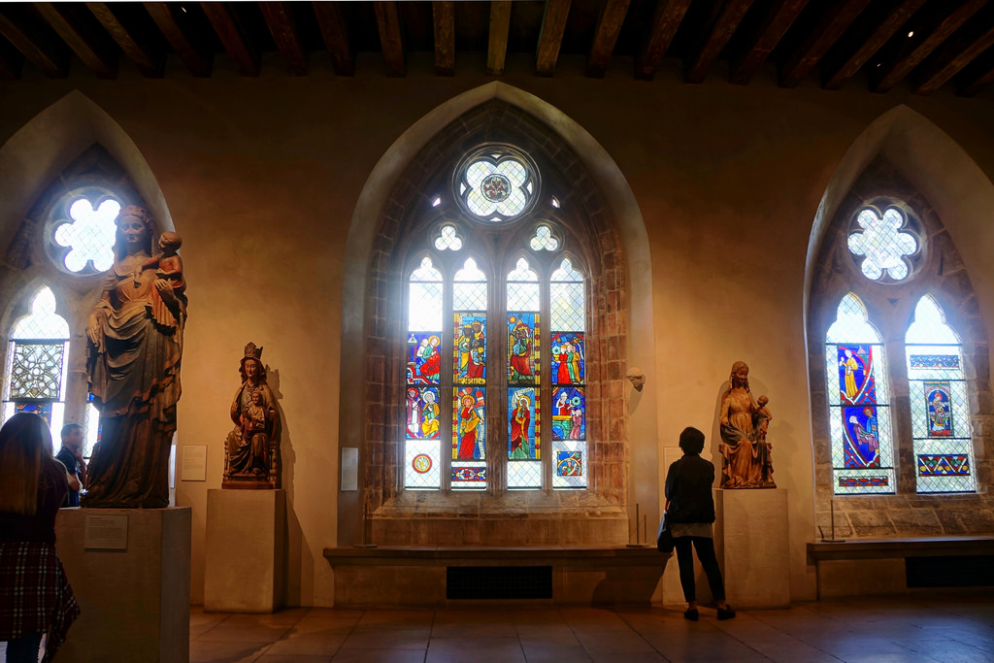
Light and Perception: On View in NYC:
“Early Gothic Hall” at the Cloisters, permanent installation
Notes:
Go see it!

Slide 18
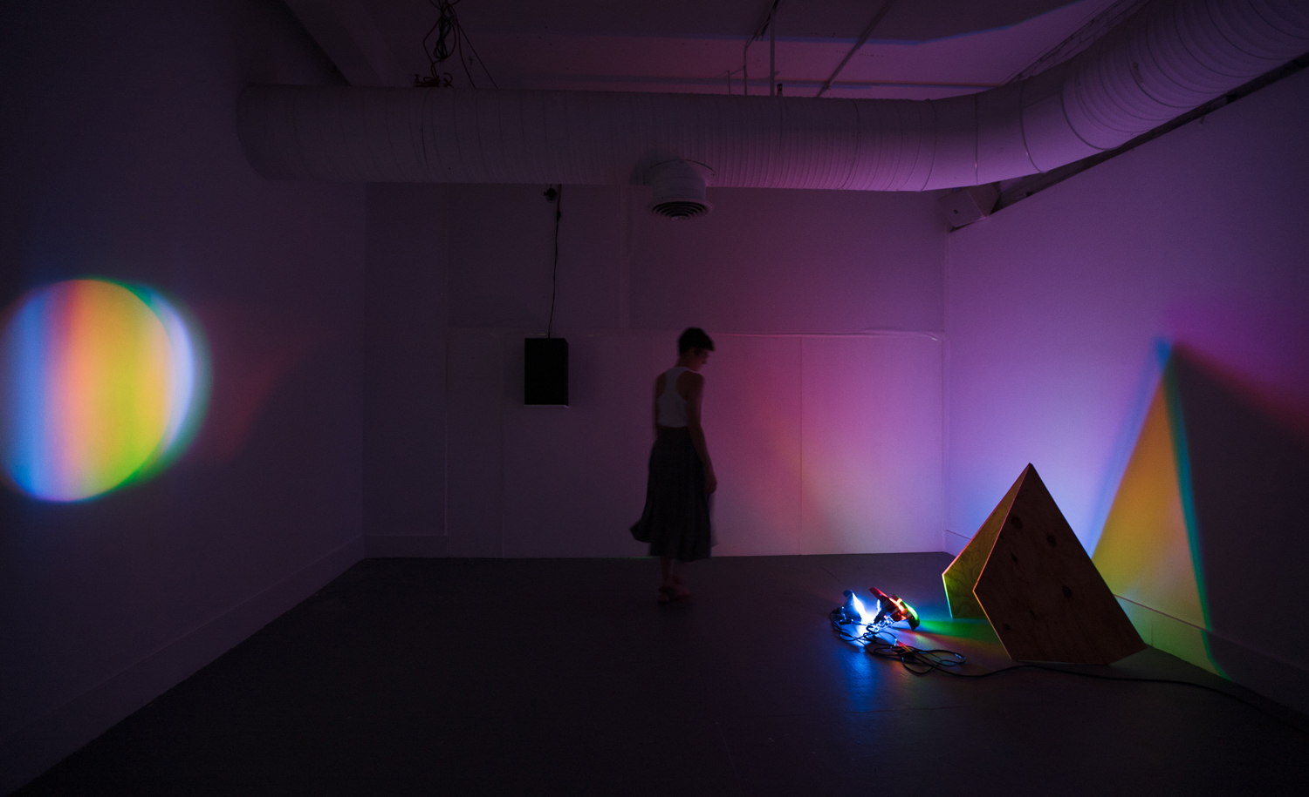
Light and Perception: On View in NYC
Lindsay Packer, Day for Night, Transmitter, Bushwick, just closed on Sunday
Packer, Chaos Theory and Why do we have days and nights?, 2016

Slide 19
Lindsay Packer, artist statement:
“I play with the call and response of color and light, found materials and architecture. My installations are
analog RGB color spaces and luminous, temporary geometries that call into question the divisions
between analog and digital ways of seeing. Like prisms, my installations combine separate colors into
white light and break that light up again into its separate parts. My working process shifts from an
Additive or RGB Color System to a Subtractive or CMYK Color System in prints and photographs that
explore luminosity, transparency, and optical color mixing through dynamic layering of color and form.
In all my work, site, movement, chance, and improvisation determine composition and color.
With a spontaneous spirit and non-hierarchical approach to materials and process, I borrow ordinary
objects like plywood, furniture, and window screens from my installation environments. I activate
these elements temporarily with light, ink, actions, and motors, then return them to their original
contexts when an exhibition ends. This process of assembly and redistribution resets possibilities for
future interactions between material and perception, encouraging viewers to become more aware
of ephemeral manifestations of luminous color and form within their own daily experience.”

Slide 20
Light and Perception: On View in NYC:
Jeanne Liotta, This Immense Space Hidden Things Appear Before Us, Microscope Gallery, Bushwick, until 2/25
“An augmented reality video installation that like Yoko Ono’s 1966 “Sky TV” – to which the work pays homage – brings a live feed of the sky outside into the gallery space. Liotta’s appropriation and use of new technologies allow for her piece, which is projected onto the walls of the gallery, to extend beyond the limits of the visible sky. Video imagery shot in real time by smartphones installed onto the building’s roof are superimposed with computer generated renditions of the actual planets, stars, constellations and other celestial bodies as well as space stations, “junk”, and other known objects in Earth’s orbit.”
Watch short clip of her experimental film, Observando El Cielo (Watching the Sky), 2007

Slide 21
Light and Perception: On View in NYC
Tania Bruguera, Untitled (Havana, 2000), MoMA, until 3/11
Listen to her statement on the MoMA website.

Slide 22
Light and Perception: No Longer on View in NYC
Wang Ningde, Form of Light, Bryce Wolkowitz, Chelsea
Read Ningde’s artist statement on his website

