Slide 1
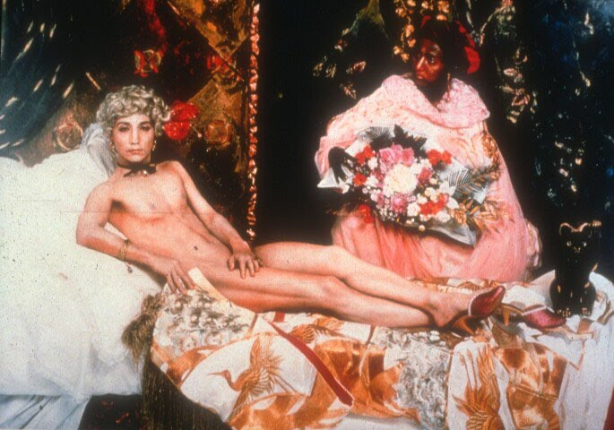
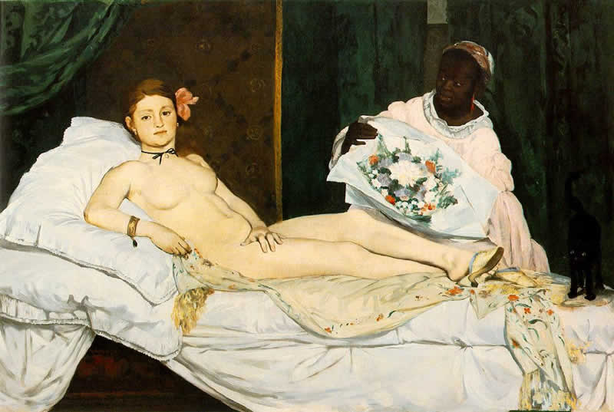
Yasumasa Morimura, Olympia, 1999
Photograph
Edouard Manet, Olympia, 1963
Painting (oil on canvas)
“Throughout history artists have drawn, sculpted and painted the human form. Recent art history, however,
reveals a significant shift in artists’ perceptions of the body, which has been used not simply as the ‘content’ of
the work, but also as canvas, brush, frame and platform. Over the course of the last hundred years artists
and others have interrogated the way in which the body has been depicted and how it has been conceived.
The idea of the physical and mental self as a stable and finite form has gradually eroded, echoing influential
twentieth-century developments in the fields of psychoanalysis, philosophy, anthropology, medicine and science.
Artists have investigated the temporality, contingency and instability of the body, and have explored the notion
that identity is ‘acted-out’ within and beyond cultural boundaries, rather than being an inherent quality. They
have explored the notion of consciousness, reaching to express the self that is invisible, formless and liminal.
They have addressed issues of risk, fear, death, danger and sexuality, at times when the body has been most
threatened by these things…
…Since the 1960s artists using their bodies have explored the constructed visual and linguistic identities of gender,
sexuality and race, offering up these representations as hierarchies of power…
…The body is a fluid signifying system, which in the twentieth century is continuously undergoing challenging
and liberating transformations. The boundaries of the individual shift constantly as the boundaries between
public and private, and the notion of the individual change. The idea of a hermeneutic, essentialist self – what
Amelia Jones refers to as ‘the Cartesian subject’ – is no longer simply accepted.”
- Tracey Warr -

