Slide 1

Home Prices Investment Bank
Case Study
This Photo by Unknown Author is licensed under CC BY

Slide 2
Overview
Let’s have a glance over the baseline situation of the mortgage current data .

Slide 3
Data Analyzed
A total of 1460 home sales from Jan 2006 – July 2010
Data include Overall Condition, Year Built, Total Square Feet
Those data originally come from Kaggle and the raw data is available here.

Slide 4
Problematic
Factors of significant differences that drive house sale prices.

Slide 5
How to allocate dollars earmarked for investment into mortgage-backed securities?
We will analyze how to boost the house prices from 3 different strategies:

Slide 6
Strategy # 1
Considering the year built and the year remodeling added
Statistically significant difference between year built and year remod add:
With 95% confidence, the average sale is on a scale base 1100 and 1230 higher for houses remod add
For the 1460 in our sample, this translates to a possible lift from $135,000 to $143,000.

Slide 7
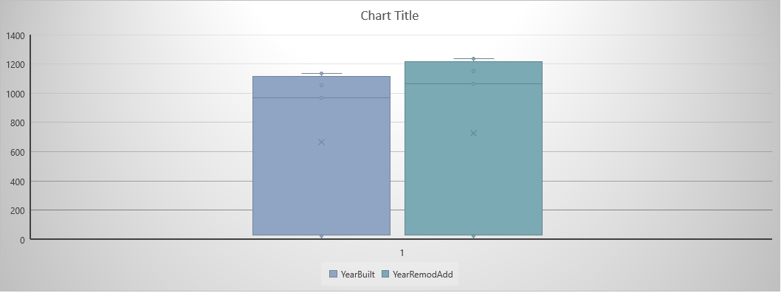
Visual 1

Slide 8
Strategy # 2
Considering the OverAll Qual and the OverAll Condition
Statistically significant difference between OverAll Qual and OverAll Cond:
With 95% confidence, the average sale is on a scale base 8100 and 10300 higher for OverAll Cond
For the 1418 sales in our sample, this translates to a possible lift of between $120,000 to $188,000.

Slide 9
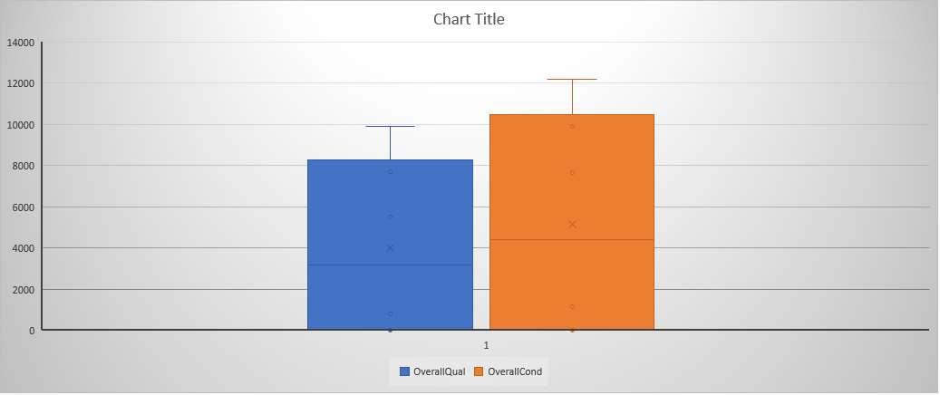
Visual 2

Slide 10
Strategy #3
Considering the 1stFlrSF and 2ndFlrSF
Statistically significant difference between 1stFlrSF and 2ndFlrSF :
With 95% confidence, the average sale is on a scale of 100 and 117 higher for houses with larger 1stFlrSF
For the 1281 in our sample, this translates to a possible lift of between $185, 000 and $225,000.

Slide 11
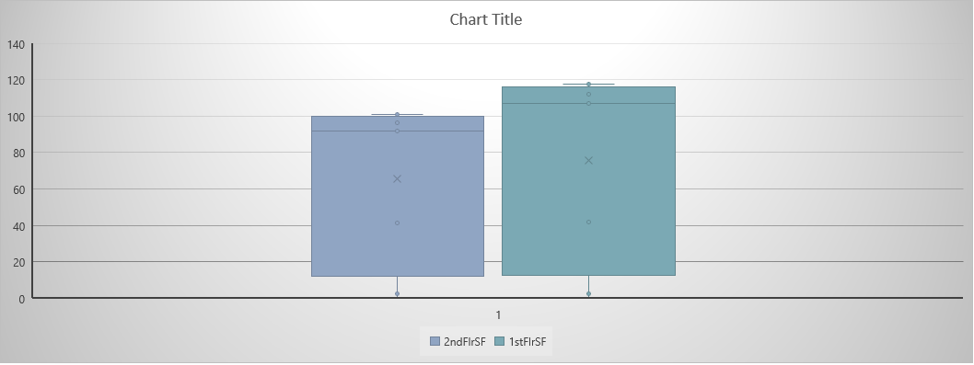
Visual 3

Slide 12
Recommendation
I would recommend that we adopt that the investment being done by the bank focus on the year remod add, the OverAll Cond and houses with greater 1stFlrSF.

Slide 13

THANK YOU

