Slide 1

Travelling Salesman Problem | Local Search
by Nicolas Nemeth
UE Computational Optimisation WS21

Slide 2
Table of Content
Introduction
Algorithm overview
Analysis
December 9, 2021
Nicolas Nemeth

Slide 3
I. Introduction
Hardware: Intel Core i5-1135G7 CPU @ 2.40GHz, 16 GB RAM
Problem: Find the shortest path visiting all nodes once and return to the start
Algorithm: Variable Neighbourhood Search with R-opt improvement heuristic
Programming language: Python
December 9, 2021
Nicolas Nemeth

Slide 4
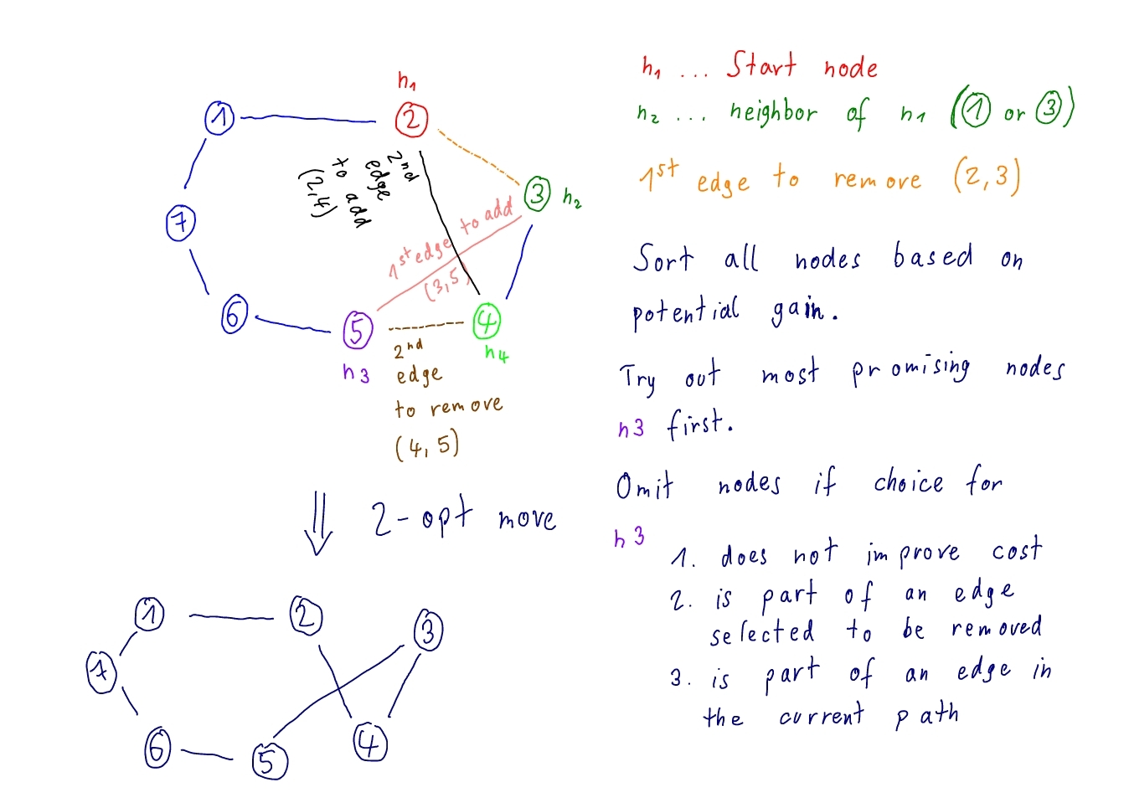
II. Algorithm overview
December 9, 2021
Nicolas Nemeth

Slide 5
II. Algorithm overview
→ look at the source code
December 9, 2021
Nicolas Nemeth

Slide 6
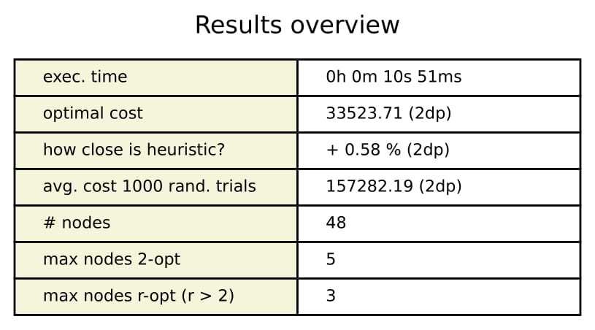
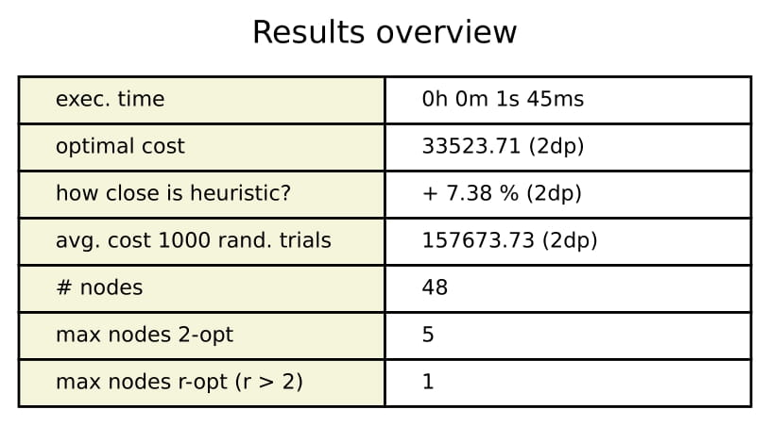
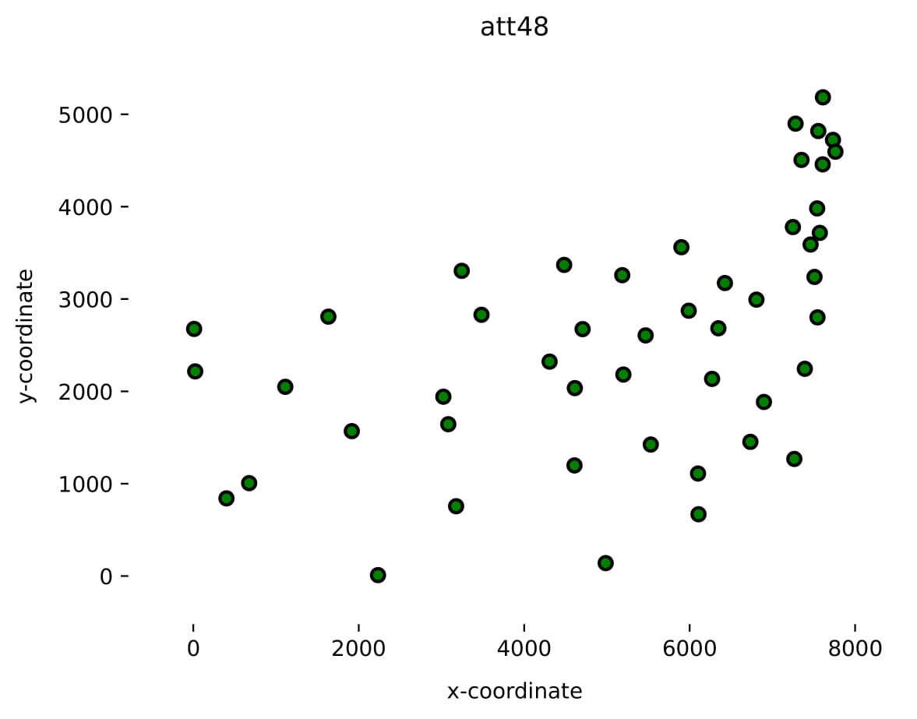
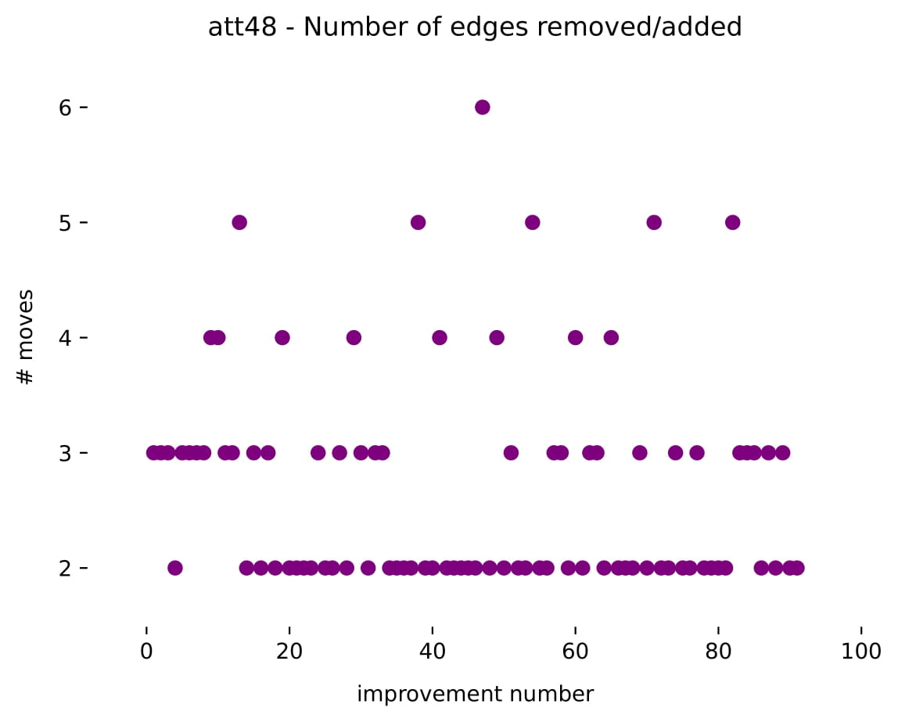
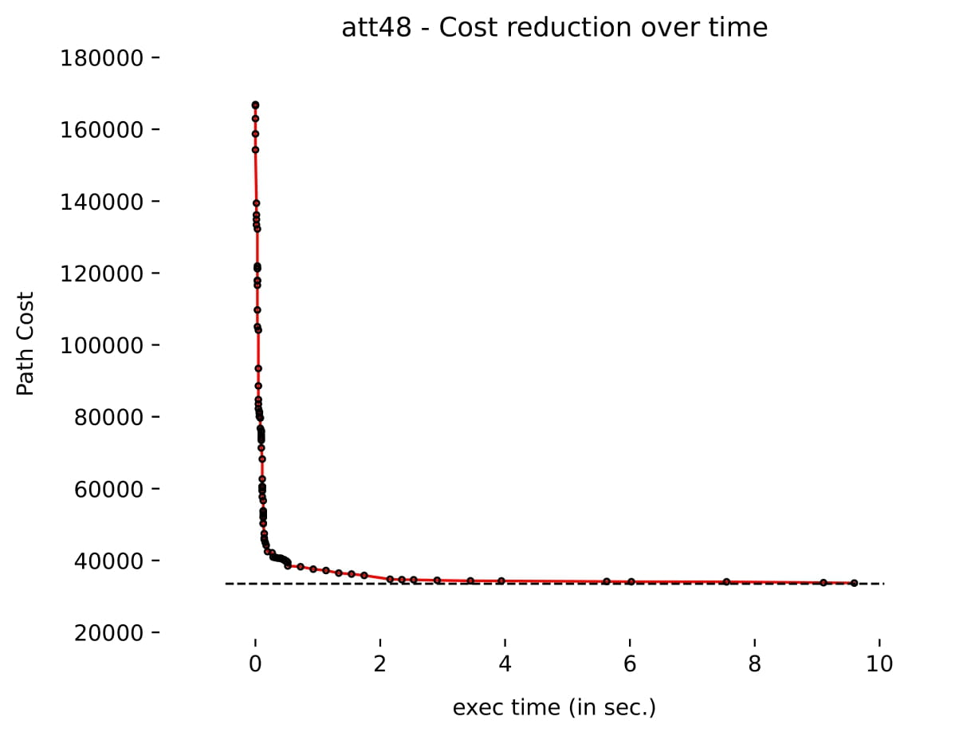
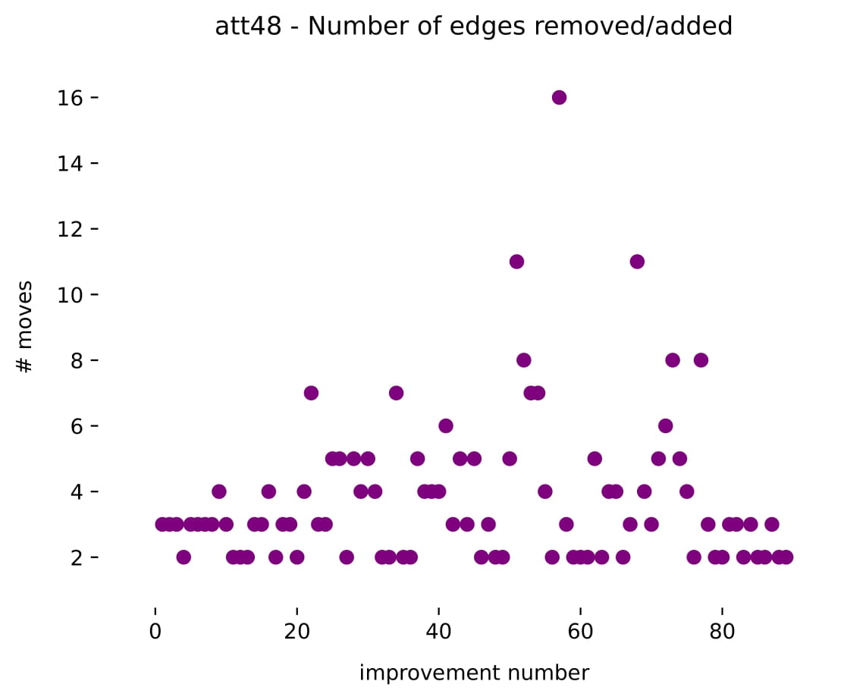
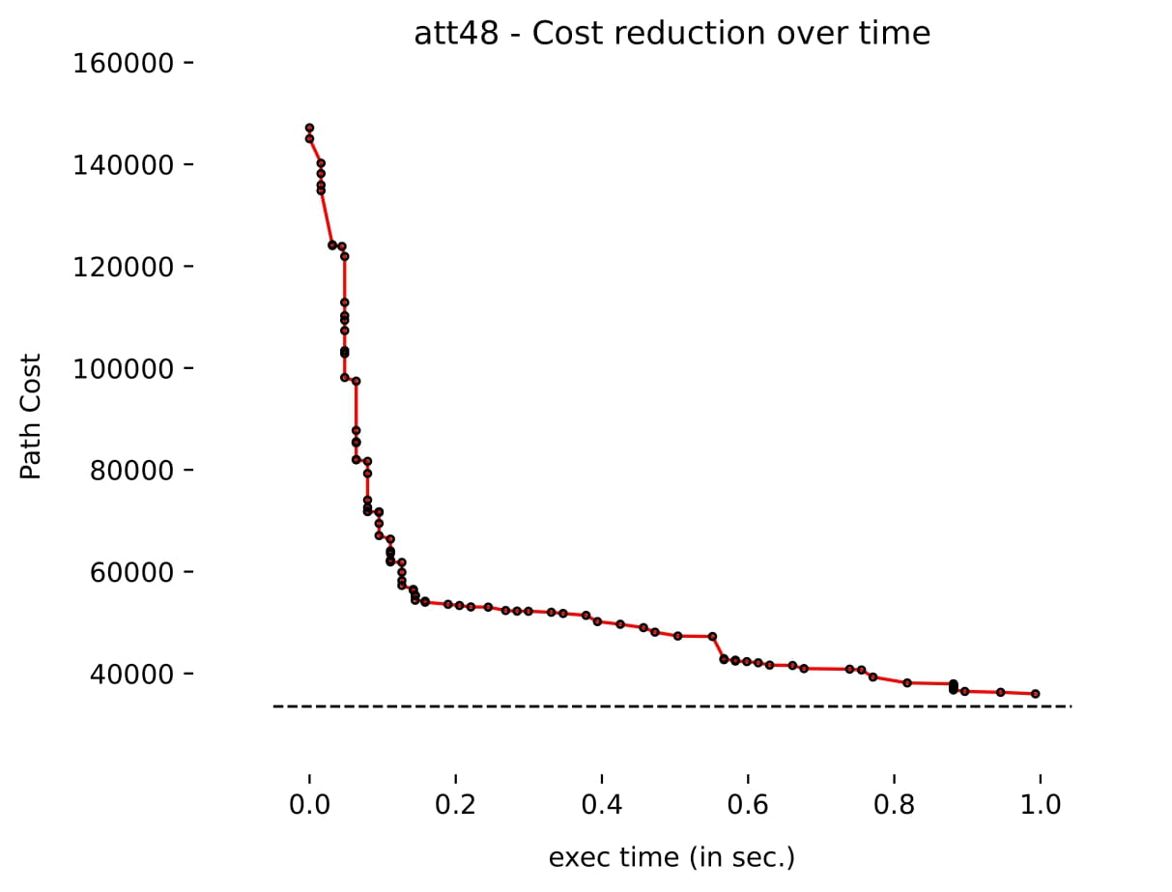
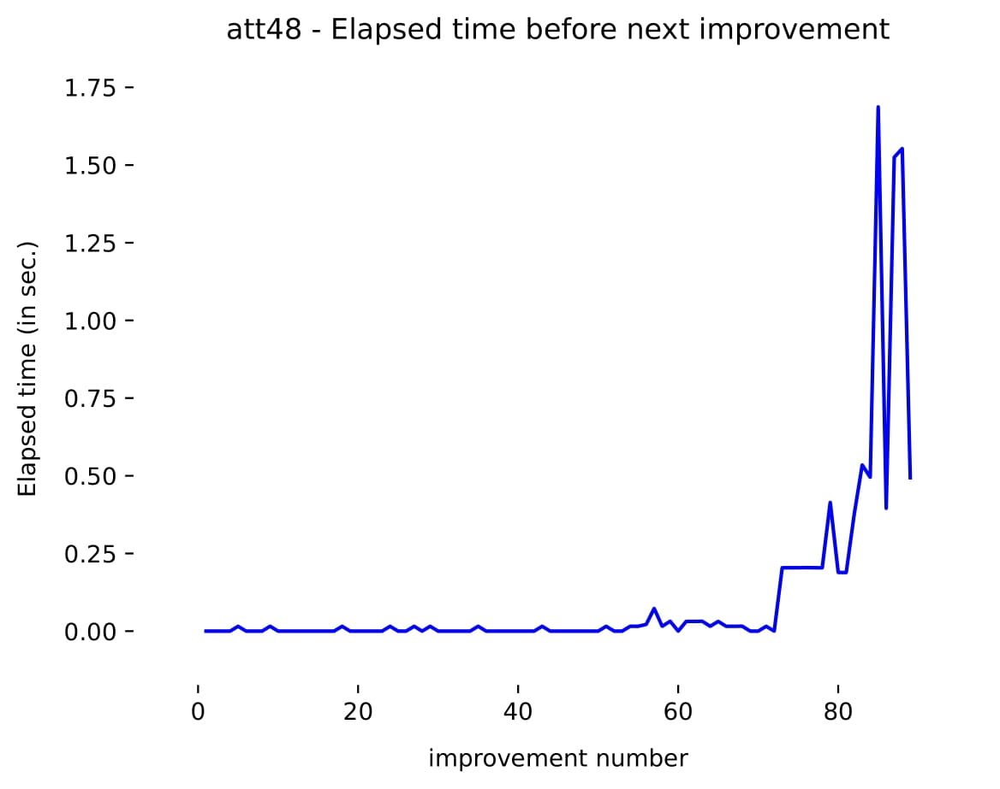
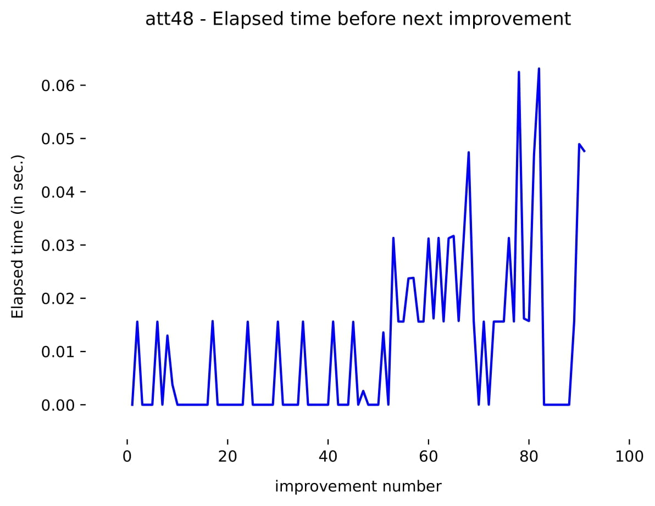
III. Analysis
December 9, 2021
Nicolas Nemeth

Slide 7
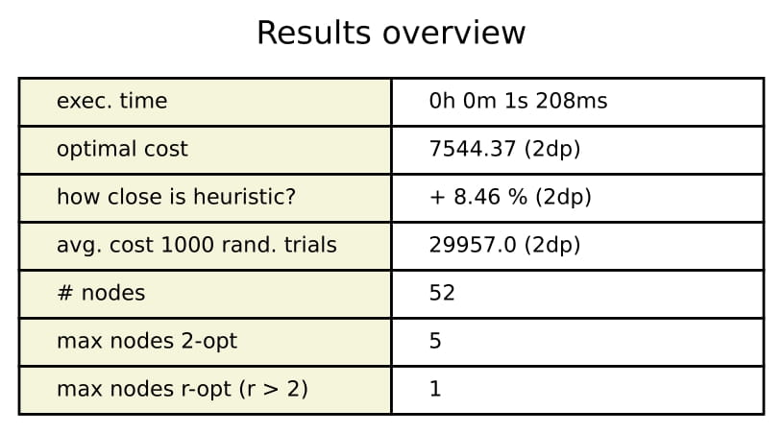

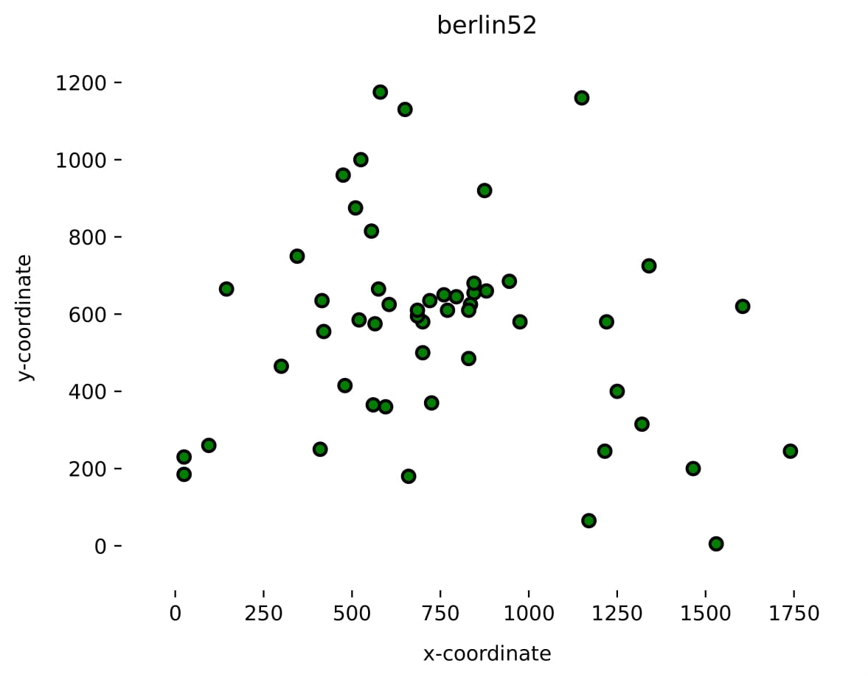
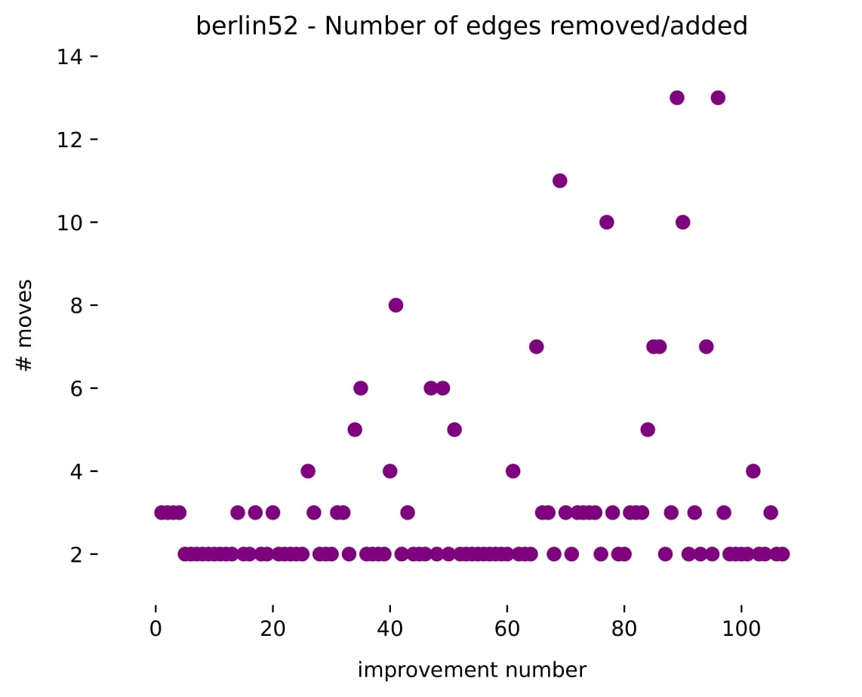
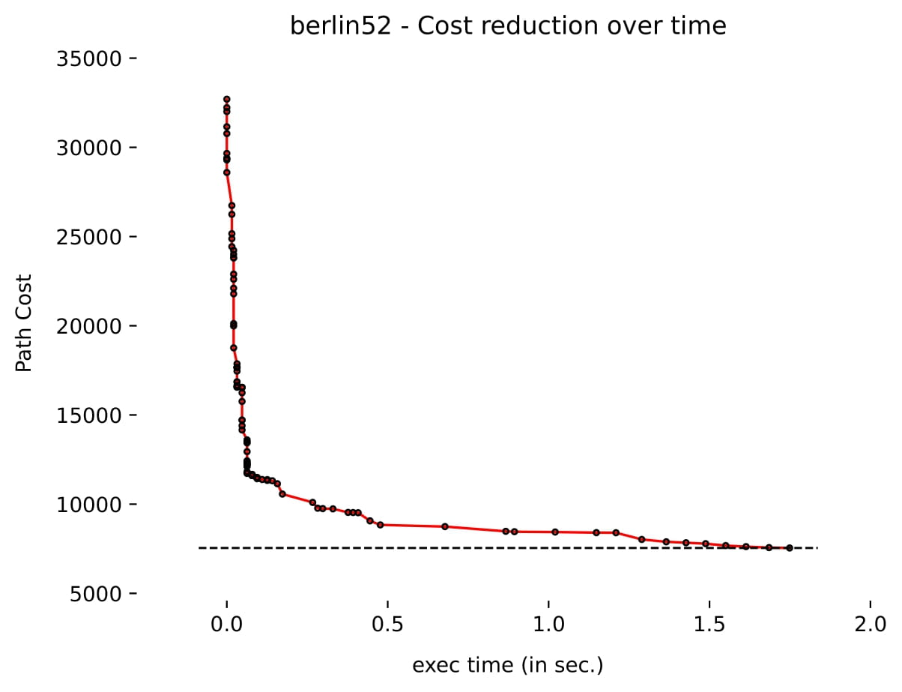
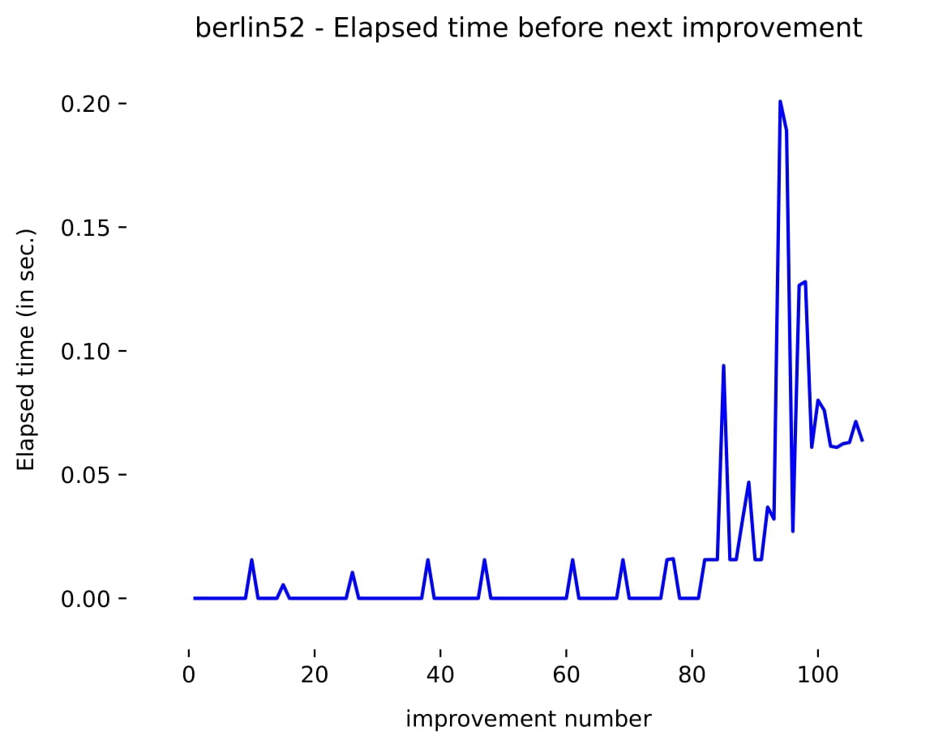
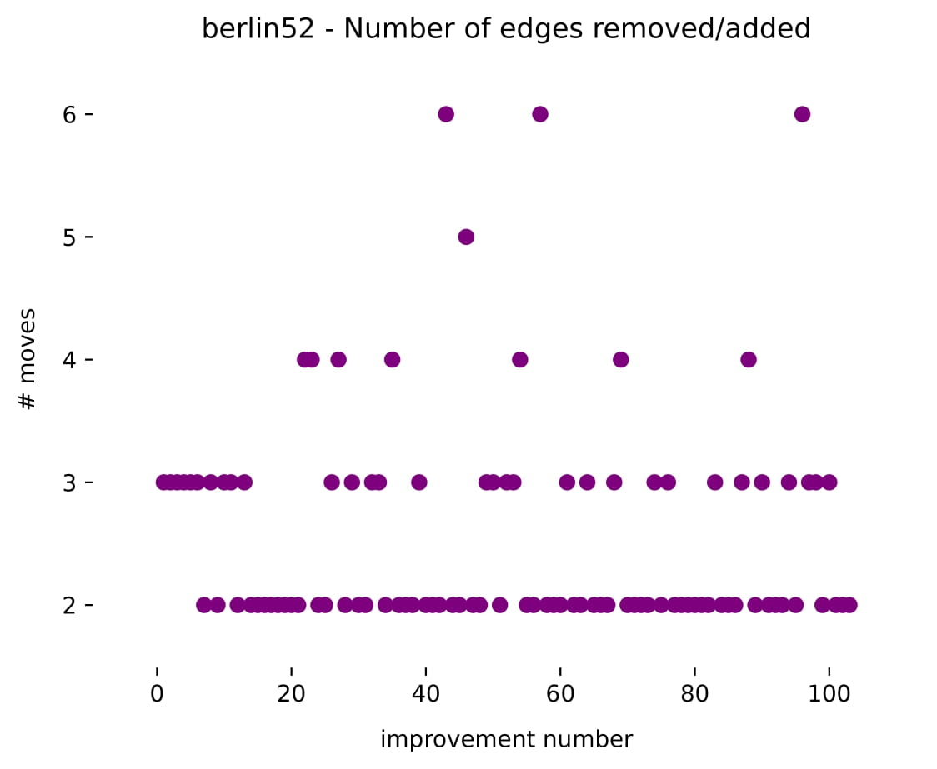
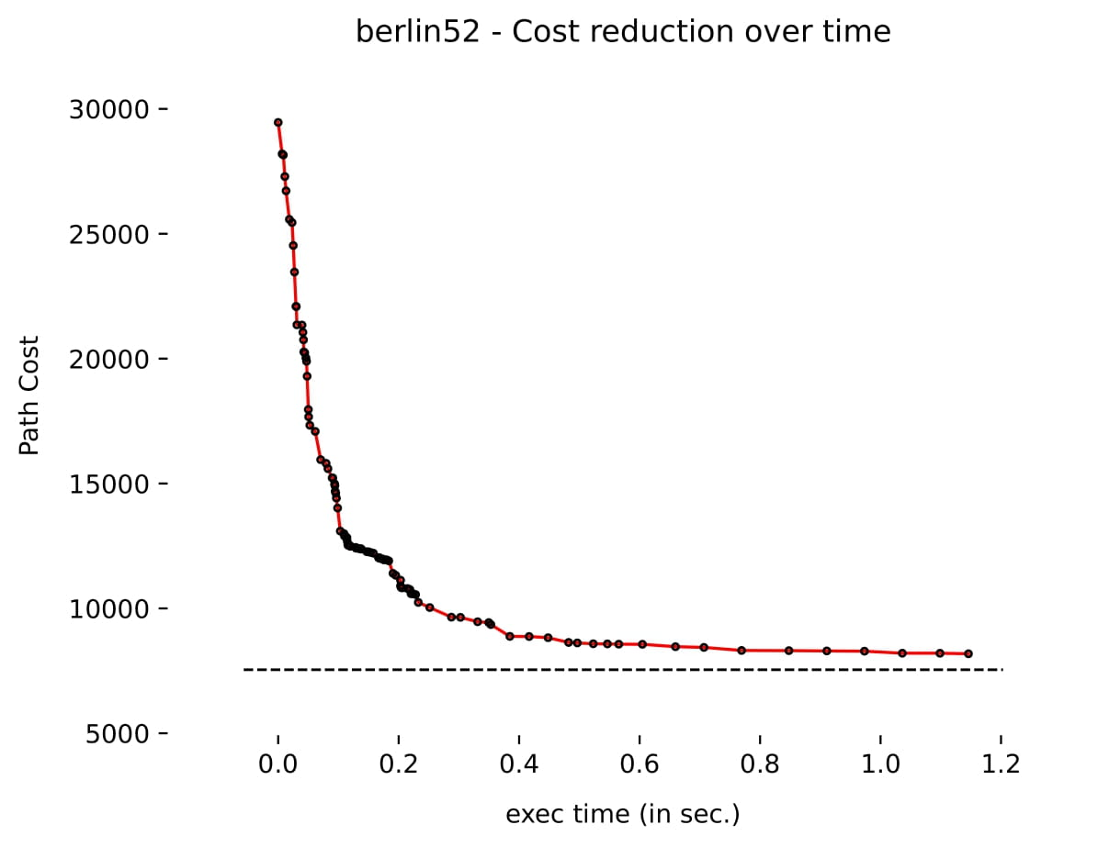
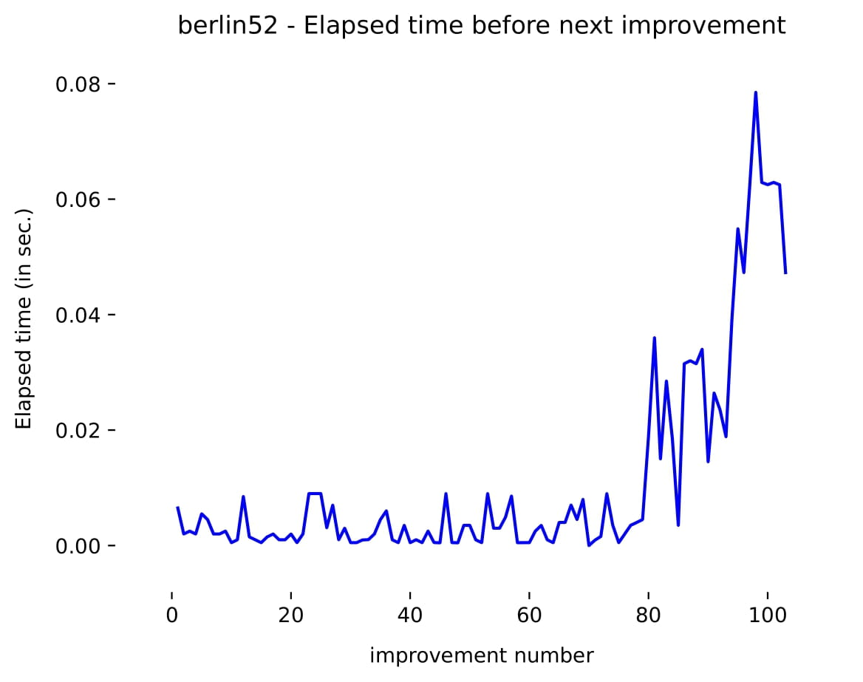
III. Analysis
December 9, 2021
Nicolas Nemeth

Slide 8

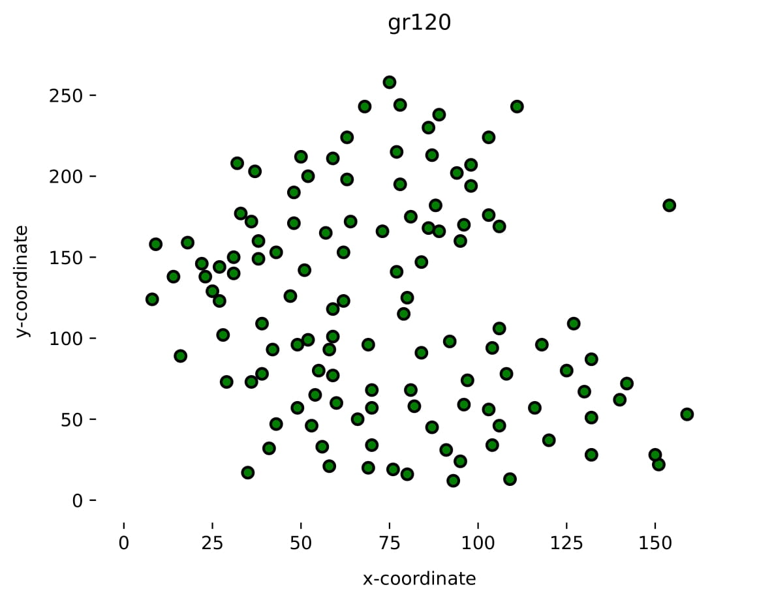

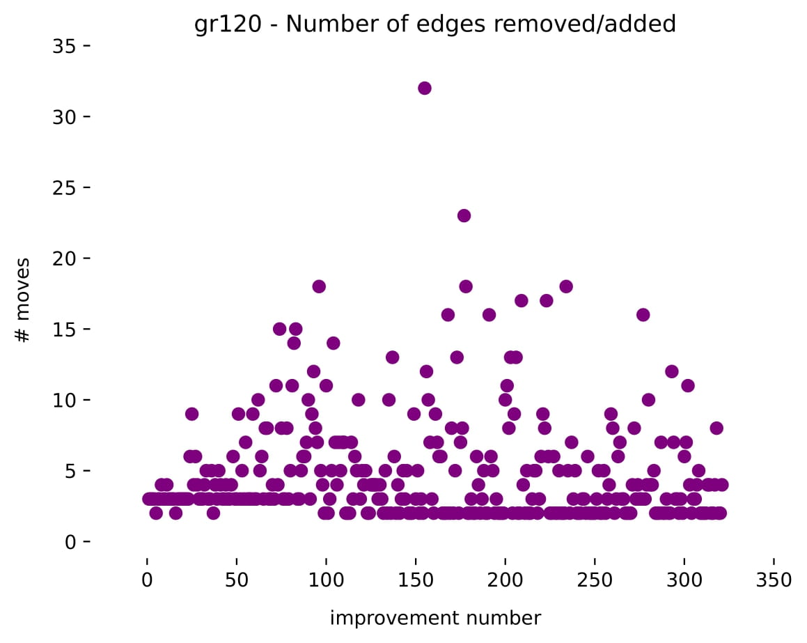
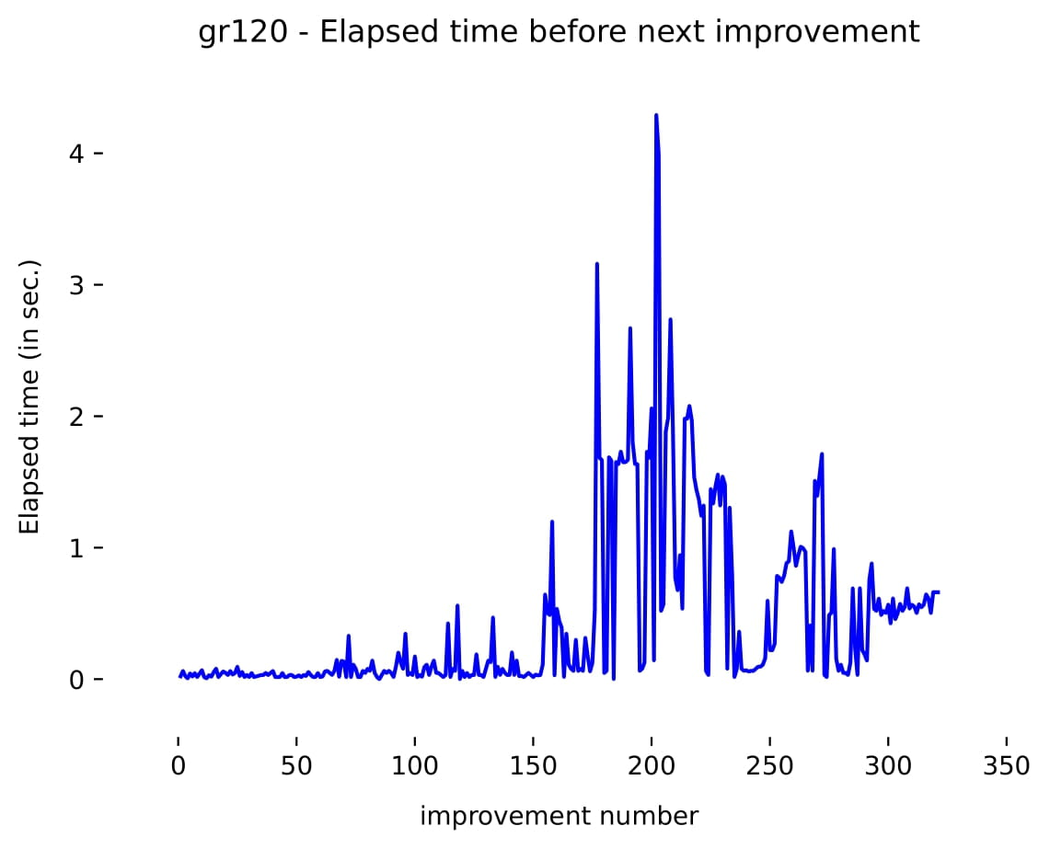
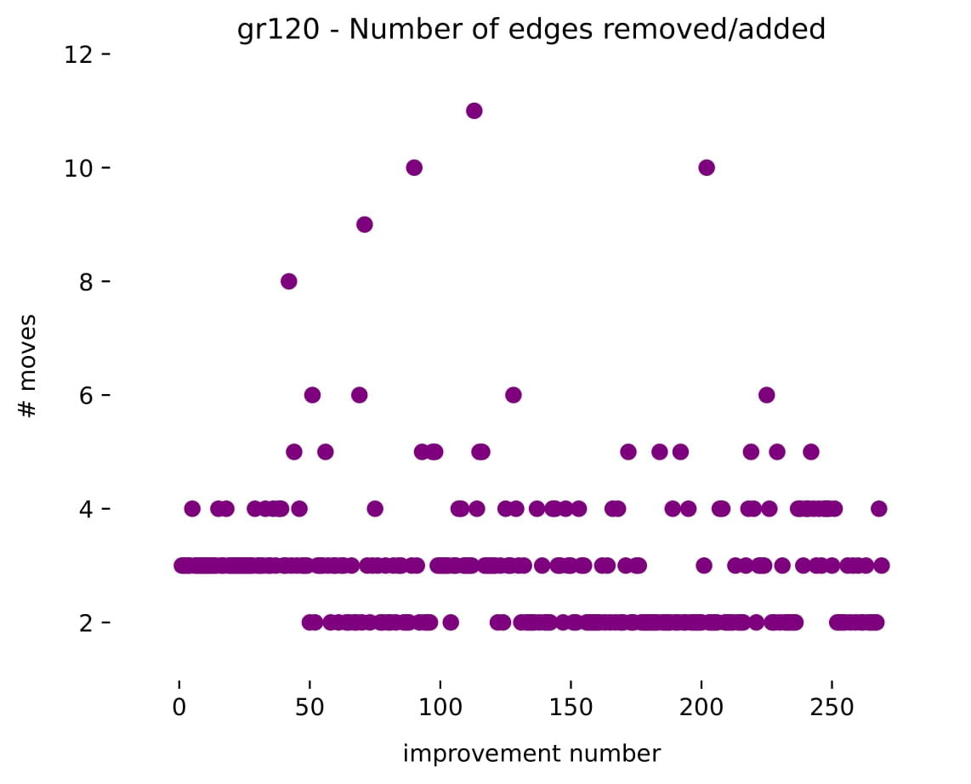
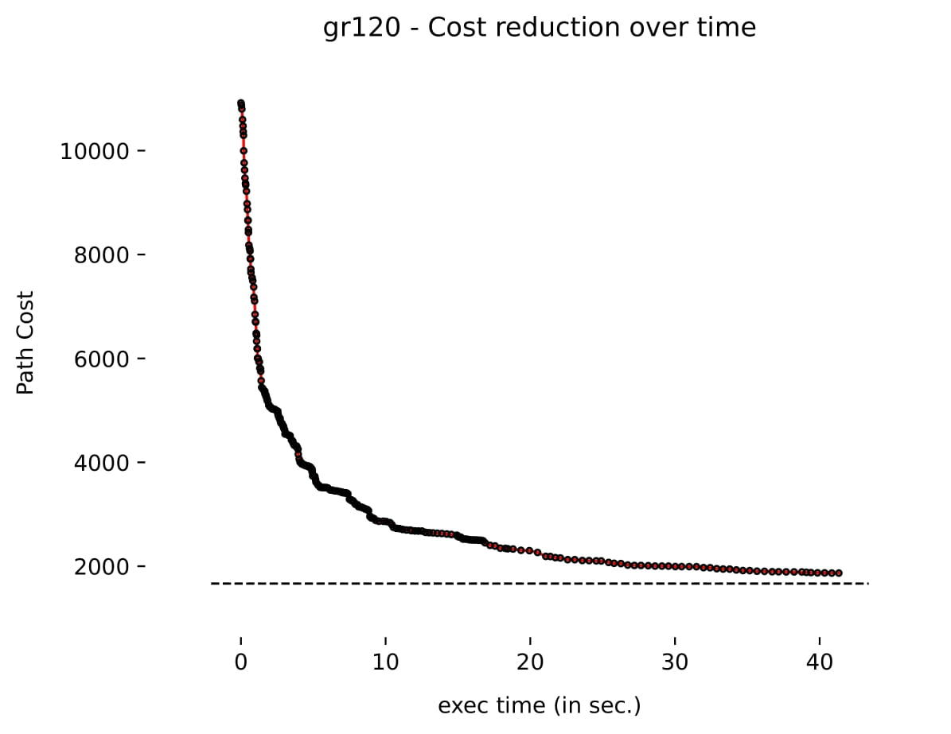
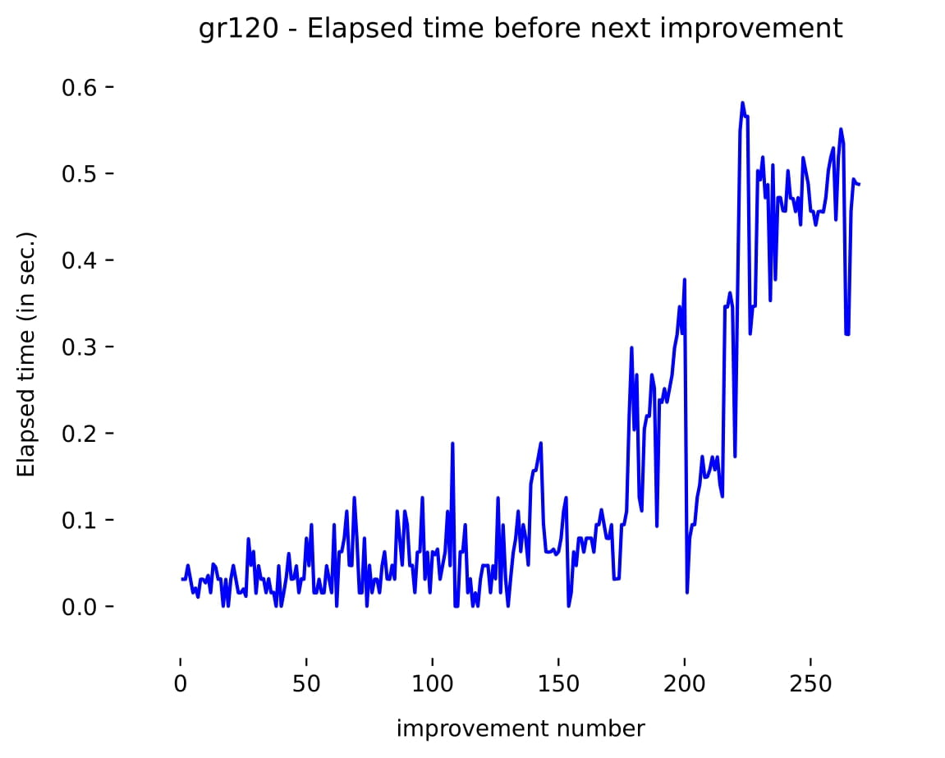
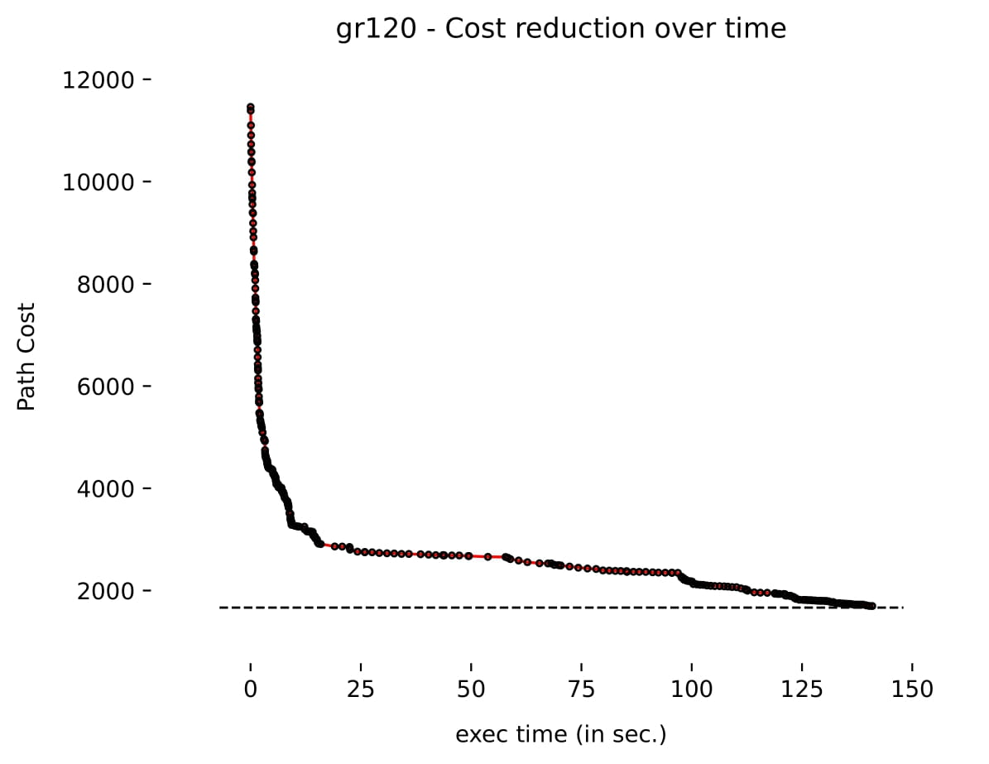
III. Analysis
December 9, 2021
Nicolas Nemeth

Slide 9

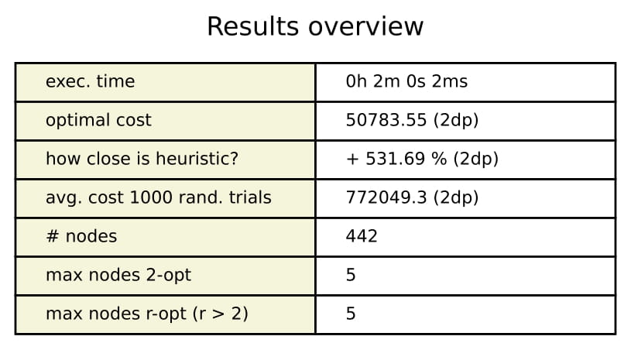
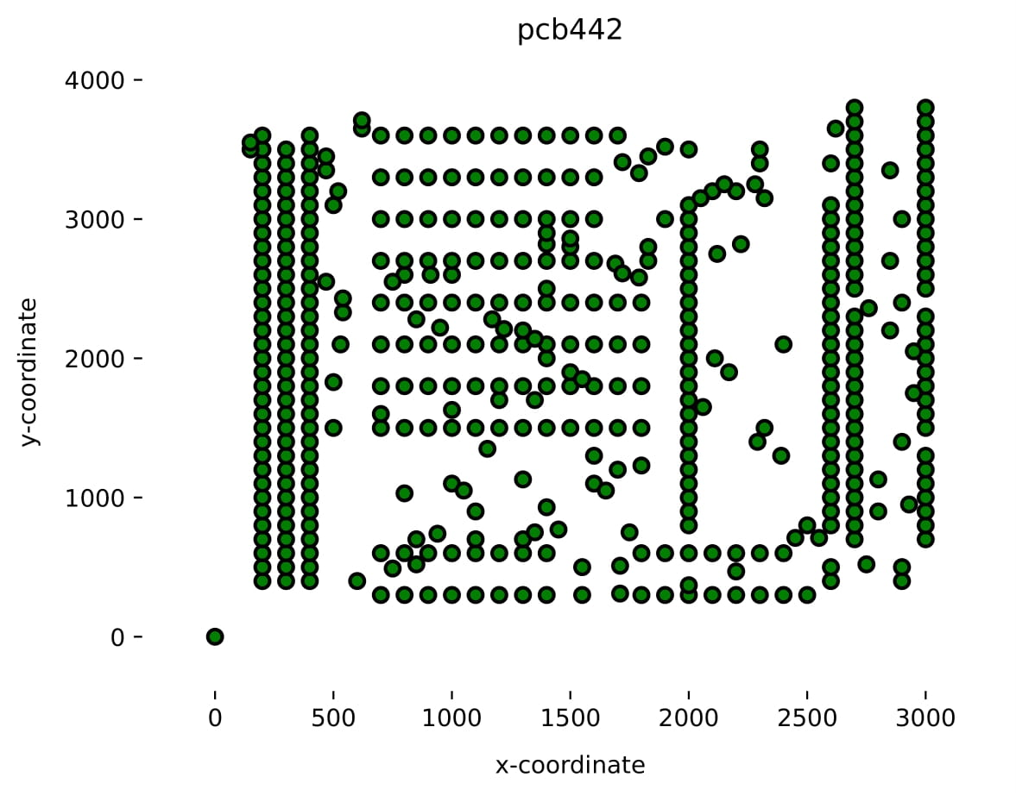
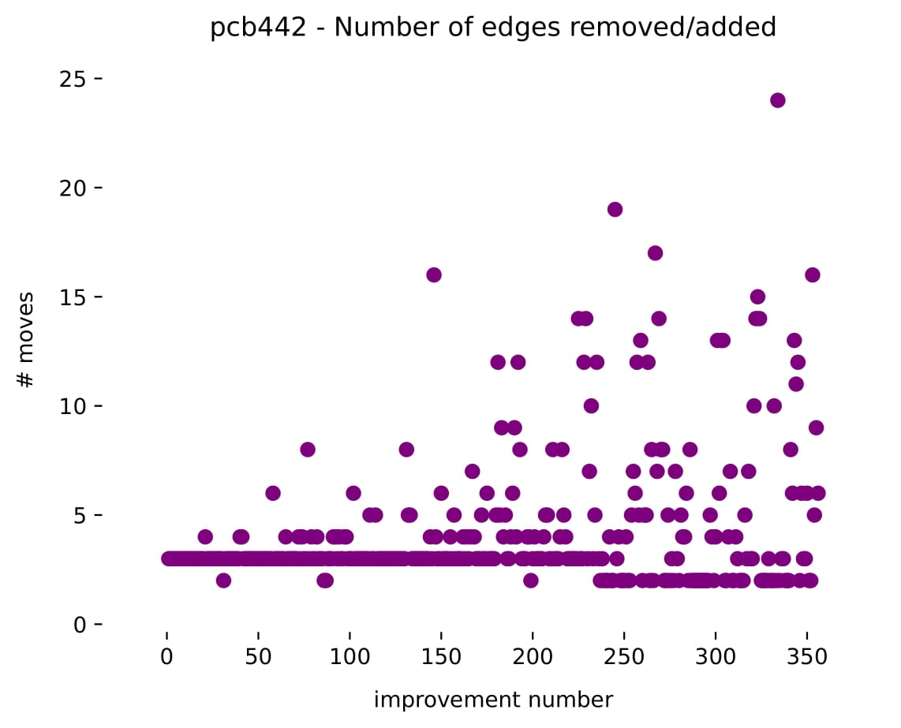
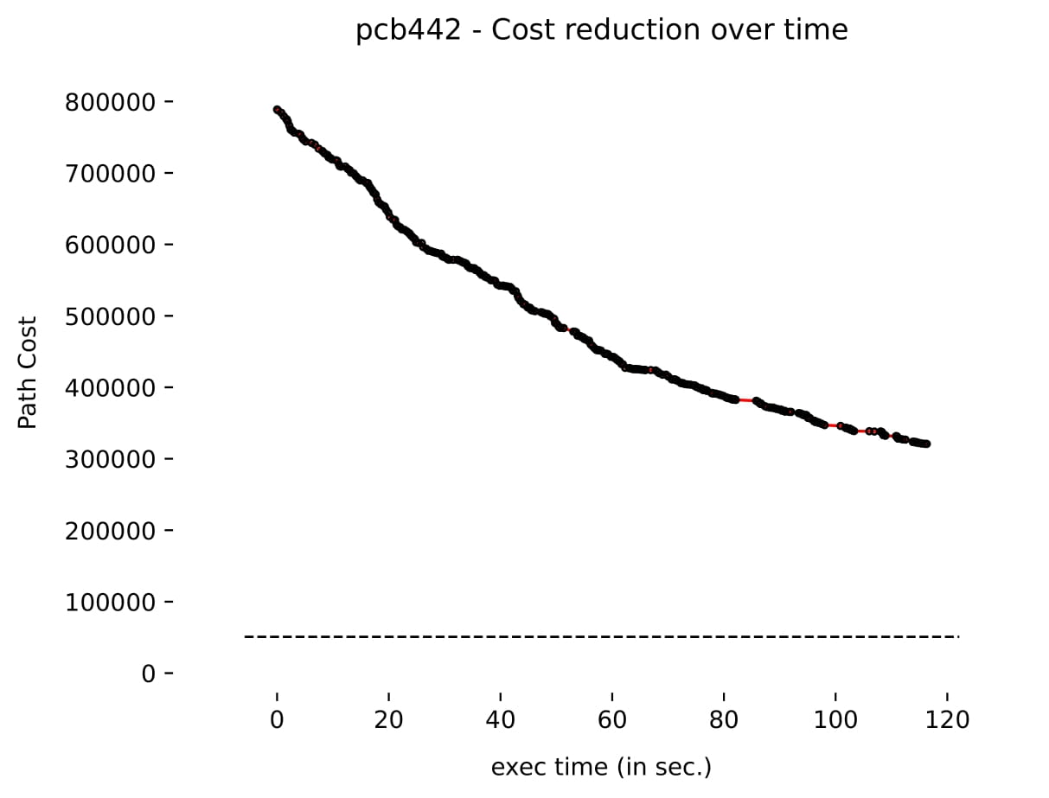
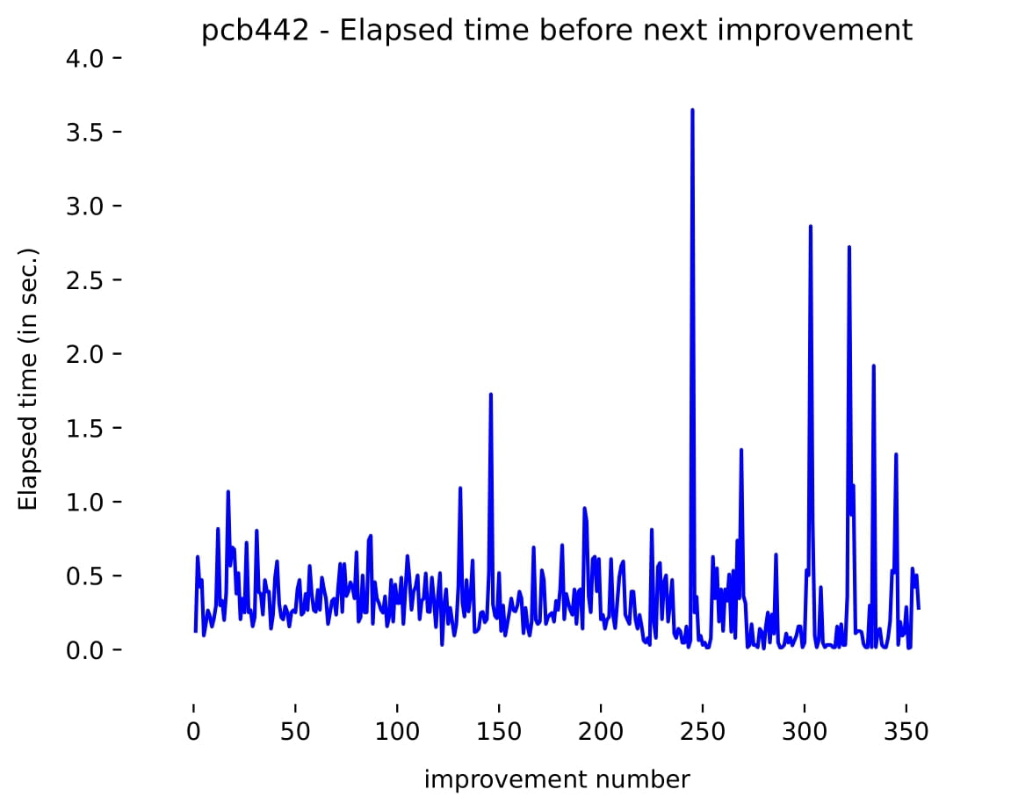
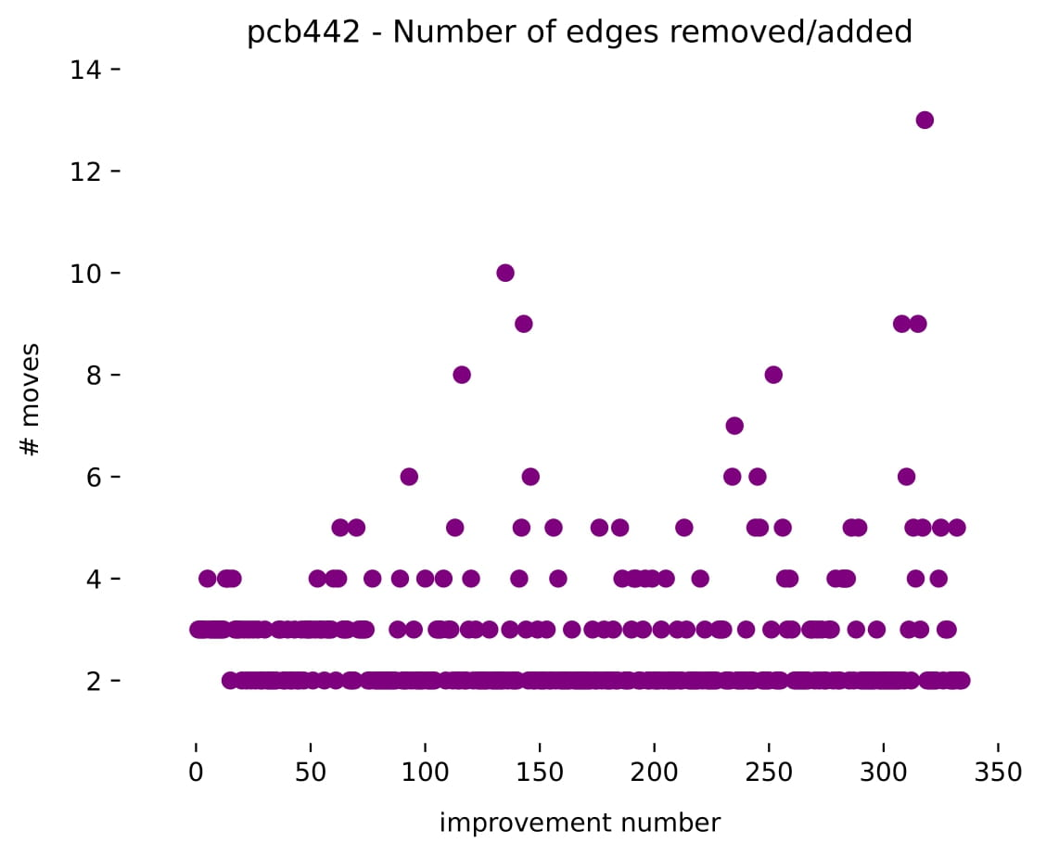
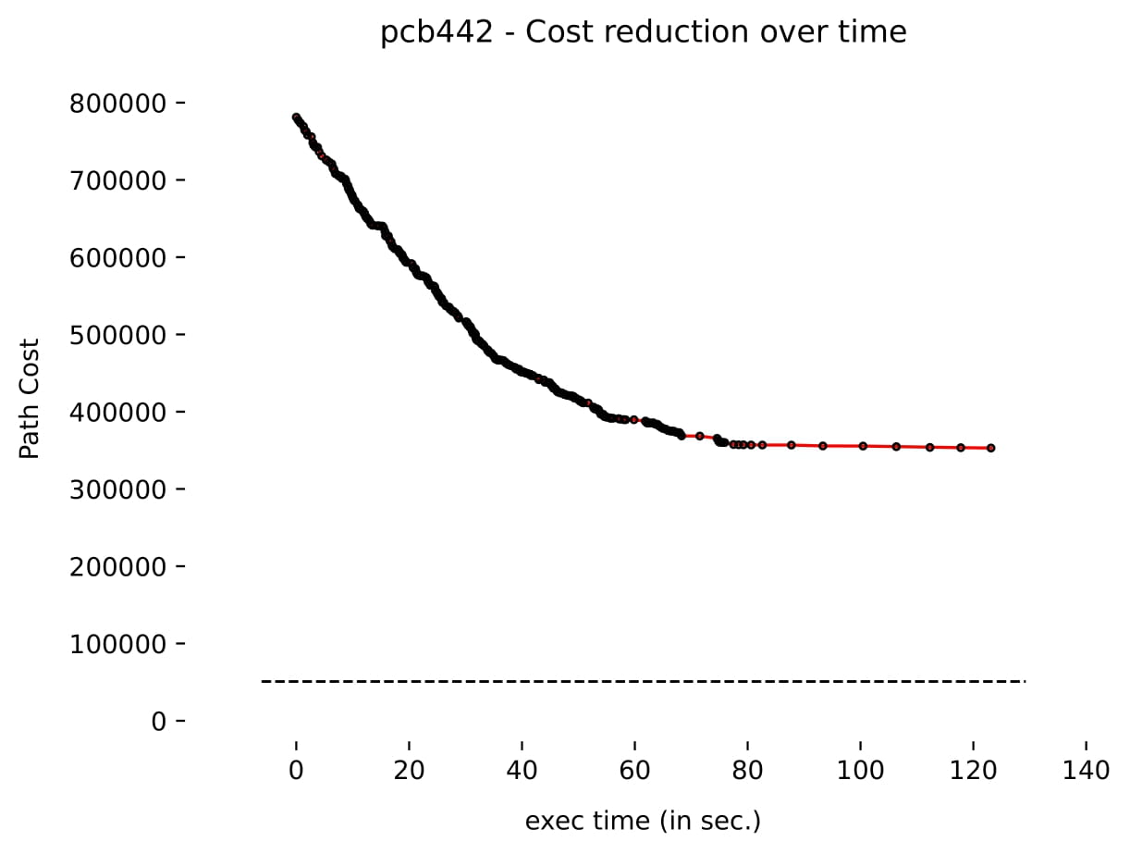
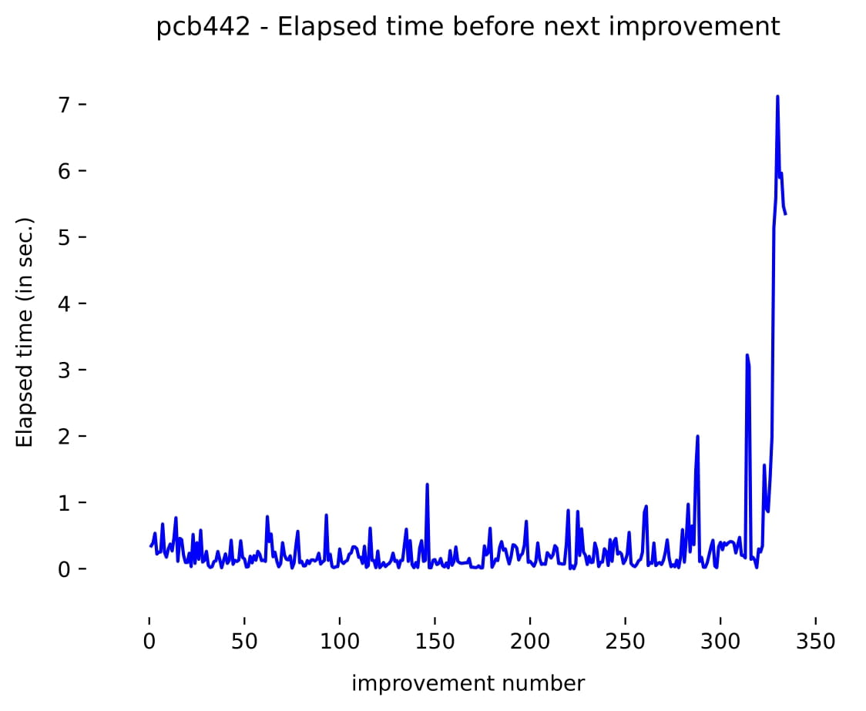
III. Analysis
December 9, 2021
Nicolas Nemeth

Slide 10
Thank you for your attention!
☺
December 9, 2021
Nicolas Nemeth

Slide 11
Sources:
image slide 1: https://cs.uef.fi/~radum/lamad/old/autumn_2018/projects/Final/TSP/2/app/startPage.html
December 9, 2021
Nicolas Nemeth

