Slide 1
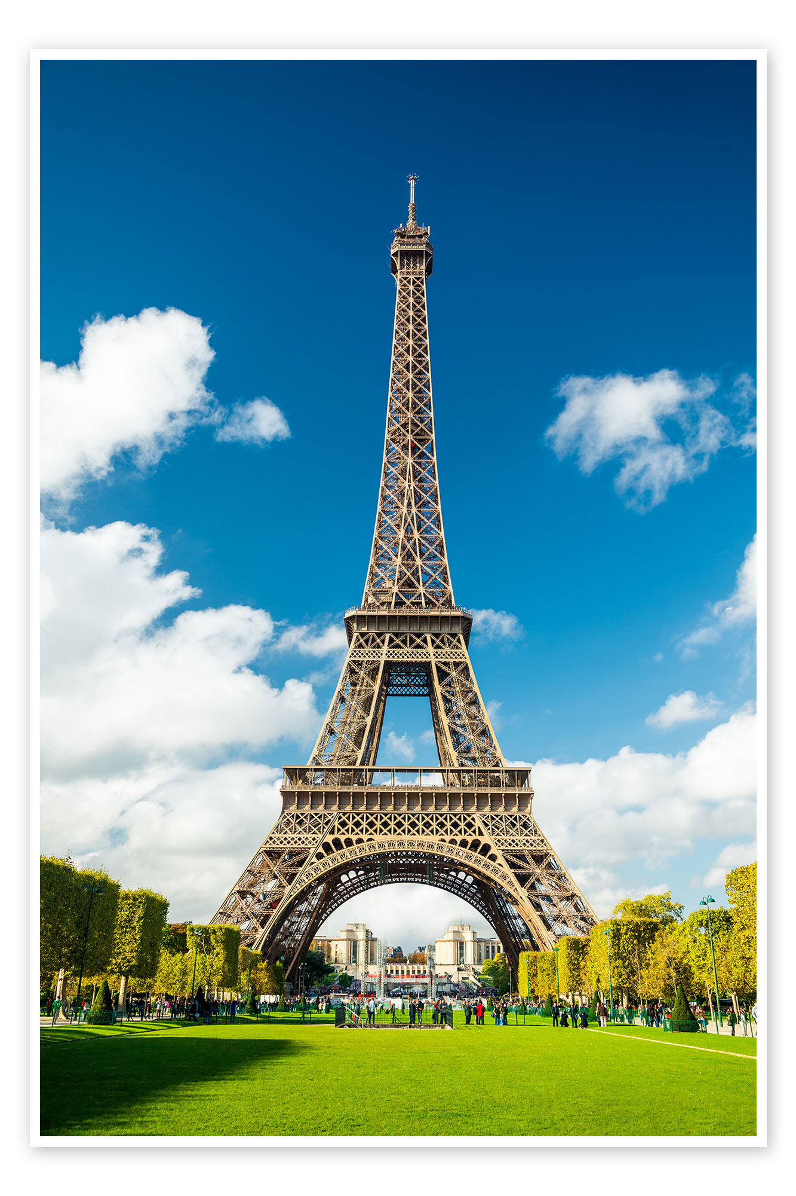
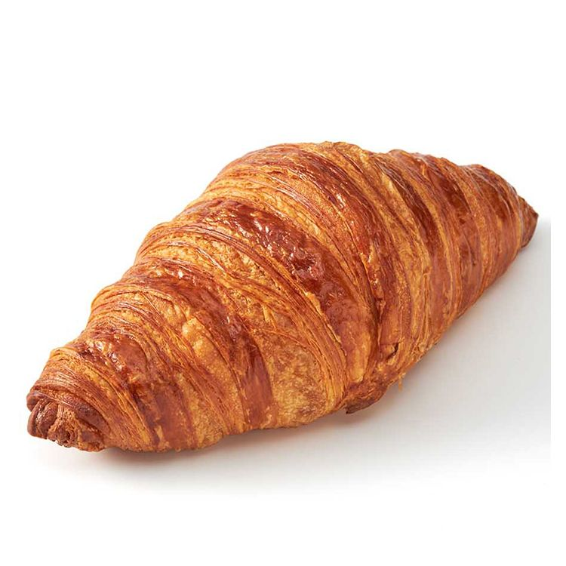

Detecting the level difficulty of French texts
Data Science and Machine Learning Project
HEC Lausanne
Team Neuchâtel
by Francisco Díaz and Nicolas Roques

Slide 2

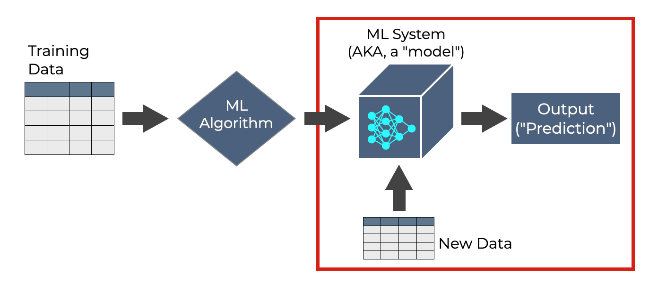
Summary
Problematic
Applications
Outline what the project covers
Presentation of our Streamlit application
Conclusion

Slide 3

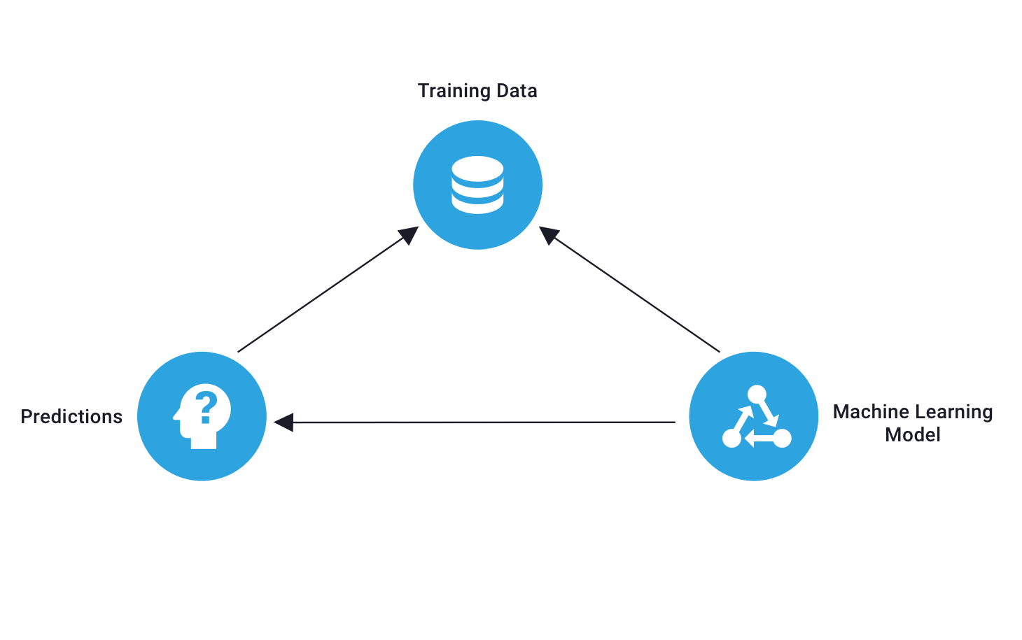
Data overview
Competition
« Detecting the difficulty level of French texts »
Training data
Predictions on unlabelled test data
Machine Learning Model

Slide 4
Model Exploration
Models Tested
Comparison Criteria

Slide 5
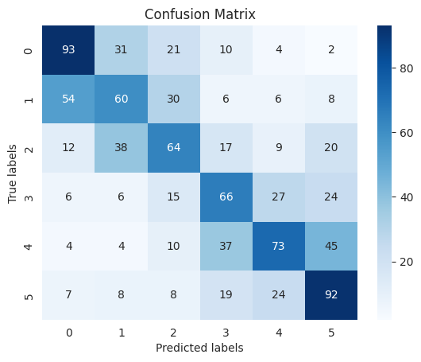
Models’ presentation
Logistic Regression
Precision | 0.4645
Recall | 0.4677
F1-score | 0.4640
Accuracy | 0.4667

Slide 6
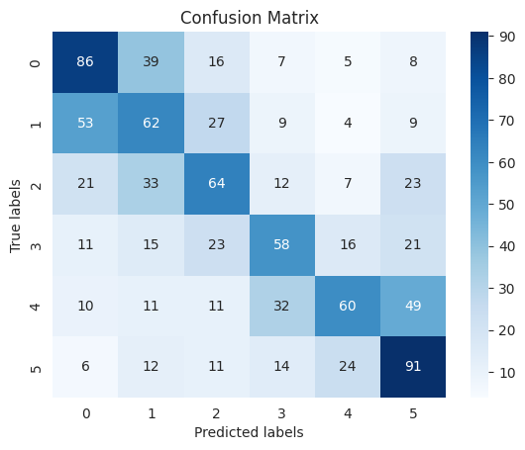
Models’ presentation
Logistic Regression with data cleaning
Precision | 0.4418
Recall | 0.4396
F1-score | 0.4360
Accuracy | 0.4385

Slide 7
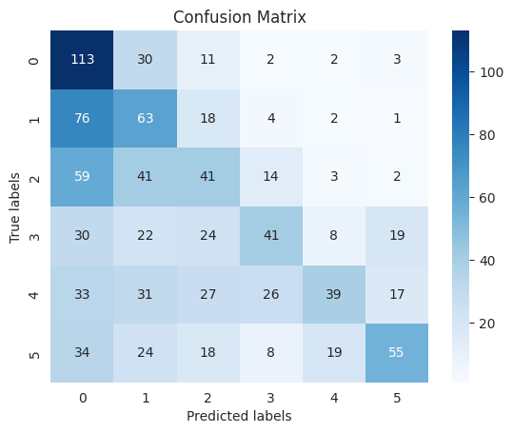
Models’ presentation
k-Nearest Neighbors (kNN)
Precision | 0.4021
Recall | 0.3194
F1-score | 0.3029
Accuracy | 0.3198

Slide 8
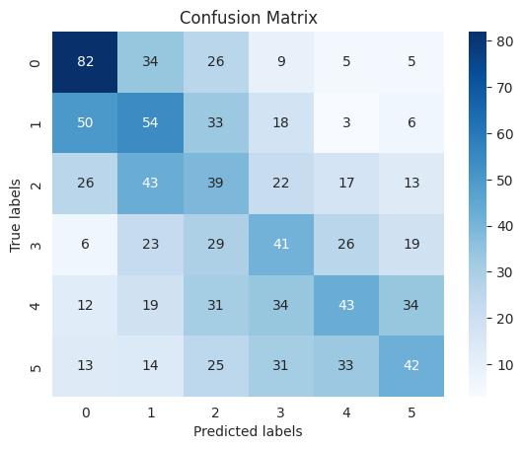
Models’ presentation
Decision Tree
Precision | 0.3066
Recall | 0.3060
F1-score | 0.3033
Accuracy | 0.3063

Slide 9
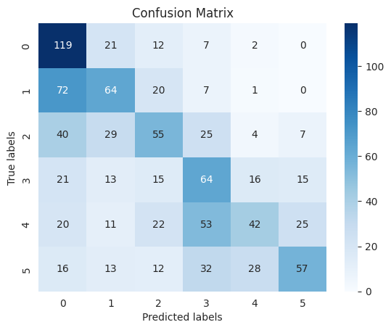
Models’ presentation
Random Forest
Precision | 0.4303
Recall | 0.4202
F1-score | 0.4074
Accuracy | 0.4177

Slide 10
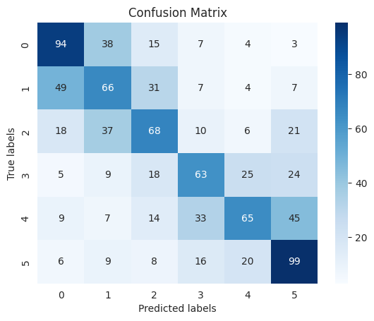
Models’ presentation
Ridge Regression
Precision | 0.4739
Recall | 0.4752
F1-score | 0.4709
Accuracy | 0.4740

Slide 11
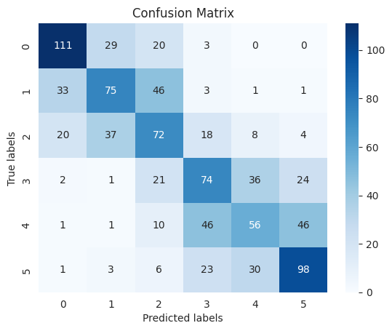
Models’ presentation
SVC (Support Vector Classifier)
Precision | 0.5038
Recall | 0.5054
F1-score | 0.5035
Accuracy | 0.5062

Slide 12
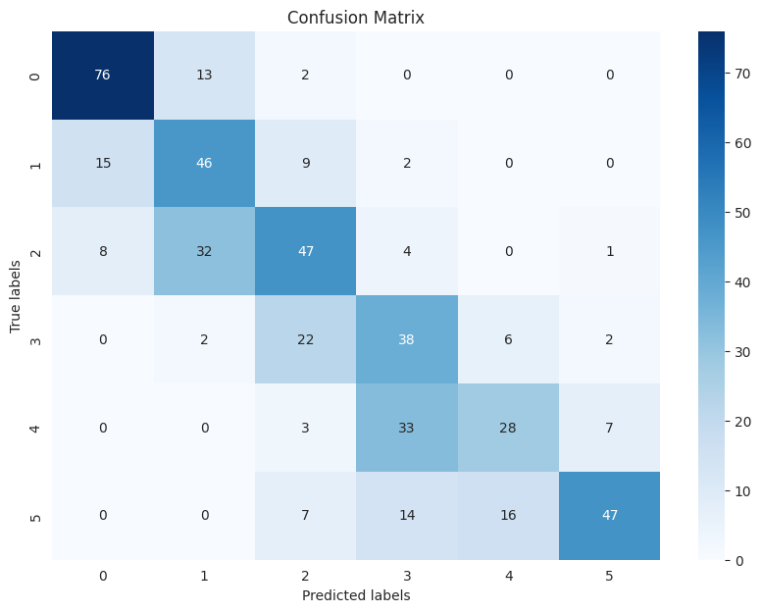
Models’ presentation
CamemBERT
Best performing model:
Precision | 0.6079
Recall | 0.5875
F1-score | 0.5941
Accuracy | 0.5883

Slide 13
Evaluation metrics summary
 | Logistic regression | kNN | Decision Tree | Random Forests
Precision | 0.4645 | 0.4021 | 0.3066 | 0.4303
Recall | 0.4677 | 0.3194 | 0.3060 | 0.4202
F1-score | 0.4640 | 0.3029 | 0.3033 | 0.4074
Accuracy | 0.4667 | 0.3198 | 0.3063 | 0.4177
 | Logistic regression with data cleaning | Ridge regression | Word embedding with SVC | CamemBERT
Precision | 0.4418 | 0.4739 | 0.5038 | 0.6079
Recall | 0.4396 | 0.4752 | 0.5054 | 0.5875
F1-score | 0.4360 | 0.4709 | 0.5035 | 0.5941
Accuracy | 0.4385 | 0.4740 | 0.5062 | 0.5883

Slide 14
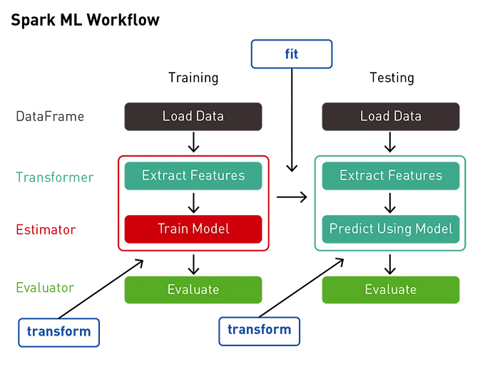
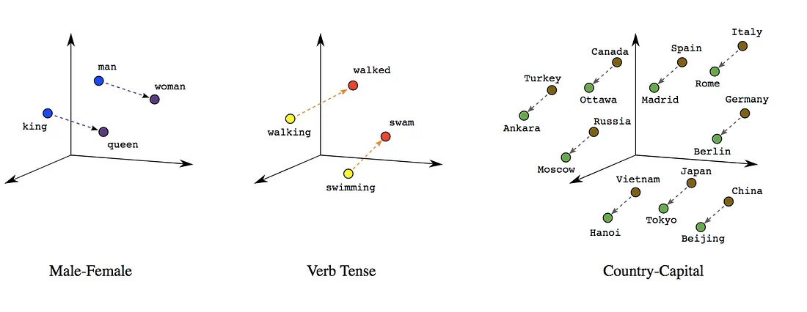
Some features used
TF-IDF Vectorization
Pipeline
Word Embeddings

Slide 15

Presentation of our Streamlit application
Streamlit App for Analyzing French Text Difficulty
Purpose of the App
Target Audience
Key Features

Slide 16
Thank you!

