Slide 1
CSE2004: Database Management System
Module 2
Data Modeling – ER Model and Relational Model

Slide 2
Topics to be Covered
Entity-Relationship Model
Types of Attributes
Relationship
Structural Constraints
Relational Model
Relational Model Constraints
Mapping E-R Model to Relational Schema
Integrity Constraints

Slide 3
Entity-Relationship(ER) Model
The ER model is a high-level conceptual data model. It has not been implemented in any commercial DBMS , but is a powerful short hand often used in database design for a first rendition of the miniworld.
The ER model was introduced by Peter Chen in 1976, and is now the most widely used conceptual data model.

Slide 4
Definitions
An entity is an object in the mini world.
An attribute is the properties of an entity which can have a value from a value set (domain)
An entity set is the set of entities of same type that same same properties
A relationship is an association among several entities
A relationship set is a mathematical relation among n ≥ 2 entities, each taken from entity sets
A key attribute of an entity type is one whose value uniquely identifies an entity of that type.
A combination of attributes may form a composite key.
If there is no applicable value for an attribute that attribute is set to a null value.

Slide 5
Attribute & Attribute Value
Attribute
Student
ID
Name
Faculty
Major
475020126-3 Kamonphon Science IT
465020100-0 PiyathiDa Science Comp SC.
Attribute Value

Slide 6
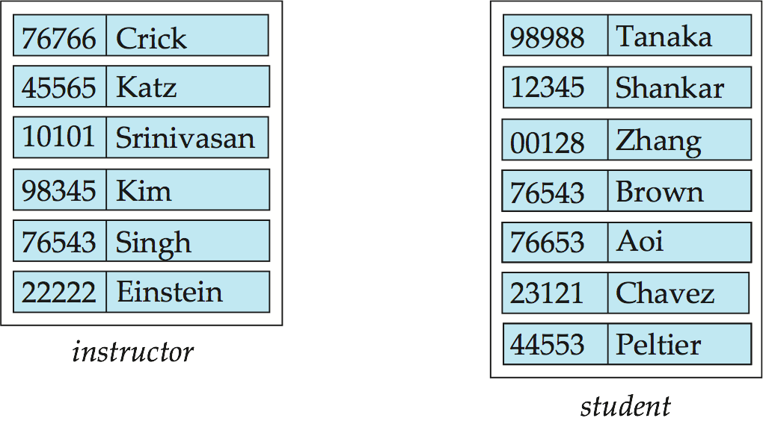
Entity Sets
instructor_ID instructor_name student-ID student_name
Database System Concepts, Silberschatz, Korth and Sudharsan 7th Edition

Slide 7
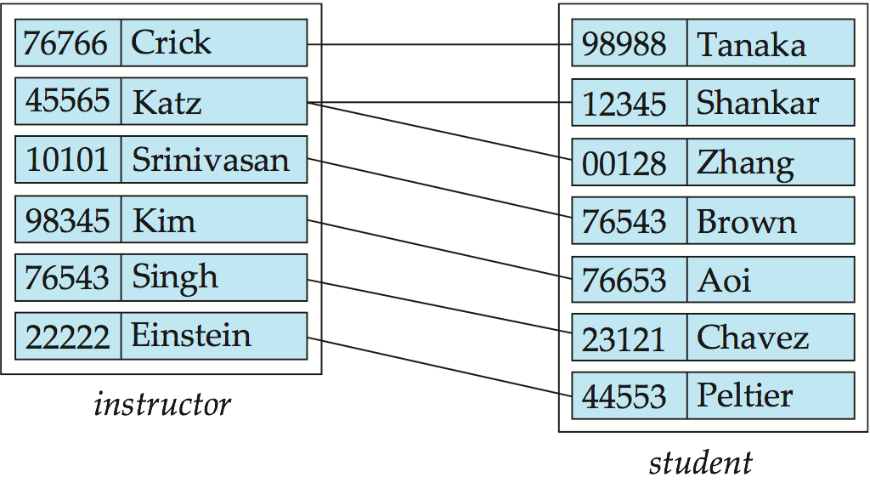
Relationship Set advisor (student-instructor)
Database System Concepts, Silberschatz, Korth and Sudharsan 7th Edition

Slide 8
E-R Diagram - Symbols
Rectangles represent entity sets.
Diamonds represent relationship sets.
Lines link attributes to entity sets and entity sets to relationship sets.
Ellipses represent attributes
Double ellipses represent multivalued attributes.
Dashed ellipses denote derived attributes.
Underline indicates primary key attributes (will study later)
Database System Concepts, Silberschatz, Korth and Sudharsan 4th Edition

Slide 9
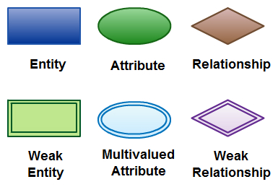

Slide 10
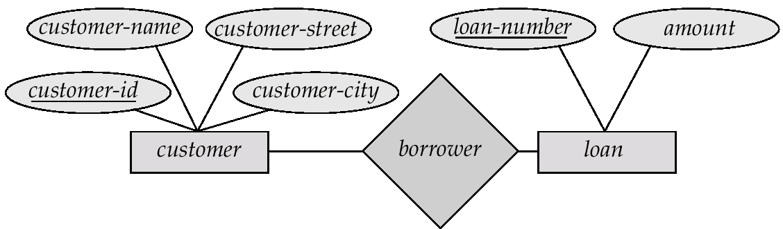
E-R Diagram - Symbols
Database System Concepts, Silberschatz, Korth and Sudharsan 4th Edition

Slide 11
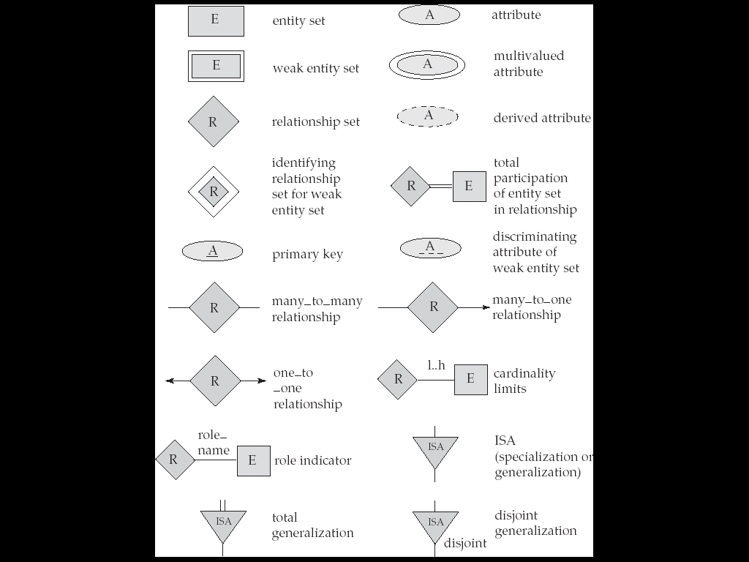
Summary of Symbols Used in E-R Notation

Slide 12
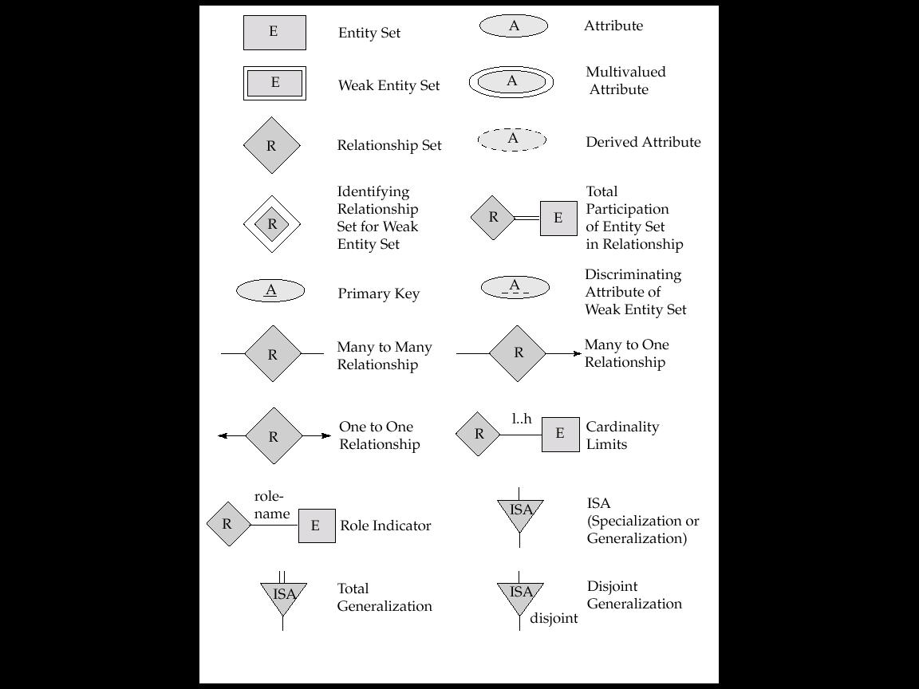
Summary of Symbols Used in E-R Notation

Slide 13
Types of Attributes
Attributes can be
composite / simple (atomic)
single-valued / multivalued
stored / derived
descriptive
key / nonkey.

Slide 14

Composite Attributes
Database System Concepts, Silberschatz, Korth and Sudharsan 7th Edition

Slide 15
Composite Attributes
Composite
Attribute
Address
ZipCode
District
Street name

Slide 16
Single valued Vs. Multi valued
Attribute
Age
Degree
A : 24 Years
B : 27 Years
A : B.Sc.
B : B.Sc, M.Sc., M.Phil., Ph.D.
Single Value
Multi Value

Slide 17
Stored Vs. Derived
Attribute
Age
Birth Day
Stored Attribute
A : 24 Years
B : 40 Years
A : 13 July 1980
B : 23 Dec 1964
Derived Attribute

Slide 18
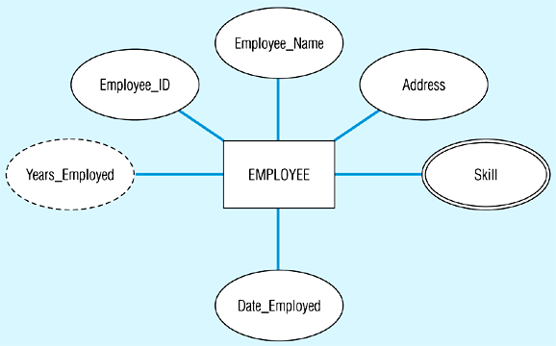
Entity with a multivalued attribute (Skill) and derived attribute (Years_Employed)

Slide 19
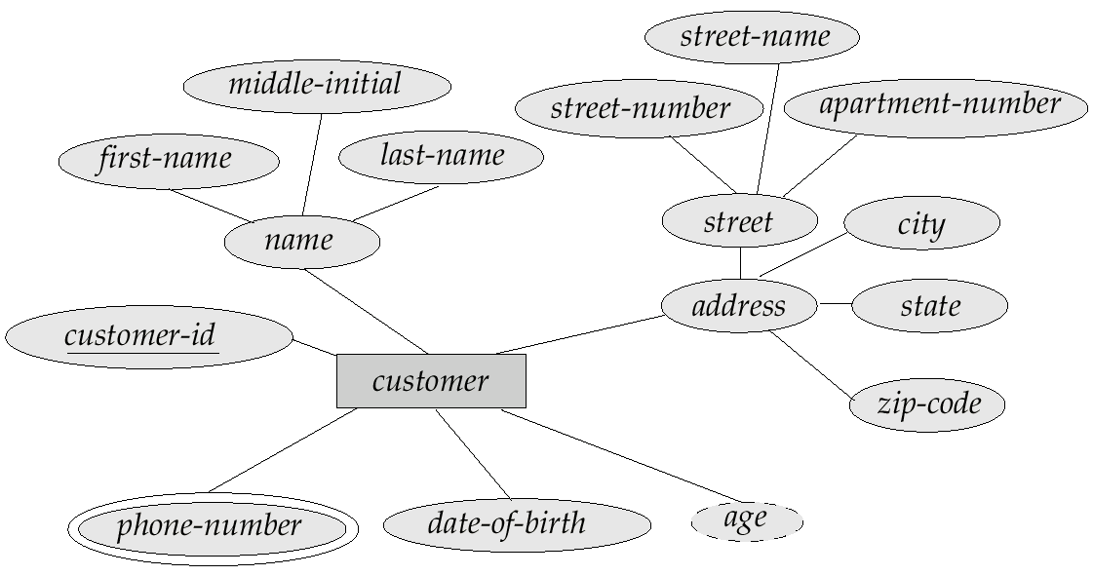
ER Diagram with Composite, Multi-valued and Derived Attributes
Database System Concepts, Silberschatz, Korth and Sudharsan 4th Edition

Slide 20
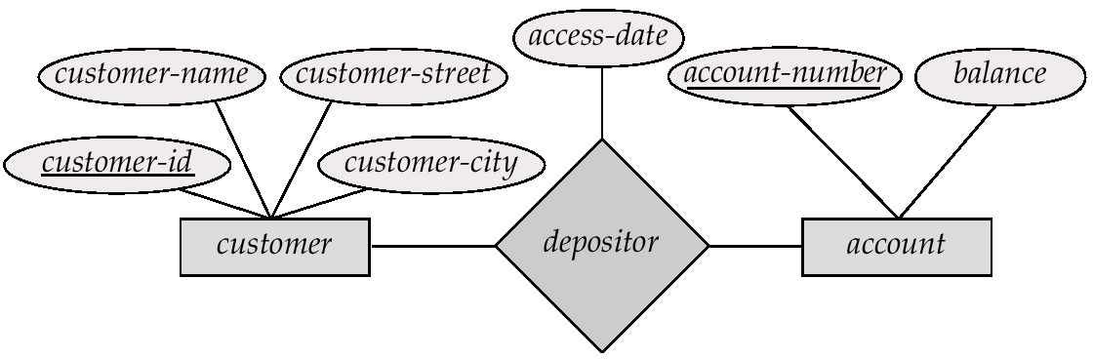
ER Diagram with Descriptive Attributes (Relationship Sets with attributes)
Database System Concepts, Silberschatz, Korth and Sudharsan 4th Edition

Slide 21
EXample
The company stores the information about the currently working employees. The information includes employee number, name gender ,salary, date of birth , date of joining, address, phone no ,department no , department name, email id. The name of the employee contains first name, middle name and last name. The address includes house number, street, city, state and zip code. Every employee is uniquely identified by the employee no. The employee may have multiple phone numbers such as home, office or mobile. The year of experience of each employee can be calculated by year of joining entities associated with that employee. Design an E-R diagram for a company database

Slide 22
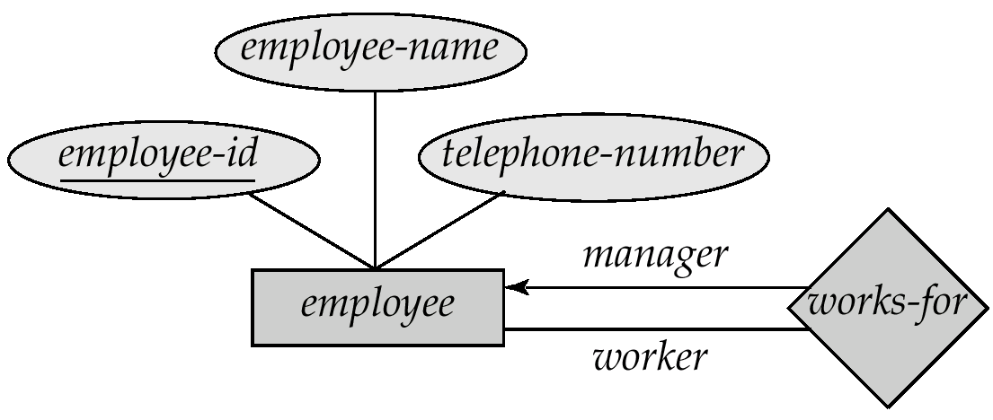
Roles
Database System Concepts, Silberschatz, Korth and Sudharsan 4th Edition

Slide 23
Structural Constraints
Mapping Cardinalities
One-to-One
One-to-Many
Many-to-One
Many-to-Many
Participation Constraints
Total
Partial

Slide 24
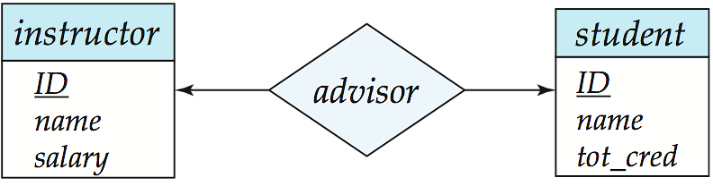
Mapping Cardinalities – One-to-One
Example: One student can register for one faculty
Database System Concepts, Silberschatz, Korth and Sudharsan 7th Edition

Slide 25

Mapping Cardinalities – One-to-Many
For example, one class is consisting of multiple students.
Database System Concepts, Silberschatz, Korth and Sudharsan 7th Edition

Slide 26
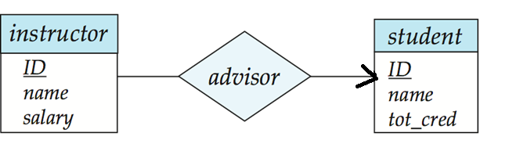
Mapping Cardinalities – Many-to-One
For example, many students belong to the same class.
Database System Concepts, Silberschatz, Korth and Sudharsan 7th Edition

Slide 27
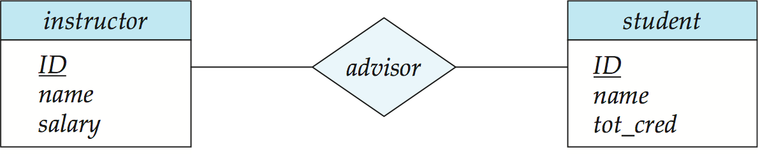
Mapping Cardinalities – Many-to-Many
For example, Students as a group are associated with multiple faculty members, and faculty members can be associated with multiple students.
Database System Concepts, Silberschatz, Korth and Sudharsan 7th Edition

Slide 28
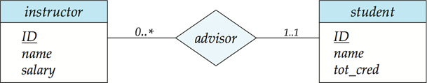
Notation for Expressing More Complex Constraints
Database System Concepts, Silberschatz, Korth and Sudharsan 7th Edition

Slide 29
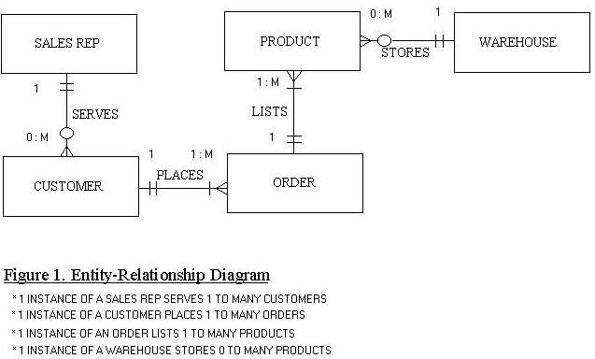
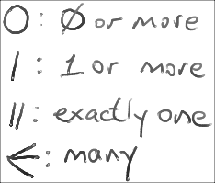
Alternative: Crow’s Foot Notation

Slide 30
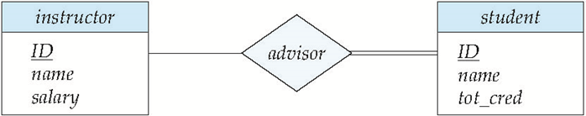
Total Participation
Total participation (indicated by double line): every entity in the entity set participates in at least one relationship in the relationship set
Example: every student must have an associated instructor
Partial participation: some entities may not participate in any relationship in the relationship set
Example: participation of instructor in advisor is partial
Database System Concepts, Silberschatz, Korth and Sudharsan 7th Edition

Slide 31
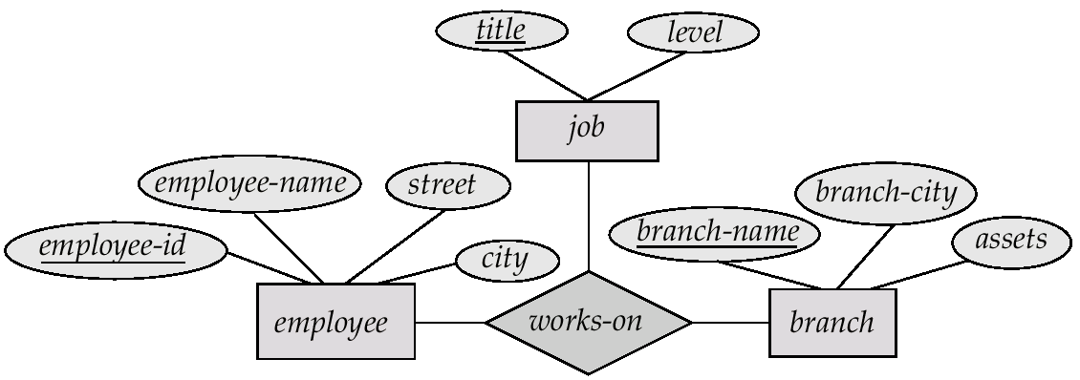
ER Diagram with Ternary Relationship
Database System Concepts, Silberschatz, Korth and Sudharsan 4th Edition

Slide 32
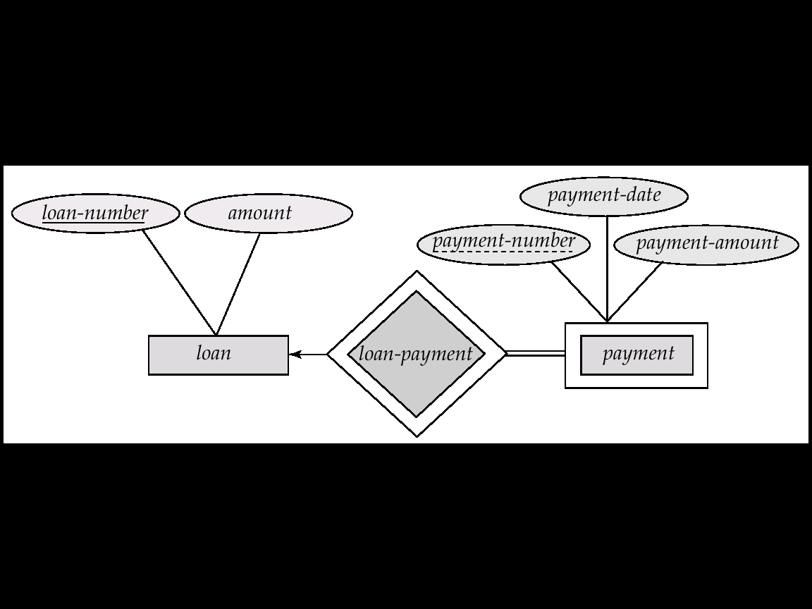
Weak Entity Set
Entity with No primary key
Weak Entity is depicted with Double Rectangle
Weak Relationship is depicted with Double Diamonds
Participation is Total for all weak entity sets.
Mapping Cardinality is One-to-Many
Weak entity depends on the identifying entity (Strong entity) for its unique representation.
Database System Concepts, Silberschatz, Korth and Sudharsan 4th Edition

Slide 33
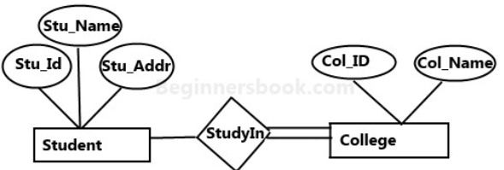
simple ER Diagram
Student entity has attributes such as Stu_Id, Stu_Name & Stu_Addr and College entity has attributes such as Col_ID & Col_Name. college can have many students however a student cannot study in multiple colleges at the same time.Each student must be study any one college.

Slide 34
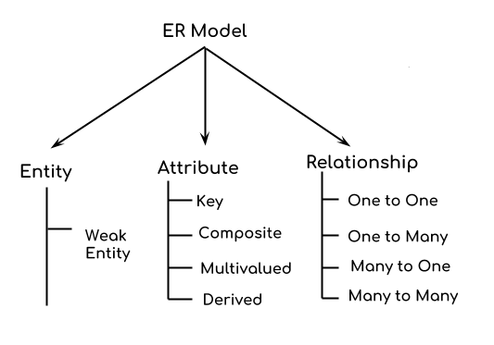
Components of a ER Diagram

Slide 35

How to Create an Entity Relationship Diagram (ERD)

Slide 36
The music database stores details of a artists, albums, and tracks. Artists, albums, and tracks each have a name. Artist, which has an artist_id attribute that uniquely identifies it. Each Album entity is uniquely identified by its album_id combined with the artist_id of the corresponding Artist entity. A Track entity is similarly uniquely identified by its track_id combined with the related album_id and artist_id attributes. The Played entity is uniquely identified by a combination of its played time, and the related track_id, album_id, and artist_id attributes. Each track has a time length. An album is made by exactly one artist. · An artist makes one or more albums. An album contains one or more tracks. When a track is played, the date and time the playback began (to the nearest second) should be recorded; this is used for reporting when a track was last played, as well as the number of times music by an artist, from an album, or a track has been played.

Slide 37
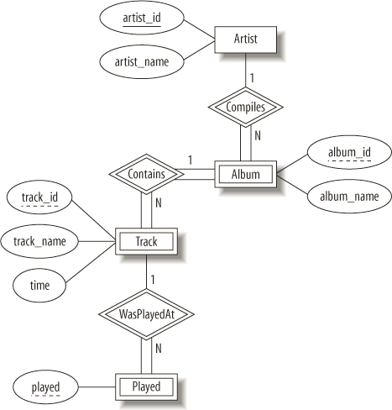

Slide 38
A salesperson may manage many other salespeople. A salesperson is managed by only one salespeople. A salesperson can be an agent for many customers. A customer is managed by one salespeople. A customer can place many orders. An order can be placed by one customer. An order lists many inventory items. An inventory item may be listed on many orders. An inventory item is assembled from many parts. A part may be assembled into many inventory items. Many employees assemble an inventory item from many parts. A supplier supplies many parts. A part may be supplied by many suppliers.

Slide 39
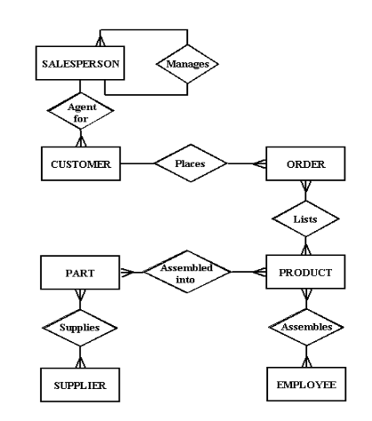

Slide 40
Suppose you are given the following requirements for a simple database for the National Hockey League (NHL):•the NHL has many teams, •each team has a name, a city, a coach, a captain, and a set of players, •each player belongs to only one team, •each player has a name, a position (such as left wing or goalie), a skill level, and a set of injury records, •a team captain is also a player, •a game is played between two teams (referred to as host_team and guest_team) and has a date (such as May 11th, 1999) and a score (such as 4 to 2). Construct a clean and concise ER diagram for the NHL database

Slide 41
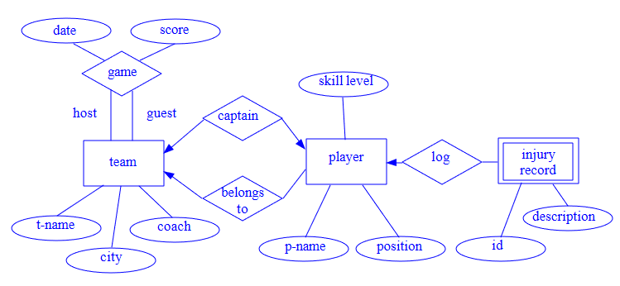

Slide 42
Extended E-R Model
Specialization – Subgrouping
Generalization – Top-Down Design Process
Design Constraint
Disjoint
Overlapping
Completeness Constraint
Total
Partial
Attribute Inheritance
Database System Concepts, Silberschatz, Korth and Sudharsan 4th Edition

Slide 43
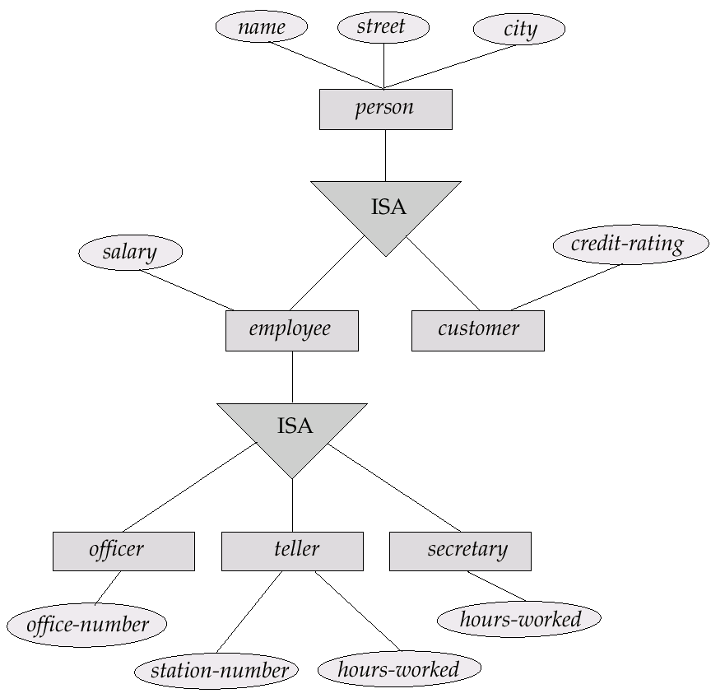
Example
Database System Concepts, Silberschatz, Korth and Sudharsan 4th Edition

Slide 44
Disjointness Constraints
Disjoint (d)
The subclasses must have disjoint sets of entities
Overlap (o)
The subclasses may have overlapping sets of entities

Slide 45
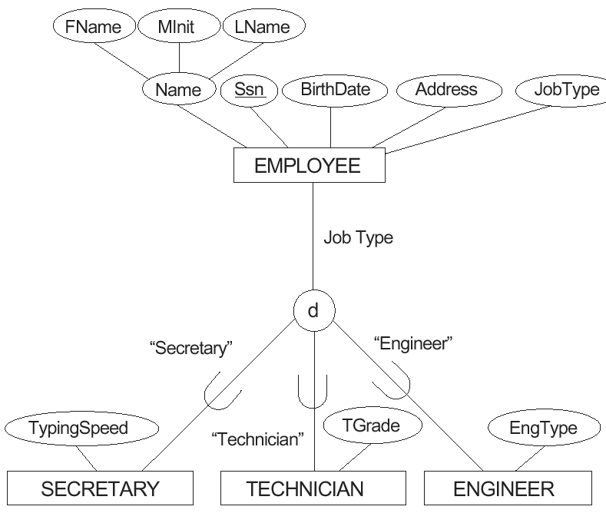
An attribute-defined specialization on the JobType attribute of EMPLOYEE.

Slide 46
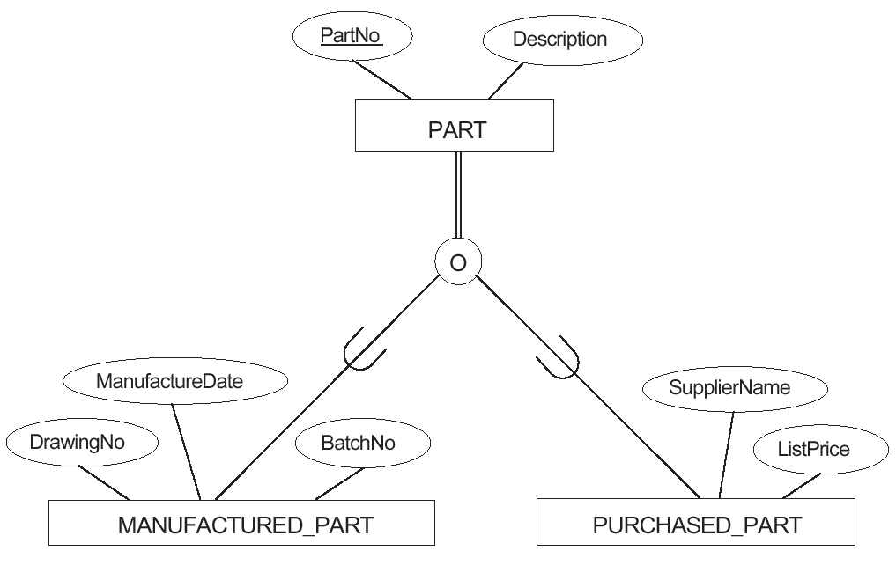
Figure 4.5 Notation for specialization with overlapping (nondisjoint) subclasses.

Slide 47
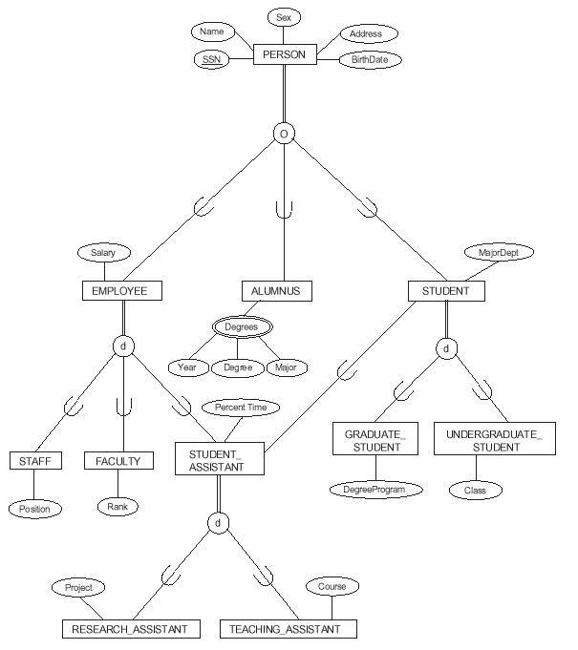
Figure 4.7 A specialization lattice (with multiple inheritance) for a UNIVERSITY database.

Slide 48
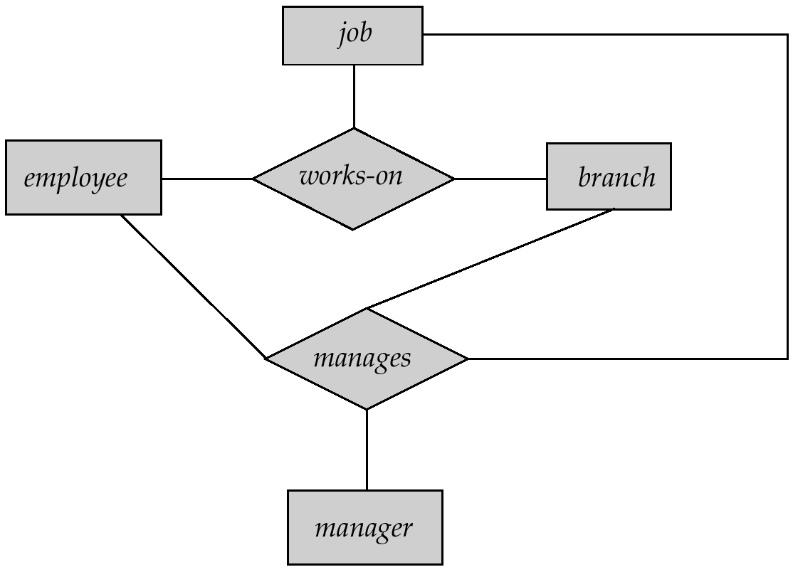
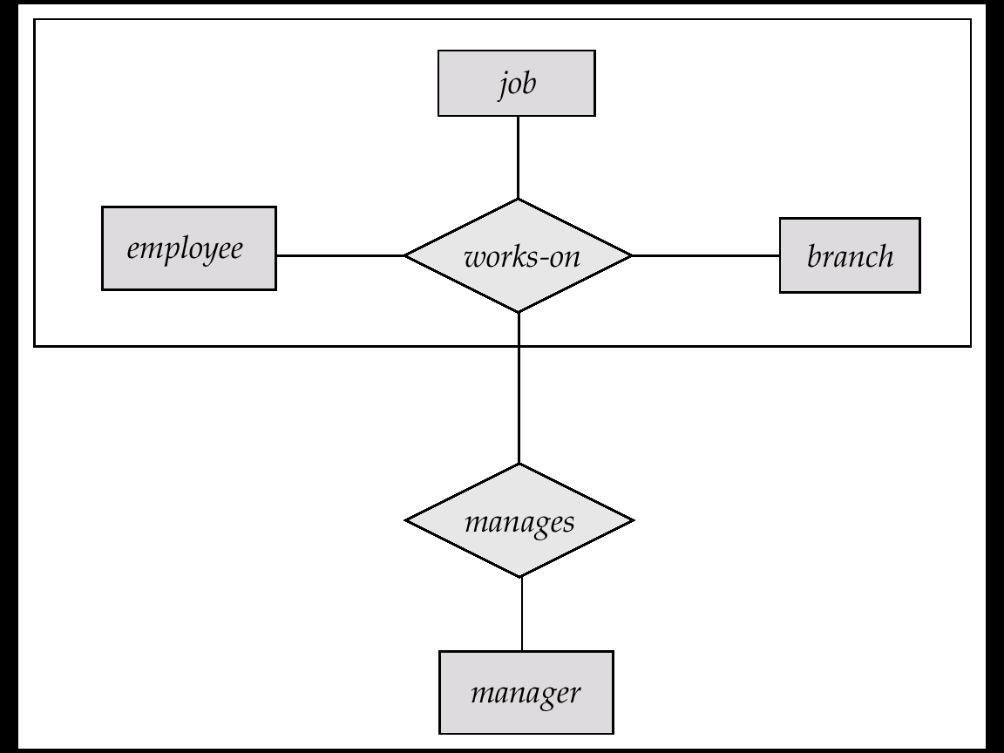
Aggregation
Database System Concepts, Silberschatz, Korth and Sudharsan 4th Edition

Slide 49
Aggregation
Aggregation represents a ‘has-a’ relationship between entity types, where one represents the ‘whole’ and the other the ‘part’
An example of aggregation is the Car and Engine entities. A car is made up of an engine. The car is the whole and the engine is the part. Aggregation does not represent strong ownership. This means, a part can exist on its own without the whole. There is no stronger ownership between a car and the engine. An engine of a car can be moved to another car.

Slide 50
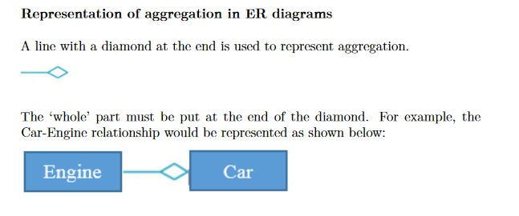

Slide 51
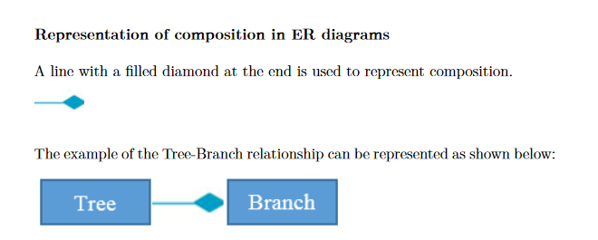
Composition
Composition is a form of aggregation that represents an association between entities, where there is a strong ownership between the ‘whole’ and the ‘part’. For example, a tree and a branch have a composition relationship. A branch is ‘part’ of a ‘whole’ tree - we cannot cut the branch and add it to another tree

Slide 52
Summary of Symbols
Database System Concepts, Silberschatz, Korth and Sudharsan 4th Edition

Slide 53
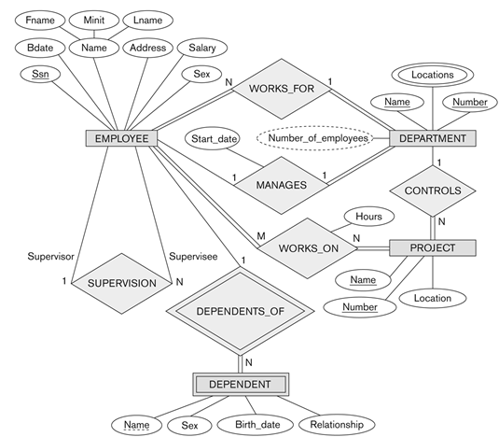
Example
Fundamentals Database Systems, Elmasri, Navathe, 7th Edition

Slide 54
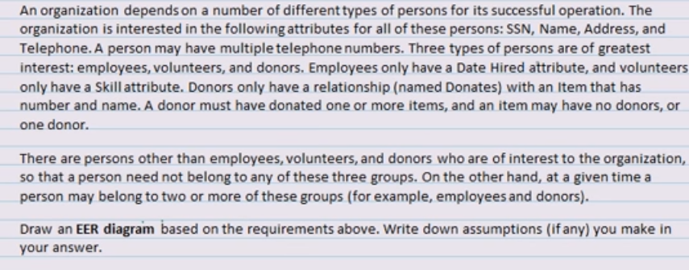

Slide 55
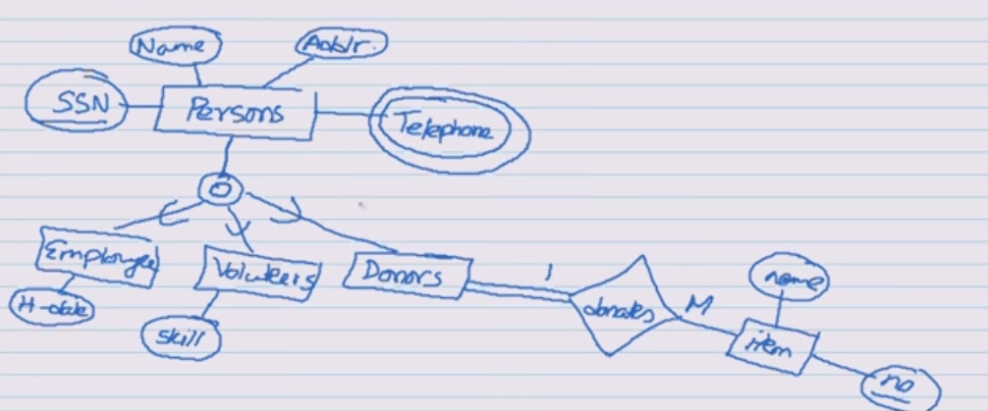

Slide 56
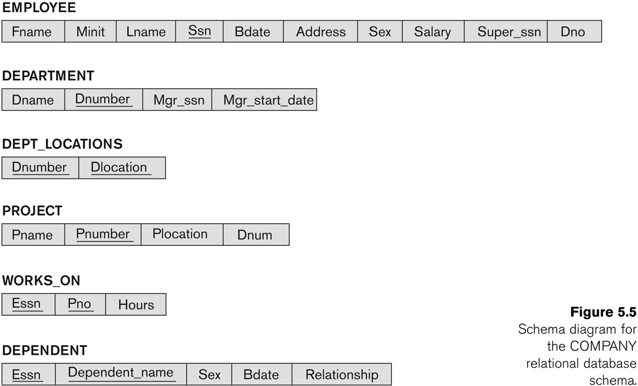
Relational Schema
Fundamentals Database Systems, Elmasri, Navathe, 7th Edition

Slide 57
ER to Relational Mapping
ER-to-Relational Mapping Algorithm
Step 1: Mapping of Regular Entity Types
Step 2: Mapping of Weak Entity Types
Step 3: Mapping of Binary 1:1 Relation Types
Step 4: Mapping of Binary 1:N Relationship Types.
Step 5: Mapping of Binary M:N Relationship Types.
Step 6: Mapping of Multivalued attributes.
Step 7: Mapping of N-ary Relationship Types.
Mapping EER Model Constructs to Relations
Step 8: Options for Mapping Specialization or Generalization.
Step 9: Mapping of Union Types (Categories).
Fundamentals Database Systems, Elmasri, Navathe, 7th Edition

Slide 58
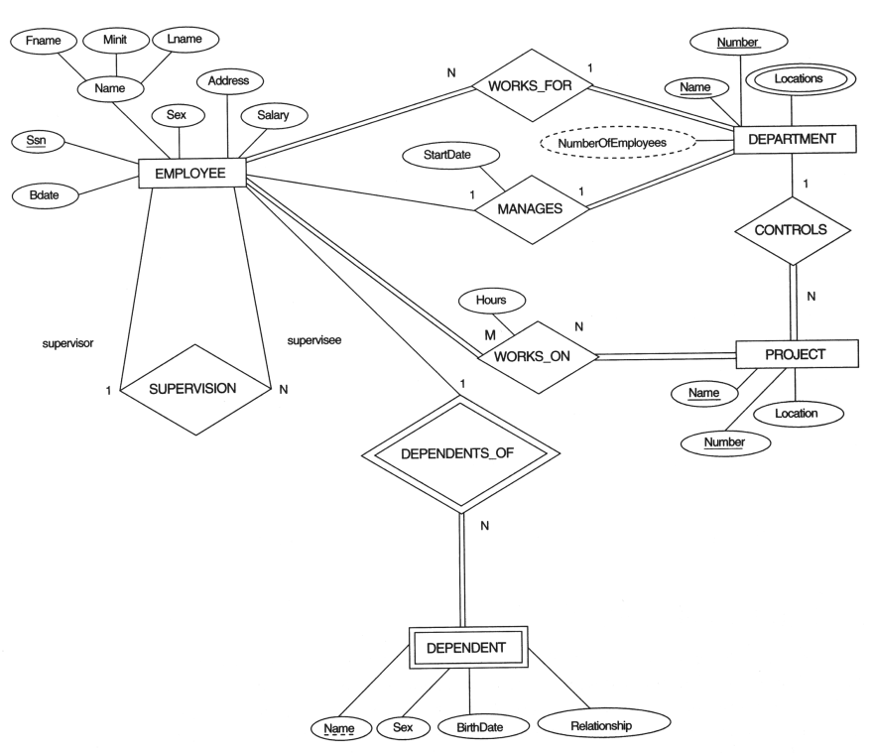
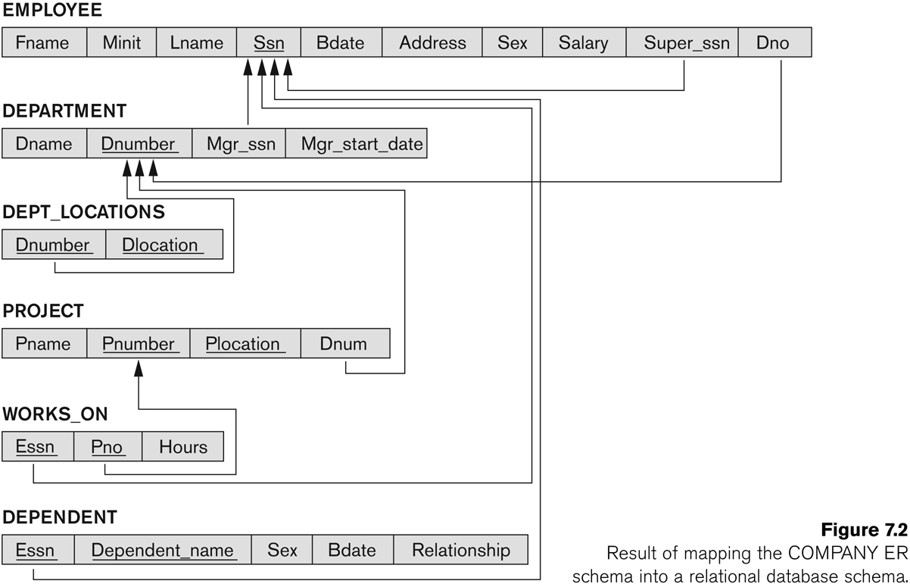
ER to Relational Mapping
Fundamentals Database Systems, Elmasri, Navathe, 7th Edition

Slide 59
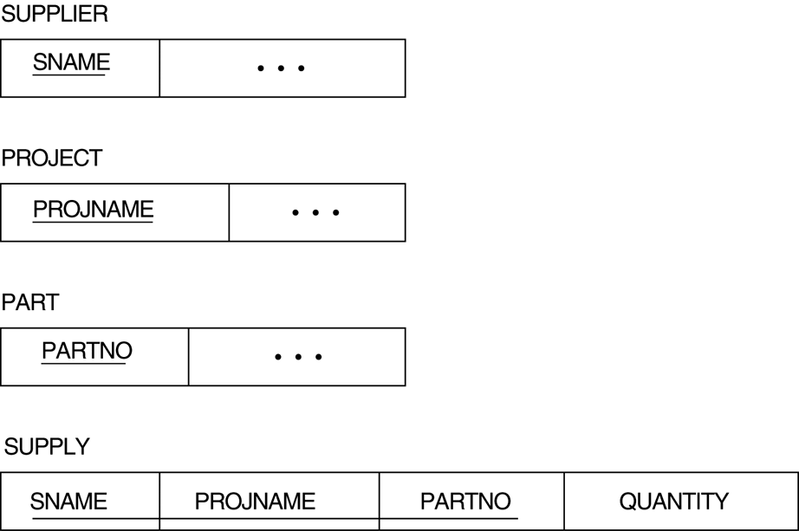
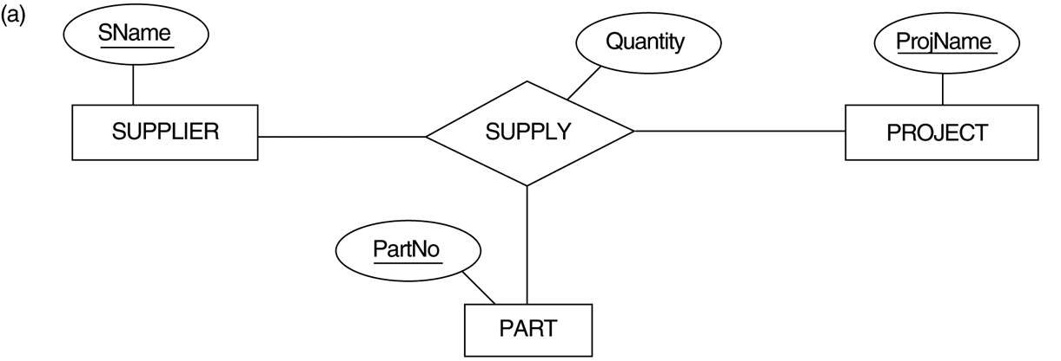
ER to Relational Mapping
Fundamentals Database Systems, Elmasri, Navathe, 7th Edition

Slide 60
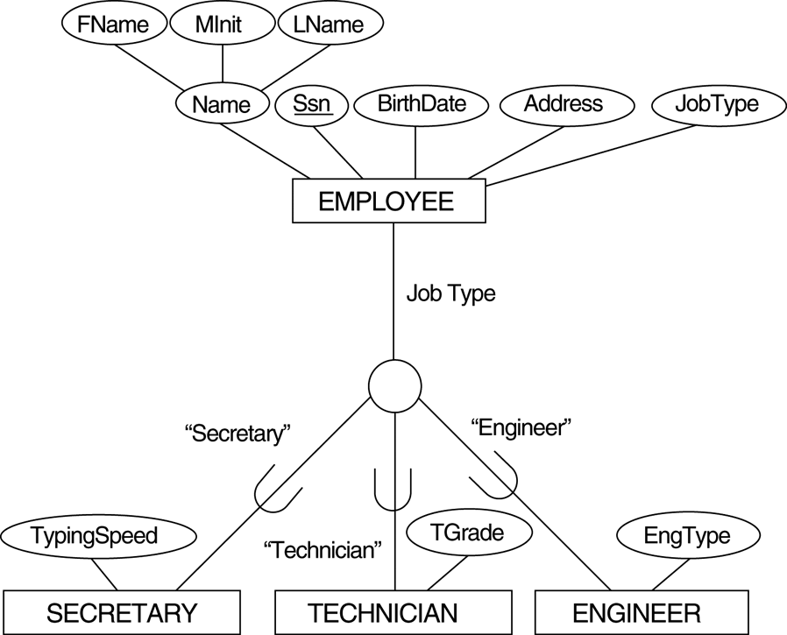

EER to Relational Mapping
Fundamentals Database Systems, Elmasri, Navathe, 7th Edition

Slide 61
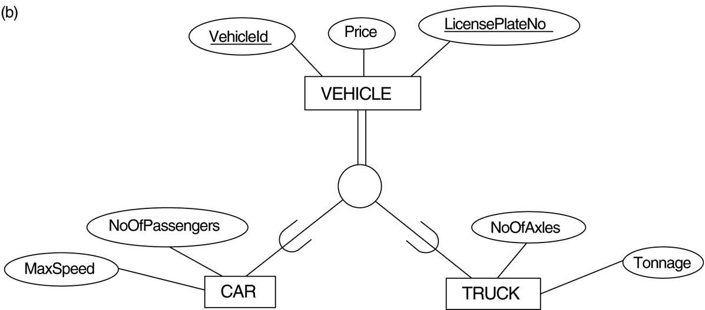
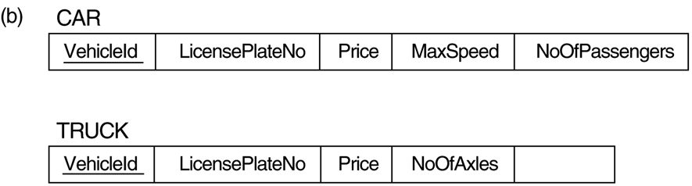
EER to Relational Mapping
Fundamentals Database Systems, Elmasri, Navathe, 7th Edition

Slide 62
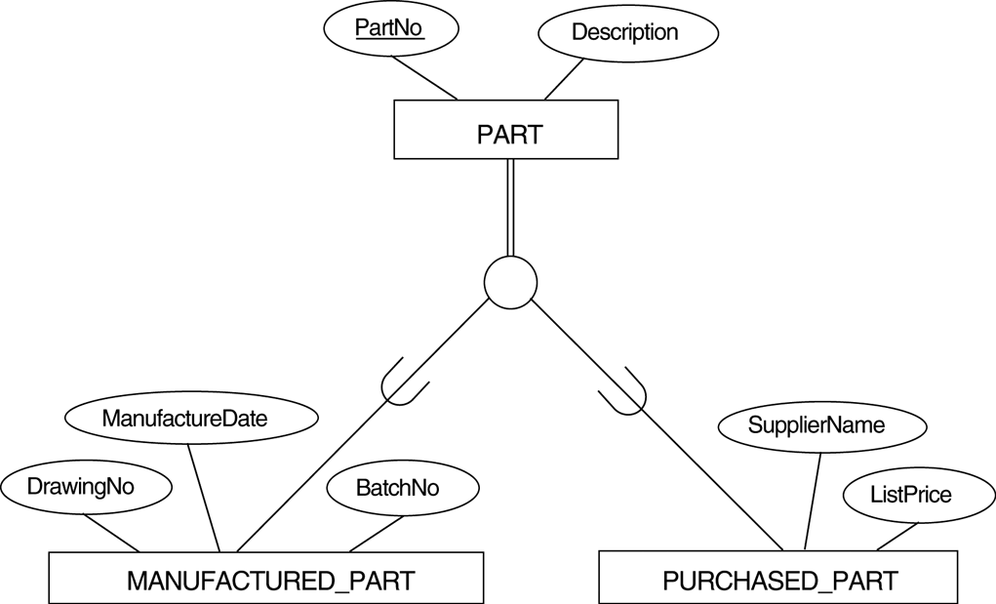
EER to Relational Mapping
Fundamentals Database Systems, Elmasri, Navathe, 7th Edition

Slide 63
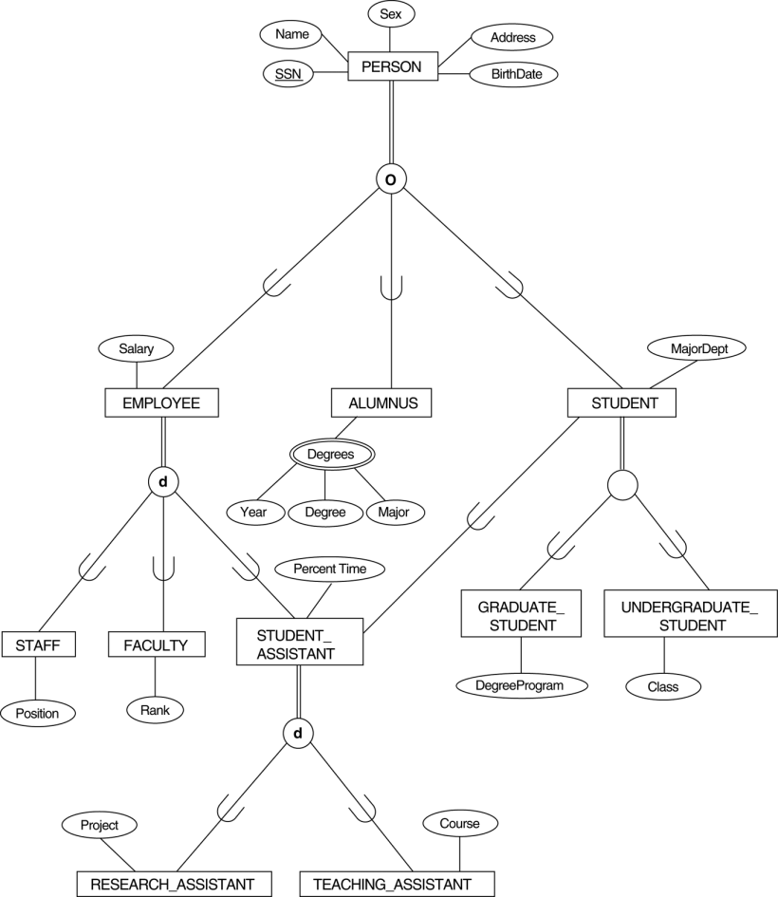
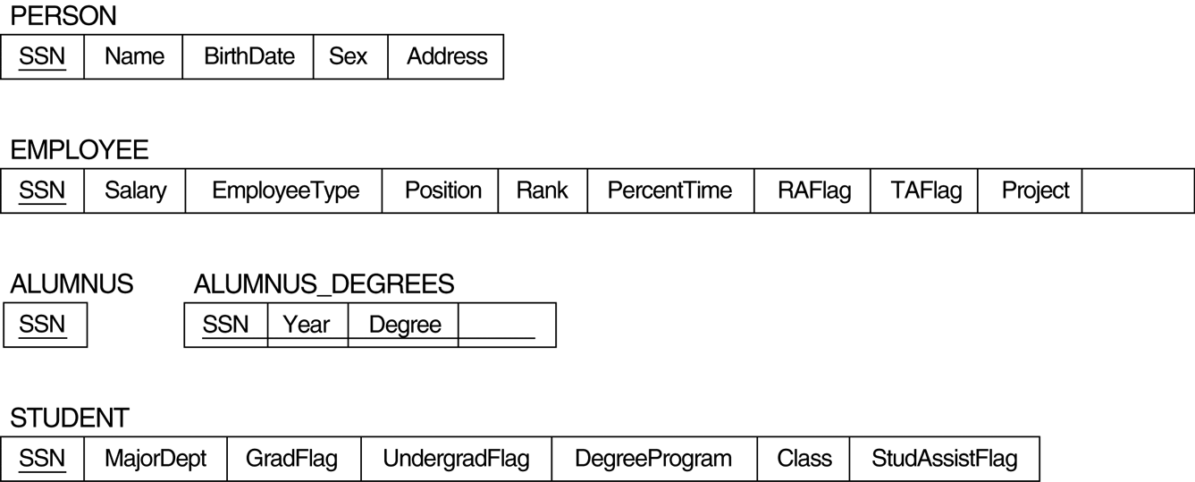
EER to Relational Mapping
Fundamentals Database Systems, Elmasri, Navathe, 7th Edition

Slide 64
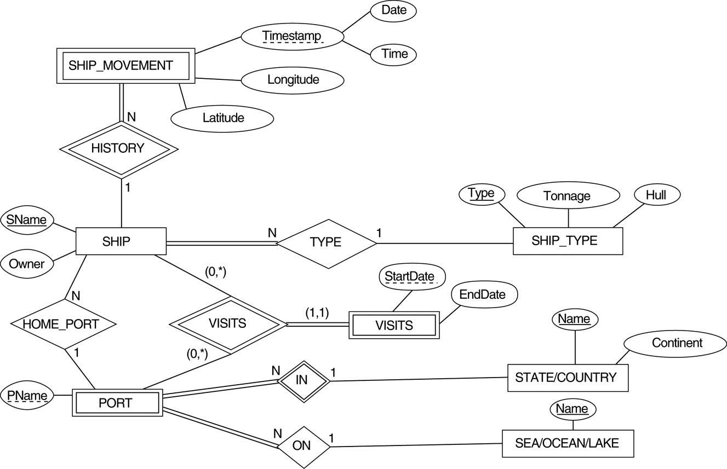
EER to Relational Mapping - Exercise
Fundamentals Database Systems, Elmasri, Navathe, 7th Edition

Slide 65
Relational Model
The relational Model of Data is based on the concept of a Relation
Informally, a relation looks like a table of values.
A relation typically contains a set of rows.
The data elements in each row represent certain facts that correspond to a real-world entity or relationship
In the formal model, rows are called tuples
Each column has a column header that gives an indication of the meaning of the data items in that column
In the formal model, the column header is called an attribute name (or just attribute)
Fundamentals Database Systems, Elmasri, Navathe, 7th Edition

Slide 66
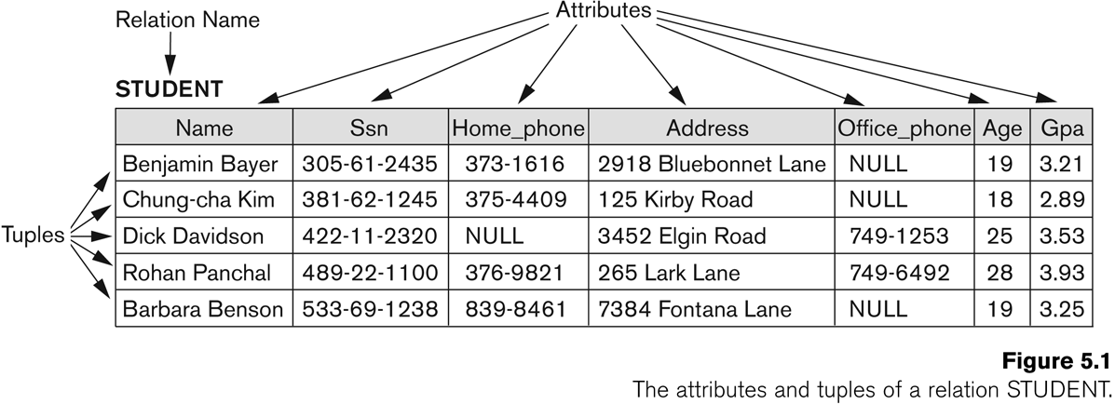
Relational Model
Fundamentals Database Systems, Elmasri, Navathe, 7th Edition

Slide 67
Relational Model
Informal Terms | Formal Terms
Table | Relation
Column Header | Attribute
All possible Column Values | Domain
Row | Tuple
Table Definition | Schema of a Relation
Populated Table | State of the Relation
Fundamentals Database Systems, Elmasri, Navathe, 7th Edition

Slide 68
Types of Keys in Database Management System
Key Constraints
Primary Key (1 Key)
Foreign Key (Referential Integrity)
Candidate key (Minimal Super Key)
Super Key (1 or more Keys)
Fundamentals Database Systems, Elmasri, Navathe, 7th Edition

Slide 69
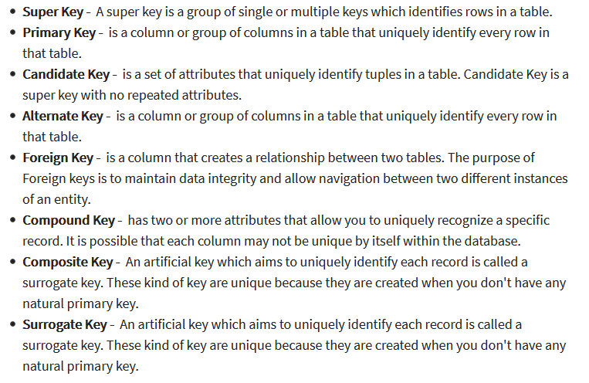

Slide 70
A superkey is a group of single or multiple keys which identifies rows in a table.
A Super key may have additional attributes that are not needed for unique identification.
Example:
In the below -given example, EmpSSN and EmpNum name are superkeys.
EmpSSN | EmpNum | Empname
9812345098 | AB05 | Shown
9876512345 | AB06 | Roslyn
199937890 | AB07 | James

Slide 71
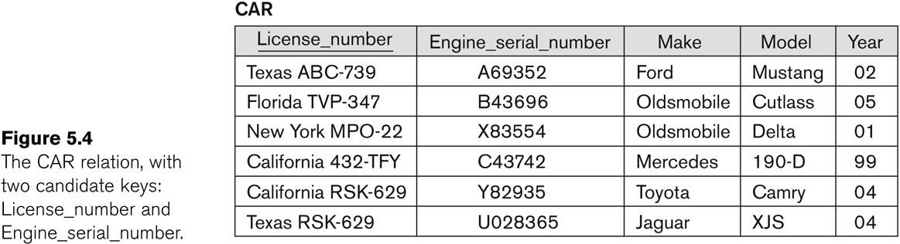
Relational Model Constraints – Candidate Keys
Fundamentals Database Systems, Elmasri, Navathe, 7th Edition

Slide 72


Slide 73

Compound key
COMPOUND KEY has two or more attributes that allow you to uniquely recognize a specific record. It is possible that each column may not be unique by itself within the database. However, when combined with the other column or columns the combination of composite keys become unique.

Slide 74
Composite key
COMPOSITE KEY is a combination of two or more columns that uniquely identify rows in a table. The combination of columns guarantees uniqueness, though individually uniqueness is not guaranteed. Hence, they are combined to uniquely identify records in a table.
The difference between compound and the composite key is that any part of the compound key can be a foreign key, but the composite key may or maybe not a part of the foreign key.

Slide 75
Surrogate key
SURROGATE KEYS is An artificial key which aims to uniquely identify each record is called a surrogate key. This kind of partial key in dbms is unique because it is created when you don't have any natural primary key.

Slide 76
Integrity Constraints
NOT NULL Constraint: Ensures that a column cannot have NULL value.
DEFAULT Constraint: Provides a default value for a column when none is specified.
UNIQUE Constraint: Ensures that all values in a column are different.
PRIMARY Key: Uniquely identified each rows/records in a database table.
FOREIGN Key: Uniquely identified a rows/records in any another database table.
CHECK Constraint: The CHECK constraint ensures that all values in a column satisfy certain conditions.

Slide 77
constraints
Types of integrity constraints:
Domain integrity constraints
Entity Integrity constraints
Referential integrity constraints

Slide 78
How to Create and Maintain Integrity Constraints
Two methods for creating integrity constraints:
Code them in the CREATE TABLE command
Add them later with the ALTER TABLE command

Slide 79
Domain integrity constraints
These constraints set a range and any violations that take place will prevent the user from performing the manipulation that caused the breach. There are basically two types of domain integrity constraints.
Not Null constraints
Check constraint

Slide 80
Not Null Constraints
When a ‘Not null’ constraints is enforced through either on a column or a set of columns in a table, it will not allow Null values. The user has to provide a value for the column.
Syntax:
Create table table_name (columnname datatype constraint constraint_name not null);
Check constraints:
Check constraints specify conditions that each row must satisfy. These are rules governed by logical expressions or Boolean expressions. Check conditions cannot contain subqueries.
Syntax:
Create table table_name (columnname datatype constraint constraint_name check (condition));

Slide 81
Entity Integrity constraints
Each entity represents a table and each row of a table represents an instance of that entity. Each row in a table can be uniquely identified using the entity constraint. There are basically two types of Entity Integrity constraints.
Unique constraints
Primary key constraints

Slide 82
Unique constraints
Usage of the unique key constraint is to prevent the duplication of values within the rows of a specified columns or a set of columns in a table. Columns defined with this constraint can also allow null values.
Syntax:
Create table table_name (columnname datatype… constraint constraint_name unique (colname)) ;
Primary key constraints
The primary key constraint avoids duplication of rows and does not allow Null values, when enforced in a column or set of columns. A table can have only one primary key.
Syntax:
Create table table_name (columnname datatype constraint constraint_name primary key);

Slide 83
Referential integrity constraints
To establish a ‘parent-child’ or a ‘master-detail’ relationship between two tables having a common column, we make used of referential integrity constraints. To implement this, we should define the column in the parent table as a primary key and the same column in the child table as a foreign key referring to the corresponding parent entry.
Syntax:
Create table table_name (columnname datatype constraint constraint_name references table_name (columnname));

Slide 84
Creating Tables With Constraints
(Not Null)
SQL> CREATE TABLE STUD(ROLLNO NUMBER(6) NOT NULL,NAME VARCHAR2(10),BRANCH VARCHAR2(6));
Table created.
SQL> DESC STUD;
Name Null? Type
----------------------------------------- -------- ----------------------------
ROLLNO NOT NULL NUMBER(6)
NAME VARCHAR2(10)
BRANCH VARCHAR2(6)

Slide 85
(UNIQUE)& primary key)
SQL> CREATE TABLE STUD(ROLLNO NUMBER(6) UNIQUE ,NAME VARCHAR2(10),BRANCH VARCHAR2(6));
> CREATE TABLE STUD(ROLLNO NUMBER(6) PRIMARY KEY ,NAME VARCHAR2(10),BRANCH VARCHAR2(6));
Create table stu( roll no number(4), gender vharchar(1) check (gender in (‘m’,’f’),
mark number(3) check (marks>=0 and marks<=100)

Slide 86
(check)
SQL> create table stud(rno number(5),name varchar2(10),sal number(10) constraint no_ck check(sal between 10000 and 30000));
Example
SQL> /
Enter value for rno: 565
Enter value for name: rohit
Enter value for sal: 35000
old 1: insert into stud values(&rno,'&name',&sal)
new 1: insert into stud values(565,'rohit',35000)
insert into stud values(565,'rohit',35000)
*
ERROR at line 1:
ORA-02290: check constraint (SCOTT.NO_CK) violated

Slide 87
Foreign Key
SOL>create table adm(stuid number(6) constraint stuid_pk primary key,sname varchar2(15),per number(5));
SQL> create table course(stuid number(6) constraint sid_fk references adm(stuid),branch varchar2(5),sec varchar2(10));

Slide 88
Operations in Relational Model
Insert, update, delete and select.
Insert is used to insert data into the relation
Delete is used to delete tuples from the table.
Modify allows you to change the values of some attributes in existing tuples.
Select allows you to choose a specific range of data.

Slide 89
Advantages of using Relational Model
implicity: A Relational data model in DBMS is simpler than the hierarchical and network model.
Structural Independence: The relational database is only concerned with data and not with a structure. This can improve the performance of the model.
Easy to use: The Relational model in DBMS is easy as tables consisting of rows and columns are quite natural and simple to understand
Query capability: It makes possible for a high-level query language like SQL to avoid complex database navigation.
Data independence: The Structure of Relational database can be changed without having to change any application.
Scalable: Regarding a number of records, or rows, and the number of fields, a database should be enlarged to enhance its usability.

Slide 90
Disadvantages of using Relational Model
Few relational databases have limits on field lengths which can’t be exceeded.
Relational databases can sometimes become complex as the amount of data grows, and the relations between pieces of data become more complicated.
Complex relational database systems may lead to isolated databases where the information cannot be shared from one system to another.

Slide 91
References
Fundamentals Database Systems, Elmasri, Navathe, 7th Edition, Pearson Publication
Database System Concepts, Silberschatz, Korth and Sudharsan, 7th Edition
Database System Concepts, Silberschatz, Korth and Sudharsan, 4th Edition

Slide 92
Thank You…

