Slide 1
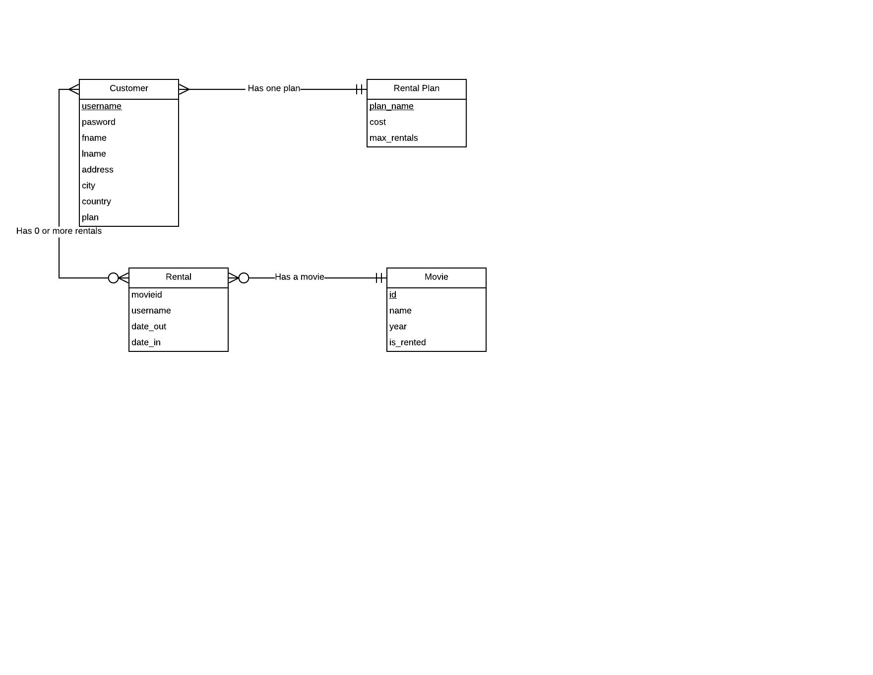
Nicola Licata, Jack Blanc, Dylan Collins, Andrew Leung

