Slide 1
birds and plants
stochasticity
realized dispersal distance
potential dispersal rate
range expansion rate
range size
body size
age at maturity
Notes:
Want to get at there being lower extinction risk in new leading edge/in trailing edge populations when environment is red and asynchronous, which leads to better tracking at leading edge and lagging at trailing edge.
What could I measure?
At leading edge:
Position of leading range edge
Average cumulative population size in “new habitat” beyond the range edge at each time step
At trailing edge:
- Position of trailing range edge
Average cumulative population size in “unsuitable” (r < 0) habitat within the range at each time step
Predict:
Rescue effects always higher in asynchronous noise
Highest in asynchronous red noise

Slide 2
plants
seed shape
dispersal syndrome
stochasticity
seed mass
realized dispersal distance
potential dispersal rate
range expansion rate
number of seeds
seed release height
breeding system
age at maturity
Notes:
Want to get at there being lower extinction risk in new leading edge/in trailing edge populations when environment is red and asynchronous, which leads to better tracking at leading edge and lagging at trailing edge.
What could I measure?
At leading edge:
Position of leading range edge
Average cumulative population size in “new habitat” beyond the range edge at each time step
At trailing edge:
- Position of trailing range edge
Average cumulative population size in “unsuitable” (r < 0) habitat within the range at each time step
Predict:
Rescue effects always higher in asynchronous noise
Highest in asynchronous red noise

Slide 3
birds
site fidelity
But dags shouldn’t include proxies….
competition
stochasticity
migration tendencies
realized dispersal distance
potential dispersal rate
range expansion rate
clutch size
wing size
wing shape
age at maturity
Notes:
Want to get at there being lower extinction risk in new leading edge/in trailing edge populations when environment is red and asynchronous, which leads to better tracking at leading edge and lagging at trailing edge.
What could I measure?
At leading edge:
Position of leading range edge
Average cumulative population size in “new habitat” beyond the range edge at each time step
At trailing edge:
- Position of trailing range edge
Average cumulative population size in “unsuitable” (r < 0) habitat within the range at each time step
Predict:
Rescue effects always higher in asynchronous noise
Highest in asynchronous red noise

Slide 4
plants
seed
mass
seed shape
seed release height
dispersal distance
dispersal syndrome
stochasticity
dispersal rate
range expansion rate
age at maturity
dispersal frequency
breeding system
rate of climate change
number of seeds
Notes:
Want to get at there being lower extinction risk in new leading edge/in trailing edge populations when environment is red and asynchronous, which leads to better tracking at leading edge and lagging at trailing edge.
What could I measure?
At leading edge:
Position of leading range edge
Average cumulative population size in “new habitat” beyond the range edge at each time step
At trailing edge:
- Position of trailing range edge
Average cumulative population size in “unsuitable” (r < 0) habitat within the range at each time step
Predict:
Rescue effects always higher in asynchronous noise
Highest in asynchronous red noise

Slide 5
birds
migration tendencies
wing
size
site fidelity
dispersal distance
wing shape
stochasticity
dispersal rate
range expansion rate
age at maturity
dispersal frequency
clutch size
rate of climate change
Notes:
Want to get at there being lower extinction risk in new leading edge/in trailing edge populations when environment is red and asynchronous, which leads to better tracking at leading edge and lagging at trailing edge.
What could I measure?
At leading edge:
Position of leading range edge
Average cumulative population size in “new habitat” beyond the range edge at each time step
At trailing edge:
- Position of trailing range edge
Average cumulative population size in “unsuitable” (r < 0) habitat within the range at each time step
Predict:
Rescue effects always higher in asynchronous noise
Highest in asynchronous red noise

Slide 6
birds and plants
body size
range size
dispersal distance
stochasticity
dispersal rate
range expansion rate
age at maturity
dispersal frequency
rate of climate change
Notes:
Want to get at there being lower extinction risk in new leading edge/in trailing edge populations when environment is red and asynchronous, which leads to better tracking at leading edge and lagging at trailing edge.
What could I measure?
At leading edge:
Position of leading range edge
Average cumulative population size in “new habitat” beyond the range edge at each time step
At trailing edge:
- Position of trailing range edge
Average cumulative population size in “unsuitable” (r < 0) habitat within the range at each time step
Predict:
Rescue effects always higher in asynchronous noise
Highest in asynchronous red noise

Slide 7
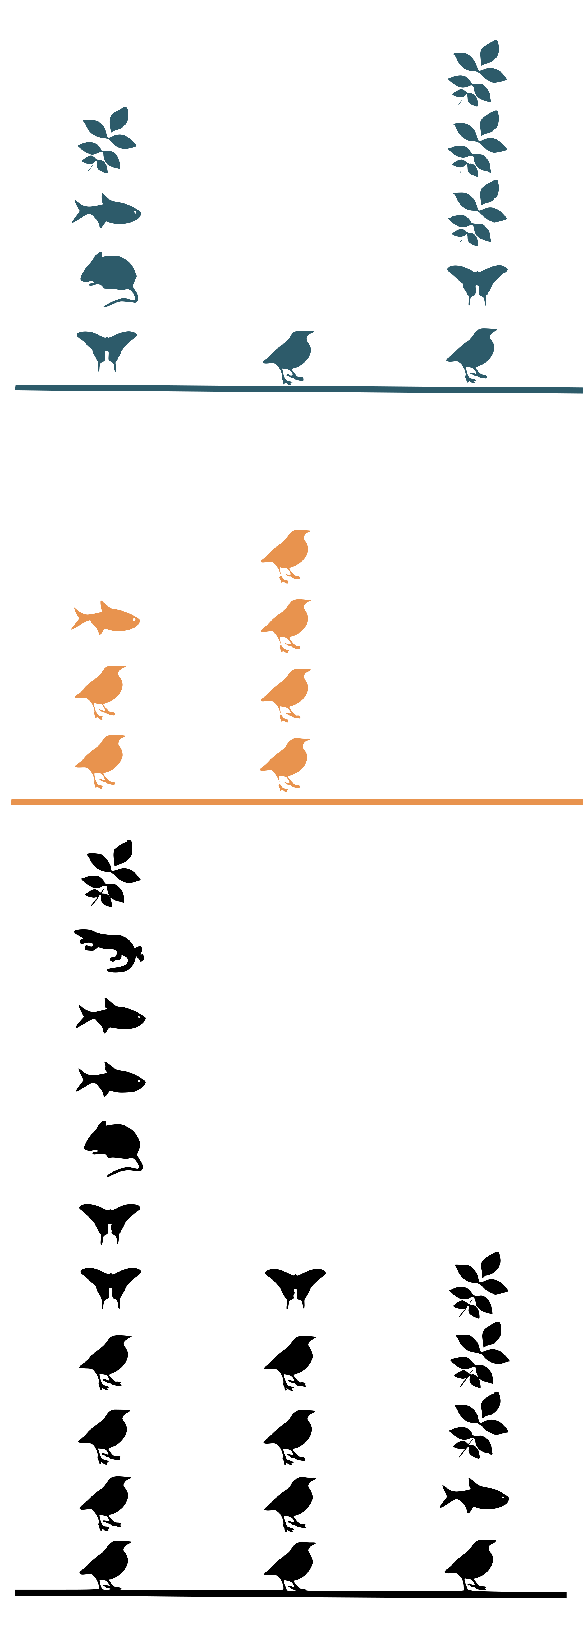
a)
dispersal distance
stochasticity
dispersal rate
range expansion rate
dispersal frequency
rate of climate change
b)
wing shape
body
size
seed release height
range
size
seed shape
migration tendencies
wing
size
site fidelity
dispersal distance
seed
mass
dispersal syndrome
stochasticity
dispersal rate
range expansion rate
clutch size
dispersal frequency
number of seeds
rate of climate change
age at maturity
breeding system
Notes:
Want to get at there being lower extinction risk in new leading edge/in trailing edge populations when environment is red and asynchronous, which leads to better tracking at leading edge and lagging at trailing edge.
What could I measure?
At leading edge:
Position of leading range edge
Average cumulative population size in “new habitat” beyond the range edge at each time step
At trailing edge:
- Position of trailing range edge
Average cumulative population size in “unsuitable” (r < 0) habitat within the range at each time step
Predict:
Rescue effects always higher in asynchronous noise
Highest in asynchronous red noise

Slide 8
a)
dispersal distance
stochasticity
dispersal rate
range expansion rate
dispersal frequency
rate of climate change
b)
wing shape
body
size
seed release height
range
size
seed shape
migration tendencies
wing
size
dispersal syndrome
site fidelity
dispersal distance
seed
mass
range expansion rate
clutch size
dispersal frequency
number of seeds
age at maturity
breeding system
Notes:
Want to get at there being lower extinction risk in new leading edge/in trailing edge populations when environment is red and asynchronous, which leads to better tracking at leading edge and lagging at trailing edge.
What could I measure?
At leading edge:
Position of leading range edge
Average cumulative population size in “new habitat” beyond the range edge at each time step
At trailing edge:
- Position of trailing range edge
Average cumulative population size in “unsuitable” (r < 0) habitat within the range at each time step
Predict:
Rescue effects always higher in asynchronous noise
Highest in asynchronous red noise

Slide 9
Limiting rate model of dispersal limitation
a) Maximum dispersal rate < rate of climate change
b) Maximum dispersal rate > rate of
climate change
dispersal distance
maximum dispersal rate
range expansion rate
rate of climate change
range expansion rate
dispersal frequency
Trait models of dispersal limitation
body
size
seed release height
wing shape
range
size
seed shape
wing
size
dispersal syndrome
migration tendencies
dispersal distance
traits
range expansion rate
clutch size
dispersal frequency
traits
number of seeds
age at maturity
breeding system
Notes:
Want to get at there being lower extinction risk in new leading edge/in trailing edge populations when environment is red and asynchronous, which leads to better tracking at leading edge and lagging at trailing edge.
What could I measure?
At leading edge:
Position of leading range edge
Average cumulative population size in “new habitat” beyond the range edge at each time step
At trailing edge:
- Position of trailing range edge
Average cumulative population size in “unsuitable” (r < 0) habitat within the range at each time step
Predict:
Rescue effects always higher in asynchronous noise
Highest in asynchronous red noise

Slide 10
a) Limiting rate model of dispersal limitation
1. Maximum dispersal rate < rate of climate change
2. Maximum dispersal rate > rate of climate change
dispersal distance
dispersal distance
maximum dispersal rate
range expansion rate
maximum dispersal rate
range expansion rate
dispersal frequency
rate of climate change
dispersal frequency
rate of climate change
b) Trait models of dispersal limitation
farthest dispersal distance
body
size
seed release height
wing shape
range
size
seed shape
wing
size
dispersal syndrome
migration tendencies
dispersal distance
traits
range expansion rate
clutch size
dispersal frequency
traits
number of seeds
age at maturity
breeding system
Notes:
Want to get at there being lower extinction risk in new leading edge/in trailing edge populations when environment is red and asynchronous, which leads to better tracking at leading edge and lagging at trailing edge.
What could I measure?
At leading edge:
Position of leading range edge
Average cumulative population size in “new habitat” beyond the range edge at each time step
At trailing edge:
- Position of trailing range edge
Average cumulative population size in “unsuitable” (r < 0) habitat within the range at each time step
Predict:
Rescue effects always higher in asynchronous noise
Highest in asynchronous red noise

