Slide 1
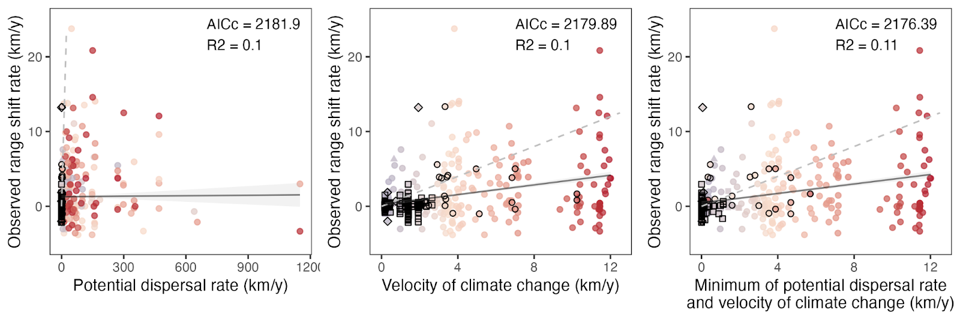
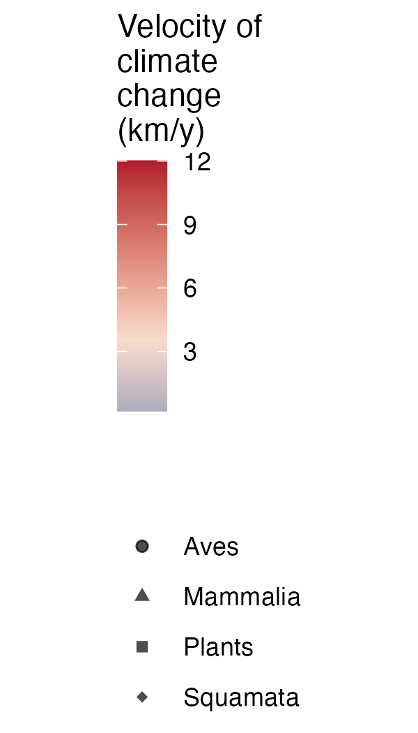

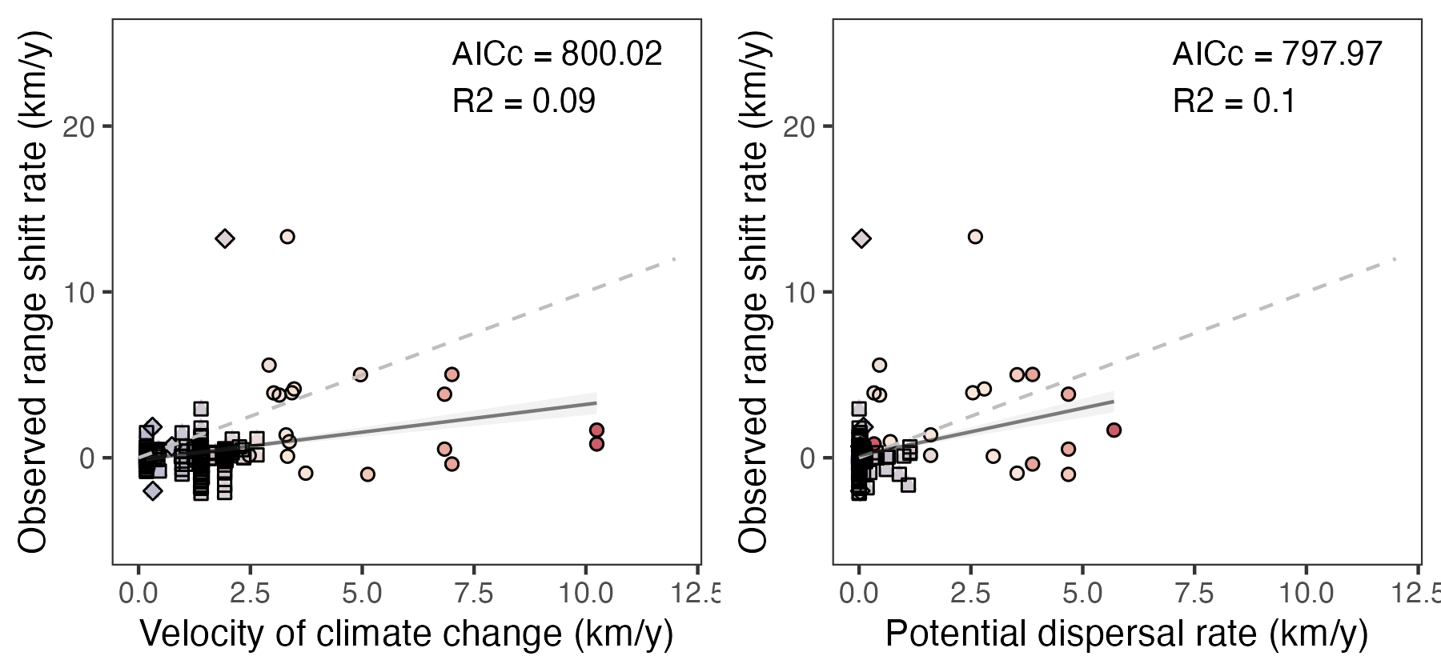
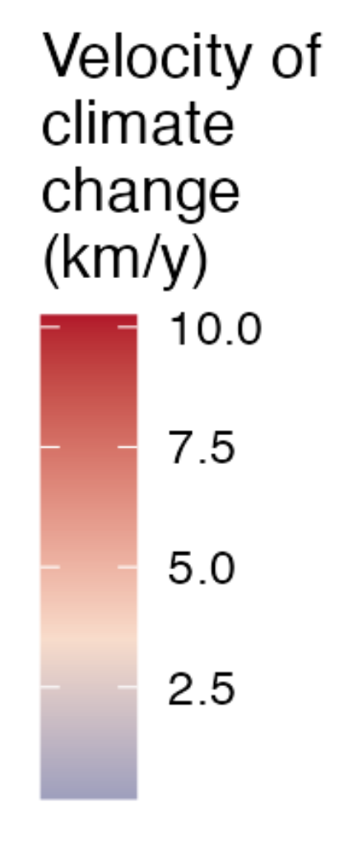
a)
b)
c)
1:1
dispersal rate slower than velocity of climate change
4
3
2
1
4
3
2
1
a)
1:1
b)
Velocity
of climate change (km/y)
dispersal rate slower than velocity of climate change
Range expansion rate (km/y)
3
2
1
1 2 3 4
1 2 3 4
Potential dispersal rate (km/y)
Minimum of potential dispersal rate and velocity of climate change (km/y)
a)
b)
1:1

