Slide 1
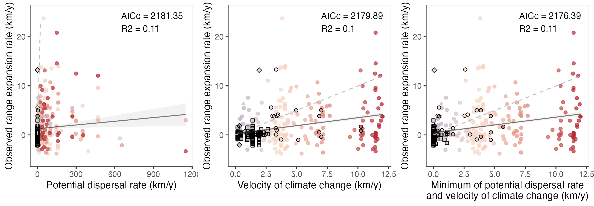
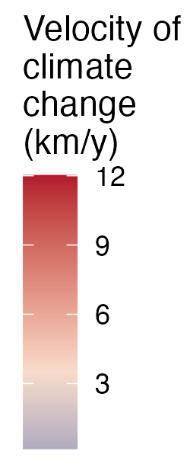
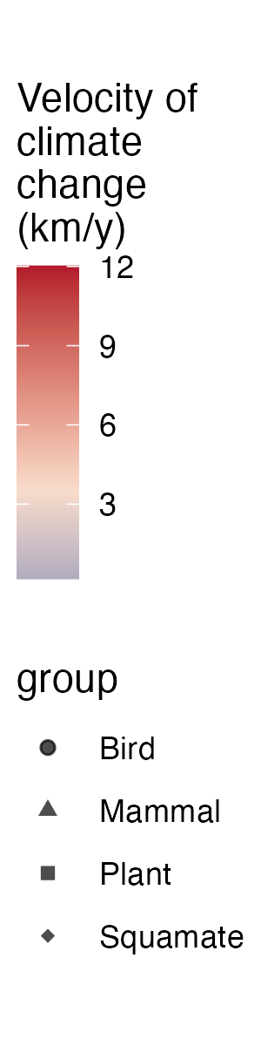
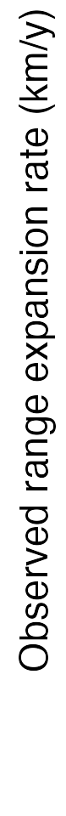
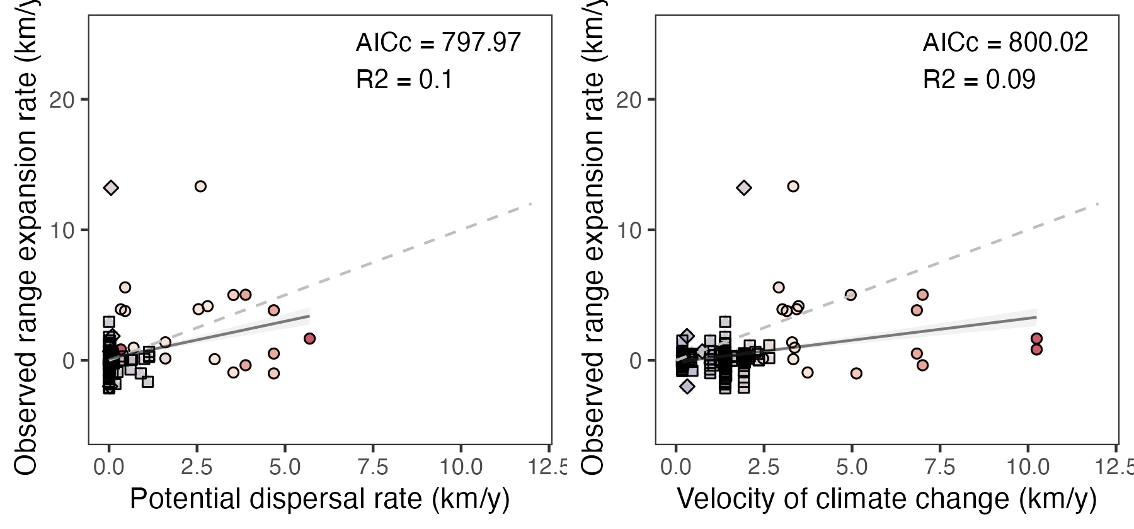
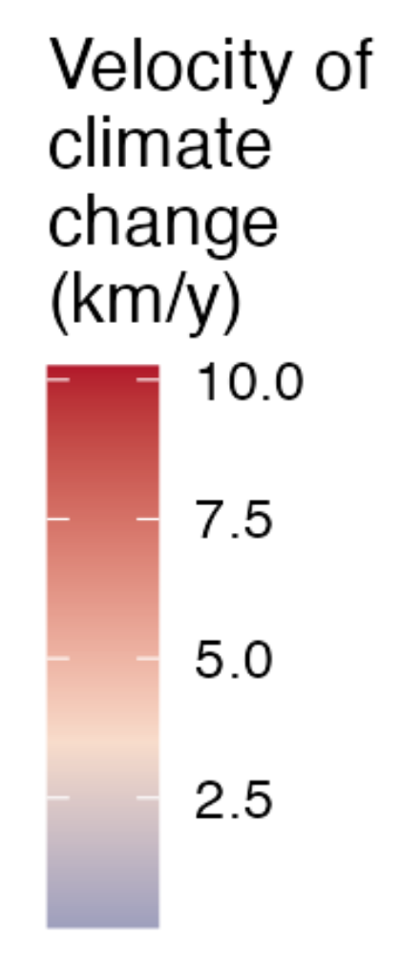
a)
b)
c)
1:1
²
²
²
Dispersal rate < velocity of climate change
Dispersal rate > velocity of climate change
n = 418
n = 418
n = 418
1200
4
3
2
1
4
3
2
1
(a)
1:1
(b)
Velocity of climate change (km/yr)
Range expansion rate (km/yr)
3
2
1
Dispersal rate < velocity of climate change
Dispersal rate > velocity of climate change
1 2 3 4
1 2 3 4
Potential dispersal rate (km/yr)
Minimum of potential dispersal rate and velocity of climate change (km/yr)
a)
b)
²
²
1:1
n = 211
n = 211
12.5
12.5

Slide 2
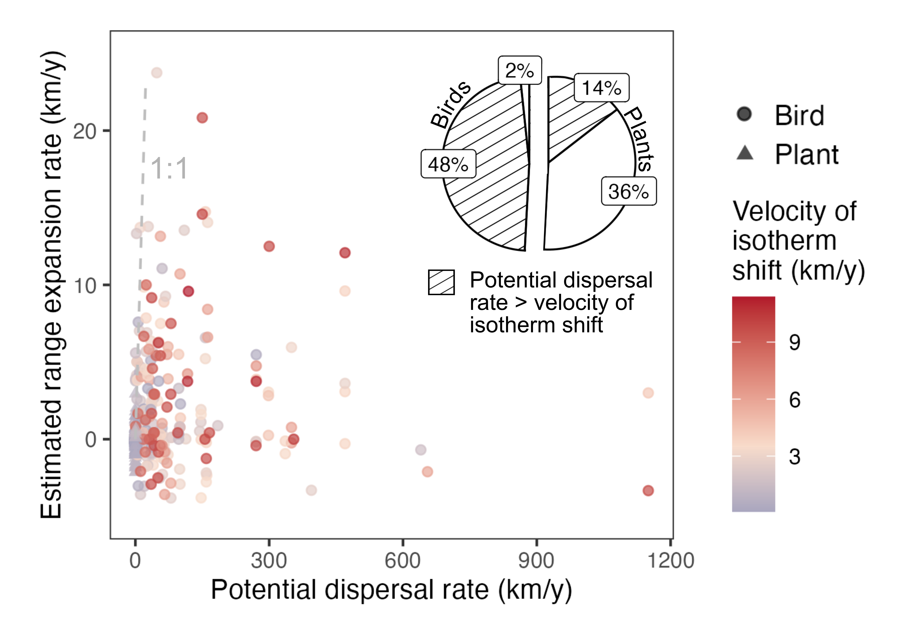
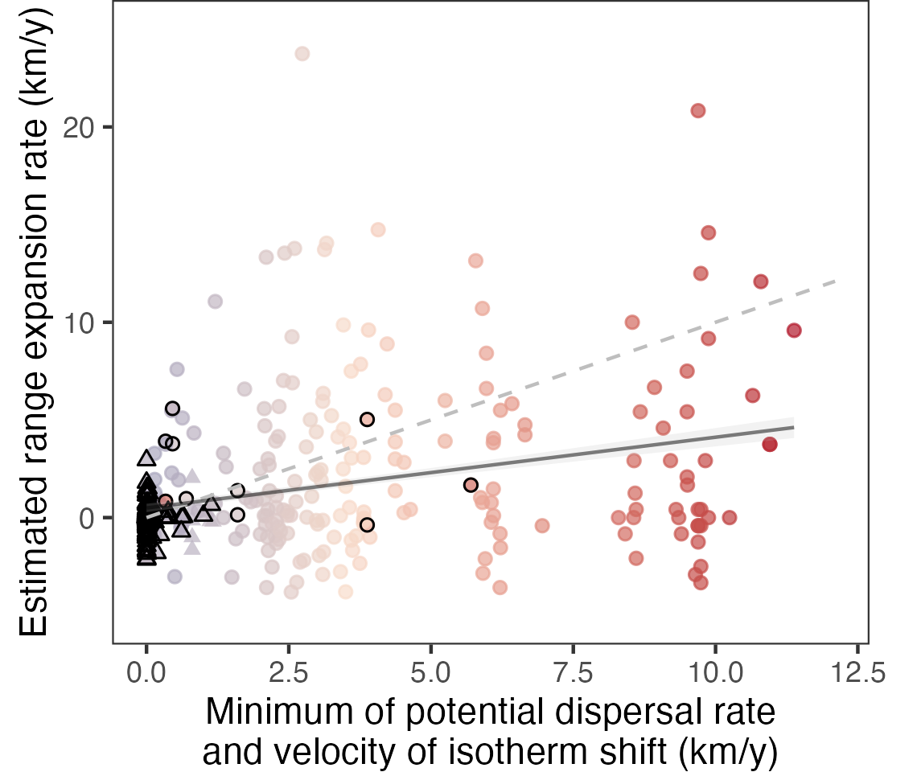
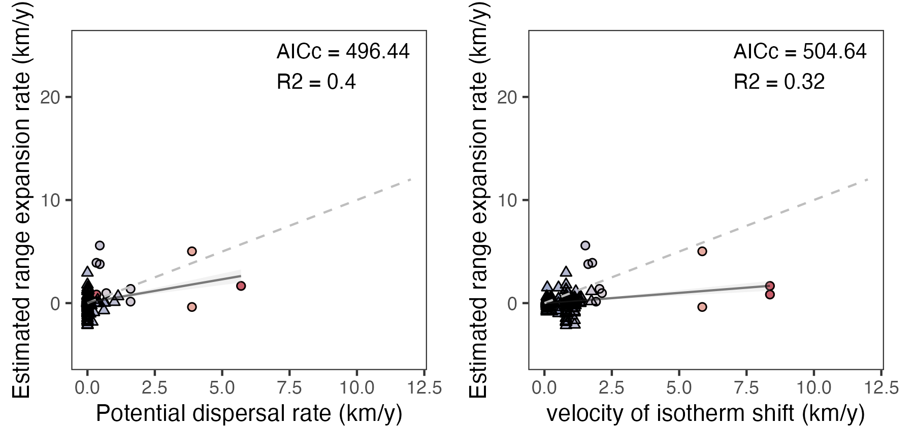
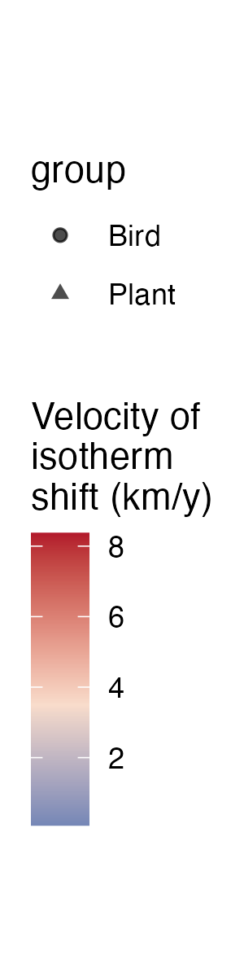
Dispersal rate < velocity of isotherm shift
Dispersal rate > velocity of isotherm shift
1:1
1:1
n = 421
n = 421
4
3
2
1
4
3
2
1
a)
1:1
b)
Velocity of climate change (km/yr)
Local range expansion rate (km/yr)
3
2
1
Dispersal rate < velocity of climate change
Dispersal rate > velocity of climate change
1 2 3 4
1 2 3 4
Potential dispersal rate (km/yr)
Minimum of potential dispersal rate and velocity of climate change (km/yr)
a)
b)
²
²
1:1
n = 189
n = 189

Slide 3
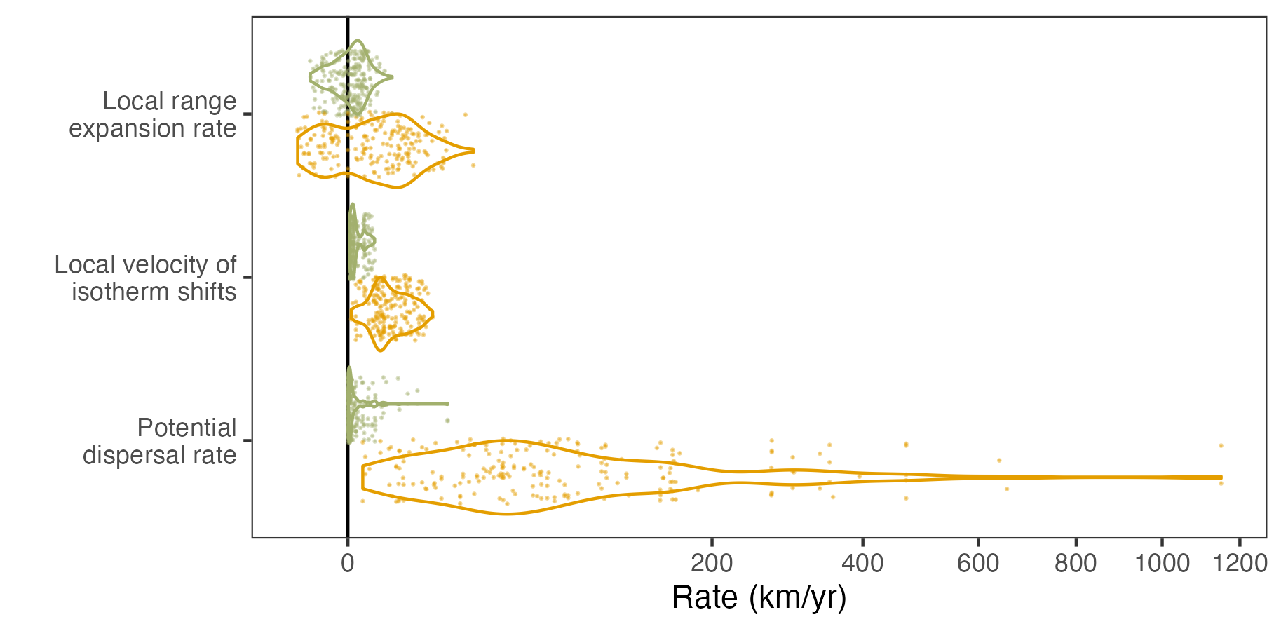
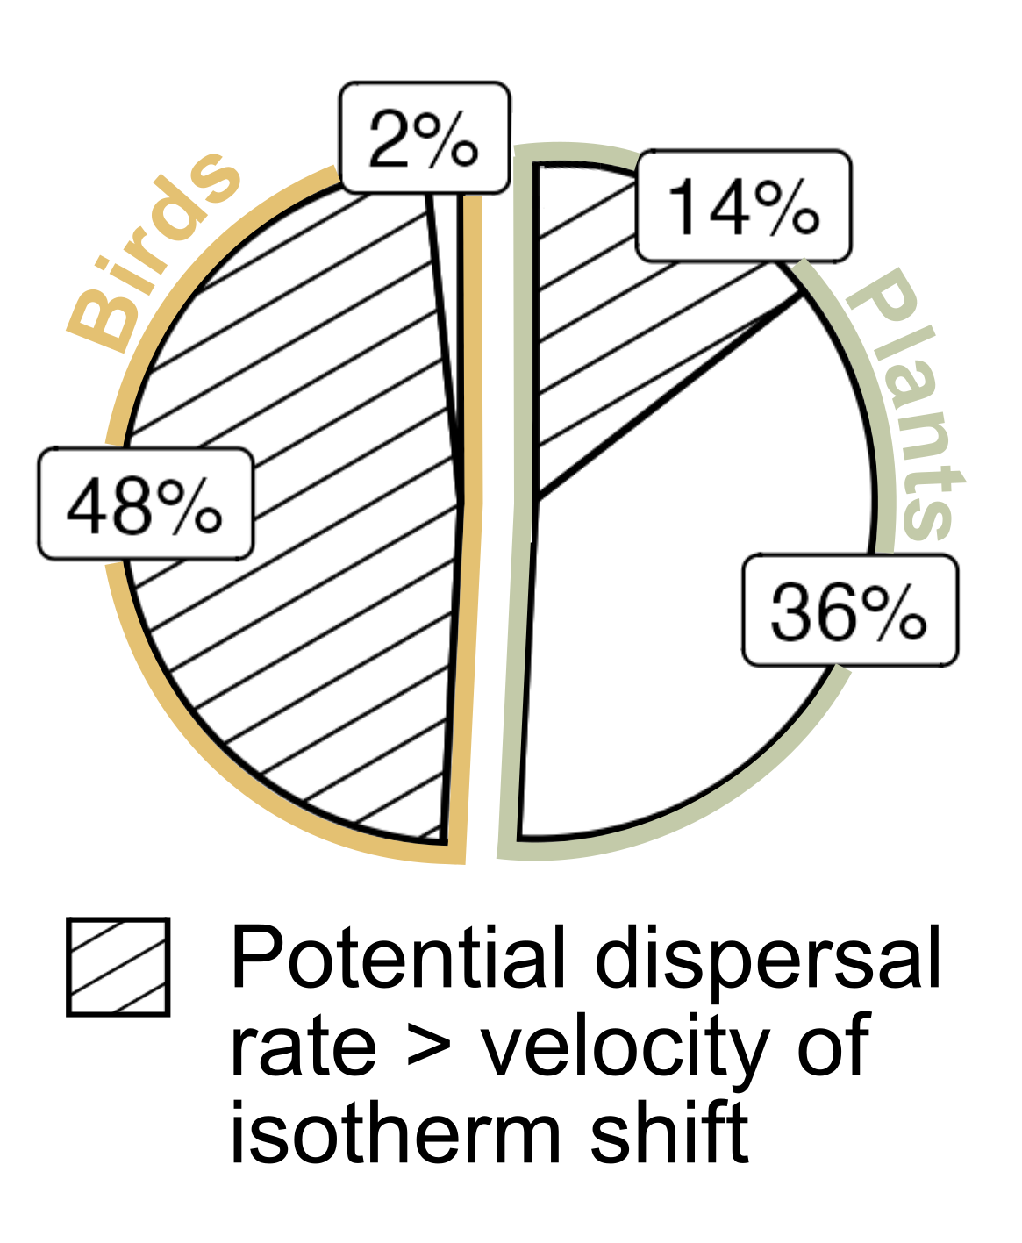
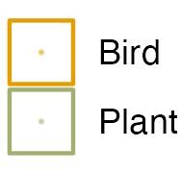
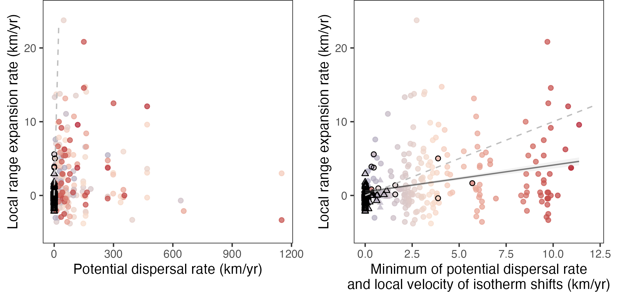
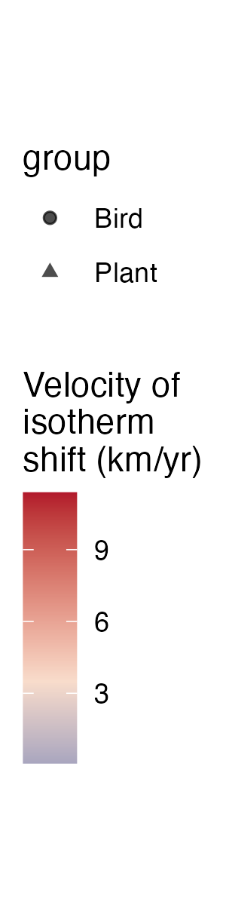
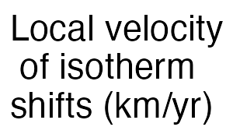
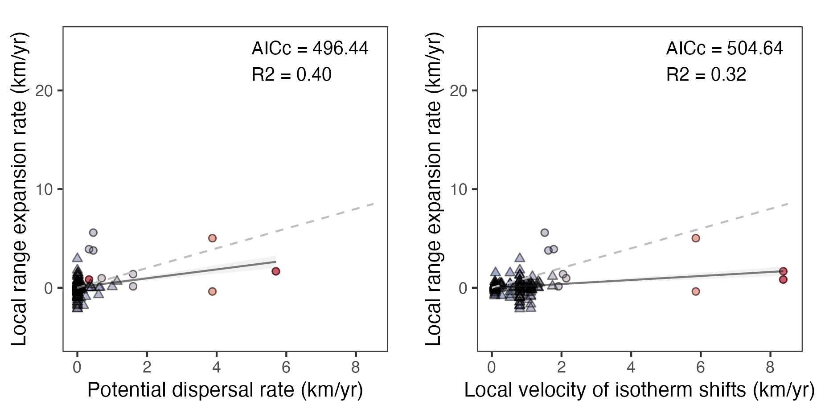
(a)
(b)
1:1
1:1
Dispersal rate < velocity of isotherm shifts
Dispersal rate > velocity of isotherm shifts
n = 421
n = 421
(a)
(b)
²
²
1:1
1:1
n = 189
n = 189

