Slide 1
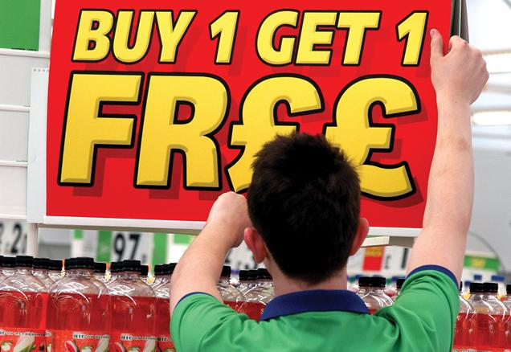
Marketing Campaign Analysis
Nicole An

Slide 2
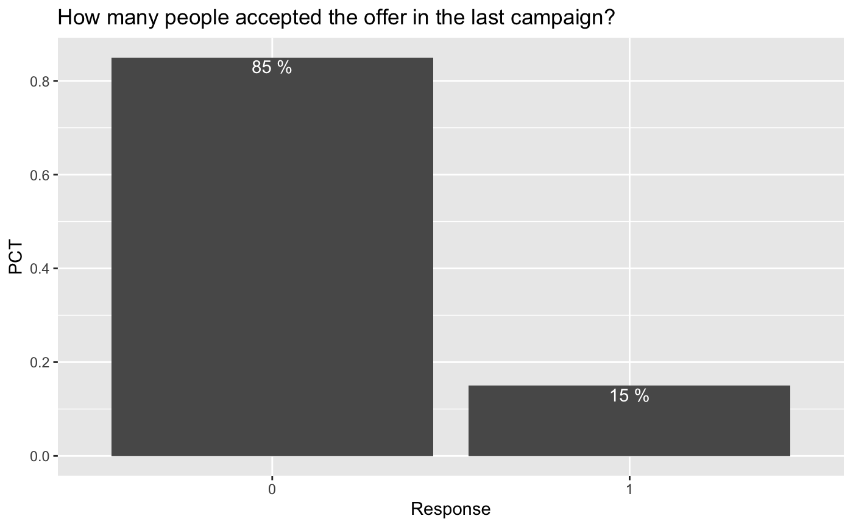
Overview of the Data – Target Variable
Rejected
Accepted
85% of the customers within the dataset rejected the offer from the last marketing campaign
15% of the customers within the dataset accepted the offer from the last marketing campaign

Slide 3
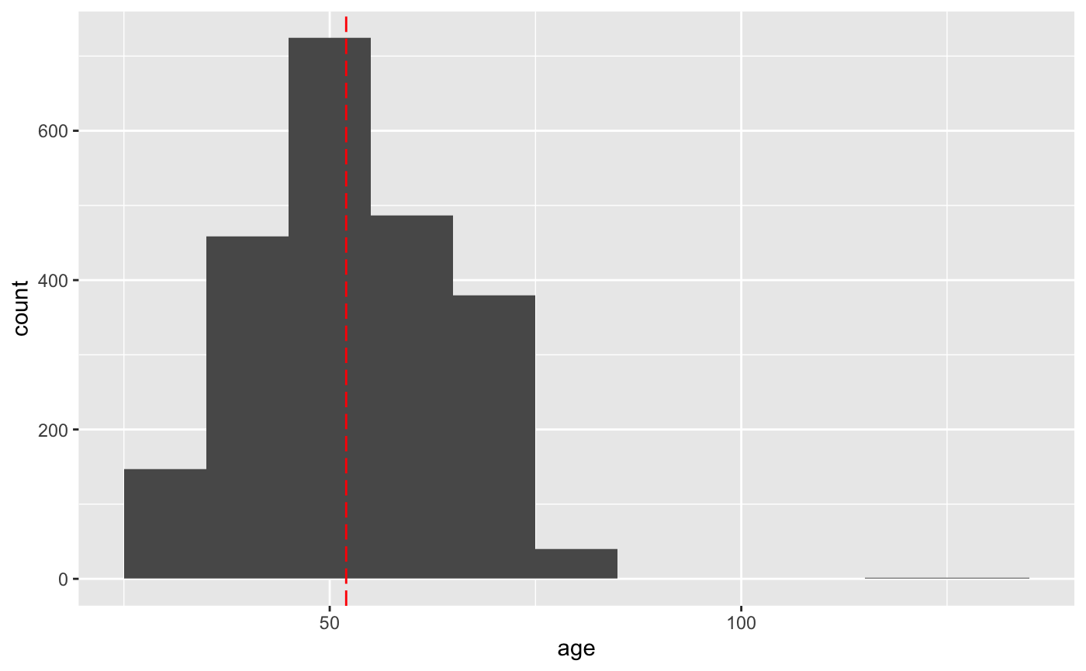
Overview of the Data – Customer Demographics
Center
01
Age
Center: 52
Minimum: 24
Maximum: 129

Slide 4
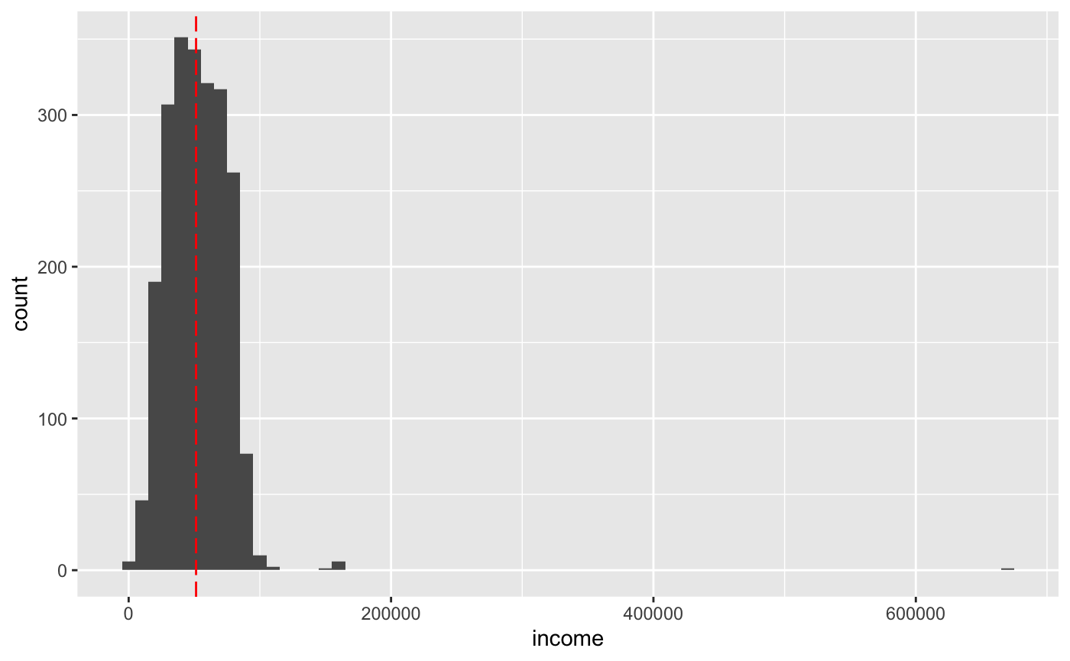
Overview of the Data – Customer Demographics
Center
02
Income
Center: $51,381.50
Minimum: $1,730
Maximum: $666,666

Slide 5
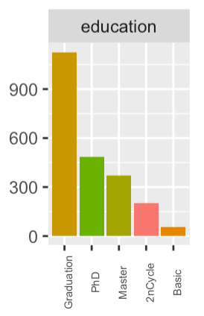
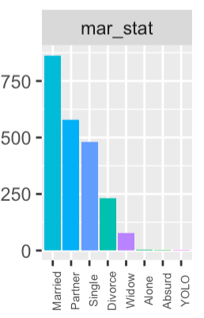
Overview of the Data – Customer Demographics
03
Education
21% PhD
Basic education only accounts for 9% of the data
50% Graduation
64% Married or Partner
04
Marital Status
Other categories account for 5% of the data
31% Single or Divorced

Slide 6
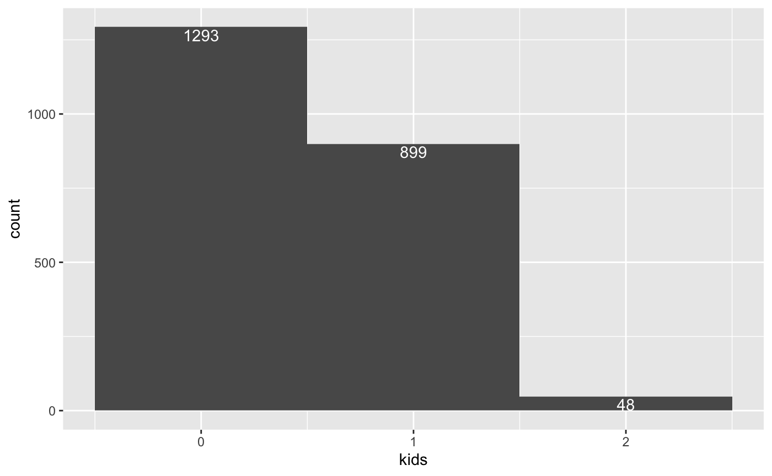
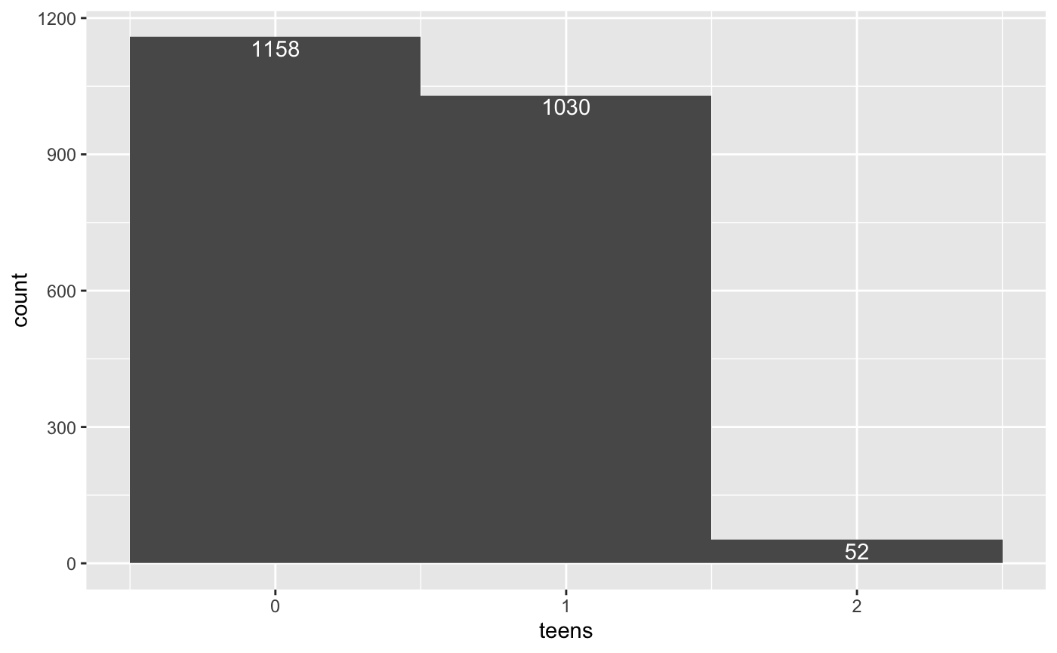
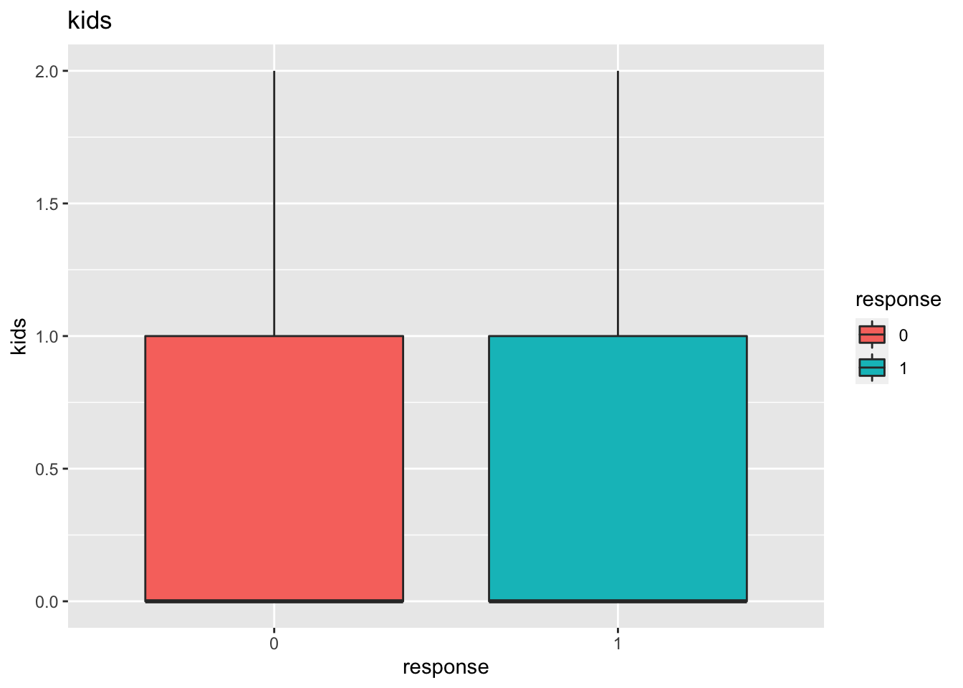

Overview of the Data – Customer Demographics
05
Number of Children
Mostly 0 or 1 children at home
Average number of kids: 0.44
Average number of teens: 0.51
Number of children do not seem to influence marketing campaign acceptance rate

Slide 7
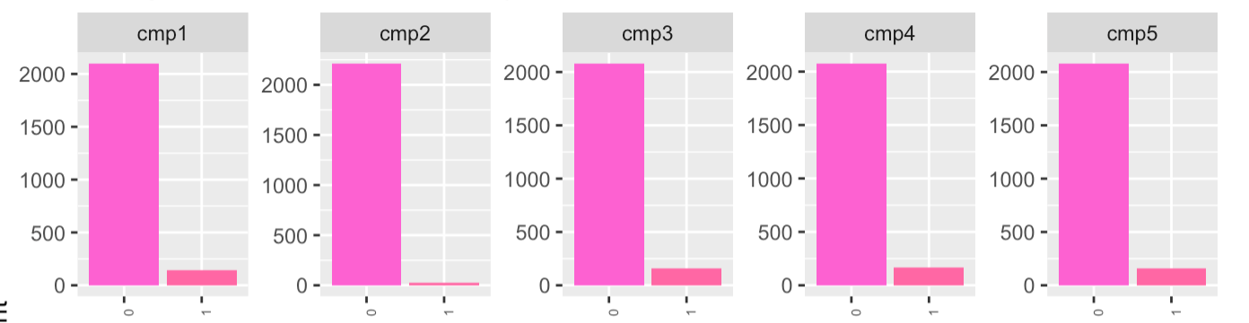
Overview of the Data – Customer Demographics
06
Responses to previous campaigns
Average acceptance rate ~ 5.9%
Minimun: 1.3%
Maximum: 7.5%

Slide 8
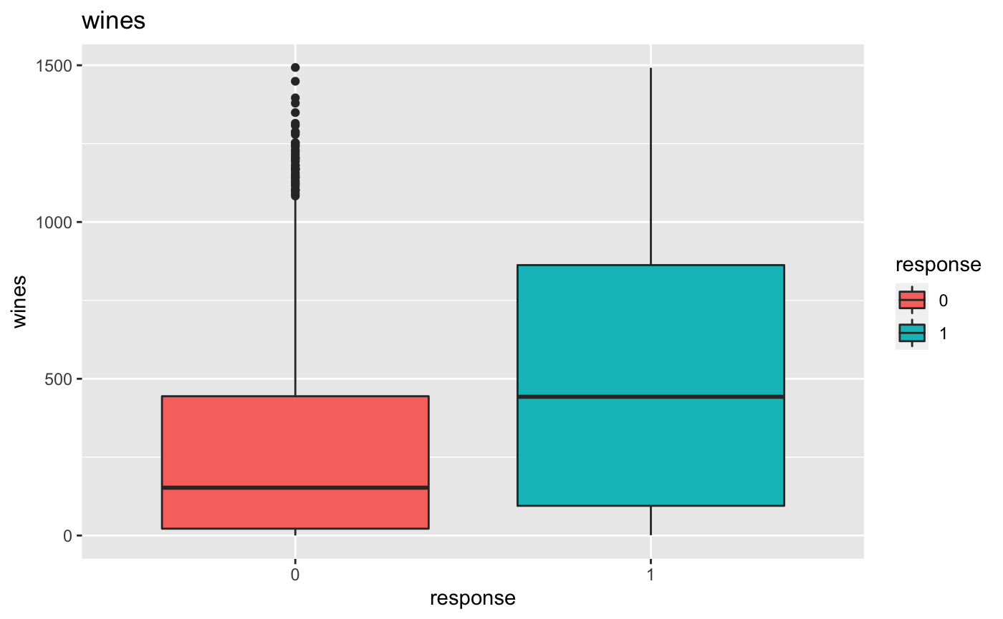
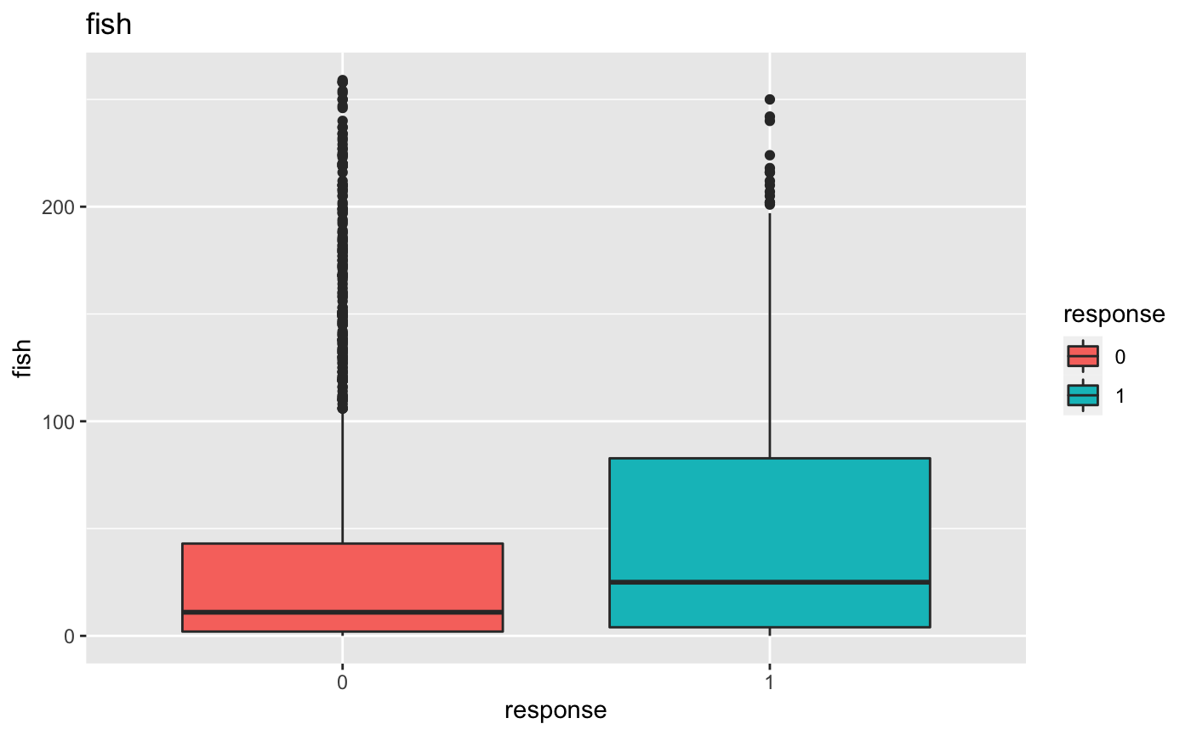
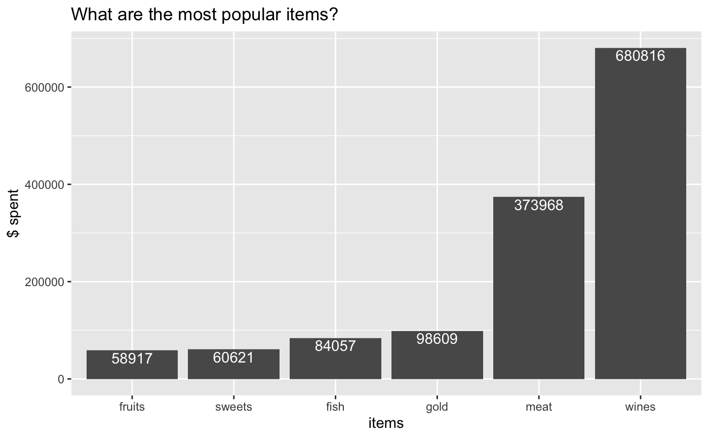
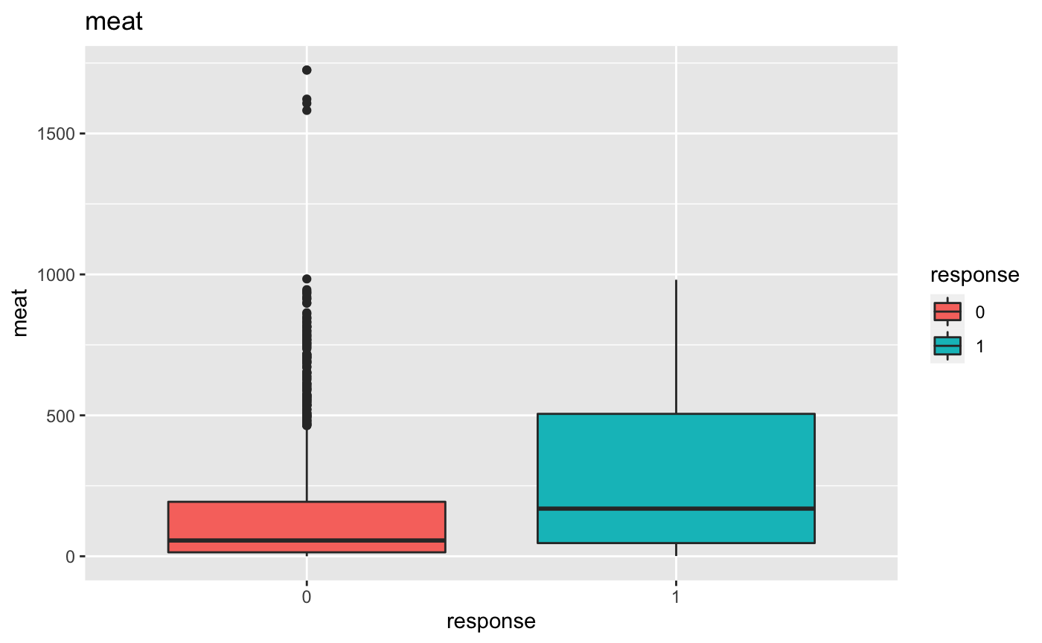
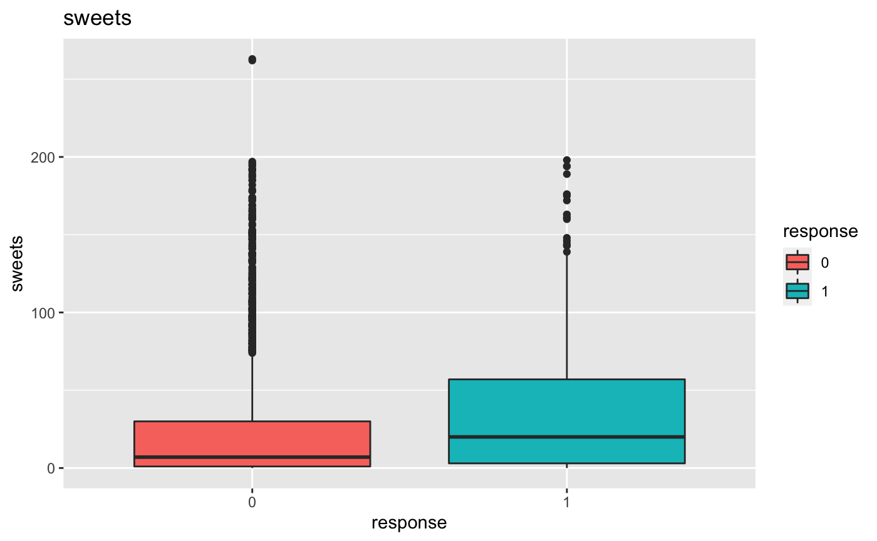
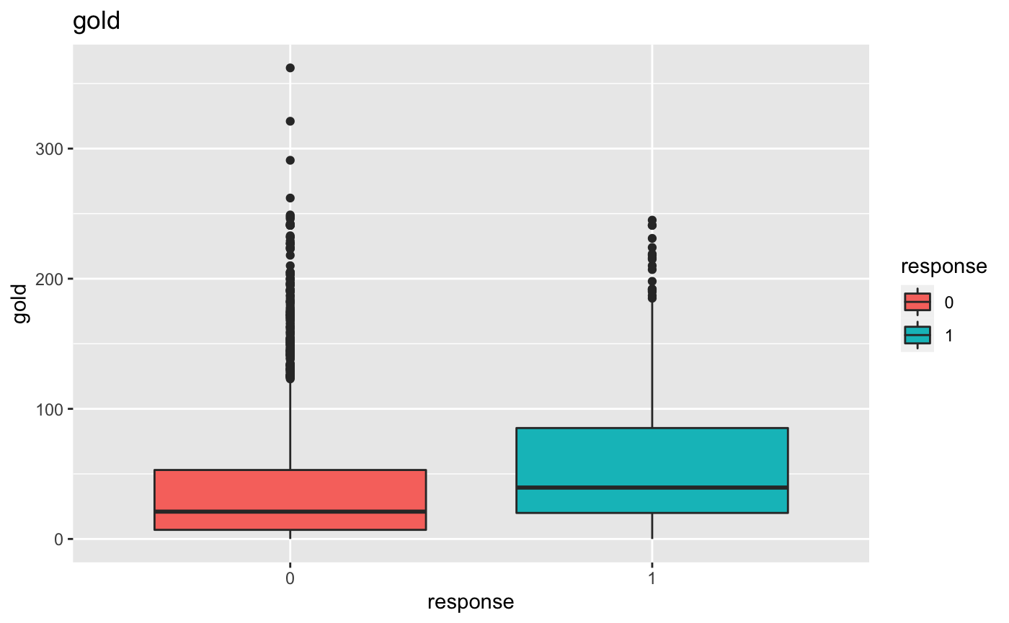
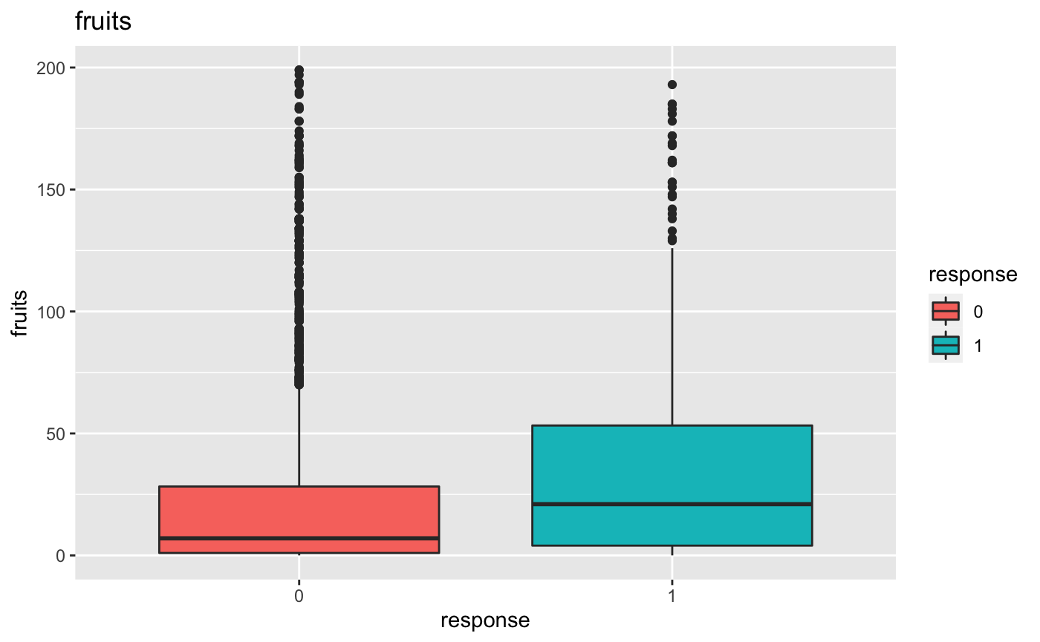
Overview of the Data – Most Purchased Items
Wines
01
Fish
Earth is the third planet from the Sun
04
Meat
Sweets
02
05
Gold
Fruits
03
06
Saturn is composed of hydrogen and helium

Slide 9
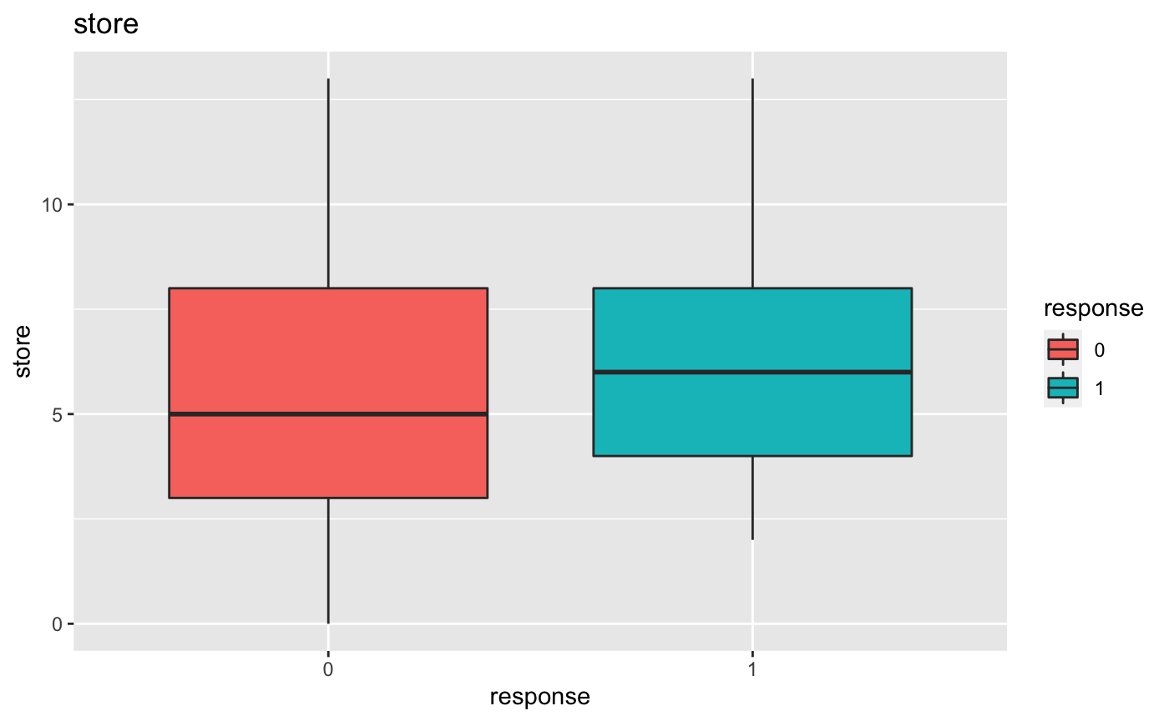
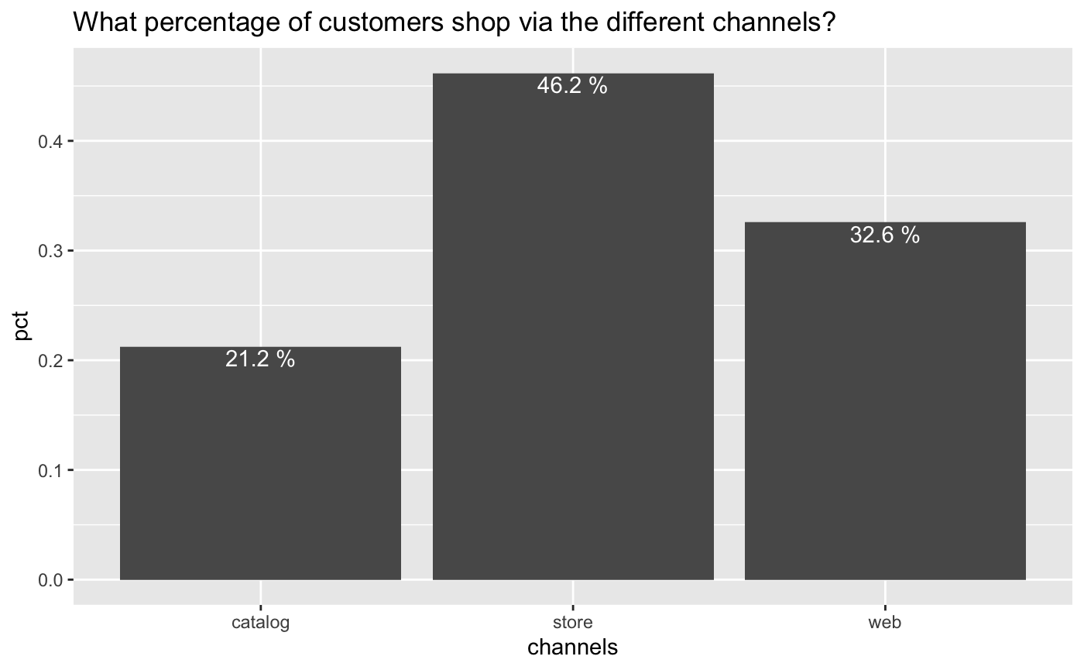
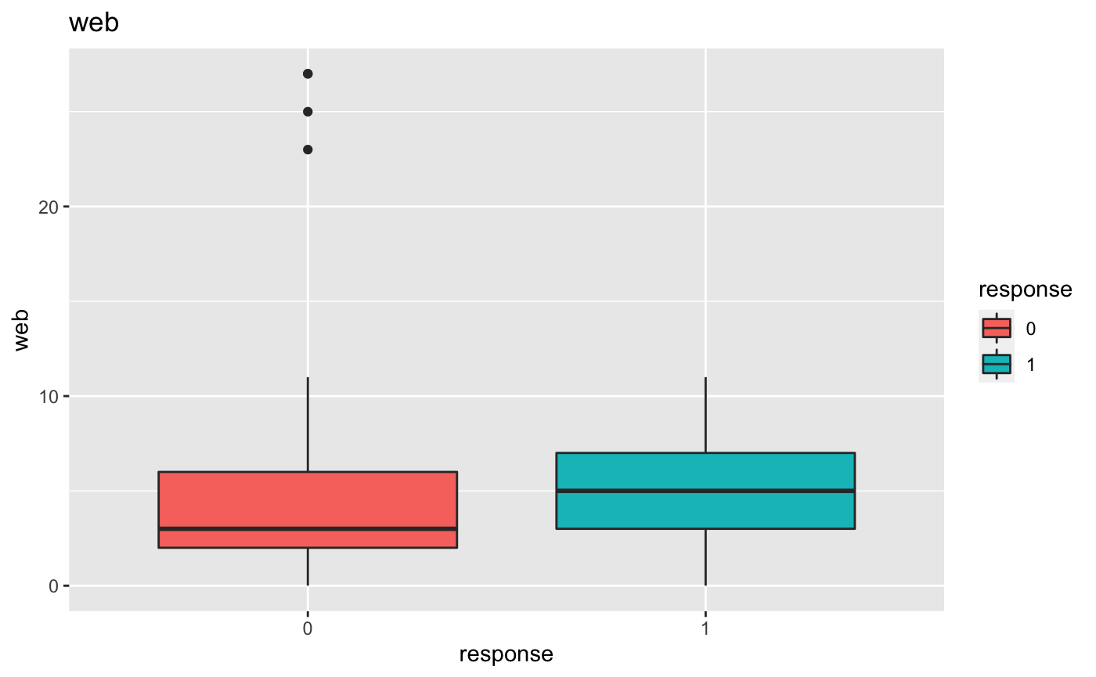
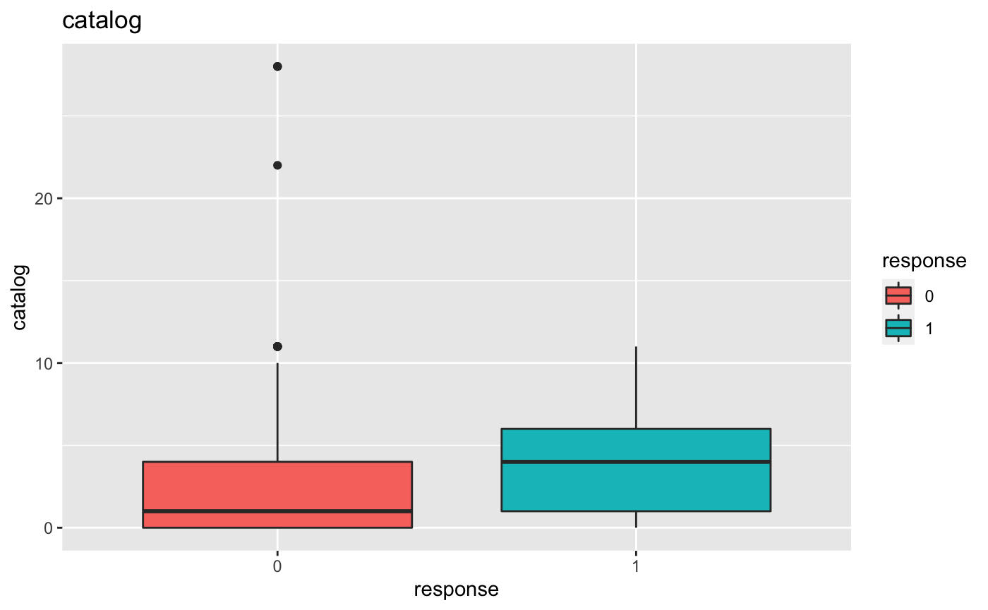
Overview of the Data – Purchase Channels
Store
Median number of purchases v.s. last campaign:
Rejected: 5
Accpeted: 6
01
Web
02
Median number of purchases v.s. last campaign:
Rejected: 3
Accpeted: 5
Catalog
Median number of purchases v.s. last campaign:
Rejected: 1
Accpeted: 4
Store: main purchase channel
More purchases lead to a tendancy of accpeting the last marketing campaign
03

Slide 10
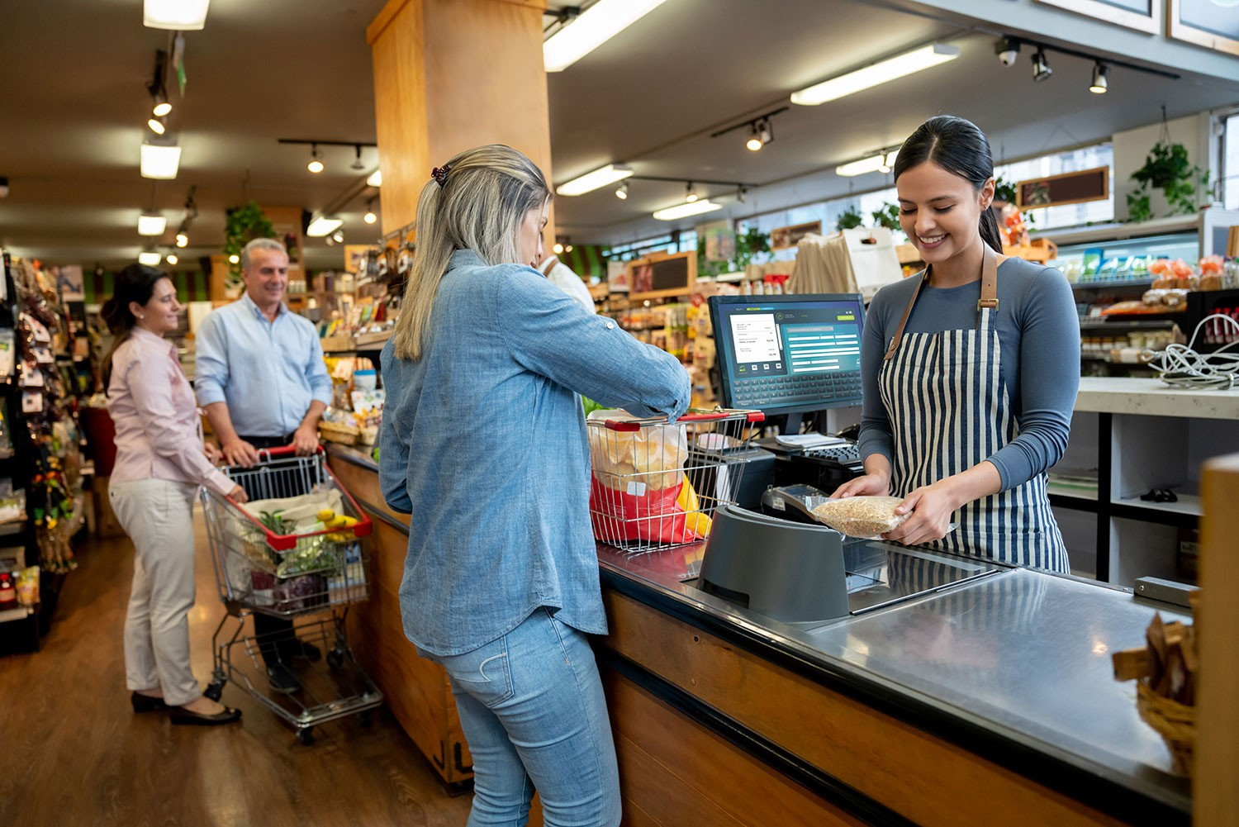
Customer Segments

Slide 11

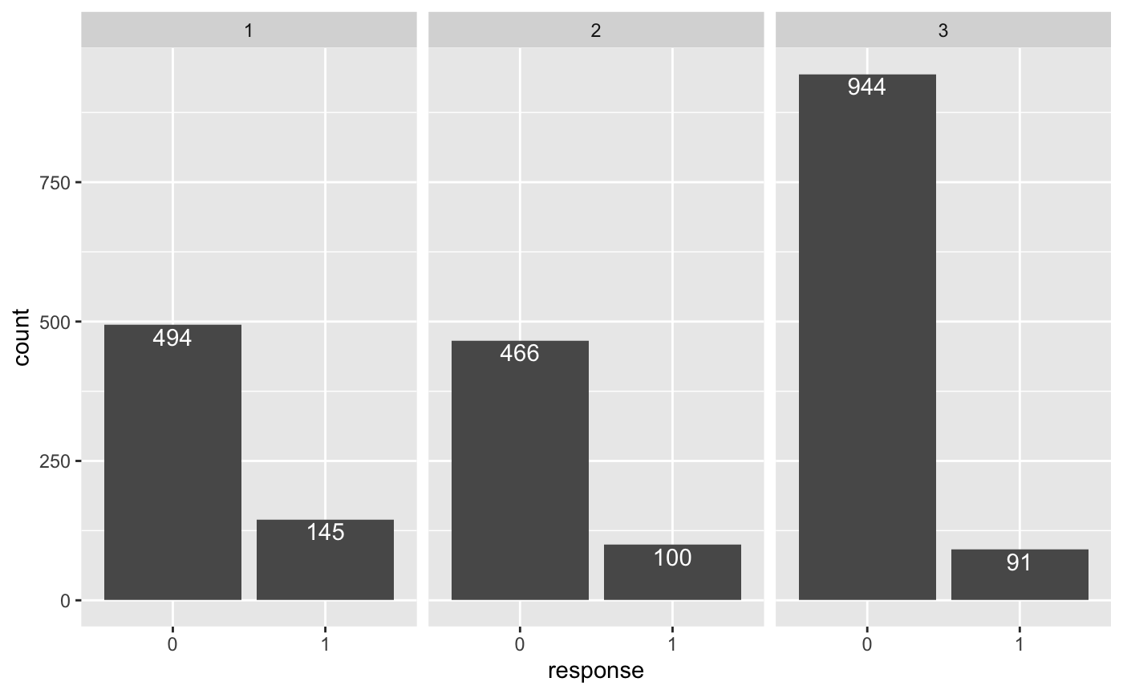
Cluster 1: Retired Elites
Age:
~55
Income:
~$74,230.12
Education:
Mostly Graduation
~0.03 kids; ~0.29 teens
Children:
Married?:
~0.38
Complains:
~0.008
Big spenders (mean overall purchase amount ~ $1,197)
Love to buy meat and wines
Span the older age brackets
Little number of children at home
Enjoy store shopping the mos
22.7%
Marketing Message Suggestion
Channel: catalog mailer, in-store customer services
Offer: 10% off on prime steak/imported wines if purchase > $75 on weekdays
Very high (> 15% target acceptance) number of customers accepted the offer from last campaign

Slide 12

Cluster 2: Tech Savvy Investors
Age:
~56
Income:
~$58,368.87
Education:
Mostly PhD
~0.33 kids; ~0.82 teens
Children:
Married?:
~0.39
Complains:
~0.007
Make the most purchases with discounts (mean ~ 4)
Love to shop online using the web
Diverse in age, spending, marital status
Amount spent on gold is relatively high (mean ~ $63)
Relatively small cluster with the most PhD degrees (mean ~ 0.26)
17.7%
Marketing Message Suggestion
Channel: email
Offer: Exclusive to online shoppers - $10 rewards on online orders if share the invitation code with friends
Moderate (> 15% target acceptance) number of customers accepted the offer from last campaign

Slide 13
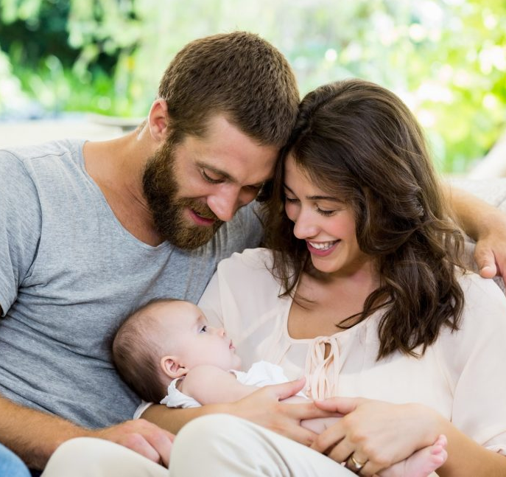
Cluster 3: Thrifty Younger Parents
Age:
~51
Income:
~$35,307.47
Education:
Mostly Basic
~0.76 kids; ~0.46 teens
Children:
Married?:
~0.39
Complains:
~0.01
Rarely make purchases (mean overall purchase amount ~ $83)
Approximately 1 kid or 1 teen at each customer’s home
Span the younger age brackets
Love to visit the website but usually make in-store purchases
Largest cluster but slightly less affluent
8.8 %
Marketing Message Suggestion
Channel: email, SMS, pop-up window ads
Offer: 15% off on first order after signing up with meat purchases by scanning member barcode in store
Very Low (< 15% target acceptance) number of customers accepted the offer from last campaign

Slide 14

Recommendation to New Customers

Slide 15
For the next market campaigning, who should we solicit?
Do Not Contact
Contact
id | EVENT_LABEL | PROB
111 | 0 | 0.25716493
112 | 0 | 0.16099714
113 | 0 | 0.04532619
114 | 0 | 0.21266631
116 | 0 | 0.13601627
117 | 0 | 0.06185771
118 | 0 | 0.05512559
119 | 0 | 0.04440915
120 | 0 | 0.114298
122 | 0 | 0.09337386
123 | 0 | 0.11759651
124 | 0 | 0.03141183
125 | 0 | 0.09601929
126 | 0 | 0.22549629
127 | 0 | 0.21571489
128 | 0 | 0.22744759
129 | 0 | 0.01930045
130 | 0 | 0.02339361
132 | 0 | 0.23758638
135 | 0 | 0.0603854
136 | 0 | 0.05958746
136 | 0 | 0.29144749
138 | 0 | 0.02151926
139 | 0 | 0.28594427
140 | 0 | 0.0458847
141 | 0 | 0.01425631
142 | 0 | 0.09462551
143 | 0 | 0.07637742
144 | 0 | 0.07843961
145 | 0 | 0.00333658
147 | 0 | 0.17609823
148 | 0 | 0.16149529
149 | 0 | 0.24866414
150 | 0 | 0.08385184
id | EVENT_LABEL | PROB
115 | 1 | 0.824006
121 | 1 | 0.9086906
131 | 1 | 0.97512377
133 | 1 | 0.64305358
134 | 1 | 0.73632964
146 | 1 | 0.68875851
Predicted acceptance rate: 15%

