Slide 1
Startup Investments
Rachel Wang, Daniel Peng, Ann Li, Nicole Erich

Slide 2
The Background
After the Dot-com bubble burst in 2000, venture capital spending did not fully recover to previous levels until approximately 2005
Since then, spending has increased continually, both in investment dollars and number of investments
With the exception of the 2009 economic downturn
High company valuations and record-level investment in 2014 has led to a decline in 2015, as companies that are over-valuated are not prepared to go public
Less certainty of investments has led to more companies vying for limited resources

Slide 3
The Big Question
Where does the money come from?
Do investors typically invest in niche industries or diversify?
Do some venture capital firms prefer to invest early or late?
Is there evidence of a “fear of missing out” effect among investors?
Where is it going?
What are some common characteristics of startups that receive funding?
Are certain markets more successful than others?
Do startup companies tend to receive funding from one or multiple investors?

Slide 4
The Data
104,246 unique investment transactions from January 2005 - October 2014
29,742 unique companies from 650 markets and 98 countries
20,613 unique investors
Other variables:
Year / quarter
Funding round (Angel, Seed, A, B, C, etc.)
Investor market
Amount of investment

Slide 5
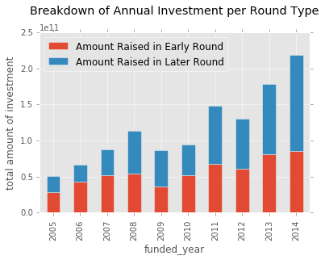
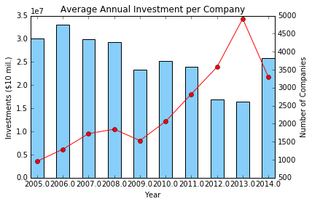
Exploration - General
Overall investment has been increasing since 2005
Funding at early rounds has been decreasing in recent years, as a percentage of total
Notes:
Increase in investment from LATER rounds – more stable investments
Avg. investment per company in early rounds decreasing, because companies are increasing. (share more of the same resources)

Slide 6
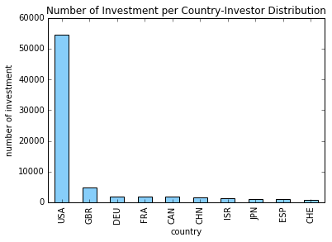
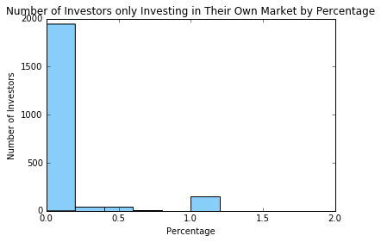
Exploration - Investors
CrunchBase data skewed to US-related information
Tend to diversify from their self-described market

Slide 7
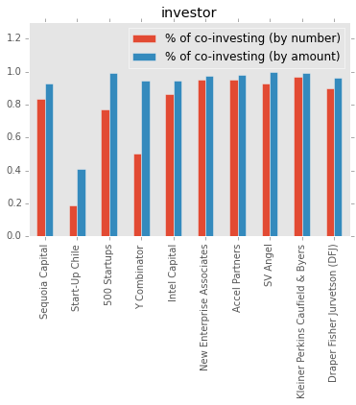
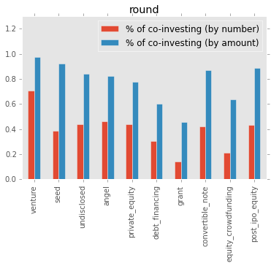
Exploration – Co-Investment
Co-investment is common among VC. Even industry leaders do most of their investments by co-investing
VC tends to invest small amounts alone, especially during the early rounds

Slide 8
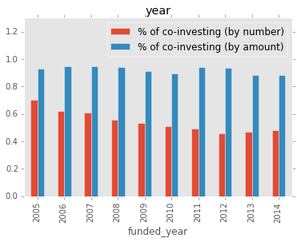
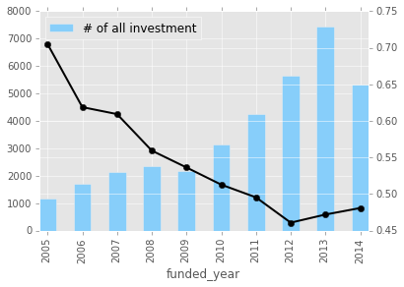
Exploration – Co-Investment
The percentage of co-investment events decreased
The pattern of co-investments stable as a percentage of dollar amount invested

Slide 9
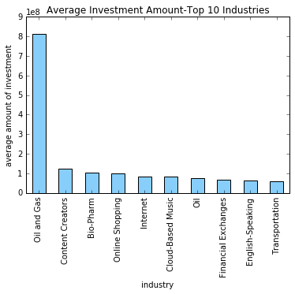
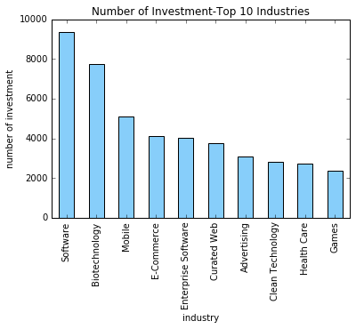
Exploration - Startups
More money needed, less opportunities to be funded

Slide 10
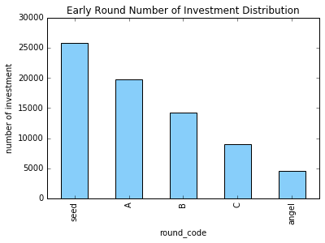
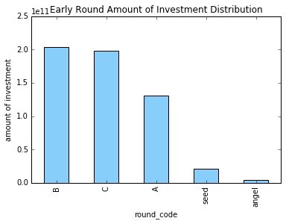
Exploration - Startups
More money needed, less opportunities to be funded

Slide 11
Conclusion
Investors increasingly prefer low-cost, low-risk investment opportunities
Industries with lower barriers to entry
Later rounds of funding
The amount of startups searching for funding is increasing, but the early funding available remains stable
Is actually decreasing as a percent of total available
Startups need stay competitive in valuation and start-up costs, not just traditional “bootstrap” mentality

