Slide 1
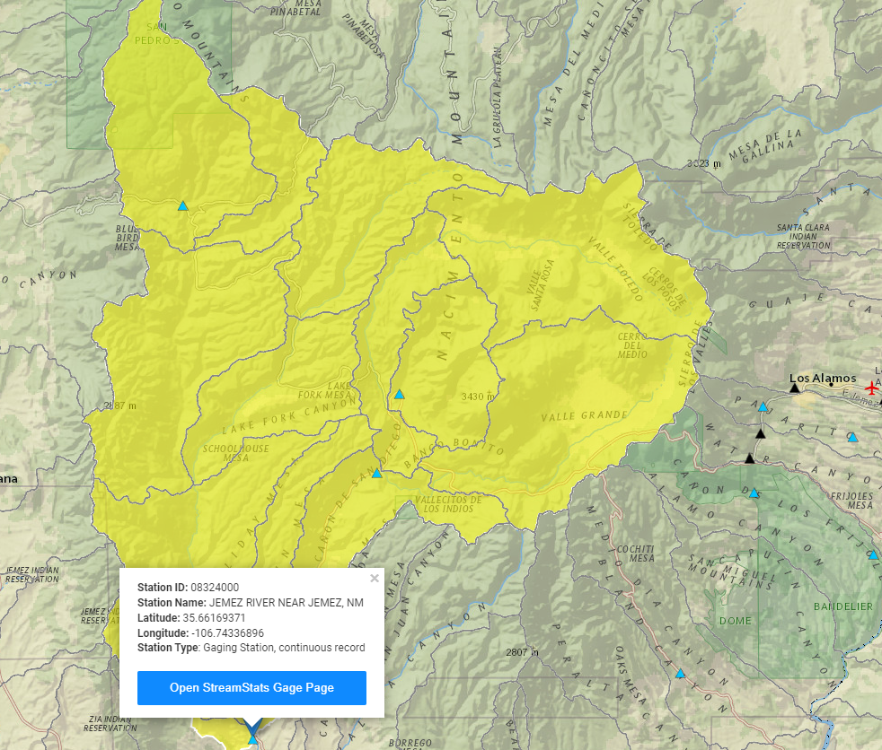

Drainage Area: 472 mi^2

Slide 2
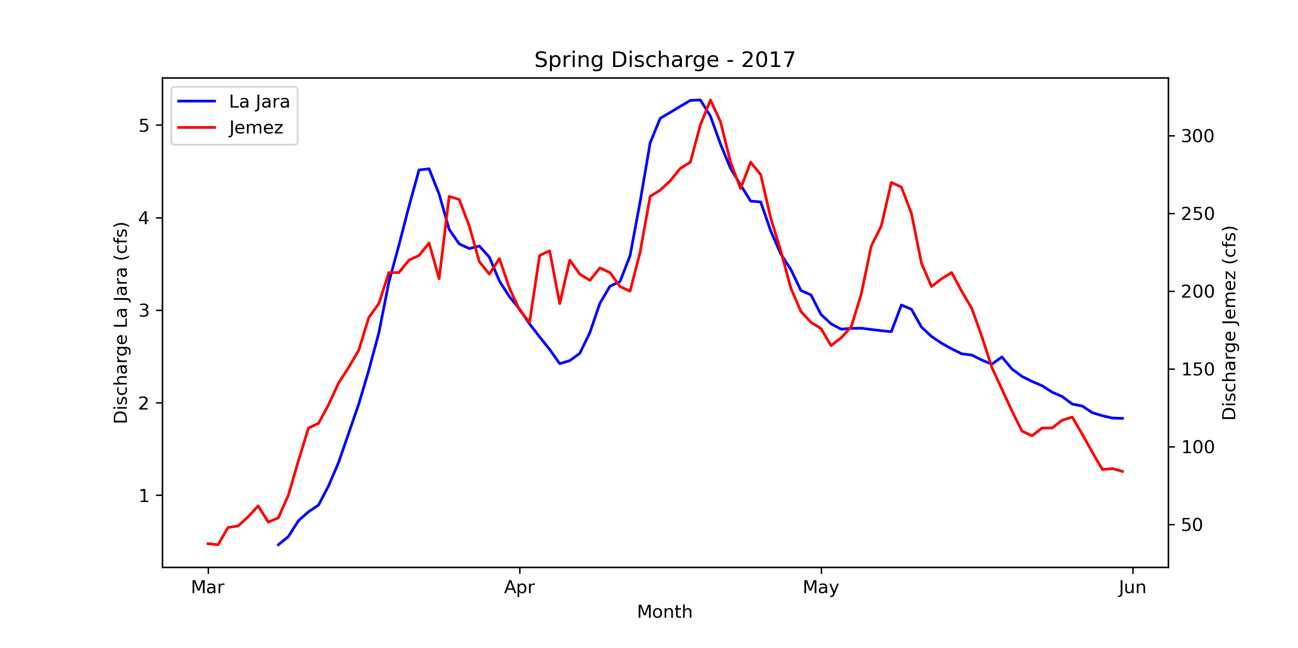

Slide 3
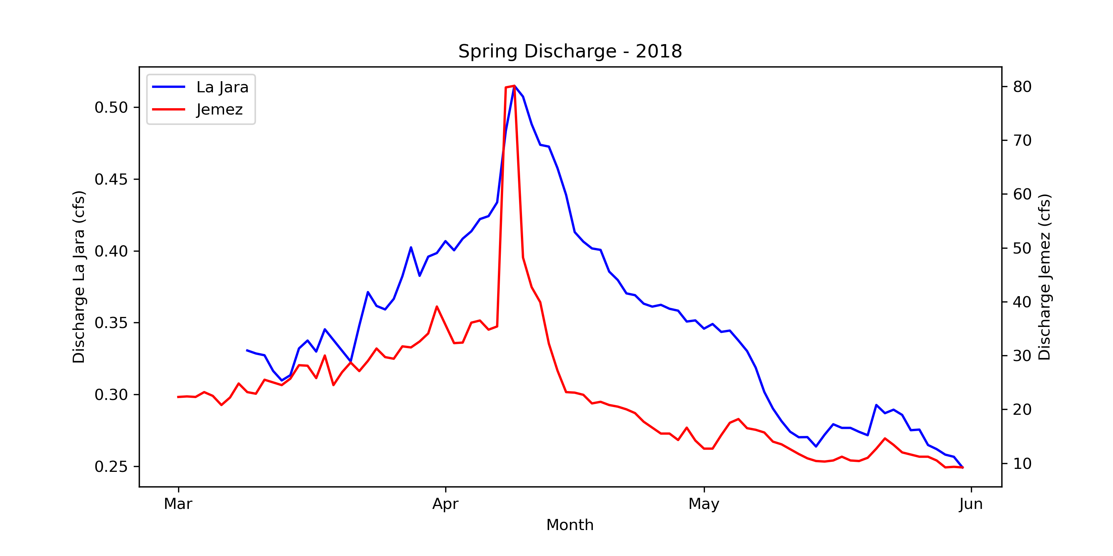

Slide 4
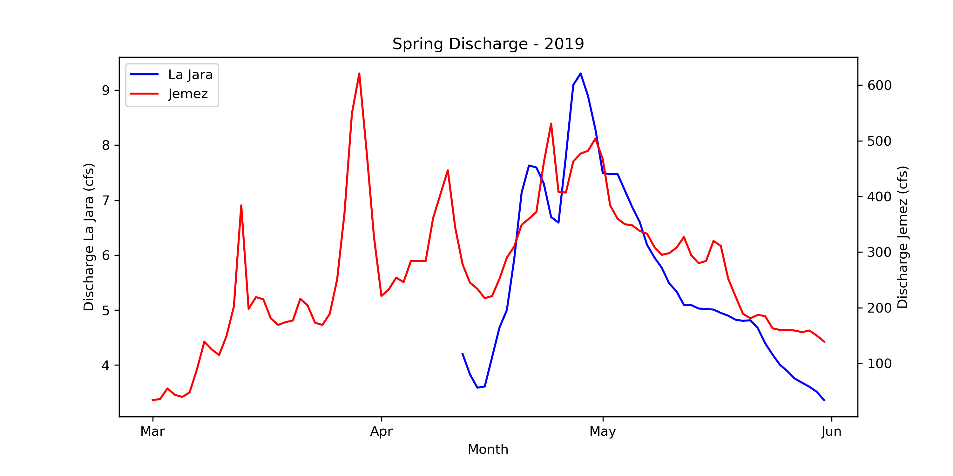

Slide 5
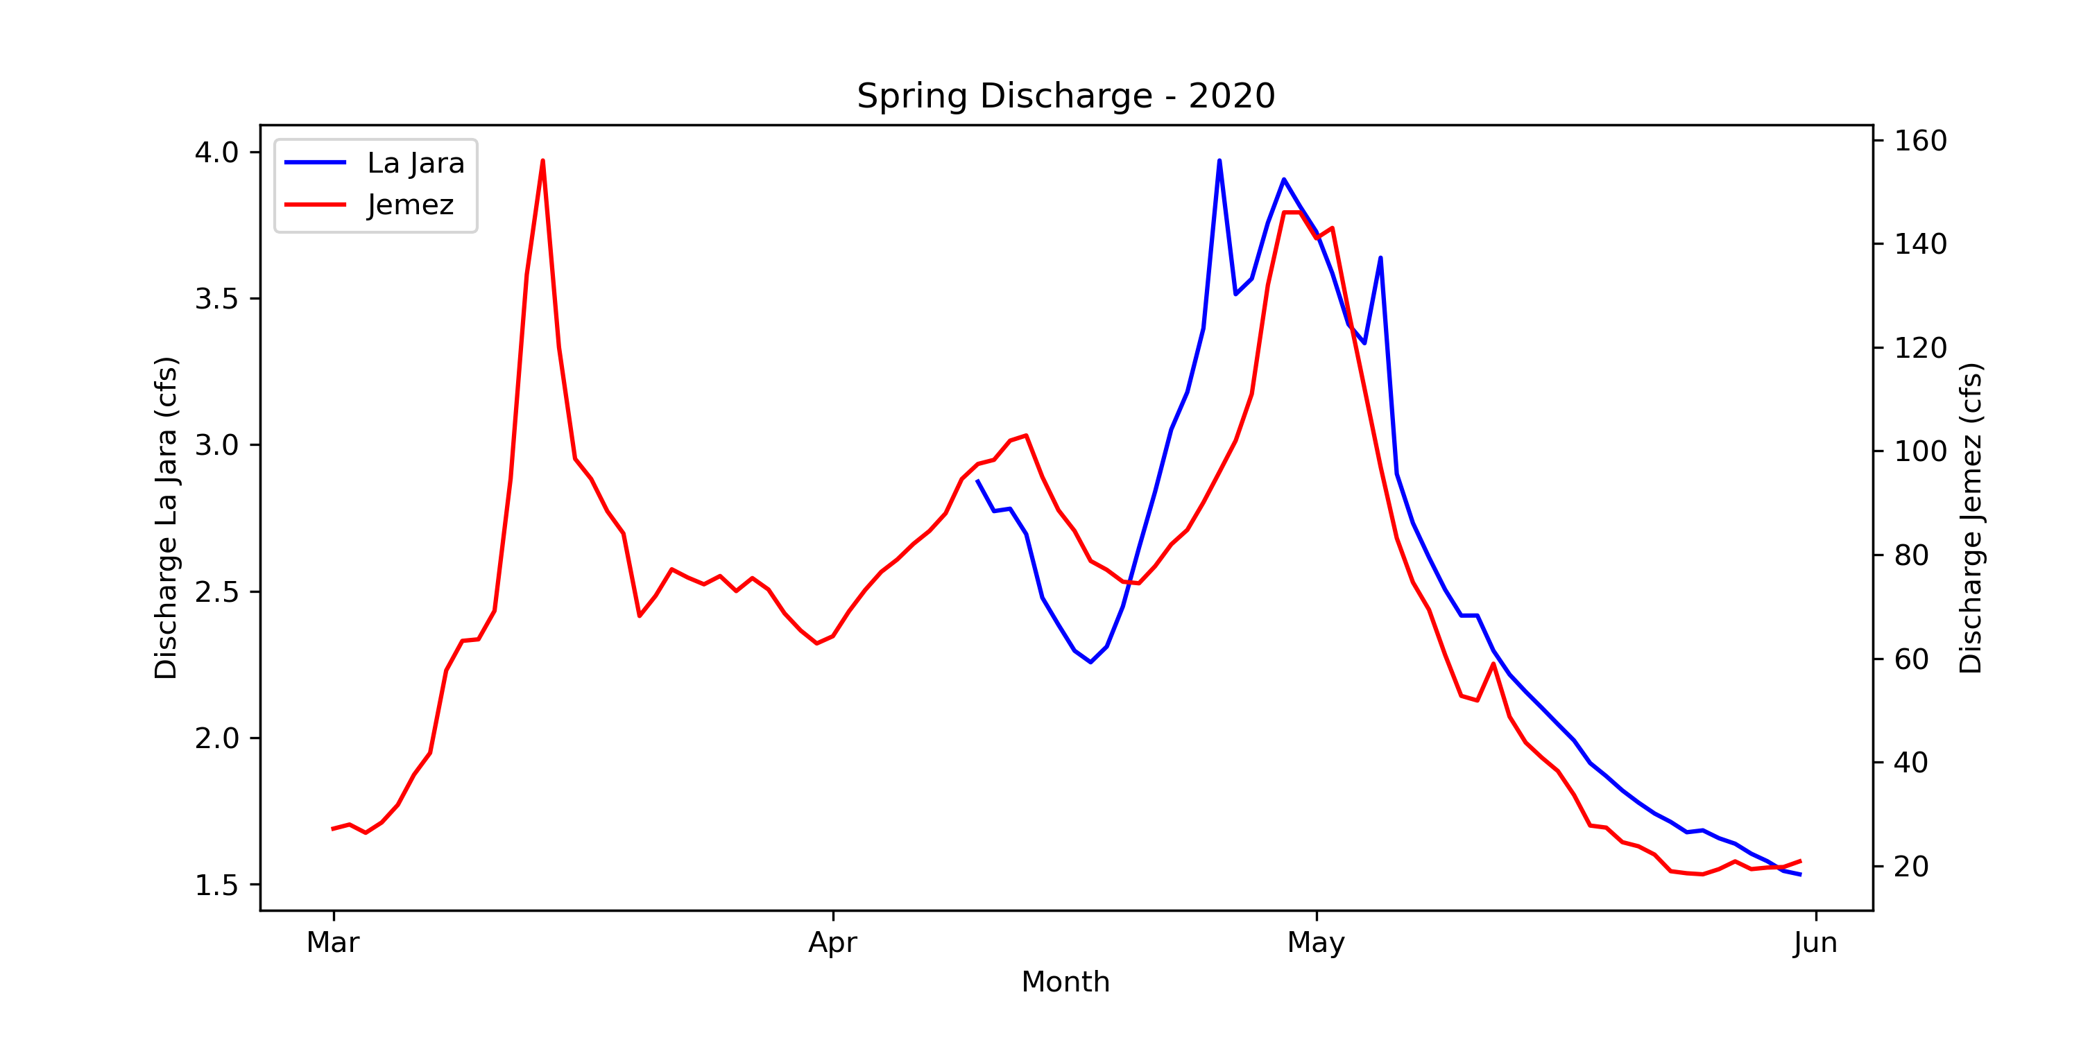

Slide 6
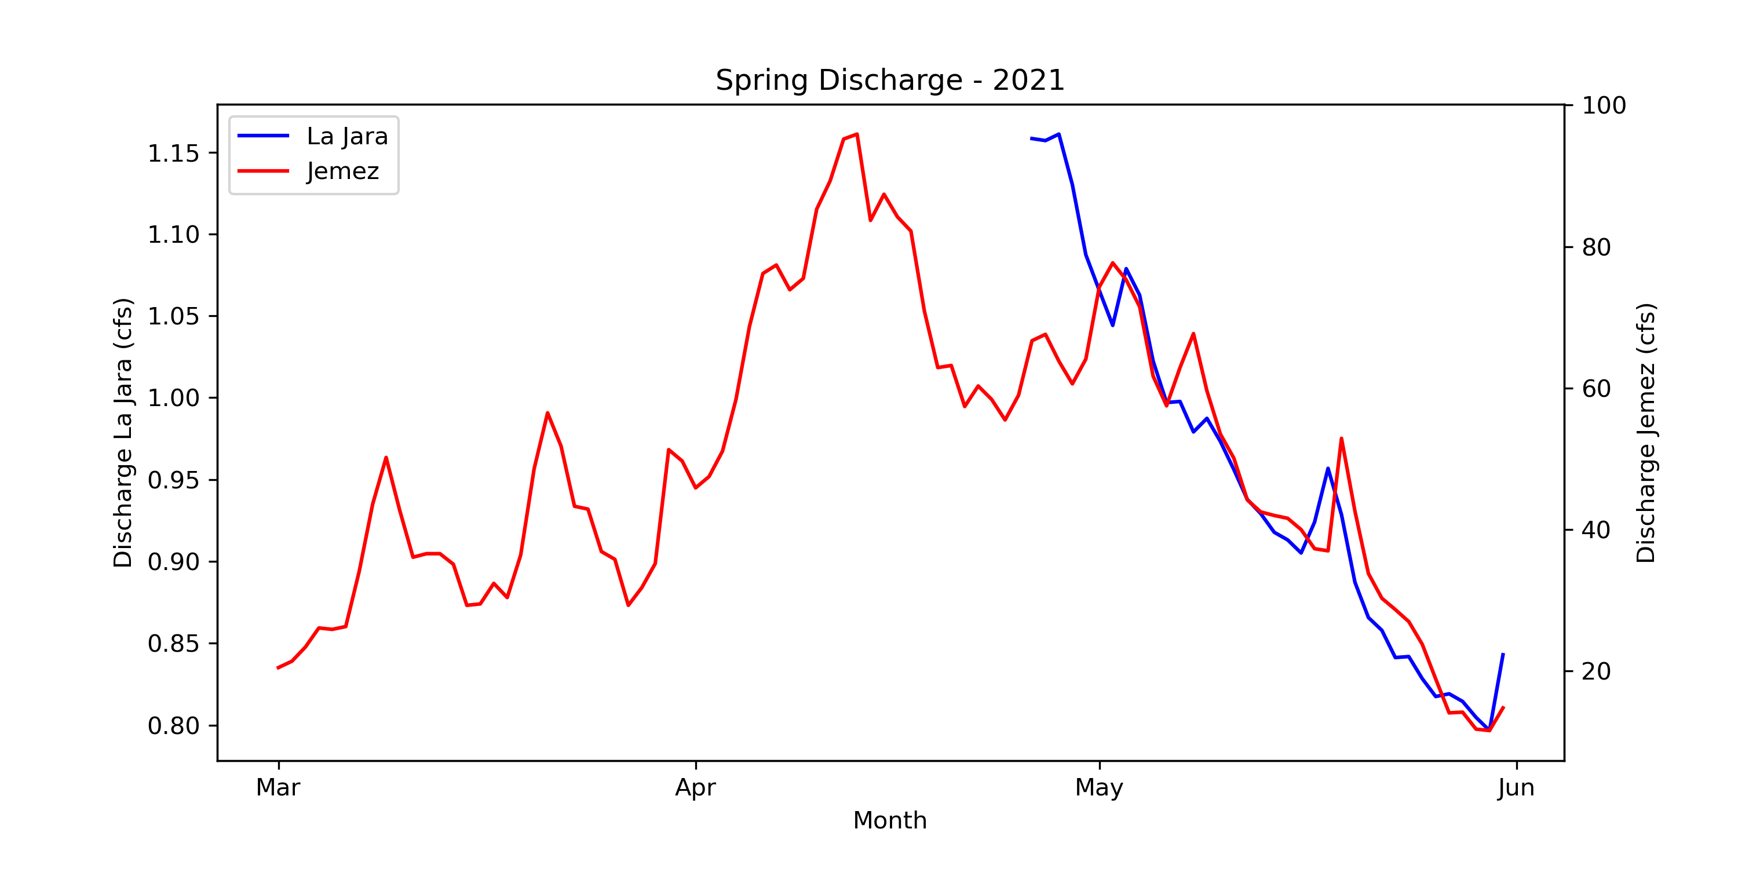

Slide 7
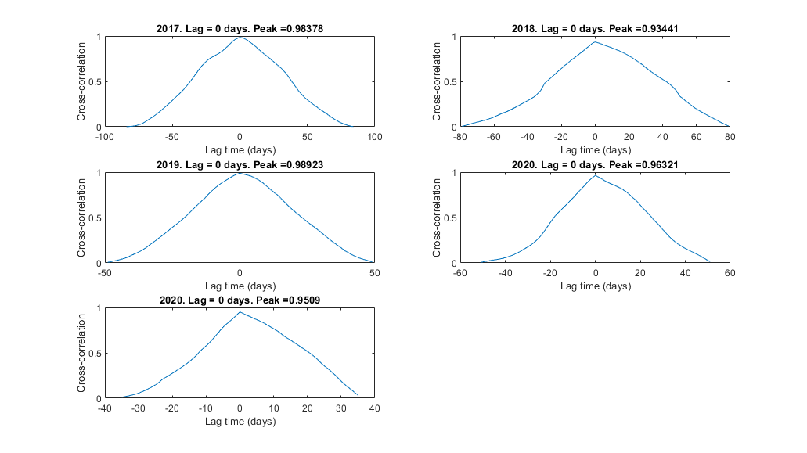

Slide 8
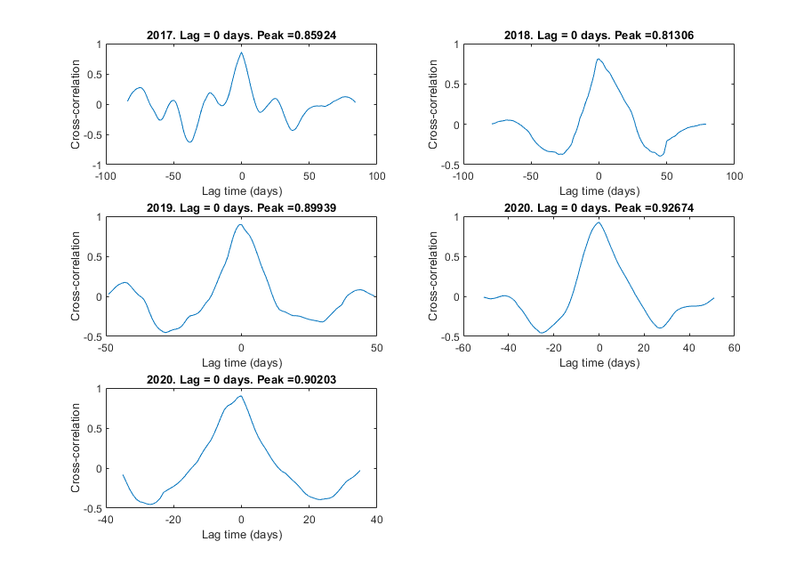

Slide 9
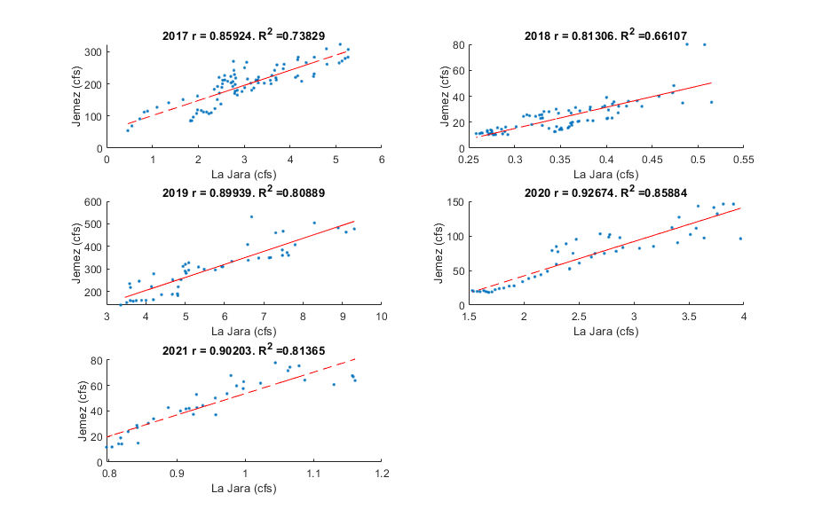

Slide 10
 | La Jara Peak Flow |  | Jemez Peak Flow
Year | Date | Magnitude (cfs) | Date | Magnitude (cfs)
2017 | 4/19 | 5.27 | 4/20 | 323
2018 | 4/9 | 0.51 | 4/9 | 80.1
2019 | 4/28 | 9.3 | 4/24 | 621
2020 | 4/25 | 3.97 | 4/29 | 156
2021 | 4/28 | 1.16 | 04/13 | 95.9
Current Conditions:
Jemez: ~200-300 cfs
Snow depth: Valley = 25 in
Redondo = ~45 in?
No flood warnings yet. Kind of confused by how high the Jemez is compared to other years…
 | Winter
YEAR | Avg. Snow
2017 | 13.99
2018 | 1.05
2019 | 19.69
2020 | 20.89
2021 | 4.18
27.86

