Slide 1
Chapter 3: Searching, Sorting, and Complexity
Fundamentals of Python: Data Structures, Second Edition
Fundamentals of Python: Data Structures, Second Edition. © 2019 Cengage. May not be copied, scanned, or duplicated, in whole or in part, except for use as permitted in a license distributed with a certain product or service or otherwise on a password-protected website for classroom use.

Slide 2
Learning Objectives
Determine the rate of growth of the work of an algorithm in terms of its problem size
Use big-O notation to describe the running time of an algorithm
Recognize the common rates of growth of work, or complexity classes – constant, logarithmic, linear, quadratic, and exponential
Describe how the sequential search and binary search algorithms work
Describe how some sorting algorithms work

Slide 3
Measuring the Run Time of an Algorithm (1 of 6)
Use the computer’s clock to obtain an actual run time:
  Process is called benchmarking or profiling
Starts by determining the time for several different data sets of the same size and then calculates the average time
Next, similar data are gathered for larger and larger data sets:
  After several tests, enough data are available to predict how the algorithm will behave for a data set of any size
Code for a tester program is found on the following slide

Slide 4
Measuring the Run Time of an Algorithm (2 of 6)
"""
File: timing1.py
Prints the running times for problem sizes that double,
using a single loop.
"""
import time
problemSize = 10000000
print("%12s%16s" % ("Problem Size", "Seconds"))
for count in range(5):
start = time.time()
# The start of the algorithm
work = 1
for x in range(problemSize):
work += 1
work -= 1
# The end of the algorithm
elapsed = time.time() - start
print("%12d%16.3f" % (problemSize, elapsed))
problemSize *= 2

Slide 5
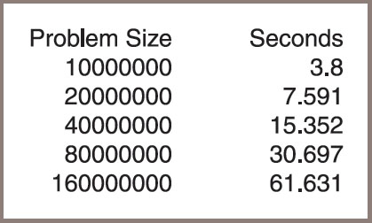
Measuring the Run Time of an Algorithm (3 of 6)
Figure 3-1: The output of the tester program

Slide 6
Measuring the Run Time of an Algorithm (4 of 6)
As another example, consider the following change in the tester’s program’s algorithm:
  for j in range(problemSize):
  for k in range(problemSize):
  work += 1
  work -= 1
The extended assignments have been moved into a nested loop:
  Loop iterates through the size of the problem within another loop that also iterates through the size of the problem
  The results are shown in Figure 3.2 on the following slide.

Slide 7
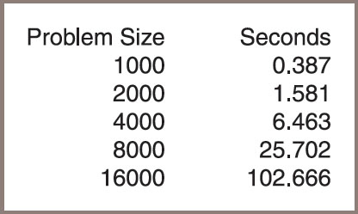
Measuring the Run Time of an Algorithm (5 of 6)
Figure 3-2: The output of the second tester program

Slide 8
Measuring the Run Time of an Algorithm (6 of 6)
This method permits accurate predictions of running times of many algorithms with only two problems:
  Different hardware platforms have different processing speeds, so the running times of an algorithm differ from machine to machine
  It is impractical to determine the running time for some algorithms with very large data sets

Slide 9
Counting Instructions (1 of 3)
Another technique to estimate efficiency of an algorithm
  Count the instructions executed with different problem sizes
When analyzing an algorithm this way, you distinguish between two classes of instructions:
  Instructions that execute the same number of times regardless of the problem size
  Instructions whose execution count varies with the problem size
For now, ignore the instructions in the first class:
  They do not figure significantly in this kind of analysis
The instructions in the second class normally are found in loops or recursive functions:
  In the case of loops, zero in on instructions performed in any nested loops

Slide 10
Counting Instructions (2 of 3)
"""
File: counting.py
Prints the number of iterations for problem sizes
that double, using a nested loop.
"""
problemSize = 1000
print("%12s%15s" % ("Problem Size", "Iterations"))
for count in range(5):
number = 0
# The start of the algorithm
work = 1
for j in range(problemSize):
for k in range(problemSize):
number += 1
work += 1
work -= 1
# The end of the algorithm
print("%12d%15d" % (problemSize, number))
problemSize *= 2

Slide 11
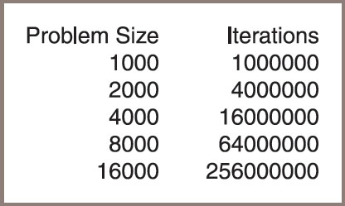
Counting Instructions (3 of 3)
Figure 3-3: The output of a tester program that counts iterations

Slide 12
Complexity Analysis
This section focuses on developing a method of determining the efficiency of algorithms that allows you to rate them
  Independently of platform-dependent timings or impractical instruction counts
This method is called complexity analysis:
  Entails reading the algorithm and using pencil and paper to work out some simple algebra

Slide 13
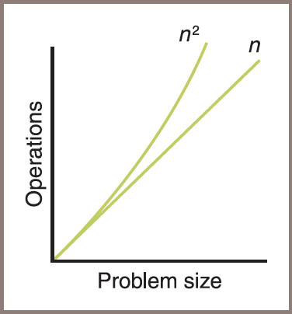
Orders of Complexity (1 of 5)
Figure 3-5: A graph of the amounts of work done in the tester programs

Slide 14
Orders of Complexity (2 of 5)
Table 3.1 The Amounts of Work in the Tester Programs
Problem Size | Work of the First Algorithm | Work of the Second Algorithm
2 | 2 | 4
10 | 10 | 100
1000 | 1000 | 1,000,000

Slide 15
Orders of Complexity (3 of 5)
Performances of these algorithms differ by an order of complexity:
  First algorithm is linear – work grows in direct proportion to the size of the problem
  Second algorithm is quadratic – work grows as a function of the square of the problem size
Other orders:
  Constant – requires the same number of operations for any problem size
  Logarithmic – amount of work is proportional to the log₂ of the problem size
  Polynomial time – grows at a rate of
where k is a constant greater than 1
Exponential – example rate of growth of this order is

Slide 16
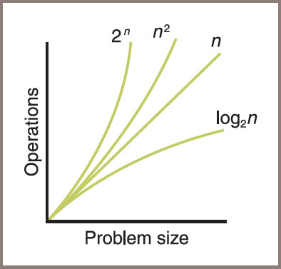
Orders of Complexity (4 of 5)
Figure 3-6: A graph of some sample orders of complexity

Slide 17
Orders of Complexity (5 of 5)
Table 3.2 Some Sample Orders of Complexity
n | Logarithmic (log₂n) | Linear (n) | Quadratic (n squared) | Exponential (2 to the power n)
100 | 7 | 100 | 10,000 | Off the chart
1,000 | 10 | 1000 | 1,000,000 | Off the chart
1,000,000 | 20 | 1,000,000 | 1,000,000,000,000 | Really off the chart

Slide 18
Big-O-Notation (1 of 2)
An algorithm rarely performs a number of operations exactly equal to
  An algorithm usually performs other work in the body of a loop, above the loop, and below the loop
Whenever the amount of work is expressed as a polynomial, one term is dominant:
  As n becomes large, the dominant term becomes so large that you can ignore the amount of work represented by the other terms

Slide 19
Big-O-Notation (2 of 2)
One notation used to express the efficiency or computational complexity of an algorithm is called big-O notation:
  “O” stands for “on the order of,” a reference to the order of complexity of the work of the algorithm
For example,
  The order of complexity of a linear-time algorithm is O(n)
  Big-O notation formalizes our discussion of orders of complexity

Slide 20
The Role of the Constant of Proportionality
Constant of proportionality
  Involves the terms and coefficients that are usually ignored during the big-O analysis
For example,
  The work performed by a linear time algorithm might be expressed as work = 2 * size, where the constant of proportionality, 2 in this case, is work / size
Try to determine the constant of proportionality for the first algorithm discussed in this chapter – the code:
  work = 1
  for x in range(problemSize):
  work += 1
  work -= 1</

Slide 21
Search Algorithms
This section covers several algorithms that can be used for searching and sorting lists
You will
  Learn the design of an algorithm
  See its implementation as a Python function
  See an analysis of the algorithm’s computational complexity

Slide 22
Sequential Search of a List
Python code for a sequential search function:
  def sequentialSearch(target, lyst):
  """Returns the position of the target item if found,
  or -1 otherwise."""
  position = 0
  while position < len(lyst):
  if target == lyst[position]:
  return position
  position += 1
  return -1

Slide 23
Best-Case, Worst-Case, and Average-Case Performance
The performance of some algorithms depends on the placement of the data processed:
  The sequential search algorithm does less work to find a target at the beginning of a list than at the end of the list
Analysis of a sequential search considers three cases:
  In the worst case, the target item is at the end of the list or not in the list at all:
    Algorithm must visit every item and perform n iterations for a list of size n
    Thus, the worst-case complexity of a sequential search is O(n)
  In the best case, the algorithm finds the target at the first position, after making one iteration, for an O(1) complexity
  To determine the average case, add the number of iterations required to find the target at each possible position and divide the sum by n:
    Thus, the algorithm performs

Slide 24
Binary Search of a Sorted List (1 of 2)
Python code for the binary search function:
  def binarySearch(target, sortedLyst):
  left = 0
  right = len(sortedLyst) - 1
  while left <= right:
  midpoint = (left + right) // 2
  if target == sortedLyst[midpoint]:
  return midpoint
  elif target < sortedLyst[midpoint]:
  right = midpoint - 1
  else:
  left = midpoint + 1
  return -1

Slide 25
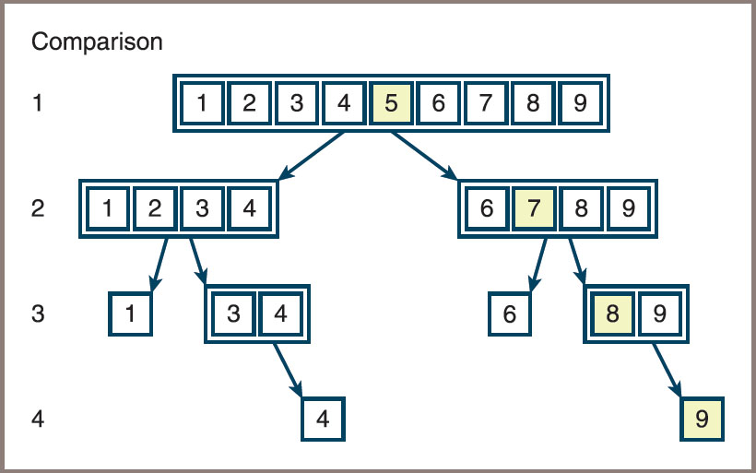
Binary Search of a Sorted List (2 of 2)
Figure 3-7: The items of a list visited during a binary search

Slide 26
Basic Sort Algorithms
Each of the Python sort functions that are developed operates on a list of integers and uses a swap function to exchange the positions of two items in the list
Here is the code for that function:
  def swap(lyst, i, j):
  """Exchanges the items at positions i and j."""
  # You could say lyst[i], lyst[j] = lyst[j], lyst[i]
  # but the following code shows what is really going on
  temp = lyst[i]
  lyst[i] = lyst[j]
  lyst[j] = temp

Slide 27
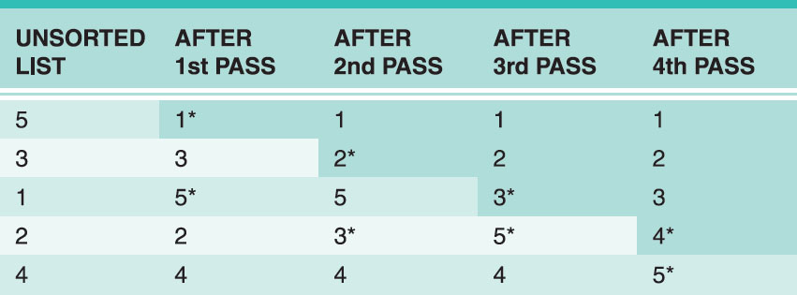
Selection Sort (1 of 2)
Figure 3.8 shows the states of a list of five items after each search and swap pass of a selection sort:
  The two items just swapped on each pass have asterisks next to them and the sorted portion of the list is shaded
Figure 3-8: A trace of data during a selection sort

Slide 28
Selection Sort (2 of 2)
Python function for a selection sort:
  def selectionSort(lyst):
  i = 0
  while i < len(lyst) - 1: # Do n - 1 searches
  minIndex = i # for the smallest
  j = i + 1
  while j < len(lyst): # Start a search
  if lyst[j] < lyst[minIndex]:
  minIndex = j
  j += 1
  if minIndex != i: # Exchange if needed
  swap(lyst, minIndex, i)
  i += 1

Slide 29
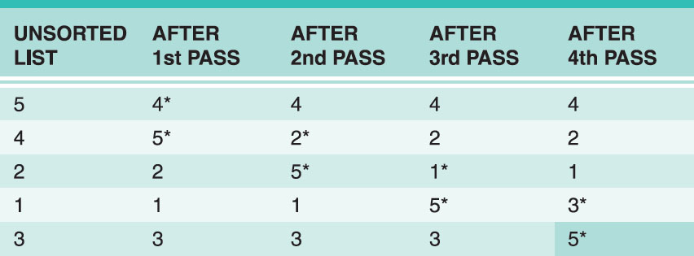
Bubble Sort (1 of 2)
Figure 3.9 shows a trace of the bubbling process through a list of five items:
  This process makes four passes through a nested loop to bubble the largest item down to the end of the list
Figure 3-9: A trace of data during a bubble sort

Slide 30
Bubble Sort (2 of 2)
You can make a minor adjustment to the bubble sort to improve its best-case performance to linear
Modified bubble sort function:
  def bubbleSortWithTweak(lyst):
  n = len(lyst)
  while n > 1:
  swapped = False
  i = 1
  while i < n:
  if lyst[i] < lyst[i - 1]: # Exchange if needed
  swap(lyst, i, i - 1)
  swapped = True
  i += 1
  if not swapped: return # Return if no swaps
  n -= 1

Slide 31
Insertion Sort (1 of 3)
An insertion sort attempts to exploit the partial ordering of the list in a different way
The strategy:
  On the ith pass through the list, where i ranges from 1 to n − 1, the ith item should be inserted into its proper place among the first i items in the list
  After the ith pass, the first i items should be in sorted order:
    This process is analogous to the way in which many people organize playing cards in their hands. That is, if you hold the first i − 1 cards in order, you pick the ith card and compare it to these cards until its proper spot is found
  Insertion sort consists of two loops:
    The outer loop traverses the positions from 1 to n − 1
    For each position i in this loop, you save the item and start the inner loop at position i − 1
    For each position j in this loop, you move the item to position j + 1 until you find the insertion point for the saved (ith) item

Slide 32
Insertion Sort (2 of 3)
Code for the insertionSort function:
  def insertionSort(lyst):
  i = 1
  while i < len(lyst):
  itemToInsert = lyst[i]
  j = i - 1
  while j >= 0:
  if itemToInsert < lyst[j]:
  lyst[j + 1] = lyst[j]
  j -= 1
  else:
  break
  lyst[j + 1] = itemToInsert
  i += 1

Slide 33
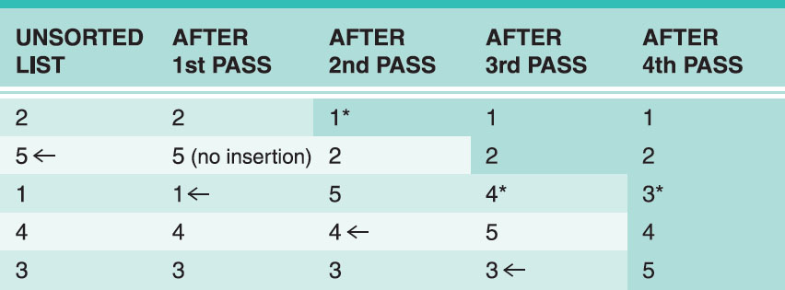
Insertion Sort (3 of 3)
Figure 3-10: A trace of data during insertion sort

Slide 34
Faster Sorting
The secret to these better algorithms is a divide-and-conquer strategy:
  Each algorithm finds a way of breaking the list into smaller sublists
  These sublists are then sorted recursively
Ideally, if the number of these subdivisions is log(n) and the amount of work needed to rearrange the data on each subdivision is n,
  Then the total complexity of such a sort algorithm is O(n log n)

Slide 35
Merge Sort (1 of 7)
A merge sort employs a recursive, divide-and-conquer strategy to break the O
  Compute the middle position of a list and recursively sort its left and right sublists
  Merge the two sorted sublists back into a single sorted list
  Stop the process when sublists can no longer be subdivided
Three Python functions collaborate:
  Function called by users
  Helper function that hides the extra parameters required by recursive calls
  A function that implements the merging process

Slide 36
Merge Sort (2 of 7)
Implementing the merging process
  Merging process uses an array of the same size as the list
  Array is called the copyBuffer
  The buffer is allocated once in mergeSort and subsequently passed as an argument to mergeSortHelper and merge
Code for mergeSort:
  from arrays import Array
  def mergeSort(lyst):
  # lyst list being sorted
  # copyBuffer temporary space needed during merge
  copyBuffer = Array(len(lyst))
  mergeSortHelper(lyst, copyBuffer, 0, len(lyst) - 1)

Slide 37
Merge Sort (3 of 7)
Code for mergeSortHelper:
  def mergeSortHelper(lyst, copyBuffer, low, high):
  # lyst list being sorted
  # copyBuffer temp space needed during merge
  # low, high bounds of sublist
  # middle midpoint of sublist
  if low < high:
  middle = (low + high) // 2
  mergeSortHelper(lyst, copyBuffer, low, middle)
  mergeSortHelper(lyst, copyBuffer, middle + 1, high)
  merge(lyst, copyBuffer, low, middle, high)

Slide 38
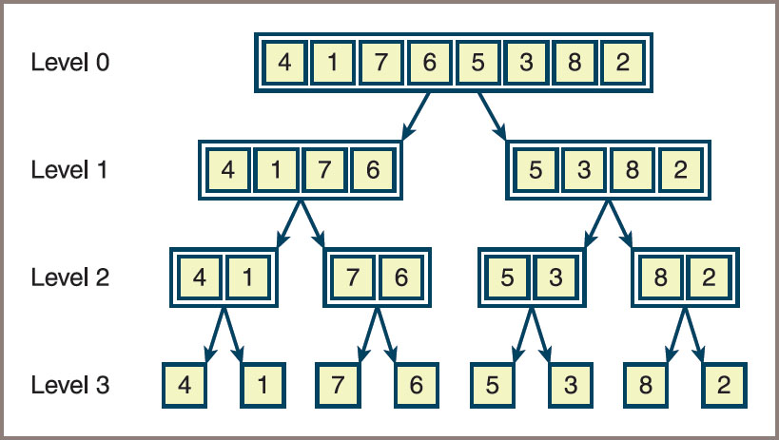
Merge Sort (4 of 7)
Figure 3-14: Sublists generated during calls of mergeSortHelper

Slide 39
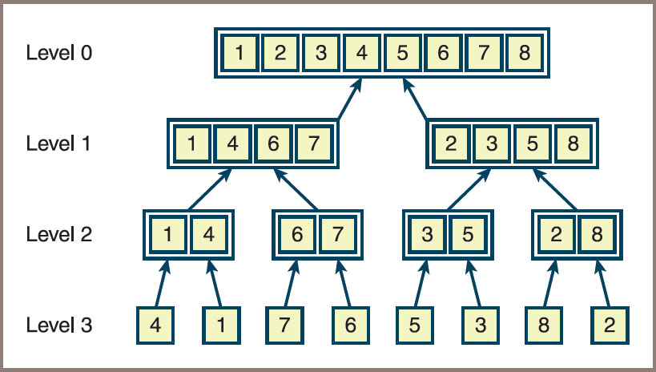
Merge Sort (5 of 7)
Figure 3-15: Merging the sublists generated during a merge sort

Slide 40
Merge Sort (6 of 7)
Code for the merge function:
  def merge(lyst, copyBuffer, low, middle, high):
  # lyst list that is being sorted
  # copyBuffer temp space needed during the merge process
  # low beginning of first sorted sublist
  # middle end of first sorted sublist
  # middle + 1 beginning of second sorted sublist
  # high end of second sorted sublist
  # Initialize i1 and i2 to the first items in each sublist
  i1 = low
  i2 = middle + 1
  # Interleave items from the sublists into the
  # copyBuffer in such a way that order is maintained.
  for i in range(low, high + 1):
  if i1 > middle:
  copyBuffer[i] = lyst[i2] # First sublist exhausted
  i2 += 1
  elif i2 > high:
  copyBuffer[i] = lyst[i1] # Second sublist exhausted
  i1 += 1
  elif lyst[i1] < lyst[i2]:
  copyBuffer[i] = lyst[i1] # Item in first sublist <
  i1 += 1
  else:
  copyBuffer[i] = lyst[i2] # Item in second sublist <
  i2 += 1
  for i in range(low, high + 1): # Copy sorted items back to
  lyst[i] = copyBuffer[i] # proper position in lyst

Slide 41
Merge Sort (7 of 7)
Complexity analysis for merge sort
  The running time of the merge function is dominated by the two for statements, each of which loops (high − low + 1) times
  The function’s running time is O(high − low)
  All the merges at a single level take O(n) time
  Because mergeSortHelper splits sublists as evenly as possible at each level, the number of levels is O(log n), and the maximum running time for this function is O(n log n) in all cases

Slide 42
Overview of Quicksort (1 of 4)
Outline of the strategy used in the quicksort algorithm:
  Select the item at the list’s midpoint (called the pivot)
  Partition items in the list so that all items less than the pivot are moved to the left of the pivot (rest are moved to the right)
  Divide and conquer
  Process terminates each time it encounters a sublist with fewer than two items
Partitioning
  The most complicated part of the algorithm is partitioning the items in a sublist
  See Figures 3.11 and 3.12 on the following slides for an illustration of the steps

Slide 43
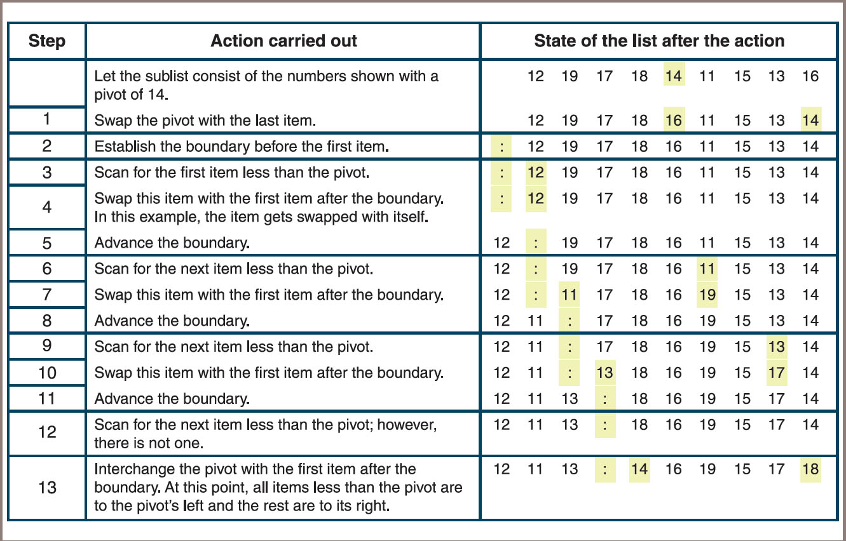
Overview of Quicksort (2 of 4)
Figure 3-11: Partitioning a sublist

Slide 44
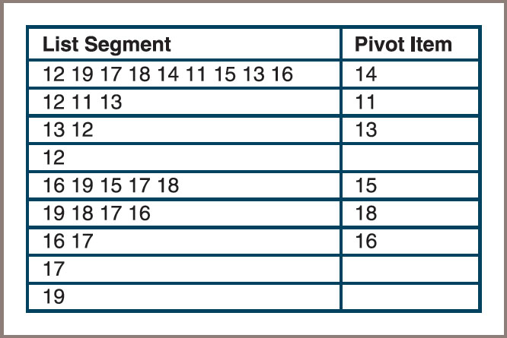
Overview of Quicksort (3 of 4)
Figure 3-12: Partitioning a sublist

Slide 45
Overview of Quicksort (4 of 4)
Complexity analysis of quicksort
  During the first partition operation, you scan all the items from the beginning of the list to its end
  The amount of work during this operation is proportional to n, the list’s length
  The amount of work after this partition is proportional to the left sublist’s length plus the right sublist’s length, which together yield n − 1
  When these sublists are divided, there are four pieces whose combined length is approximately n, so the combined work is proportional to n yet again
  As the list is divided into more pieces, the total work remains proportional to n.
  To complete the analysis, you need to determine how many times the lists are partitioned

Slide 46
Implementation of Quicksort (1 of 2)
The quicksort algorithm is most easily coded using a recursive approach
The following script defines a top-level quicksort function for the client, a recursive quicksortHelper function to hide the extra arguments for the endpoints of a sublist, and a partition function:
  Script is continued on the next slide
  def quicksort(lyst):
  quicksortHelper(lyst, 0, len(lyst) - 1)
  def quicksortHelper(lyst, left, right):
  if left < right:
  pivotLocation = partition(lyst, left, right)
  quicksortHelper(lyst, left, pivotLocation - 1)
  quicksortHelper(lyst, pivotLocation + 1, right)

Slide 47
Implementation of Quicksort (2 of 2)
  def partition(lyst, left, right):
  # Find the pivot and exchange it with the last item
  middle = (left + right) // 2
  pivot = lyst[middle]
  lyst[middle] = lyst[right]
  lyst[right] = pivot
  # Set boundary point to first position
  boundary = left
  # Move items less than pivot to the left
  for index in range(left, right):
  if lyst[index] < pivot:
  swap(lyst, index, boundary)
  boundary += 1
  # Exchange the pivot item and the boundary item
  swap (lyst, right, boundary)
  return boundary
  # Earlier definition of the swap function goes here
  import random
  def main(size = 20, sort = quicksort):
  lyst = []
  for count in range(size):
  lyst.append(random.randint(1, size + 1))
  print(lyst)
  sort(lyst)
  print(lyst)
  if __name__ == "__main__":
  main()

