Slide 1
Spam Email Filter
Team C:
Guiran Niu, Tianxing Liang, Zhongchuan Xiao, Sinan Zhang, Nai-Jieh Wang

Slide 2
Agenda
Background
Our Creativity
Descriptive Analysis
Data Cleansing
Data Modeling

Slide 3
BACKGROUND

Slide 4
$257 Billion
14.5 million
76%
Annual costs by spam emails
spam emails in every single day
companies reported falling victim to phishing
Notes:
The cost of spam could grow to $257 billion annually.
About 14.5 billion spam emails are sent every single day
76% of companies reported falling victim to phishing scams in 2016

Slide 5
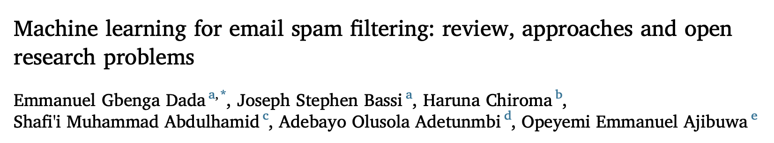
Related Paper vs. Our Creativity
Research Paper:
Popular email spam datasets
NN, Naive Bayes, firefly algorithm, decision tree, random forest...
Penalize spam words in models
Our Solution:
Ling-Spam Dataset
Word Frequency & TDM
Zeppelin for visualization
Sentiment Analysis
Specialized VM environment with big data tools
LSTM
Notes:
unwanted commercial bulk emails called spam has become a huge problem on the internet. https://www.propellercrm.com/blog/email-spam-statistics
Research paper link: http://www.aueb.gr/users/ion/docs/ir_memory_based_antispam_filtering.pdf

Slide 6
DATA CLEANING

Slide 7
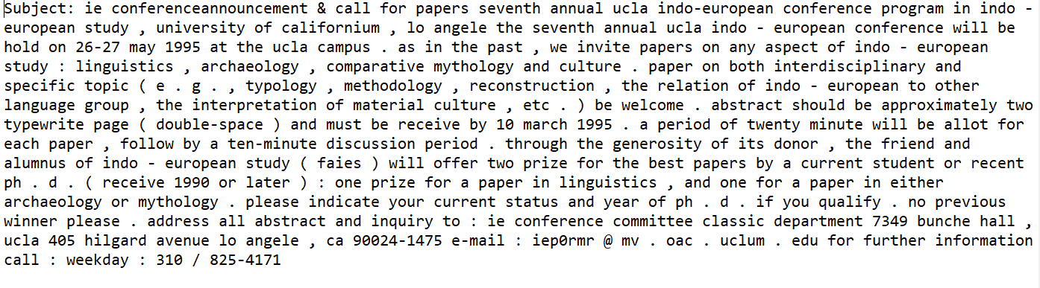
Data Preview
2893 emails, containing 2412 normal message and 481 spam message.

Slide 8
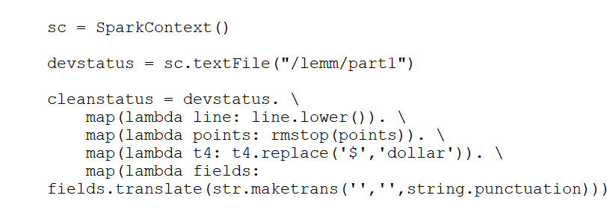
Data Cleaning
Environment:
Ubuntu 19.10, Spark 3.0.0, Python 3.7.5, Hadoop 2.9.2
Load data
Lowercase
Remove stopwords
Replace ‘$’ with ‘dollar’
Remove punctuations

Slide 9
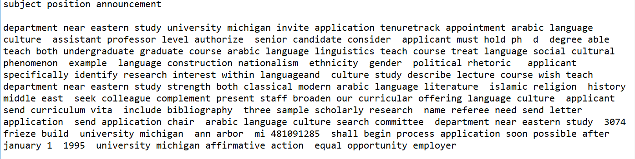
Data Cleaning
Codes from terminal
Create output folder lemm under Hadoop
hdfs dfs -mkdir -p lemm
Read files
hdfs dfs -cat [path to file]
Load file to hdfs
hdfs dfs -put [path to file]
Run Python file
spark -submit [file]
Sample output

Slide 10
DATA DESCRIPTIVE

Slide 11
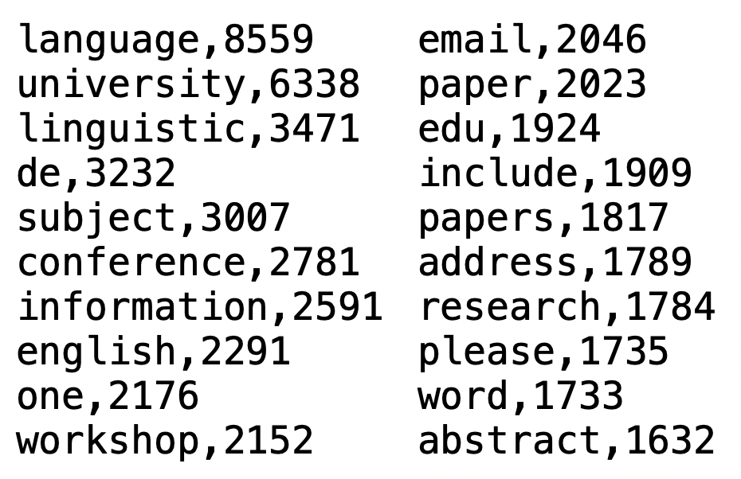
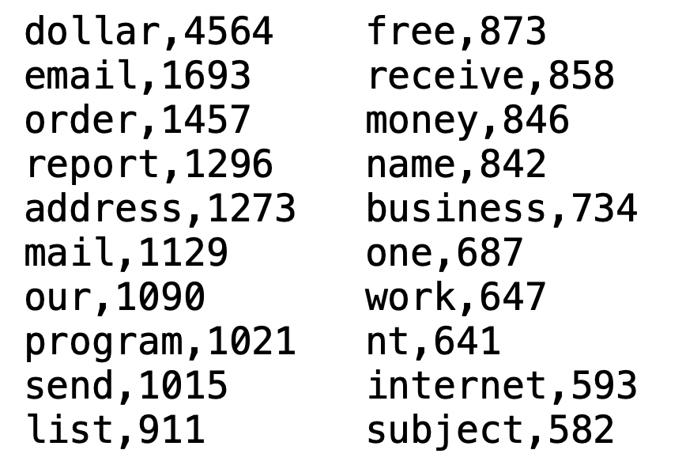
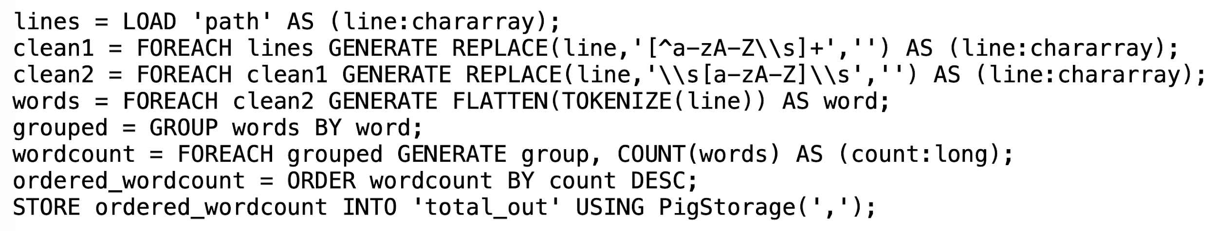
Word Frequency - PIG
Normal
Spam
remove numbers, signs and single letters
tokenize words

Slide 12
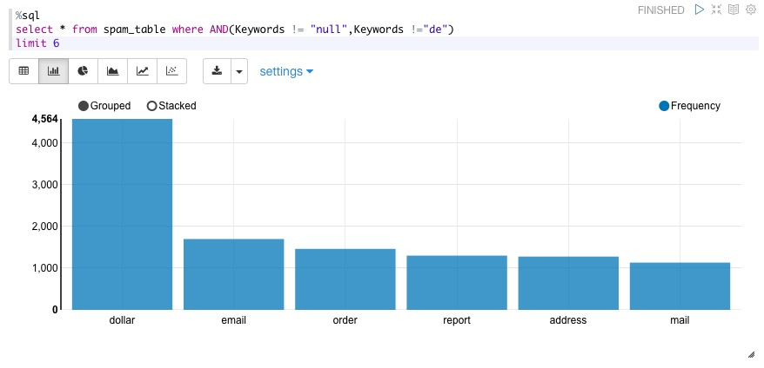
Data Visualization - Zeppelin
Words frequency in spam emails

Slide 13
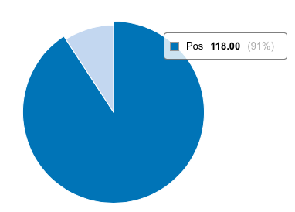
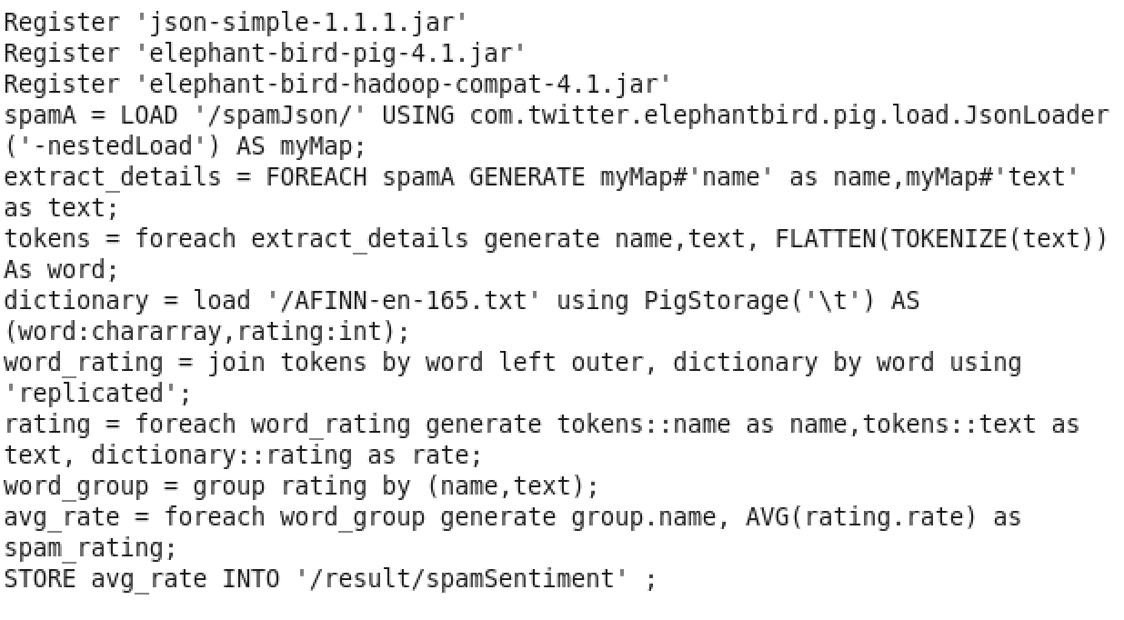
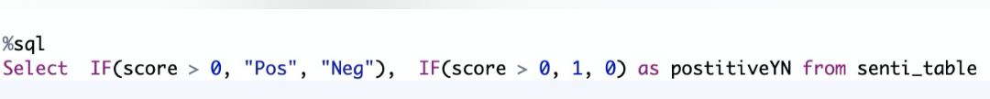
Sentiment Analysis- Pig, Zeppelin
Sentiment Analysis of Spam Emails
Notes:
according to our sentiment analysis by 'pig'
We discovered that for most of the spam emails, words there are mostly positive
Afinn package to score each words from each file and sum up the score for each files

Slide 14
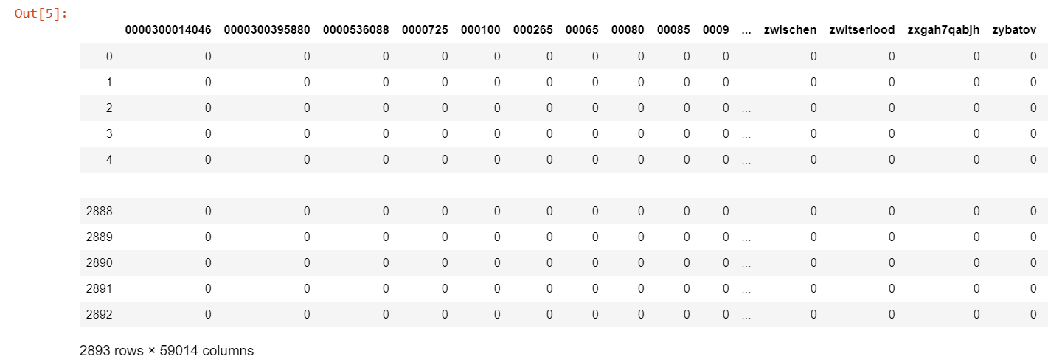
TDM on original text
Too many meaningless words. Causing the matrix too large.

Slide 15
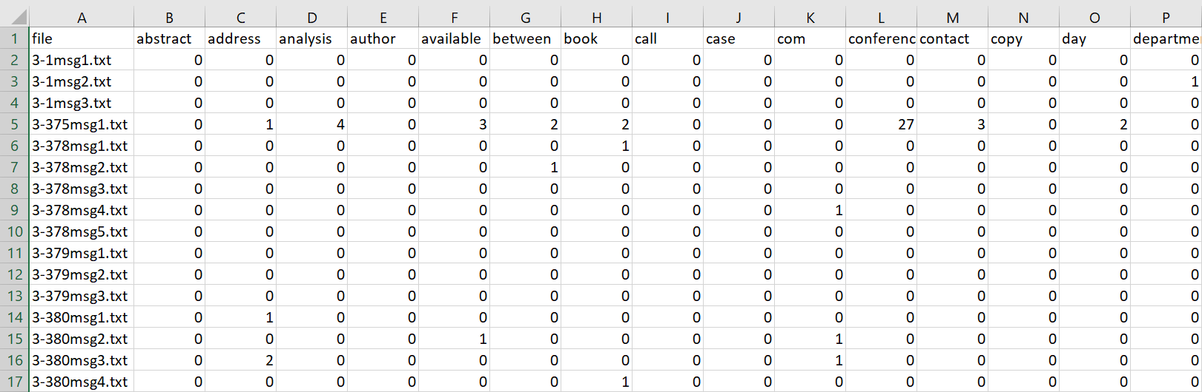
TDM on cleaned text
Chose feature words according to word frequency
Filtered each text file, remained only feature words
Did TDM on cleaned data.

Slide 16
DATA MODELING

Slide 17
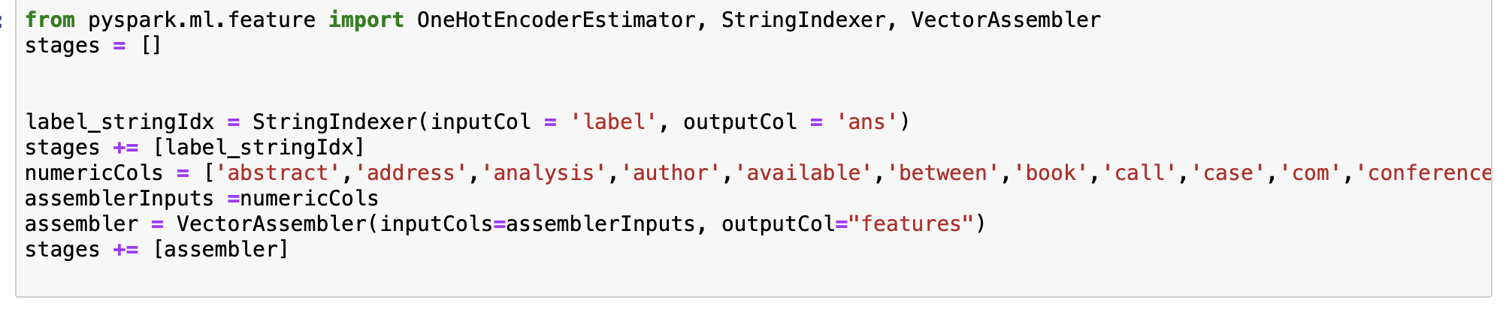
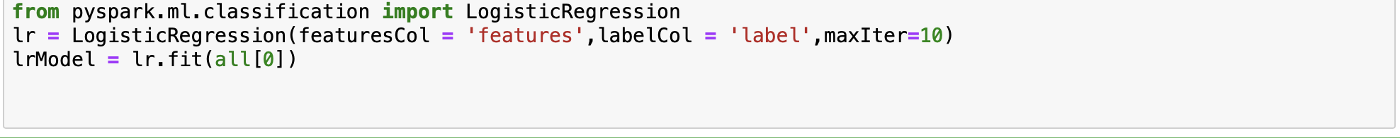
Logistic Regression- PySpark

Slide 18
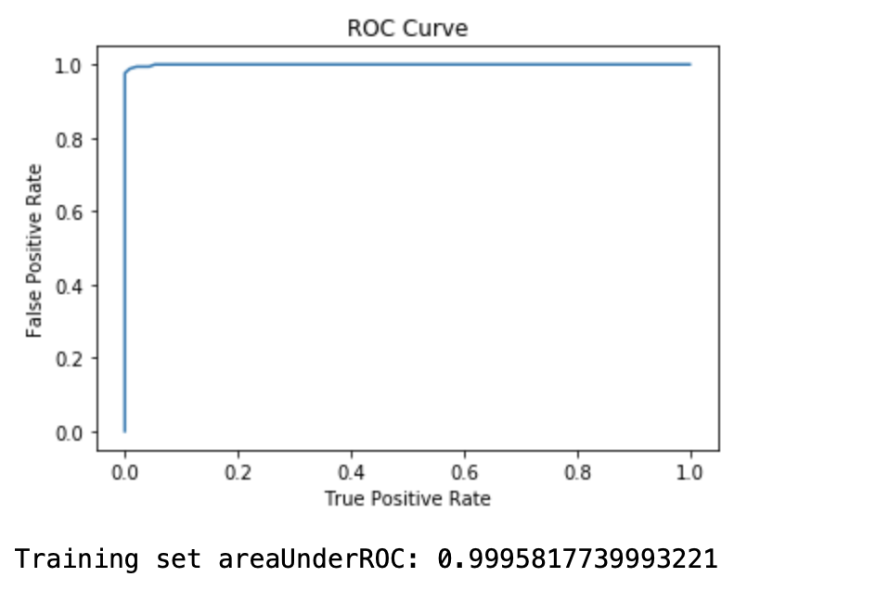
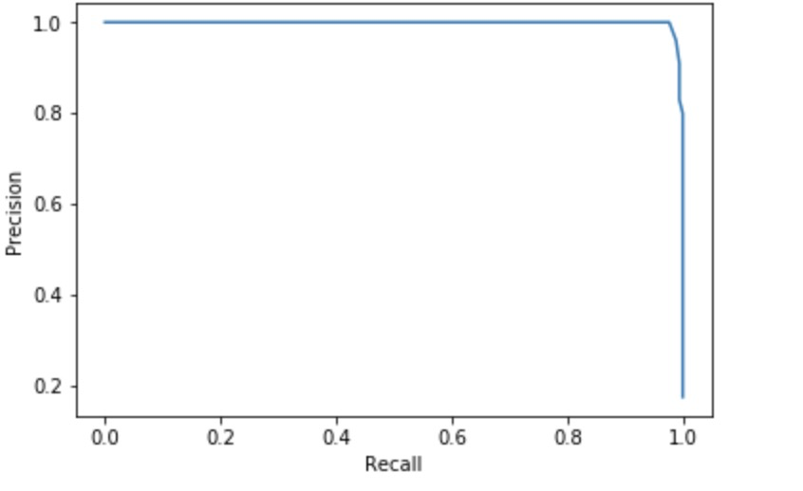
ROC Curve
Precision Recall

Slide 19
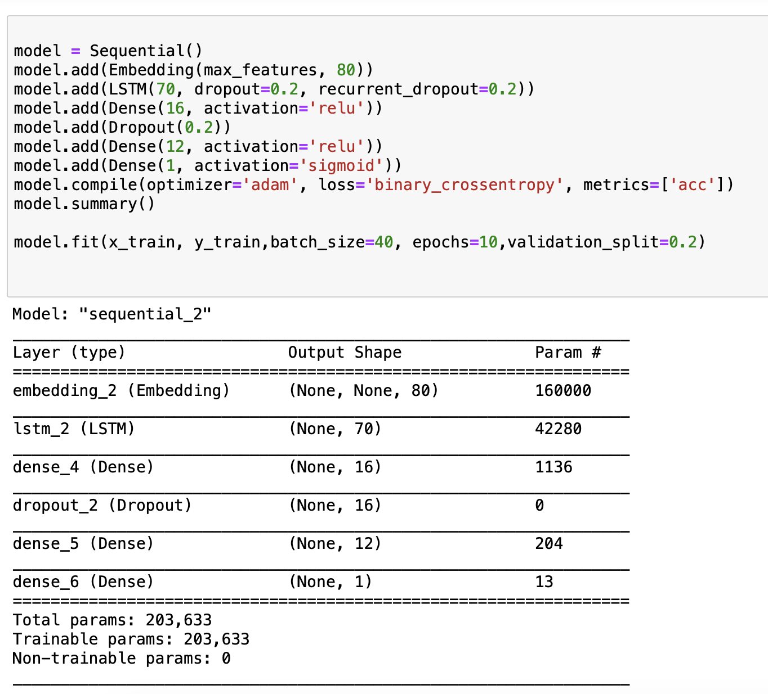
LSTM

Slide 20
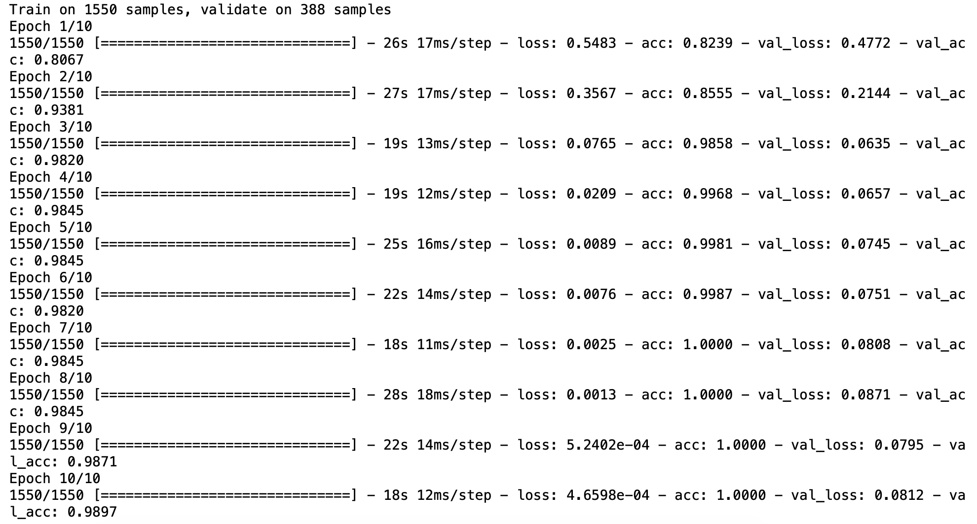
LSTM
Accuracy hits 99%

Slide 21
Challenges
AWS - Incompatible Python version for packages
New virtual machine-Ubuntu(Pyspark with python 3)
Use languages we learned in customized build virtual environment with limited resources
Notes:
unwanted commercial bulk emails called spam has become a huge problem on the internet.
https://www.propellercrm.com/blog/email-spam-statistics

Slide 22
THANKS!
Questions?

Slide 23
References
unwanted commercial bulk emails called spam has become a huge problem on the internet. https://www.propellercrm.com/blog/email-spam-statistics
Research paper link: http://www.aueb.gr/users/ion/docs/ir_memory_based_antispam_filtering.pdf
Pig word frequency code
https://www.folkstalk.com/2013/09/word-count-example-pig-script.html
pyspark Logistic regression:
https://towardsdatascience.com/machine-learning-with-pyspark-and-mllib-solving-a-binary-classification-problem-96396065d2aa
https://spark.apache.org/docs/latest/api/python/pyspark.sql.html#pyspark.sql.DataFrame.randomSplit
https://spark.apache.org/docs/latest/ml-classification-regression.html#logistic-regression
pig sentiment analysis:
https://acadgild.com/blog/sentiment-analysis-tweets-afinn-dictionary
Zeppelin code
https://stackoverflow.com/questions/32966978/reading-csv-files-in-zeppelin-using-spark-csv
Notes:
unwanted commercial bulk emails called spam has become a huge problem on the internet.
https://www.propellercrm.com/blog/email-spam-statistics

Slide 24
Future Scope
Reduce business cost:
Better Marketing Emails
Protect company against phishing
Notes:
unwanted commercial bulk emails called spam has become a huge problem on the internet.
https://www.propellercrm.com/blog/email-spam-statistics

