Slide 1

Terps Ocean
Smith MSIS Alumni Contacts Information Database
Nai jieh Wang
Guiran Niu
Tianxing Liang
Yiwen Wei
Yuheng Zhong
11/26/2018

Slide 2
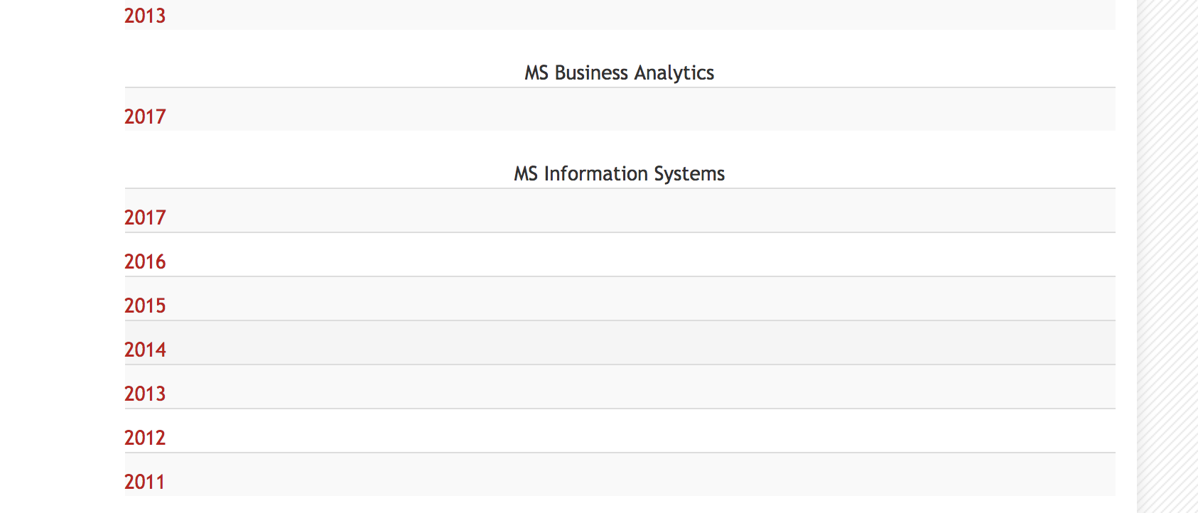
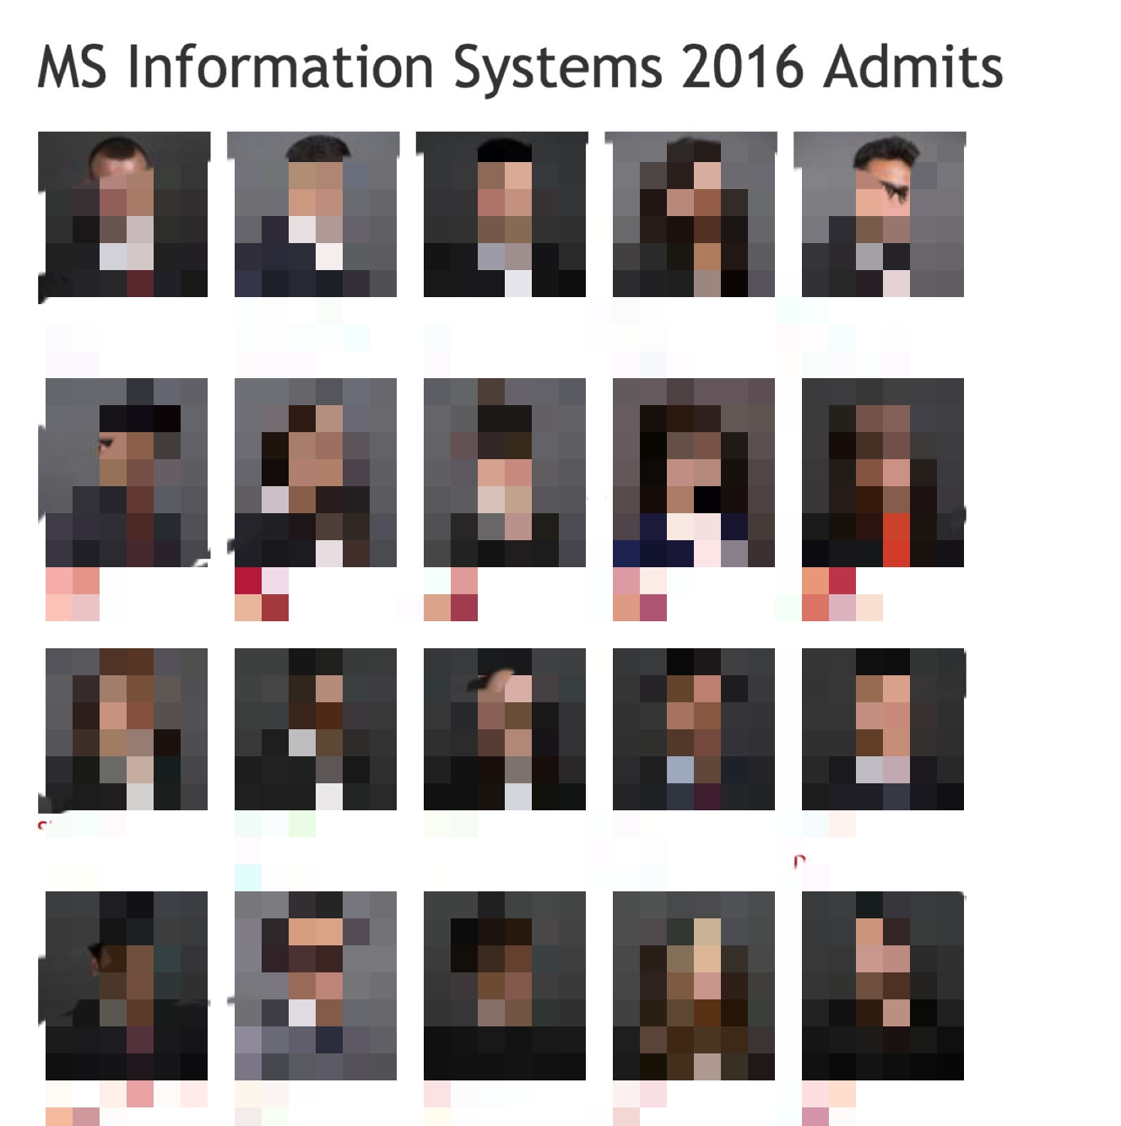
Background
Users of the database
Alumni Association
Smith Career Office
Smith Job Seekers
Data included
Alumni Data
Company & Location
Job Role & description
Skills & Certificates
Data source: Networth—Smith Cohorts

Slide 3
Introduction:Terps Ocean
Mission statement
Cataloging system to track Smith alumni working information
Adequacy and accuracy
Mission Objectives for clients
Organizing alumni events in each state
Inviting companies to information sessions

Slide 4






Tools
Backend:
Excel: clean data
Lucidchart: ER diagram
SSMS: manage data
Frontend:
Power BI: visualize data
HTML: create website
Wix: publish website

Slide 5
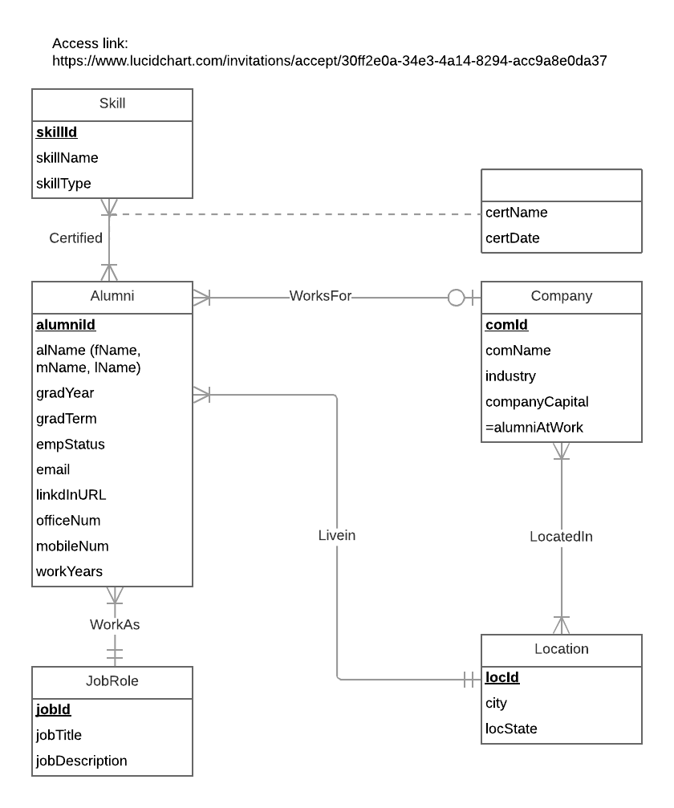
ERD
Alumni--Skill relationship:
Own: many-to-many binary
Alumni--Company relationship:
WorksFor: Binary
Alumni--Job Position relationship:
WorkAs: Binary
Alumni-Working Location relationship:
Livein: Binary
Company---Location relationship:
LocatedIn: Many-to-Many Binary
Notes:
Alumni--Skill relationship:
Own: many-to-many binary
1 Skill to 1 or more Alumni
1 Alumni to 1 or more Skill
Alumni--Company relationship:
WorksFor: Binary
1 Alumni to 0 or 1 Company
1 Company to 1 or more Alumni
Alumni--Job Position relationship:
WorkAs: Binary
1 Alumni can work as 1 Job position
1 Job position can be owned by 1 or many Alumni
Alumni-Working Location relationship:
WorksAt: Binary
1 Alumni to 1 Location
1 Location to 1 or more Alumni
Company---Location relationship:
LocatedIn: Binary
1 company can locate in 1 or more locations
1 location can have multiple companies

Slide 6
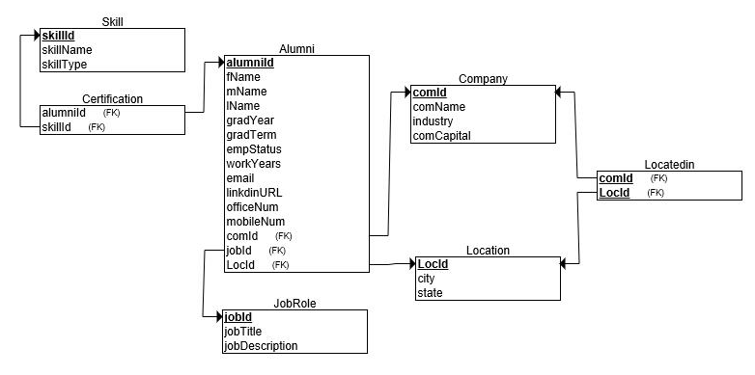
Relation Schema
Alumni (alumniId, fName, mName, lName, gradYear, gradTerm, workYears, email, linkedinURL, officeNum, mobileNum, comId, locId, jobId)
Company (comId, comName, industry, comCapital)
Location (locId, city, locState)
Locatedin (comId, locId)
JobRole (jobId, jobTitle, jobDescription)
Skill (skillId, skillName, skillType)
Certification (alumniId, skillId, certName, certDate)

Slide 7
SQL
CREATE TABLE [Certification] ( alumniId CHAR (7) NOT NULL, skillId CHAR(8) Not Null, certName VARCHAR(MAX) Null, certDate Datetime Null, CONSTRAINT pk_Certification_alumniId_skillId PRIMARY KEY (alumniId,skillId), CONSTRAINT fk_Certification_alumniId FOREIGN KEY (alumniId) REFERENCES [Alumni](alumniId) ON DELETE NO ACTION ON UPDATE NO ACTION, CONSTRAINT fk_Certification_skillId FOREIGN KEY (skillId) REFERENCES [Skill](skillId) ON DELETE NO ACTION ON UPDATE NO ACTION);

Slide 8
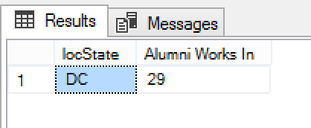
User Story
Which state has the most alumni working in, so that we can hold an alumni event in this state.
SQL code:
select top 1 l.locState, count(L.locState) as 'Alumni Works In'
from Location l, Alumni a
where l.locId=a.locId
group by l.locState
order by count(l.locState) desc;

Slide 9
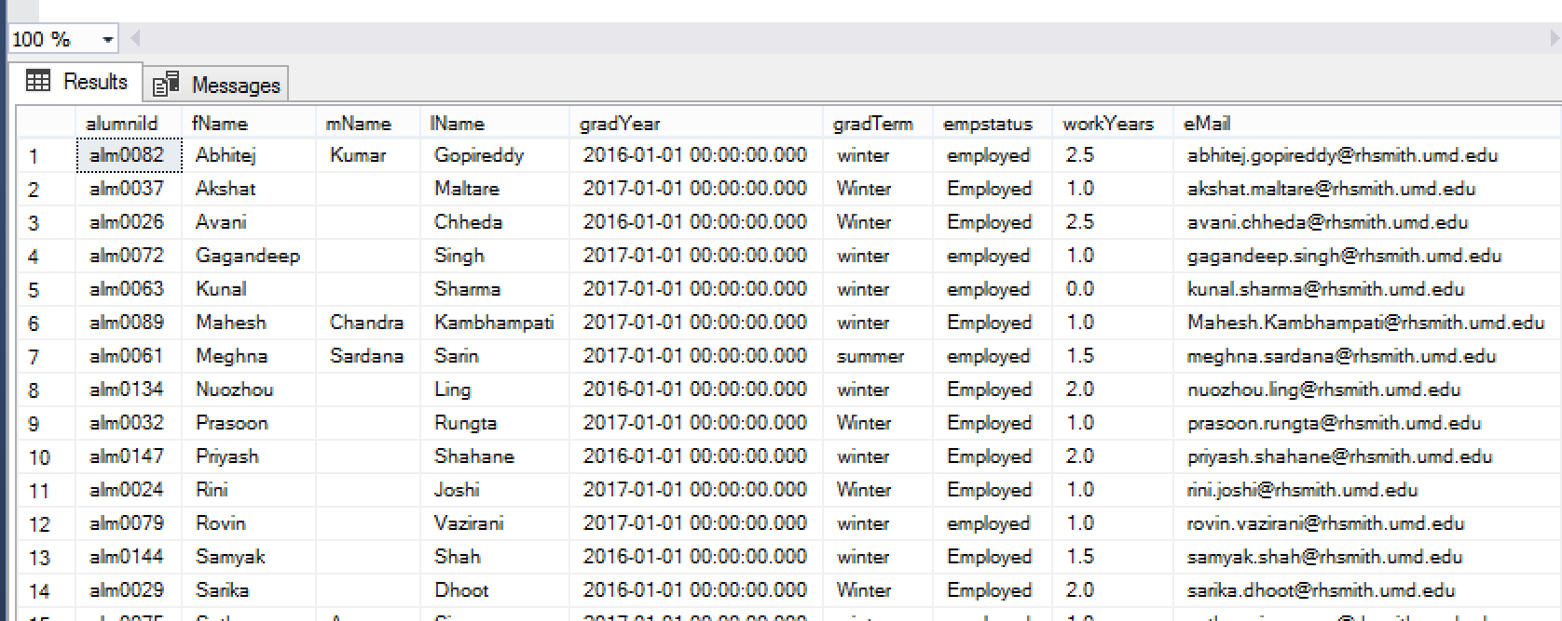
User Story
Who has SQL skill in Washington DC, as well as their detailed information, so that we can invite them come to on-campus SQL workshop to share their experience.
select A.*
from dbo.Alumni A,dbo.Location B, dbo.Certification as C, dbo.Skill as skill
where A.locId=B.locId
and A.alumniId=C.alumniId
and C.skillId=skill.skillId
and B.locState='DC'
and skill.skillName='SQL'
order by A.fName ASC, A.lName ASC

Slide 10
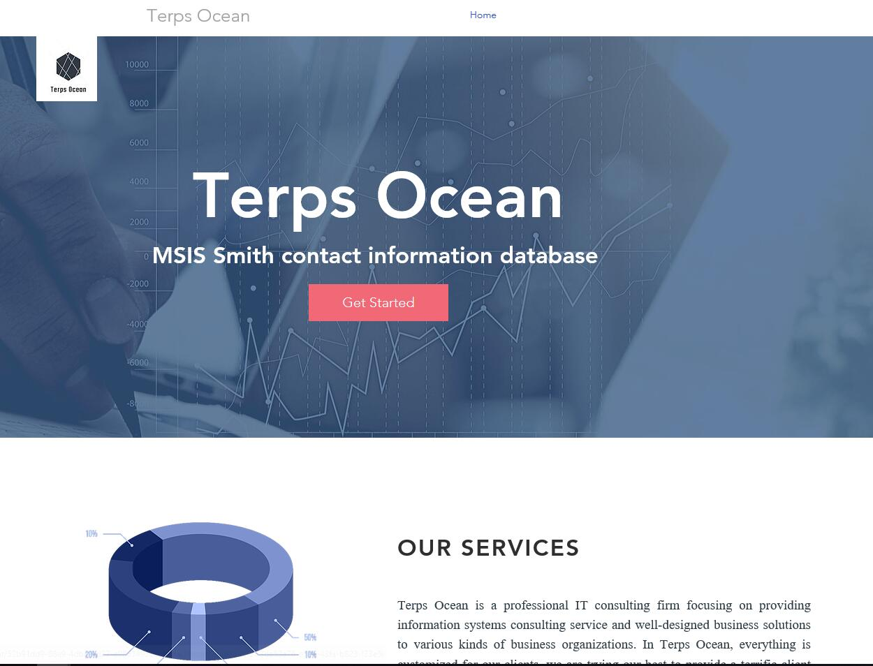
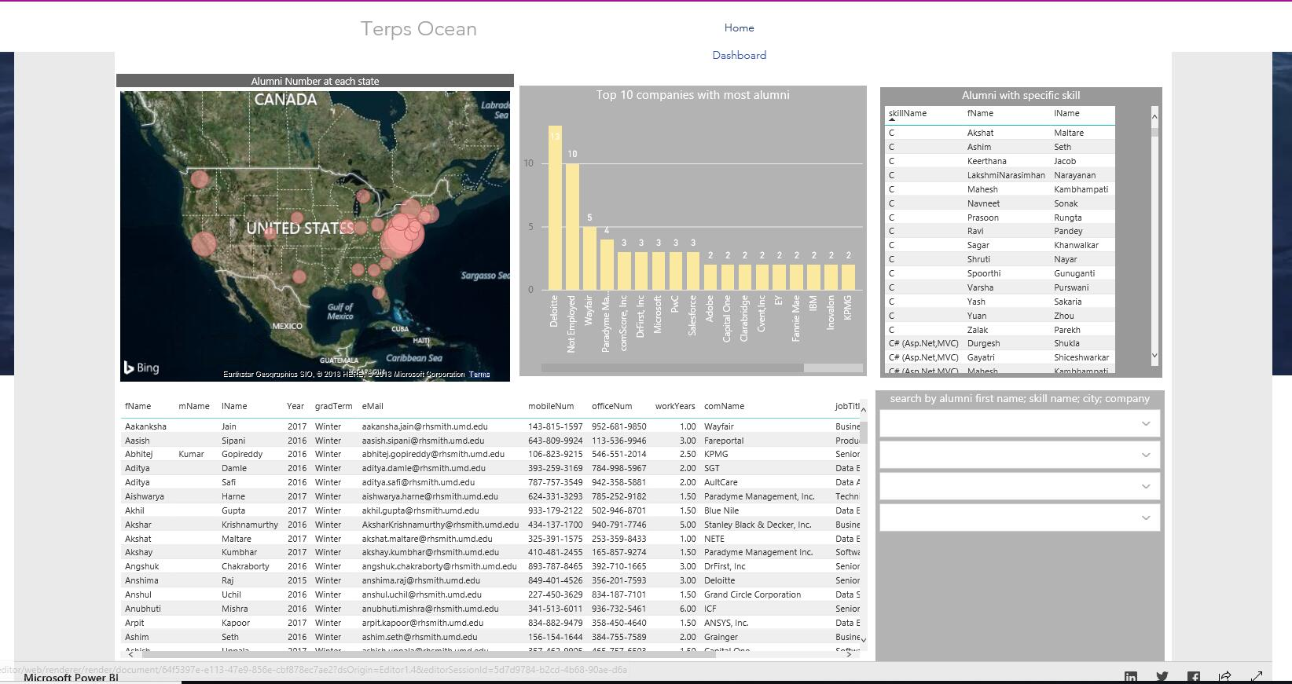
Application-Introduction
Presentation domain address https://826001623.wixsite.com/website-1

Slide 11
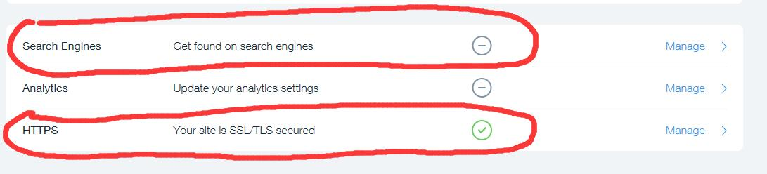
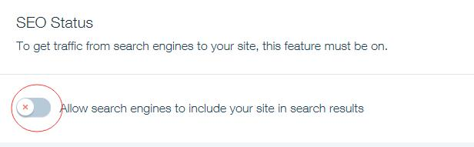
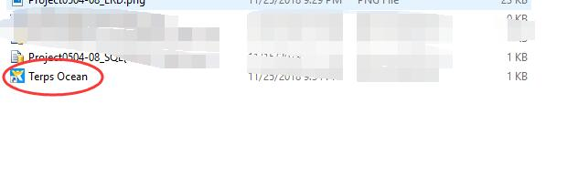
Security Concerns
All traffics from search engines have been blocked, and the site is secured by SSL/TLS
Domain address will be modified after presentation, new URL will be embed into a port file included in final suite package. Only the person who has the port file can be access to the website.
Authorization function can be added based on client's’ requirement.

Slide 12
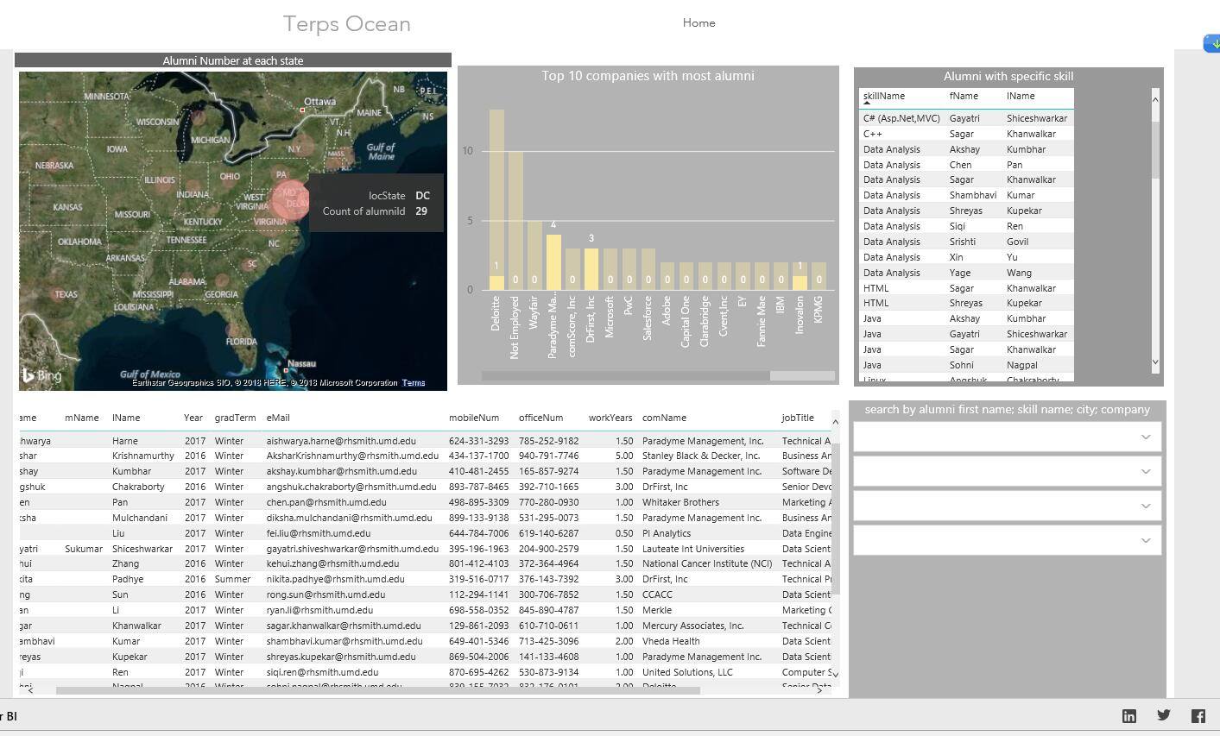
Application---screenshot for user story 1
User story : Which state has the most alumni live in, so that we can hold an alumni event in this state

Slide 13
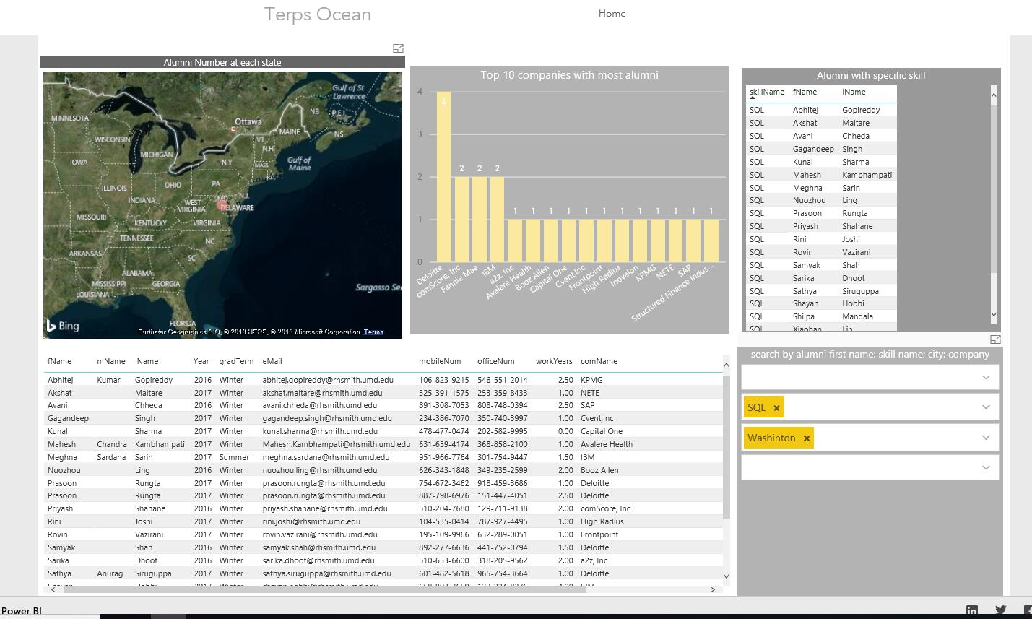
Application---screenshot for user story 2
User story : Who has SQL skill in Washington DC, as well as their detailed information, so that we can invite them come to on-campus SQL workshop to share their experience.

Slide 14
Q&A

Slide 15
Thank you!

