Slide 1







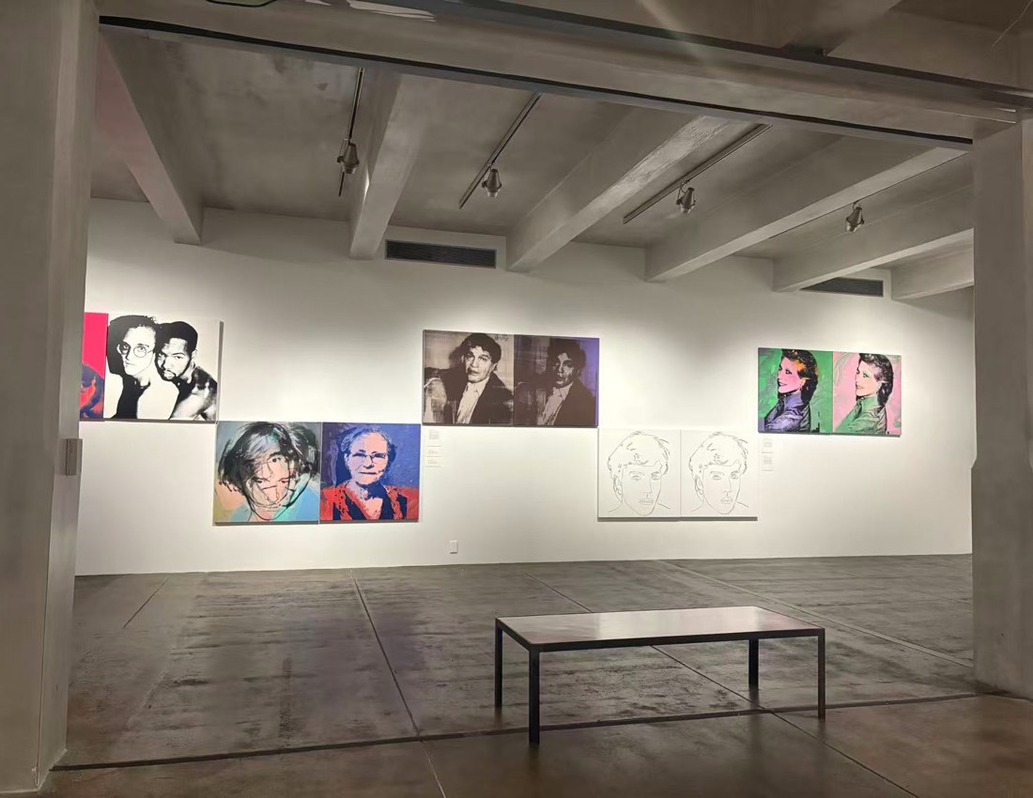

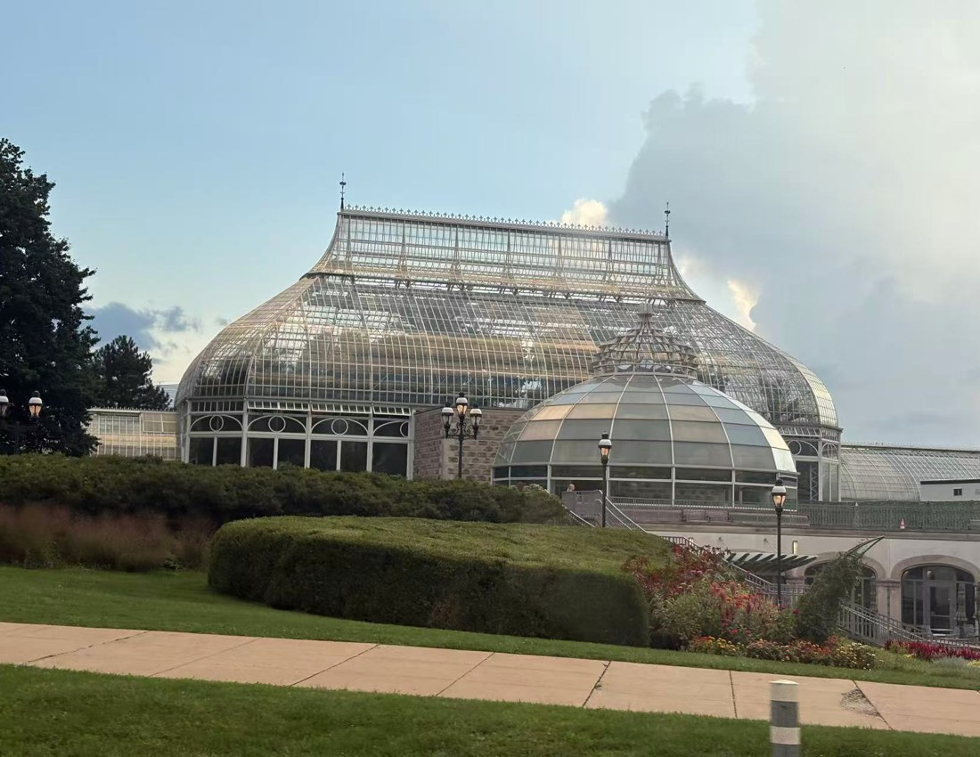

THE PROBLEM
Notes:
Think about the last trip you actually loved. When you got home, where did it go? The itinerary is in one app, the photos are in your camera roll, and the film you meant to make never happened. You lived a weekend. You remember a pile of files.

Slide 2



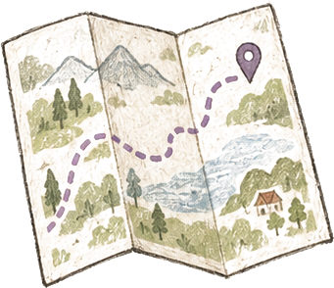



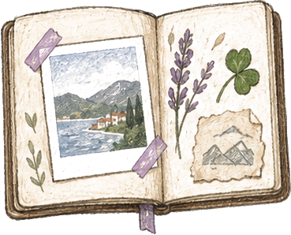



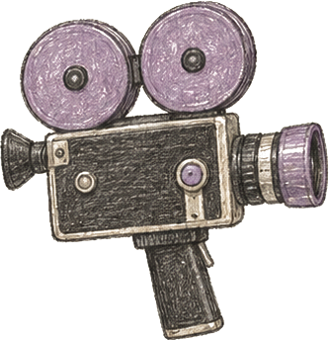

HOW WE SOLVE IT
OTHER APPS
PINLOG
1
2
3
Notes:
Pinlog is a map-first travel diary. You plan the trip as pins on a map, you live it by dropping photos and notes onto those same pins, and when you want the weekend back, the notebook cuts you a little film. Everything is a pin.

Slide 3


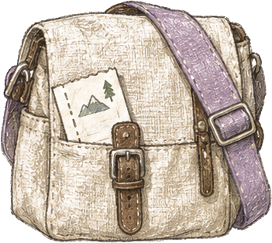
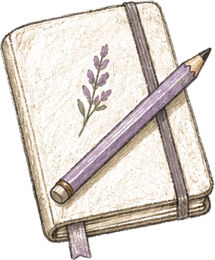





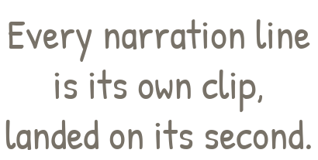
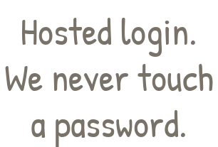

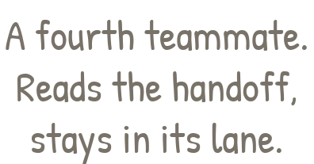
THE STACK
Notes:
ElevenLabs: every line of the voice-over is its own text-to-speech clip, dropped on its timestamp so narration matches the map, pins and title cards. Auth0: hosted login with email or Google; our server trades the one-time code for an encrypted session cookie, so the app never handles a credential. IFM K2-Think-v2 behind one LLM port: plan and replan as structured JSON, pin ask and journal chat grounded in the trip, day summary, and the vlog script that cites notes so the film does not invent the weekend. Cursor: a fourth teammate that read the handoff docs and the schema package, stayed inside one owner folder, kept the notebook look consistent, and debugged the MapLibre worker, seed photos, Auth0 and IFM wiring.

