Slide 1


Introduction to Time Series
Nicole Lee
30 March 2023
0900 - 1730

Slide 2
Time series analysis is a statistical method that deals with data collected over time. It involves analysing and modelling data to identify patterns and trends, and make predictions about future values in the series. Time series data can be found in a wide range of fields, including economics, finance, and engineering
What is Time Series Analysis

Slide 3

Can you name some examples of time series data?
Scan the QR code or visit www.menti.com
6553 3599

Slide 4
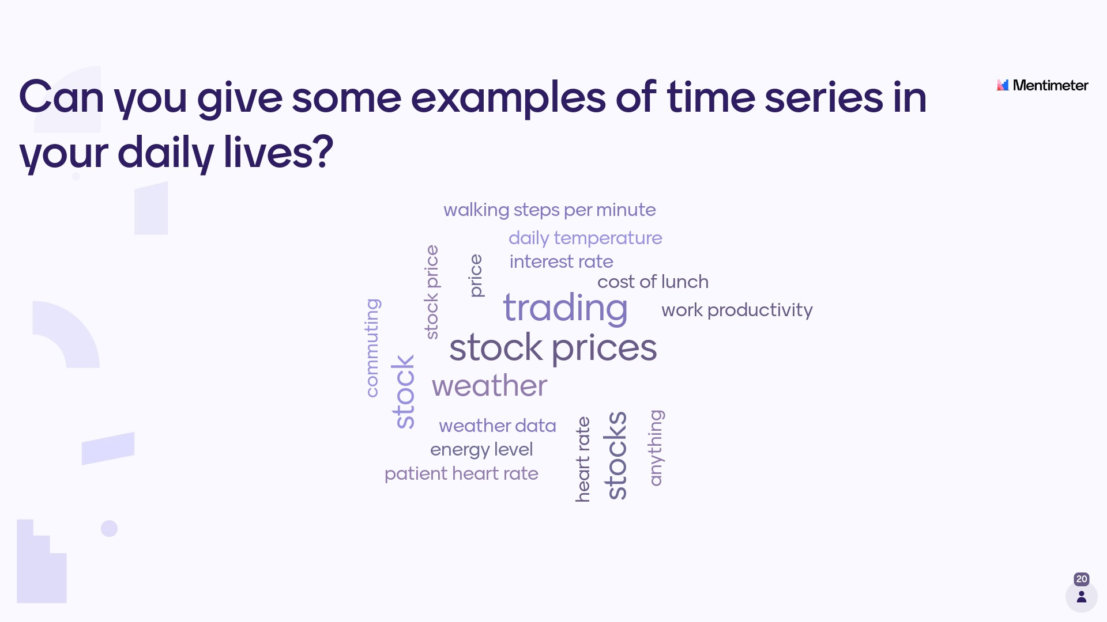

Slide 5
Time | Agenda
0915 - 0930 | Introduction to Time Series
0930 - 1015 | Stationarity, Seasonality and Correlation
1015 - 1100 | Break and hands-on exercise
1100 - 1230 | Univariate Time Series Forecasting
1230 - 1330 | Lunch
1330 - 1500 | Multivariate Time Series Forecasting
1500 - 1515 | Break
1515 - 1630 | Hands on Activity: Mini Group Project
1630 - 1715 | Project Sharing, Takeaways and Reflections
1715 - 1730 | Wrap up
Agenda

Slide 6
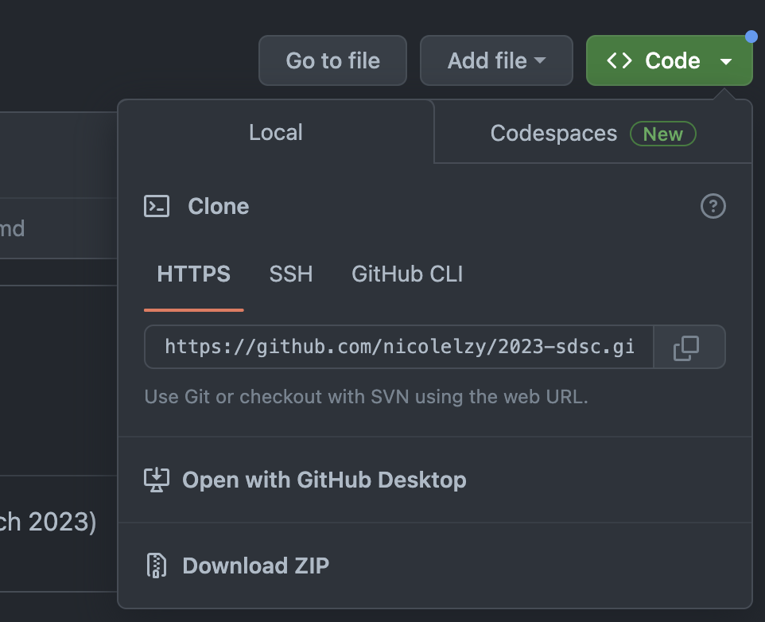
Visit https://github.com/nicolelzy/2023-sdsc and download the repository in a zip file. (Do not close the tab!) Extract the zip file to your local machine
Getting Started 01

Slide 7
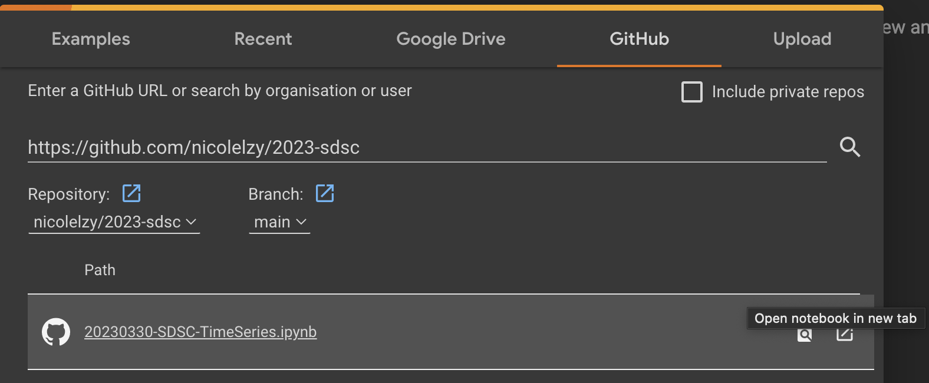
Go to https://colab.research.google.com and sign in (or sign up). Once logged on, click the Github tab Enter the GitHub URL (https://github.com/nicolelzy/2023-sdsc) and click on “Open notebook in new tab”.
Getting Started 02

Slide 8

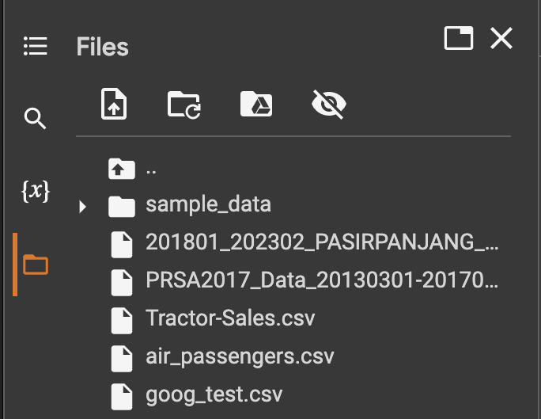
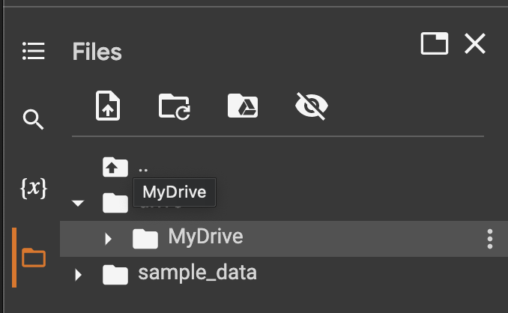
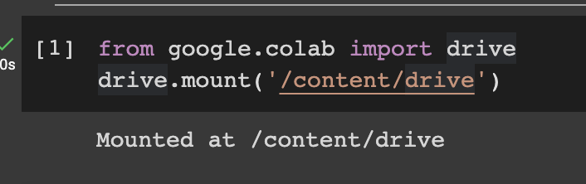
A. Upload all files in the data folder in your notebook
Getting Started 03
B. Upload all files in the data folder to your Google Drive and mount the Drive to the notebook
2
4
1
3

Slide 9
Beyond Basic Time Series Analysis
sktime
Features a unified interface for multiple time series learning tasks, including forecasting, classification, regression and time series clustering
Kats
Released by Facebook’s Data Science Team
Contains FBProphet (deprecated Time Series package)
AutoTS
Designed for large-scale AutoML detection
Supports Parallelization
Tsfresh
Automated feature engineering and feature generation of time series characteristics

Slide 10
Thank You

