Slide 1
Predicting Business Needs Through Time Series Analysis
Nicole-Marie Farley, Ph.D.

Slide 2



About Me
Biomedical Background
B.A. Neuroscience
Ph.D. Cellular and Molecular Biology
Interested in using data science to improve healthcare

Slide 3

The Problem
WellPsyche: provider of mental health services
*Thanks to Vincent Serpico
Given historical data, can we anticipate future demand for mental healthcare providers?
Project Objective: predict the number of providers in each category that will be needed to meet future demand with 3 months lead time.
Provider categories: doctors/psychiatrists, RN/PAs, therapists

Slide 4

Approach
Step 1: Model Demand
Step 2: Determine the number of providers needed to meet that demand

Slide 5
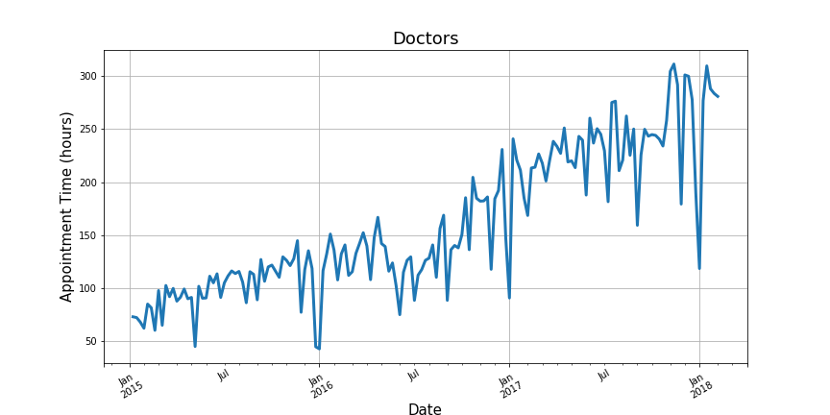
Modeling Demand:
How much time (Appointment Hours) will be needed?

Slide 6
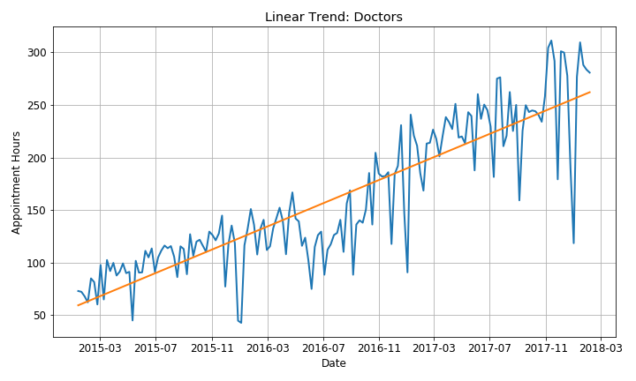
A Simple Model: Linear Regression

Slide 7
Simple Model: Linear Regression
Not a good fit!!!

Slide 8
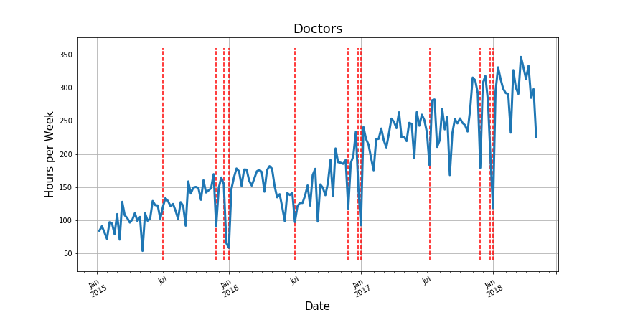
Variation Due to Time of Year
Example: Major Holidays

Slide 9
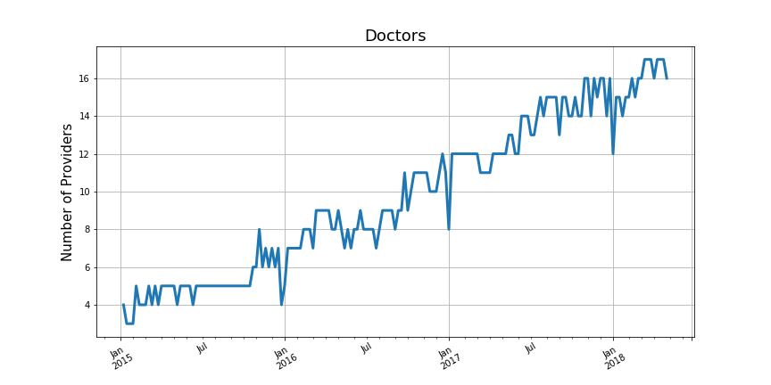
Modeling Supply

Slide 10
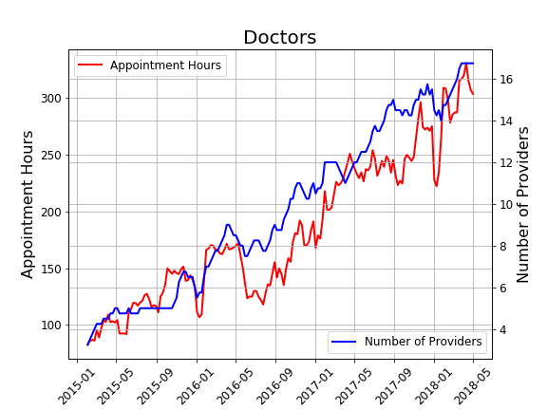
Supply and Demand

Slide 11
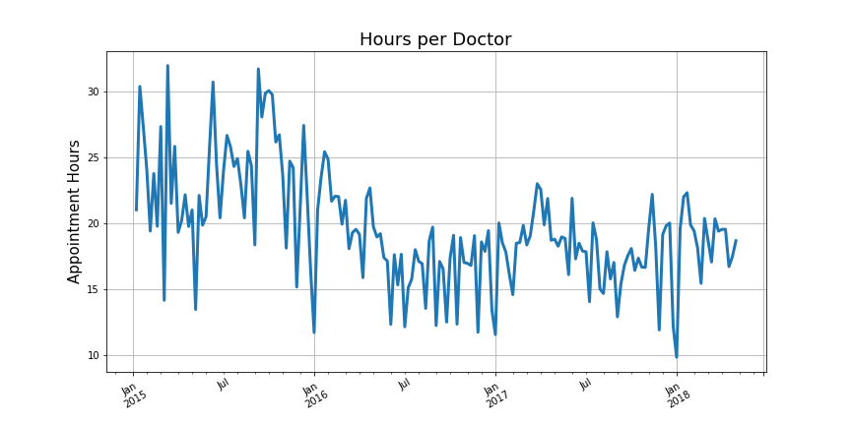
Supply and Demand
Number of providers needed = Predicted number of hours (demand) / average hours per provider (supply)

Slide 12
Modeling Weekly Demand for Psychiatrists
Linear Regression (not good)
AR: AutoRegressive / MA: Moving Average (getting better)
ARIMA/ARIMAX: AutoRegressive Integrated Moving Average/with Explanatory Variable
Prophet: new forecasting library from Facebook

Slide 13
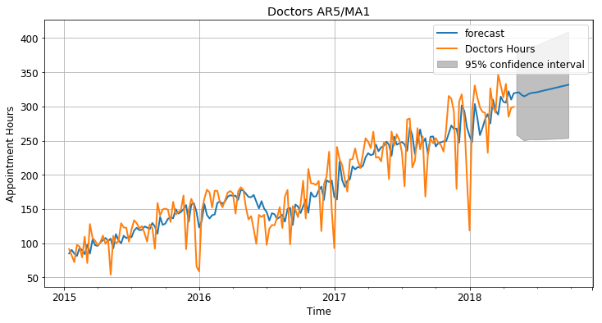
ARIMAX

Slide 14
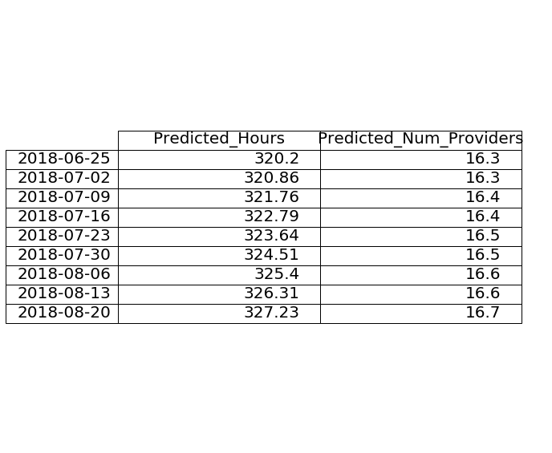
ARIMAX
8-16 week forecast

Slide 15
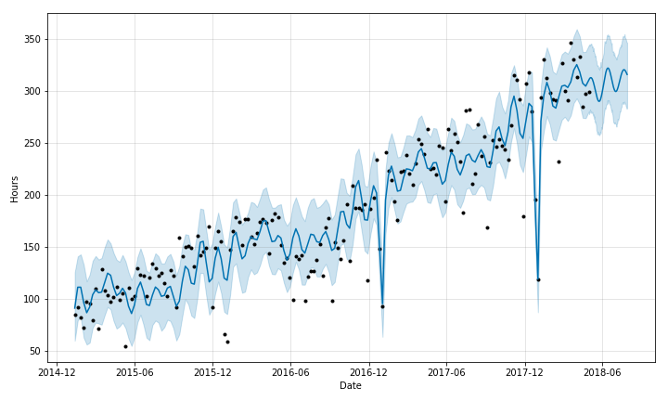
Prophet

Slide 16
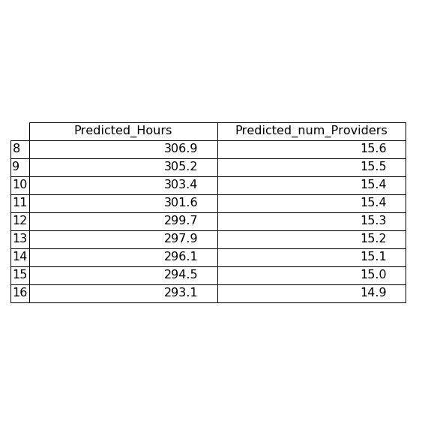
Prophet
8-16 week forecast

Slide 17
Conclusions
ARIMAX Predictions: 16-17 psychiatrists needed 8 to 16 weeks in the future
Prophet Predictions: 15-16 psychiatrists over the same interval

Slide 18
Conclusions
ARIMAX Predictions: 16-17 psychiatrists needed 8 to 16 weeks in the future
Prophet Predictions: 15-16 psychiatrists over the same interval
Which model is better?

Slide 19
Conclusions
ARIMAX Predictions: 16-17 psychiatrists needed 8 to 16 weeks in the future
Prophet Predictions: 15-16 psychiatrists over the same interval
Which model is better?
Mean squared error for test data (March & April 2018) was lower for Prophet model than ARIMAX

Slide 20
Next Steps
LSTM: Long Short-Term Memory Recurrent Neural Network

Slide 21
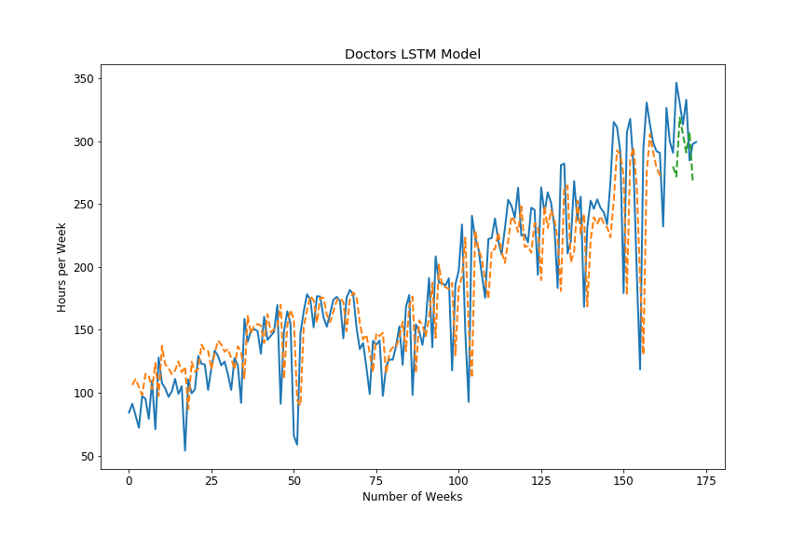
Next Steps
LSTM: Long Short-Term Memory Recurrent Neural Network

Slide 22
Next Steps
LSTM: Long Short-Term Memory Recurrent Neural Network
Add additional features/variables to existing models

Slide 23
Next Steps
LSTM: Long Short-Term Memory Recurrent Neural Network
Add additional features/variables to existing models
Breakdown by different types of appointments

Slide 24


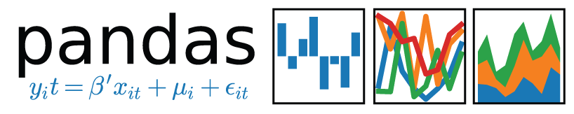




Tools/Libraries Used

Slide 25
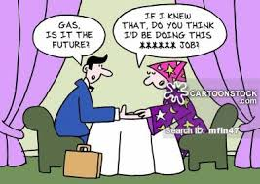
Thank you!!!!
nicole.m.h.farley@gmail.com
https://www.linkedin.com/in/nicole-farley-ph-d/
https://github.com/nicolemhfarley

