Slide 1

FINANCIAL DATA
ANALYSIS
REPORT
BY NICOLE MUTHEE

Slide 2
Problem statement
The business needs to understand how sales, costs, profit, discounts, products, countries, customer segments, and months affect overall financial performance. This analysis identifies the best and weakest-performing areas and provides recommendations for improving profitability and resource allocation

Slide 3
Goals
Analyze the dataset to identify patterns and trends related to revenue, expenses, and profit across various product categories and regions.
Evaluate findings and propose recommendations for cost-saving measures and revenue growth, supported by data visualizations and key metrics.

Slide 4
Data Understanding
The dataset contains 700 sales records and 16 fields (segment, country, product, discount band, units sold, manufacturing price, sale price, gross sales, discounts, sales, COGS, profit, date, month, year), covering September 2013 to December 2014 across 5 segments, 5 countries and 6 products.

Slide 5
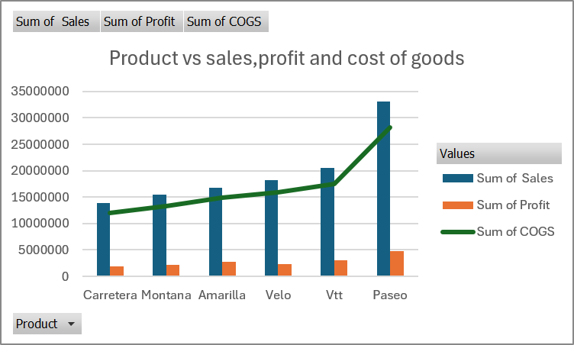
PRODUCT PERFORMANCE
Paseo is the best performing product in terms of sales ,profit and cost of goods sold
This is with sales of over 30,000,000,profit of 5,000,000 and COGS of approximately 28,000,000
Carretera is the least performing product in terms of sales,profit and COGS
This is with sales of less than 15,000,000,profit of less than 5,000,000 and COGS of less than 15,000,000

Slide 6
COUNTRY PERFORMANCE
The performance improved from 2013 to 2014
Germany was the best-performing country in 2013, with a value of 5109516
United States of America was the best-performing country in 2014 with a value of 17,529,325.5

Slide 7
DISCOUNT PERFORMANCE
The relationship between discount level and sales is not strictly linear. Medium discounts produced the highest sales, while high discounts produced lower profit than medium and low discounts

Slide 8
SEGMENT PERFORMANCE
Enterprise is the only segment with a negative total profit and is therefore the least profitable segment
Government is the most profitable with the most number of sales

Slide 9
MONTHLY PERFORMANCE
In 2014, December was the most profitable month and November the least profitable
In 2013 October was the most profitable and December the least profitable

Slide 10
COUNTRY PERFOMANCE
United States of America has the highest COGS and sales but among the least profit wise
The most profitable country is France with a value 3,770,130

Slide 11
CONCLUSION
Paseo leads on sales 33.1M and profit 4.8M.
Government is the strongest segment .Enterprise is the only loss-making segment
High discounts cut margin without out-selling Medium discounts.
France is the most profitable country (3.77M). The United States has the highest sales and COGS but the lowest margin among the large markets.
December is the peak profit month

Slide 12
RECOMMENDATIONS
Prioritize Paseo as the flagship product
Since Paseo generates the highest sales and profit, ensure it has strong inventory availability, marketing support, and distribution coverage.
Analyze the factors behind its success such as pricing, customer segment, or country demand and apply those lessons to weaker products.
Reduce dependence on high discounts
Higher discounts are associated with lower sales hence reducing profit, while lower discounts produce higher sales.
Test smaller, targeted discounts to identify the level that improves demand without reducing revenue or profit.

Slide 13
RECOMMENDATIONS
Focus growth efforts on the Government segment
Government is the most profitable segment and generates the largest volume of sales.
Develop an improvement plan for Carretera
Review its pricing, marketing, product positioning, and target customers.Consider promotional campaigns, bundling, or repositioning it toward higher-potential customer segments.
Expand investment in France
France is the most profitable country, so it should be prioritized for market expansion. The United States has the highest expenses, so it should review operating, marketing, logistics, and sales costs .
Use France as a benchmark for evaluating other markets

Slide 14
RECOMMENDATIONS
Prepare early for December demand
Increase inventory planning, staffing, marketing activity, and sales outreach ahead.

