Slide 1
World's Spotify Musicality Data
Alex Giang, Aman Kaur, Benjamin Le, Nicole Witt

Slide 2
Agenda
Project Objective
Filtering/Cleaning Process
Metadata
Analysis

Slide 3
PROJECT OBJECTIVE
To learn how to filter spotify API song data to find songs that can be used to build custom playlists based on specific criteria.
Examples: Find songs with a BPM between 125-135 for a running playlist

Slide 4
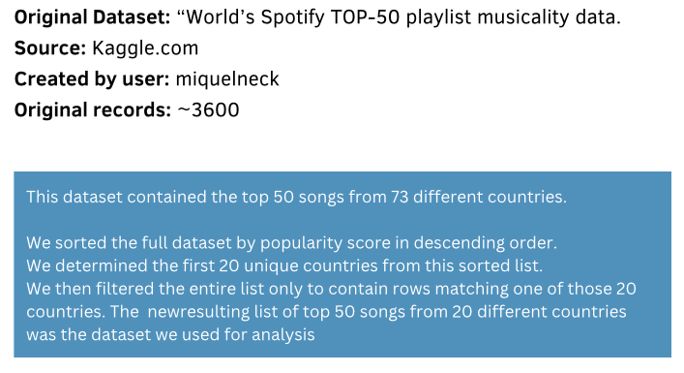

Slide 5
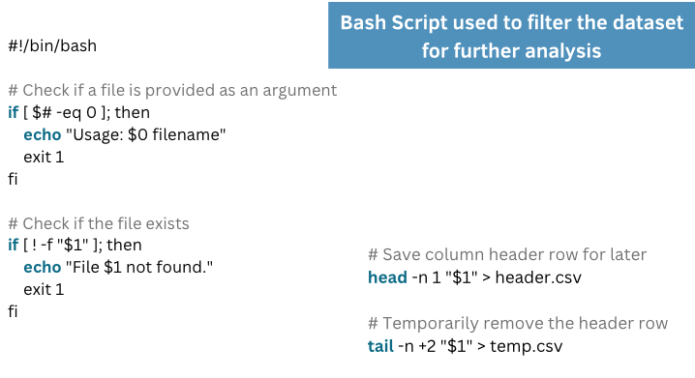

Slide 6
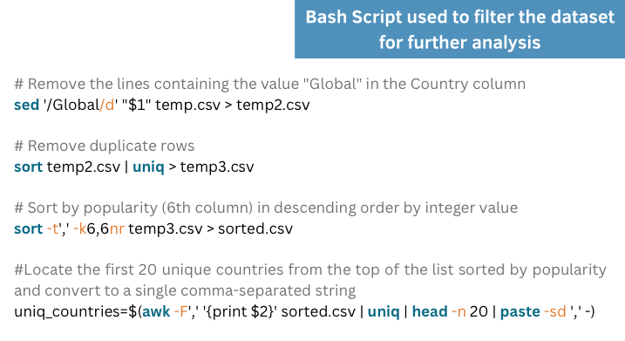

Slide 7
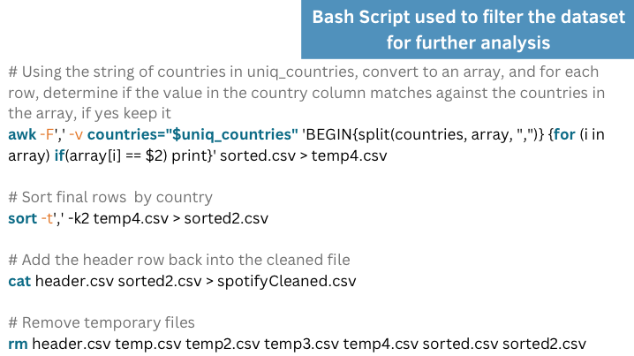

Slide 8
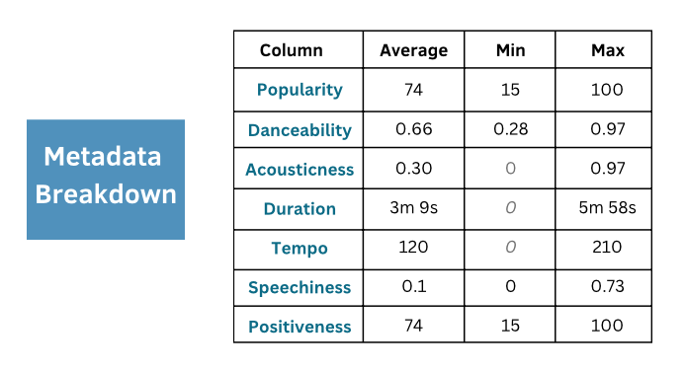

Slide 9
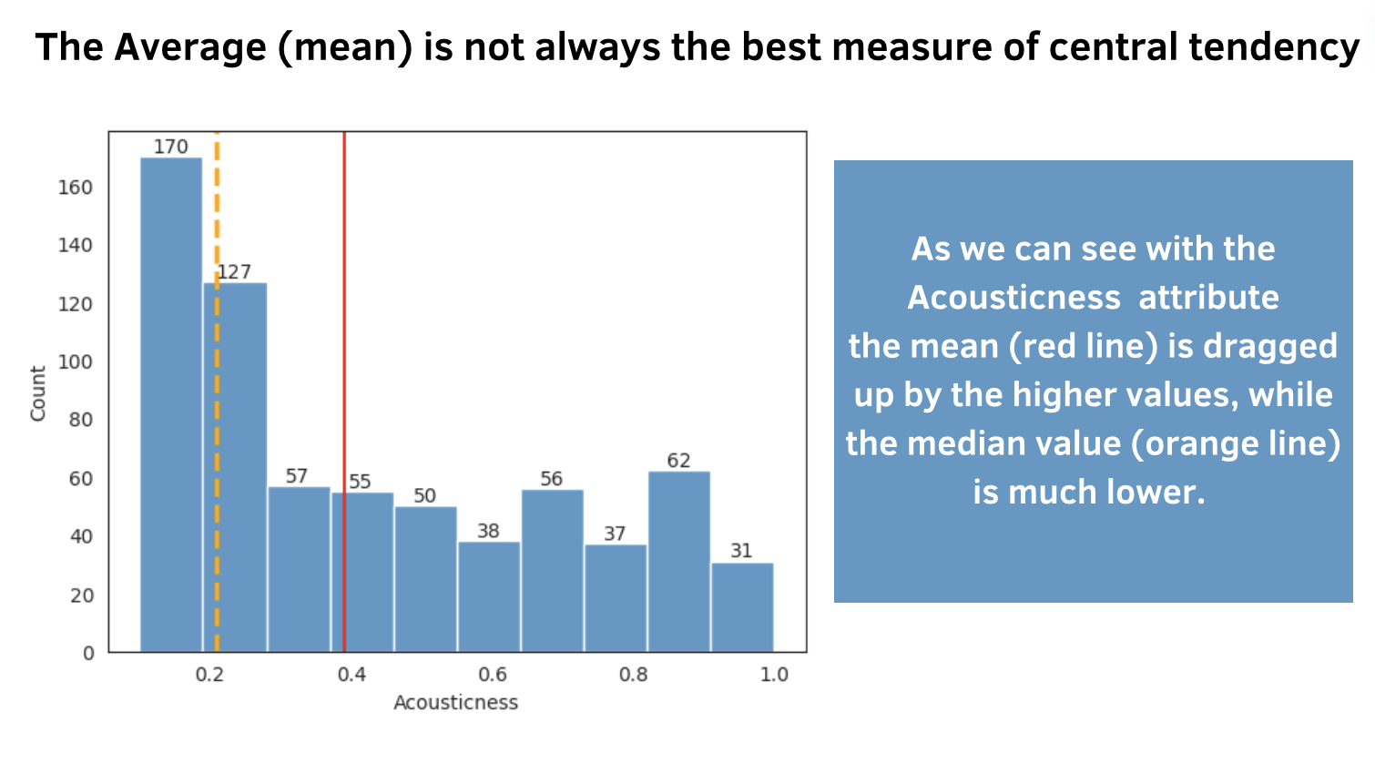

Slide 10
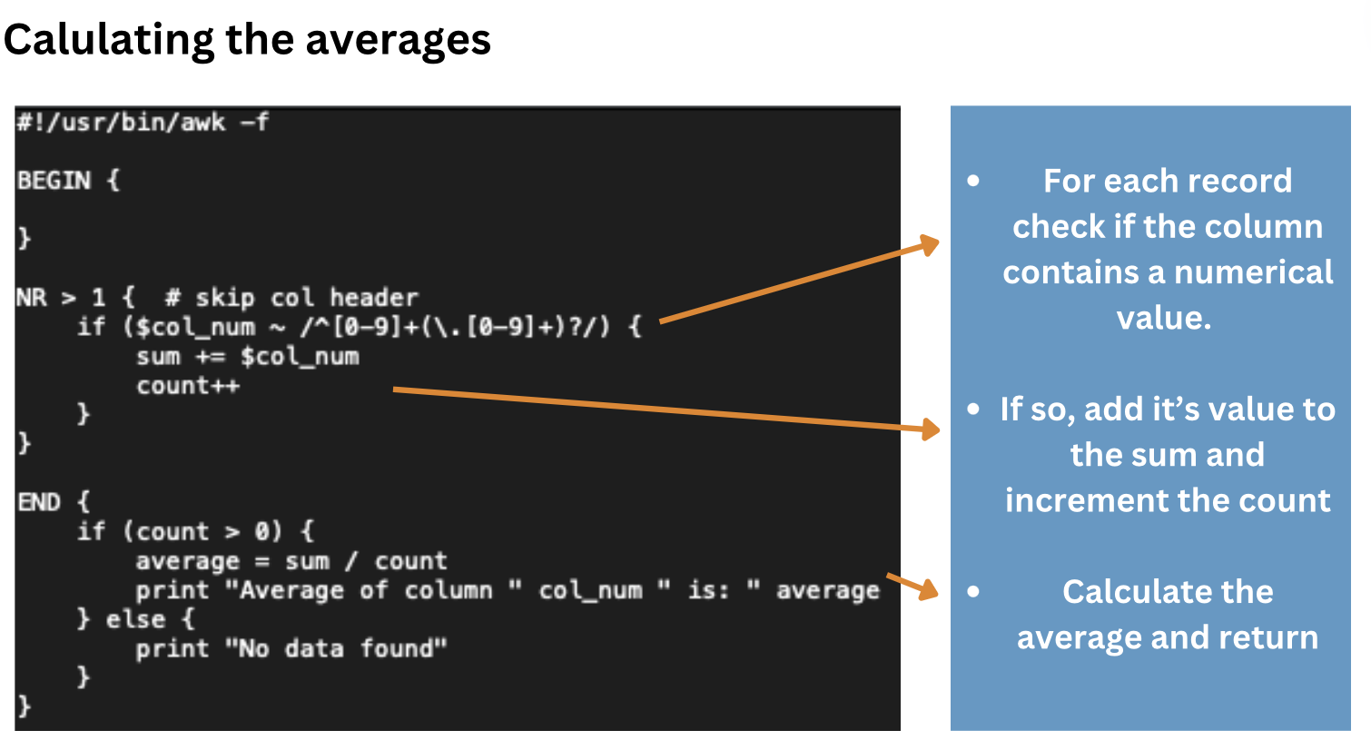

Slide 11
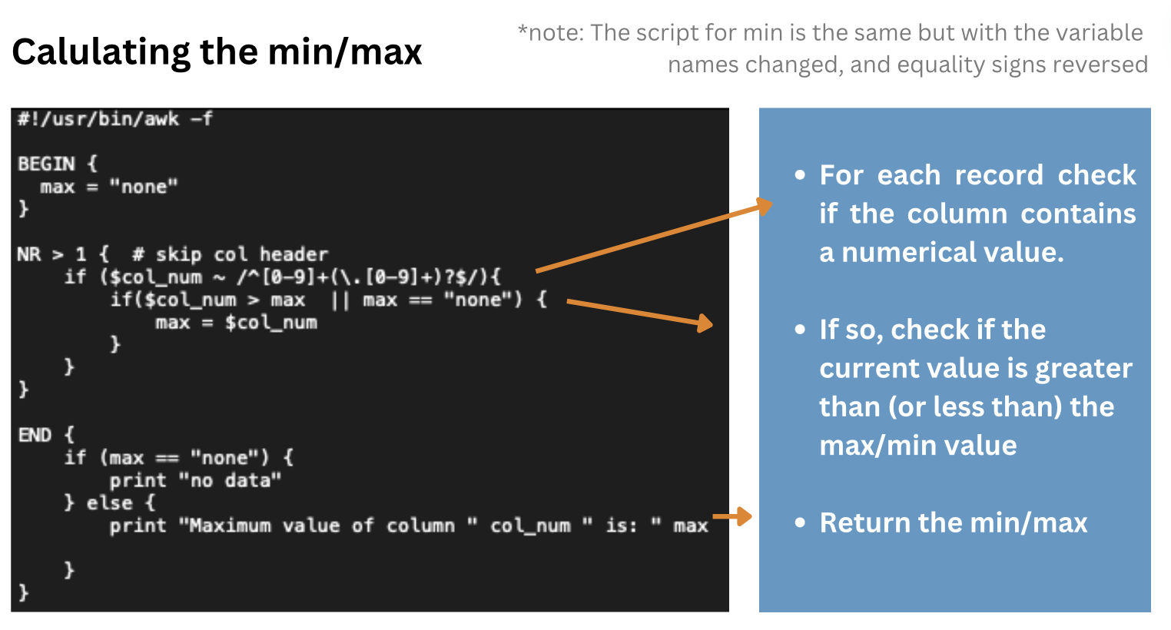

Slide 12
Metadata Continued
Number of entries
All features + Amount
Number of countries
Number of artists
Popularity Range

Slide 13
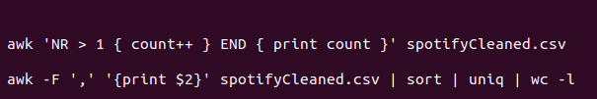
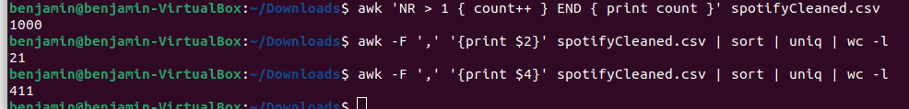
Number of entries
Command:
awk 'NR > 1 { count++ } END { print count }' spotifyCleaned.csv
Result:

Slide 14
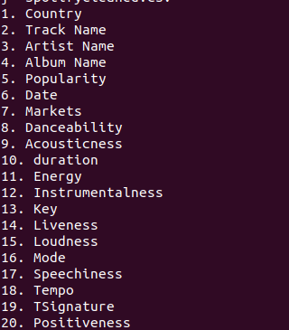
Overview of Features
Command:
awk -F ',' 'NR==1 {
for (i=2; i<=NF; i++) {
printf "%d. %s\n", i-1, $i
}
}' spotifyCleaned.csv

Slide 15
Number of countries + artists
Command for Countries:
awk -F ',' '{print $2}' spotifyCleaned.csv | sort | uniq | wc -l
Country Result:
Command for Artists:
Artist Result:

Slide 16
Popularity Range
Smallest Score:
awk -F ',' 'NR > 1 && $6 ~ /^[0-9]+$/ {print $6}' spotifyCleaned.csv | sort -n | head -n 1
Result: 15
Biggest Score:
awk -F ',' 'NR > 1 && $6 ~ /^[0-9]+$/ {print $6}' spotifyCleaned.csv | sort -n | tail -n 1
Result: 100

Slide 17

Check popularity of first 1000 songs
Command:
awk -F ',' 'NR > 1 && NR <= 1001 { if ($6 > 50) above_50++; else below_50++ } END { print "Above 50: " above_50; print "Below 50: " below_50 }' spotifyCleaned.csv
Result:

Slide 18
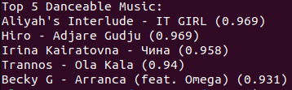
Danceable Music
Commands:
cut -d’,’ -f3,4,9 spotifyCleaned.csv > spotify_cut.csv { echo “Top 5 Danceable Music: “; sort -t’,’ -l3 -r spotify_cut.csv | uniq | tail -n +15 | head -n 10; } > top_5_danceable_music.csv awk -F’,’ ‘NR==1{print $0} NR>1 {gsub(/\(|\)/,””,$3); print $2 “ - “ $1 “ (“ $3 “)”}; top_5_danceable_music.csv
Output:

Slide 19
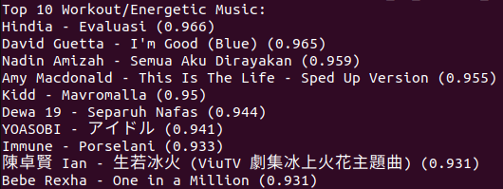
Workout Music
Commands:
cut -d’,’ -f3,4,12 spotifyCleaned.csv > spotify_cut2.csv { echo “Top 10 Workout/Energetic Music: “; sort -t’,’ -l3 -r spotify_cut2.csv | uniq | tail -n +15 | head -n 10; } > top_10_workout_energetic_music.csv awk -F’,’ ‘NR==1{print $0} NR>1 {gsub(/\(|\)/,””,$3); print $2 “ - “ $1 “ (“ $3 “)”}; top_10_workout_energetic_music.csv
Output:

Slide 20
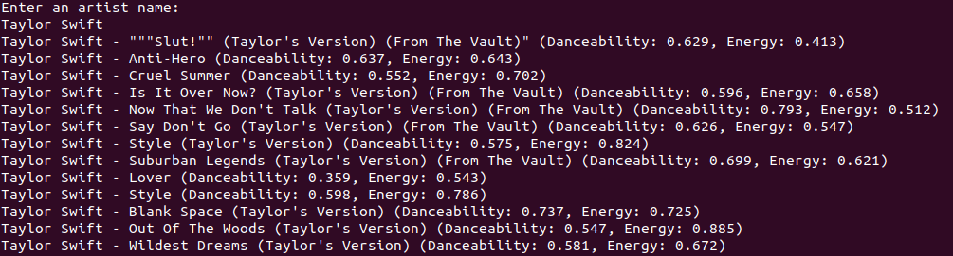
Searching Workout / Dance Music by Artist
Script:
echo “Enter an artist name:”
read userInput
grep -iE “^[^,]*,[^,]*,[^,]*,$UserInput,” spotifyCleaned.csv | \ awk -F’,’ ‘!seen[$3 “ - “ $4]++ {printf “%s - %s (Danceability: %s, Energy: %s)\n”, $4, $3, $9, $12}’)
Output:

Slide 21
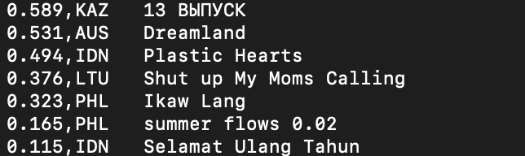
Top 10 w/highest positiveness
Command:
awk -F ',' 'NR>1 && substr($7, 1,
4)=="2020" {print $21","$2, " ",$5}' spotifyCleaned.csv | sort -t',' -k1nr | head -n 10
Result:

Slide 22
Top Artist in Top 50 Countries
Result:
Command:
awk -F ',' 'NR>1 && NR<=50 {artists[$2]++} END {count=0; max_count=0; max_artist=""; for (artist in artists) {count++; if (artists[artist] > 1) multi_country_count++; if (artists[artist] > max_count) {max_count=artists[artist]; max_artist=artist}}} END {print "Number of artists in top 50 for more than one country:", multi_country_count; print "Artist in the most countries:", max_artist, $4 "(", max_count, "countries)"}' spotifyCleaned.csv

Slide 23
Percentage of signature other than 4/4
Result
Command:
awk -F ',' 'NR>1 {total++; if ($20 != "4") not_4++} END {percentage = (not_4 / total) * 100; print "Percentage of songs with time signature not equal to 4:", percentage, "%"}' spotifyCleaned.csv

Slide 24
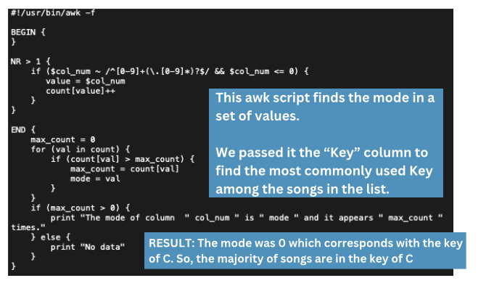

Slide 25
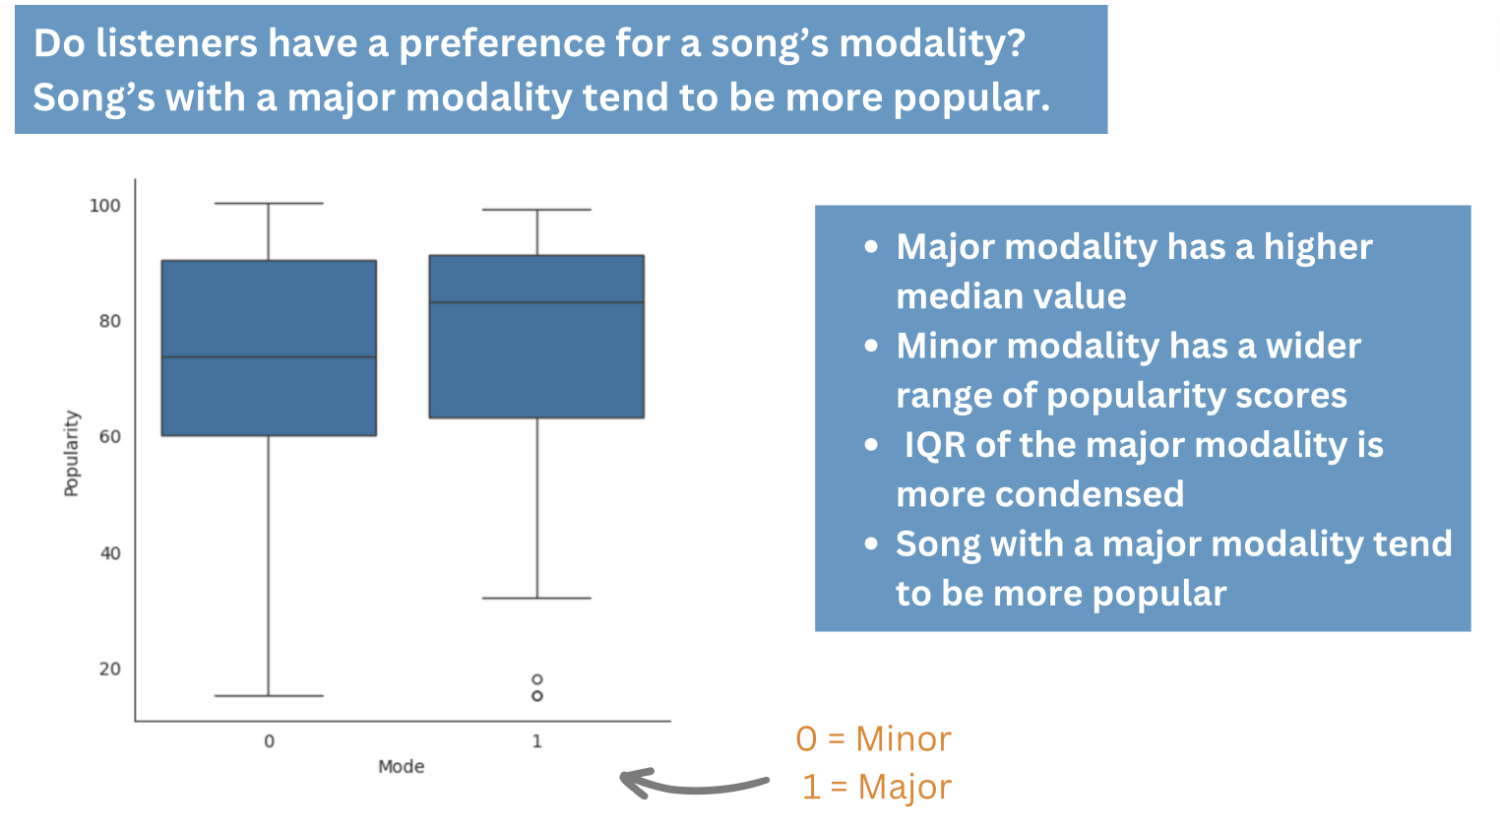

Slide 26
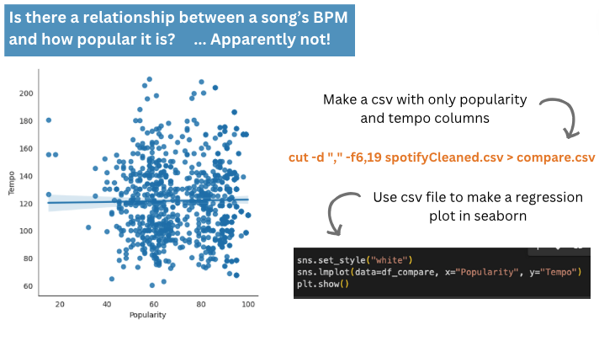

Slide 27
