Slide 1
Seismic Performance Assessment Tool (SPAT) User Manual
Nicole Paul

Slide 2
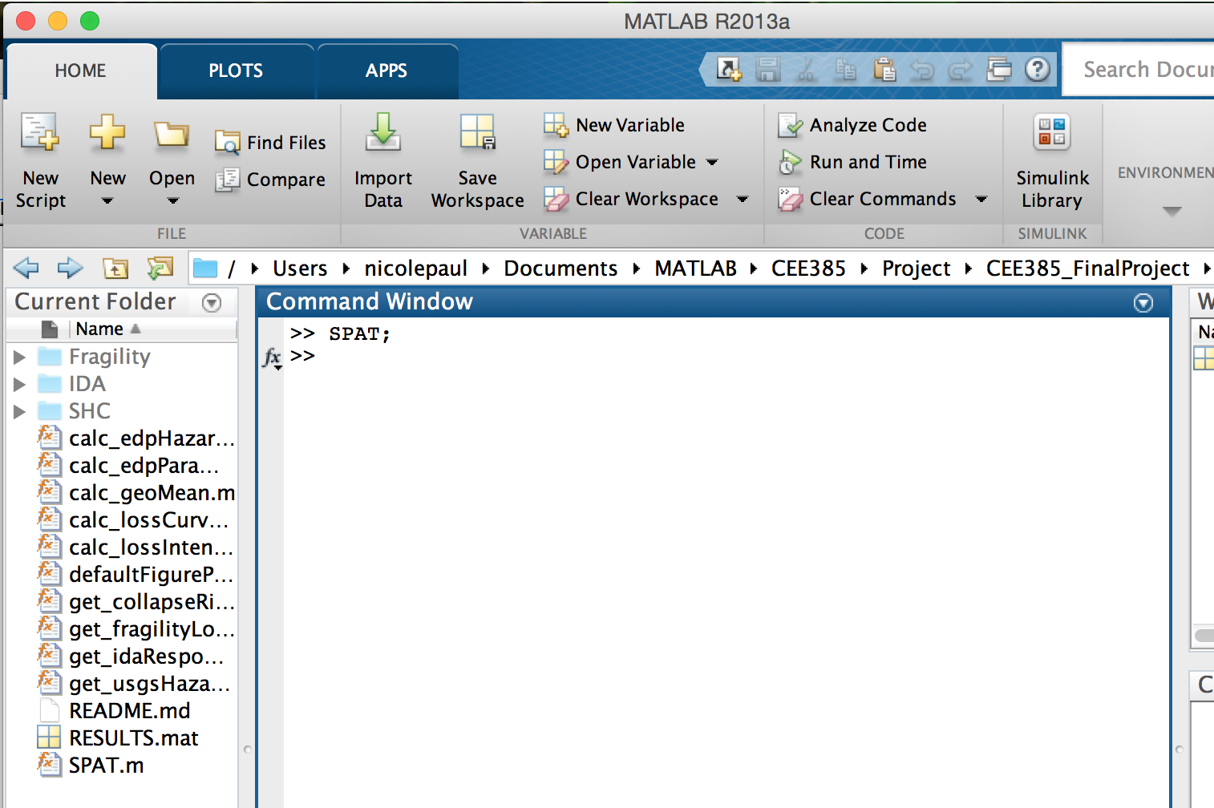
To open GUI, open the “CEE385_FinalProject” directory in MATLAB and type the following into the command window: >> SPAT;

Slide 3
Hazard
Inputs:
Longitude
Latitude
Site class
Period
Outputs:
Seismic hazard curve
Rate for probability of exceedance in t years
Ground motion for probability of exceedance in t years

Slide 4
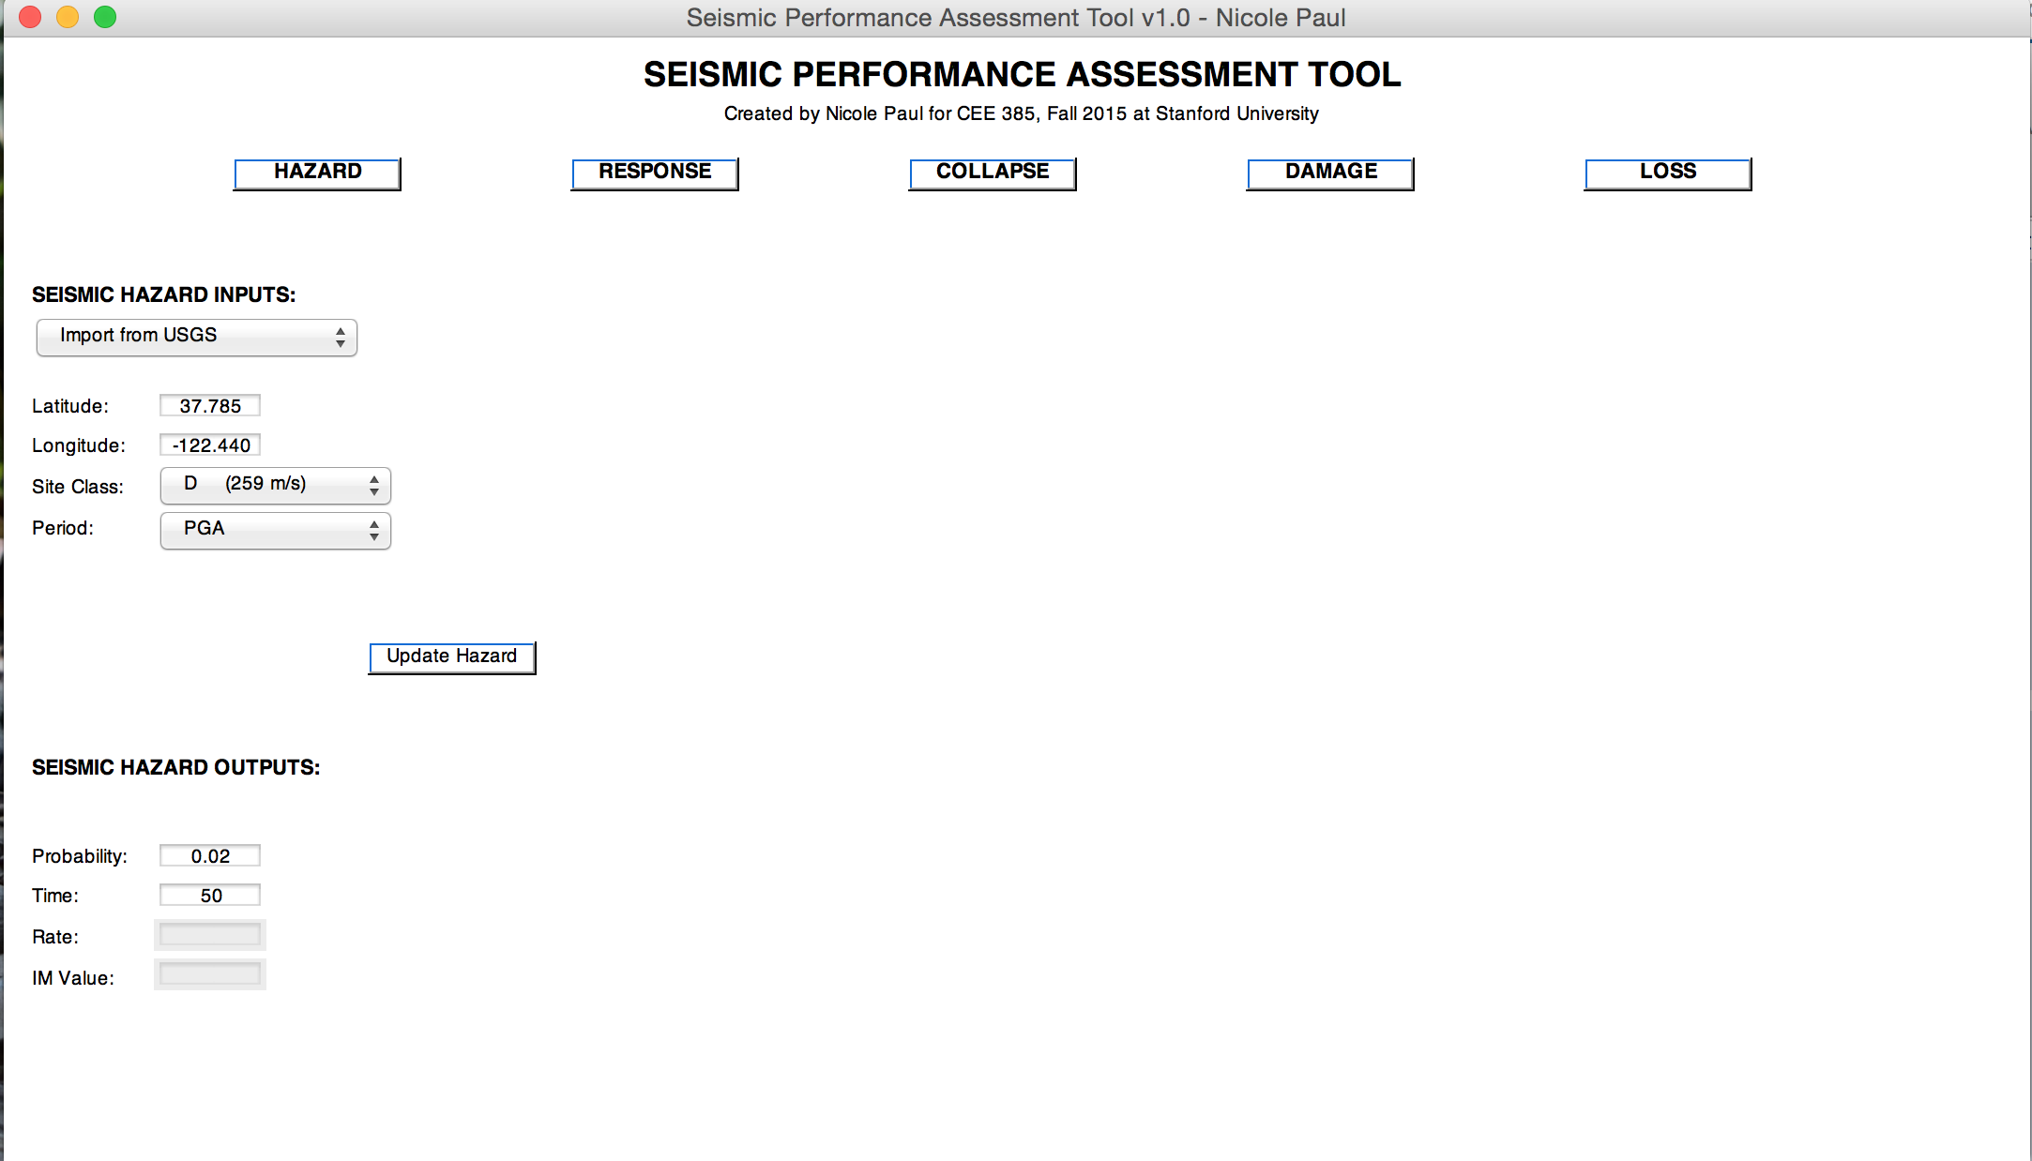
Enter the longitude, latitude, site class, and period of structure in the left bar titled “Seismic Hazard Inputs”. When finished, click the “Update Hazard” button.

Slide 5
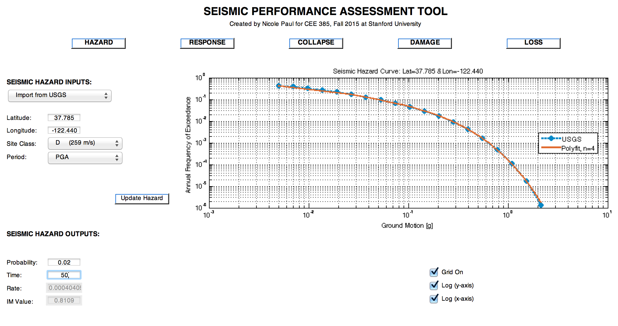
To calculate the rate and ground motion at a targeted probability of exceedance in a given span of time, edit the “Probability” and “Time” textboxes and hit the enter key

Slide 6
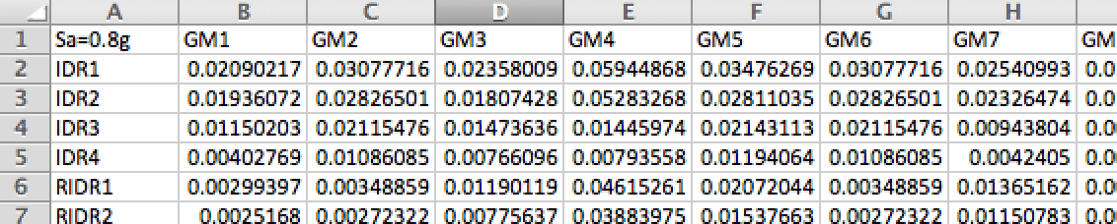
Response
Inputs:
Results from stripe analysis
Expected to be a directory containing one csv file for each stripe
Expected format:
Number of GMs
Number of floors
Number of EDPs (Note: This corresponds to the number of rows with EDP information, so for the SampleStripe given it will be 13 since there are 4 IDR rows, 4 RIDR rows, and 5 PFA rows = 4 + 4 + 5 = 13)
Outputs:
Plot of all stripe analysis results and geomean for each EDP
Plot of the lognormal standard deviation of each EDP
Mean annual frequency of each EDP with and without collapse
Probability density of each EDP given IM, assuming lognormal

Slide 7
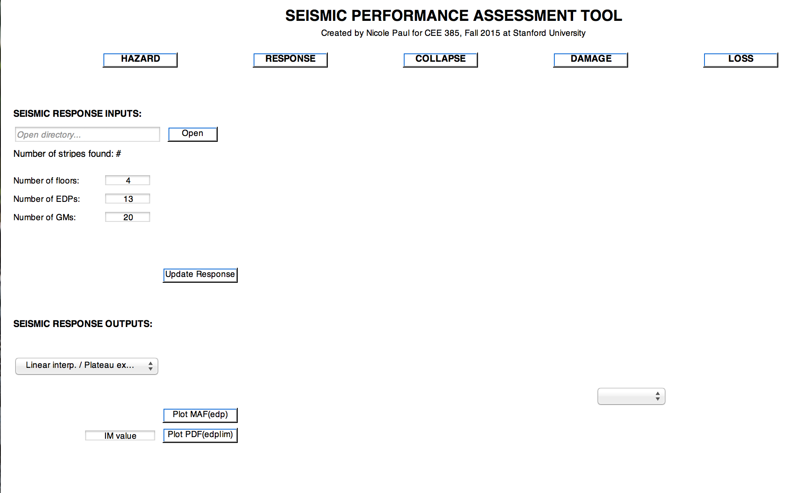
Switch to the Response tab by clicking the “Response” button. Click “Open” to locate the directory which contains the stripe analysis result csv files. Enter in the number of floors, EDPs, and GMs from the stripe analyses and then hit “Update Response”

Slide 8
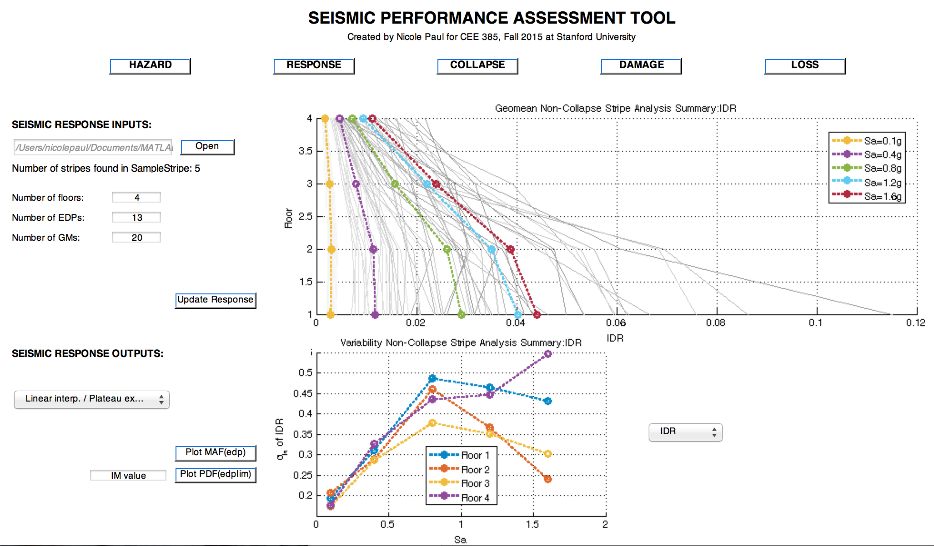
Toggle EDP of interest using the dropdown menu to the right of the smaller axes

Slide 9
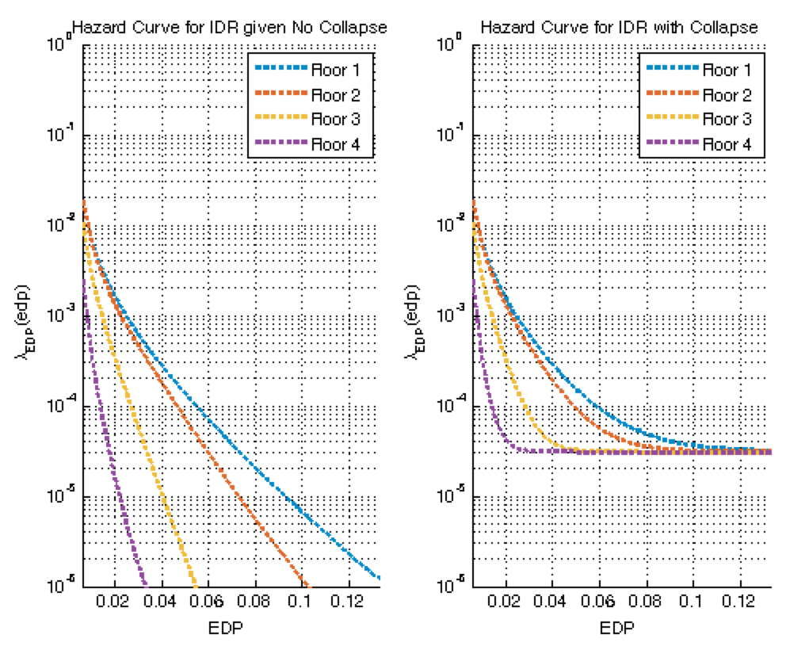
Plot mean annual frequency of EDP of interest using the “Plot MAF(edp)” button

Slide 10
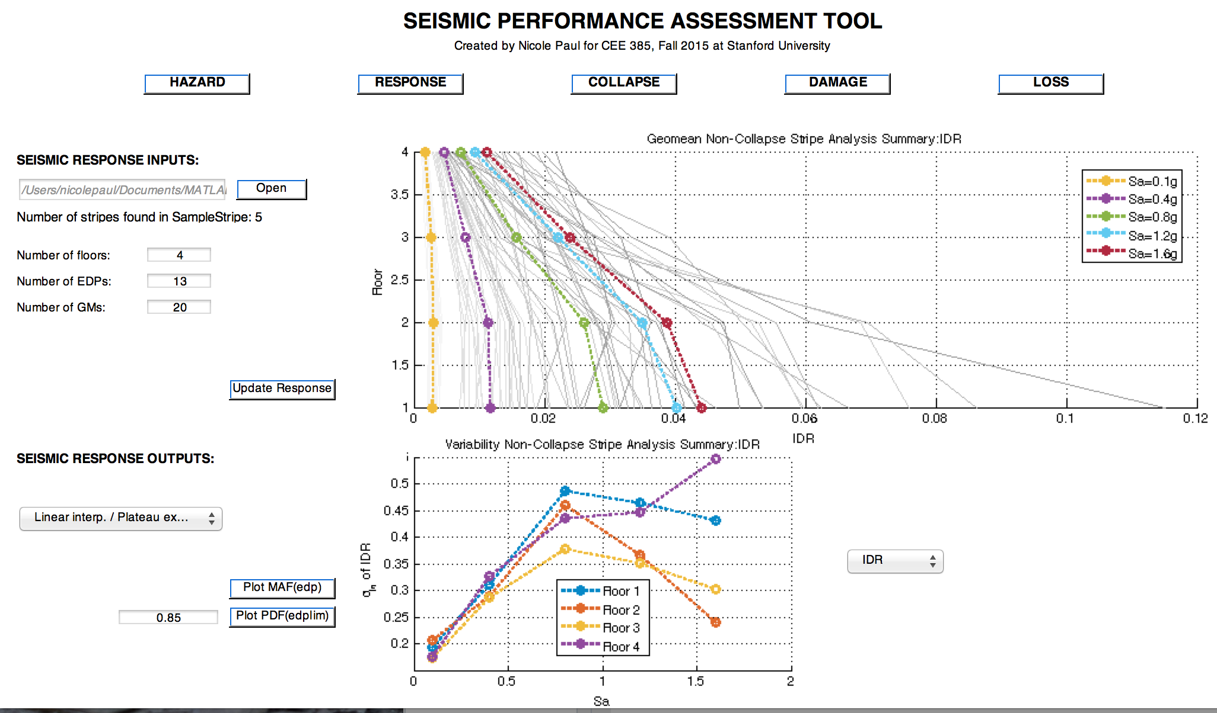
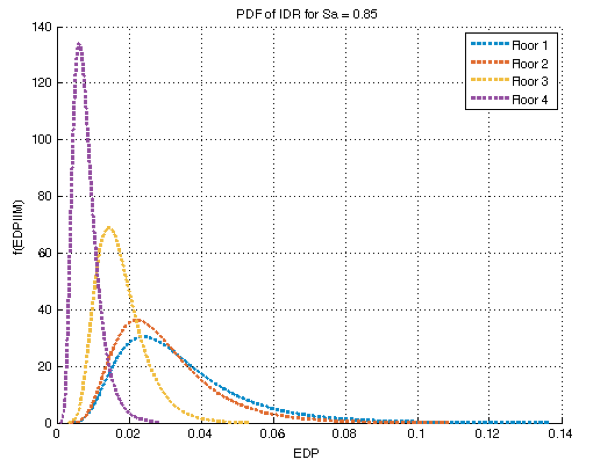
Plot probability density of EDP of interest by entering an IM value of interest into the editbox and clicking the “Plot PDF(edp|im)” button.

Slide 11
Collapse
Inputs:
Inputs from Hazard window
Inputs from Response window
Outputs:
Probability of collapse from each stripe analysis
Fitted collapse fragility to stripe results (MLE or least squares)
Collapse deaggregation curve

Slide 12
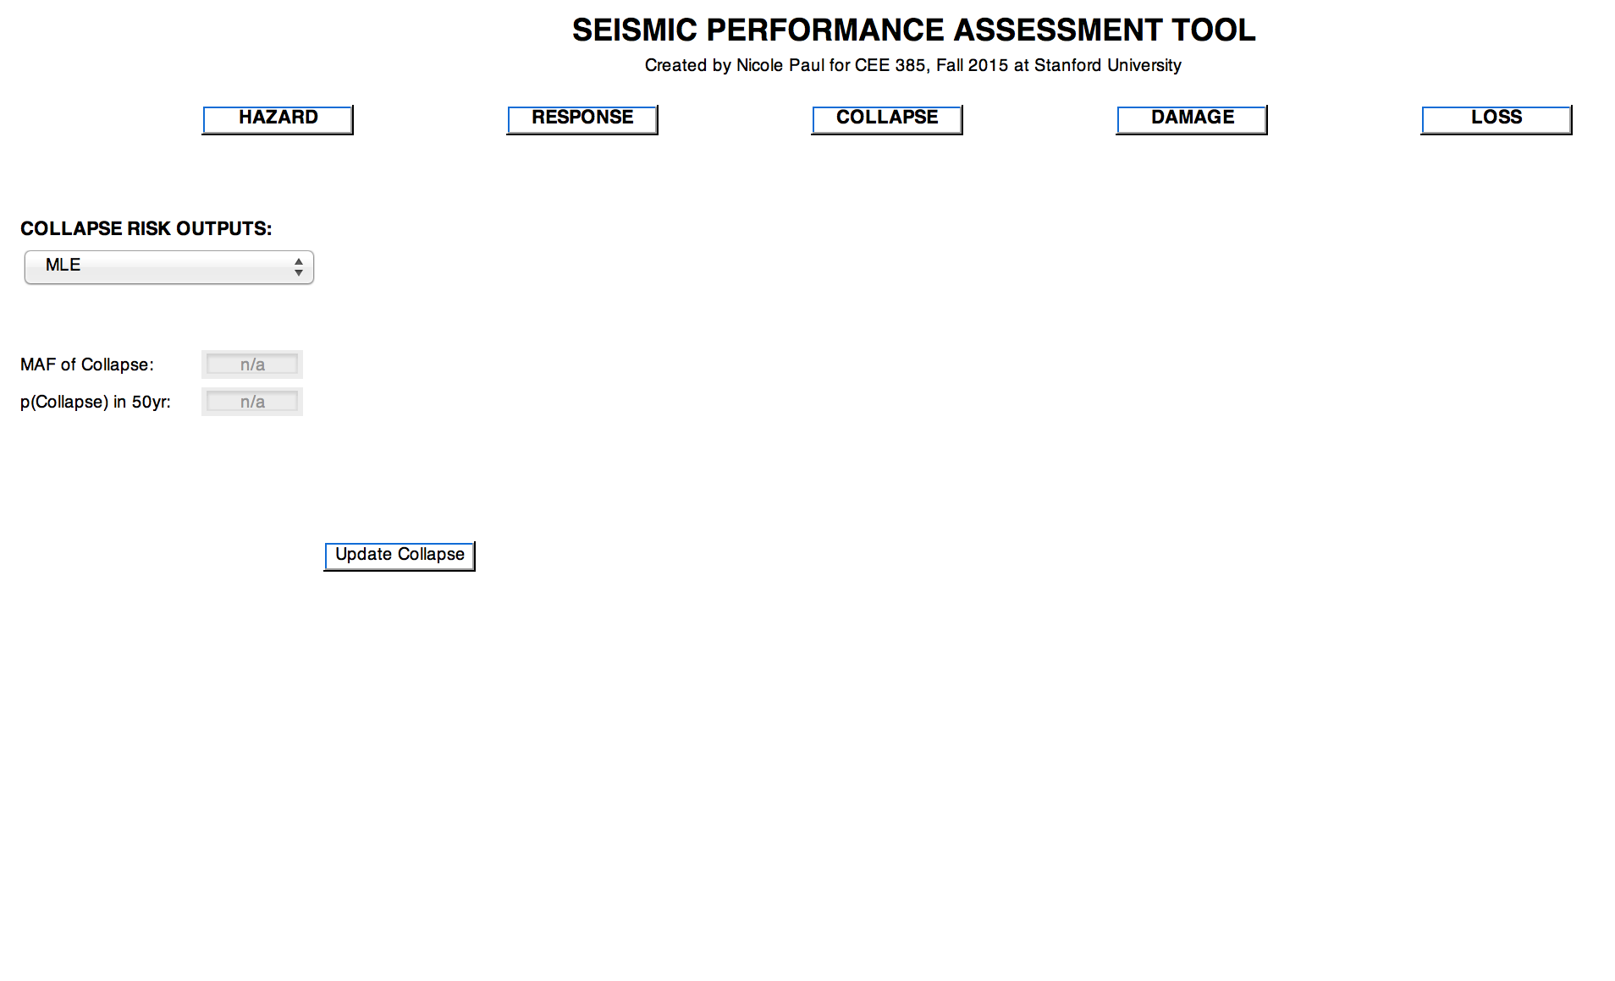
Switch to the Collapse tab by hitting the “Collapse” button. Use dropdown menu to select fit type of interest, either MLE or least squares. Then hit the “Update Collapse” button.

Slide 13
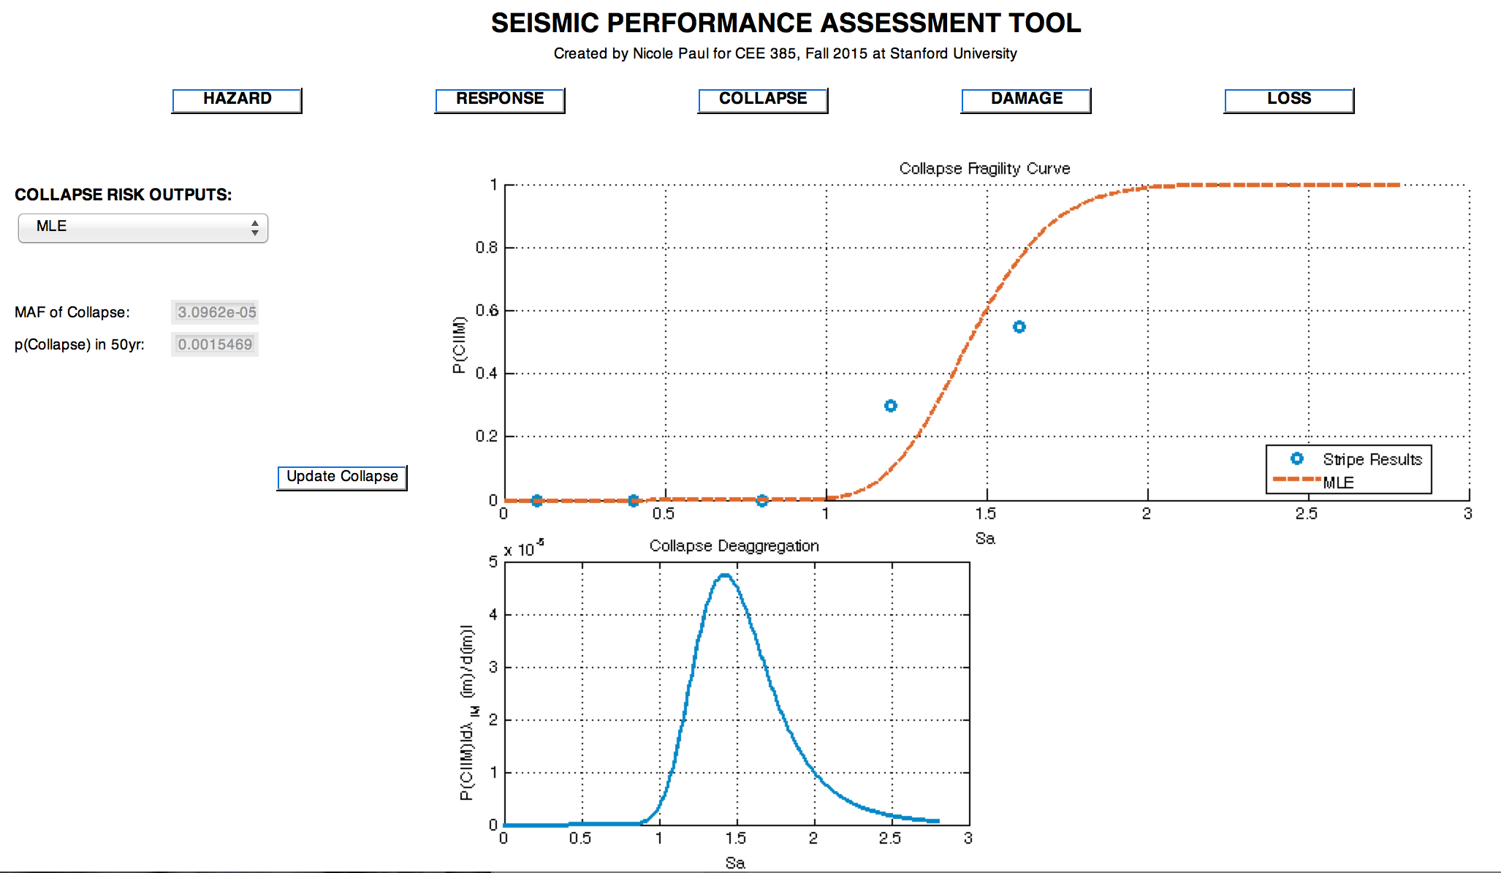
The mean annual frequency of collapse of probability of collapse in 50 years are shown in the greyed out edit boxes below the dropdown menu.

Slide 14
Damage
Inputs:
Fragility curve parameters
Expected to be a csv containing all damage and loss parameters
Expected format:
Number of DS
Number of fragilities (performance groups)
Demolition fragility curve (median RIDR, dispersion)
Outputs:
Fragility curves, p(DM|EDP)
Loss curves, p(Loss|DM)

Slide 15
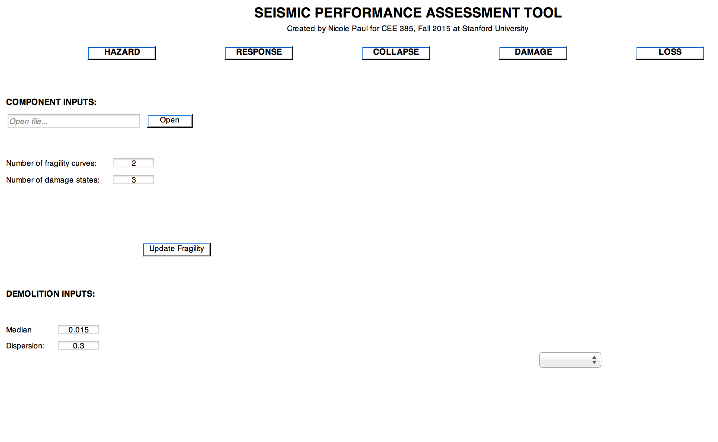
Switch to the Damagetab by hitting the “Damage” button. Click “Open” to locate the csv file with all fragility and loss parameters. Use the edit boxes to enter the number of fragility curves (performance groups) and damage states for each fragility curve. Enter in the median RIDR and dispersion for demolition fragility. Hit “Update Fragility” when finished.

Slide 16
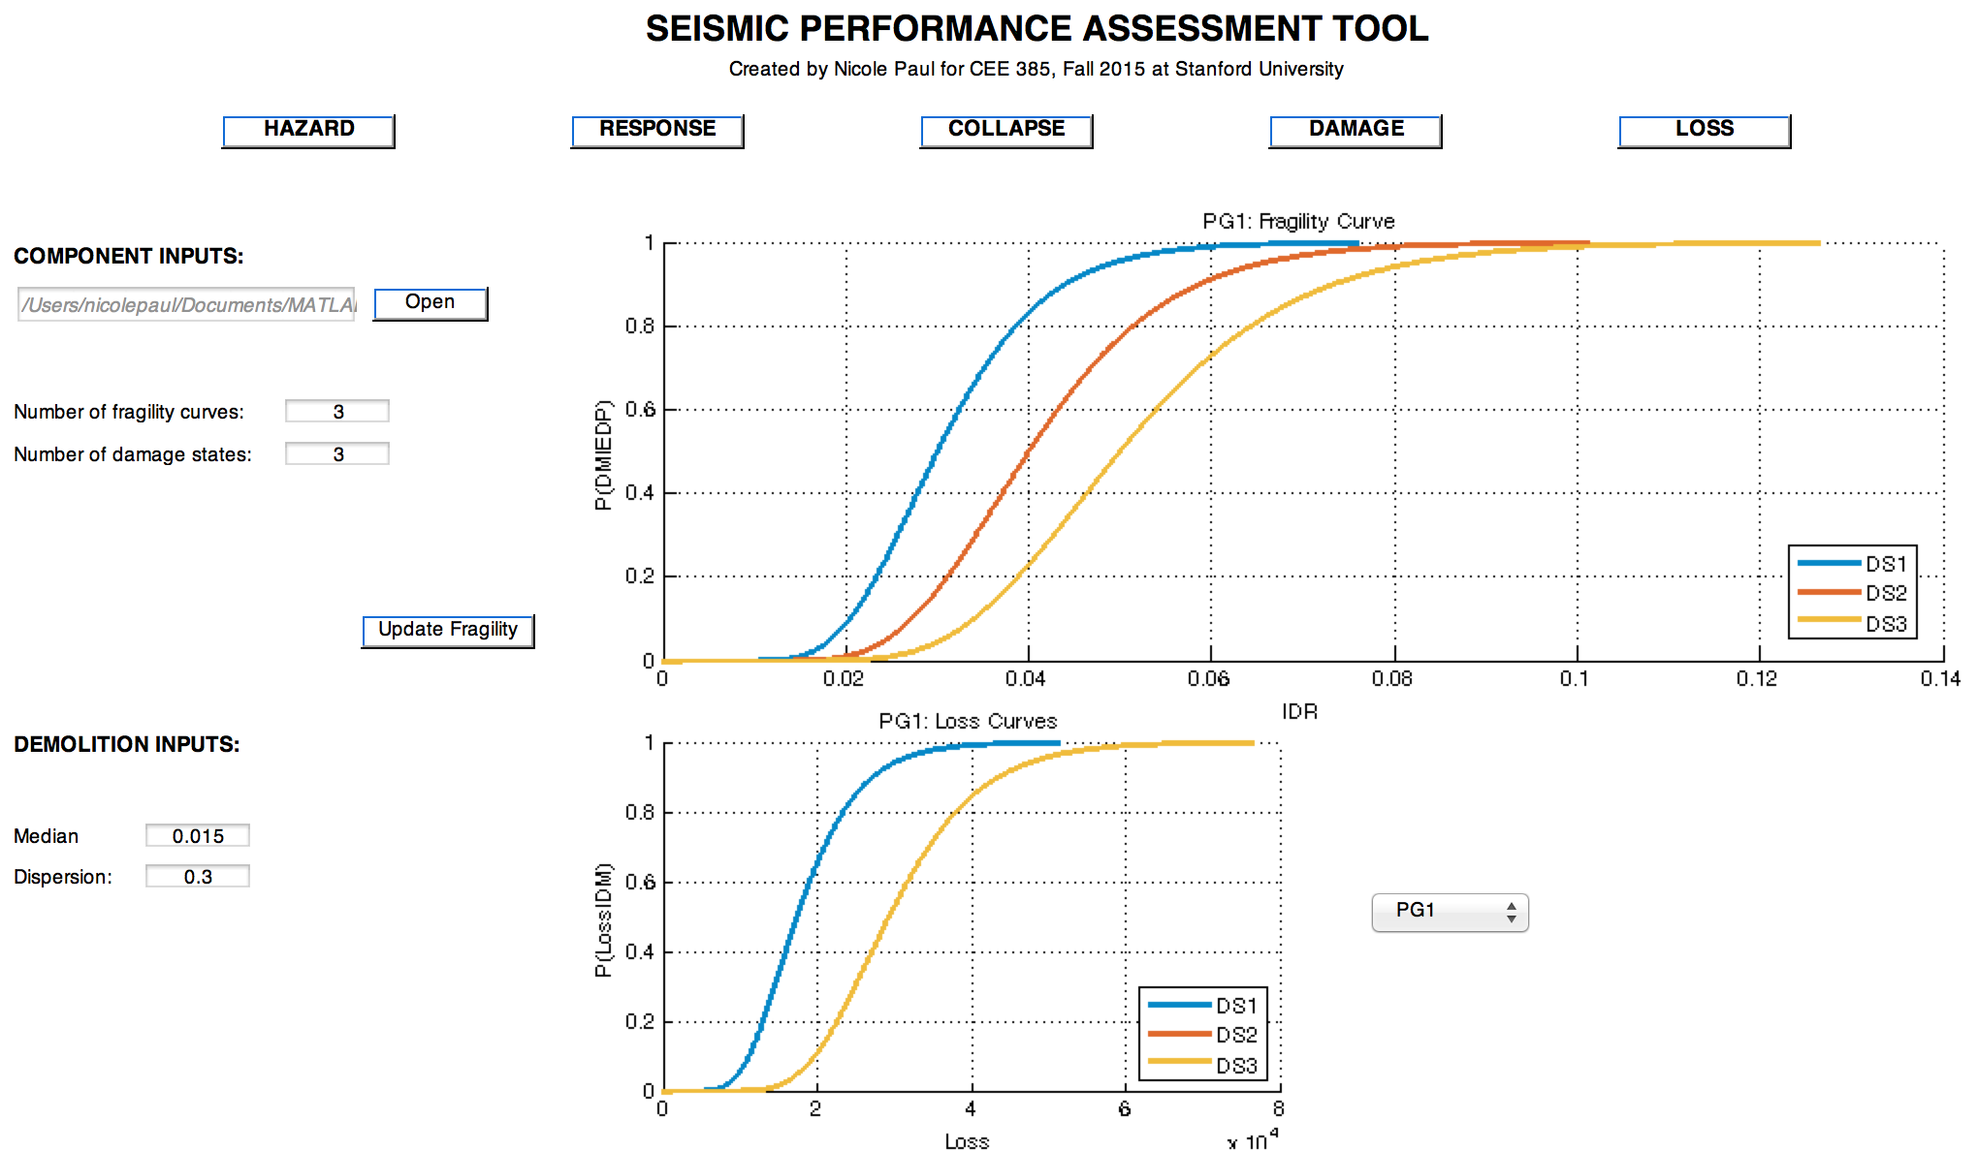
Toggle performance group of interest using the dropdown menu to the right of the smaller axes

Slide 17
Loss
Inputs:
Replacement cost new (RCN)
Demolition cost (expected)
Collapse cost (expected)
Quantity of each performance group on each floor for each EDP
Outputs:
Average annual loss (total, repair, demolition, collapse)
Expected loss, given IM (total, repair, demolition, collapse)
Curves as a function of IM:
Deaggregation of E[L|IM]
E[L|IM] as value and percentage of RCN
Probability and contribution of each case (R, D, C) to total expected loss
Pie charts showing %age of case, EDP, story, and performance group to:
AAL
E[L|IM]

Slide 18
Switch to the Collapse tab by hitting the “Collapse” button. Use dropdown menu to select fit type of interest, either MLE or least squares. Then hit the “Update Collapse” button.

Slide 19
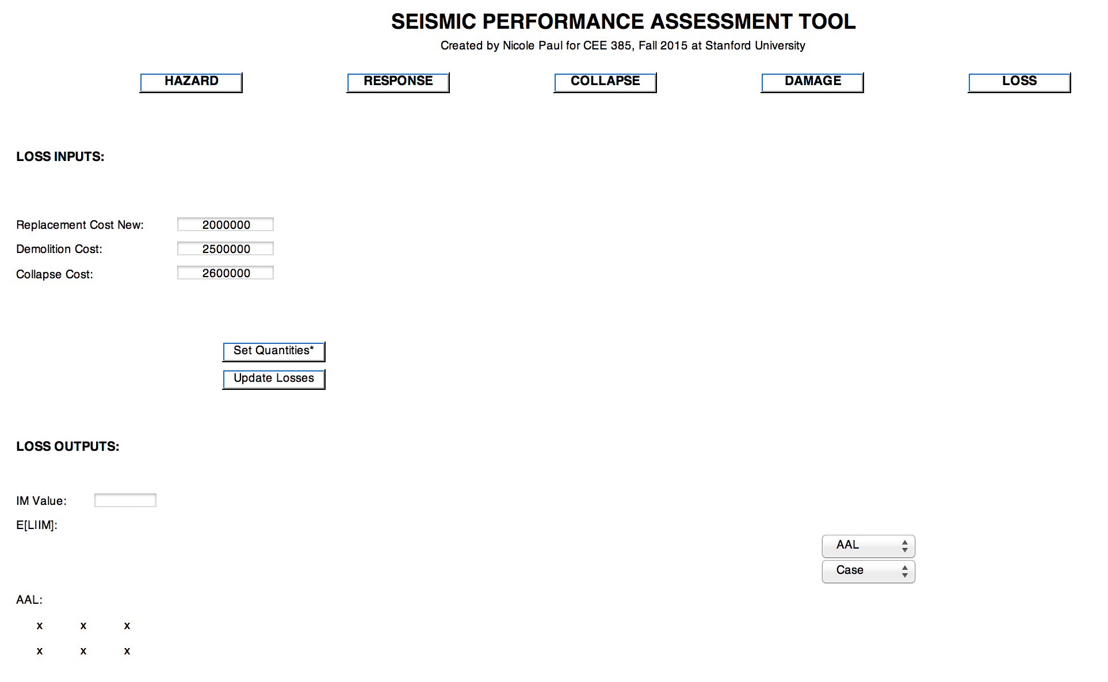
Switch to the Loss tab by hitting the “Loss” button. Enter replacement, demolition, and collapse cost.

Slide 20
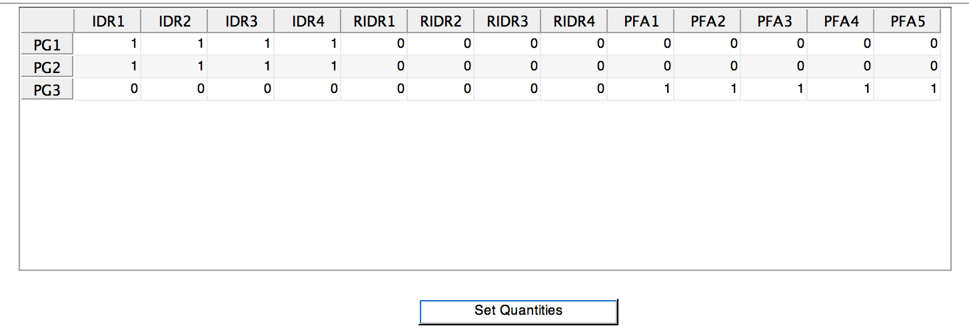
Enter quantities of each performance group by selecting the “Set Quantities*” tab. By default, each performance group will have one unit on each floor that has data for the EDP it is sensitive to. Edit quantities if desired, then hit “Set Quantities”

Slide 21
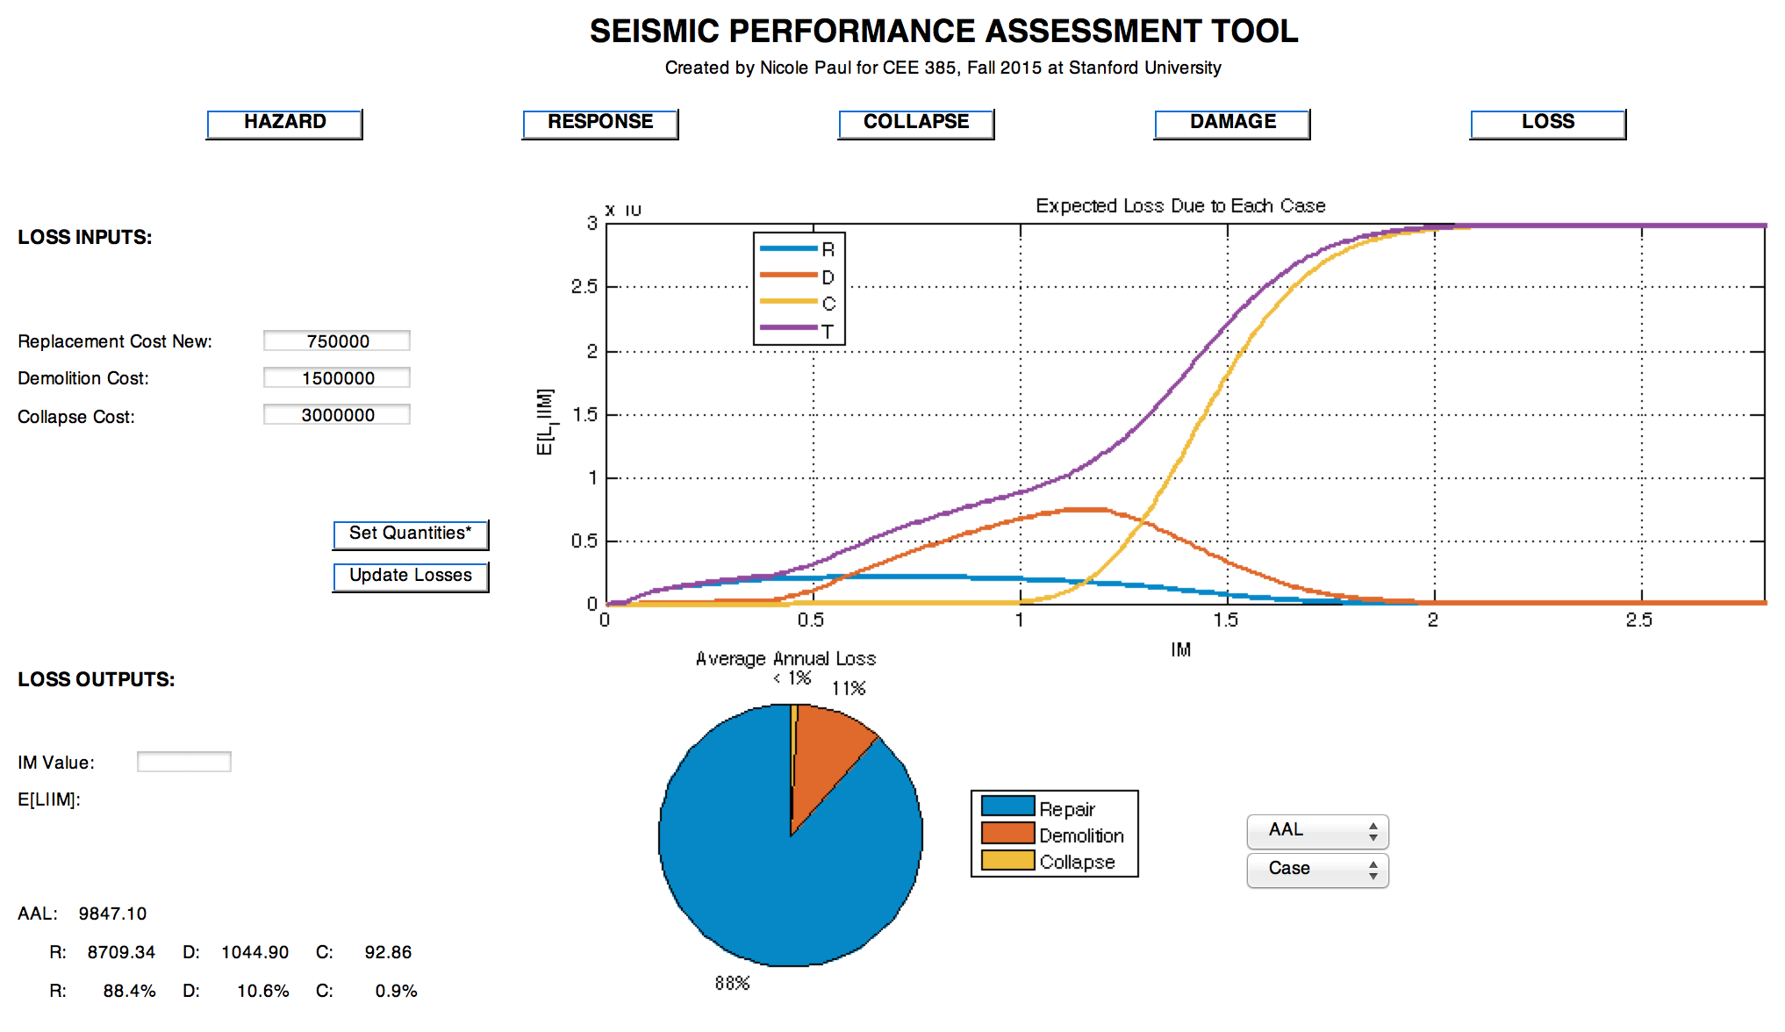
Hit the “Update Losses” button and two windows will pop up. One will have the E[L|IM] as value and percentage of RCN, as well as the probability and contribution of each case to E[L|IM]. The other window will have the deaggregation of loss.

Slide 22
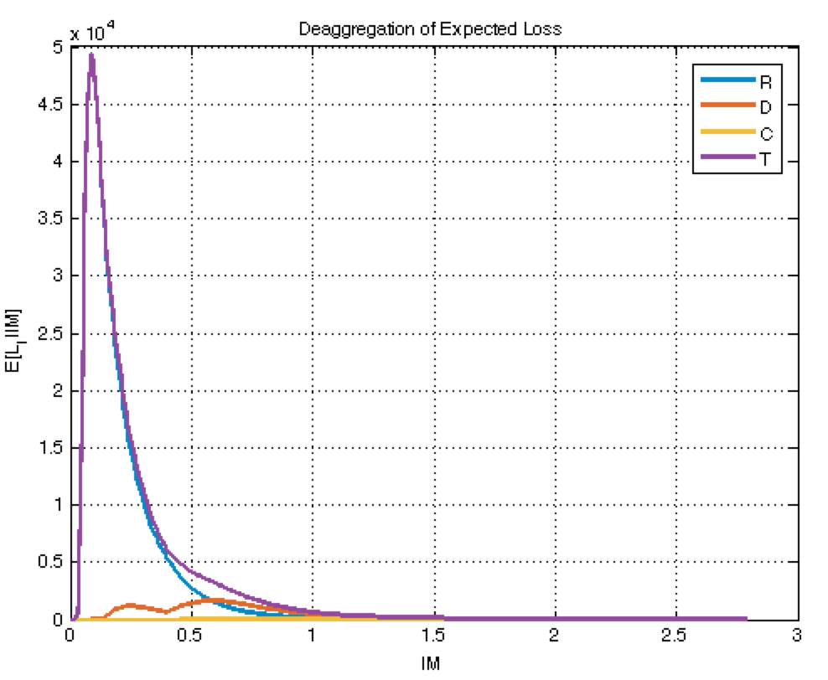
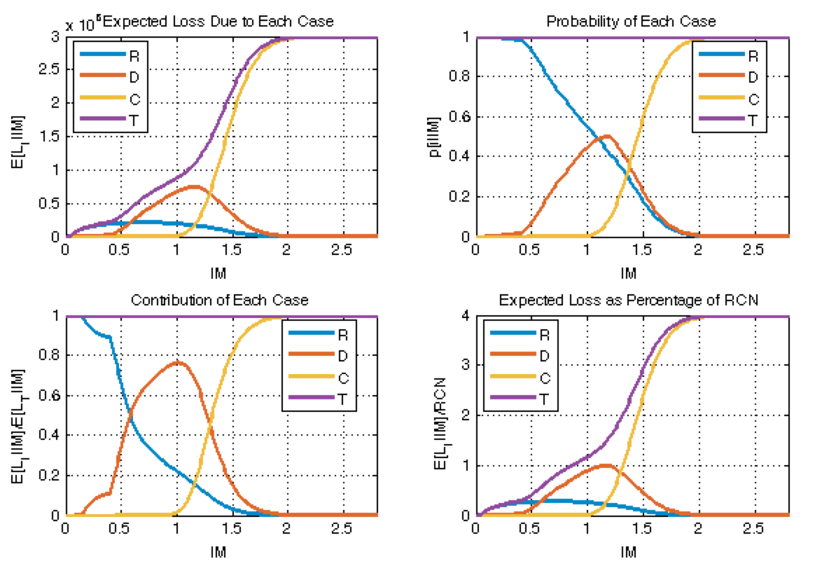
These are the figures that will pop up.

Slide 23
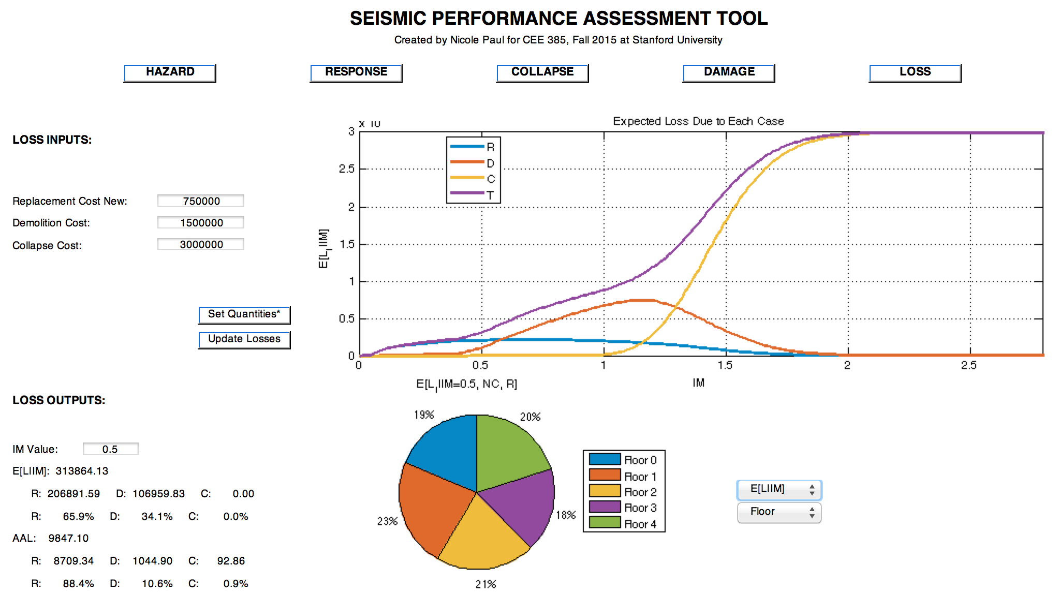
Enter IM of interest in edit box under “Loss Outputs”. Toggle pie chart using the drop down menus to the right of the pie chart.

