Slide 1
Seismic Performance Assessment Tool (SPAT) User Manual
Nicole Paul

Slide 2
Hazard
Inputs:
Longitude
Latitude
Site class
Period
Outputs:
Seismic hazard curve
Rate for probability of exceedance in t years
Ground motion for probability of exceedance in t years

Slide 3
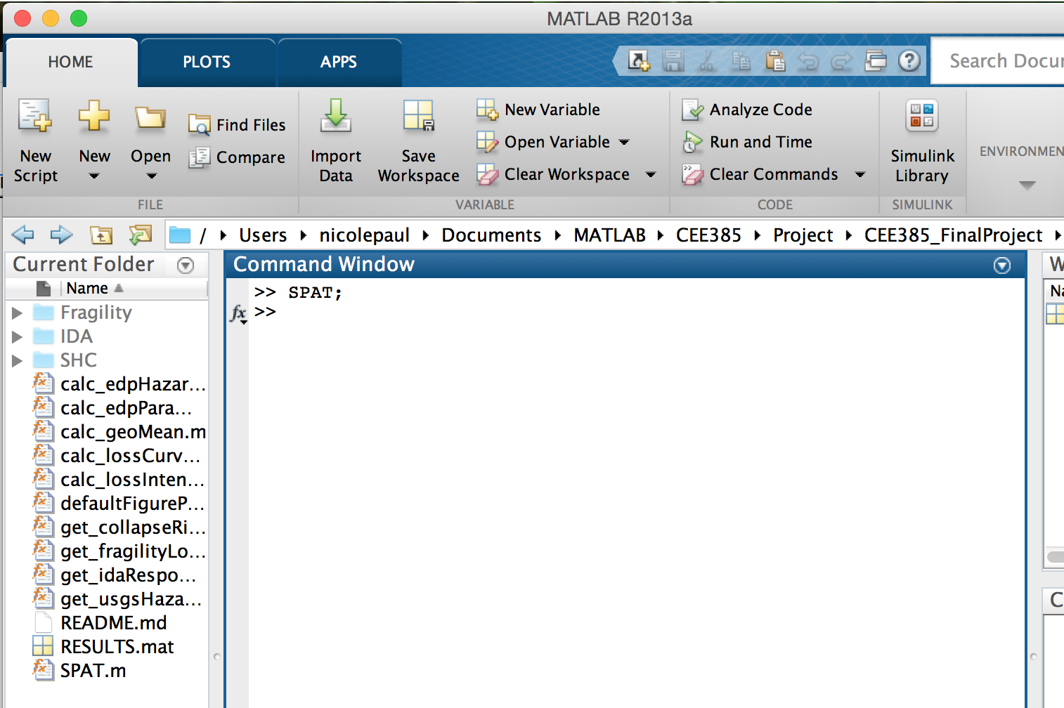
To open GUI, open the “CEE385_FinalProject” directory in MATLAB and type the following into the command window: >> SPAT;

Slide 4
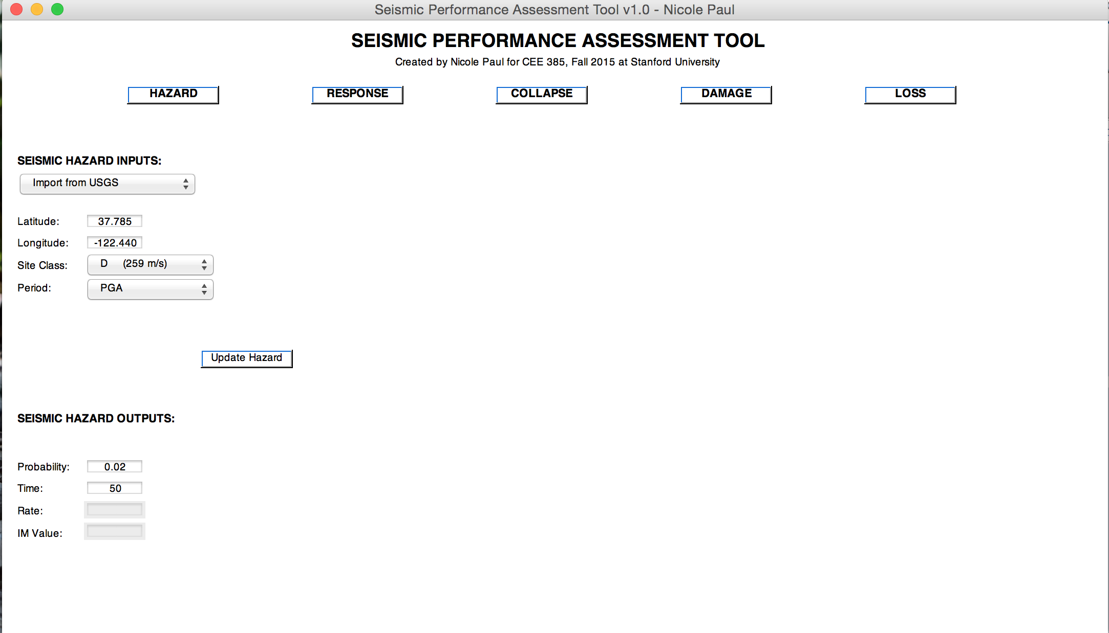
Enter the longitude, latitude, site class, and period of structure in the left bar titled “Seismic Hazard Inputs”. When finished, click the “Update Hazard” button.

Slide 5
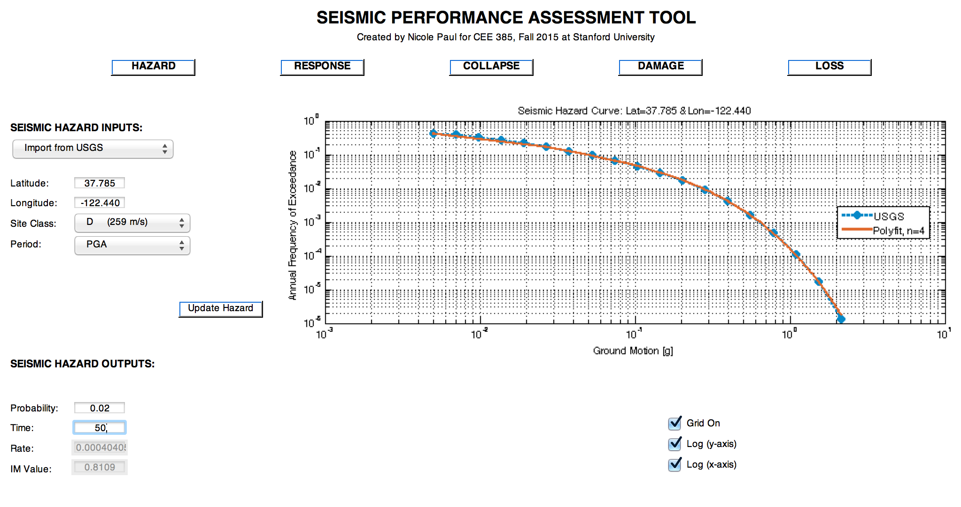
To calculate the rate and ground motion at a targeted probability of exceedance in a given span of time, edit the “Probability” and “Time” textboxes and hit the enter key

