Slide 1
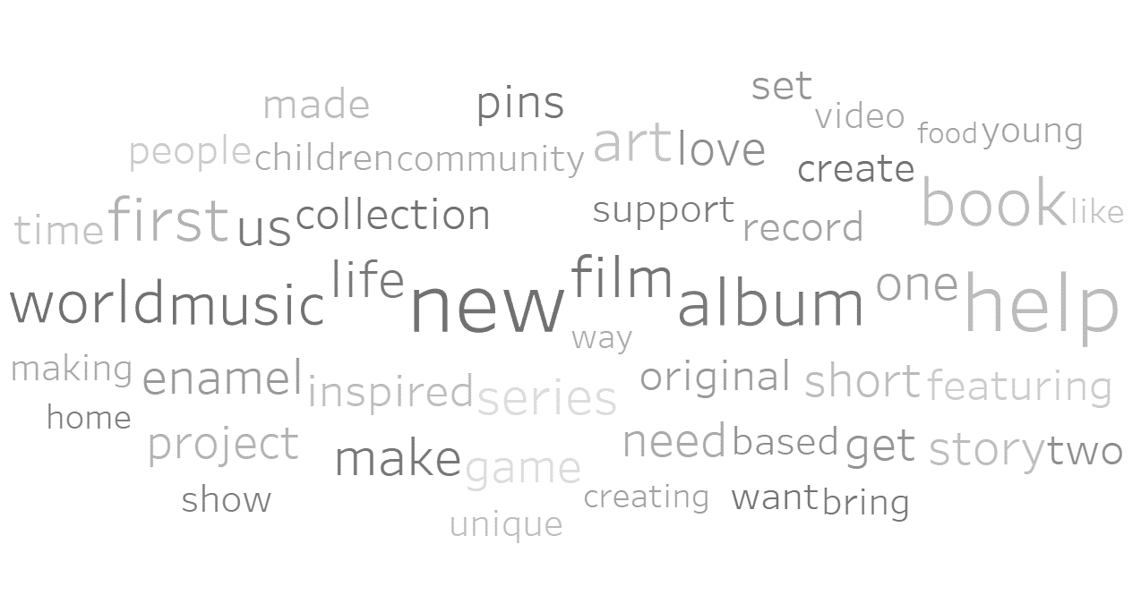
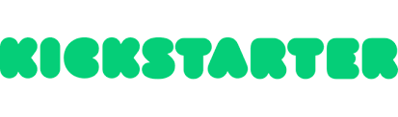
Predict if a project launched on kickstarter will reach it‘s funding goal
Notes:
What is Kickstarter? ‘Kickstarter is a funding platform for creative projects. ...
There are different categories like … comics, games, movies, art, music, photography, fashion
Every project creator sets their project's funding goal and deadline.
If people like the project, they can pledge money to make it happen.
Only If the project succeeds in reaching its funding goal, all backers' credit cards are charged when time expires.’
The benefit of predicting success of a project could be on both sides: kickstarter and project owners – possibly find ways to improve your project?
$6,268,107,713 - total dollars pledged to Kickstarter projects
212,340 - Successfully funded projects

Slide 2
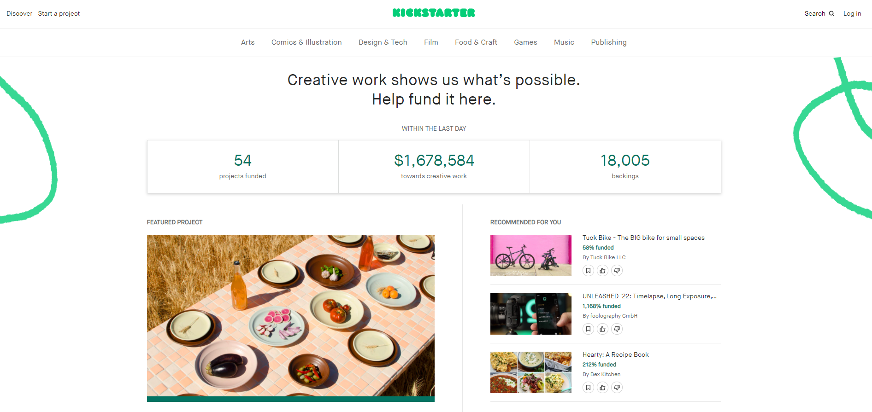
Notes:
This is how the website looks like
I analysed 186.303 unique projects from all categories
Projects are from 2011 to 2021
In my data roughly 60% are funded projects and 40% are failed projects
Overall 36% get funded (could be also difference in calculation)

Slide 3
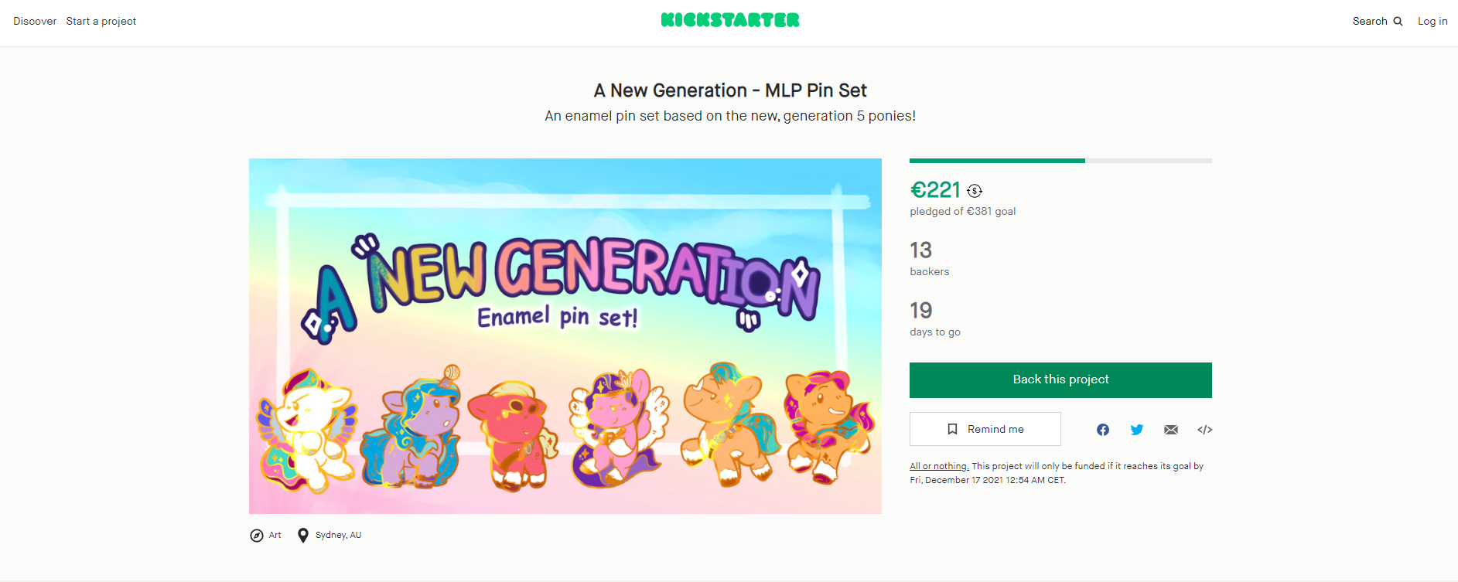
Notes:
THE CHALLENGE
No pictures
No videos
No product presentations
No information about ‘reward’ for backing the project

Slide 4




Which variables can to into the model?
Notes:
Category and subcategory
Goal amount
Launched and end date – thus project duration
Description of the project – language – words – word count
location

Slide 5
success
Notes:
best accuracy 82.37%
Decision Tree Classifier- Winsorize outliers – manual upscaling – MinMaxScaler

Slide 6
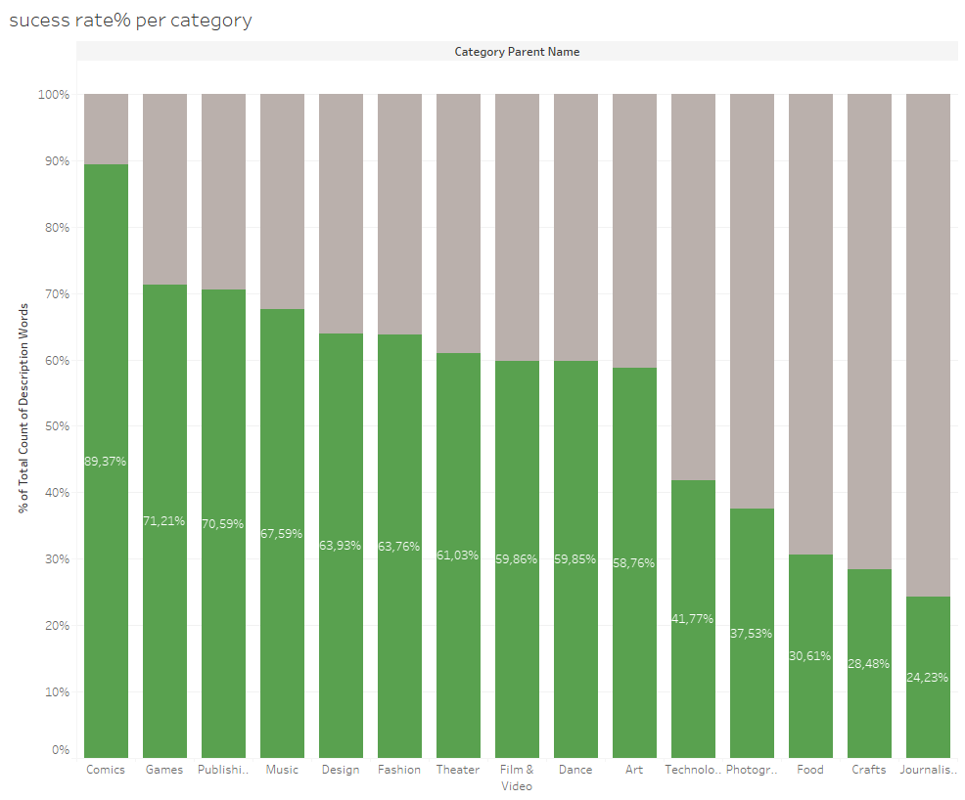
Notes:
Just based on the category our project had a bit higher than average chances of success
Though most funded projects are in categories comics, games, publishing
Least funded projects are in categories food, crafts, journalism

Slide 7
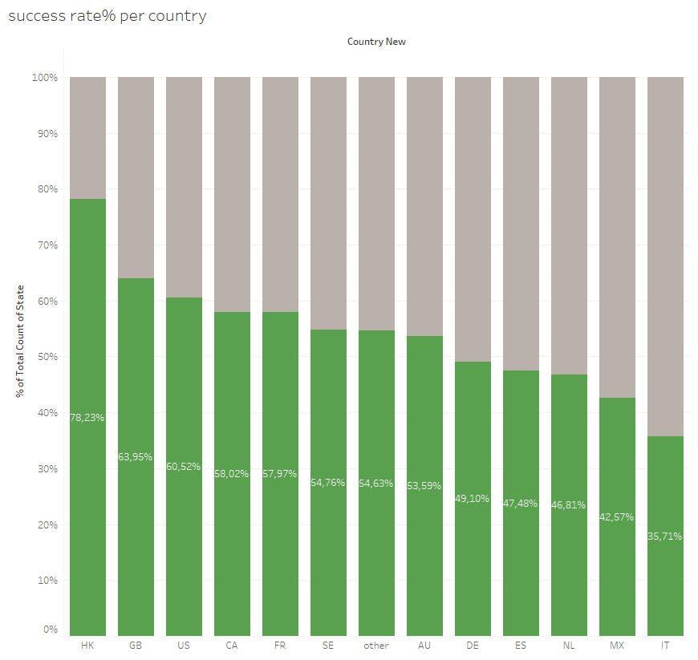
Notes:
Also based on the country our project had a bit higher than average chances of success
Though most funded projects are from Hong Kong and Great Britain
Least funded projects are from countries Italy, Mexico, Netherlands

Slide 8
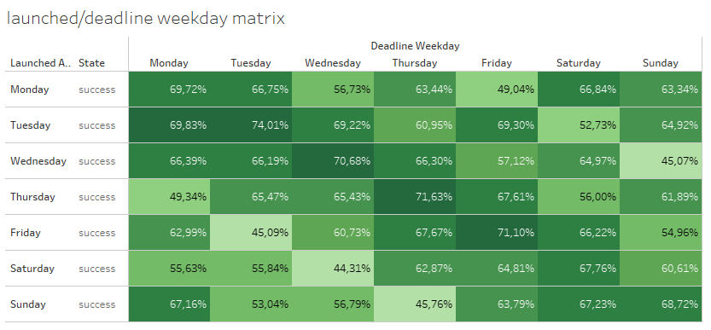
Notes:
It seems that projects are more successful when they are launch and end the same weekday

Slide 9
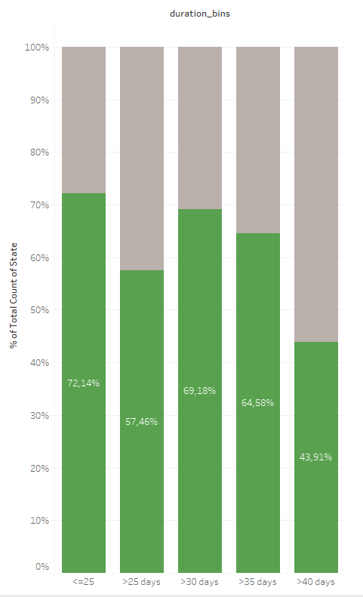
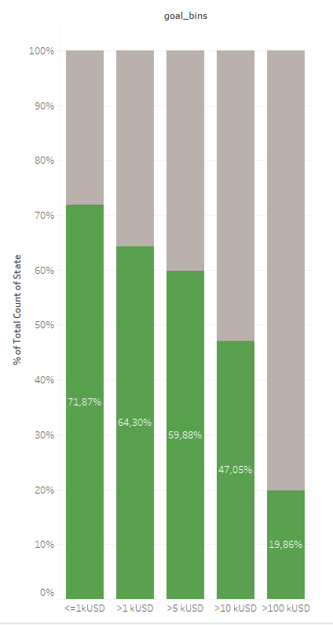
Notes:
Both graphs show duration in days and goal amount in k USD
21 days
381euro
The higher the goal amount the less likely it is going to be funded – our example project has a very high goal with almost 150kUSD

Slide 10
Keywords after removing stopwords and punctuation are:
enamel
pin
set
based
new
generation
ponies
Notes:
What are stopwords:
{‘ourselves’, ‘hers’, ‘between’, ‘yourself’, ‘but’, ‘again’, ‘there’, ‘about’, ‘once’, ‘during’, ‘out’, ‘very’, ‘having’, ‘with’, ‘they’, ‘own’, ‘an’, ‘be’, ‘some’, ‘for’, ‘do’, ‘its’, ‘yours’, ‘such’, ‘into’, ‘of’, ‘most’, ‘itself’, ‘other’, ‘off’, ‘is’, ‘s’, ‘am’, ‘or’, ‘who’, ‘as’, ‘from’, ‘him’, ‘each’, ‘the’, ‘themselves’, ‘until’, ‘below’, ‘are’, ‘we’, ‘these’, ‘your’, ‘his’, ‘through’, ‘don’, ‘nor’, ‘me’, ‘were’, ‘her’, ‘more’, ‘himself’, ‘this’, ‘down’, ‘should’, ‘our’, ‘their’, ‘while’, ‘above’, ‘both’, ‘up’, ‘to’, ‘ours’, ‘had’, ‘she’, ‘all’, ‘no’, ‘when’, ‘at’, ‘any’, ‘before’, ‘them’, ‘same’, ‘and’, ‘been’, ‘have’, ‘in’, ‘will’, ‘on’, ‘does’, ‘yourselves’, ‘then’, ‘that’, ‘because’, ‘what’, ‘over’, ‘why’, ‘so’, ‘can’, ‘did’, ‘not’, ‘now’, ‘under’, ‘he’, ‘you’, ‘herself’, ‘has’, ‘just’, ‘where’, ‘too’, ‘only’, ‘myself’, ‘which’, ‘those’, ‘i’, ‘after’, ‘few’, ‘whom’, ‘t’, ‘being’, ‘if’, ‘theirs’, ‘my’, ‘against’, ‘a’, ‘by’, ‘doing’, ‘it’, ‘how’, ‘further’, ‘was’, ‘here’, ‘than’}

Slide 11
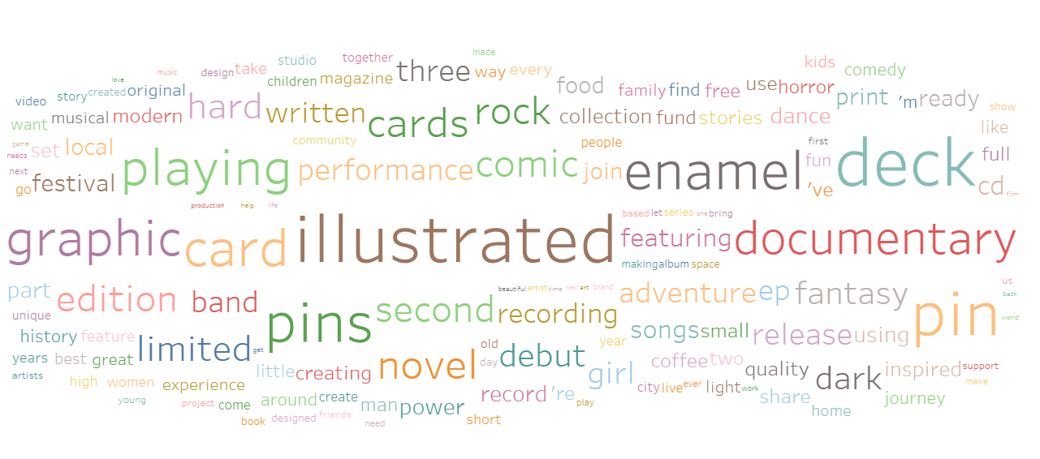
Common keywords in successful projects
Notes:
150 most common words used in successful project & highest score difference between success and failure
What does this actually mean – explain

Slide 12
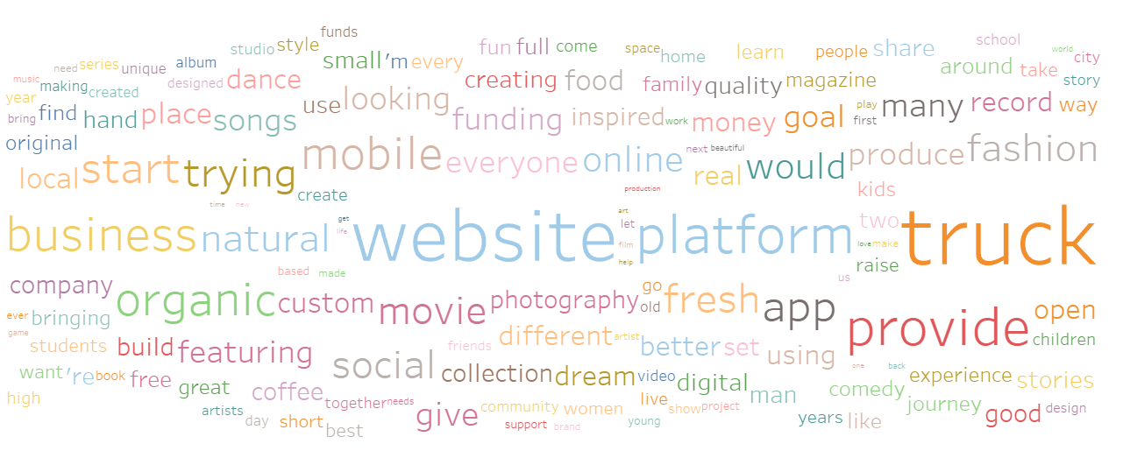
Common keywords in failed projects
Notes:
150 most common words used in successful project & highest score difference between success and failure
What does this actually mean – explain

Slide 13
success
Notes:
Now that we know the project failed let’s take a look what could be the factors

Slide 14
THANK YOU!
Notes:
Final words
Correlation vs causation
Do not mix … the word does not bring the success
It’s more of an explanation what kind of projects backers are interested in
If you think about doing a kickstarter feel free to check my prediction first

