Slide 1

What is Kickstarter?
‘Kickstarter is a funding platform for creative projects. ... Every project creator sets their project's funding goal and deadline. If people like the project, they can pledge money to make it happen. If the project succeeds in reaching its funding goal, all backers' credit cards are charged when time expires.’
Project Objective
Predict whether a project will reach it‘s funding goal.

Slide 2
Wordcloud for successful and failed projects

Slide 3
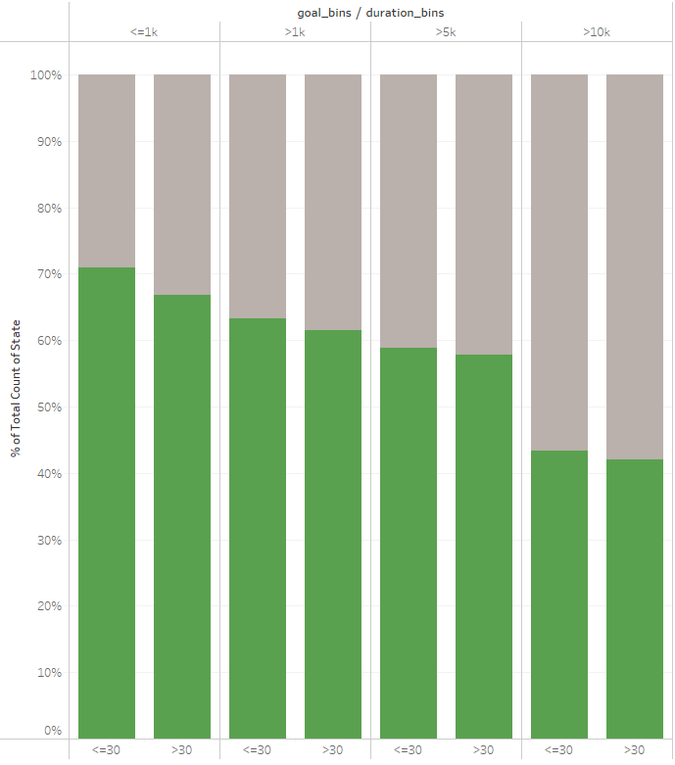
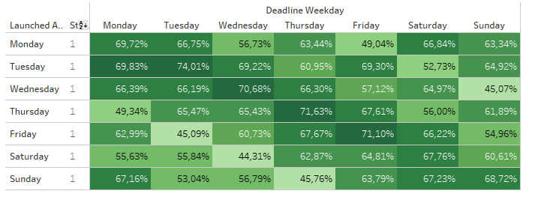
With increasing goal amount and duration the chance of success decreases
Projects that start Tuesdays and end Tuesday have the highes success rate

Slide 4
One slide to briefly describe modelling inputs

Slide 5
One slide to summarize learnings and predictions

Slide 6

