Slide 1

What is Kickstarter?
‘Kickstarter is a funding platform for creative projects. ... Every project creator sets their project's funding goal and deadline. If people like the project, they can pledge money to make it happen. If the project succeeds in reaching its funding goal, all backers' credit cards are charged when time expires.’
Objective
Predict if a project launched on kickstarter will reach it‘s funding goal

Slide 2
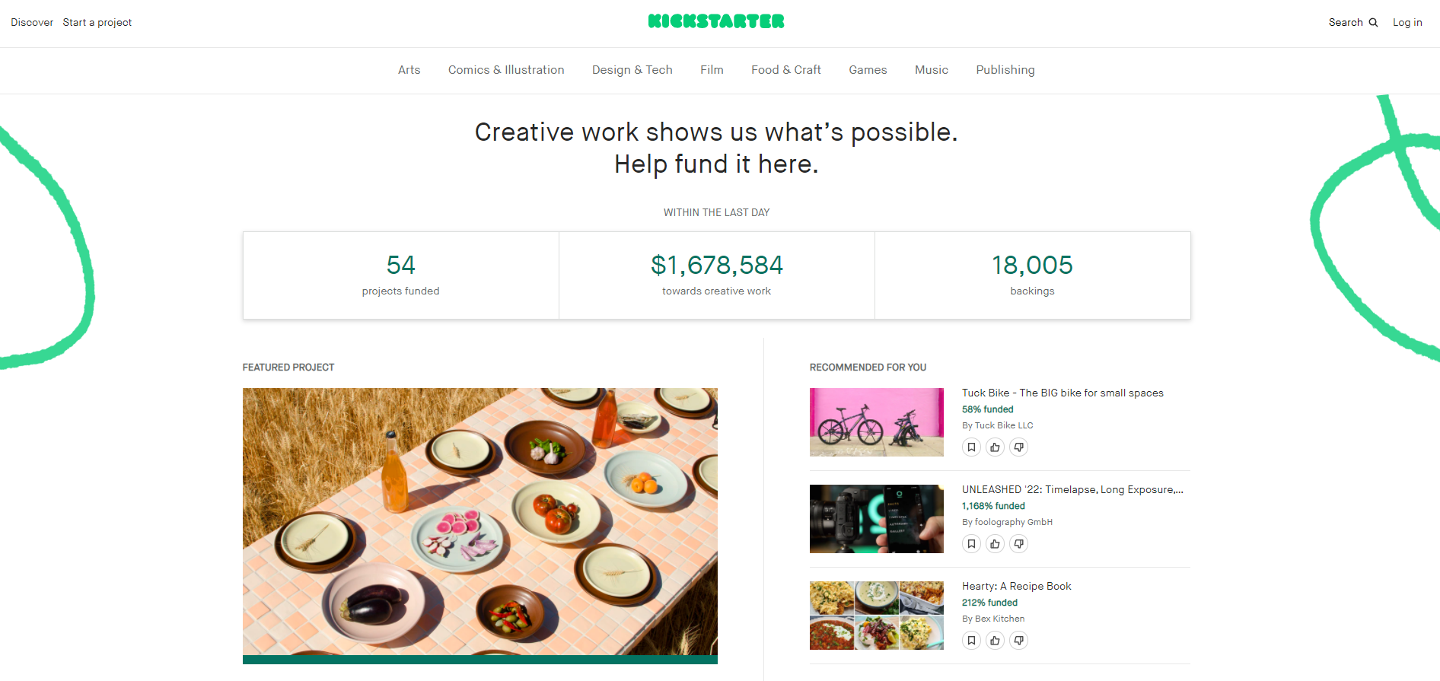

Slide 3
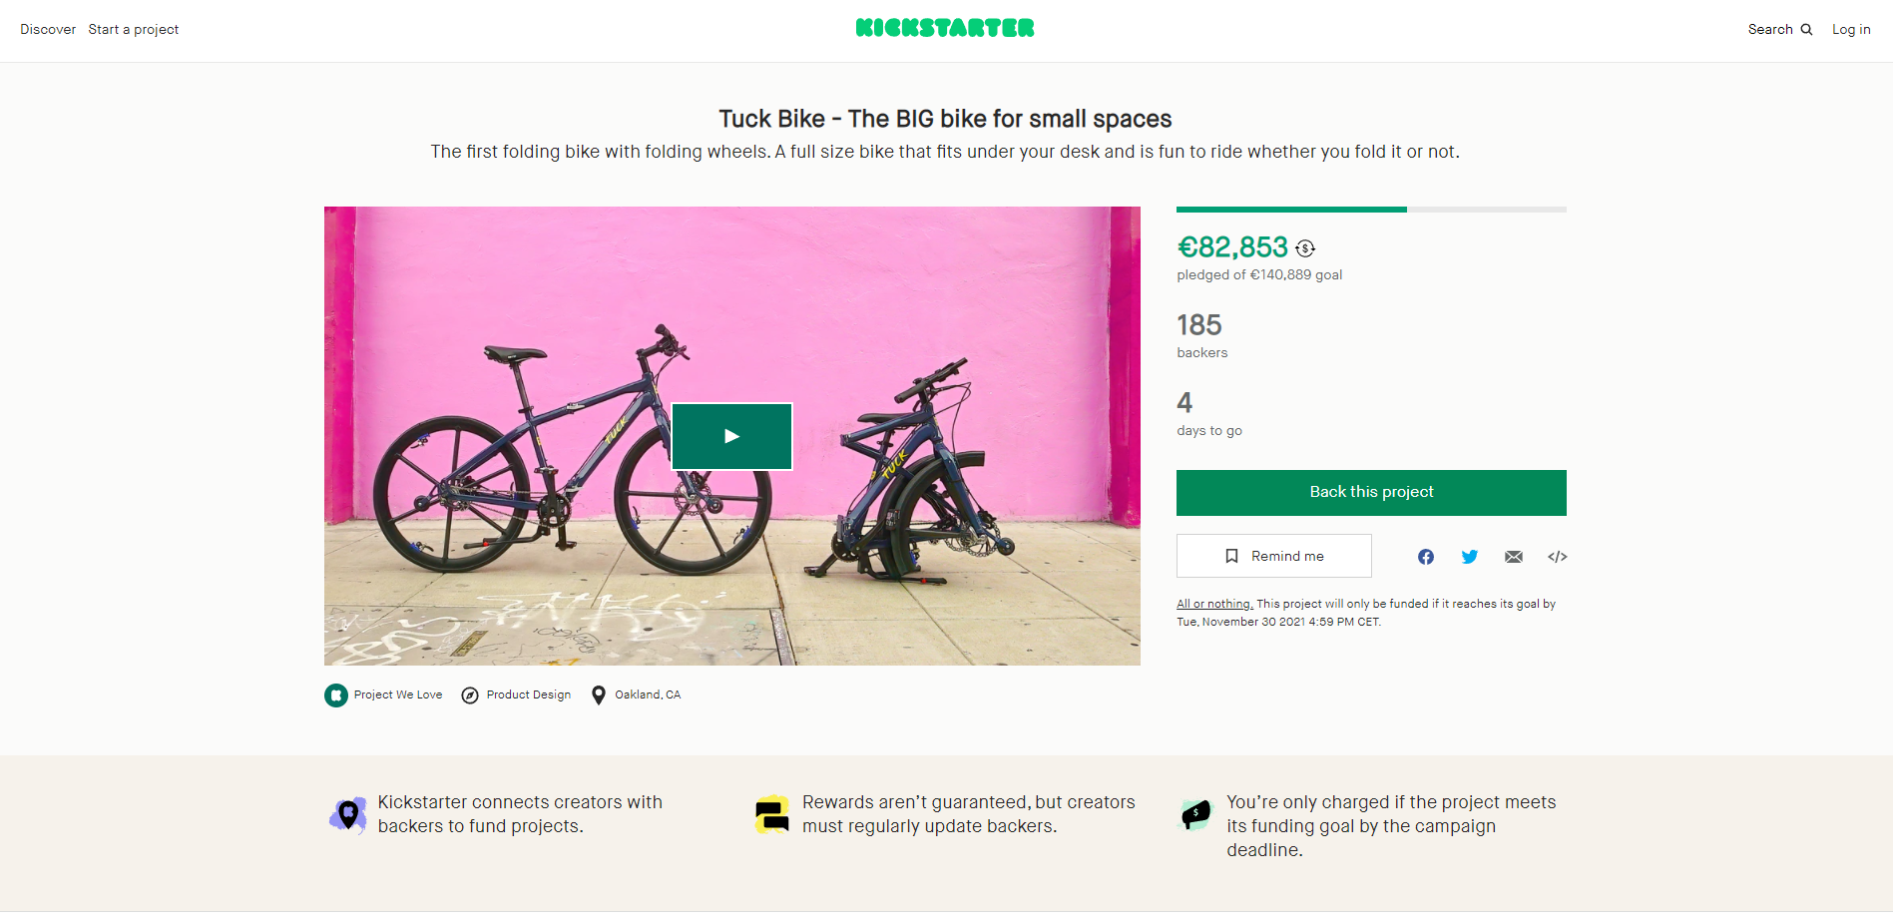
Notes:
No pictures
No videos
No product presentations
No information about ‘reward’ for backing the project

Slide 4
Red line along the example project
What information can go into the model from this project?

Slide 5
success
fail
Notes:
best accuracy 82.33%
Tree Classifier - Winsorize outliers – manual upscaling – MinMaxScaler
Differentiate on quality depending on success or failure (quality true positives or false negative)
Remove boxes to see if we change our mind including the other inputs

Slide 6
Go step by step through the fail prediction

Slide 7
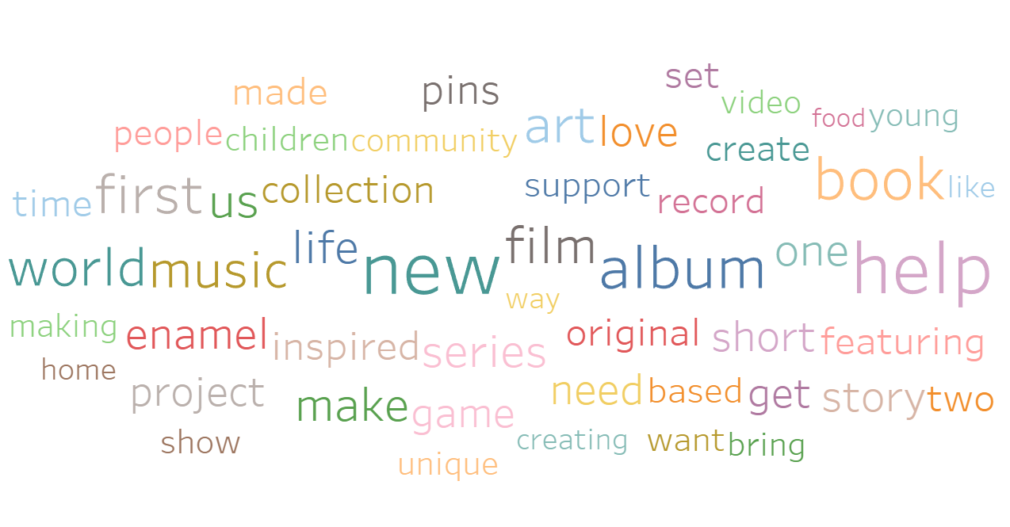
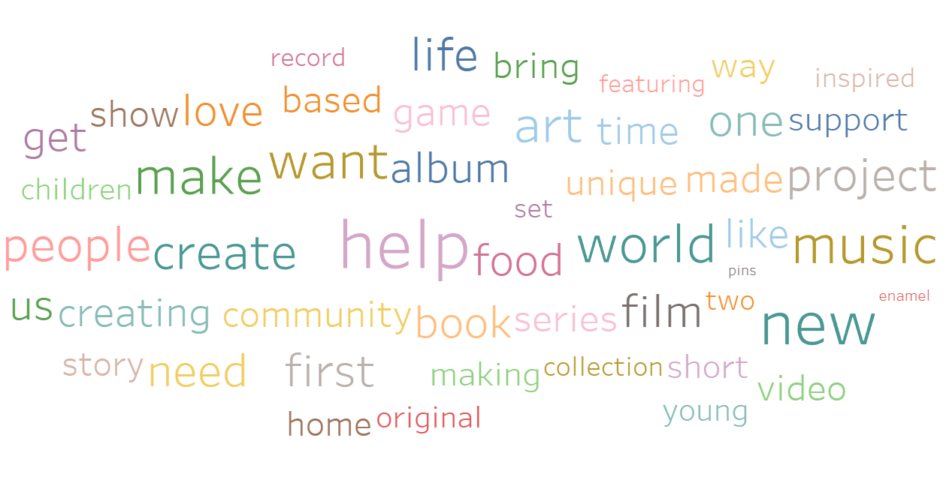
successful
failed
Notes:
Go into success factors

Slide 8
Instead of most common success_words or fail_words
Notes:
Go into success factors

Slide 9
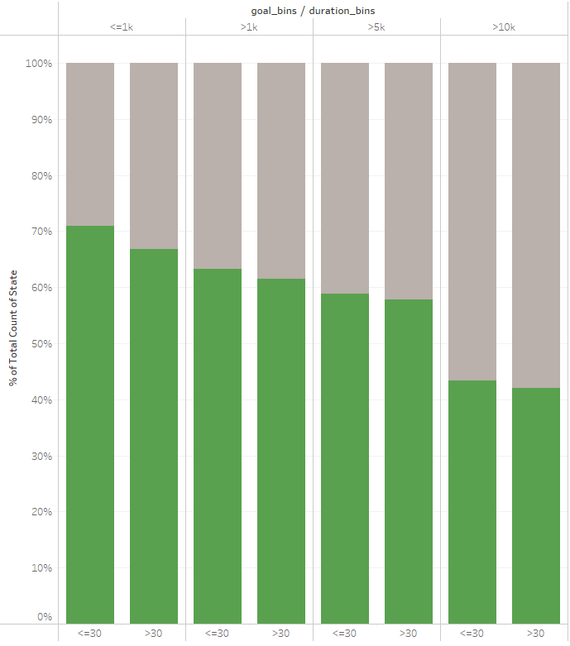
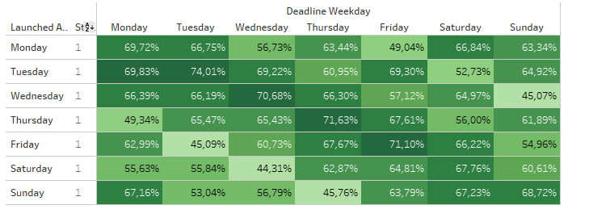
With increasing goal amount and duration, the chance of success decreases
Projects that start Tuesdays and end Tuesday have the highest success rate
Notes:
Go into success factors

