Slide 1

The role of gender in the determination of adult income. A data-driven analysis.
Irish Levi Bawingan
Nicole Segura Salas

Slide 2
Adult income: Dataset structure
Data card:
Collected by: US Census Bureau, and Current Population Survey
Distributed by: UC Irvine MLR
Year = 1996 (based on Kaggle source)
Data reduction: -28%
Data cleaned: ~ 6%
Demographic
age
gender
Education
Education level
Educational-num
race
Employment details
Workclass
Occupation
Hours per week
Capital gain
Financial indicators
Capital loss
Income
Over 50k
Under 50k
Final weight
Relationship
status

Slide 3
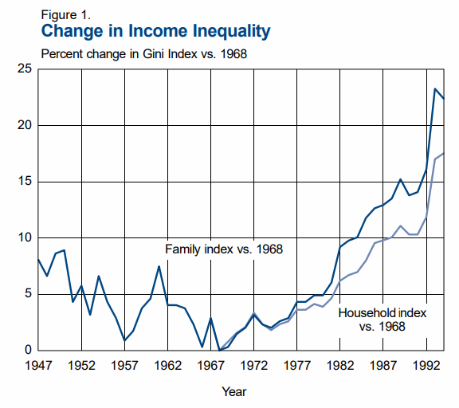
Sample context : Rise of income inequality
Gini index: A measure of income disparity in households.
Wage distribution changes: disproportion between highly skilled/trained jobs vs low end Jobs.
Decline of workers belonging to unions.
Increased temporary works.
Weinberg,D.H, Current Population Reports,1996
What about gender?
Notes:
Gini index: 0 all people in the household earn equally and 1 when only one person holds most of the income.

Slide 4
Are there noticeable income disparities across genders?
What aspects influence the income across genders?
Are there significant race disparities?
Notes:
### **Key Questions**
1. **Are there noticeable income disparities across demographic groups such as gender?**
2. **How do societal roles (household relationship) interact with gender to influence income?**
3. **What are the primary structural barriers to higher income, and how do they interact?**
- Sub-question: Are racial disparities evident in income distribution?

Slide 5
Results

Slide 6
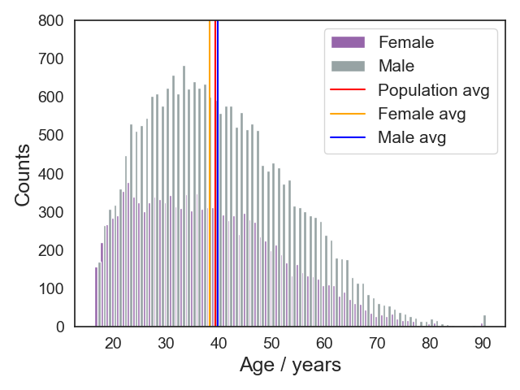
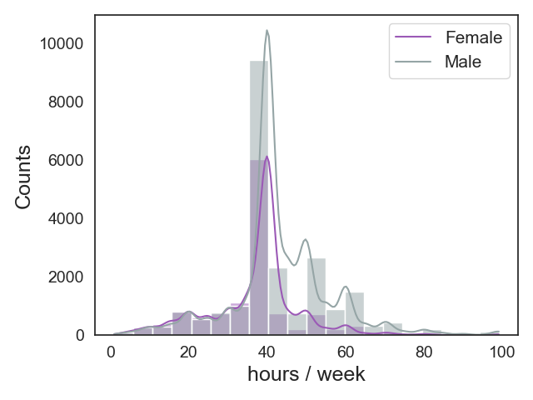
Workforce characteristics
Positive skewness in both gender S_{f} = 0.58 > S_{m} 0.54
Close to the age of retirement.
Median of marriage (by 1994):24.5 (fem), 26.7 (male)
US.Bureau of the Census. Series:P23-P191,1996.
Notes:
Median of marri

Slide 7
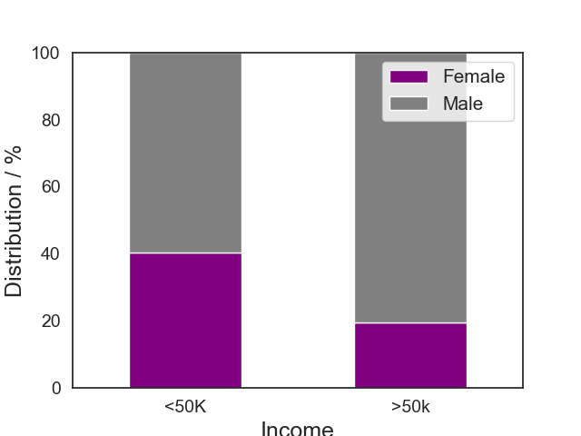
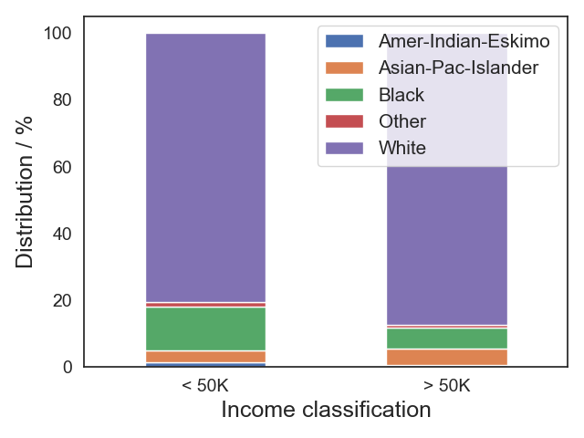
Income inequality (Gender & Race distribution)
77% vs 23%
Notes:
77% of the population has a low income.
Male are 2.3x more likely to earn higher salaries

Slide 8
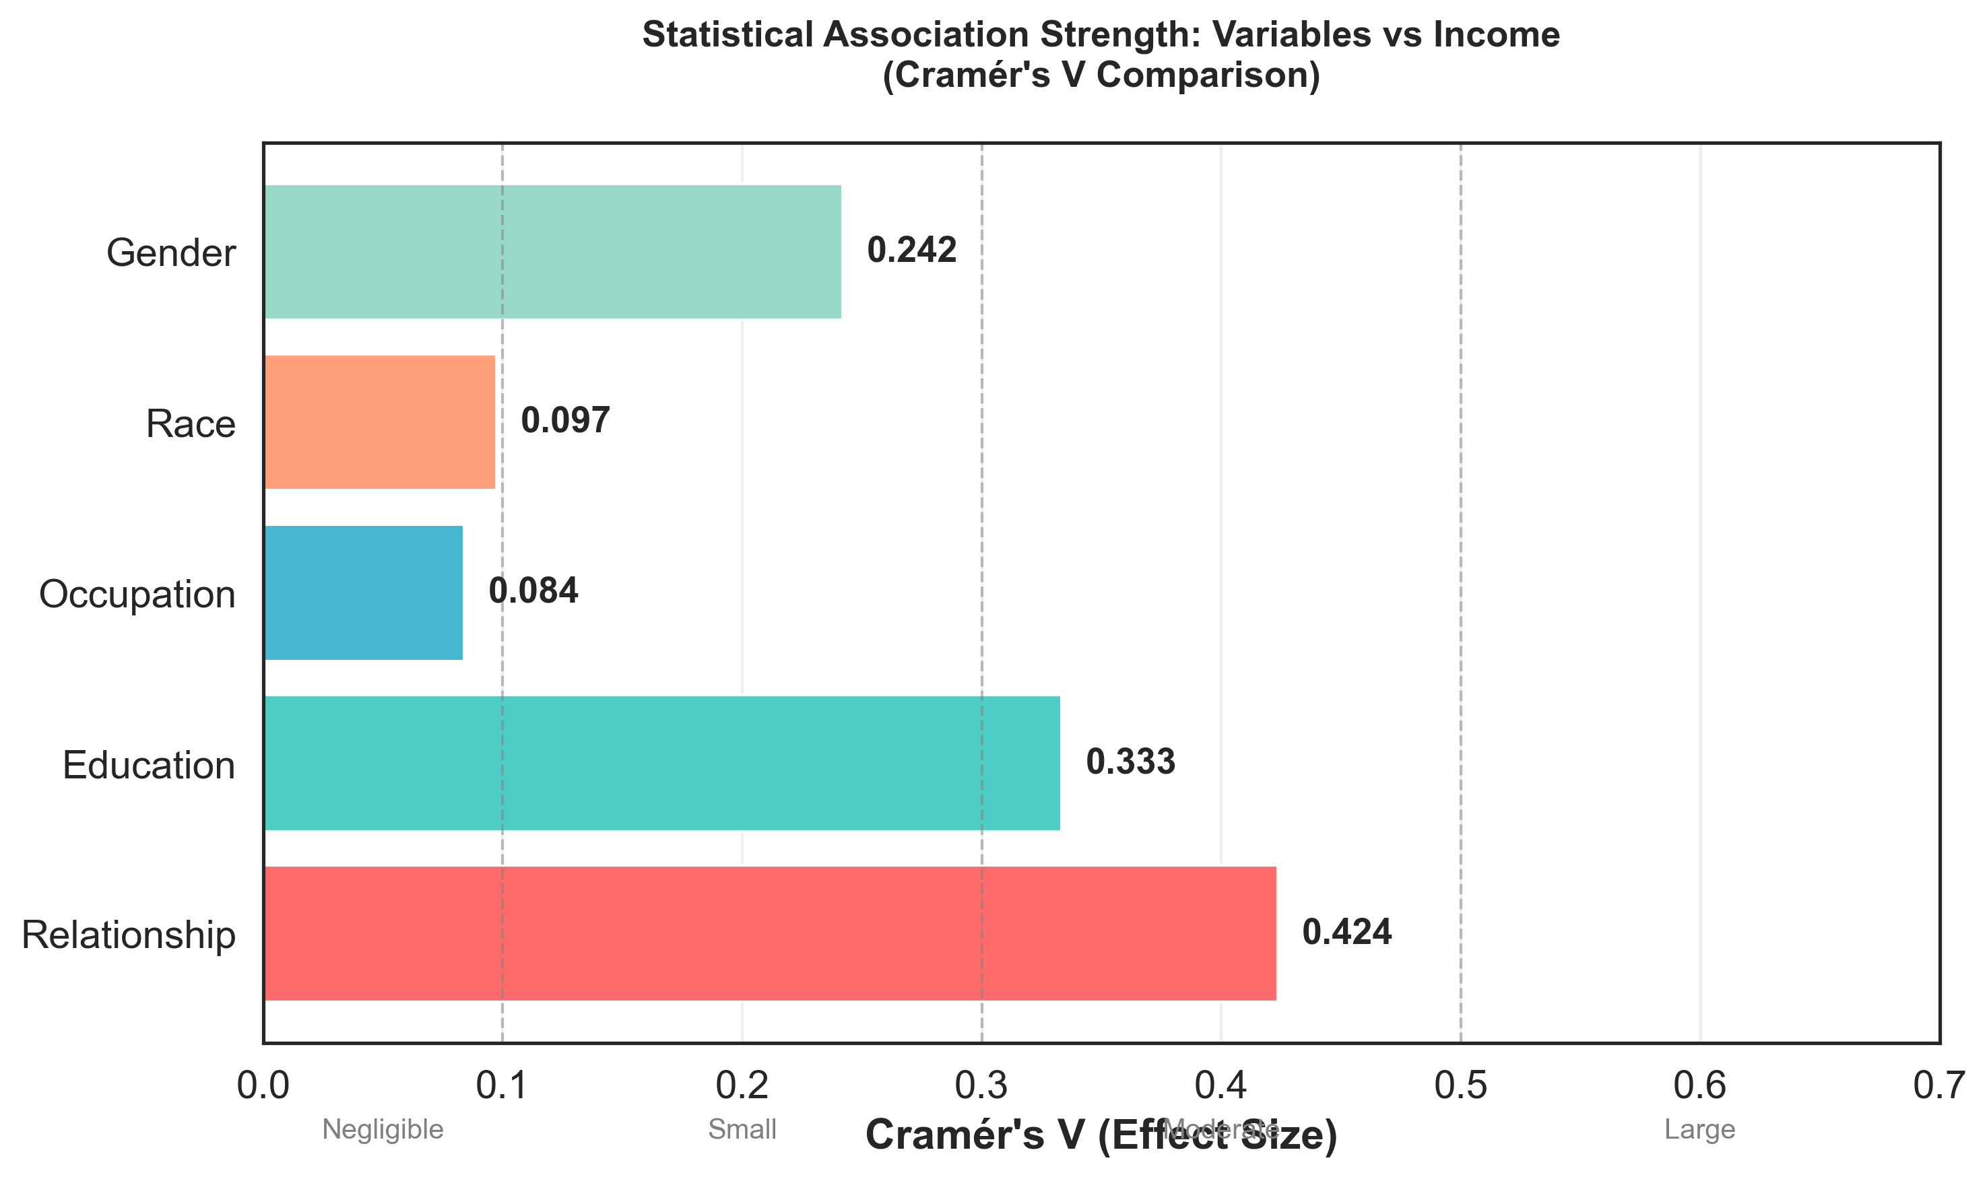
Where to look?
Considering that: all p < 0 The most relevant statistical effects are:
Relationship
Education
Gender
The weak effect of the individual parameters is a result of their interdepence.
Notes:
MALE ARE 2.3x more likely to earn more than male

Slide 9
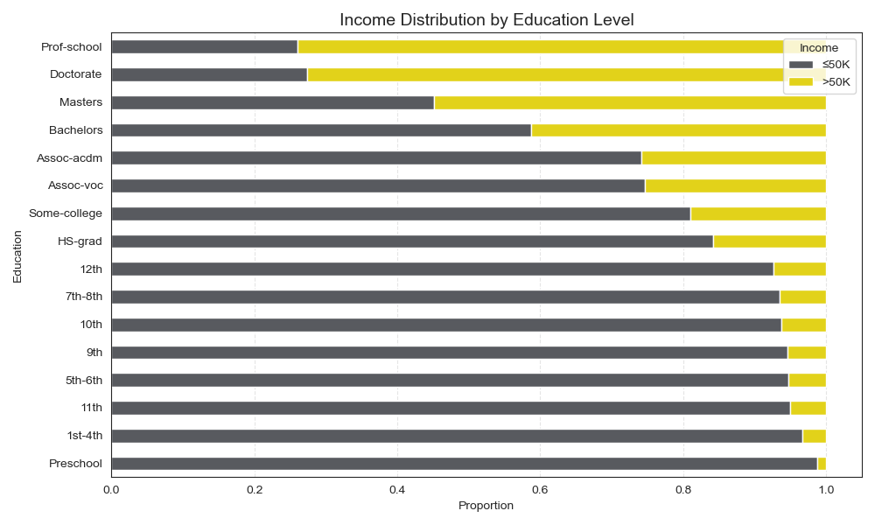
Education grants access to high-end jobs
Is access equal across genders?
Notes:
Highest high-income rate: Prof-school → 69.3% Lowest high-income rate: Preschool → 1.4%

Slide 10
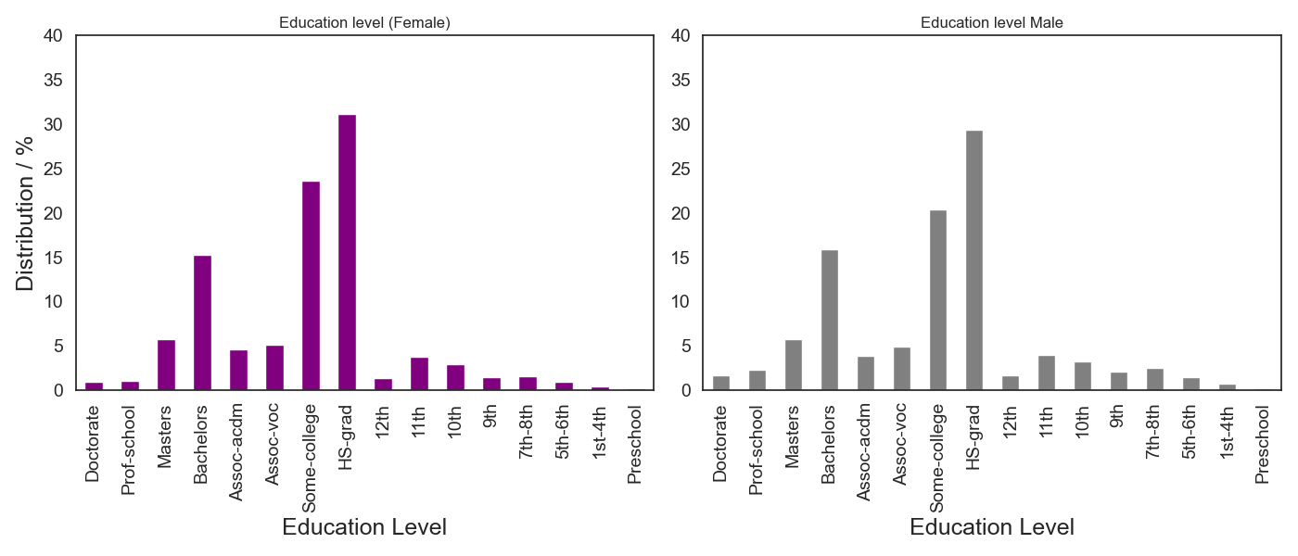
Education access on across on gender
Both genders have similar access to education

Slide 11
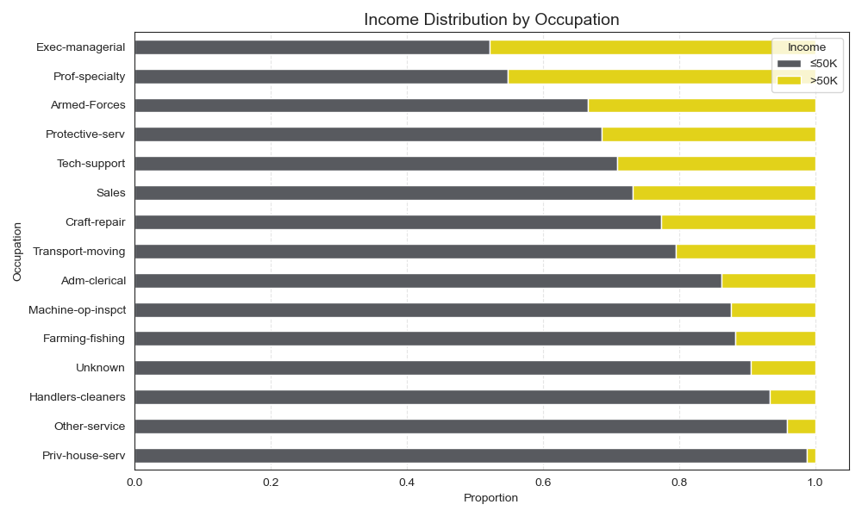
Occupation and industry
Exec-managerial
Prof. Specialty
Tech-support
High-paying occupations (>30%): ['Exec-managerial', 'Prof-specialty', 'Armed-Forces', 'Protective-serv'] Low-paying occupations (<10%): ['Handlers-cleaners', 'Other-service', 'Priv-house-serv']
Lowest incomes: priv house service
Highest incomes: exec. Managerial, prof,speciality
Farming-Fishing
Handlers-cleaners
Priv-house-serv

Slide 12
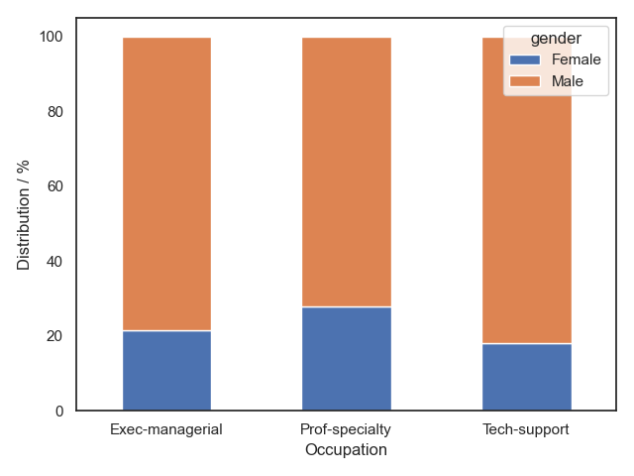
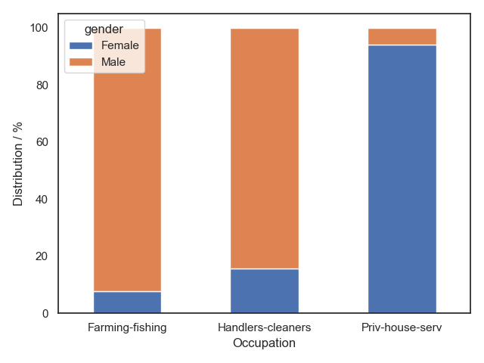
Occupation vs Gender distribution
High-end jobs
Low-end jobs
Notes:
*What races dominate the high income careers?

Slide 13
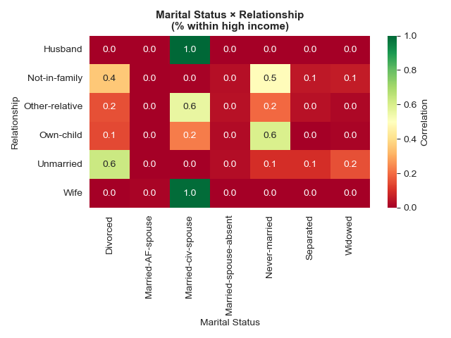
Common association types
Three main categories are:
Married (80%)
Never married (with child) (9%)
Divorced (8%)
People inside marriage agreements are more likely to be high earners.
Never-married (w Child) 1.5x more likely in men.
Notes:
Patterns in household relationship shows that married subjects are well distributed amongst low and high income.
It is in categories like “unmarried” , “not in family that above 95% of the distribution in female falls in the low income category.

Slide 14
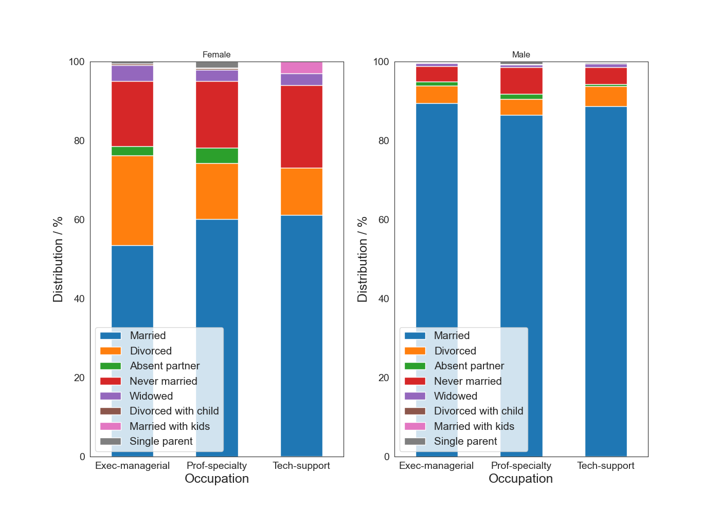
Association in high income levels per gender

Slide 15
Conclusions
Income inequality is present in all demographic levels of the sample surveyed.
Noticeable income disparities found among high-income earners.
The stronger influencing aspect is the type of occupation, while education shows equal opportunities across the population.
Relationship status was an important factor for success in both genders by prevalence of Married status.
Distribution in women at high end Jobs shows an increase of single status.

Slide 16
Thanks for your attention!

Slide 17
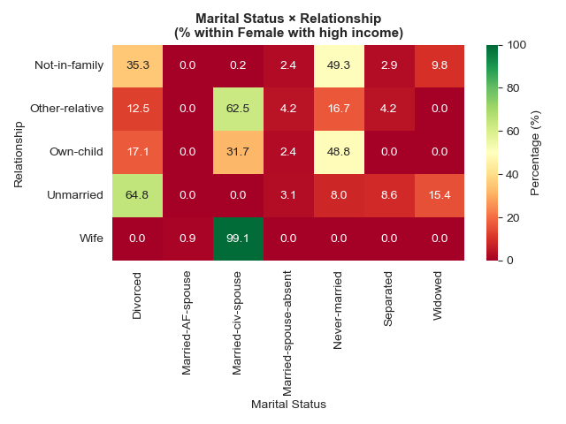
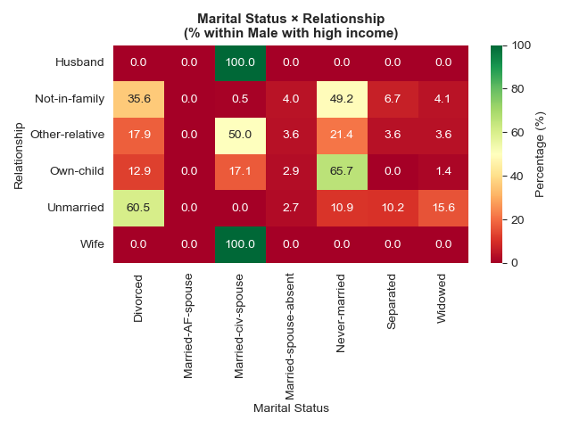
57% Female are married with spouse
15% Divorced
13% Not-in Family, Never married
83% married with spouse
5% Divorced
5% Not-in Family, Never married
25% Divorced
18% Not-in Family, Never married
15% Own a child but were never married
44% married with spouse
17% Not-in Family, Never married
14% Own a child but were never married

