Slide 1
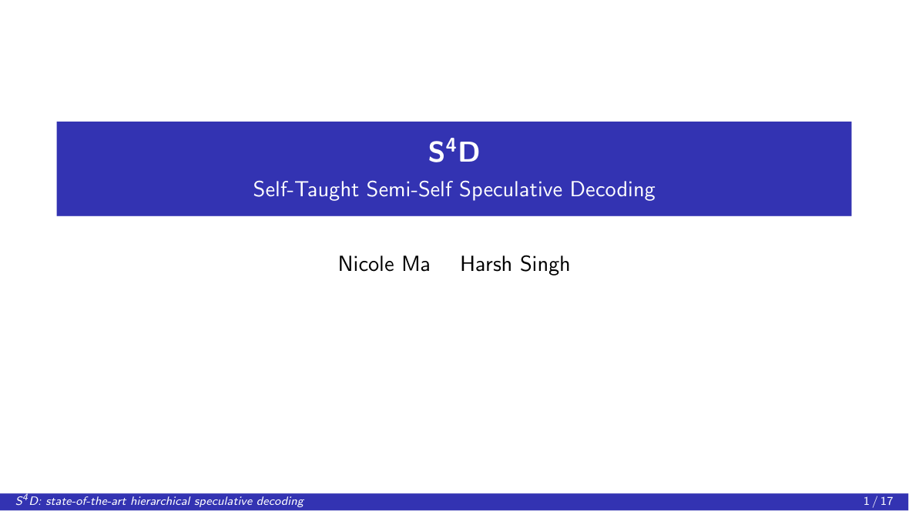
Notes:
We're Nicole and Harsh, presenting S-four-D, a new state-of-the-art method for hierarchical speculative decoding.

Slide 2
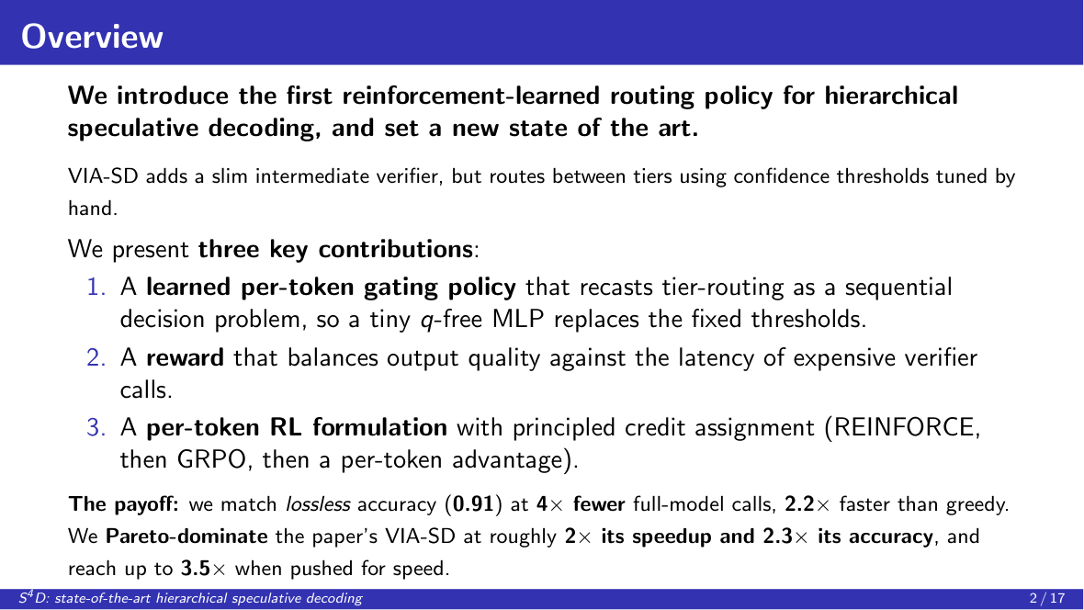
Notes:
Speculative decoding speeds up LLMs. VIA-SD adds a slim middle verifier but routes with hand-tuned thresholds. Our three contributions: a learned per-token gate, a quality-versus-cost reward, and per-token RL. The payoff: lossless accuracy at four times fewer calls, up to three and a half times faster, a new state of the art.

Slide 3
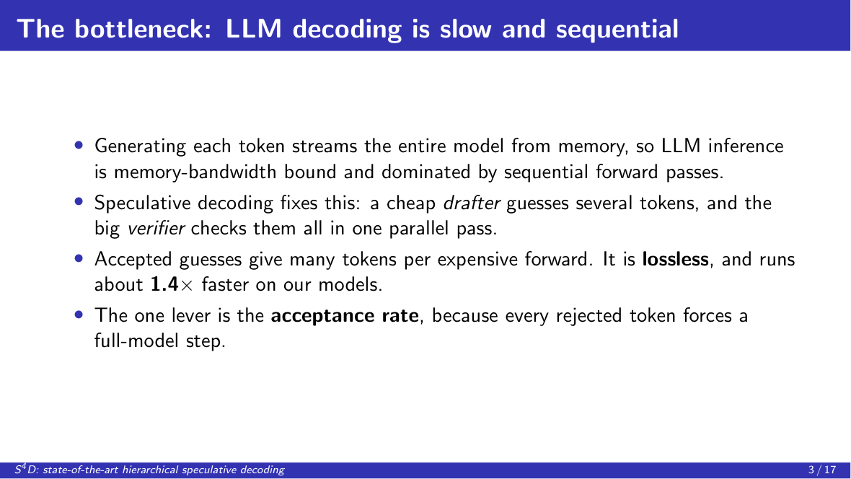
Notes:
Each token streams the whole model from memory, so inference is slow. Speculative decoding lets a small drafter guess and the big model verify in parallel: lossless, about 1.4 times faster. The lever is the acceptance rate.

Slide 4
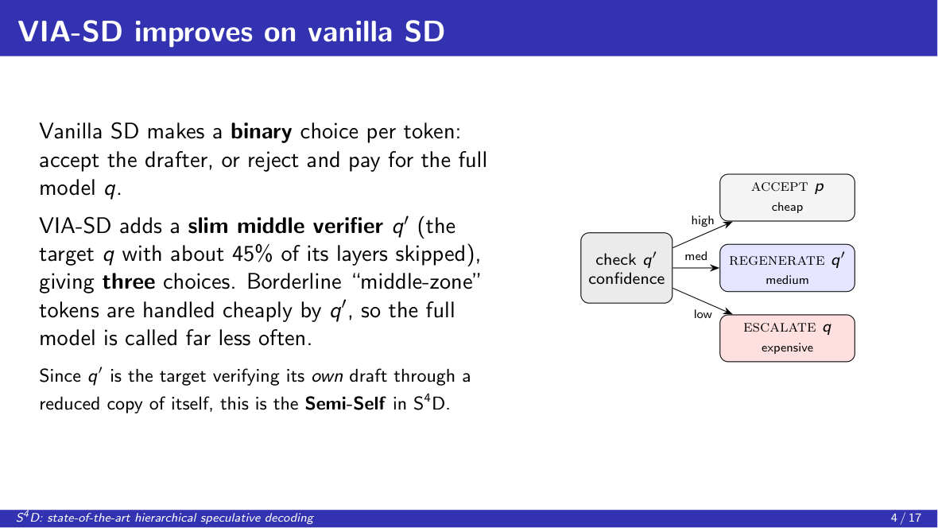
Notes:
VIA-SD adds a slim middle verifier, the target with half its layers skipped, giving three choices: accept, regenerate, or escalate. Borderline tokens go to the cheap tier. Because the model verifies its own draft through a reduced copy of itself, that is the Semi-Self in our name.

Slide 5
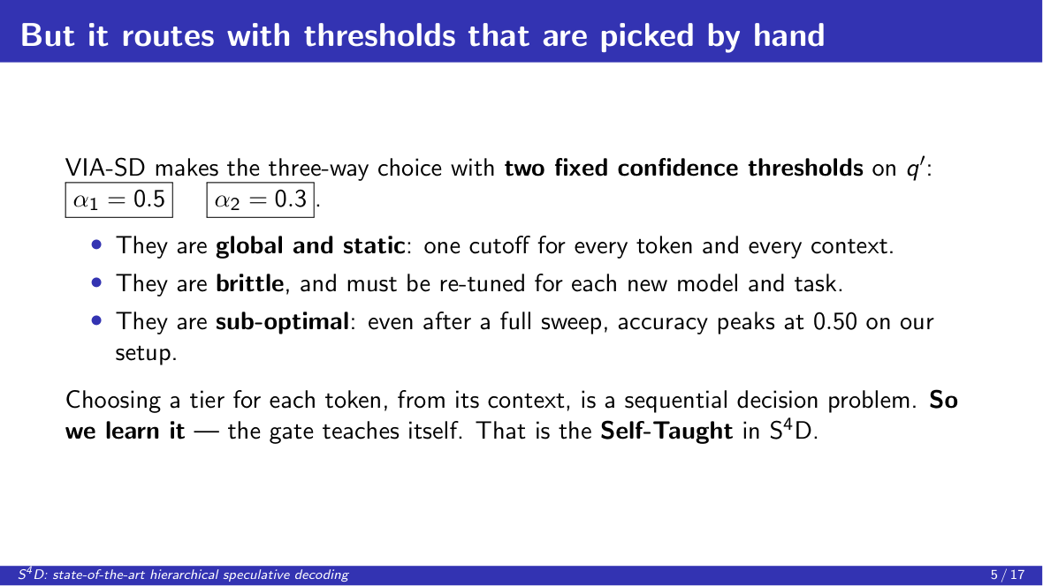
Notes:
But VIA-SD picks between tiers with two hand-tuned thresholds, 0.5 and 0.3. They're global, brittle, and cap at 0.50 accuracy even fully swept, because one cutoff can't adapt to context. Routing per token is a decision problem, so the gate teaches itself: the Self-Taught.

Slide 6
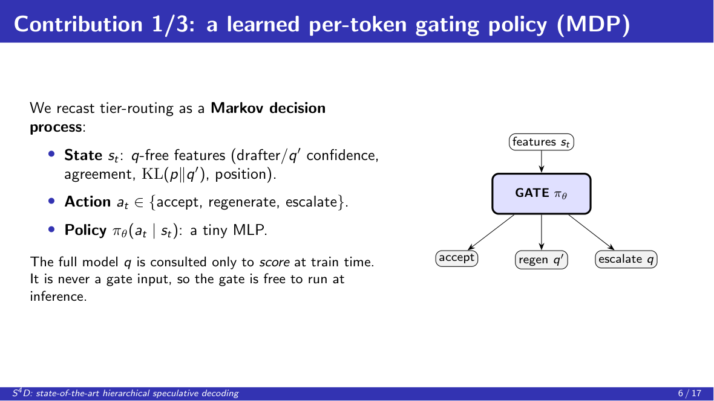
Notes:
Contribution one: the learned gate, framed as an MDP. State is cheap q-free features, action is the tier, policy is a tiny MLP. The full model is used only for rewards at training time, never to decide, so the gate is free to deploy.

Slide 7
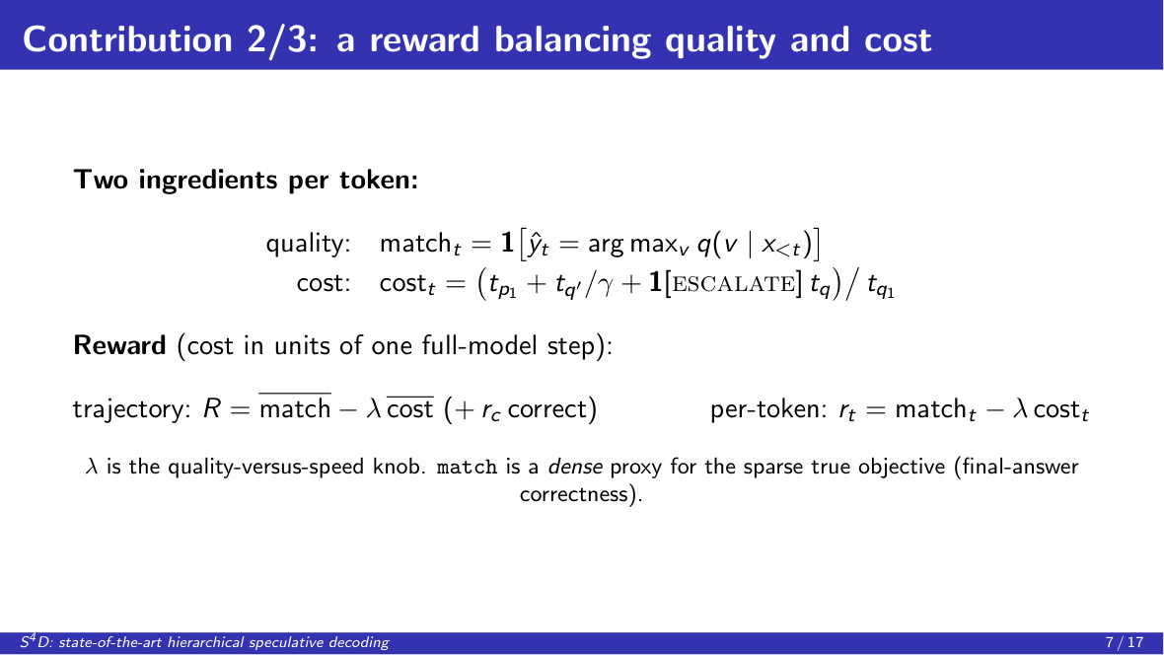
Notes:
Contribution two: the reward, match minus lambda times cost. Quality is whether our token matches the full model; lambda trades accuracy for speed. One caveat: match is a proxy, and ninety-eight percent token match still gives only 0.72 final accuracy, because slips compound.

Slide 8
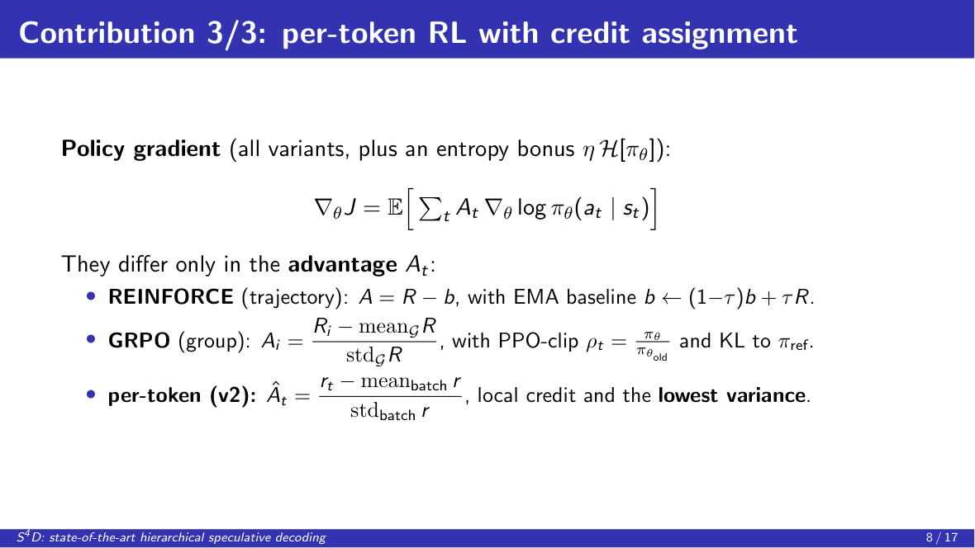
Notes:
Contribution three: per-token RL. Same policy gradient; they differ only in the advantage. REINFORCE uses one noisy trajectory reward, GRPO normalizes within a group, and our per-token version gives each decision its own advantage: lowest variance, best results. Credit assignment is everything.

Slide 9
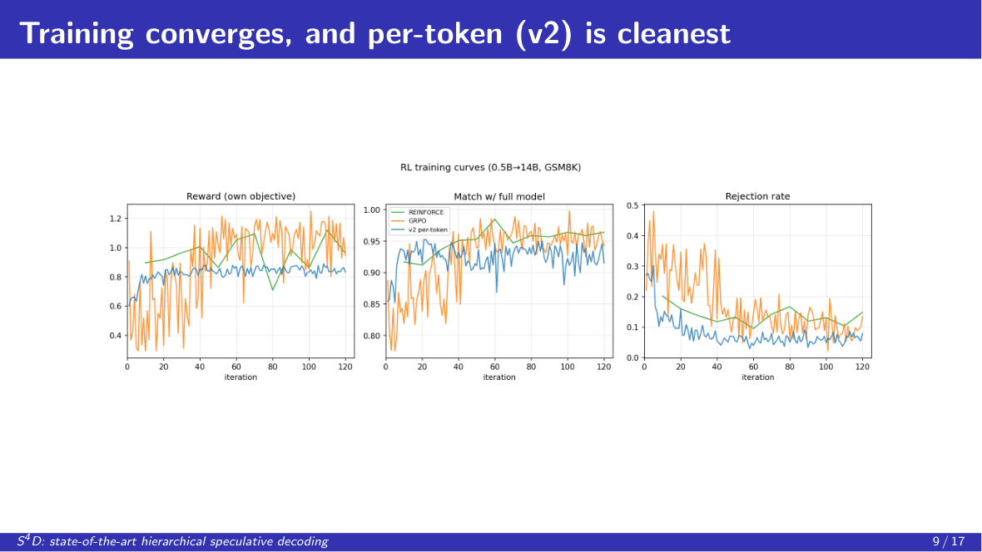
Notes:
All three converge, match reaches about 0.95, rejection falls, and per-token in blue is smoothest. Match plateaus at 0.95, not 1.0, and that residual is what compounds into the accuracy gap.

Slide 10
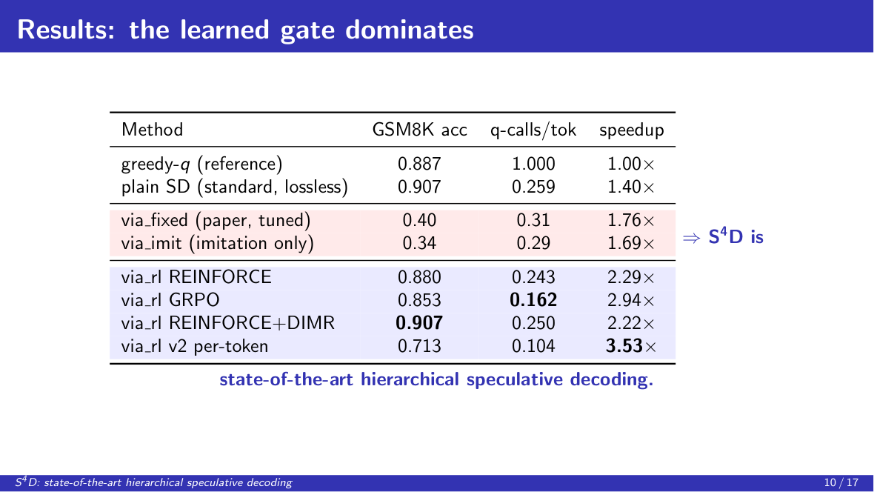
Notes:
The numbers. The hand-tuned thresholds, in red, are broken at 0.34 to 0.40: the slim verifier is miscalibrated, so a global cutoff can't tell confident-correct from confident-wrong, and errors compound. Our learned gates, in blue, recover full lossless accuracy, 0.907. This is state-of-the-art hierarchical speculative decoding.

Slide 11
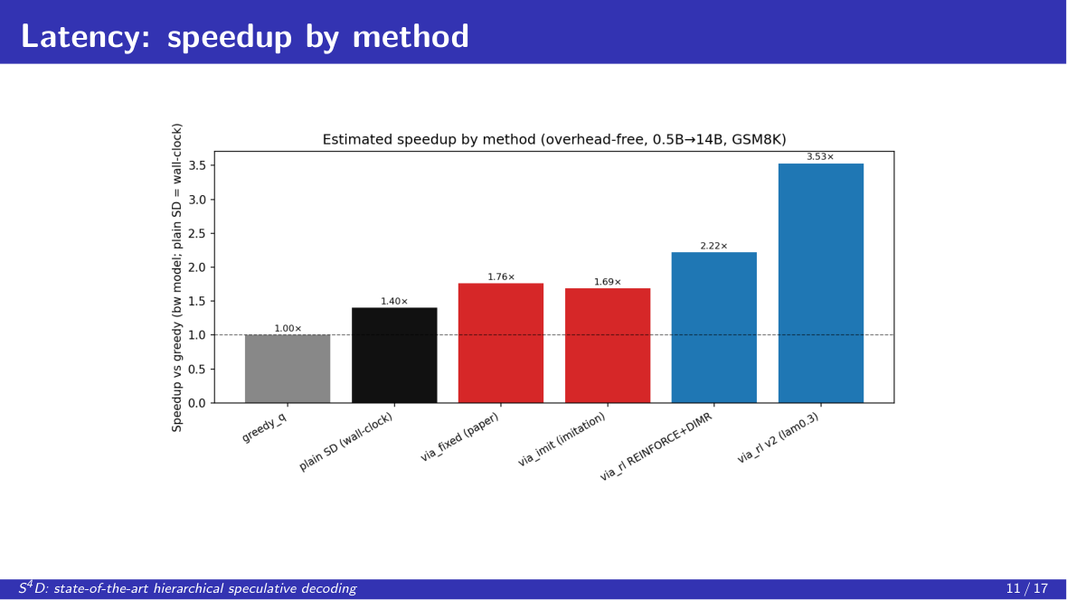
Notes:
Latency. The hand-tuned gate is slow because it over-escalates. Our learned gates are fastest, with per-token on top.

Slide 12
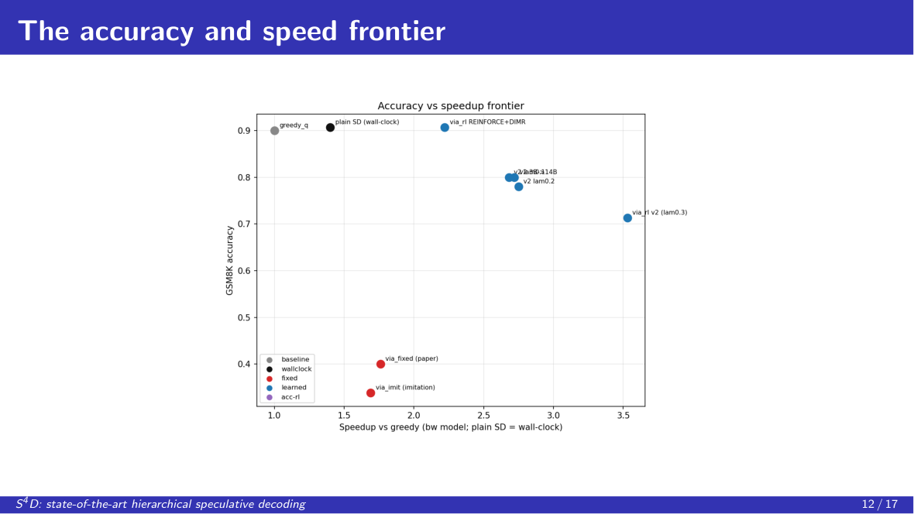
Notes:
Accuracy versus speed. Red is dominated on both axes, because one cutoff can't both avoid over-escalating and avoid over-accepting. Blue, our learned gates, dominate, with a full frontier from lambda. We Pareto-dominate the baseline, which makes S4D state of the art.

Slide 13
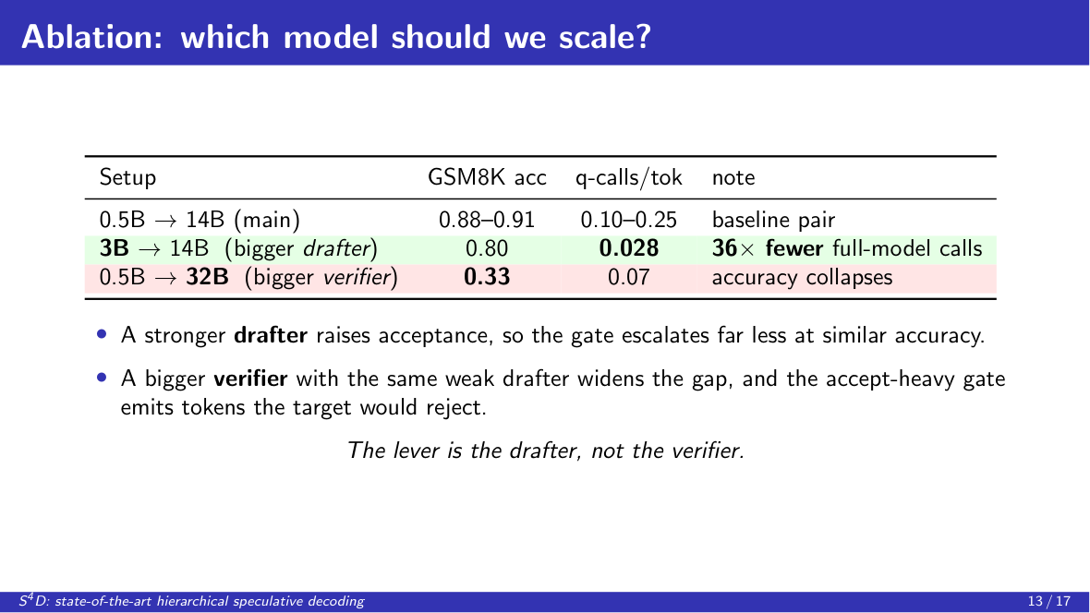
Notes:
Which model to scale? A bigger drafter, 3B, holds 0.80 accuracy at thirty-six times fewer calls, because it's accepted more. A bigger verifier, 32B, collapses to 0.33, because the weak drafter's tokens no longer match. The lever is the drafter.

Slide 14
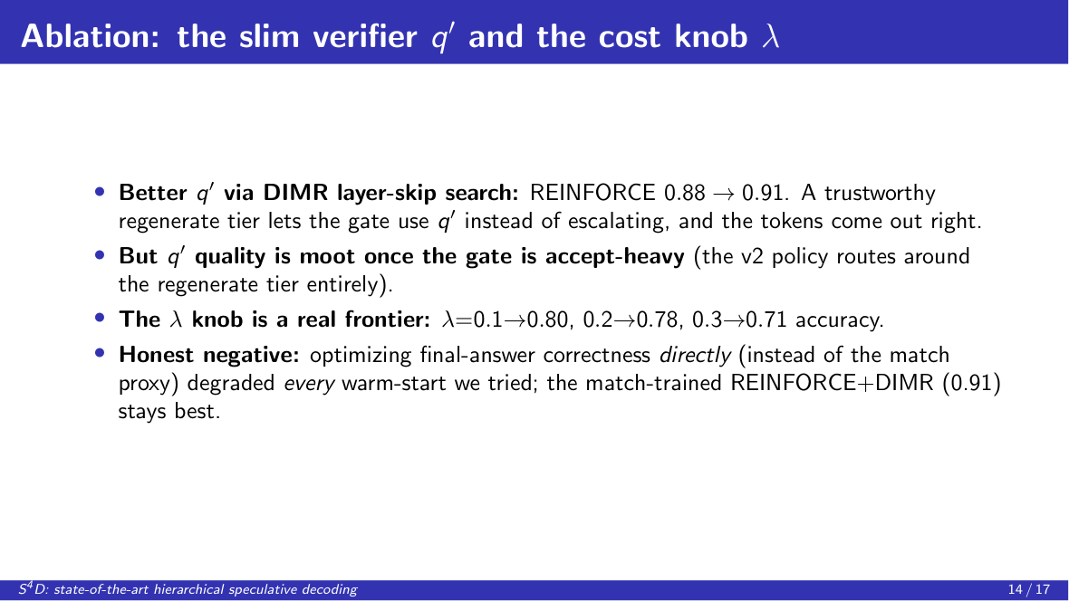
Notes:
Two more knobs. A better slim verifier via DIMR lifts REINFORCE from 0.88 to 0.91, but is moot once the gate is accept-heavy. And the honest negative: optimizing correctness directly degraded every policy, so the match-trained gate stays best.

Slide 15
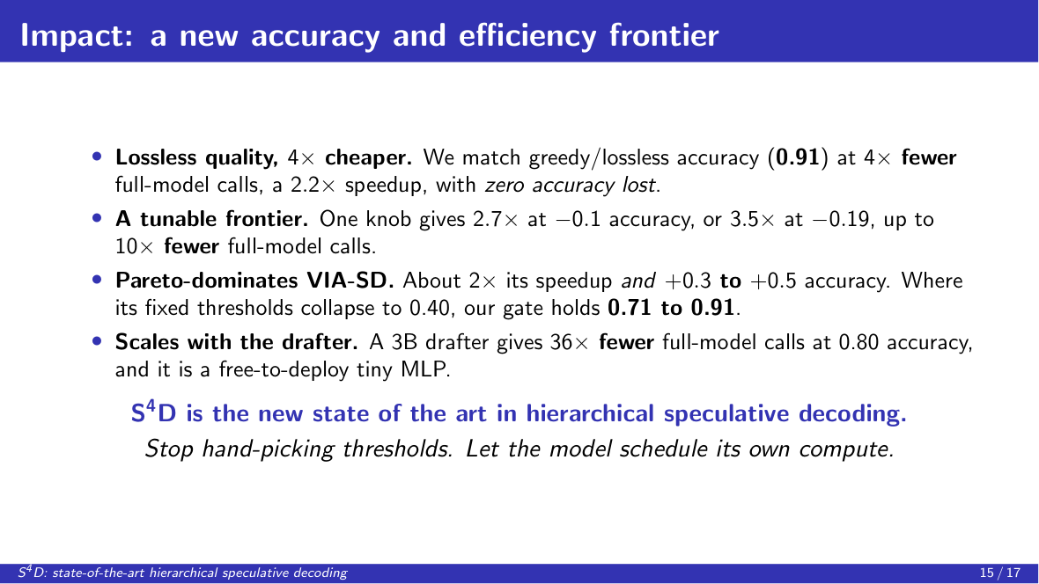
Notes:
Impact: lossless accuracy at four times fewer calls with zero accuracy lost; a tunable frontier up to ten times fewer calls; and we Pareto-dominate VIA-SD at twice its speedup and higher accuracy. S4D is the new state of the art in hierarchical speculative decoding.

Slide 16
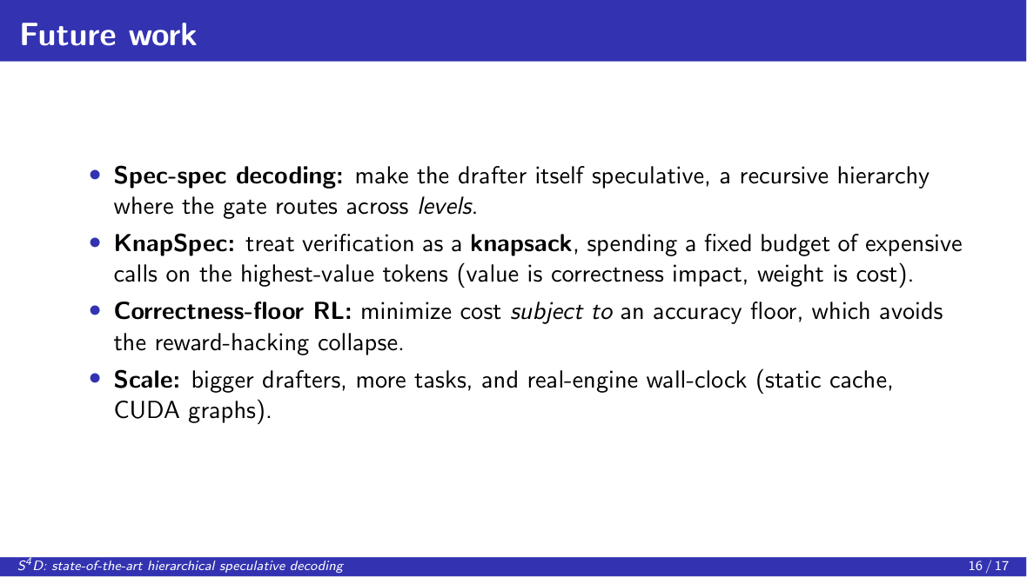
Notes:
Next: spec-spec decoding, making the drafter itself speculative; KnapSpec, spending a verifier budget like a knapsack on the highest-impact tokens; a correctness-floor objective; and real wall-clock at scale.

Slide 17
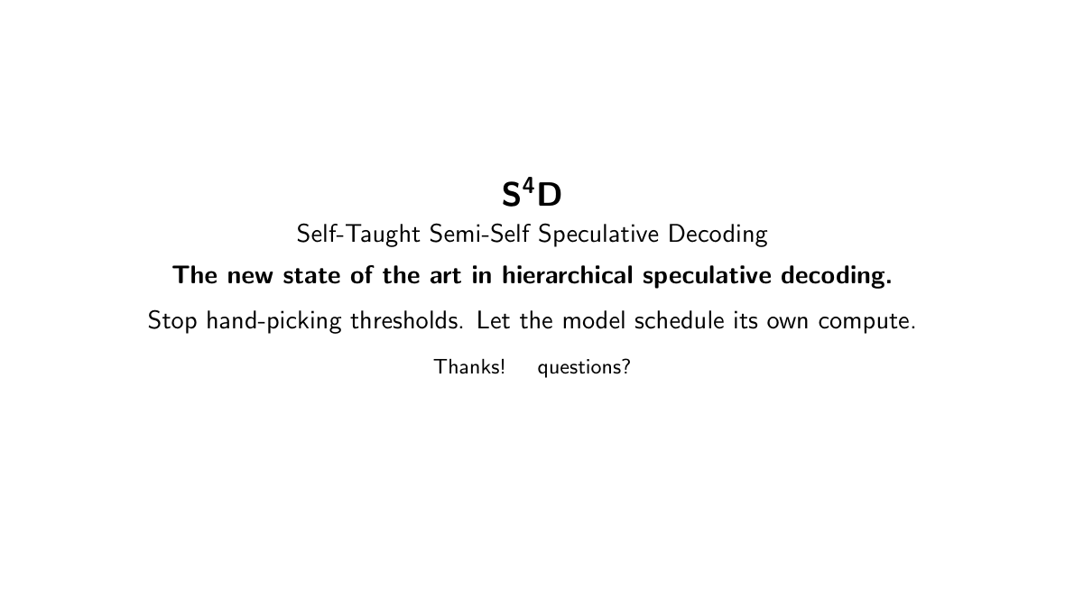
Notes:
To sum up: S4D turns hand-tuned thresholds into a learned policy and sets the state of the art in hierarchical speculative decoding. Thank you.

