Slide 1
Data Analysis - New Residential Sales
Allison Kim, Shamiya Lin, Nicole Xu Tompkins High School FBLA
2021–2022

Slide 2

Overview
New Residential Sales Historical Time Series
US Census Bureau Survey of Construction
Last updated January 2022
Housing Crisis and COVID-19 Pandemic
Recommendations

Slide 3
Housing Sales Over Time
Supply at Current Rate (in months)
Number of Houses Sold (in thousands)

Slide 4
Median and Average Home Prices

Slide 5

$$Value in X=Value in Y(\frac{{CPI}_{X}}{{CPI}_{Y}})$$

Slide 6
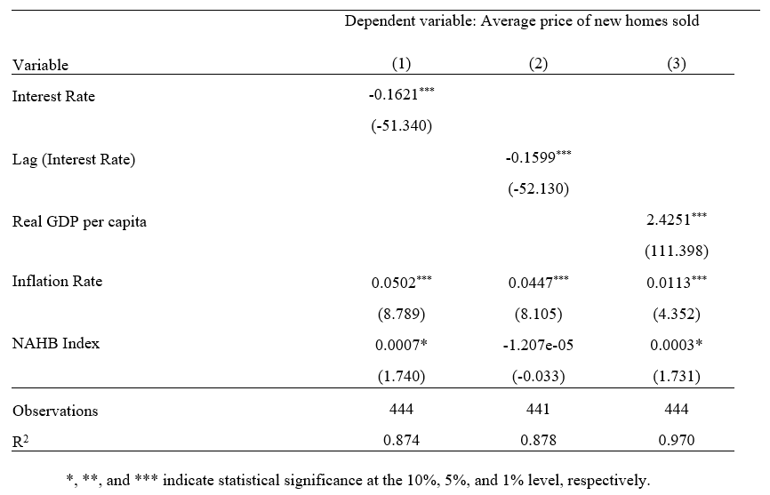
Multiple Linear Regression

Slide 7
2008 Housing Crisis

Slide 8
Covid-19 Pandemic

Slide 9
Covid-19 Pandemic (con.)
Reasons for increased demand
Historically low interest rates
Growing millennial homebuyer population

Slide 10
Regional Analysis

Slide 11
Recommendations
Home Affordability
Construction of affordable homes
Lower infrastructure levies
Minority Inclusiveness
Support for minorities

Slide 12

Housing Affordability
More land for development
Lower infrastructure levies
Increase supply for affordable homes

Slide 13
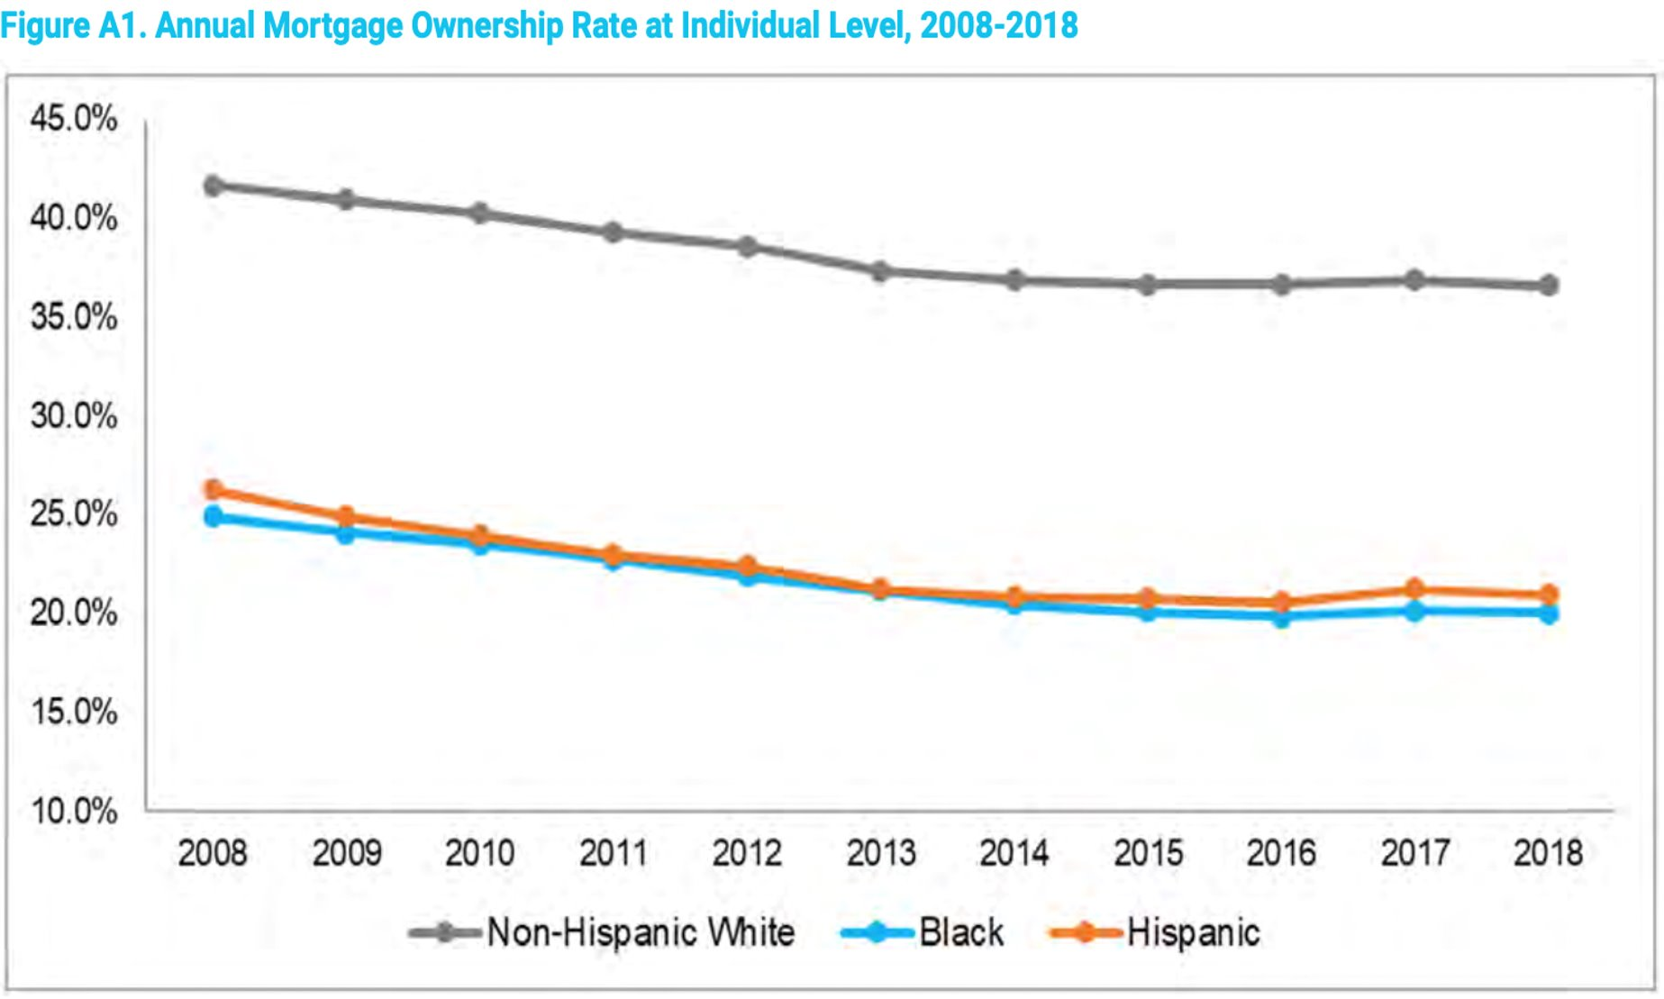
Inclusiveness
Counseling and Credit Education
Income Creation Opportunities
Debt Rehabilitation

Slide 14
Works Cited
Anenberg, Elliot, and Daniel Ringo. “Housing Market Tightness during COVID-19: Increased Demand or Reduced Supply?” The Fed - Housing Market Tightness During COVID-19: Increased Demand or Reduced Supply?, 7 Aug. 2021, https://www.federalreserve.gov/econres/notes/feds-notes/housing-market-tightness-during-covid-19- increased-demand-or-reduced-supply-20210708.htm.
Karantonis, Angelo. “Population Growth and Housing Affordability in the ... - PRRES.” Population Growth and Housing Affordability in the Modern City, 2008, http://www.prres.net/papers/KarantonisPopulationGrowthandHousingAffordability.pdf.
Mulder, Clara H. “Key Note Presentation the Relationship between ... - Unece.org.” The Relationship Between Population and Housing, 2021, https://unece.org/fileadmin/DAM/hlm/archive/Key%20note%20population%20and%20housing.pdf.

Slide 15
Works Cited
National Association of Realtors. “Housing Affordability Index (Fixed).” FRED Economic Data, 14 Jan. 2022, https://fred.stlouisfed.org/series/FIXHAI.
US Census Bureau (MCD): Cheryl Cornish, Stephen Cooper. “New Residential Sales.” United States Census Bureau, 23 Aug. 2011, https://www.census.gov/construction/nrs/historical_data/index.html.
Who Are the Future Borrowers? . Freddie Mac, 16 July 2021, http://www.freddiemac.com/fmac- resources/research/pdf/202110-Insight.pdf.

