Slide 1





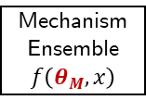


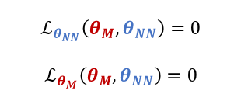
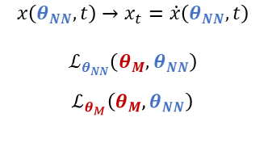




Artificial
Experimental Data
Preprocessing
$$f\left( \right)$$
$$\tilde{x}$$
Data
ANN Generator
ANN $$x\left(θ_{NN},t\right)$$
$$\left\|x\left(θ_{NN},t\right)−\tilde{x}\right\|$$
ANN Objective Function
TensorFlow
Stoichiometric Matrix
$$\left\|f\left(θ_{M},x\left(θ_{NN},t\right)\right)−\dot{x}\left(θ_{NN},t\right)\right\|$$
Mechanism Ensemble
$$f\left(θ_{M},x\right)$$
Mechanism Generator
ODE Objective Function
$$M$$
Automatic Differentiation
$$ℒ\left(θ_{M},θ_{NN}\right)=\left\|x\left(θ_{NN},t\right)−\tilde{x}\right\|+\left\|f\left(θ_{M},x\left(θ_{NN},t\right)\right)−\dot{x}\left(θ_{NN},t\right)\right\|$$
NSGA-II ?
Combined Cost Function
$$ℒ\left(θ_{M}^{∗},θ_{NN}^{∗}\right)$$
JAX
Continuous Improvement
$$x\left(θ_{NN},t\right)→x_{t}=\dot{x}\left(θ_{NN},t\right)$$
$$ℒ_{θ_{NN}}\left(θ_{M},θ_{NN}\right)$$
$$ℒ_{θ_{M}}\left(θ_{M},θ_{NN}\right)$$
$$θ_{M}^{∗},θ_{NN}^{∗}$$
$$ℒ_{θ_{NN}}\left(θ_{M},θ_{NN}\right)=0$$
$$ℒ_{θ_{M}}\left(θ_{M},θ_{NN}\right)=0$$
Optimization
Optimality Conditions
$$M$$
$$M$$
$$M,θ_{M}^{∗},θ_{NN}^{∗}$$
scipy

Slide 2



Artificial
Experimental Data
Preprocessing
$$f\left( \right)$$
$$\tilde{x}$$
Data
JAX: XLA + Autograd
https://github.com/google/jax
ANN Generator
ANN $$x\left(θ_{NN},t\right)$$
$$\left\|x\left(θ_{NN},t\right)−\tilde{x}\right\|$$
Error NN-DATA
Future Work
ANN Objective Function
Stoichiometric Matrix
Error NN-MODEL
$$\left\|f\left(θ_{M},x\left(θ_{NN},t\right)\right)−\dot{x}\left(θ_{NN},t\right)\right\|$$
Mechanism Ensemble
$$f\left(θ_{M},x\right)$$
Mechanism Generator
ODE Objective Function
$$M$$
Automatic Differentiation
$$𝓛\left(θ_{M},θ_{NN}\right)=\left\|x\left(θ_{NN},t\right)−\tilde{x}\right\|+\left\|f\left(θ_{M},x\left(θ_{NN},t\right)\right)−\dot{x}\left(θ_{NN},t\right)\right\|$$
Error NN-DATA
Error NN-MODEL
$$ℒ\left(θ_{M}^{∗},θ_{NN}^{∗}\right)$$
Combined Cost Function
Continuous Improvement
$$x\left(θ_{NN},t\right)→x_{t}=\dot{x}\left(θ_{NN},t\right)$$
$$ℒ_{θ_{NN}}\left(θ_{M},θ_{NN}\right)$$
$$ℒ_{θ_{M}}\left(θ_{M},θ_{NN}\right)$$
$$θ_{M}^{∗},θ_{NN}^{∗}$$
$$ℒ_{θ_{NN}}\left(θ_{M},θ_{NN}\right)≈0$$
$$ℒ_{θ_{M}}\left(θ_{M},θ_{NN}\right)≈0$$
Optimization
Optimality Conditions
$$M$$
$$M$$
$$M,θ_{M}^{∗},θ_{NN}^{∗}$$

