Slide 1
EFFICIENT INFORMATION DISTRIBUTION IN INTERNET OF MEDICAL THINGS (IOMT) SCENARIOS
TULLIA FONTANA, NICOLÁS ORTIZ DE ZARATE, NICOLE ZATTARIN

Slide 2
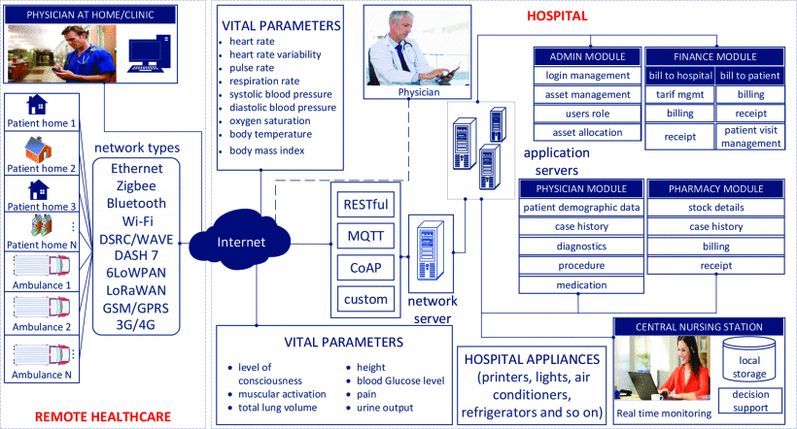
INTERNET OF MEDICAL THINGS (IOMT): ARCHITECTURE
Architecture of Internet of Medical Things (IoMT), taken from [9]

Slide 3
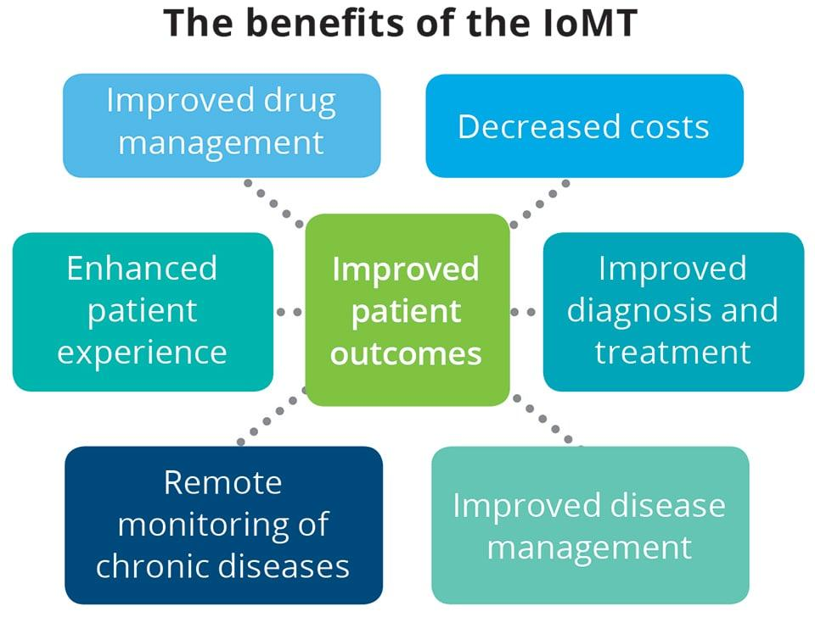
INTERNET OF MEDICAL THINGS (IOMT): ADVANTAGES

Slide 4
INTERNET OF MEDICAL THINGS (IOMT): CHALLANGES
Problems:
Large amount of data
Fast processing
Limited capacity of communication networks
Trade-off:
Transmitted information – Channel saturation

Slide 5
WORK OUTLINE
Correlations: Principal Component Analysis [2]
Dimensionality reduction: Kmeans Clustering [4]
Heterogeneous analysis: data of the same kind
Homogeneous analysis: data of different kind
Validation: binary classification task
Network design

Slide 6
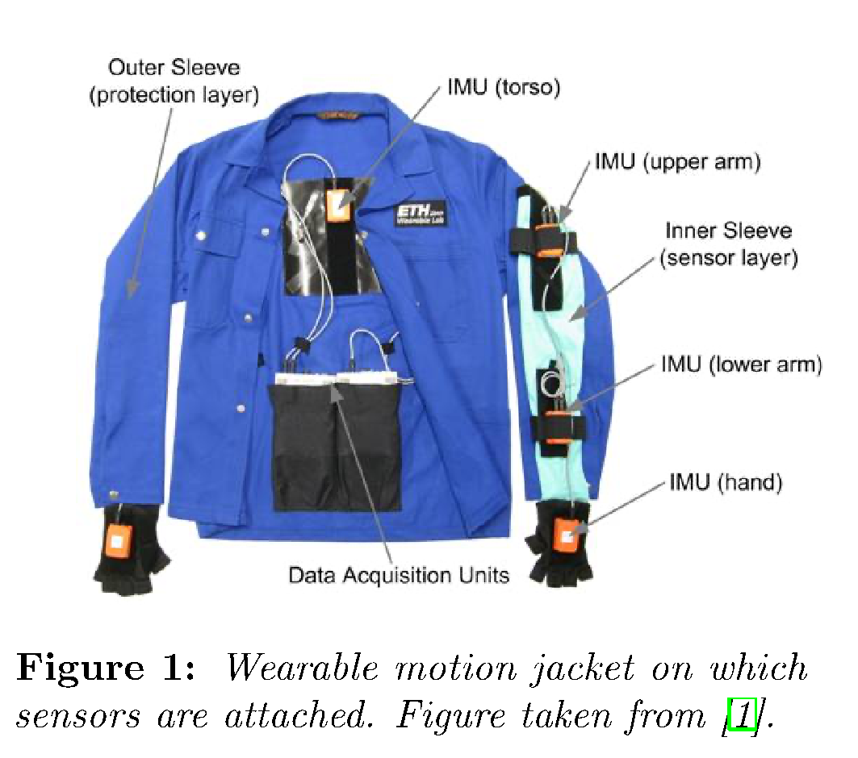
DATASET
Dataset:
OPPORTUNITY Activity Recognition Dataset [1]
Termed activity of daily living (ADL) dataset:
Start: lie on the deckchair, get up
Groom: move in the room
Relax: go for a walk
Prepare/drink coffee
Prepare/eat sandwich
Cleanup
Break: lie on the deckchair

Slide 7
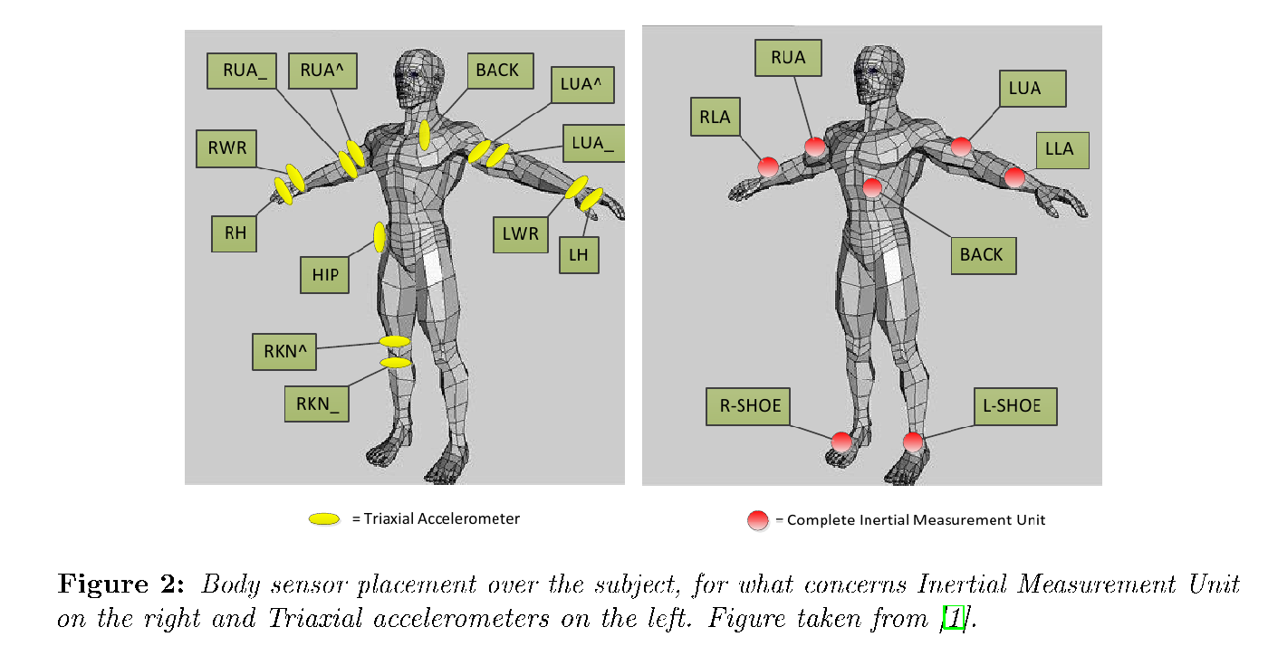
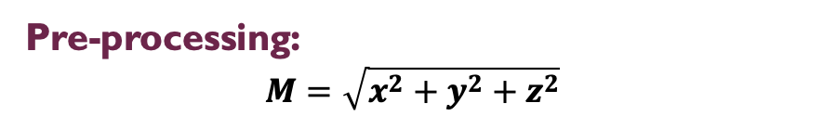
DATASET
Sensor types:
Inertial Measurement Units (IMU) accelerators and gyroscopes
Triaxial accelerometers

Slide 8
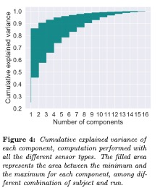
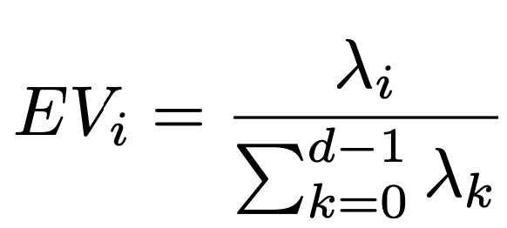
CORRELATIONS: PRINCIPAL COMPONENT ANALYSIS (PCA) [2]
Dimensionality reduction technique based on the correlation among features;
Principal Components (PCs): linear combination of original features;
Explained Variance: measurement of the percentage of variance which can be attributed to each of the PCs:

Slide 9
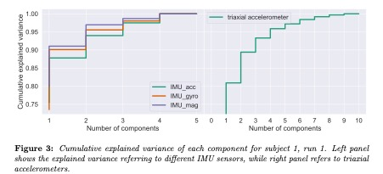
CORRELATIONS: PRINCIPAL COMPONENT ANALYSIS (PCA)

Slide 10
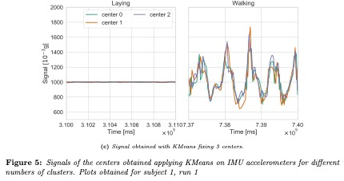
DIMENSIONALITY REDUCTION: CLUSTERING
Data: signals from different sensors while the subject is walking/laying;
Kmeans clustering [4] [5]: computes centroids with a fixed number of clusters;
Metrics: Euclidean, dynamic time wrapping distance [6];
Approach: apply Kmeans at each millisecond.

Slide 11
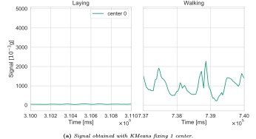
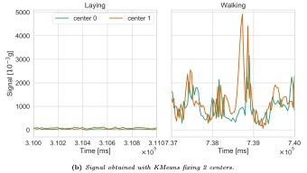
DIMENSIONALITY REDUCTION: CLUSTERING

Slide 12
VALIDATION: BINARY CLASSIFICATION
How well can we still distinguish high level activity after clustering?
Train a binary classifier (walking/laying) on original features
ORIGINAL FEATURES
80% train set
20%
test set
Test on data obtained from the signals of KMeans centroids
CLUSTERING DATA
Accuracy answers the question

Slide 13
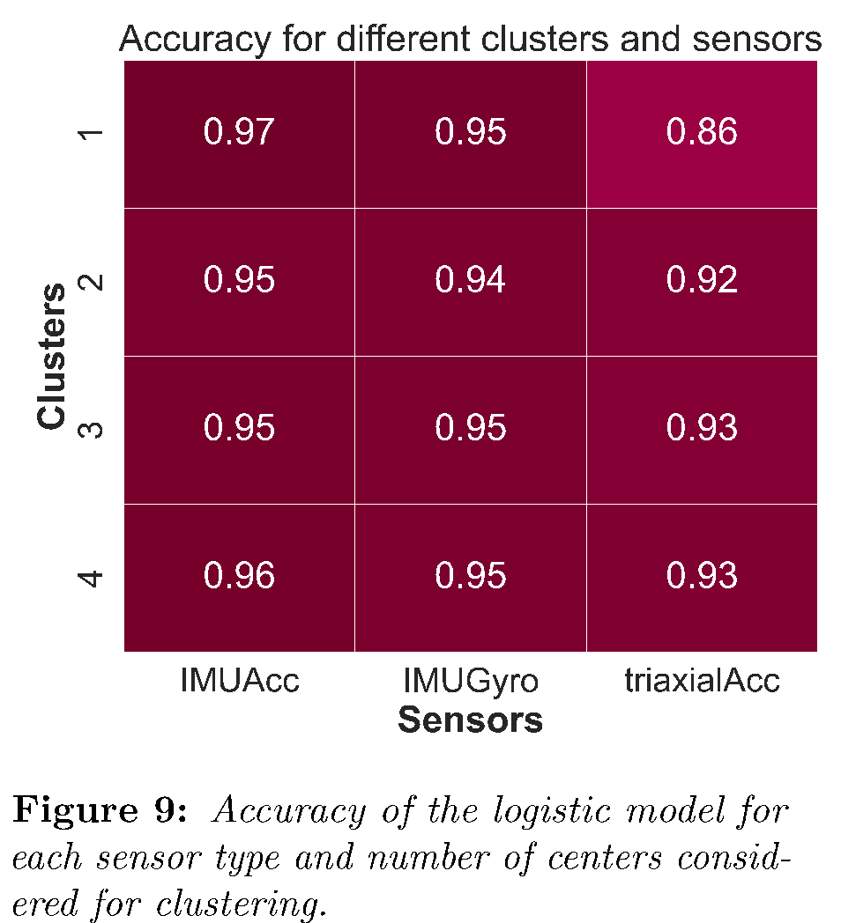
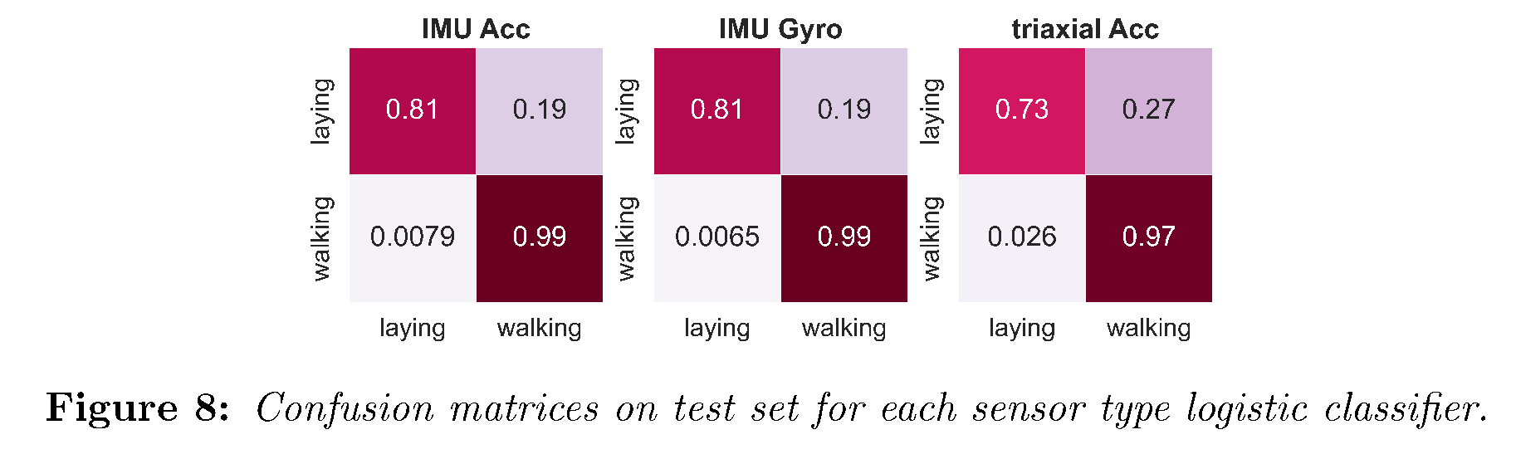
CLASSIFICATION OF HOMOGENEOUS DATA
Dataset: amplitude of the signals in a window of 80 ms;
Linear model: logistic regressor

Slide 14
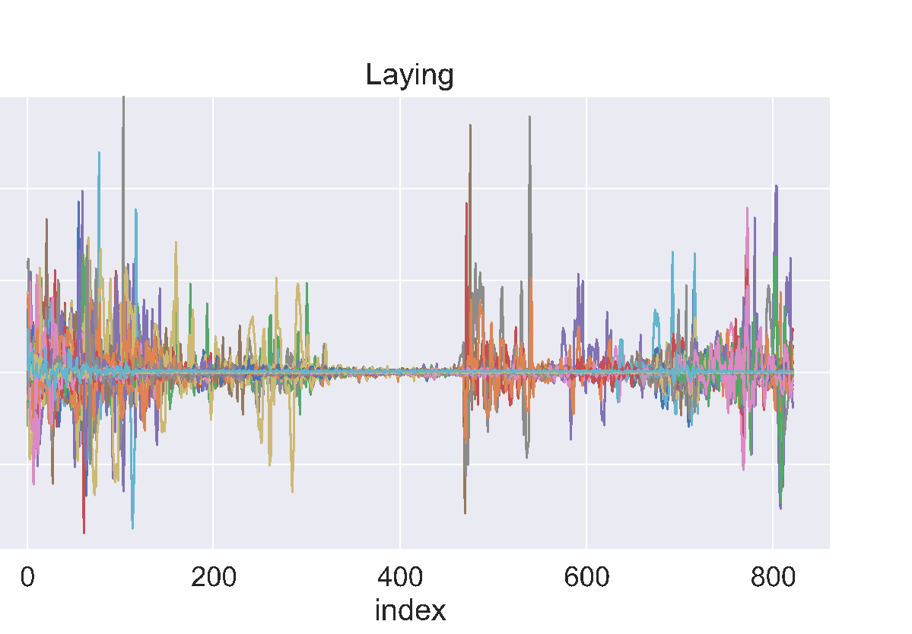
CLASSIFICATION OF HOMOGENEOUS DATA
Linear model drawback:
False positive rate: non negligible ~20%
Dataset: entire time-series;
Accuracy: high accuracy, diagonal confusion matrix;
Drawbacks:
Training: slower and more delicate;
Tuning: requires specific hyperparameters according to the specific kind of data;
Neural model:
Figure: IMU accelerometer signals in laying conditions.

Slide 15
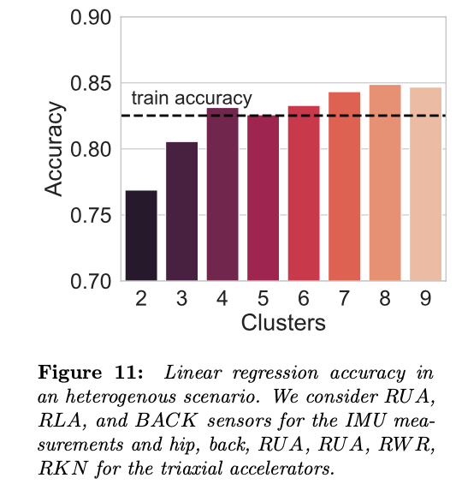
CLASSIFICATION OF HETEROGENEOUS DATA
Dataset: RUA, RLA, and BACK sensors for the IMU measurements and hip, back, RUA^, RUA_, RWR, RKN_ for the triaxial accelerators;
Preprocessing: standardization among data coming form different sensors;

Slide 16
CHECKPOINT
Homogeneous analysis:
IMU sensors (4 each): a single PC accounts for ~90% of variance → one cluster is enough to correctly classify with more than 95% accuracy;
Triaxial accelerometers (9 each): 2/3 PCs account for ~90% of variance → 2/3 clusters are needed to reduce the leak of information (~93% accuracy).
Heterogeneous analysis:
PCA: 8 PCs worst case - 2/3 best case to account for the 90% variance for all runs/subjects;
Clustering and classification: more than 4 centers to reach train accuracy;

Slide 17
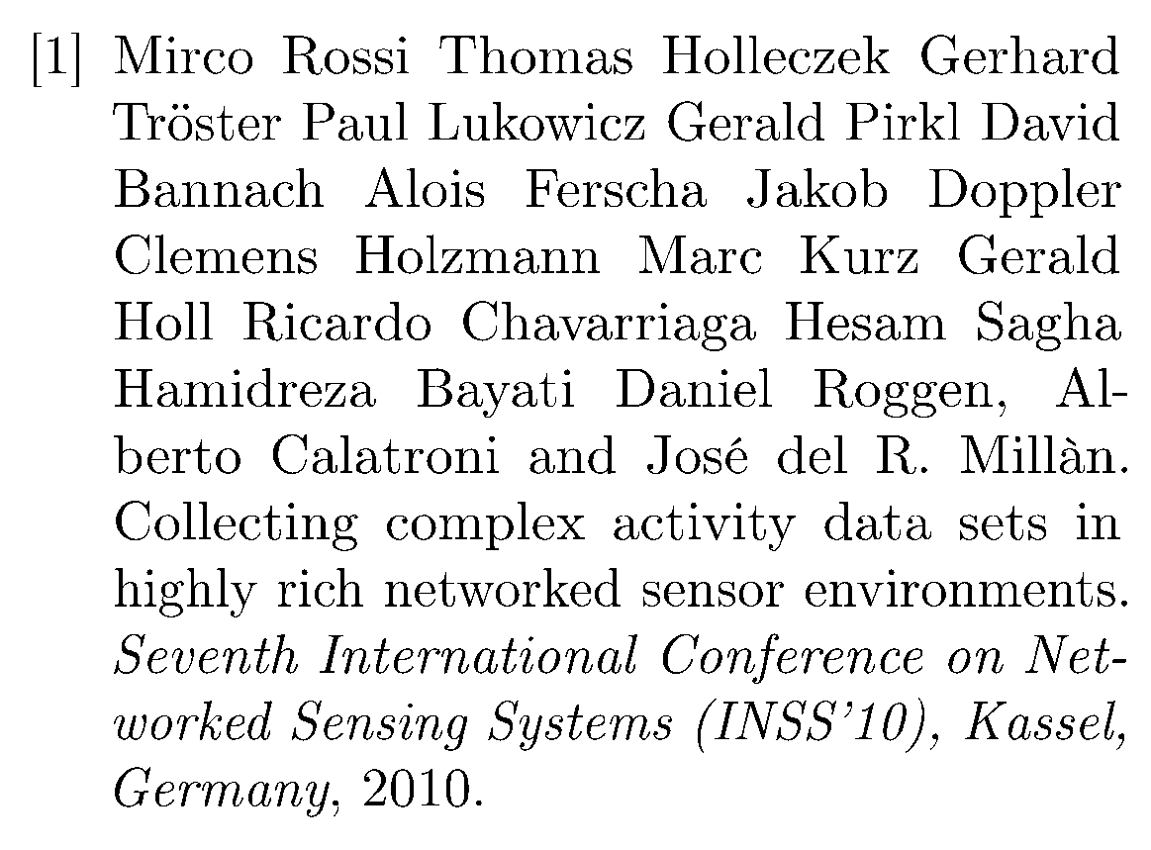
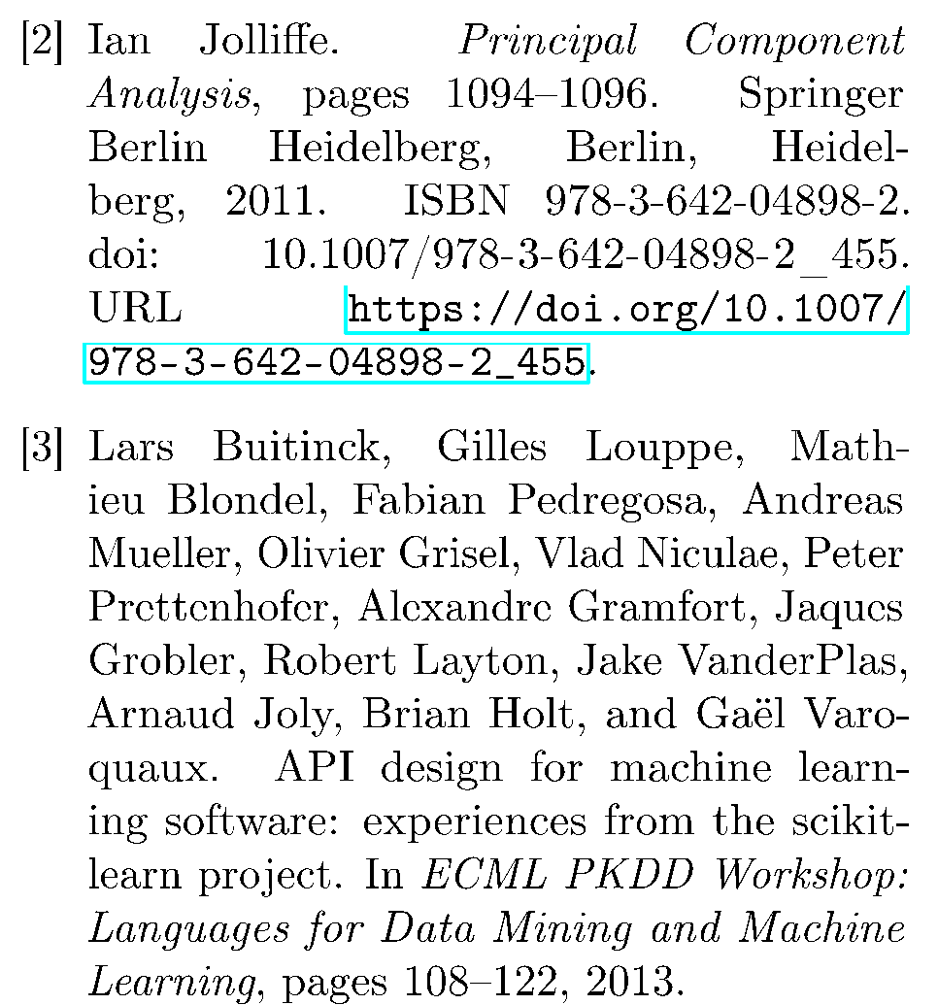
REFERENCES

Slide 18
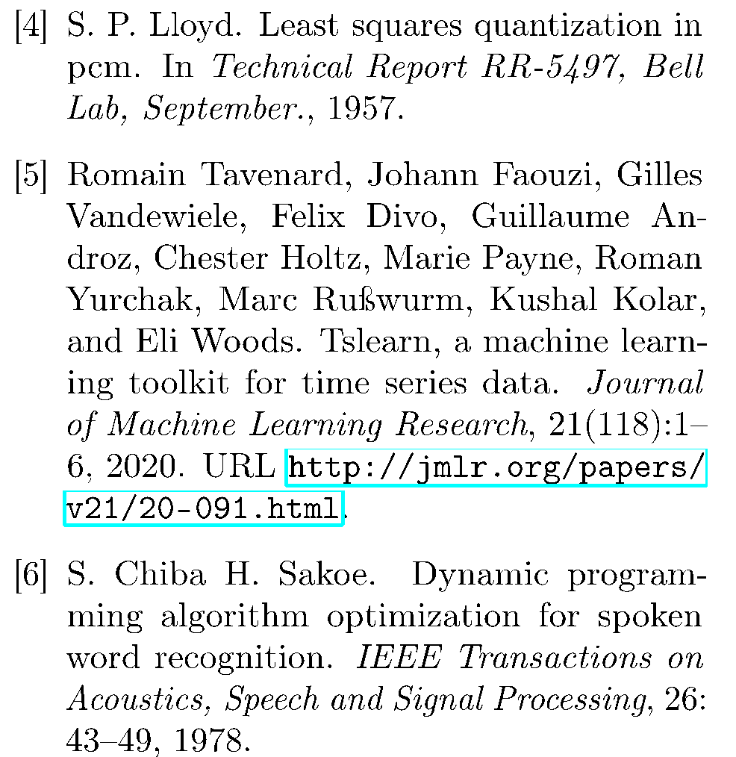
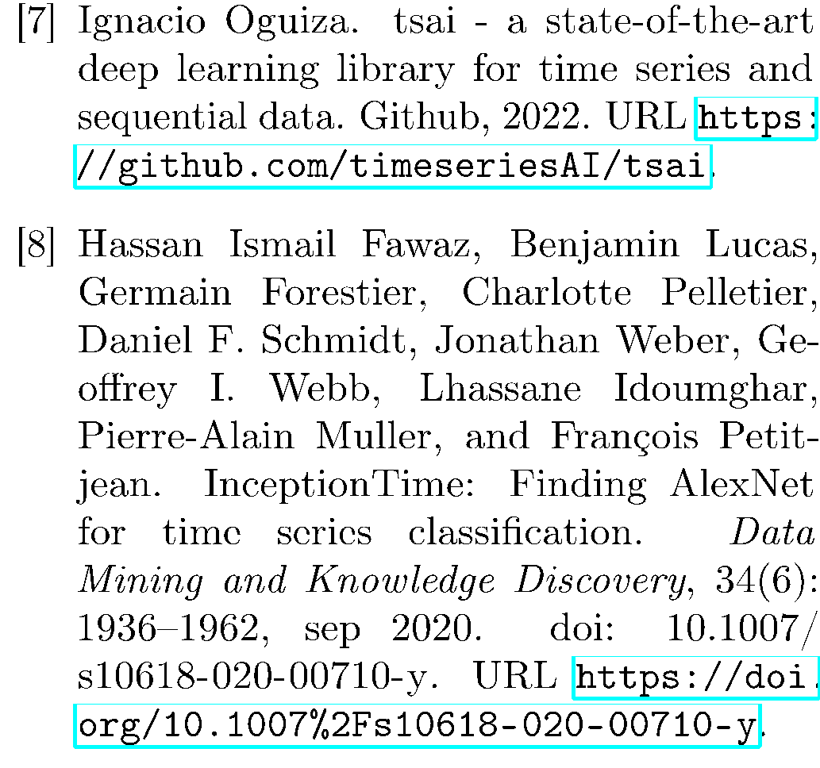
REFERENCES

Slide 19
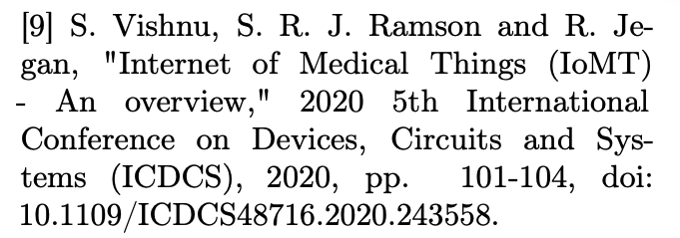
REFERENCES

