Slide 1
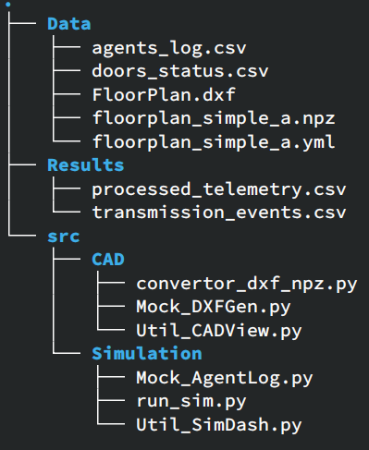
WarpScratchBox
Native DXF Extraction: Python tools (convertor_dxf_npz.py) to extract geometry directly for NVIDIA Warp.
Visual Unit Testing: Mock data pipelines to validate Bounding Volume Hierarchy (BVH) queries, collision detection, and HashGrid proximity calculations prior to full integration.
Warp ScratchBox (run_sim.py): A standalone testing environment for the CUDA kernels that includes templates for interfacing with Machine Learning libraries.
Data Folder: contains the CAD files and the mock data for agent behavior and movable assets ( eg, doors).
src/CAD: convertor_dxf_npz.py creates the python friendly input that is need for GPU spatial queries. The other scripts are mock data and viz unit testing.
src/Simulation: run_sim.py tests the spatial query on the GPU by reading the mock agents_log, this is in place of agent logic. The other scripts are mock data and viz unit testing.

Slide 2
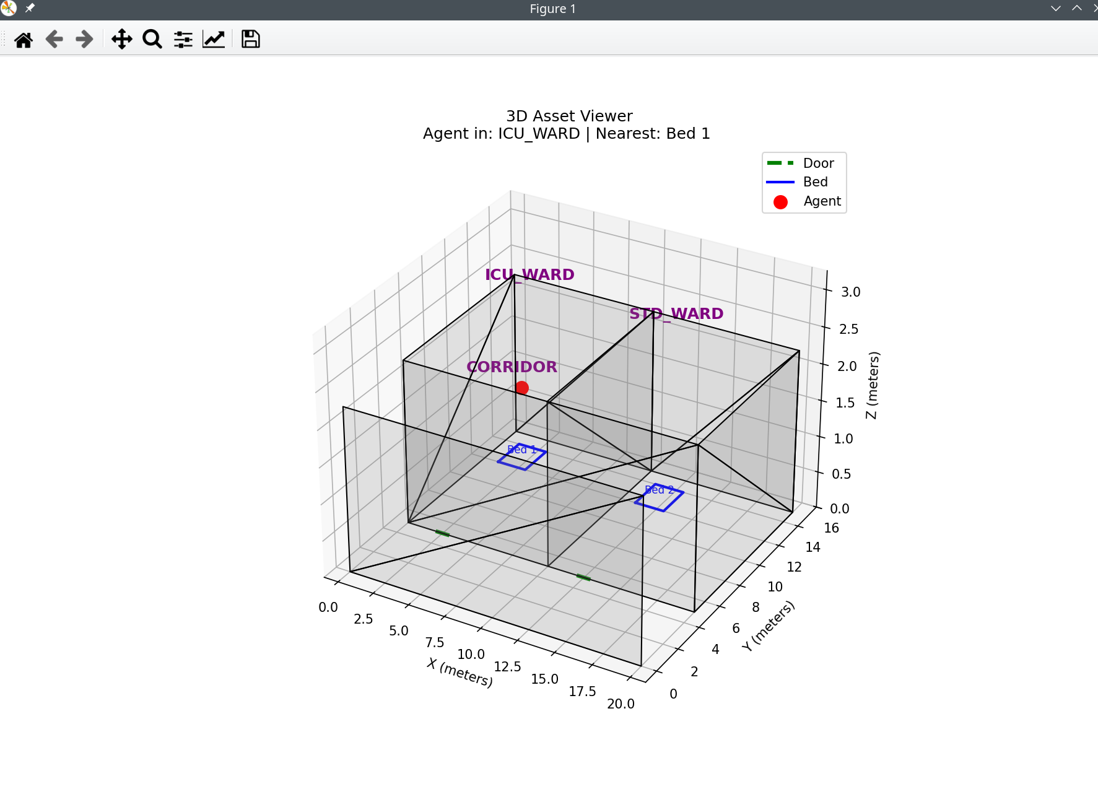
CAD Processing
Mock CAD Generation
1] Input: Creates a floor plan src/CAD/Mock_DXFGen
2] Converts from DXF to npz arrays src/CAD/convertor_dxd_npz
3] Output: Viewer to check the conversion is correct and can be queried

Slide 3
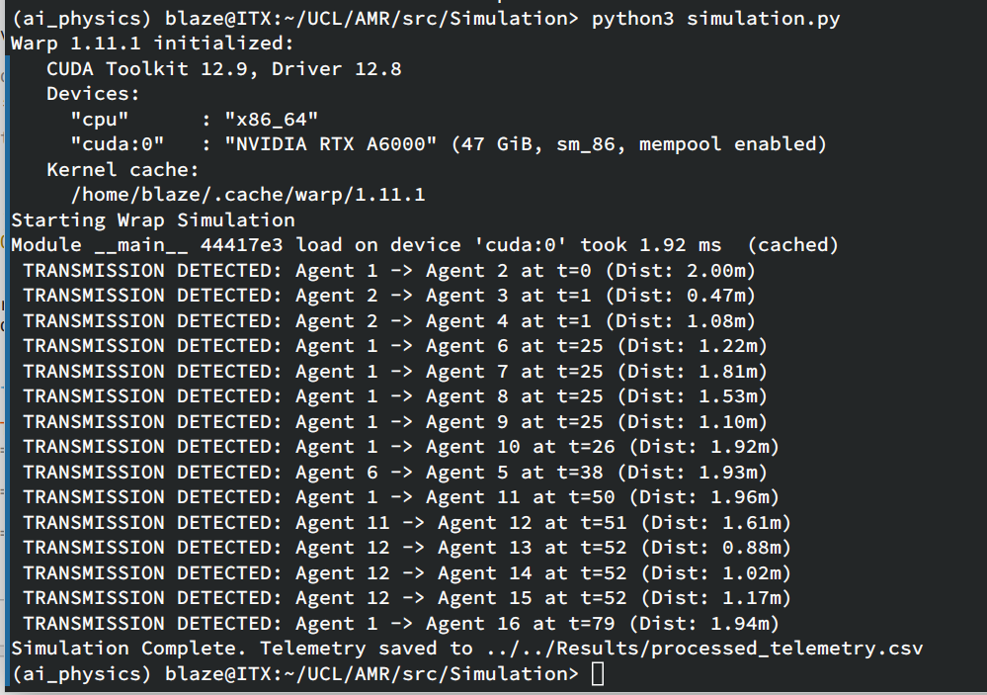
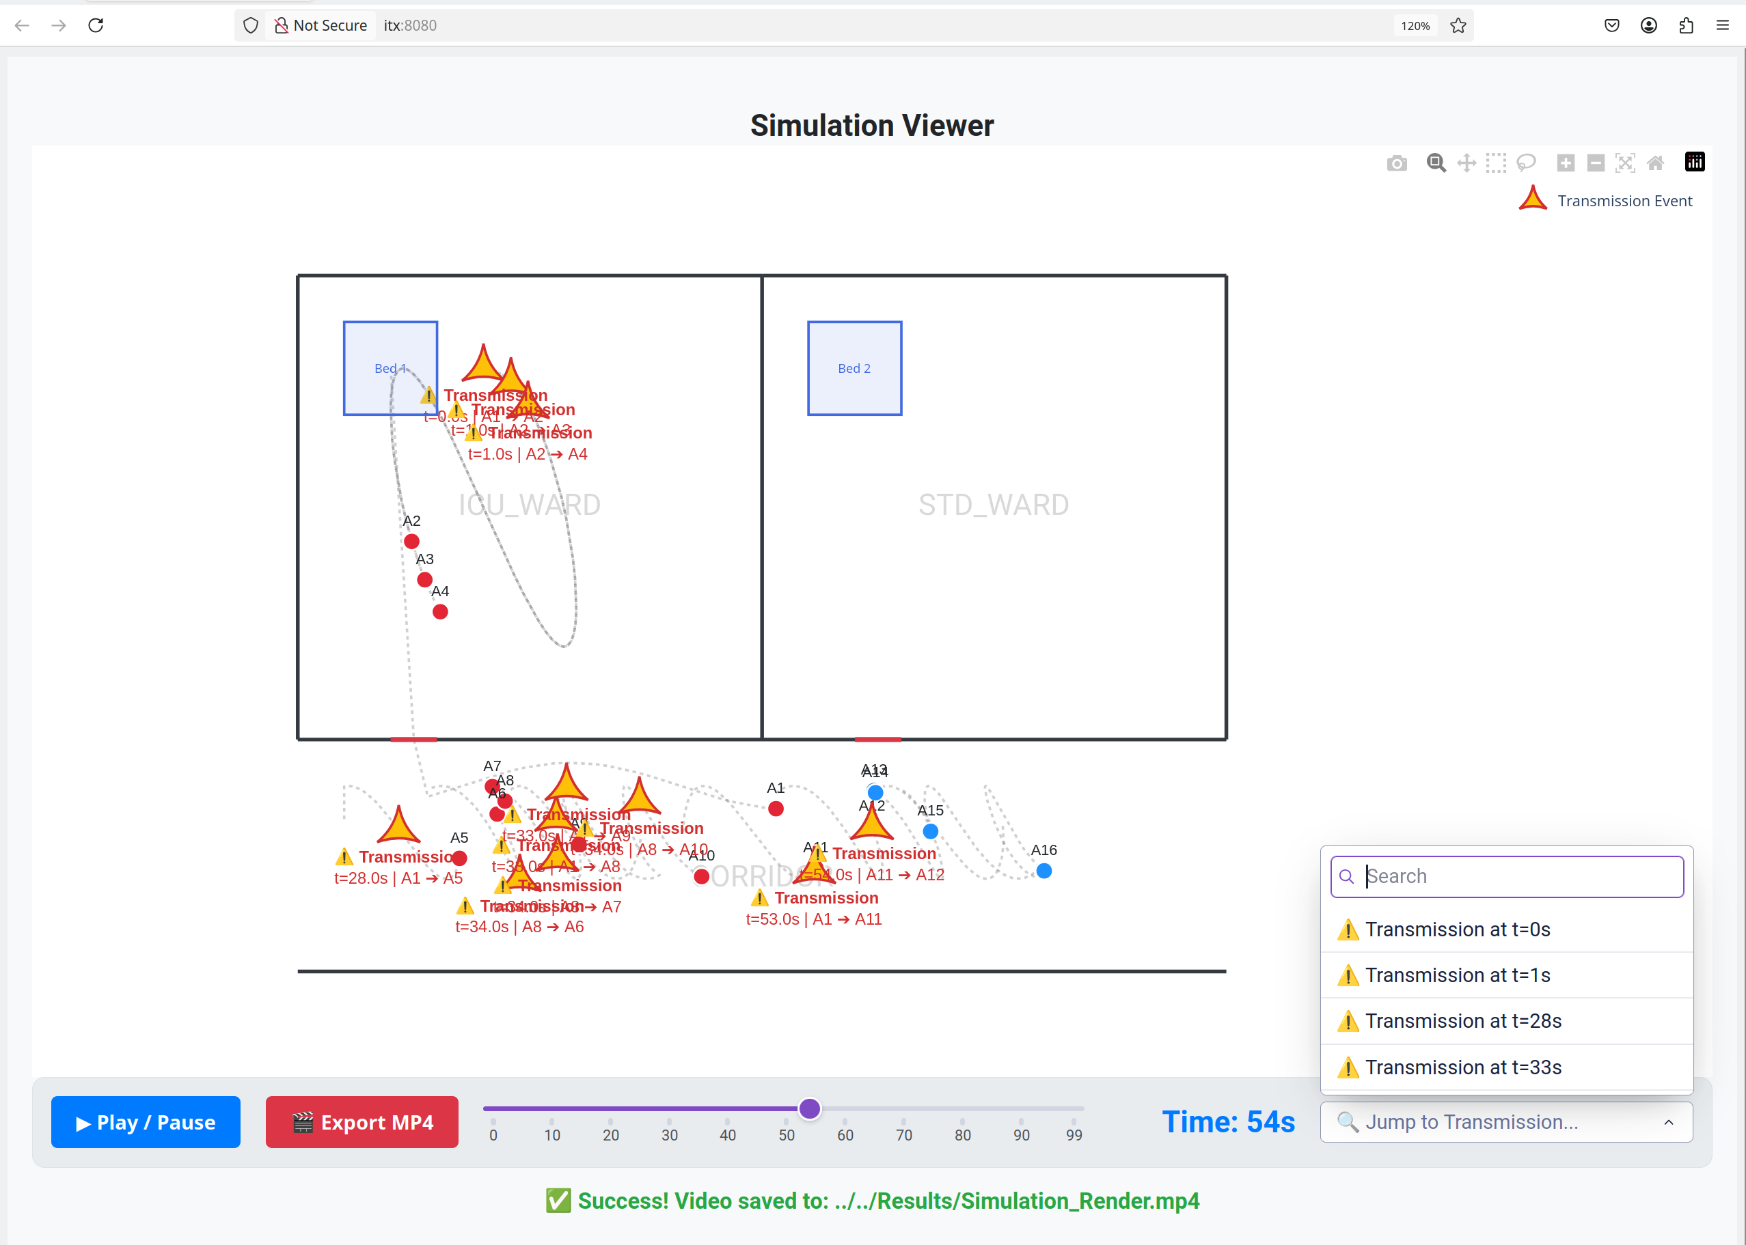
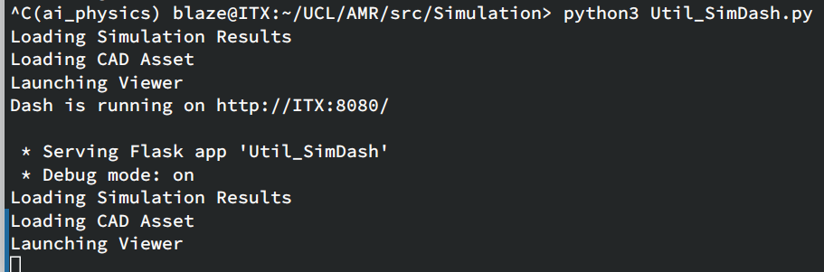
WarpScratchBox
Mock Agent Generation
1] Input: Creates an agent log and door events src/Simulation/Mock_AgentLog
2] Loads npz geometry, AgentsLog,DoorLog and runs the sim using BVH and Grid queries on the GPU src/Simulation/simulation.py
3] Output: Viewer to check the results of the GPU BVH and trajectories src/Simulation/Util_SimDash.py

