Slide 1
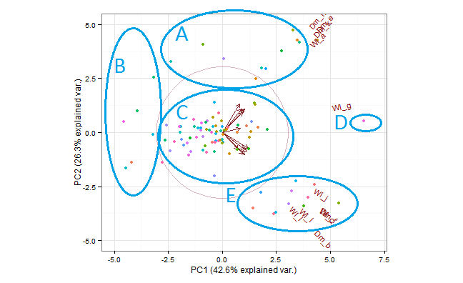
Notes:
principal component analysis (PCA) of lesion size across the isolates on the different hosts.
domestication was not evident until PC3. unrecognized clustering of the isolates based on their ability to infect tomato. with group A infecting all hosts and group B‐E having one or more tomato genotypes that they were unable to infect

Slide 2
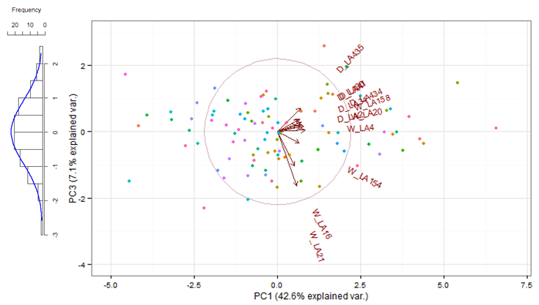
Notes:
Effect of domestication evident – PC3

