Slide 1
 | Wild |  |  |  |  |  | Domesticated
 | LA0480 | LA1547 | LA1589 | LA1684 | LA2093 | LA2176 | LA0410 | LA2706 | LA3008 | LA3475 | LA4345 | LA4355
1.01.01 | 0.489 | 0.308 | 0.700 | 0.282 | 0.399 | 0.594 | 0.504 | 0.476 | 0.505 | 0.677 | 0.780 | 0.860
1.01.02 | 0.753 | 0.656 | 0.454 | 0.626 | 0.792 | 0.894 | 1.485 | 0.357 | 0.583 | 1.144 | 0.354 | 0.397
1.01.03 | 1.066 | 0.437 | 1.057 | 0.279 | 0.889 | 0.345 | 0.772 | 0.864 | 1.090 | 1.217 | 0.700 | 0.582
1.01.04 | 0.606 | 0.446 | 0.182 | 0.881 | 0.915 | 1.095 | 0.610 | 0.631 | 1.151 | 1.259 | 0.765 | 0.586
1.01.06 | 0.666 | 0.550 | 0.881 | 0.587 | 0.861 | 0.911 | 1.093 | 0.762 | 0.910 | 0.940 | 0.647 | 0.510
1.01.15 | 0.500 | 0.569 | 0.577 | 0.558 | 0.675 | 1.009 | 1.138 | 0.627 | 0.336 | 0.941 | 0.135 | 0.582
1.02.01 | 0.962 | 0.840 | 1.004 | 0.463 | 0.625 | 1.060 | 0.828 | 1.337 | 0.839 | 1.587 | 0.573 | 0.611
1.02.02 | 0.436 | 0.728 | 0.504 | 0.359 | 0.744 | 0.574 | 0.816 | 0.505 | 0.380 | 0.514 | 0.531 | 0.384
1.02.03 | 0.782 | 0.131 | 0.753 | 0.768 | 0.525 | 0.614 | 0.876 | 1.071 | 0.578 | 0.694 | 0.747 | 0.575
1.02.04 | 0.728 | 0.170 | 0.762 | 0.242 | 0.479 | 0.930 | 0.959 | 0.915 | 0.305 | 0.695 | 0.712 | 0.732
1.02.05 | 0.524 | 0.614 | 0.652 | 0.993 | 0.641 | 0.869 | 0.801 | 1.092 | 0.494 | 0.817 | 0.692 | 0.590
1.02.06 | 0.398 | 0.166 | 0.372 | 0.250 | 0.365 | 0.068 | 0.269 | 0.664 | 0.369 | 1.026 | 0.531 | 0.373
1.02.15 | 0.911 | 0.490 | 0.287 | 0.492 | 0.619 | 0.394 | 0.434 | 0.680 | 0.663 | 0.545 | 0.401 | 0.315
1.02.16 | 0.648 | 0.561 | 0.588 | 0.119 | 0.507 | 1.010 | 1.237 | 0.844 | 0.894 | 0.586 | 0.511 | 0.639
1.02.17 | 0.649 | 0.282 | 0.575 | 0.228 | 0.681 | 0.466 | 0.771 | 0.803 | 0.493 | 0.642 | 0.274 | 0.308
1.02.18 | 0.428 | 0.308 | 0.357 | 0.523 | 0.545 | 0.497 | 0.645 | 0.225 | 0.299 | 0.802 | 0.239 | 0.513
1.02.20 | 1.036 | 0.574 | 0.457 | 0.632 | 0.493 | 0.568 | 0.760 | 0.900 | 0.534 | 0.936 | 0.472 | 0.590
1.03.02 | 0.501 | 0.516 | 0.525 | 0.962 | 0.609 | 0.738 | 0.956 | 0.621 | 0.375 | 0.752 | 0.495 | 0.656
1.03.04 | 0.475 | 0.756 | 0.815 | 0.340 | 0.750 | 0.694 | 1.241 | 0.839 | 0.625 | 0.966 | 0.499 | 0.850
1.03.12 | 0.693 | 0.543 | 1.055 | 0.757 | 0.935 | 1.062 | 1.414 | 0.914 | 0.620 | 0.963 | 0.552 | 0.878
1.03.16 | 0.422 | 0.671 | 0.425 | 0.594 | 0.805 | 0.992 | 1.264 | 1.096 | 0.641 | 0.643 | 0.662 | 1.031
1.03.18 | 0.838 | 0.383 | 0.679 | 0.917 | 0.807 | 0.464 | 0.801 | 0.521 | 0.868 | 1.542 | 0.285 | 0.571
1.03.19 | 0.367 | 0.441 | 0.320 | 0.335 | 0.491 | 0.553 | 0.657 | 0.276 | 0.342 | 0.624 | 0.243 | 0.199
1.03.20 | 0.359 | 0.569 | 0.372 | 0.595 | 0.304 | 0.314 | 0.584 | 0.501 | 0.928 | 0.961 | 0.660 | 0.683
1.03.22 | 0.446 | 0.351 | 0.448 | 0.445 | 0.437 | 0.433 | 0.494 | 0.509 | 0.619 | 0.369 | 0.294 | 0.589
1.03.23 | 0.744 | 0.500 | 0.814 | 0.472 | 0.739 | 0.892 | 0.699 | 0.602 | 0.709 | 0.631 | 0.606 | 0.833
1.04.01 | 0.719 | 0.571 | 0.494 | 1.090 | 0.609 | 0.918 | 0.992 | 0.486 | 0.591 | 1.024 | 0.543 | 0.527
1.04.02 | 0.433 | 0.390 | 0.393 | 0.267 | 0.427 | 0.856 | 0.616 | 0.646 | 0.196 | 0.695 | 0.336 | 0.911
1.04.03 | 0.559 | 0.518 | 0.553 | 0.396 | 0.590 | 0.778 | 0.957 | 0.491 | 0.417 | 0.954 | 0.531 | 0.669
1.04.04 | 0.192 | 0.270 | 0.366 | 0.491 | 0.389 | 0.649 | 0.795 | 0.597 | 0.573 | 0.574 | 0.361 | 0.329
1.04.05 | 0.310 | 0.216 | 0.438 | 0.330 | 0.359 | 0.662 | 1.138 | 0.817 | 0.360 | 0.530 | 0.261 | 0.260
1.04.12 | 0.350 | 0.553 | 0.288 | 0.448 | 0.190 | 0.723 | 0.359 | 0.171 | 0.596 | 0.519 | 0.240 | 0.177
1.04.15 | 0.765 | 0.256 | 0.306 | 0.342 | 0.633 | 0.628 | 1.003 | 0.337 | 0.198 | 0.231 | 0.256 | 0.183
1.04.17 | 0.545 | 0.341 | 0.654 | 0.911 | 0.534 | 0.596 | 1.039 | 0.705 | 0.315 | 0.737 | 0.442 | 0.641
1.04.19 | 0.801 | 0.394 | 0.534 | 0.359 | 0.507 | 0.544 | 0.833 | 0.270 | 0.339 | 0.828 | 0.443 | 0.409
1.04.20 | 0.655 | 0.401 | 0.403 | 0.436 | 0.632 | 0.645 | 0.812 | 0.742 | 0.517 | 0.711 | 0.576 | 0.497
1.04.21 | 0.397 | 0.632 | 0.539 | 0.443 | 0.558 | 0.828 | 0.447 | 0.464 | 0.576 | 0.777 | 0.458 | 0.576
1.04.25 | 0.470 | 0.622 | 0.417 | 0.467 | 0.425 | 0.431 | 0.844 | 0.963 | 0.887 | 1.109 | 0.448 | 0.937
1.05.04 | 0.599 | 0.265 | 0.522 | 0.774 | 0.386 | 0.652 | 1.198 | 0.649 | 0.201 | 0.359 | 0.238 | 0.258
1.05.11 | 0.423 | 0.426 | 0.661 | 0.241 | 0.379 | 0.537 | 0.901 | 0.573 | 0.334 | 0.581 | 0.369 | 0.414
1.05.14 | 0.576 | 0.518 | 0.405 | 1.445 | 0.369 | 0.776 | 0.689 | 0.708 | 0.374 | 0.889 | 0.595 | 0.469
1.05.16 | 0.694 | 0.275 | 0.453 | 0.154 | 0.350 | 0.643 | 1.032 | 0.600 | 0.551 | 0.371 | 0.546 | 0.494
1.05.17 | 0.644 | 0.639 | 0.958 | 0.956 | 0.571 | 0.986 | 1.095 | 0.581 | 1.238 | 0.754 | 0.460 | 0.593
1.05.22 | 0.564 | 0.213 | 0.805 | 0.240 | 0.390 | 0.316 | 0.778 | 0.404 | 0.880 | 0.505 | 0.462 | 0.441
1.05.24 | 0.279 | 0.324 | 0.238 | 0.100 | 0.346 | 0.494 | 0.470 | 0.429 | 0.337 | 0.509 | 0.463 | 0.278
2.04.03 | 0.368 | 0.458 | 0.596 | 0.754 | 0.490 | 0.455 | 0.952 | 0.480 | 0.533 | 0.674 | 0.539 | 0.785
2.04.04 | 1.119 | 1.036 | 1.013 | 0.720 | 0.673 | 0.978 | 1.130 | 1.066 | 1.328 | 1.547 | 0.775 | 0.695
2.04.08 | 1.409 | 0.777 | 0.980 | 0.726 | 0.731 | 0.727 | 0.979 | 1.192 | 1.448 | 1.085 | 0.785 | 1.049
2.04.09 | 0.730 | 0.328 | 0.910 | 0.813 | 0.900 | 0.848 | 0.995 | 1.362 | 0.831 | 0.701 | 0.537 | 1.088
2.04.11 | 0.662 | 0.976 | 0.658 | 0.762 | 0.639 | 0.905 | 1.495 | 1.199 | 1.121 | 0.994 | 0.802 | 0.820
2.04.12 | 1.311 | 0.807 | 1.436 | 1.104 | 0.605 | 0.865 | 1.402 | 1.621 | 1.194 | 1.428 | 1.047 | 1.108
2.04.14 | 0.820 | 0.441 | 0.180 | 0.506 | 0.643 | 0.694 | 1.158 | 0.771 | 0.483 | 0.531 | 0.620 | 0.948
2.04.17 | 0.581 | 0.390 | 0.563 | 0.523 | 0.560 | 0.931 | 1.561 | 1.159 | 0.773 | 0.625 | 0.562 | 0.676
2.04.18 | 0.797 | 0.682 | 0.756 | 0.850 | 1.254 | 0.772 | 1.373 | 1.224 | 0.970 | 1.190 | 0.774 | 1.305
2.04.20 | 1.167 | 0.333 | 0.918 | 0.642 | 0.692 | 0.738 | 0.920 | 1.301 | 0.373 | 0.797 | 0.530 | 0.758
2.04.21 | 0.546 | 0.662 | 0.774 | 0.533 | 0.402 | 0.853 | 0.703 | 1.037 | 0.515 | 0.680 | 0.660 | 0.860
2004 | 0.474 | 0.391 | 0.507 | 0.509 | 0.689 | 0.623 | 0.647 | 0.954 | 0.437 | 1.045 | 0.587 | 0.443
94.4 | 0.571 | 0.572 | 0.433 | 0.618 | 0.525 | 1.238 | 0.672 | 0.861 | 0.491 | 1.174 | 0.583 | 0.666
Acacia | 0.465 | 0.529 | 0.662 | 0.181 | 0.599 | 1.034 | 0.773 | 0.894 | 0.721 | 0.415 | 0.527 | 1.044
Apple 404 | 0.372 | 0.585 | 0.762 | 0.762 | 0.681 | 0.534 | 0.863 | 1.020 | 0.964 | 0.791 | 0.636 | 0.725
Apple 517 | 0.802 | 1.251 | 0.690 | 1.256 | 0.897 | 0.478 | 1.203 | 0.876 | 0.808 | 0.980 | 0.689 | 1.024
Ausubel | 0.910 | 0.775 | 0.986 | 0.724 | 0.876 | 0.735 | 1.465 | 1.448 | 1.105 | 1.110 | 0.517 | 0.861
B05.10 | 0.729 | 0.312 | 0.971 | 0.449 | 0.531 | 0.726 | 0.872 | 0.690 | 0.458 | 0.999 | 0.414 | 0.909
BMM | 0.665 | 0.358 | 0.948 | 1.061 | 0.644 | 1.031 | 1.069 | 0.854 | 0.493 | 0.866 | 0.531 | 0.607
BPA1 | 0.465 | 0.418 | 0.586 | 0.689 | 0.882 | 0.610 | 0.619 | 0.900 | 0.577 | 0.831 | 0.515 | 0.617
Davis Navel | 0.655 | 0.497 | 0.475 | 0.343 | 0.645 | 0.796 | 0.812 | 0.777 | 0.606 | 0.269 | 0.538 | 0.608
Esparato Fresa | 0.311 | 0.299 | 0.202 | 0.485 | 0.226 | 0.383 | 0.604 | 0.284 | 0.246 | 0.196 | 0.287 | 0.360
Fd1 | 0.873 | 0.363 | 0.884 | 0.820 | 0.803 | 1.068 | 0.796 | 1.069 | 0.696 | 0.678 | 0.548 | 0.494
Fd2 | 0.666 | 0.398 | 0.468 | 0.587 | 0.624 | 1.134 | 0.971 | 1.415 | 1.691 | 1.390 | 1.457 | 0.820
Fresa 525 | 0.673 | 0.446 | 0.962 | 0.481 | 1.011 | 1.343 | 1.450 | 1.123 | 0.602 | 0.669 | 0.758 | 1.427
Fresa SD | 0.730 | 0.192 | 0.453 | 0.278 | 0.664 | 0.757 | 0.655 | 0.451 | 0.707 | 0.913 | 0.394 | 0.428
Gallo 1 | 0.378 | 0.329 | 0.463 | 0.477 | 0.352 | 0.450 | 0.688 | 0.375 | 0.344 | 0.525 | 0.297 | 0.391
Gallo 2 | 0.475 | 0.129 | 0.684 | 0.053 | 0.591 | 0.297 | 0.433 | 0.506 | 0.198 | 0.863 | 0.336 | 0.292
Geranium | 0.802 | 0.479 | 0.666 | 0.563 | 0.507 | 1.083 | 0.941 | 0.950 | 0.765 | 1.418 | 0.652 | 0.679
Grape | 0.582 | 0.241 | 0.843 | 0.709 | 0.615 | 0.641 | 1.154 | 0.877 | 0.512 | 0.741 | 0.501 | 0.695
Katie Tomato | 0.705 | 1.030 | 0.860 | 1.004 | 0.751 | 0.663 | 0.943 | 1.628 | 1.131 | 1.058 | 0.733 | 0.919
Kern A2 | 1.709 | 0.882 | 0.943 | 0.747 | 0.975 | 0.848 | 1.168 | 1.293 | 0.881 | 1.437 | 1.135 | 1.170
Kern B1 | 0.860 | 0.409 | 0.533 | 0.620 | 0.863 | 1.424 | 1.183 | 1.089 | 0.830 | 1.122 | 0.906 | 0.983
Kern B2 | 1.132 | 0.715 | 1.155 | 0.656 | 0.762 | 1.243 | 1.303 | 1.069 | 0.656 | 1.160 | 0.945 | 1.024
KGB1 | 0.322 | 0.426 | 0.171 | 0.211 | 0.342 | 0.217 | 0.675 | 0.288 | 0.468 | 0.548 | 0.272 | 0.333
KGB2 | 0.769 | 0.476 | 1.197 | 0.535 | 0.800 | 1.053 | 0.940 | 0.763 | 0.363 | 1.047 | 0.562 | 0.936
MEAP6G | 0.513 | 0.382 | 0.725 | 0.087 | 0.624 | 0.339 | 1.138 | 0.972 | 0.407 | 0.535 | 0.777 | 0.955
Mex 03 | 0.588 | 0.414 | 0.573 | 0.833 | 0.520 | 1.103 | 0.948 | 1.013 | 0.194 | 0.728 | 0.450 | 0.435
Molly | 0.524 | 0.653 | 0.301 | 0.668 | 0.651 | 0.605 | 0.567 | 0.662 | 0.556 | 0.788 | 0.523 | 0.733
Navel | 0.149 | 0.112 | 0.074 | 0.193 | 0.195 | 0.107 | 0.167 | 0.137 | 0.339 | 0.299 | 0.137 | 0.053
Noble Rot | 0.203 | 0.125 | 0.165 | 0.358 | 0.131 | 0.275 | 0.719 | 0.186 | 0.123 | 0.211 | 0.113 | 0.172
Peachy | 0.440 | 0.345 | 0.397 | 0.269 | 0.586 | 0.870 | 0.256 | 0.639 | 0.163 | 0.448 | 0.268 | 0.397
Pepper | 0.594 | 0.660 | 0.571 | 0.692 | 0.661 | 1.216 | 1.202 | 0.447 | 0.643 | 0.464 | 0.516 | 0.524
Pepper Sub | 0.589 | 0.584 | 0.802 | 0.606 | 0.706 | 0.897 | 1.143 | 1.130 | 0.374 | 0.931 | 0.732 | 0.814
Philo Menlo | 1.158 | 0.662 | 1.250 | 1.016 | 0.993 | 1.543 | 1.252 | 1.494 | 0.952 | 0.972 | 0.691 | 0.836
Rasp | 0.794 | 0.563 | 0.718 | 0.810 | 0.876 | 1.127 | 1.567 | 0.914 | 0.752 | 0.909 | 0.751 | 0.714
Rose | 0.200 | 0.200 | 0.072 | 0.108 | 0.208 | 0.385 | 0.681 | 0.429 | 0.654 | 0.542 | 0.218 | 0.569
Supersteak | 0.815 | 0.691 | 0.769 | 0.510 | 0.855 | 1.146 | 1.076 | 0.854 | 0.542 | 0.841 | 0.895 | 1.092
Triple 3 | 0.948 | 0.659 | 1.295 | 1.156 | 1.150 | 0.893 | 1.217 | 1.190 | 1.032 | 1.106 | 1.162 | 1.157
UK Razz | 0.907 | 0.489 | 1.072 | 0.548 | 0.761 | 1.191 | 1.291 | 1.660 | 1.111 | 0.939 | 0.898 | 1.208
Table S1. Mean of B. cinerea lesion size of all isolates across all tomato accessions.

Slide 2
 |  | Wild |  |  |  |  |  | Domesticated
 |  | LA1547 | LA1589 | LA1684 | LA2093 | LA2176 | LA480 | LA2706 | LA3008 | LA3475 | LA410 | LA4345 | LA4355
Wild | LA1547 |  | 3256 | 3975 | 3069 | 2228 | 3006 | 2165 | 3478 | 1847 | 1253 | 3942 | 2970
 | LA1589 | <0.001 |  | 5323 | 4755 | 3566 | 4563 | 3396 | 4860 | 3173 | 2406 | 5491 | 4426
 | LA1684 | 0.086 | NS |  | 4020 | 3008 | 3926 | 2885 | 4194 | 2627 | 1959 | 4776 | 3810
 | LA2093 | <0.001 | NS | NS |  | 3395 | 4575 | 3260 | 4943 | 2919 | 2093 | 5630 | 4384
 | LA2176 | <0.001 | 0.007 | <0.001 | 0.002 |  | 5766 | 4428 | 5955 | 4287 | 3411 | 6670 | 5610
 | LA480 | <0.001 | NS | 0.067 | NS | 0.012 |  | 5939 | 4376 | 6212 | 6999 | 3703 | 4869
Domesticated | LA2706 | <0.001 | 0.002 | <0.001 | <0.001 | NS | 0.003 |  | 6071 | 4564 | 3785 | 6716 | 5794
 | LA3008 | 0.003 | NS | NS | 0.607 | 0.003 | NS | 0.001 |  | 3062 | 2339 | 5309 | 4283
 | LA3475 | <0.001 | <0.001 | <0.001 | <0.001 | NS | <0.001 | NS | <0.001 |  | 3824 | 7088 | 6022
 | LA410 | <0.001 | <0.001 | <0.001 | <0.001 | 0.002 | <0.001 | 0.030 | <0.001 | 0.037 |  | 7779 | 6820
 | LA4345 | 0.072 | 0.065 | NS | 0.030 | <0.001 | 0.018 | <0.001 | NS | <0.001 | <0.001 |  | 3601
 | LA4355 | <0.001 | NS | 0.034 | NS | 0.032 | NS | 0.010 | NS | 0.002 | <0.001 | 0.009
Table S2. Rank order shifts of 97 B. cinerea isolates by lesion area across all of the tomato accessions.
Wilcoxon signed-rank test comparing mean B. cinerea lesion area on tomato accessions. This tests for a change in the rank order of the 97 isolates between each pair of tomato accessions. A significant p-value suggests that the relative performance of individual isolates is altered from one host to the other. The lower left corner of the chart includes FDR-corrected p-values, the upper right corner includes the test statistic (W). Bold text indicates significance at p<0.01 after correction, italicized text indicates suggestive p-values 0.01 < p < 0.1. NS shows non-significant interactions.

Slide 3
geneID | tot_LA0410 | tot_LA0480 | tot_LA1547 | tot_LA1589 | tot_LA1684 | tot_LA2093 | tot_LA2176 | tot_LA2706 | tot_LA3008 | tot_LA3475 | tot_LA4345 | tot_LA4355 | TotPhenos | PFAM_NAME | PFAM_DESCRIPTION | BCIN
BcT4_8813 | 1 | 1 | 1 | 1 | 1 | 1 | 1 | 1 | 1 | 1 | 1 | 1 | 12 | M20_dimer | Peptidase dimerisation domain | Bcin01g10130
BcT4_8803 | 1 | 1 | 1 | 1 | 1 | 1 | 1 | 1 | 1 | 1 | 1 | 1 | 12 | HET | Heterokaryon incompatibility protein (HET) | Bcin01g10020
BcT4_6001 | 1 | 1 | 1 | 1 | 1 | 1 | 1 | 1 | 1 | 1 | 1 | 1 | 12 | Pectinesterase | Pectinesterase | Bcin14g00860
BcT4_6000 | 1 | 1 | 1 | 1 | 1 | 1 | 1 | 1 | 1 | 1 | 1 | 1 | 12 | MFS_1 | Major Facilitator Superfamily | Bcin14g00870
BcT4_5778 | 1 | 1 | 1 | 1 | 1 | 1 | 1 | 1 | 1 | 1 | 1 | 1 | 12 | Pkinase | Protein kinase domain | Bcin15g04110
BcT4_2485 | 1 | 1 | 1 | 1 | 1 | 1 | 1 | 1 | 1 | 1 | 1 | 1 | 12 | HET | Heterokaryon incompatibility protein (HET) | NA
BcT4_8805 | 1 | 1 | 1 | 1 | 1 | 1 | 1 | 1 | 0 | 1 | 1 | 1 | 11 | DUF3506 | Domain of unknown function (DUF3506) | Bcin01g10040
BcT4_8749 | 1 | 1 | 0 | 1 | 1 | 1 | 1 | 1 | 1 | 1 | 1 | 1 | 11 | Ecm29 | Proteasome stabiliser | Bcin01g09300
BcT4_6975 | 1 | 1 | 1 | 1 | 1 | 1 | 1 | 1 | 1 | 1 | 1 | 0 | 11 | Semialdhyde_dh | Semialdehyde dehydrogenase | Bcin12g03680
BcT4_6901 | 0 | 1 | 1 | 1 | 1 | 1 | 1 | 1 | 1 | 1 | 1 | 1 | 11 | Thi4 | Thi4 family | Bcin12g02910
BcT4_6018 | 1 | 1 | 0 | 1 | 1 | 1 | 1 | 1 | 1 | 1 | 1 | 1 | 11 | KR | KR domain | Bcin14g00690
BcT4_6003 | 1 | 1 | 0 | 1 | 1 | 1 | 1 | 1 | 1 | 1 | 1 | 1 | 11 | DUF1279 | Protein of unknown function (DUF1279) | Bcin14g00840
BcT4_6002 | 1 | 1 | 0 | 1 | 1 | 1 | 1 | 1 | 1 | 1 | 1 | 1 | 11 | Glyco_hydro_28 | Glycosyl hydrolases family 28 | Bcin14g00850
BcT4_5054 | 1 | 1 | 0 | 1 | 1 | 1 | 1 | 1 | 1 | 1 | 1 | 1 | 11 | MFS_1 | Major Facilitator Superfamily | Bcin01g05010
BcT4_4123 | 1 | 1 | 1 | 1 | 1 | 0 | 1 | 1 | 1 | 1 | 1 | 1 | 11 | Ion_trans | Ion transport protein | Bcin11g05810
BcT4_2339 | 0 | 1 | 1 | 1 | 1 | 1 | 1 | 1 | 1 | 1 | 1 | 1 | 11 | CorA | CorA-like Mg2+ transporter protein | Bcin04g03640
BcT4_1921 | 1 | 1 | 0 | 1 | 1 | 1 | 1 | 1 | 1 | 1 | 1 | 1 | 11 | Sugar_tr | Sugar (and other) transporter | Bcin09g05080
BcT4_1613 | 1 | 1 | 0 | 1 | 1 | 1 | 1 | 1 | 1 | 1 | 1 | 1 | 11 | Methyltransf_23 | Methyltransferase domain | Bcin09g01570
BcT4_10249 | 1 | 1 | 0 | 1 | 1 | 1 | 1 | 1 | 1 | 1 | 1 | 1 | 11 | Cyt-b5 | Cytochrome b5-like Heme/Steroid binding domain | Bcin01g03790
Function | More Function | Enzyme | fisher.up.All | fisher.up.Do | fisher.up.Wi | fisher.up.Se
PHD-zinc-finger like domain |  |  | 0.274715652 | 0.257708474 | 0.167028635 | 0.003339128
Pre-mRNA splicing Prp18-interacting factor |  |  | 0.274715652 | 0.257708474 | 0.167028635 | 0.003339128
Dopa 4 | betalain biosynthesis | y | 0.274715652 | 0.257708474 | 1 | 0.003339128
Sulfatase | likely miscat: Type I phosphodiesterase/nucleotide pyrophosphatase/phosphate transferase | y | 0.474006167 | 1 | 1 | 0.006668033
Indoleamine 2 | possibly: trp degradation in tomato. Indoleamine 2,3-dioxygenase |  | 0.337610912 | 0.647739513 | 0.47263339 | 0.011642283
Haloacid dehalogenase-like hydrolase |  | y | 0.216119104 | 0.412560339 | 0.064377777 | 0.014945753
OPT oligopeptide transporter protein |  |  | 0.141993548 | 0.264479262 | 0.282408636 | 0.018239099
Enoyl-CoA hydratase/isomerase family |  | y | 0.595431476 | 0.832912721 | 0.315925912 | 0.019881985
Aldehyde dehydrogenase family |  | y | 0.027038641 | 0.048120046 | 0.180853822 | 0.024795532
DNA polymerase family B |  |  | 0.045924725 | 0.038230181 | 0.01084408 | 1
Clr5 domain |  |  | 0.071670613 | 0.060134627 | 0.017756436 | 1
Protein of unknown function (DUF3445) |  |  | 0.071670613 | 0.196627891 | 0.017756436 | 1
WSC domain | carbohydrate binding |  | 0.141993548 | 0.264479262 | 0.028396574 | 1
2OG-Fe(II) oxygenase superfamily |  | y | 0.095566172 | 0.155098474 | 0.031354155 | 1
Phosphotyrosyl phosphate activator (PTPA) protein |  |  | 0.107344357 | 0.094811632 | 0.040557284 | 1
Ubiquitin fusion degradation protein UFD1 |  |  | 0.107344357 | 0.094811632 | 0.040557284 | 1
C2H2 type zinc-finger (2 copies) |  |  | 0.107344357 | 0.360487301 | 0.040557284 | 1
ABC-2 type transporter |  |  | 0.175448052 | 0.150579732 | 0.049971041 | 1
Acetyltransferase (GNAT) family |  | y | 0.970918916 | 1 | 0.866412802 | 1
Alcohol dehydrogenase GroES-like domain |  | y | 0.975244541 | 1 | 0.878110635 | 1
KR domain | kringle, binding |  | 0.933177489 | 0.990056533 | 0.913715933 | 1
Phosphopantetheine attachment site |  |  | 0.988880644 | 0.983317719 | 1 | 1
Table S3. a) Genes with significant SNPs from bigRR on T4 for Botrytis virulence in 11 or 12 of the tomato accessions. b) functional categories significantly overrepresented in genes linked to Botrytis virulence response to tomato domestication.

Slide 4
Figure S1. Rank order plot of B. cinerea lesion size on two tomato genotypes.
Each B. cinerea isolate is a straight line tracing mean lesion size on LA1547 to mean on LA0410, the two host genotypes with the most pronounced effect on the rank order of isolates by lesion size (Wilcoxon signed-rank test with FDR-correction, p < 7.18e-17, Table S1).

Slide 5
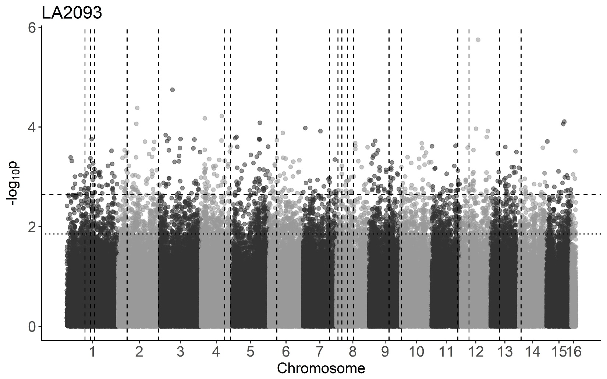
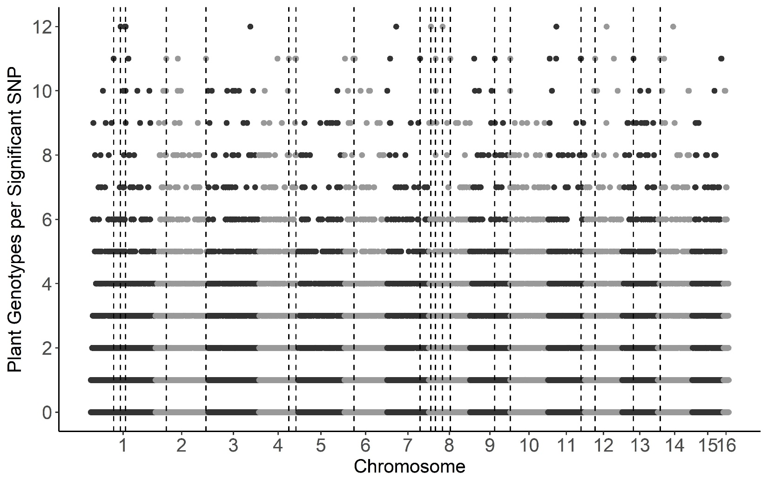

Slide 6
Figure S2. GWA by GEMMA of B. cinerea lesion size on individual tomato genotypes.
Botrytis cinerea chromosomes are differentiated by shading, alternating light and dark grey.
a) Manhattan plot of estimated SNP effect sizes for B. cinerea lesion size using a single tomato accession, LA2093. The 99% permutation threshold for SNP significance is shown with a dotted line, the 99.9% threshold is a dashed line.
b) The number of tomato accessions for which a B. cinerea SNP was significantly linked to lesion development using the 99.9% permutation threshold. Frequency is number of phenotypes in which the SNP is significant. Vertical dotted lines identify regions with overlap between the significant SNPs for LA2093 and significance across most (≥10) of tomato genotypes tested.

Slide 7
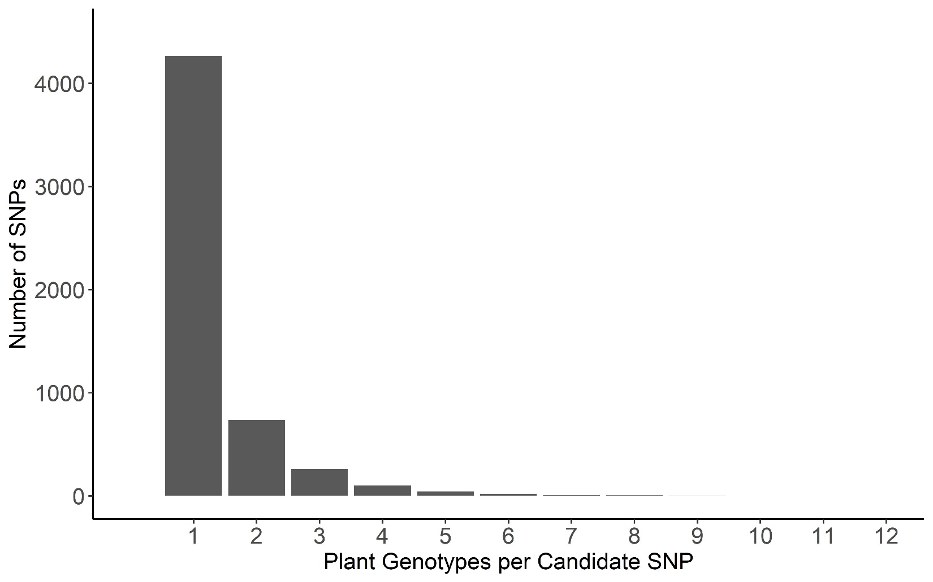
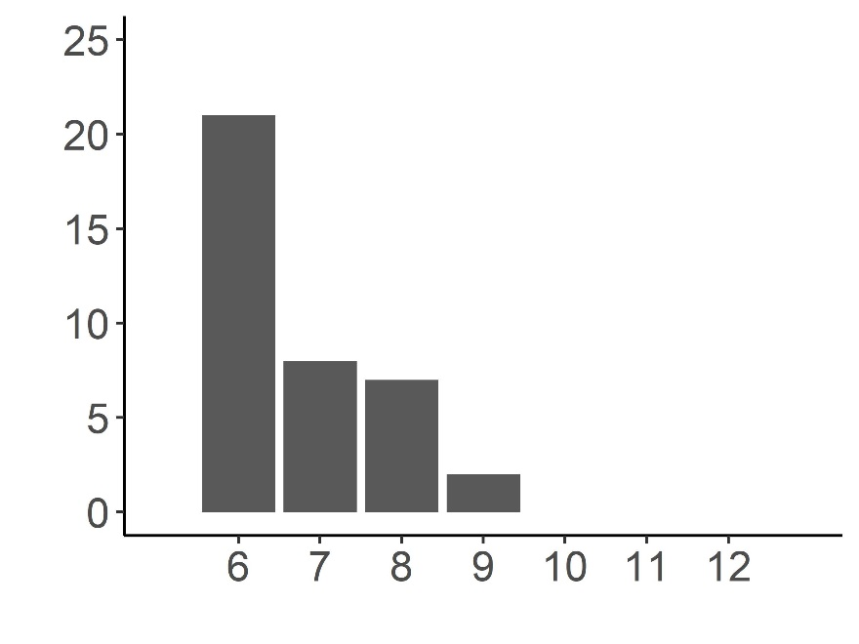
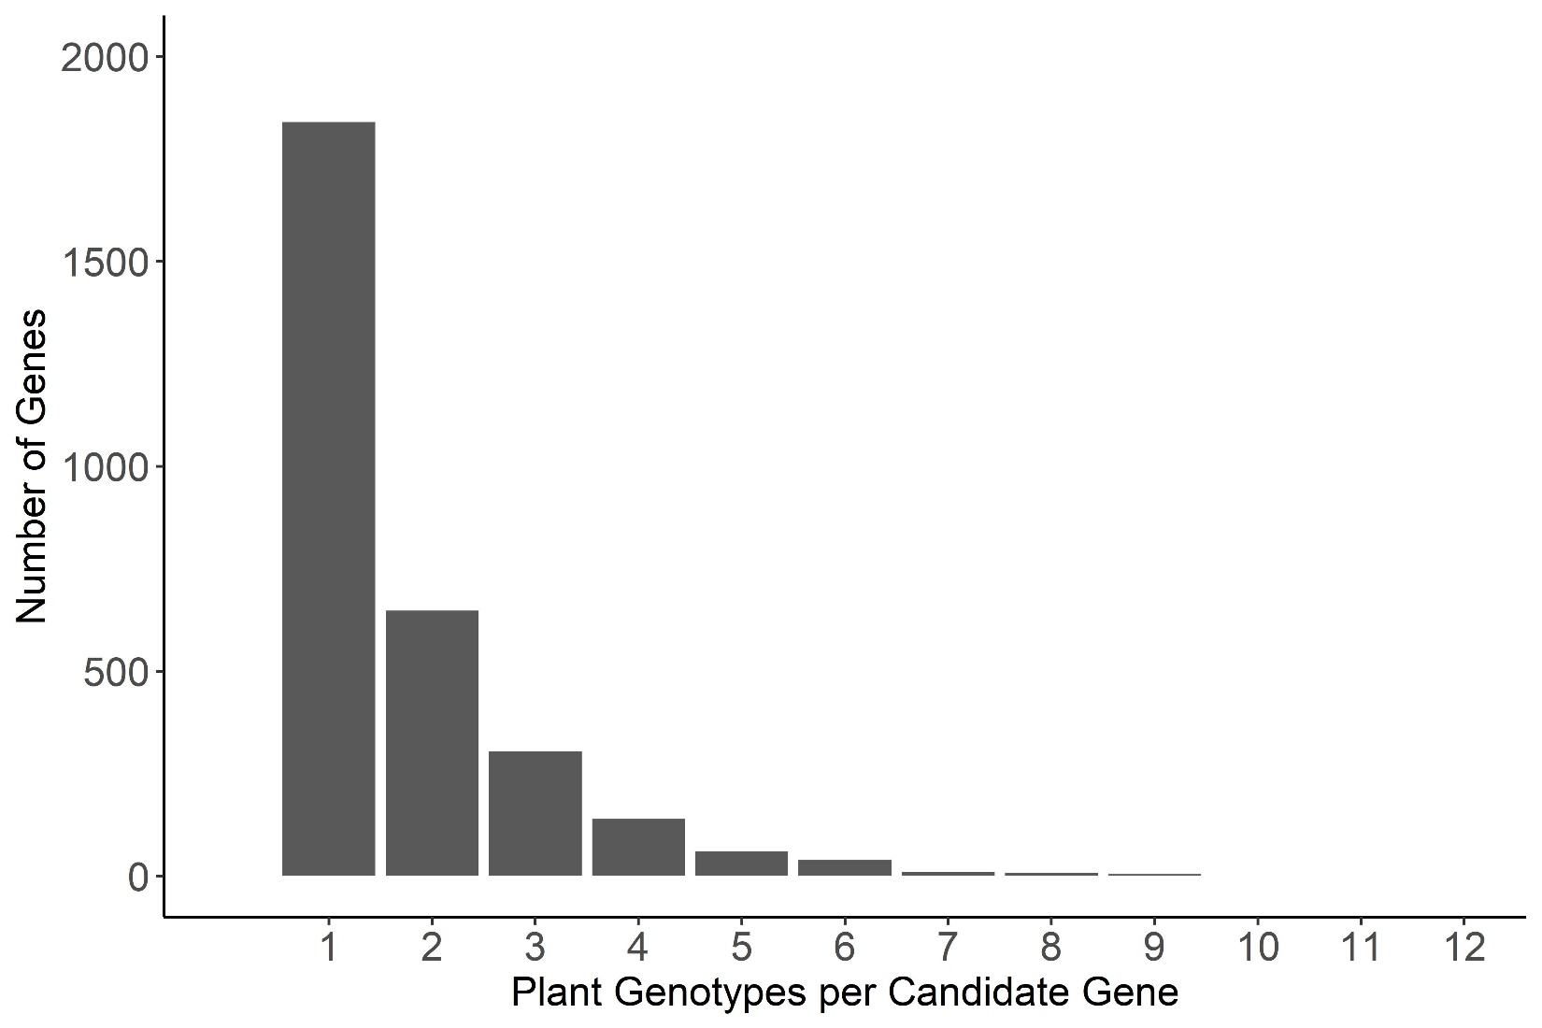
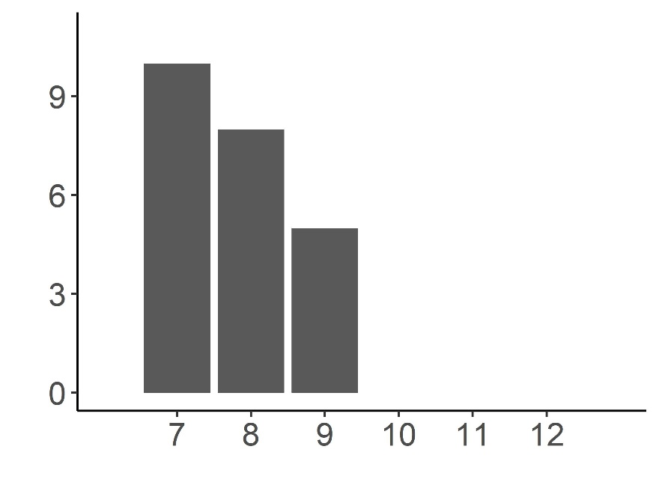

Slide 8
Figure S3. Frequency of overlap in B. cinerea GEMMA GWA significance across tomato accessions.
Frequency with which the top 1000 B. cinerea SNPs per phenotype significantly associated with lesion size on the 12 tomato accessions using the 99.9% permutation threshold.
Frequency with which a B. cinerea gene significantly associated with lesion size on the 12 tomato accessions. Genes were called as significant if there was one of the top 1000 significant SNPs per phenotype at the 99.9% permutation threshold within the gene body, or within 2kb of the gene body.

Slide 9
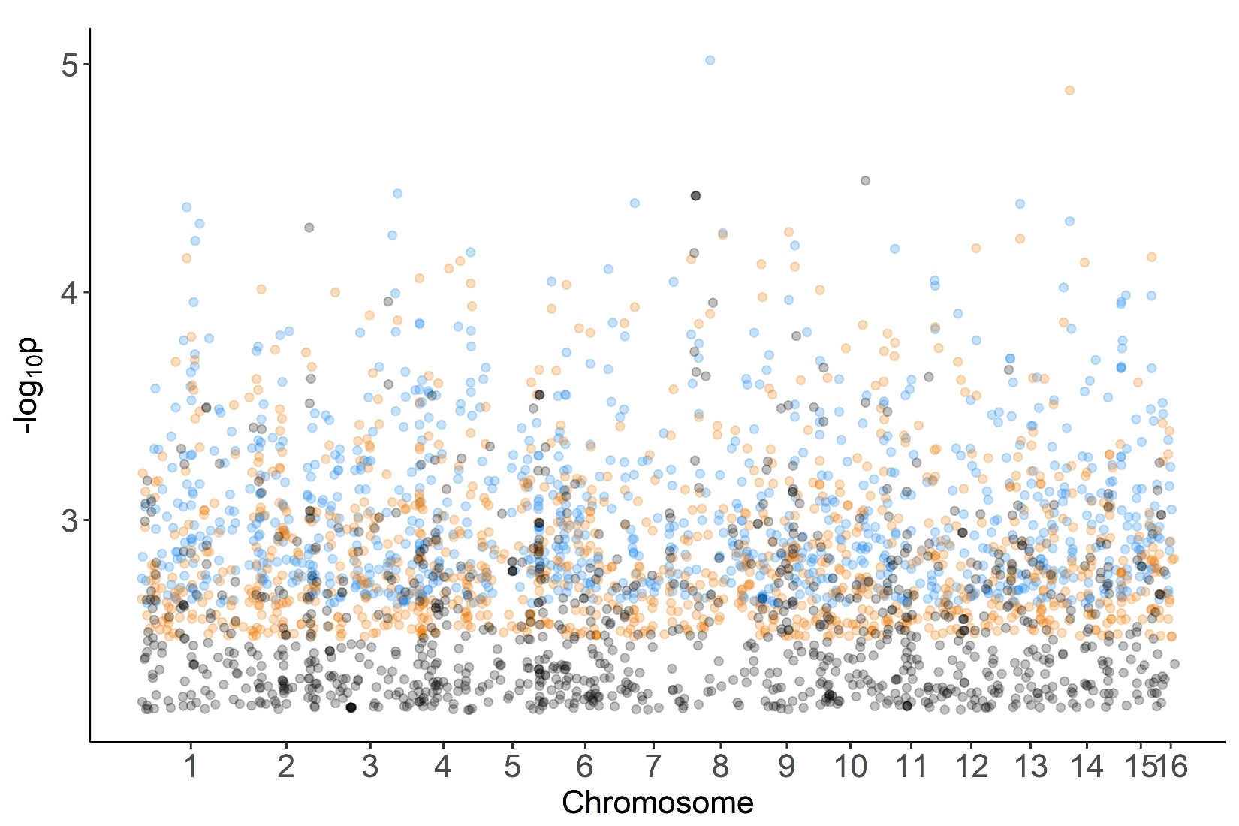
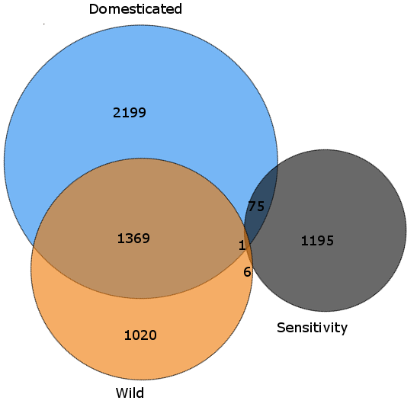
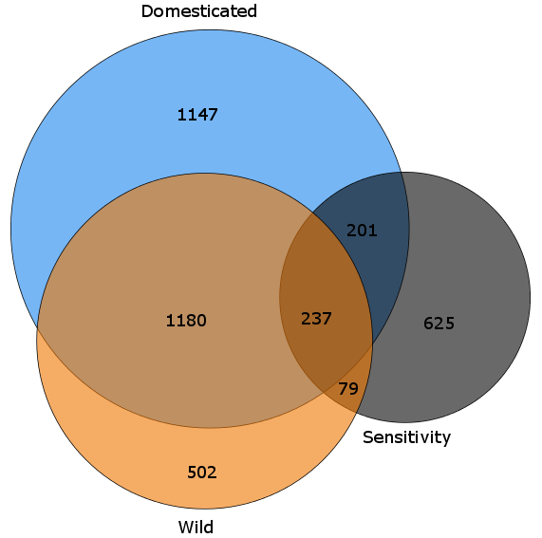

Slide 10
Figure S4. GEMMA GWA analysis of domestication sensitivity in B. cinerea.
Domestication sensitivity of each isolate was estimated using the average virulence on the wild and domesticated tomato germplasm and using calculated Sensitivity. This was then utilized for GWA mapping by GEMMA.
a) The top 1000 SNPs that significantly affect lesion size across domesticated tomato, wild tomato or domestication sensitivity are shown. Significance is called at p < 0.01 threshold.
b) Venn diagram of overlapping SNPs identified as crossing the p < 0.01 threshold for each trait.
c) Venn diagram of overlapping genes identified as crossing the p < 0.01 threshold for each trait. Genes were called as significant if there was one significant SNP within the gene body or within 2kb of the gene body.

