Slide 1
See separate .xls file
Supplemental Data Set 2. Gene and Function Annotation from B05.10 and T4 GWA Results
a) Genes with significant SNPs on at least two tomato accessions by both bigRR on T4 and GEMMA on B05.10.
b) Genes with significant SNPs linked to Botrytis virulence response to tomato domestication by both bigRR on T4 and GEMMA on B05.10.
c) Functional categories significantly overrepresented in genes linked to Botrytis virulence response to tomato by both bigRR on T4 and GEMMA on B05.10.
d) Functional categories significantly overrepresented in genes linked to Botrytis virulence response to tomato domestication by both bigRR on T4 and GEMMA on B05.10.
e) Genes with significant SNPs from bigRR on T4 for Botrytis virulence in 11 or 12 of the tomato accessions.
f) Functional categories significantly overrepresented in genes linked to Botrytis virulence response to tomato domestication by bigRR on T4 alone.

Slide 2
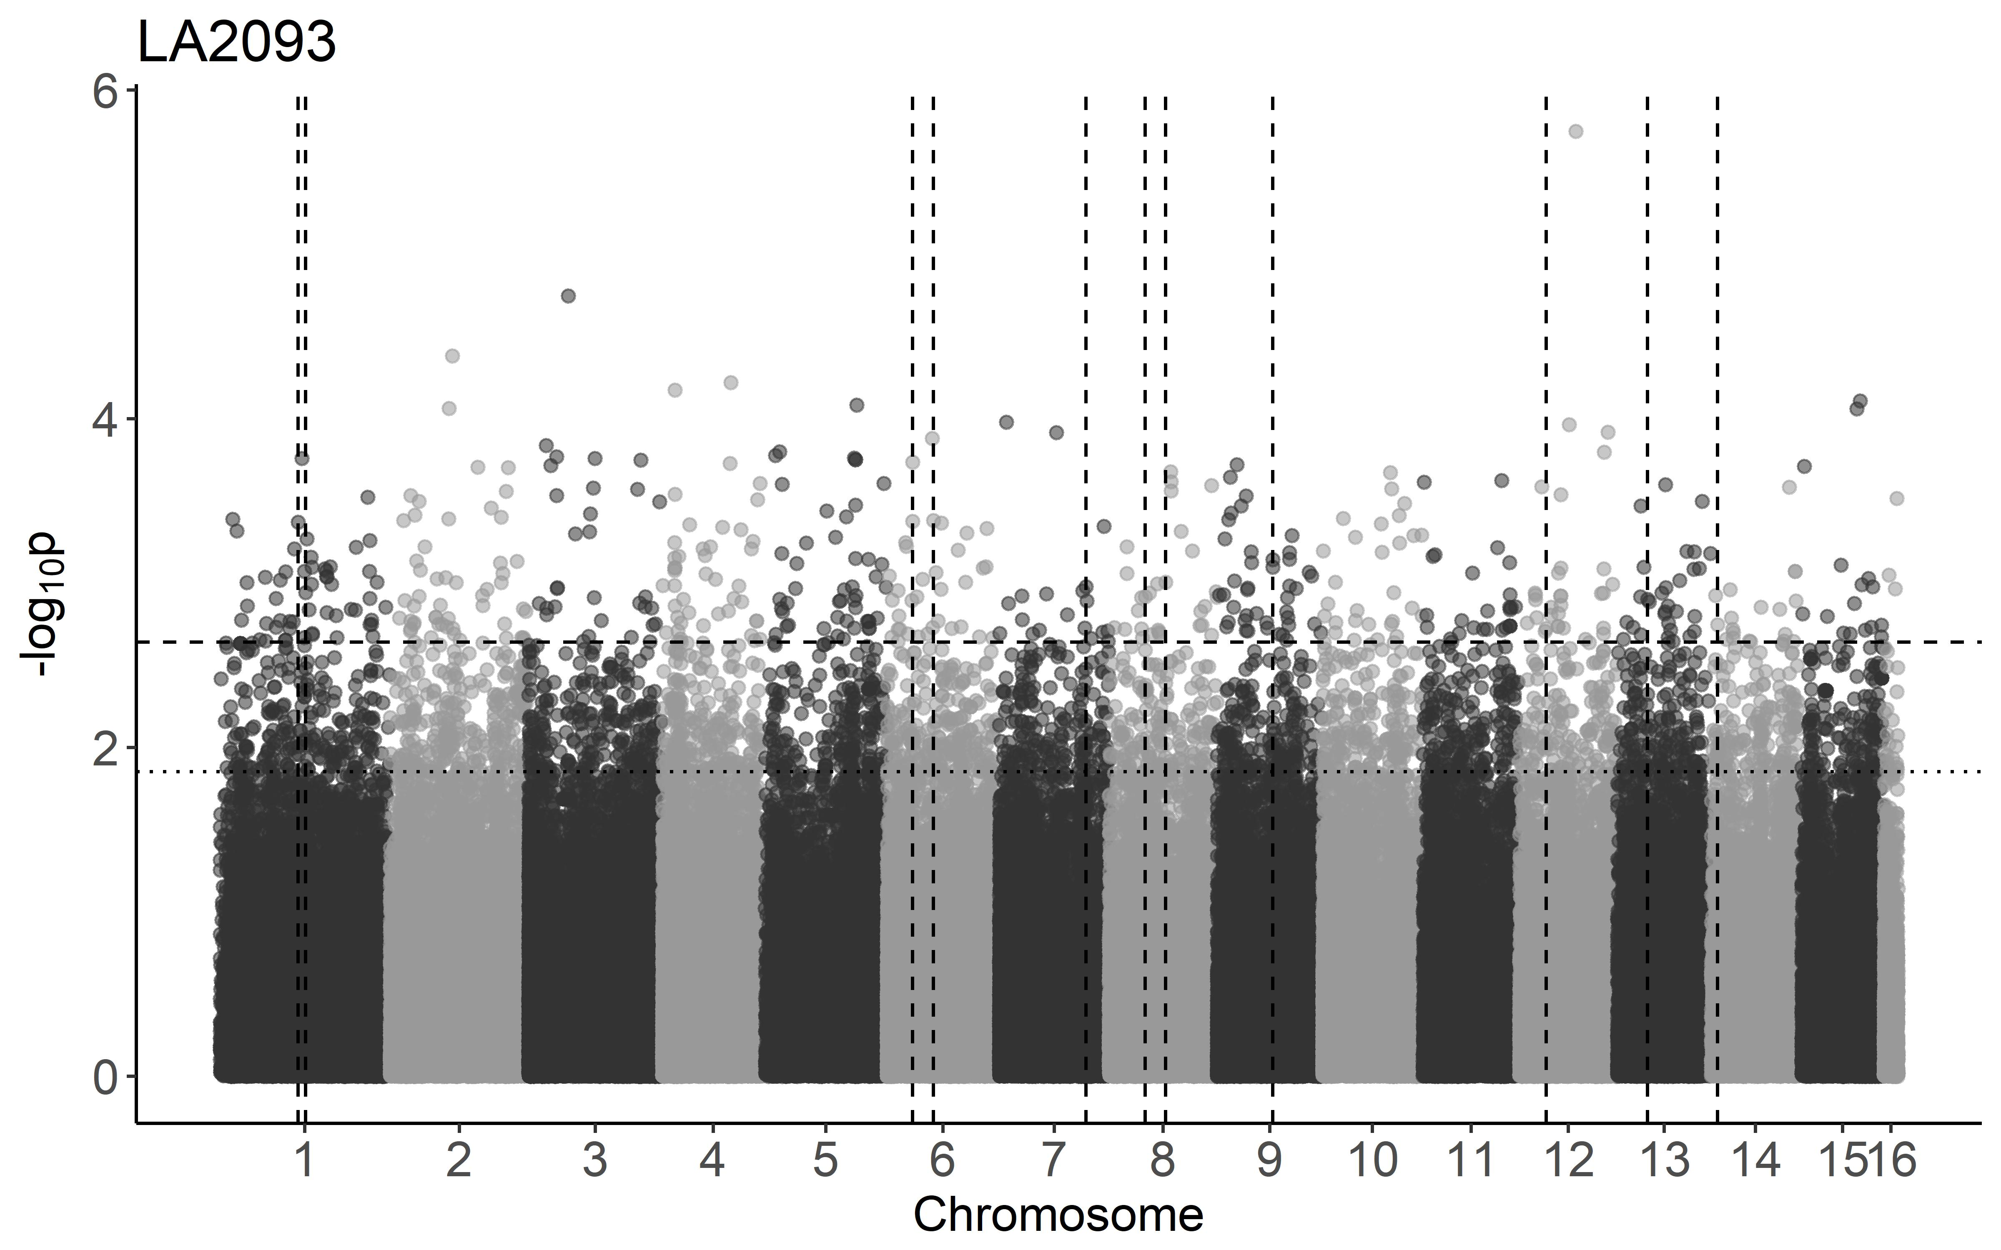
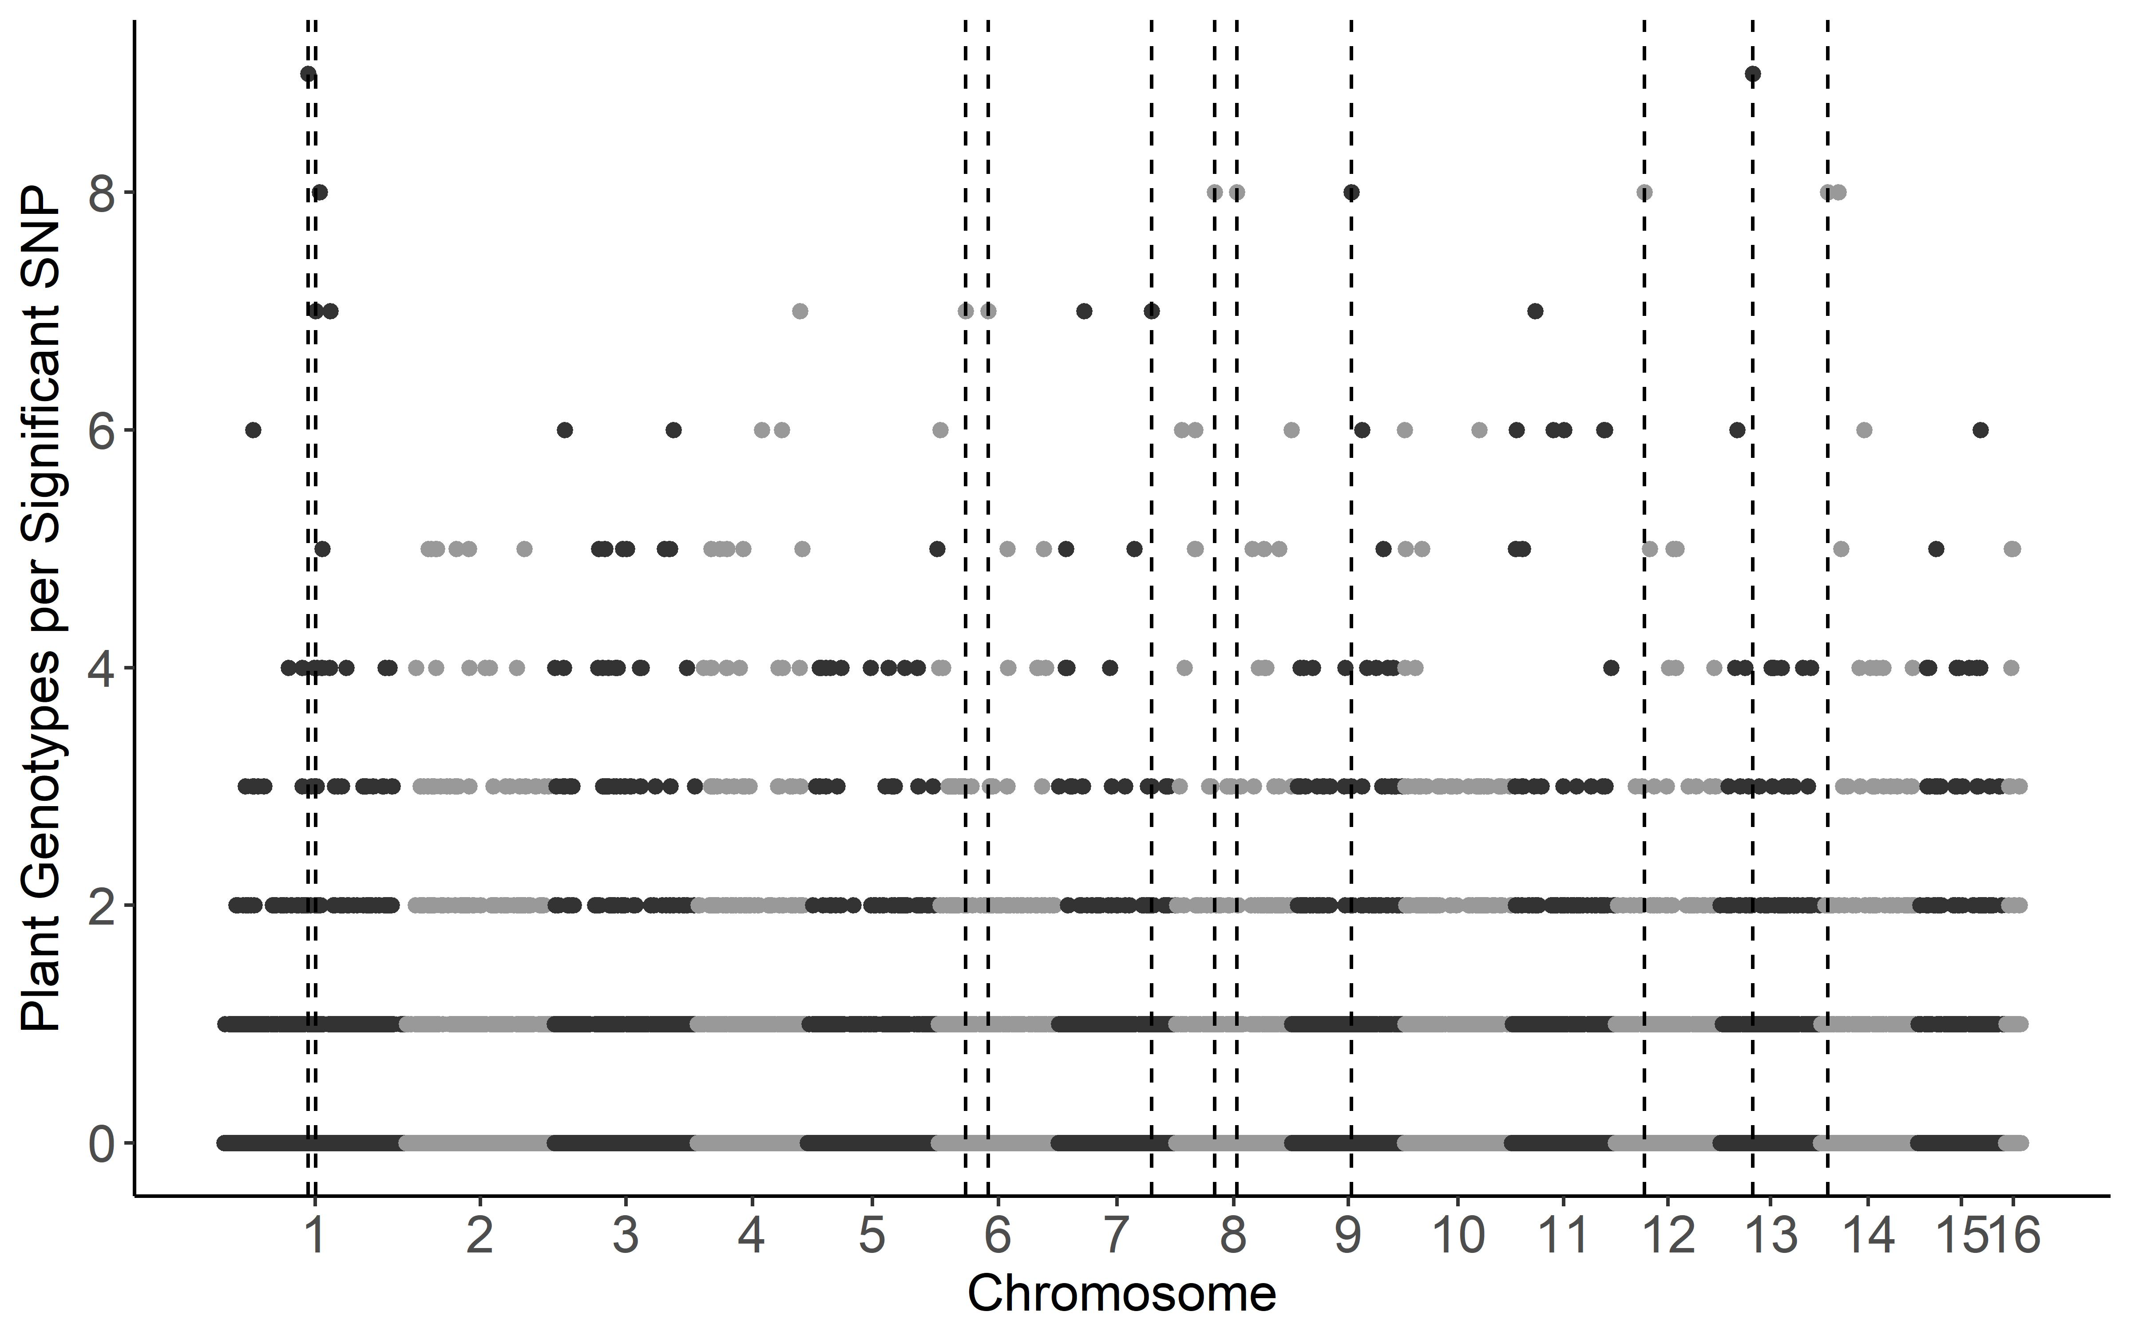
a)
b)

Slide 3
Supplemental Figure 3. GWA by GEMMA of B. cinerea lesion size on individual tomato genotypes.
Botrytis cinerea chromosomes are differentiated by shading, alternating light and dark grey.
a) Manhattan plot of estimated SNP effect sizes for B. cinerea lesion size using a single tomato accession, LA2093. The 99% permutation threshold for SNP significance is shown with a dotted line, the 99.9% threshold is a dashed line.
b) The number of tomato accessions for which a B. cinerea SNP was significantly linked to lesion development using the 99.9% permutation threshold. Frequency is number of phenotypes in which the SNP is significant. Vertical dotted lines identify regions with overlap between the significant SNPs for LA2093 and significance across most (≥10) of tomato genotypes tested.

Slide 4
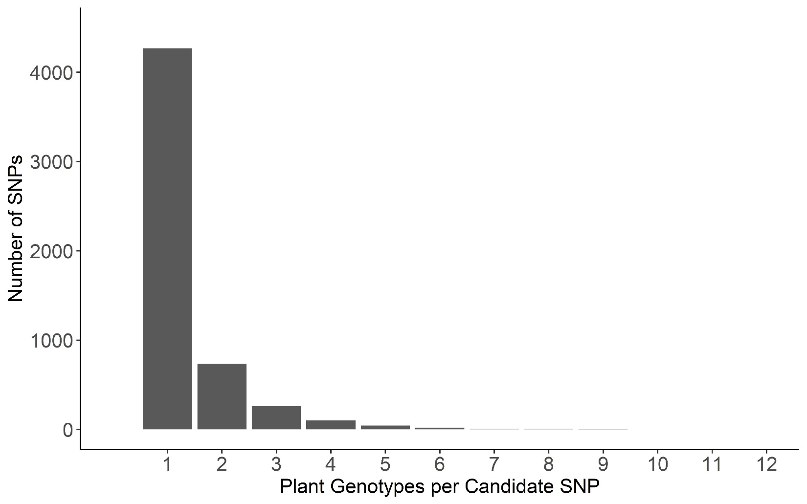
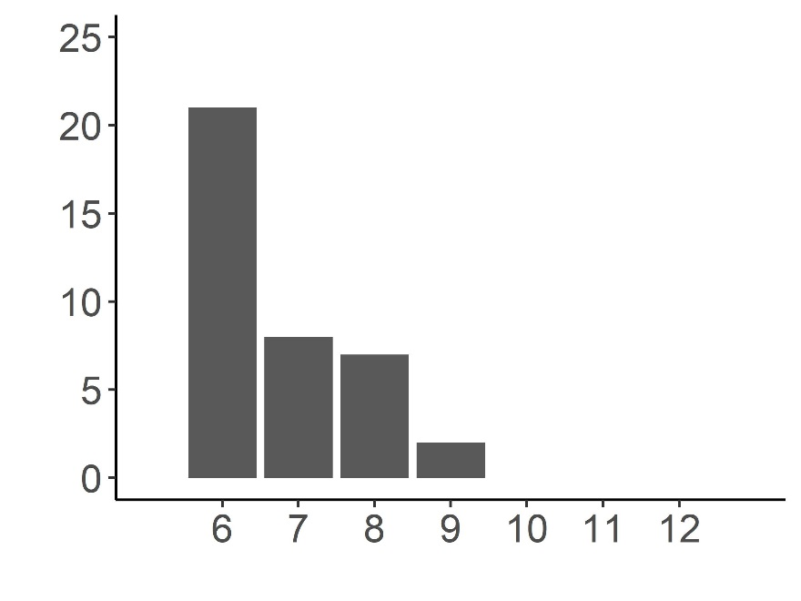
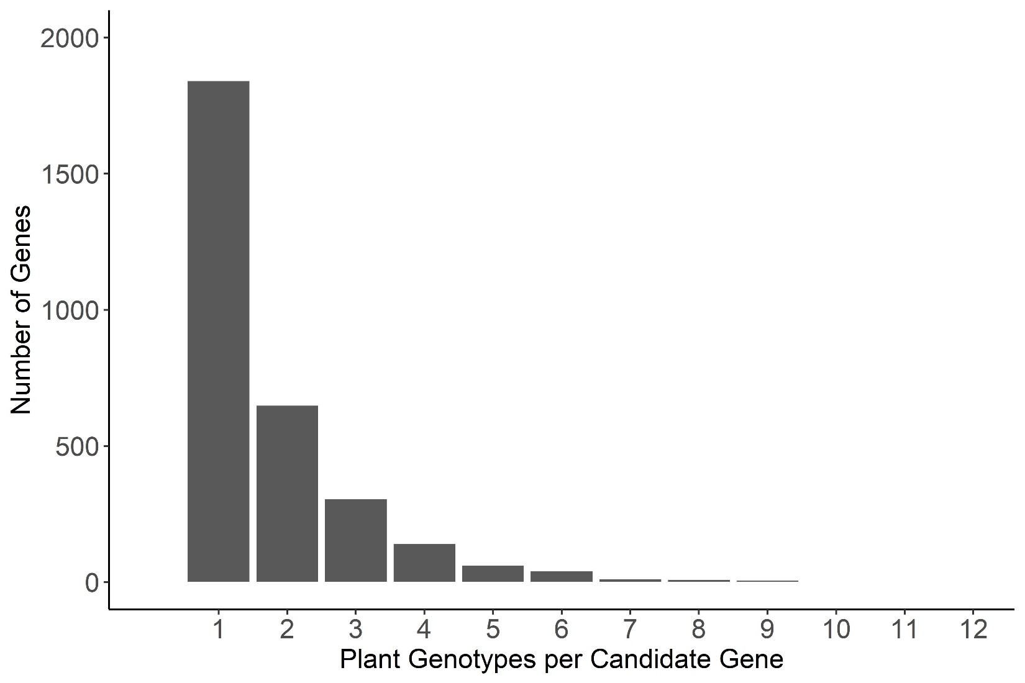
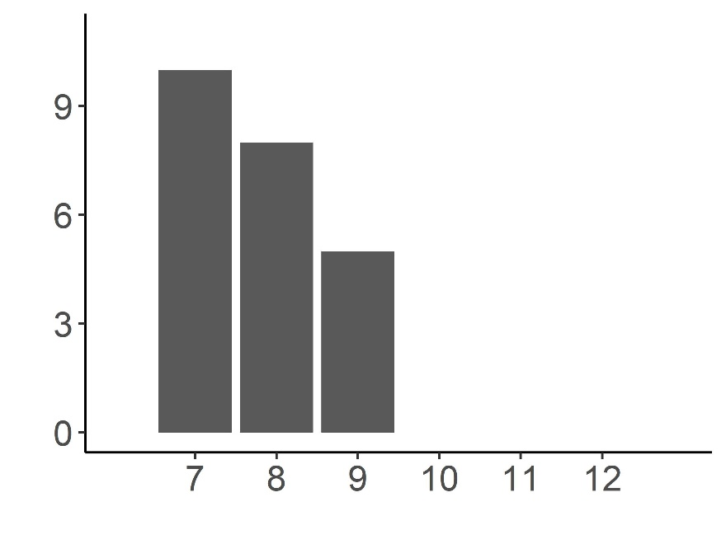
a)
b)

Slide 5
Supplemental Figure 4. Frequency of overlap in B. cinerea GEMMA GWA significance across tomato accessions.
Frequency with which the top 1000 B. cinerea SNPs per phenotype significantly associated with lesion size on the 12 tomato accessions using the 99.9% permutation threshold.
Frequency with which a B. cinerea gene significantly associated with lesion size on the 12 tomato accessions. Genes were called as significant if there was one of the top 1000 significant SNPs per phenotype at the 99.9% permutation threshold within the gene body, or within 2kb of the gene body.

Slide 6
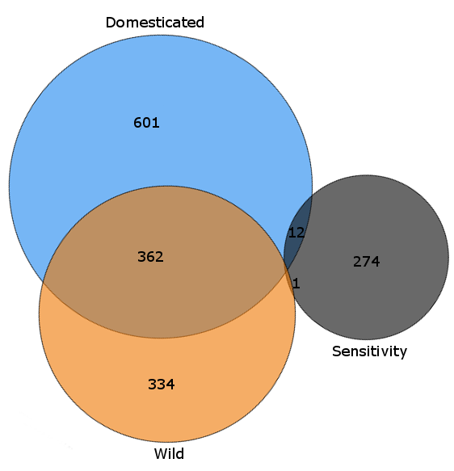
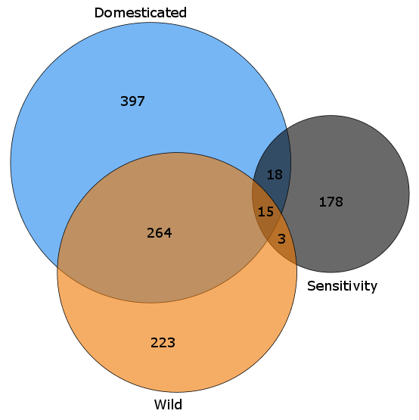
a)
b)

Slide 7
Supplemental Figure 5. GEMMA GWA analysis of domestication sensitivity in B. cinerea.
Domestication sensitivity of each isolate was estimated using the average virulence on the wild and domesticated tomato germplasm and using calculated Sensitivity. This was then utilized for GWA mapping by GEMMA.
a) Venn diagram of overlapping SNPs identified as crossing the 99.9% permutation threshold for each trait.
b) Venn diagram of overlapping genes identified as crossing the 99.9% permutation threshold for each trait. Genes were called as significant if there was one significant SNP within the gene body or within 2kb of the gene body.

