Slide 1
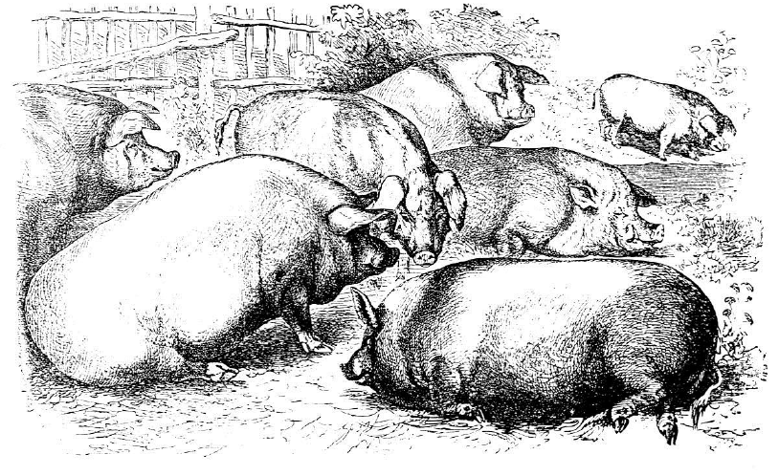
1.2 Inheritance of a Single Trait & Response to Selection
Stevan J. Arnold
Department of Integrative Biology
Oregon State University

Slide 2
Thesis
Most traits are affected by many genes
We can model the inheritance of such traits with a statistical approach
Additive genetic variance is the statistical concept that enables us to model both inheritance and response to selection

Slide 3
Outline
Phenotypic resemblance between parents and offspring reveals heritable variation.
To understand resemblance we need a model.
Some examples.
Why don’t we run out of additive genetic variance?
Changing the trait mean with selection.

Slide 4
1. Phenotypic resemblance: Galton’s plot
Notes:
Francis Galton (1889) quantified inheritance with parent-offspring plots.
Dotted line = perfect inheritance
Black line = regression line in reality. Thus “regression to the mean”

Slide 5


2. A Model of Phenotypic Resemblance
A model for phenotypic value (from Joe’s lecture
this morning)
b. An equivalent model, without the locus-by-locus details, for
phenotypic value
phenotypic mean
phenotypic variance
Notes:
Lande (1979) building on models developed by Weinberg (1908), Fisher (1918), Wright (1921) and others (see references in Joe’s lecture 1.1).

Slide 6
2. A Model of Phenotypic Resemblance
c. A new perspective on Galton’s regression
Our model identifies additive genetic variance, G,
as the key statistical property
responsible for Galton’s regression
Notes:
Using Landes (1979) notation.

Slide 7
2. A Model of Phenotypic Resemblance
d. What about resemblance between other kinds of relatives?
We need to include domiance, d, and epistasis, i, as well as additive effects, x
to obtain a general expression for resemblance between relatives X and Y
Notes:
Cockerham (1954)
For parents and offspring: r = ½
r ^ 2 = ¼
r ^ 3 = 1/8
---- Diminishing series of contributions

Slide 8
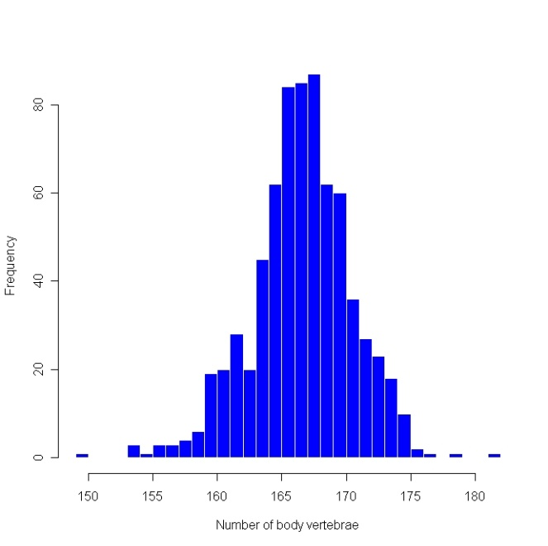
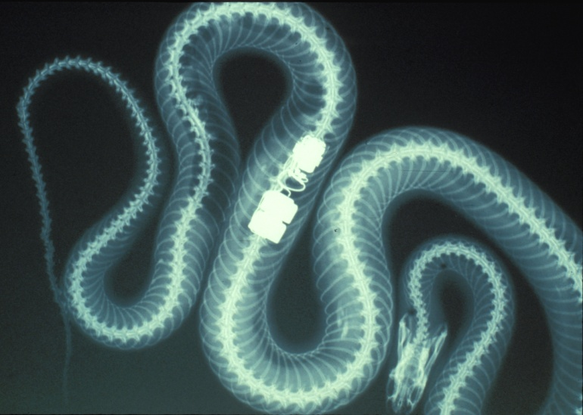
3. Some examples
Mother-daughter resemblance in vertebral counts
in garter snakes
Frequency
Body vertebral count
Notes:
Radiograph of a natricine snake showing vertebrae in the body and tail. These two vertebral numbers can be assessed, without recourse to radiography, by counting ventral and subcaudal scales. The electronic object is a radiotransmitter used to study thermoregulation in free-ranging females during pregnancy. The histogram shows variation in body vertebral counts in a single population of garter snakes (n=746).

Slide 9
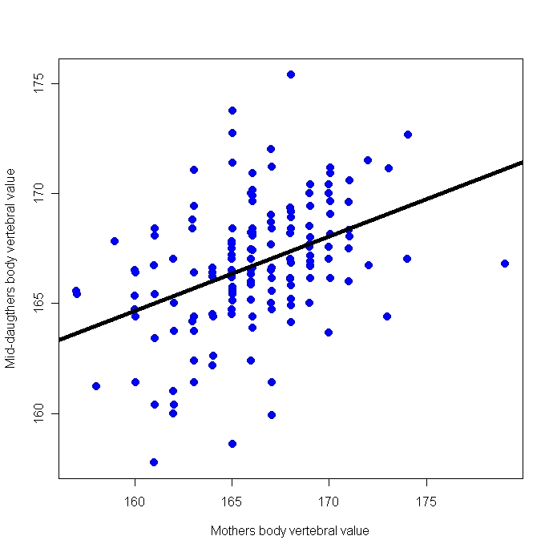
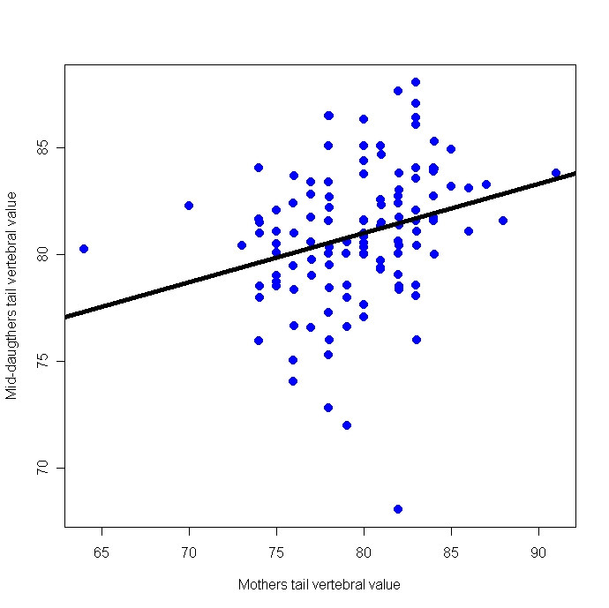
3. Some examples
Mother-daughter resemblance in vertebral counts
in garter snakes
Daughters’ body count
Daughters’ tail count
h² = 0.54
h² = 0.48
Mom’s body count
Mom’s tail count
Notes:
Offspring vs. parent heritability plots in the garter snake Thamnophis elegans (inland population). (a) The average body vertebral count of daughters is plotted against the mother’s count: n = 151, corresponding to a estimated genetic variance of 8.17 ± 1.70 s.e., h² = 0.54 ±0.10 s.e. (b) The average tail vertebral count of daughters is plotted against the mother’s count: n = 120, corresponding to an estimated genetic variance of 8.16 ± 1.73, h² = 0.48 ± 0.10 (Arnold & Phillips 1999).

Slide 10
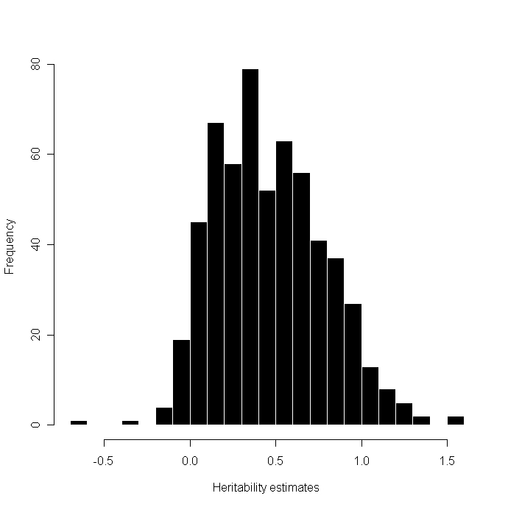
3. Some examples
b. A survey of heritability estimates
n = 580
Frequency
Heritability estimate
Notes:
Histogram of a large sample (n=580) of heritability estimates for morphological characters in vertebrate and invertebrate animals. Based on data in Mousseau & Roff (1987), courtesy of D. Roff. Note that estimates outside the parameter range (0-1.0) are possible with some estimation procedures. Mean = 0.47, median = 0.44, variance = 0.10.

Slide 11
4. Why don’t we run out of additive genetic variance?
Mutation-Selection Balance
Mutation
Recombination
Linkage disequilibrium
Expressed variation
Hidden variation stored in negatively linked combinations of alleles
Stabilizing selection
Stabilizing selection
Notes:
A flowchart illustrating Lande’s (1976) model for mutation-selection balance.

Slide 12
4. Why don’t we run out of additive genetic variance?
Mutation-Migration-Selection-Drift Balance
Mutation
Migration
Recombination
Linkage disequilibrium
Expressed variation
Hidden variation stored in negatively linked combinations of alleles
Stabilizing selection
Drift
Stabilizing selection
Notes:
A flowchart illustrating an expanded version of Lande’s (1976) model for mutation-selection balance by including migration and drift. Mutation and stabilizing selection alone fall a little short of accounting for the levels of additive genetic variance that are maintained in natural populations. A model that includes input from migration can account for observed levels.

Slide 13
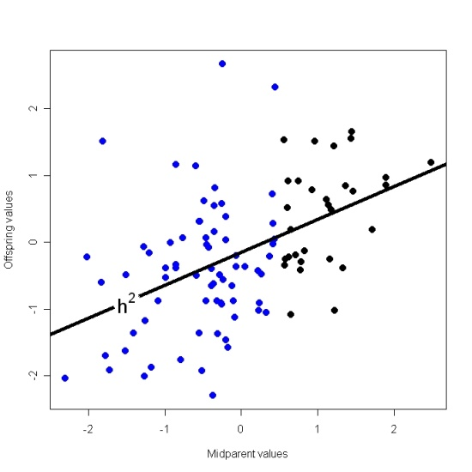

5. Changing the trait mean with selection
a. Response to selection as a regression problem
Offspring values
Heritability = $h^{2}$
Midparent values
Notes:
Response to selection as a regression problem. (a) A plot of hypothetical mid-offspring values and a function of hypothetical mid-parental values, showing, the slope of the regression line (heavy line).

Slide 14
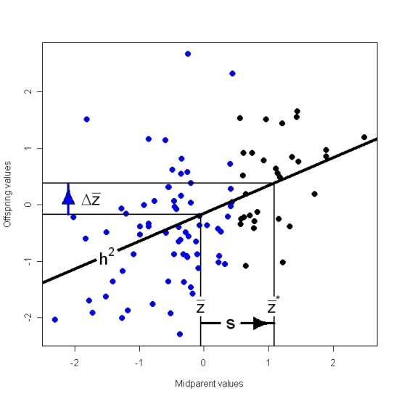

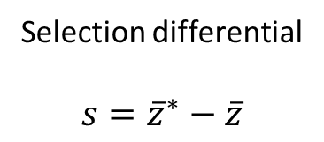
5. Changing the trait mean with selection
a. Response to selection as a regression problem
Offspring values
Selection differential
$$s={\overline{z}}^{∗}−\overline{z}$$
Midparent values
Notes:
Response to selection as a regression problem. (b) Truncation selection acts so that one set of parents (points shown in black) becomes the actual parents of the next generation. Their trait mean is z bar * , whereas the mean of all potential parents (blue and black points) is z bar. The vertical lines project those means up to the regression, which yields the two expected offspring means (horizontal lines), and hence the expected response to selection, delta z bar.

Slide 15
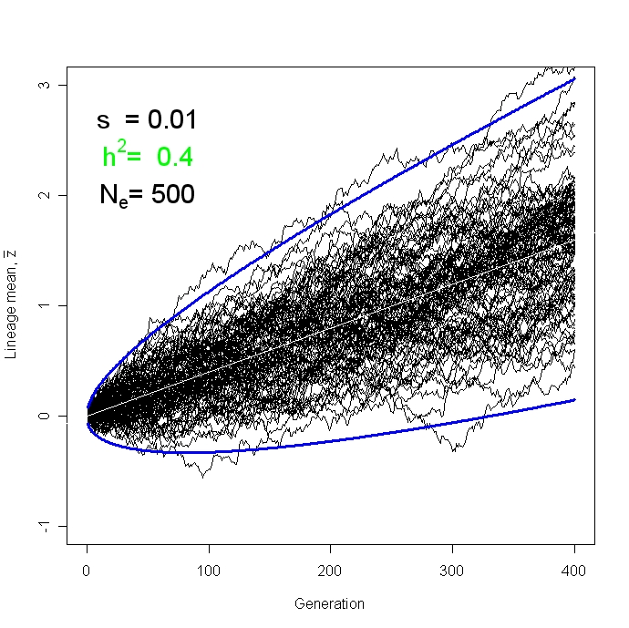
5. Changing the trait mean with selection
b. Response to selection in a finite population
Lineage mean
Animation
Generation
Notes:
Response to selection in a set of replicate populations of finite size. In the simulations depicted here, 100 lineages of moderate size ( respond to a very slight directional selection (s=0.01) for 400 generations. The trajectories of the lineage means (shown in black) reflect both response to selection and drift. The deterministic response to selection is shown as a white line. The 99% confidence limits for the overall lineage mean are shown with blue lines.

Slide 16
5. Changing the trait mean with selection
c. Response to long term selection for bristle numbers in Drosophila
Notes:
Responses to deliberate selection for increased and decreased bristle counts in Drosophila melanogater. Replicate lines were established from an inbred base population so that any responses to selection would be based on mutational input. (a) Upper panel, responses to selection on abdominal bristle counts. (truncational selection. And asymptote is nonzero. Some other selective pressure is likely opposing the experimental selection) (b) Lower panel, responses to selection on sternopleural bristle count. From Mackay et al (2005).

Slide 17
What have we learned?
Additive genetic variance, G, is the key to understanding resemblance between parents and offspring.
Consequently, G is also the key to modeling response to selection.
G is nibbled away by selection but restored by mutation (and migration).

Slide 18
References
Galton, F. 1889. Natural Inheritance. MacMillan, New York.
Lande, R. 1979. Quantitative genetic analysis of multivariate evolution, applied to brain: body size allometry. Evolution 33: 402-416.
Cockerham, C. 1954. An extension of the concept of partitioning hereditary variance for analysis of covariances among relatives when epistasis is present. Genetics 39: 859-882.
Arnold, S. J. and P. C. Phillips. 1999. Hierarchial comparison of genetic variance-covariance matrices.II. Coastal-inland divergence in the garter snake, Thamnophis elegans. Evolution 53:1516-1527.
Mousseau, T. A. & D. A. Roff. 1987. Natural selection and the heritability of fitness components. Heredity 59: 181-197.
Lande, R. 1976. The maintenance of genetic variation by mutation in a polygenic character with linked loci. Genetical Research Cambridge 26: 221-234.
Mackay, T. F. C., R. F. Lyman & F. Lawrence. 2005. Polygenic mutation in Drosophila melanogaster: mapping spontaneous mutations affecting sensory bristle number. Genetics 170: 1723-1735

