Slide 1
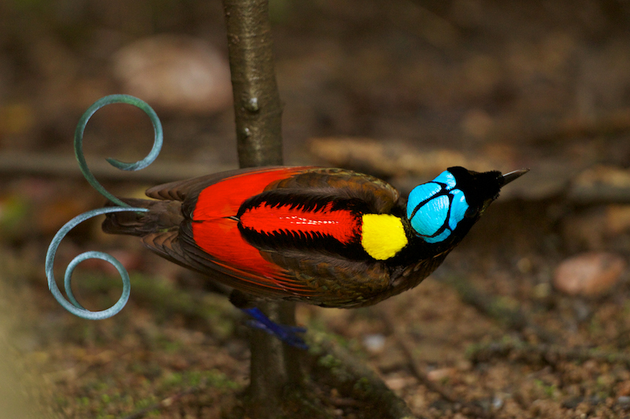
2.1 Multivariate Inheritance & Response to Selection
Stevan J. Arnold
Department of Integrative Biology
Oregon State University
Notes:
Wilson’s Bird of Paradise reminds us that organisms are composed of many traits. To account for the multivariate evolution of organisms, we need a model of multivariate inheritance and multivariate response to selection.

Slide 2
Thesis
The statistical approach that we used for a single trait can be extended to multiple traits.
The key statistical parameter that emerges is the G-matrix.
The G-matrix affects the response of the multivariate mean to selection and drift.

Slide 3
Outline
Multivariate resemblance between parents and offspring is captured by the G-matrix.
Our model of inheritance is multivariate.
Some examples.
The G-matrix is affected by opposing forces.
The G-matrix affects the evolution of the multivariate mean.

Slide 4
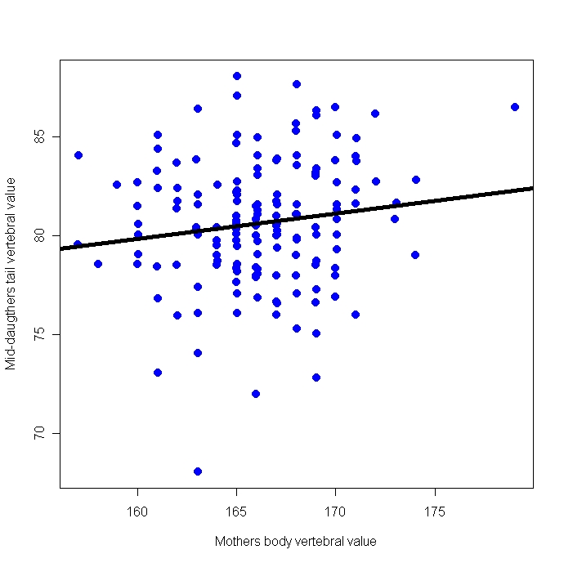
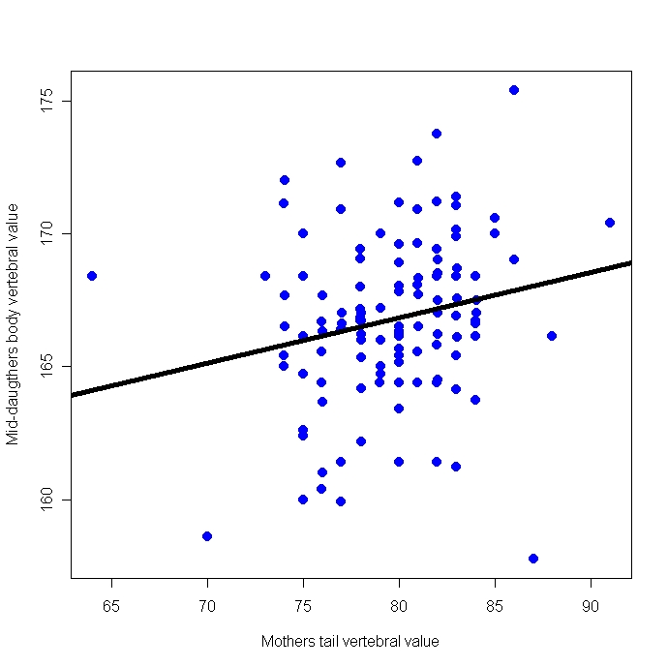
1. Multivariate resemblance
Traits can run together in families
Animation 1
Daughters’ tail count
Daughters’ body count
Mom’s body count
Mom’s tail count
Notes:
The need for a multivariate model of inheritance is underscored by the empirical fact what traits run together in families, suggesting co-inheritance (Arnold & Phillips 1999).

Slide 5
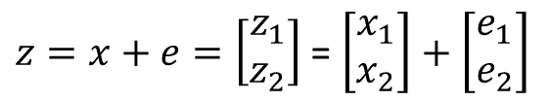
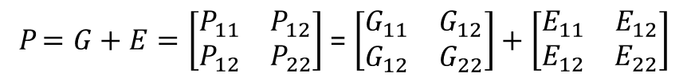
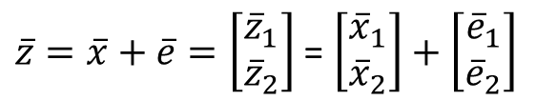
2. A Model for Multivariate Resemblance
A model for phenotypic value
phenotypic value
$z=x+e=\left[\begin{matrix}z_{1} \\ z_{2}\end{matrix}\right]$ = $\left[\begin{matrix}x_{1} \\ x_{2}\end{matrix}\right]+\left[\begin{matrix}e_{1} \\ e_{2}\end{matrix}\right]$
phenotypic mean
$\overline{z}=\overline{x}+\overline{e}=\left[\begin{matrix}{\overline{z}}_{1} \\ {\overline{z}}_{2}\end{matrix}\right]$ = $\left[\begin{matrix}{\overline{x}}_{1} \\ {\overline{x}}_{2}\end{matrix}\right]+\left[\begin{matrix}{\overline{e}}_{1} \\ {\overline{e}}_{2}\end{matrix}\right]$
phenotypic var/covar
P $=G+E=\left[\begin{matrix}P_{11} & P_{12} \\ P_{12} & P_{22}\end{matrix}\right]$ = $\left[\begin{matrix}G_{11} & G_{12} \\ G_{12} & G_{22}\end{matrix}\right]+\left[\begin{matrix}E_{11} & E_{12} \\ E_{12} & E_{22}\end{matrix}\right]$
Notes:
The multivariate model that we will use is a straight-forward extension of the univariate model we introduced in Lecture 1.2. Now we need vectors to represent values and means and vectors to represent variances and covariances (Lande 1979).
Variance on the diagonals, covariance on the off-diagonals (P12 = P21)

Slide 6
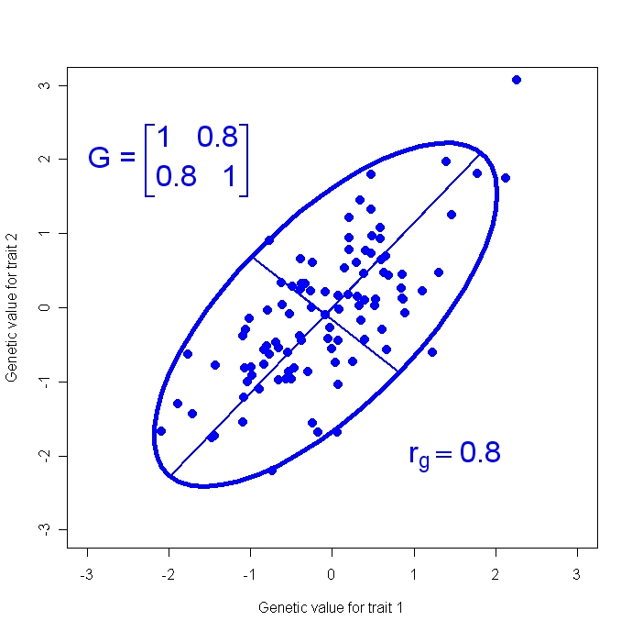
2. A Model for Multivariate Resemblance
c. The G-matrix describes a cloud of genetic values
Causes of genetic
covariance:
Pleiotropy
Linkage Disequilibrium
Genetic value for trait 2, x₂
Genetic value for trait 1, x₁
Notes:
The G-matrix, introduced in the last slide, describes a bivariate cloud of additive genetic values (sometimes known as breeding values).

Slide 7

2. A Model for Multivariate Resemblance
c. The G-matrix describes a cloud of genetic values
$$r_{g}=G_{12}/\sqrt{G_{11}}G_{22}$$
Genetic value for trait 2, x₂
Genetic value for trait 1, x₁
Notes:
The formula for genetic correlation, rg, is the standard formula for a product moment correlation that uses genetic values.

Slide 8
2. A Model for Multivariate Resemblance
c. The G-matrix describes a cloud of genetic values
95% confidence ellipse
I
First principal component
Genetic value for trait 2, x₂
II
Second principal component
Genetic value for trait 1, x₁
Notes:
Here we introduce conventions for representing the G-matrix with an ellipse. In this hypothetical example, genetic values are drawn from a bivariate normal distribution.

Slide 9
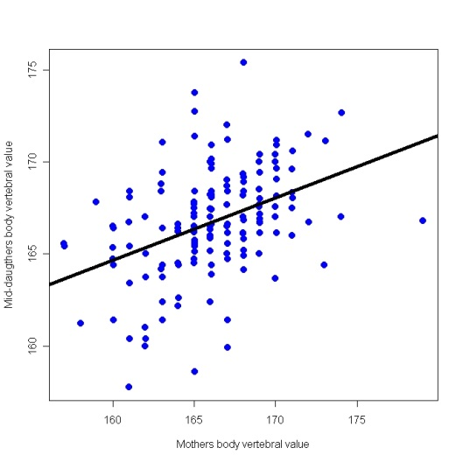



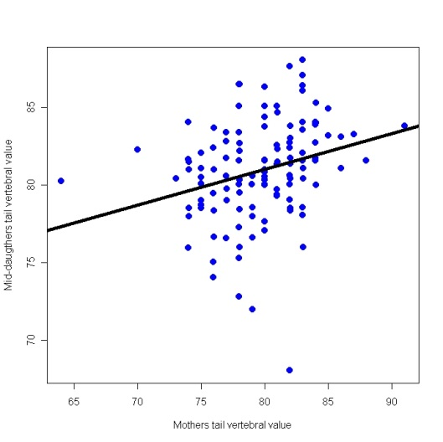
3. Some examples
Mother-daughter resemblance in vertebral counts
in garter snakes
Daughters’ body count
Daughters’ tail count
Mom’s body count
Mom’s tail count
Notes:
In this garter snake example, a 2x2 G-matrix is estimated from mother-daughter data on two traits, vertebral counts in the body and tail (Arnold & Phillips 1999). The raw data plots are shown on the left. Each point represents values for a mother and the average of her daughters.

Slide 10
3. Some examples
b. Prevalence of genetic correlation
Notes:
Histograms showing the results of a survey of genetic correlations (Roff 1997). LxL refers to correlations between life history traits; MxM refers to correlations between morphological traits.

Slide 11
4. Why don’t we run out of additive genetic variance and covariance?
a. Mutation-Selection Balance
Mutation
Recombination
Linkage disequilibrium
Expressed variation
Hidden variation stored in negatively linked combinations of alleles
Stabilizing selection
Stabilizing selection
Notes:
Lande’s (1975) model for mutation-selection balance can be extended to account for multiple traits (Lande 1980), but now mutation, genetic variation (G), and stabilizing selection are each described with matrices.

Slide 12
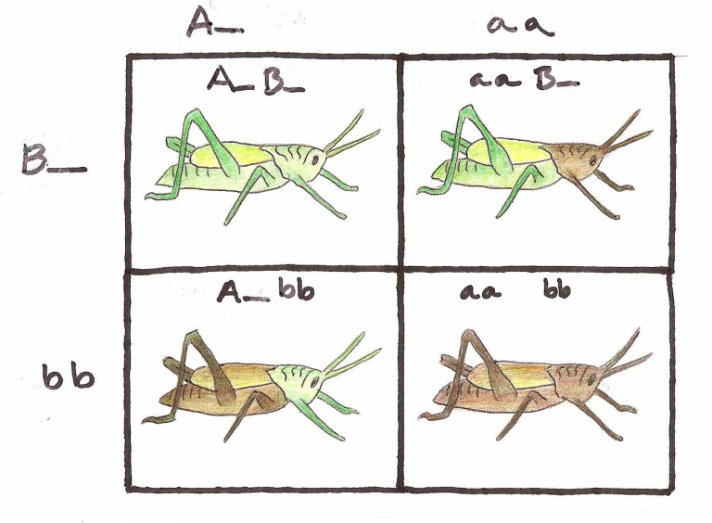
4. Why don’t we run out of additive genetic covariance?
b. Correlational selection
– one kind of multivariate stabilizing selection –
can produce linkage disequilibrium
Notes:
In this hypothetical example, two loci affect the color of the head and body in a grasshopper. If selection favors color coordination between the head and body (i.e., selection favors green and brown grasshoppers, but acts against green+brown grasshoppers), it will promote linkage disequilibrium between the two loci, resulting in a genetic correlation between coloration on the head and body. In general, correlational selection promotes integration of traits but close linkage is required to produce strong genetic correlation via linkage disequilibrium (Lande 1984).

Slide 13
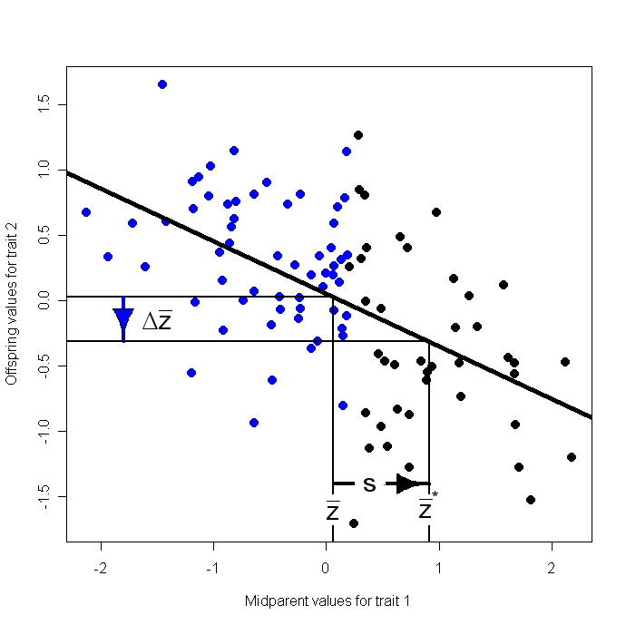
5. Changing the multivariate mean with selection
a. Genetic covariance causes selection on one trait to affect a correlated trait
Offspring value for trait 2
Midparent value for trait 1
Notes:
Genetic covariance causes selection on one trait to reverberate on correlated traits. In this example, selection for higher values of trait 1, results in a negative response in a genetically correlated trait. The cause of this peculiar response is a negative genetic covariance.

Slide 14

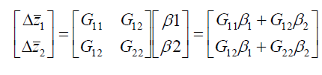
5. Changing the multivariate mean with selection
a. Direct and correlated responses to selection
Notes:
Matrix algebra helps us keep track of direct and correlated responses to selection. The upper panel shows our multivariate response to selection equation with symbols representing matrices and column vectors. The lower panel shows the composition of vectors and matrices for the two trait case. β is a measure of directional selection, the directional selection gradient, the subject of an upcoming lecture.

Slide 15
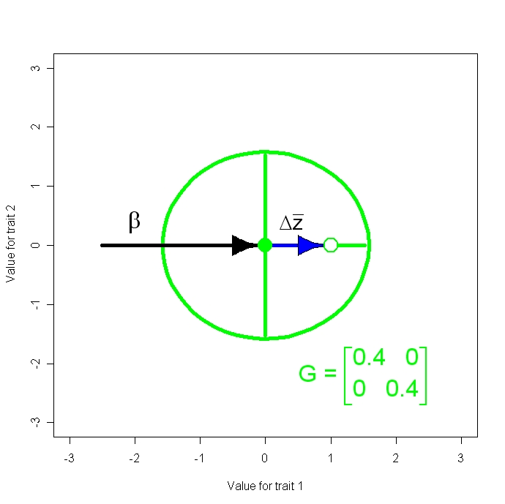
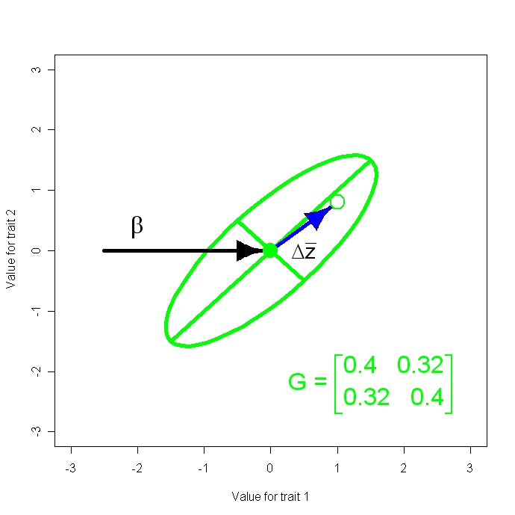
5. Changing the multivariate mean with selection
b. Response to selection as a pool shot
Phenotypic value for trait 2
Phenotypic value for trait 1
Phenotypic value for trait 1
Animation 2
Notes:
To visualize response to selection in the multivariate (i.e., bivariate) case, think of a pool shot. The pool cue is β. The path of the cue ball is the response to selection, $∆\overline{z.}$ The G-matrix, shown here as a green ellipse, affects the path of the ball in predictable ways. Try running the animation.

Slide 16
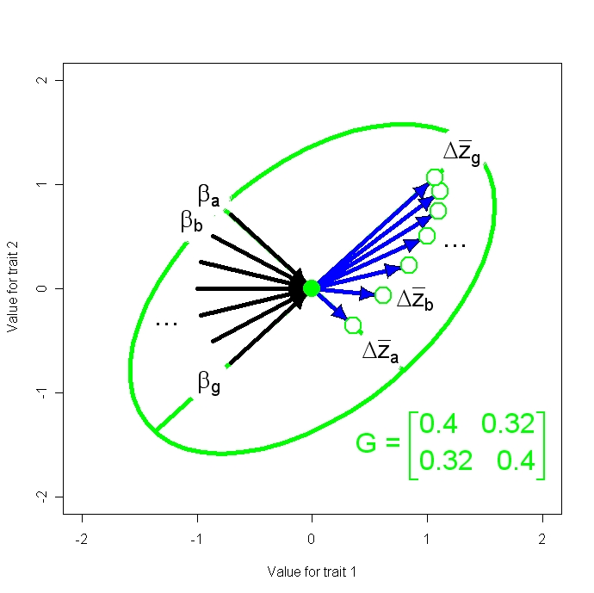
5. Changing the multivariate mean with selection
b. Response to selection as a pool shot, continued
Phenotypic value for trait 2
Animation 3
Phenotypic value for trait 1
Notes:
Try describing the effect of the G-matrix on the response to selection in your own words.

Slide 17
What have we learned?
The additive genetic variance-covariance matrix, G, is the key to understanding multivariate resemblance between parents and offspring.
Consequently, the G-matrix is also the key to modeling multivariate responses to selection.
G induces correlated responses to selection that may be non-intuitive.

Slide 18
References
Arnold, S. J. and P. C. Phillips. 1999. Hierarchial comparison of genetic variance-covariance matrices.II. Coastal-inland divergence in the garter snake, Thamnophis elegans. Evolution 53:1516-1527.
Lande, R. 1979. Quantitative genetic analysis of multivariate evolution, applied to brain: body size allometry. Evolution 33: 402-416.
Roff, D. A. 1997. Evolutionary Quantitative Genetics. Chapman & Hall.
Lande, R. 1980. The genetic covariance between characters maintained by pleiotropic mutations. Genetics 94: 203-215.
Lande, R. 1984. The genetic correlation between characters maintained by selection, linkage and inbreeding. Genetical Research Cambridge 44: 309-320.

