Slide 1

Note: The data and information in this document is reflective of a hypothetical situation and client. This document is to be used for KPMG Virtual Internship purposes only.
Sprocket Central Pty Ltd
Data analytics approach
Analyst Division - Junior Consultant – Nicolle Chuquilin

Slide 2
Note: The data and information in this document is reflective of a hypothetical situation and client. This document is to be used for KPMG Virtual Internship purposes only.
Agenda
Introduction
Data Exploration
Model Development
Interpretation

Slide 3
Note: The data and information in this document is reflective of a hypothetical situation and client. This document is to be used for KPMG Virtual Internship purposes only.
Introduction
Objective: reveal useful customer insights to optimise resource allocation for targeted marketing
Employed RFM Plu, K-means and K-Meloids clustering to segment customers based on their:
- Monetary value
- Recency
- Frequency
- Product Margin purchase (How much margin profit do the products consumers buy generate? Do they tend to buy high or low-profitable goods?)
Get the profile of high-value customers

Slide 4
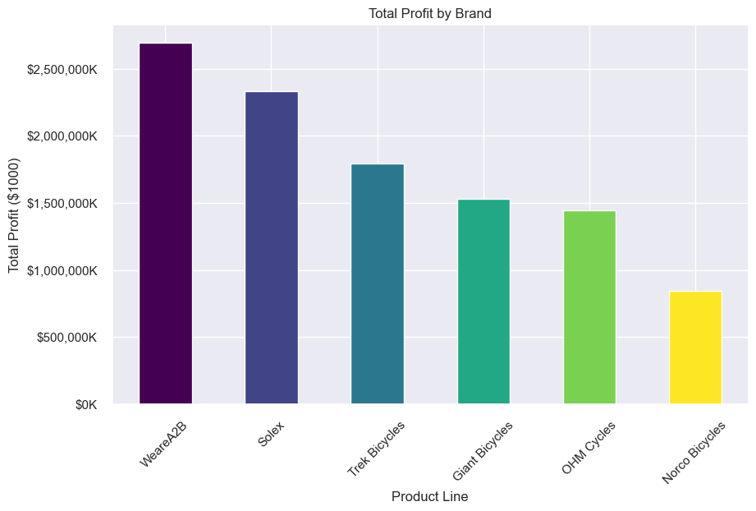
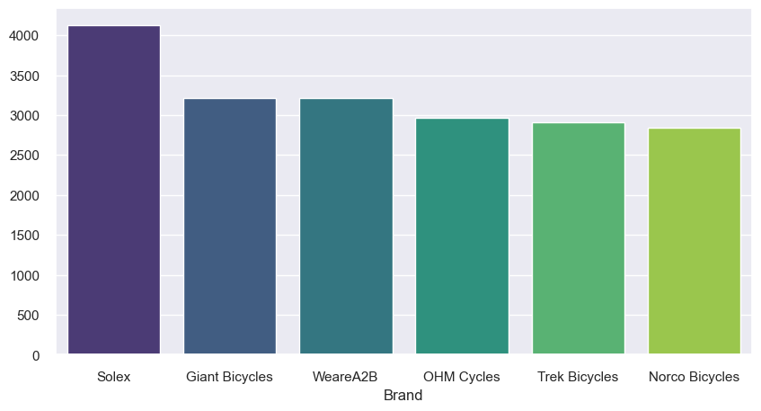
Note: The data and information in this document is reflective of a hypothetical situation and client. This document is to be used for KPMG Virtual Internship purposes only.
Data Exploration
Which brand sells the most?
Which brand generates the biggest profit?

Slide 5
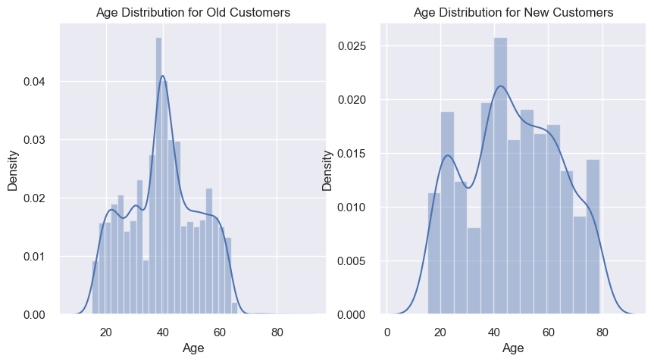
Note: The data and information in this document is reflective of a hypothetical situation and client. This document is to be used for KPMG Virtual Internship purposes only.
Data Exploration
Age Distribution: Old Customers vs New Customers
The predominant age range falls between 40 and 50
The predominant age range falls between 35 and 60

Slide 6
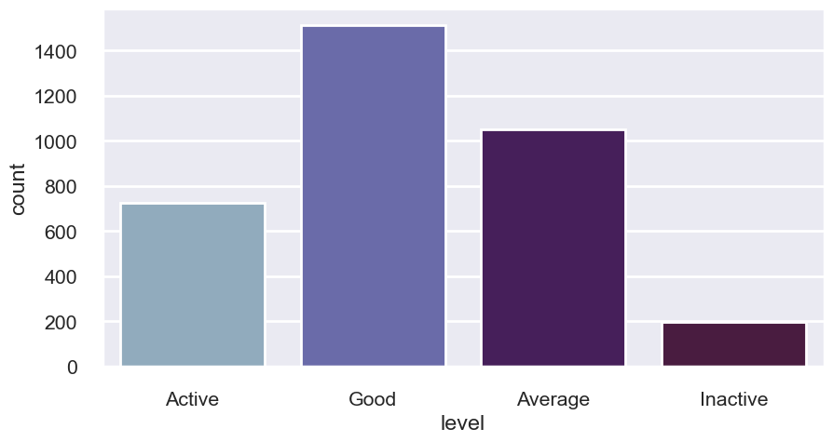
Note: The data and information in this document is reflective of a hypothetical situation and client. This document is to be used for KPMG Virtual Internship purposes only.
Model Development
RFM Plus Clustering
Conclusions:
- The RFM Plus analysis has resulted in well-defined customer segments
- The number of customers is fairly distributed among the 4 categories but the last one (Inactive customers)
4 groups were formed
Active customers, Good customers, Average Customers and Inactive customers

Slide 7
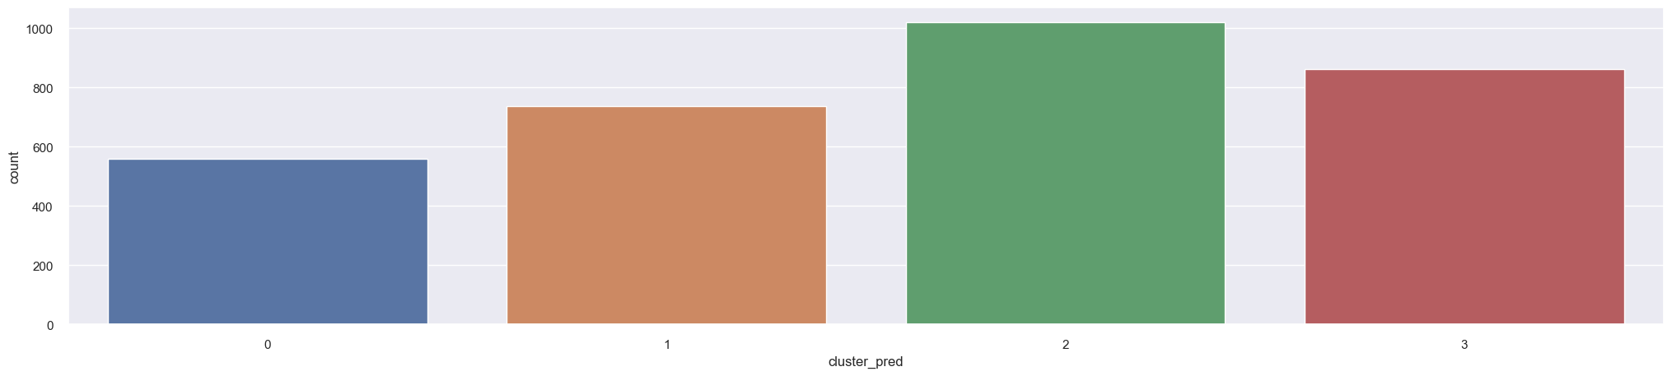
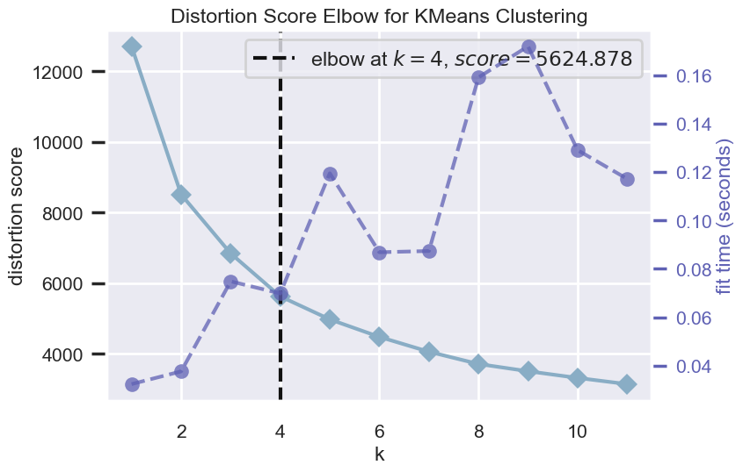
Note: The data and information in this document is reflective of a hypothetical situation and client. This document is to be used for KPMG Virtual Internship purposes only.
Model Development
K-means Clustering
Conclusions
- Although there is a clear most valuable customer segment (cluster 2).
- Overlapping characteristics among segments makes it challenging to categorize customers into well-defined groups.
- The number of customers is relatively well-distributed among the clusters.
4 clusters were found

Slide 8
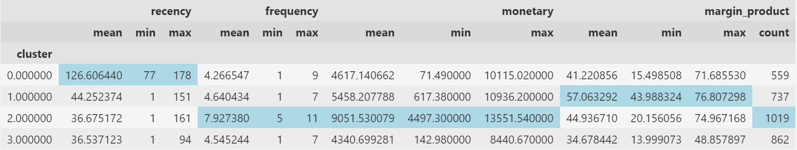
Note: The data and information in this document is reflective of a hypothetical situation and client. This document is to be used for KPMG Virtual Internship purposes only.
Model Development
K-Meloids Clustering
Conclusions
- All identified clusters exhibit heterogeneity within themselves.
- There is a more discernible understanding of segment distinctions compared to traditional k-means clustering
- However, the proximity of these values to other segments still poses challenges in precisely defining each cluster.
-The number of customers is relatively well-distributed among the clusters.

Slide 9
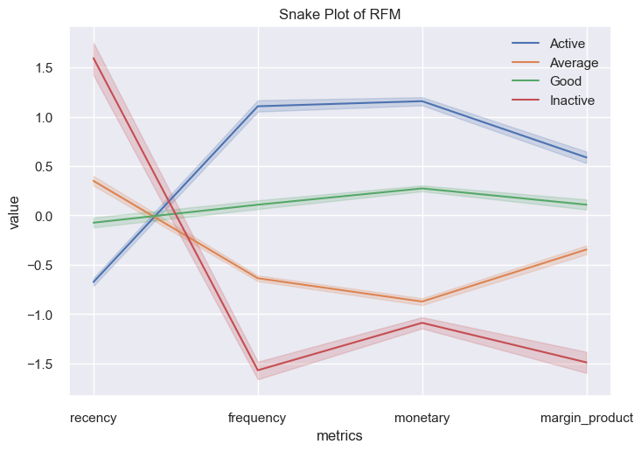
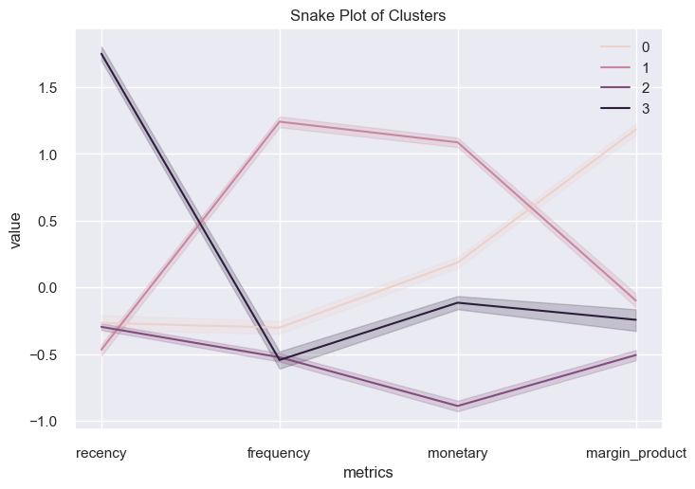
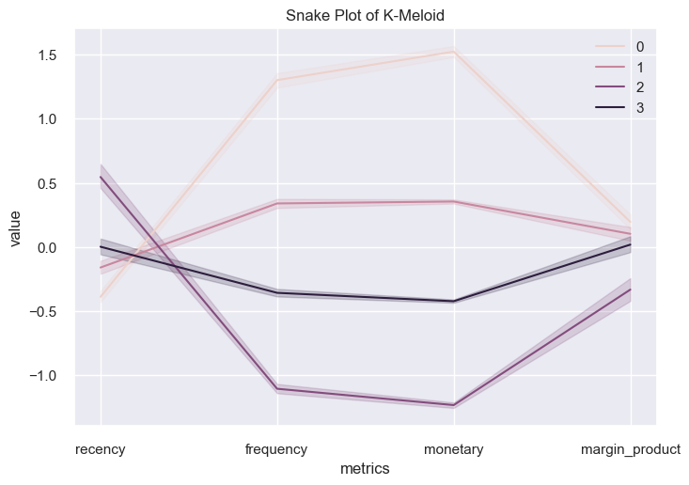
Note: The data and information in this document is reflective of a hypothetical situation and client. This document is to be used for KPMG Virtual Internship purposes only.
Model Development
Snake Plot: to compare RFM Plus, K-means, and K-Meloids clusters and choose the one that groups the data better
RFM Plus Clustering
K-means Clustering
K-Meloid Clustering

Slide 10

Note: The data and information in this document is reflective of a hypothetical situation and client. This document is to be used for KPMG Virtual Internship purposes only.
Model Development
Conclusions
- RFM Plus gives a greater segmentation of the clusters.
- Therefore, it will be the one used for the customer analysis
- With RFM Plus segmentation, we are going to create a customer profile for each segment and identify the characteristics of the high-value group.

Slide 11
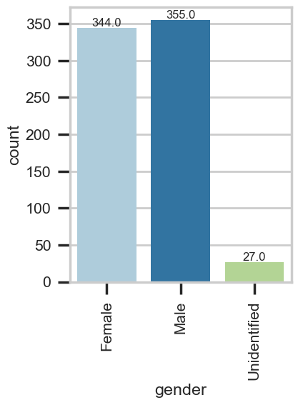
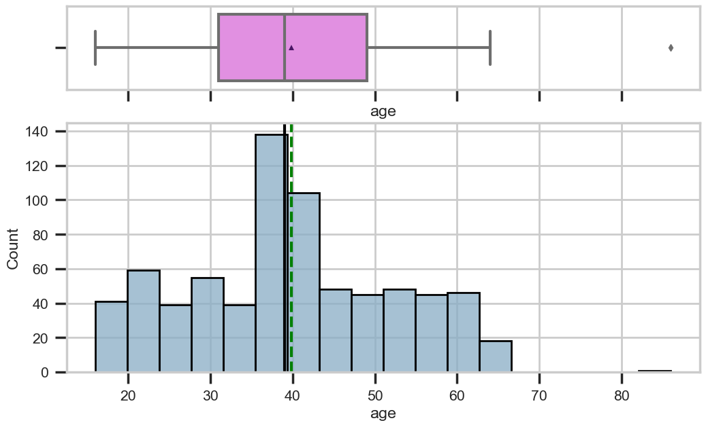
Note: The data and information in this document is reflective of a hypothetical situation and client. This document is to be used for KPMG Virtual Internship purposes only.
Interpretation
Sprocket Central should focus on active customers who follow a high value demographic profile
Active Customers Profile
The majority of customers fall within the age range spanning from late 30s to the early 40s.
Gender distribution is fairly balanced, with a slight male predominance

Slide 12
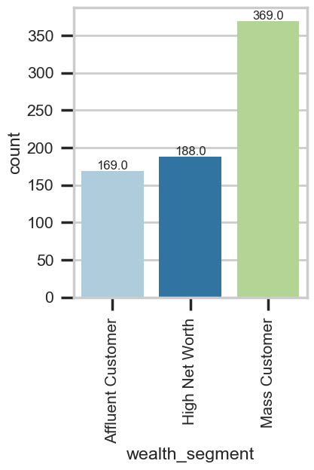
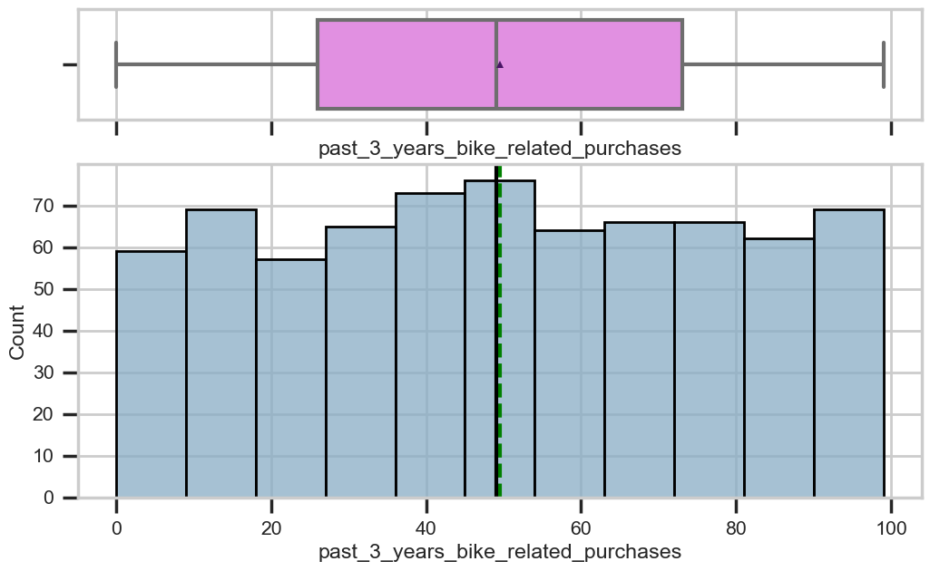
Note: The data and information in this document is reflective of a hypothetical situation and client. This document is to be used for KPMG Virtual Internship purposes only.
Interpretation
They have spent an average of 1.19k dollars in Sprocket Central.
They have an average of 50 bikes related purchases in the past 3 years
They tend to be Mass and High Network customers

Slide 13
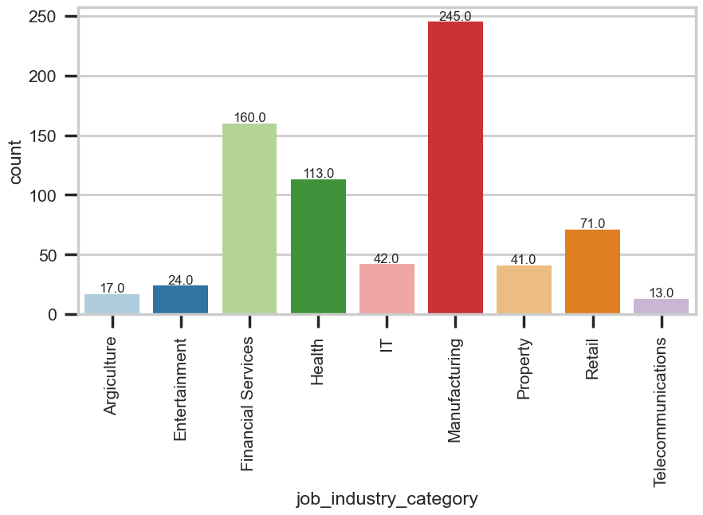
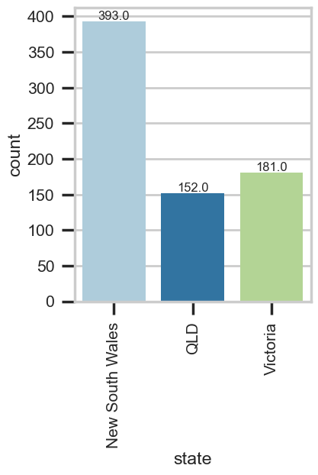
Note: The data and information in this document is reflective of a hypothetical situation and client. This document is to be used for KPMG Virtual Internship purposes only.
Interpretation
Job industries: Most of them come from the manufacturing and financial services
State: Most of them come from NSW and Victoria

Slide 14
Note: The data and information in this document is reflective of a hypothetical situation and client. This document is to be used for KPMG Virtual Internship purposes only.
Recommendations
- Target Both Genders: Develop marketing campaigns that target both genders, but consider a slight emphasis on male-focused campaigns since they represent a slightly larger active customer segment.
- Prioritize Past Bike Purchasers: Focus your marketing efforts on customers who have a history of purchasing bikes related products. Implement strategies to retain these customers and encourage repeat purchases.
- Leverage Job Industries: Create tailored marketing campaigns for customers working in manufacturing, financial services, and health job industries. Highlight how your products align with their needs and preferences.
- Expand Geographic Reach: Expand your market presence beyond NSW to tap into new customer bases. Consider opportunities to expand stores in Victoria as it has the second highest number of customers in the high value customers' segment.
- Age-Targeted Marketing: Customize marketing initiatives to appeal to different age groups. Prioritize customers aged 30-40 as your primary demographic, followed by those aged 40-50. Craft messaging and promotions that resonate with these age brackets.

