Slide 1
Monsoon: The Journey
So many ways to go wrong

Slide 2
Valves

Slide 3
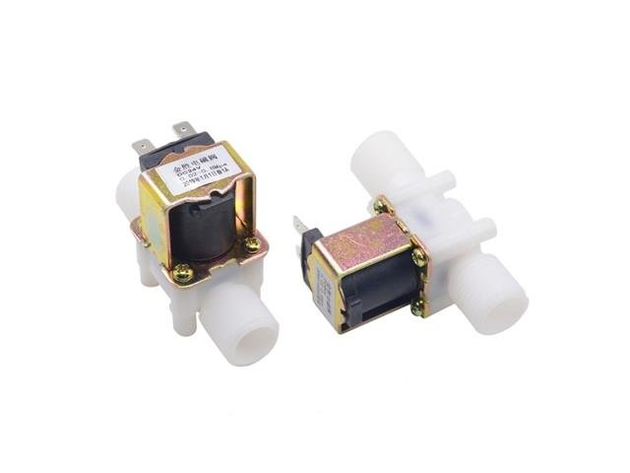
DC 12V

Slide 4
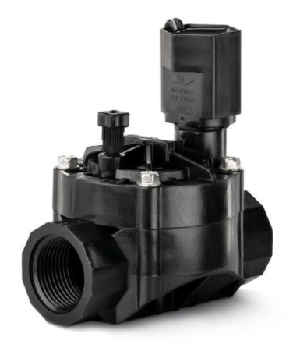
Irrigation

Slide 5
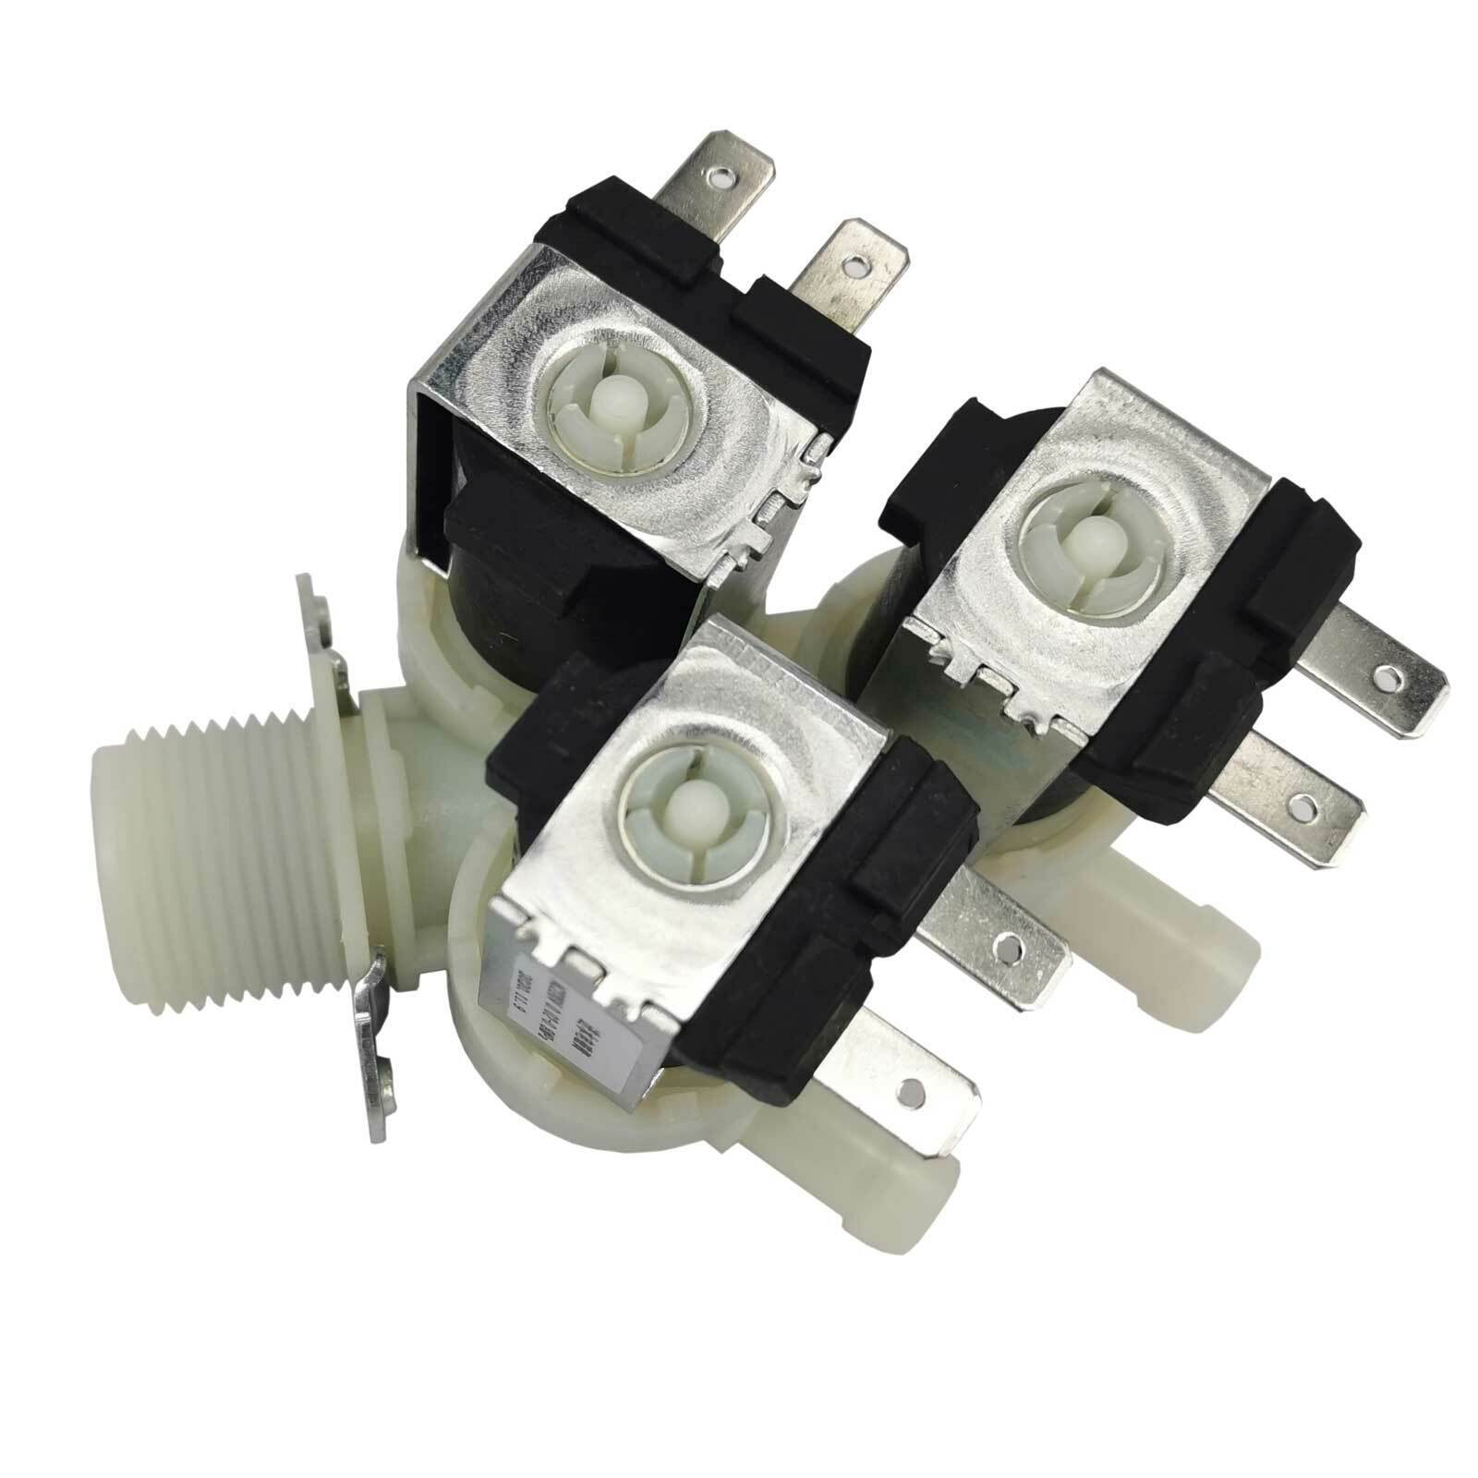

Slide 6
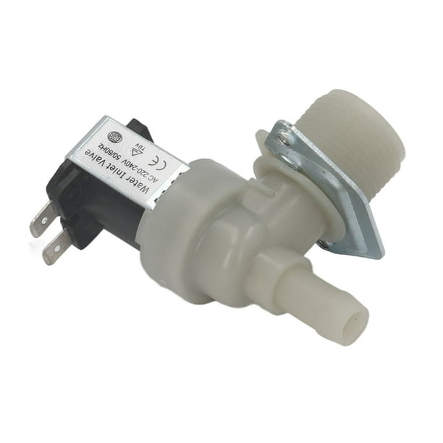

Slide 7
Don’t try to suck through a valve
It’s a washing machine

Slide 8
Pumps

Slide 9
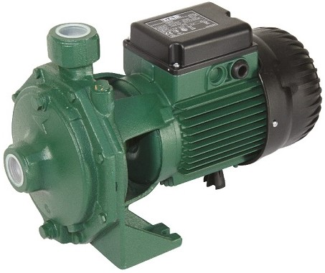
Agricultural

Slide 10
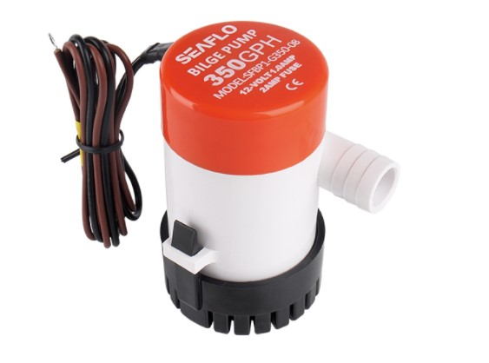
Bilge

Slide 11

Centrifugal

Slide 12
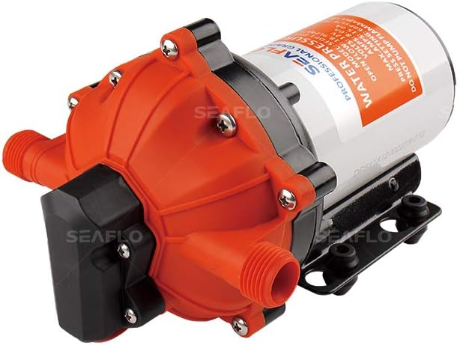
Washdown

Slide 13
Prototype mark 2

Slide 14
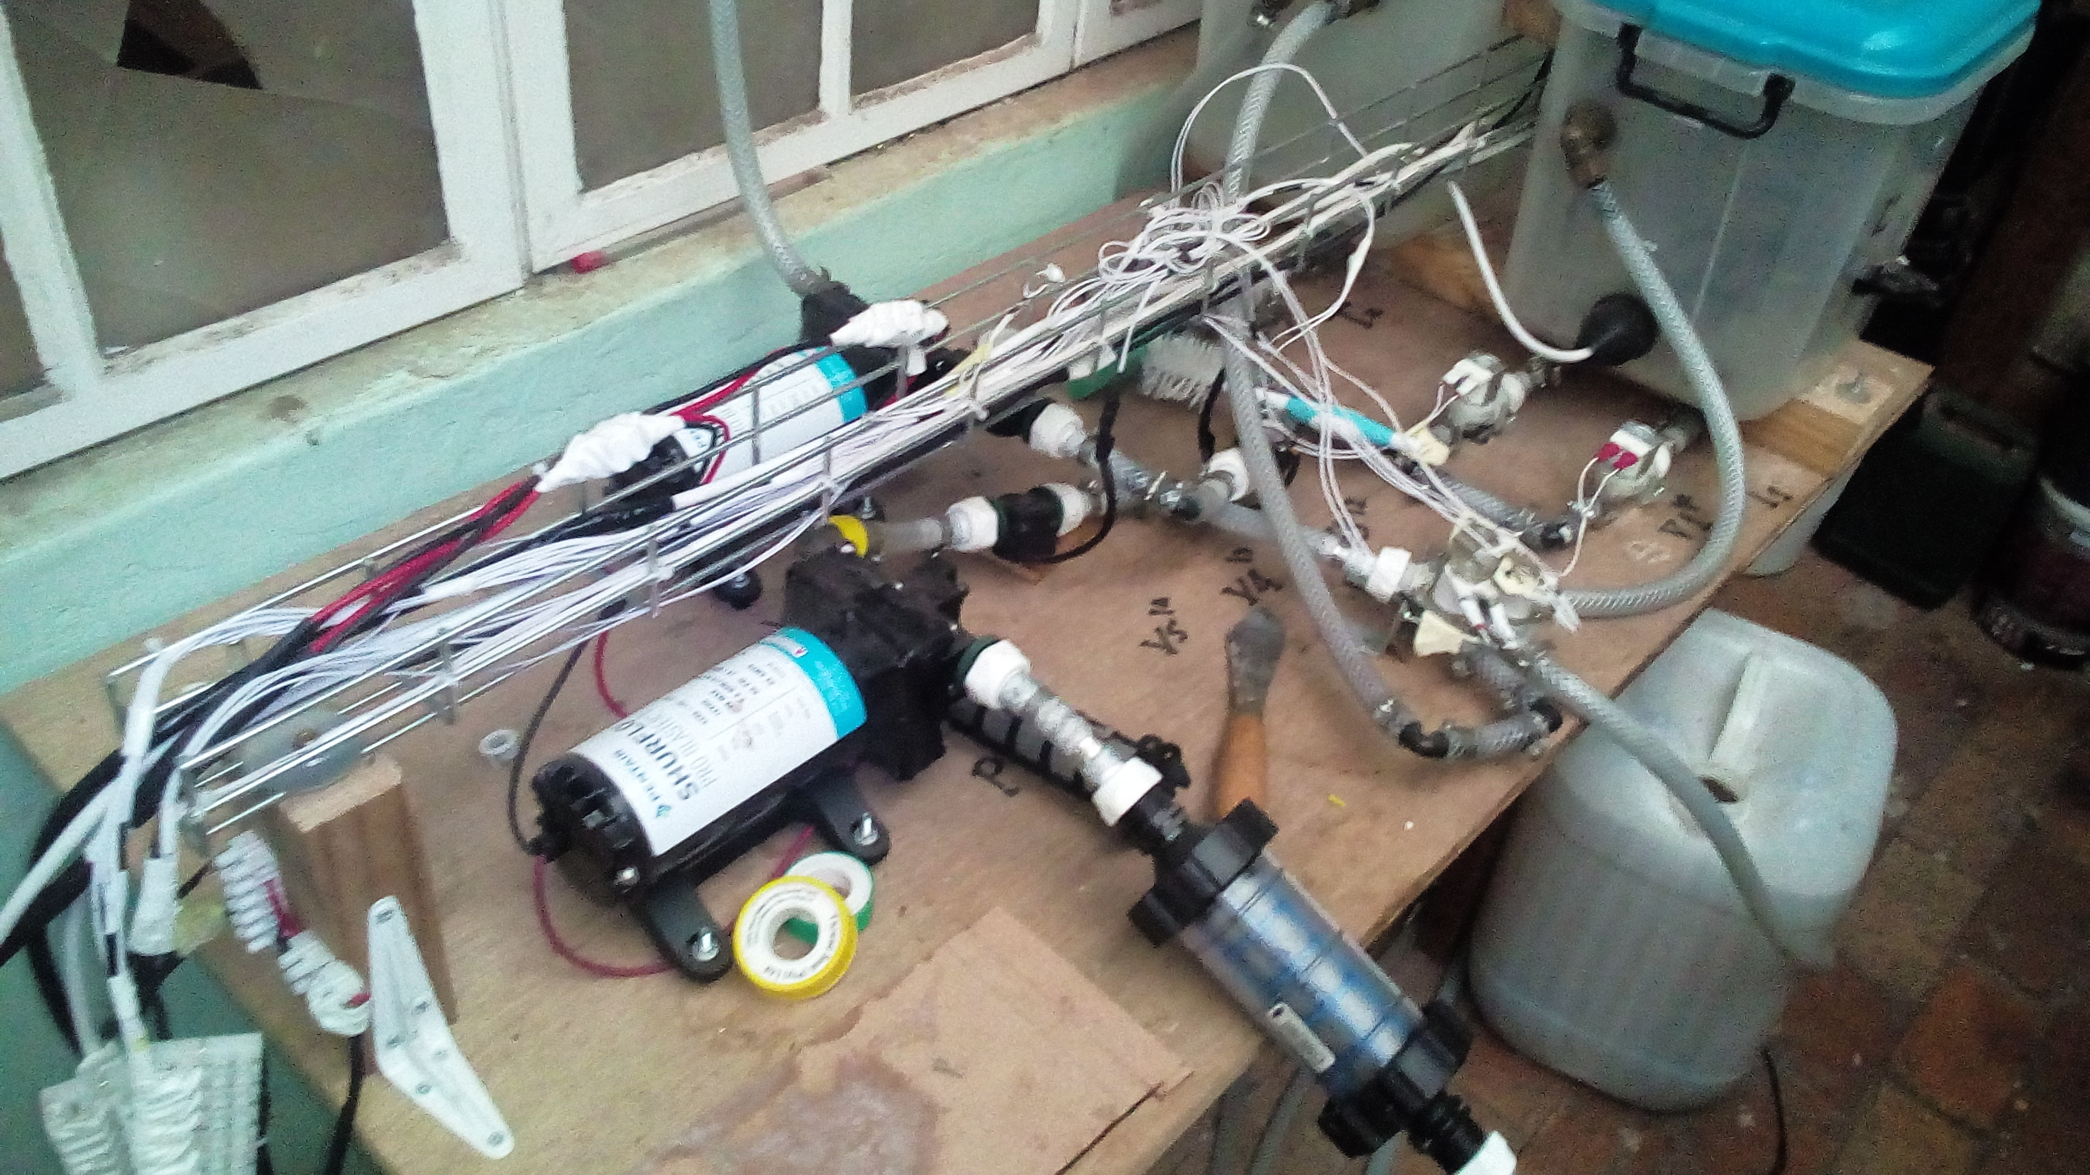

Slide 15
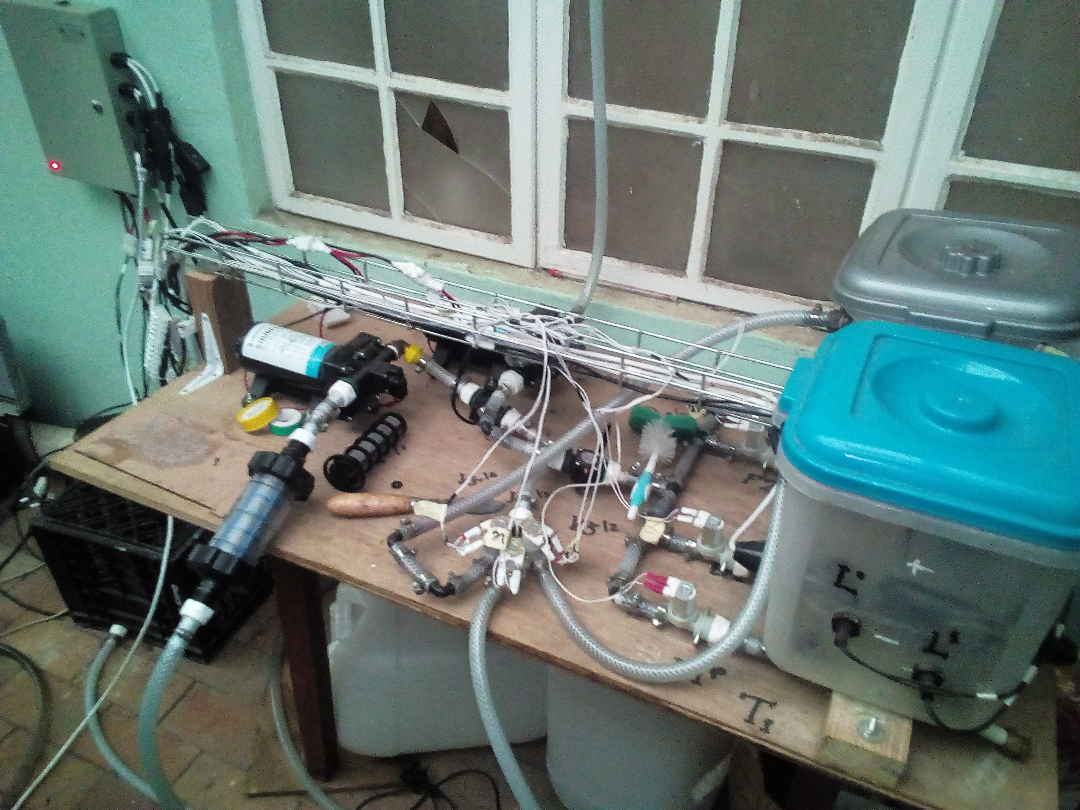

Slide 16
Prototype Mark 3

Slide 17
