Slide 1
Exercises 04
Computer Graphics 2021
Erica Stella (erica.stella@polimi.it)

Slide 2
DISCLAIMER
These exercises are purely for learning purposes, they will NOT be asked during the exams
Don’t worry if you don’t finish them today, solutions will be posted, but please review them before the next lesson because we will build upon them
If you have questions, you can use the forum or ask me next time ☺
Before plunging into the code, please open the file for a quick look ☺

Slide 3
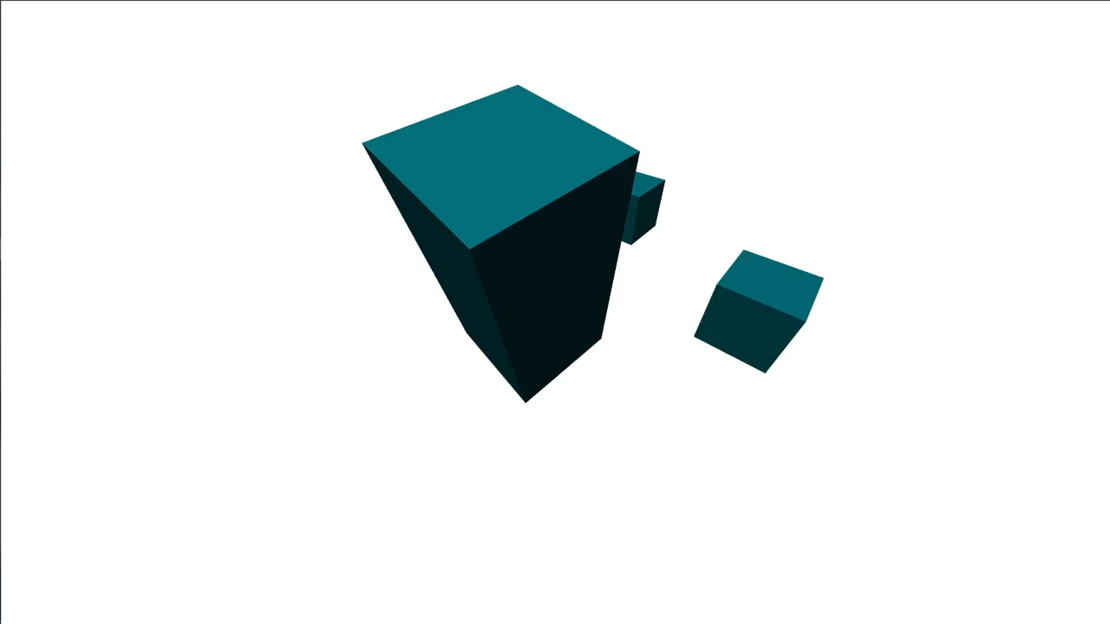
Ex 1
Complete the exercise so as to implement a correct Lambert diffuse brdf with a directional light in World Space.
Final Look:

Slide 4
Solution Ex 1
Vertex Shader
#version 300 es
in vec3 inPosition;
in vec3 inNormal;
out vec3 fsNormal;
uniform mat4 matrix;
uniform mat4 nMatrix; //matrix to transform normals
void main() {
fsNormal = mat3(nMatrix) * inNormal; //Transform the normal with 3x3 submatrix
gl_Position = matrix * vec4(inPosition, 1.0);
}

Slide 5
Solution Ex 1
Script.js
var normalMatrixPositionHandle = gl.getUniformLocation(program, 'nMatrix’);
var lightDirectionHandle = gl.getUniformLocation(program, 'lightDirection');
function animate(){
//In world space we need the inverse transpose of the world matrix for normal
//Since the last cube is the only one that has non-uniform scaling, we can use the world
//matrix for transforming the normals for the other cubes
cubeNormalMatrix = utils.invertMatrix(utils.transposeMatrix(cubeWorldMatrix[3]));
}
function drawScene() {
[..] for(i = 0; i < 4; i++){
[..]
if (i < 3) gl.uniformMatrix4fv(normalMatrixPositionHandle, gl.FALSE,
utils.transposeMatrix(cubeWorldMatrix[i]));
else gl.uniformMatrix4fv(normalMatrixPositionHandle, gl.FALSE,
utils.transposeMatrix(cubeNormalMatrix));
//Directional lights are already expressed in world coordinates, no need to transform them
gl.uniform3fv(lightDirectionHandle, directionalLight);
}
}

Slide 6
Ex 2
Complete the exercise so as to implement a correct Lambert diffuse brdf with a point light in World Space.
Final Look: (link to video)
https://polimi365-my.sharepoint.com/:v:/g/personal/10395370_polimi_it/ESCaEnjbXqJMn69r36cYA3MB9-fKPAO1TJDoUfKxBqHFJw?e=sDR76x

Slide 7
Solution Ex 2
Vertex Shader
#version 300 es
in vec3 inPosition;
in vec3 inNormal;
out vec3 fsPosition;
out vec3 fsNormal;
uniform mat4 matrix;
uniform mat4 pMatrix; //matrix to transform positions
uniform mat4 nMatrix; //matrix to transform normals
void main() {
fsNormal = mat3(nMatrix) * inNormal;
//Transform positions from object space to world space
fsPosition = (pMatrix * vec4(inPosition, 1.0)).xyz;
gl_Position = matrix * vec4(inPosition, 1.0);
}

Slide 8
Solution Ex 2
Script.js
var vertexMatrixPositionHandle = gl.getUniformLocation(program, "pMatrix");
var lightPosLocation = gl.getUniformLocation(program, "LAPos");
function drawScene() {
[..] for(i = 0; i < 4; i++){
[..]
//The matrix to transform positions from object space to world space is the world matrix
gl.uniformMatrix4fv(vertexMatrixPositionHandle, gl.FALSE,
utils.transposeMatrix(cubeWorldMatrix[i]));
}
//Position of the point light is already expressed in world coordinates,
//no need to transform it
gl.uniform3fv(lightPosLocation, lightPos);
[..]
}
+ passing world space normals as explained in Ex 1

Slide 9
Ex 3
Complete the exercise so as to implement a correct Lambert diffuse brdf with a directional light in Camera Space.
Final Look: same as Ex 1

Slide 10
Solution Ex 3
Vertex Shader
#version 300 es
in vec3 inPosition;
in vec3 inNormal;
out vec3 fsNormal;
uniform mat4 matrix;
uniform mat4 nMatrix; //matrix to transform normals
void main() {
fsNormal = mat3(nMatrix) * inNormal; //Transform the normal with 3x3 submatrix
gl_Position = matrix * vec4(inPosition, 1.0);
}

Slide 11
Solution Ex 3
Script.js
var normalMatrixPositionHandle = gl.getUniformLocation(program, 'nMatrix’);
var lightDirectionHandle = gl.getUniformLocation(program, 'lightDirection');
function drawScene() {
[..] for(i = 0; i < 4; i++){
[..]
//To go from normals in local space to normals in camera space we need the inverse
//transpose of the worldview matrix. Actually, we could have used just the worldView matrix
//for the cubes with uniform scaling.
cubeNormalMatrix = utils.invertMatrix(utils.transposeMatrix(viewWorldMatrix));
gl.uniformMatrix4fv(normalMatrixPositionHandle, gl.FALSE,
utils.transposeMatrix(cubeNormalMatrix));
}
//The direction of the directional light can be transformed with just the view matrix since
//usually there is no scaling in this matrix (otherwise inverse transpose).
//We can either use the 3x3 submatrix or add a fourth component equal to 0.0 to the
//direction of the light.
var dirLightTransformed = utils.multiplyMatrix3Vector3(
utils.sub3x3from4x4(viewMatrix), directionalLight);
gl.uniform3fv(lightDirectionHandle, dirLightTransformed);
}

Slide 12
Ex 4
Complete the exercise so as to implement a correct Lambert diffuse brdf with a point light in Camera Space.
Final Look: same as Ex 2

Slide 13
Solution Ex 4
Vertex Shader
#version 300 es
in vec3 inPosition;
in vec3 inNormal;
out vec3 fsPosition;
out vec3 fsNormal;
uniform mat4 matrix;
uniform mat4 nMatrix;
uniform mat4 pMatrix; //matrix to transform positions
void main() {
fsNormal = mat3(nMatrix) * inNormal;
//Transform positions from object space to camera space
fsPosition = (pMatrix * vec4(inPosition, 1.0)).xyz;
gl_Position = matrix * vec4(inPosition, 1.0);
}

Slide 14
Solution Ex 4
Script.js
+ passing camera space normals as explained in Ex 3
//Added fourth component for homogeneous cords for matrix multiplication
var lightPos = [0.0, 1.5, 2.0, 1.0];
var vertexMatrixPositionHandle = gl.getUniformLocation(program, "pMatrix");
var lightPosLocation = gl.getUniformLocation(program, "LAPos");
function drawScene() {
[..] for(i = 0; i < 4; i++){
[..]
//The matrix to transform positions from object space to camera space is
//the worldView matrix
gl.uniformMatrix4fv(vertexMatrixPositionHandle, gl.FALSE,
utils.transposeMatrix(viewWorldMatrix));
}
//The position of the light needs to be transformed from world space to camera space with
//the view matrix
var lightPostransformed = utils.multiplyMatrixVector(viewMatrix, lightPos);
gl.uniform3fv(lightPosLocation, lightPostransformed.slice(0,3)); //Only take 3 elements
[..]
}

Slide 15
Ex 5
Complete the exercise so as to implement a correct Lambert diffuse brdf with a directional light in Object Space.
Final Look:

Slide 16
Solution Ex 5
Vertex Shader
#version 300 es
in vec3 inPosition;
in vec3 inNormal;
out vec3 fsNormal;
uniform mat4 matrix;
void main() {
fsNormal = inNormal; //Normals are passed as is in object space
gl_Position = matrix * vec4(inPosition, 1.0);
}

Slide 17
Solution Ex 5
Script.js
var lightDirectionHandle = gl.getUniformLocation(program, 'lightDirection');
function drawScene() {
[..] for(i = 0; i < 4; i++){
[..]
//Transforming directions from world space to object space requires the inverse transpose
//of the inverse world matrix which, in the end, is just the transpose of the world matrix
var lightDirMatrix = utils.transposeMatrix(cubeWorldMatrix[i]);
var lightdirTransformed = utils.multiplyMatrix3Vector3(utils.sub3x3from4x4(
lightDirMatrix), directionalLight);
}
}

